Slide 1
Horizontal or Vertical Approach
in Heart Failure
Dr. Cinosh Mathew
MD, DM cardiology, FACC
Professor & HOD,
Department of Cardiology,
SBKS MI & RC, Piparia , Waghodia, Vadodara
11/01/23

Slide 2
Heart failure is a progressive disease with deterioration of cardiac function and quality of life
Progressive cardiac injury leads to worsening myocardial dysfunction¹⁻⁵
The phrase “stable” HF may be a misnomer, because patients with HF always carry a residual risk for hospitalization or sudden cardiac death, even when minimally symptomatic or asymptomatic receiving optimal treatment ⁶
Clinical course of HF
Compensated
Episode of acute decompensation with hospitalization
Chronically
decompensated
Clinical status
Acutely
decompensated
Death
Disease progression
Death
1. González A et al. J Am Coll Cardiol 2011;58:1833−1843; 2. Gheorghiade M et al. Am J Cardiol 2005;96:11−17G; 3. Gheorghiade M & Mebazaa A. Am J Cardiol 2005;96:1G−4G; 4. Cowie MR et al. oxfordhealthpolicyforum.org/files/reports/ahf-report.pdf. 2014 Oxford PharmaGenesis Ltd. (Accessed August 2020); 5. Allen LA et al. Circulation 2012;125:1928−1952. 6. J Cardiac Fail 2021;00:127

Slide 3
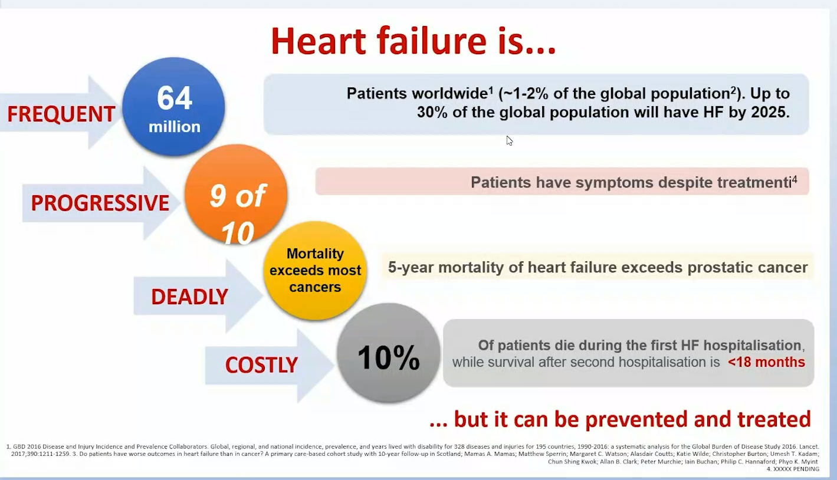

Slide 4
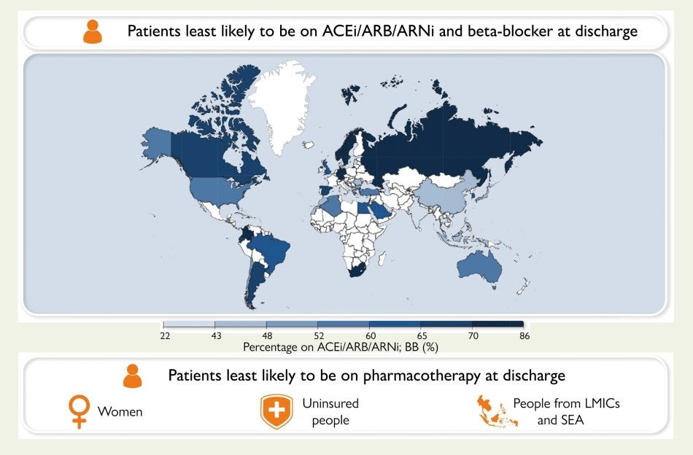
Global disparities in prescription of guideline-recommended drugs for heart failure with reduced ejection fraction
8669 patients with HFrEF hospitalized for acute HF in 44 countries in the prospective REPORT-HF study
Overall, 37% of patients at discharge and 34% of survivors at 6 months were on all three medication classes (RASi, BB, MRA).
Proportions were lower in low- and middle-income countries than in high-income countries (19 vs. 41% at discharge and 15 vs. 37% at 6 months).
In multivariable analyses, women, older patients, patients with new-onset HF, patients with chronic kidney disease, patients from low-income countries, and patients without health insurance were less likely to be on all three medication classes at discharge and at 6-month follow-up.
Tromp J et al. Eur Heart J. 2022; Apr 8 [Online ahead of print]

Slide 5
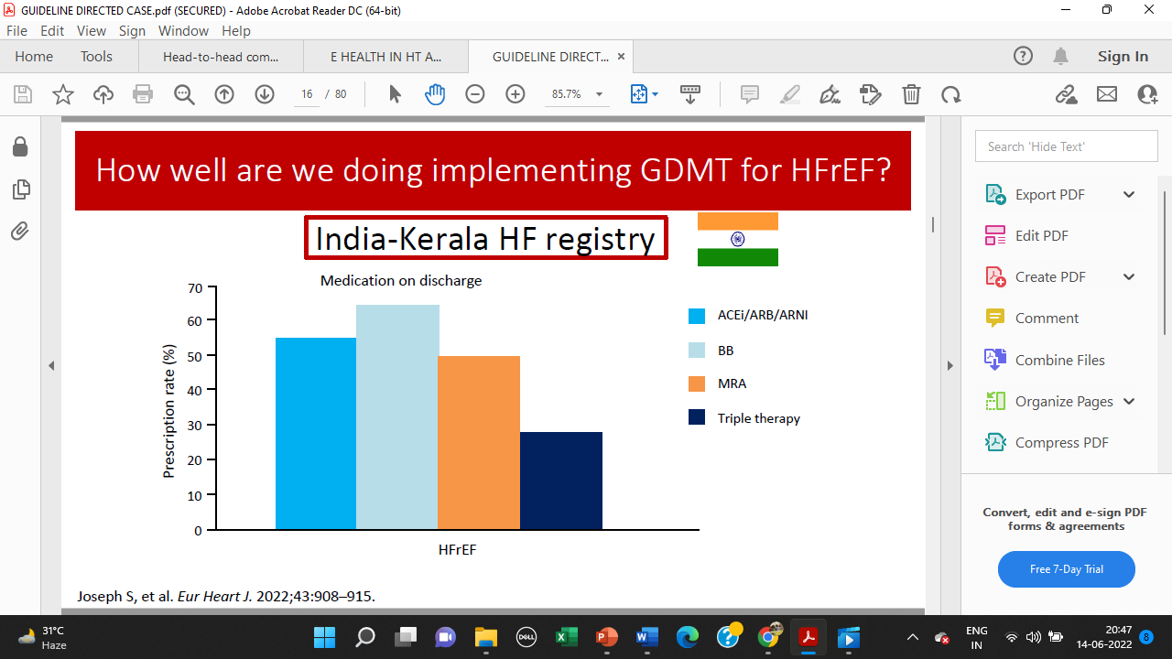

Slide 6
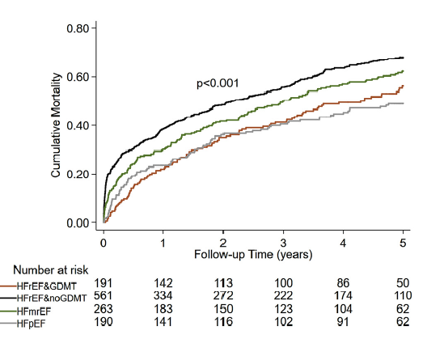
Trivandrum HF Registry ;
Only ¼ of patients were prescribed on GDMT at the time of hospital discharge
Baseline data on discharge Medication
Among 1205 patients 25% received GDMT.
5 Yrs cumulative incidence mortality rates by presence or absence of baseline GDMT
 | HFrEF ( n= 752) | HFmrEF (n= 263) | HFpEF (n= 190 )
BB | 443 (65.9) | 149 (60.6) | 106 ( 57.3)
ACEi / ARB | 369 ( 49) | 126 ( 49.8) | 83 ( 43.6)
MRA | 382 ( 51) | 110 ( 41.8) | 59 ( 31)
GDMT | 191 ( 25.4) | NA | NA
3 out of every 5 patients had died during 5-years of follow-up
GDMT was defined as being prescribed the combination of (BB),(RAS) blockers, & (MRA) for patients with HFrEF at hospital discharge.
Lack of GDMT (in HFrEF) and frequent readmissions associated with higher 5-year mortality.
Int J Cardiol . 2021 Mar 1;326:139-143.

Slide 7
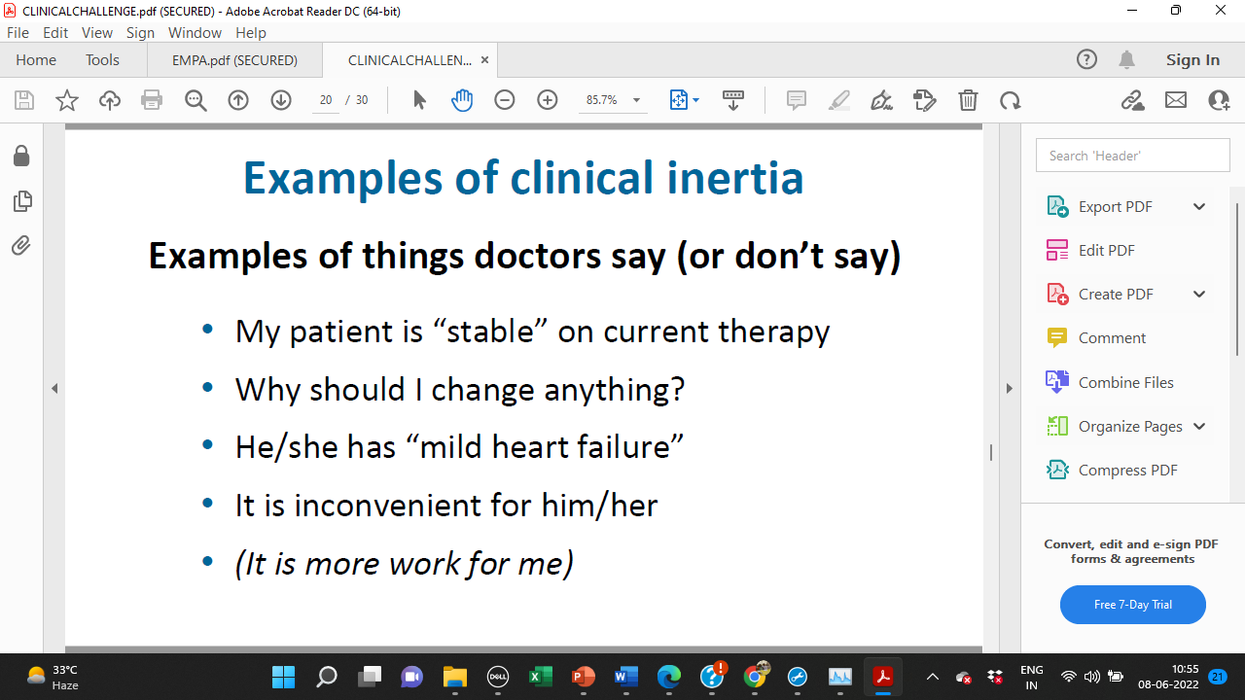
Clinical Inertia

Slide 8
Major Changes in Recent Guidelines
Large randomized controlled trials (RCTs) have led to major changes in the treatment of patients with heart failure and reduced left ventricular ejection fraction (HFrEF).
These advances are included in the recent European Society of Cardiology (ESC) and the American College of Cardiology/American Heart Association/Heart Failure Society of America (ACC/AHA/HFSA) guidelines issued in 2021 and 2022, respectively.

Slide 9
Foundational Pillars in Heart Failure (HFrEF) Therapy
Foundational Disease-modifying Therapies in HFrEF
ARNI
ACEi or ARB
MRA
Beta-
blocker
SGLT2i
(with or
without T2D)
NEW
ACEi, angiotensin-converting enzyme inhibitor; ARB, angiotensin receptor blocker; ARNI, angiotensin receptor–neprilysin inhibitor; HFrEF, heart failure with reduced ejection fraction;
MR, mineralocorticoid receptor; SGLT2i, sodium-glucose co-transporter-2 inhibitor; T2D, type 2 diabetes
Modified from Bhatt DL et al. Cell Metab. 2019;30:847

Slide 10
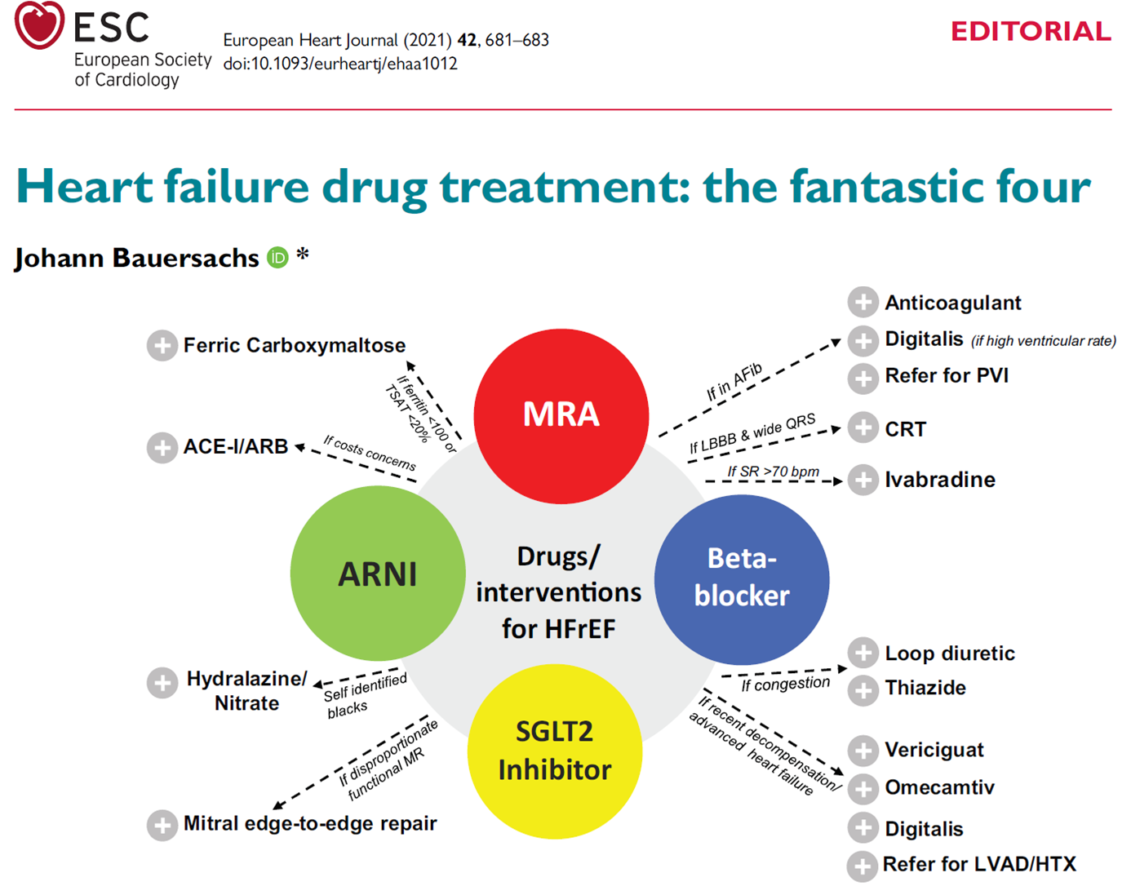

Slide 11
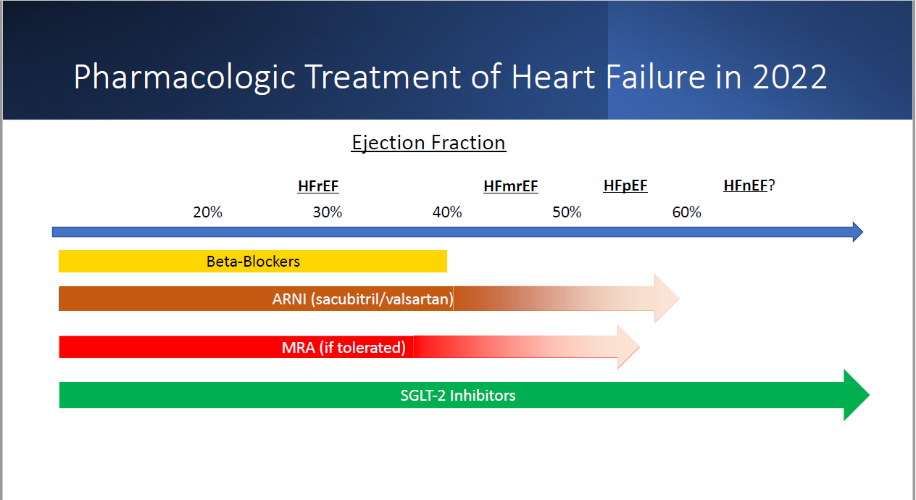
2023

Slide 12
Guidelines Recommendations

Slide 13
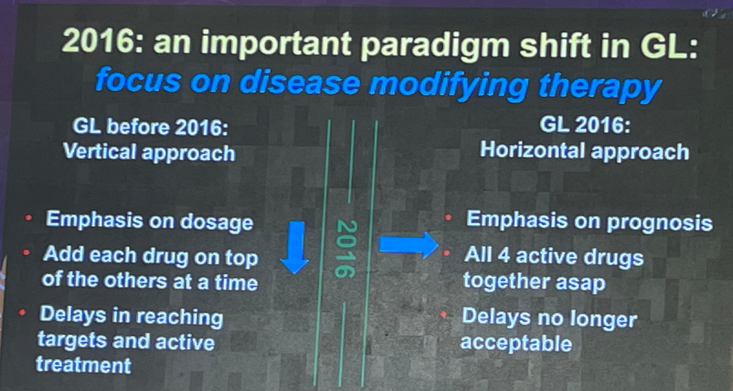

Slide 14
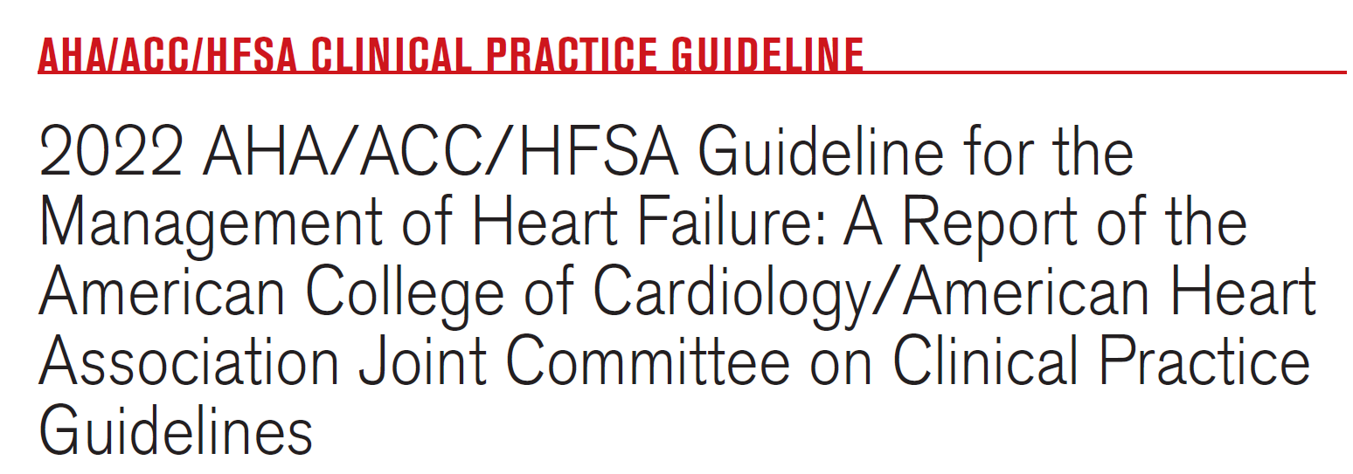

Slide 15
Treatment of HFrEF Stages C and D
STEP 1
Established diagnosis of HFrEF
Address congestion
Initiate GDMT
STEP 2
Titrate to Target dosing as tolerated, labs, health
status, and LVEF
STEP 3
Consider these patient scenarios
STEP 4
Implement additional GDMT and device therapy, as indicated
STEP 5
Reassess symptoms, labs, health status, and LVEF
STEP 6
Referral for HF specialty care for additional therapy
HFrEF
LVEF ≤40% (Stage C)
NYHA III-IV, in African American patients
Hydral-nitrates (1)
In Selected patients, durable MCS (1)
Refractory HF
(Stage D)
ARNI in NYHA II-III;
ACEi or ARB in NYHA II-IV (1)
LVEF ≤40%
Persistent HFrEF
(Stage C)
NYHA I-III; LVEF ≤35%;
>1 y survival
ICD (1)
Cardiac transplant (1)
Symptoms improved
Beta blocker (1)
NYHA I-III; ambulatory
IV; LVEF ≤35%;
NSR and QRS ≥150 ms
with LBBB
CRT-D (1)
Palliative care (1)
(Can be initiated before Stage D)
MRA (1)
LVEF >40%
HFImpEF
(Stage C)
Consider additional therapies
Investigational studies*
SGLT2i (1)
NOTE: *Participation in investigational studies is appropriate for stage C, NYHA class II and III HF.
Diuretics as needed (1)
Continue GDMT with serial reassessment and optimize dosing, adherence and patient education, address goals of care
Abbreviations: ACEi indicates angiotensin-converting enzyme inhibitor; ARB, angiotensin receptor blocker; ARNi, angiotensin receptor-neprilysin inhibitor; CRT, cardiac resynchronization therapy; GDMT, guideline-directed medical therapy; HF, heart failure; HFrEF, heart failure with reduced ejection fraction; hydral-nitrates, hydralazine and isosorbide dinitrate; ICD, implantable cardioverter-defibrillator; LBBB, left bundle branch block; LVEF, left ventricular ejection fraction; MCS, mechanical circulatory support; MRA, mineralocorticoid receptor antagonist; NSR, normal sinus rhythm; NYHA, New York Heart Association; SCD, sudden cardiac death; and SGLT2i, sodium-glucose cotransporter 2 inhibitor.

Slide 16
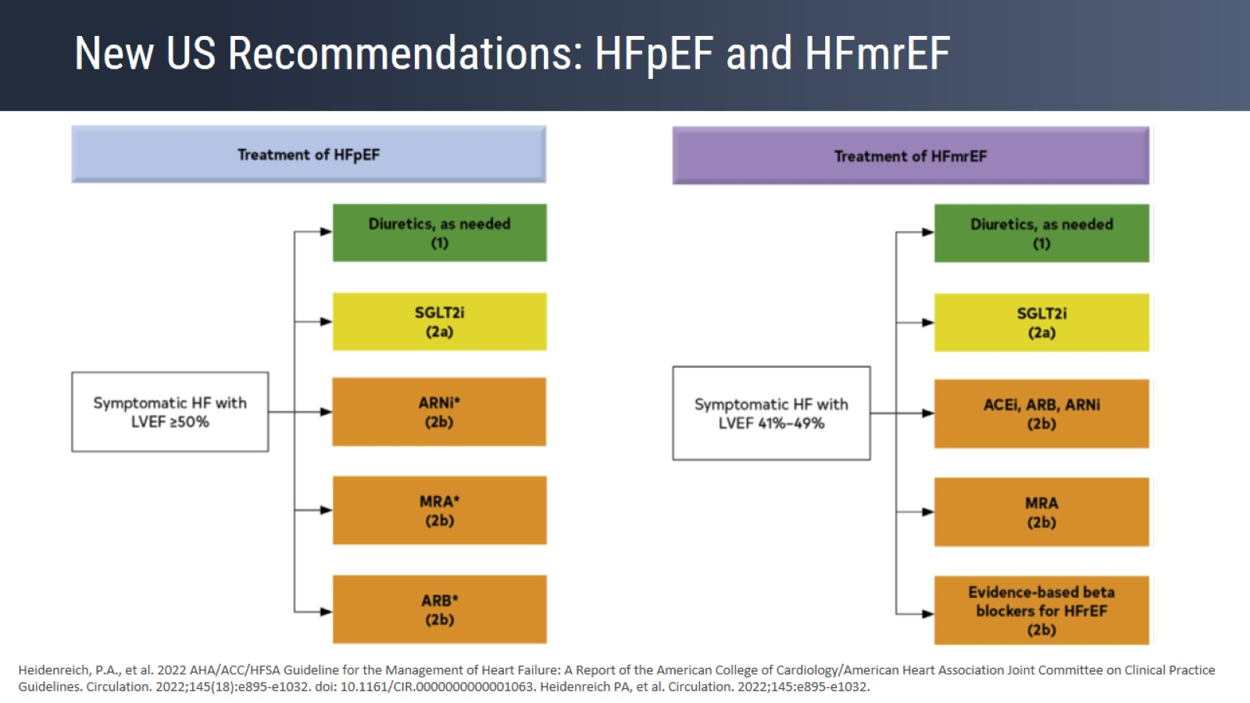
New US Recommendations: HFpEF and HFmrEF
AHA/ACC/HFSA2022 Recommendations
Treatment of HFpEF & HFmrEF

Slide 17
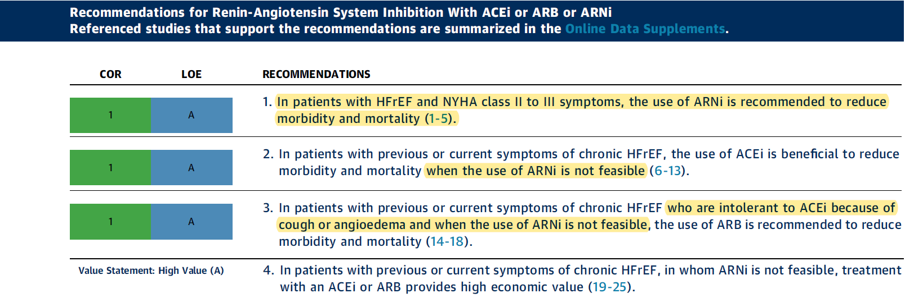
HFrEF Management
2022 AHA/ACC/HFSA Guideline for the Management of Heart Failure
Use ACE/ARB ONLY when ARNI is not feasible

Slide 18


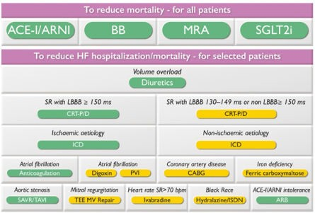

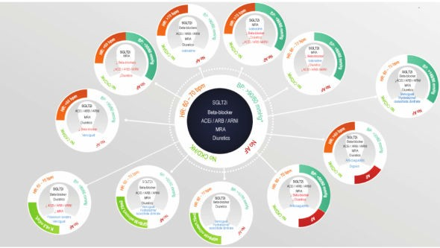
2021 ESC/HFA Guidelines for heart failure
New strategies for medical treatment
Quarduple, instead of triple, basic medical treatment
Simultaneous, instead of sequential, introduction of the drugs
Patients profiling (Strategic phenotyping)

Slide 19
Guideline recommendations for quadruple therapy across HF types

Slide 20
In-hospital initiation of quadruple medical therapy for HFrEF
European Journal of Heart Failure (2022) 24, 227–229

Slide 21

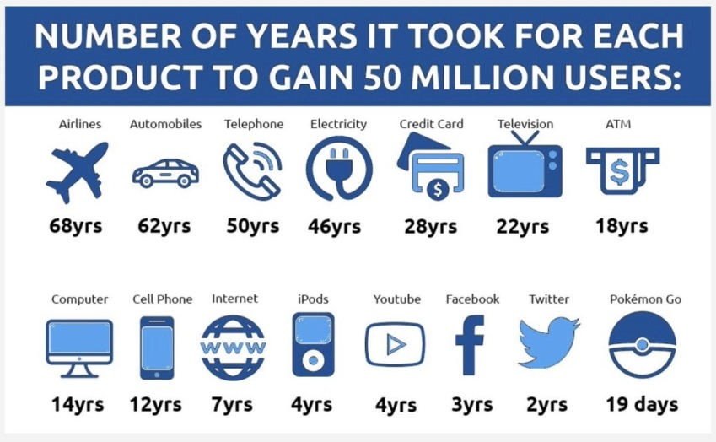
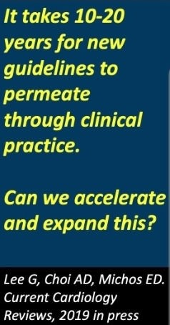
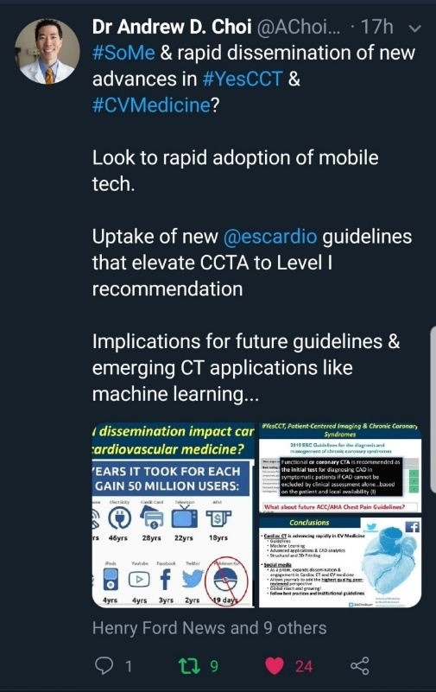

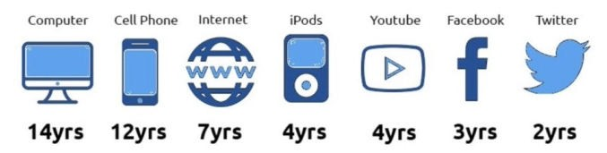
Can we accelerate the adoption of new guidelines in clinical practice?

Slide 22
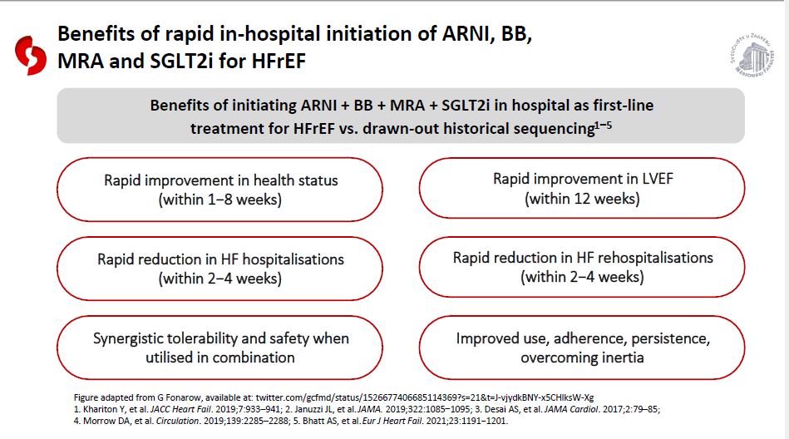

Slide 23
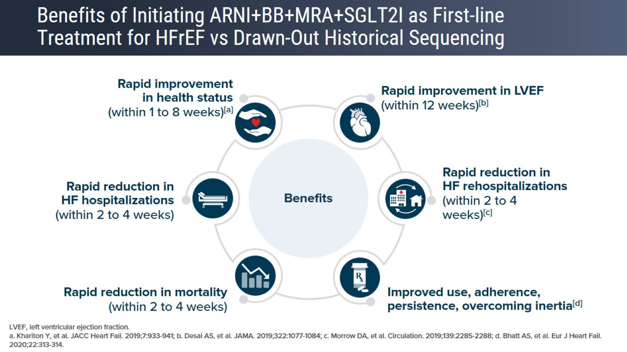
Benefits of Initiating ARNI+BB+MRA+SGLT2I as First-line Treatment for HFrEF vs Drawn-Out Historical Sequencing

Slide 24
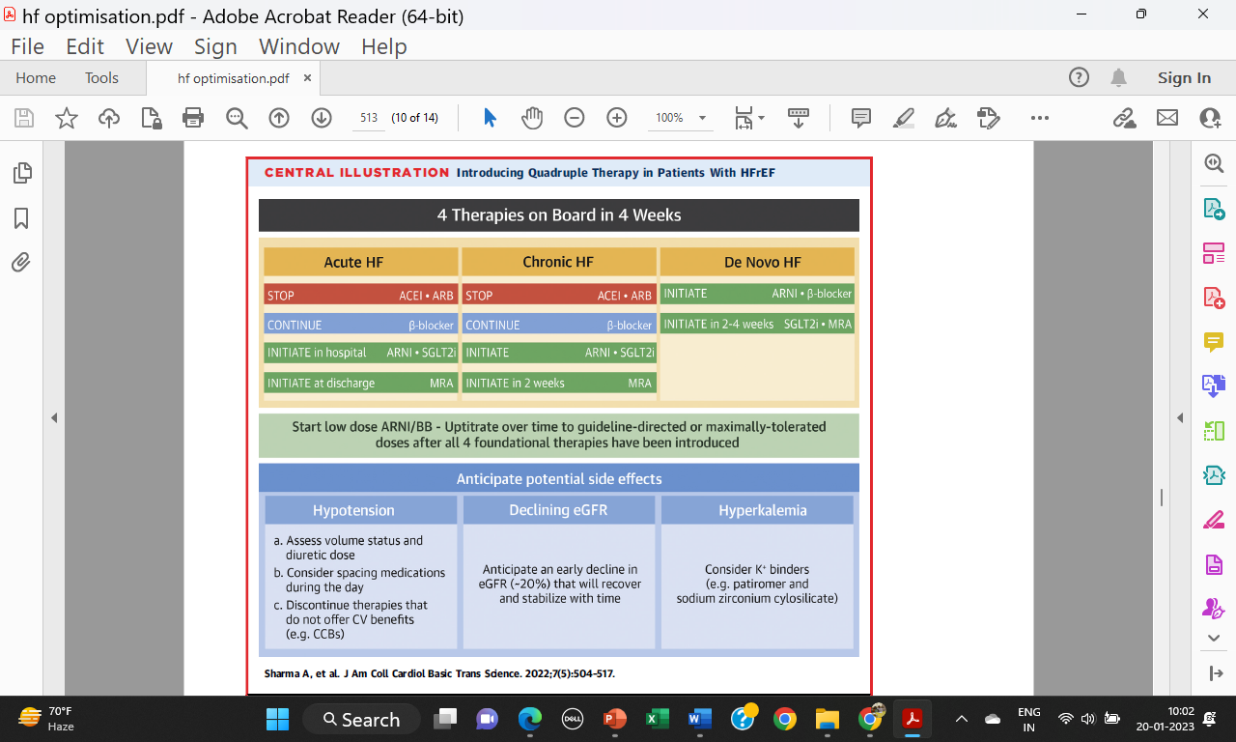

Slide 25
Targeting ‘peri-discharge’ phase of in-hospital stay in order to improve long-term outcomes
European Heart Journal Supplements (2022) 24 (Supplement L), L38–L44

Slide 26
ESC Heart Failure 2021; 8: 4444–4453

Slide 27
The four pillars of HFrEF therapy: is it time to treat heart failure regardless of ejection fraction?
European Heart Journal Supplements, Volume 24, Issue Supplement_L, December 2022, Pages L10–L19

Slide 28




Recommendations for Managing Comorbidities in Patients With HF
Management of anemia or iron deficiency
Management of sleep disorders
COR | RECOMMENDATIONS
2a | In patients with HFrEF and iron deficiency with or without anemia, intravenous iron replacement is reasonable to improve functional status and QOL
3: Harm | In patients with HF and anemia, erythropoietin-stimulating agents should not be used to improve morbidity and mortality
COR | RECOMMENDATIONS
2a | In patients with HF and suspicion of sleep-disordered breathing, a formal sleep assessment is reasonable to confirm the diagnosis and differentiate between obstructive and central sleep apnea
2a | In patients with HF and obstructive sleep apnea, continuous positive airway pressure may be reasonable to improve sleep quality and decrease daytime sleepiness
3: Harm | In patients with NYHA class II to IV HFrEF and central sleep apnea, adaptive servo-ventilation causes harm
Management of hypertension
Management of diabetes
COR | RECOMMENDATIONS
1 | In patients with HFrEF and hypertension, uptitration of GDMT to the maximally tolerated target dose is recommended.
COR | RECOMMENDATIONS
1 | In patients with HF and type 2 diabetes, the use of SGLT2i is recommended for the management of hyperglycemia and to reduce HF-related morbidity and mortality
Abbreviations: GDMT indicates guideline directed medical therapy; HF, heart failure; HFrEF, heart failure with reduced ejection fraction; NYHA, New York Heart Association; QOL, quality of life; and SGLT2i, sodium-glucose cotransporter-2 inhibitor.

Slide 29
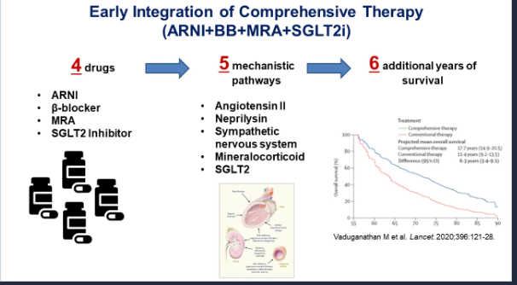

Slide 30
