Slide 1
Haemodynamics of pericardial diseases
Dr Cinosh Mathew
MD, DM(Cardiology), FACC
Professor & Head of Department
SBKS Medical Institute & Research Centre,
Sumandeep Vidyapeeth Deemed to be University, Vadodara

Slide 2
Pericardium - Anatomy
Fibro-serous sac
The inner visceral layer-- thin layer of mesothelial cells.
Parietal pericardium- collagenous fibrous tissue and elastic fibrils.
Between the 2 layers lies the pericardial space- 10-50ml of fluid- ultrafiltrate of plasma.
Drainage of pericardial fluid is via right lymphatic duct and thoracic duct.

Slide 3
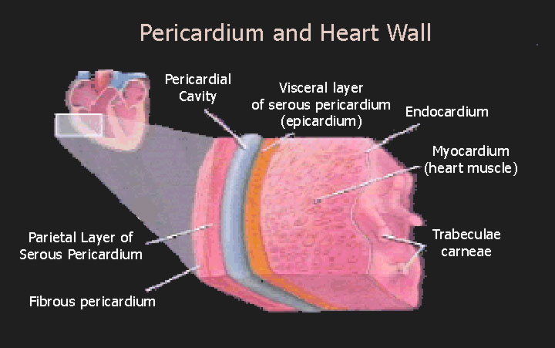
Pericardium: Anatomy
Pericardial Layers:
Visceral layer
Parietal layer
Fibrous pericardium

Slide 4
FUNCTIONS

Slide 5
1)Effects on chambers
Limits short-term cardiac distention
Facil chamber coupling and diast interaction
Maint P-V relation of chambers and output
Maint geometry of left ventricle
2) Effects on whole heart
Lubricates, min friction
Equal gravit inertial, hydrostatic forces
3) Mech barrier to infection
4) Immunologic
5) Vasomotor
6) Fibrinolytic
7) Modulation of myo structure and function and gene expression

Slide 6
Physiology of the Pericardium
Limits distension of the cardiac chambers
Facilitates interaction and coupling of the ventricles and atria.
Changes in pressure and volume on one side of the heart can influence pressure and volume on the other side
Influences quant and qualit aspects of vent filling- RV and RA > influence of the pericardium than is the resistant, thick-walled LV.

Slide 7
Magnitude & imp of pericardial restraint of vent filling at physiologic cardiac volumes- controversial
Pericardial reserve volume - diff between unstressed pericardial volume and cardiac volume.
PRV-relatively small & peri influences become signi when the reserve volume is exceeded
Rapid ↑ in blood volume
Rapid ↑ in heart size-a/c acuteMR, pulm embolism, RV infarction

Slide 8
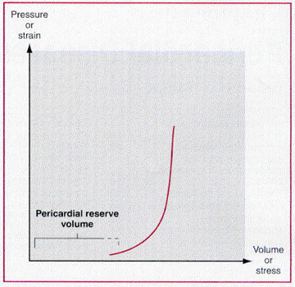
Stress-strain and pressure-volume curves of the normal pericardium.

Slide 9
Flat compliant segment transitions abruptly to noncompliant seg
Small reserve volume –exceeded , pr within the sac –acting on the heart ↑ rapidly-transmitted to inside the chambers
Once critical level of effusion is reached- small amounts of addl fluid –marked ↑ peri pr and ↓ function
Removal of small amounts- improves

Slide 10
Chronic stretching of the pericardium results in "stress relaxation“
Large but slowly developing effusions do not produce tamponade.
Pericardium adapts to cardiac growth by "creep" (i.e., an increase in volume with constant stretch) and cellular hypertrophy

Slide 11
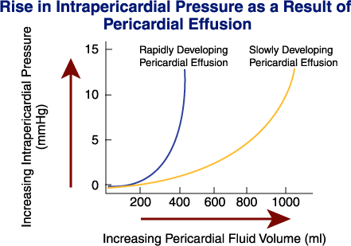

Slide 12
Restrain cardiac vol
Force it exerts on the heart influences filling
A component of intracavitary filling pressure –transmission of peri pr
Contact pr is more imp 4 R heart which have a lower filling pressure than L
Diastolic interaction
Transmission of intracavitary pr to adjoining chambers
Once card vol ↑ above phy range-pericardium contributes ↑nly to filling pressure
dir-contact pr
indir-diastolic interaction

Slide 13
3 possible pericardial compression syndromes
  Cardiac tamponade
    Accumulation of pericardial fluid under pressure and may be acute or subacute
  Constrictive pericarditis
    Scarring and consequent loss of elasticity of the pericardial sac
  Effusive-constrictive pericarditis
    Constrictive physiology with a coexisting pericardial effusion

Slide 14
CARDIAC TAMPONADE`

Slide 15
CardiacTamponade -- Pathophysiology
Accumulation of fluid under high pressure:
compresses cardiac chambers & impairs
diastolic filling of both ventricles
↓ SV ↑venous pressures
↓ CO systemic pulmonary congestion
Hypotension/shock ↑JVP rales
Reflex tachycardia hepatomegaly
ascites
peripheral edema

Slide 16
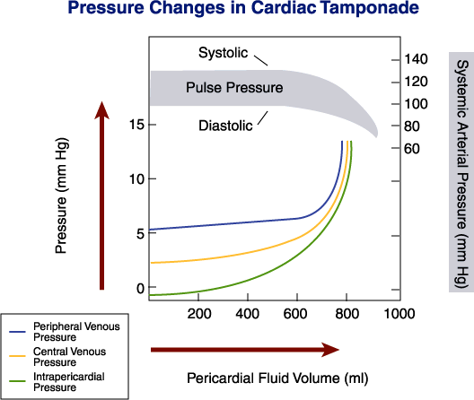

Slide 17
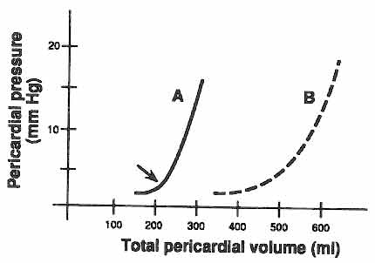
Pathophysiology
Pericardium relatively stiff
Symptoms of cardiac compression dependant on:
1. Volume of fluid
2. Rate of fluid accumulation
3. Compliance characteristics of the pericardium
A. Sudden increase of small amount of fluid (e.g. trauma)
B. Slow accumulation of large amount of fluid (e.g. CHF)

Slide 18
↑intrapericardial pr-throughout the cardiac cycle-> ↓ cardiac vol during ejection- momentary relief
Nl –biphasic venous return- at the vent ejection
- early diastole-TV opens
In tamponade– unimodal - vent systole
Severe tamp- venous return halted in diastole-when cardiac vol & peri pr are maximal
↓ intrathoracic pr in inspiration is transmitted to heart- preserved venous return- kussmaul absent

Slide 19
Hemodynamic features of
Cardiac Tamponade
Decrease in CO from reduced SV + increase in CVP
Equalization of diastolic pressure throughout the heart RAP=LAP=RVEDP=LVEDP
Reduced transmural filling pr
Total cardiac volume relatively fixed-small
Blood enters only when blood leaves the chamber
--CVP waveform
accentuated x descent + abolished y descent

Slide 20
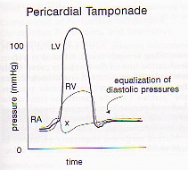
Equalization of Pressures

Slide 21
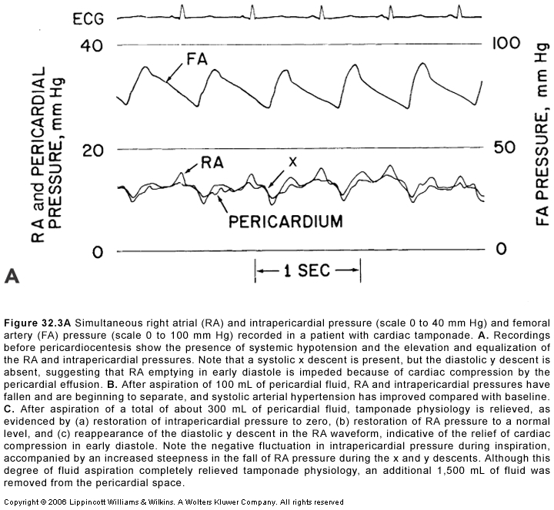

Slide 22
As the fluid accumulates in the peri sac-L&R sided pr rises and equalises to a pr llar to that of peri pressure(15-20mm)
Closest during inspiration
Vent filling press decided by the pr in pericardial sac- prog decline in the EDV
Compensatory ↑ in contractility & heart rate-↓ESV
Not sufficient to normalise SV-CO↓

Slide 23
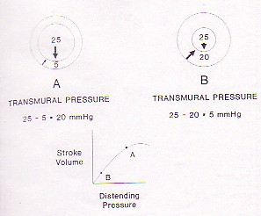
Transmural pressure = intracavity - pericardial pressure

Slide 24
Absence of Y Descent Wave in Cardiac Tamponade
Bcoz- equalization of 4 chambers pressures, no blood flow crosses the atrio-ventricular valve in early diastole (passive ventricular filling, Y descent)
X wave occurs during ventricular systole-when blood is leaving from the heart-prominent

Slide 25
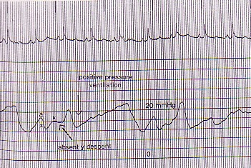
Absence of Y Descent Wave
in Cardiac Tamponade

Slide 26
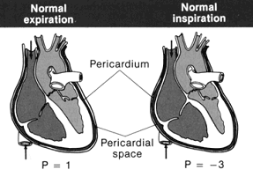
Pulsus Paradoxus
Intraperi pressure (IPP) tracks- intrathoracic pressure.
Inspiration:
  -ve intrathoracic pressure is transmitted to the pericardial space
  ↓ IPP
  ↑ blood return to the right ventricle
  ↓ jugular venous and right atrial pressures
  ↑ right ventricular volume → IVS shifts towards the left ventricle
  ↓ left ventricular volume
  ↓ LV stroke volume
⇒ ↓ blood pressure (<10mmHg is normal) during inspiration

Slide 27
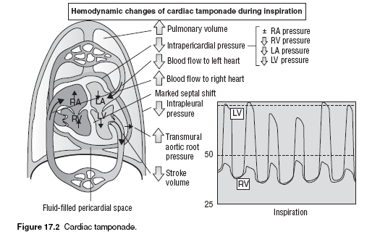

Slide 28
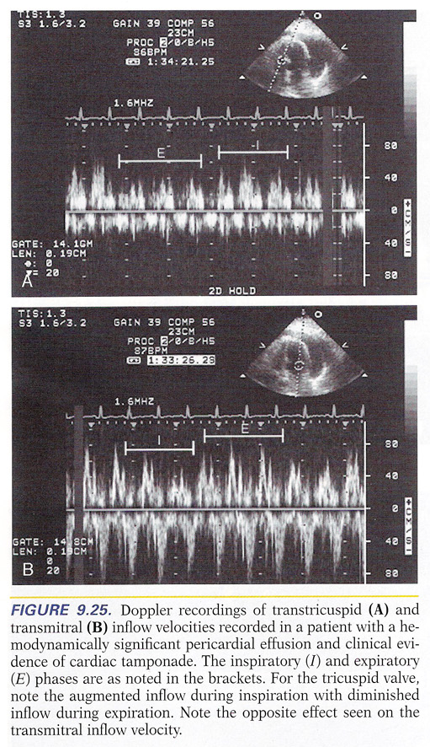

Slide 29
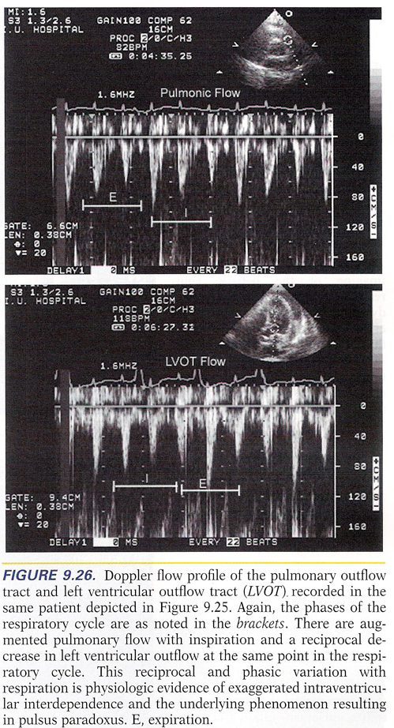

Slide 30
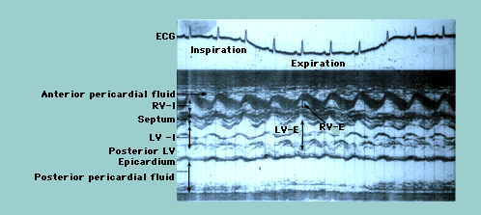
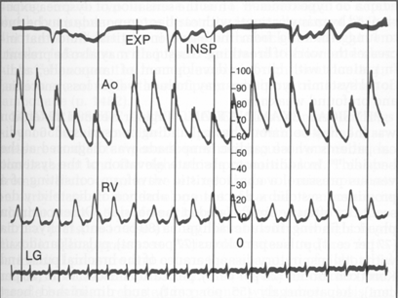
Pulsus Paradoxus
> 10 mm Hg drop in BP
with inspiration
Exaggeration of normal physiology

Slide 31
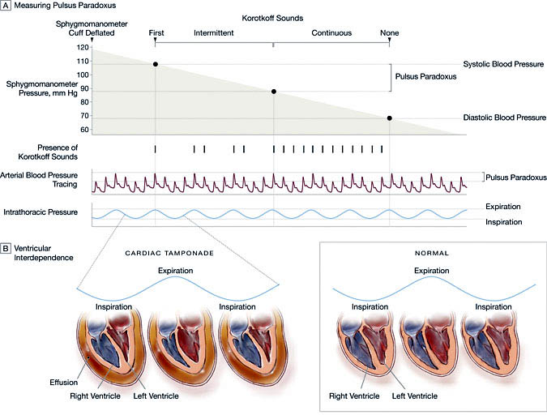
Pulsus Paradoxus

Slide 32
Other factors
↑afterload –transmission of-ve intrathoracic pr to aorta
Traction on the pericardium caused by descent of the diaphragm-↑ peric pr
Reflex changes in vas resistance& card contractility
↑ respi effort due to pulmonary congestion

Slide 33
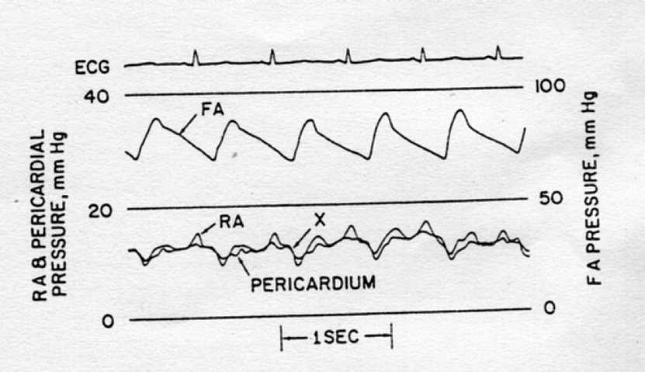
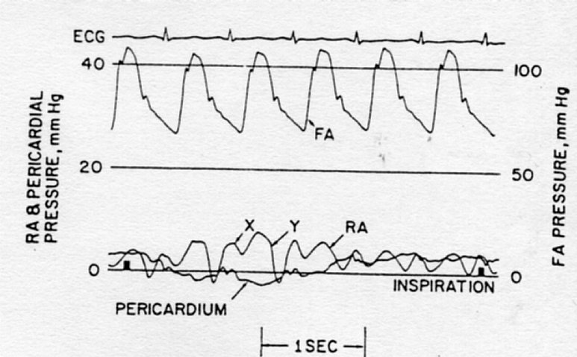
Pericardial tamponade
after pericardiocentesis

Slide 34
Stress Responses to
Cardiac Tamponade
Reflex sympathetic activation => ↑ HR + contractility
Arterial vasoconstriction to maintain systemic BP
Venoconstriction augments venous return
Relatively fixed SV
CO is rate dependent

Slide 35
TAMPONADE WITHOUT PP
When preexisting elevations of diastolic pressures/ volumes exist –no PP
Eg;- LV dysfunction
AR
ASD
Aortic dissection with AR

Slide 36
Low pressure tamponade
Intrvascular volume low in a preexisting effusion
Modest ↑ in peri pr can compromise already↓ SV
Dialysis patient
Diuretic to effusion patient
Pats with blood loss and dehydration
JVP & pulsus paradoxus absent

Slide 37
CONSTRICTIVE PERICARDITIS

Slide 38
Pathophysiology
Rigid, scarred pericardium encircles heart:
Systolic contraction normal
Inhibits diastolic filling of both ventricles
↓ SV ↑venous pressures
↓ CO systemic pulmonary congestion
Hypotension/shock ↑ JVP rales
Reflex tachycardia hepatomegaly
ascites
peripheral edema

Slide 39
Pathophysiology
Heart encased by rigid ,non compliant shell
1. uniform impairment of RV and LV filling
EARLY DIASTOLIC filling normal(↑RAP+suction due to ↓ESV)
filling abruptly halted in mid and late diastole
pressure rises mid to late diastole
2. ↑interventricular interdependence
3. dissociation of thoracic and cardiac chambers
- Kussmaul’s
- decreased LV filling with inspiration and increased RV filling

Slide 40
CP- card vol is fixed- attained after initial1/3rd of diastole
Biphasic venous return- dias≥ to systolic component
Card compression insignificant –end systole
+
↑RAP+vent suction due to ↓ ESV- rapid early diastolic filling

Slide 41
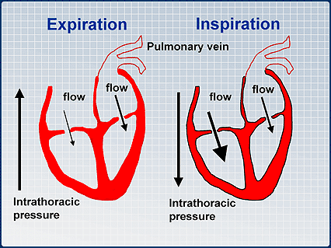
Normal

Slide 42
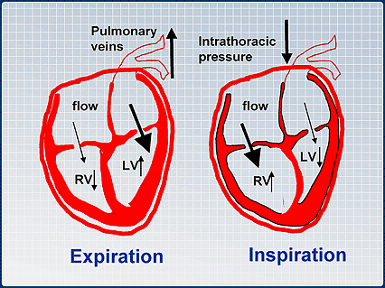
CCP

Slide 43
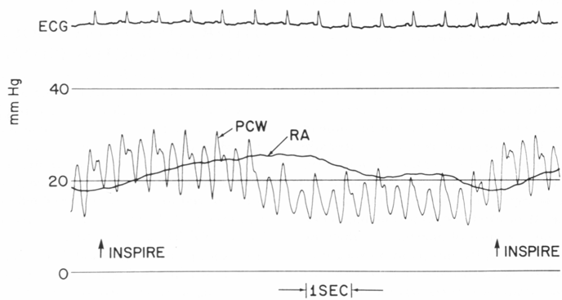
Kussmaul’s Sign
Inspiration: ↓intrathoracic pr, ↑ venous return to thorax
↓intrathoracic pr not transmitted to RV
⇒ no pulsus paradoxus
no inspiratory augmentation of RV filling (rigid pericardium)
intrathoracic systemic veins become distended
⇒JVP rises with inspiration

Slide 44
Kussmaul’s Sign
Mechanism:
1) Increase ven pressure due to ↓
compliance of pericardium and heart
2) ↑ abdominal presssure during
inspiration with elevated venous pressure
Clinical presentation: inspiratory engorgement
of jugular vein
Also seen in cardiomyopathy, pulmonary
embolism, and RVMI

Slide 45
Friedreich's sign
Early diastolic pressure dip observed in cervical veins or recorded from RA / SVC
Rapid early filling of vent-↑ RAP+ suction due to ↓ ESV

Slide 46
HEMODYNAMICS OF CP
Impairement of RV/LV filling with chamber vol limited by rigid pericardium
1) high RAP with prom X & Y descent
2) ‘Squre root’ sign of RV & LV PR wave form
3) PASP & RVSP < 50 mm Hg
4) RVEDP> 1/3 RVSP
↑Interventricular dependence & dissociation of thoracic & cardiac chambers
1) kussmaul’s sign
2) RVEDP & LVEDP < 5 mm apart
3) Respiratory discordance in peak RVSP & LVSP

Slide 47
↓intra thoracic pr fails to get transmitted into heart- inspirat ↑ in venous return doesn’t occur-
Kussmaul’s sign
Inspiratory ↑ in ven return & RV vol-doesn’t occur
+
position of vent septum not dramatically altered
=no pulsus paradoxus

Slide 48
Cath
↑ RAP
Prominent X and Y descents of atrial pressure tracings
↑RVEDP ≥ 1/3 of RVSP
"Square root" signs in the RV and LV diastolic pressure tracings
> insp ↓in PCWP compared to LVEDP
Equalization of LV and RV diastolic plateau pressure tracings
Discordance between RV and peak LV systolic pressures during inspiration(100%sen,spec)

Slide 49
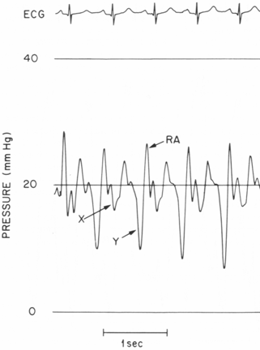
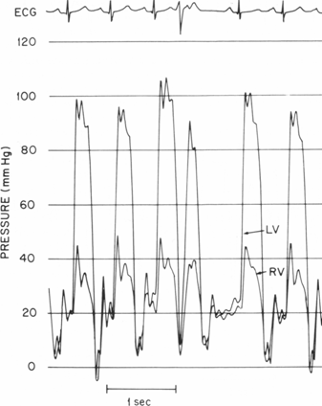
Cardiac Catheterization
Elevated and equalized diastolic pressures (RA=RVEDP=PAD=PCW)
Prominent y descent: “dip and plateau”:
rapid atrial emptying rapid ventricular filling
then abrupt cessation of blood flow due to rigid pericardium

Slide 50
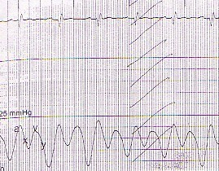
M/W Shaped Atrial Tracing

Slide 51
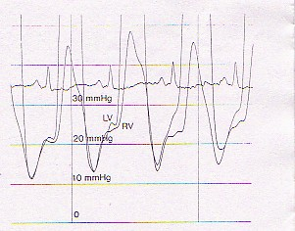
Equalization of Pressures

Slide 52
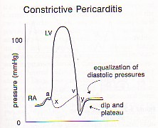

Slide 53
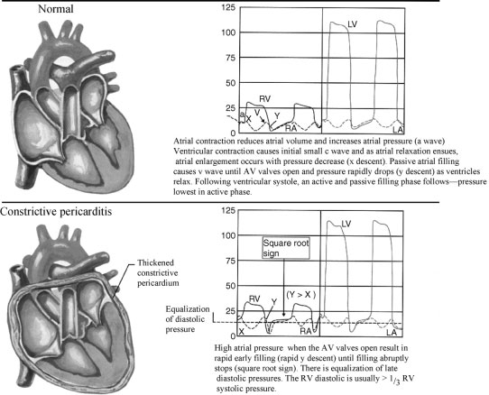

Slide 54
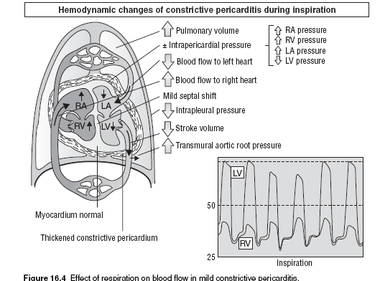

Slide 55
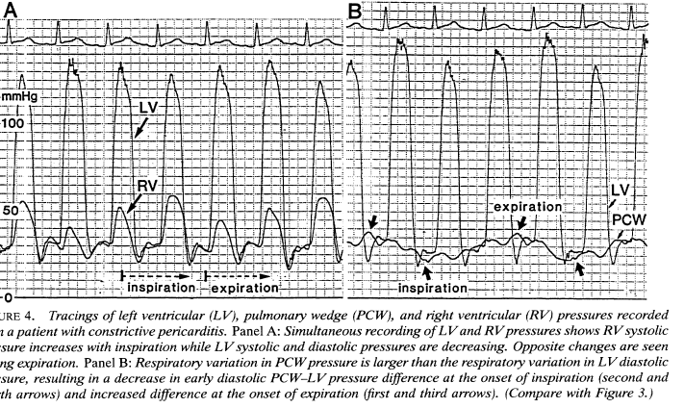

Slide 56
Echo in ccp
Abrupt relaxation of post wall and septal bounce
Related to competitive ventricular filling
Lack of respiratory variation of IVC diameter
Doppler
Exaggerated E/A of mitral flow, short DT and exaggerated respiratory variation >25% of velocity and IVRT
Augmented by vol loading

Slide 57
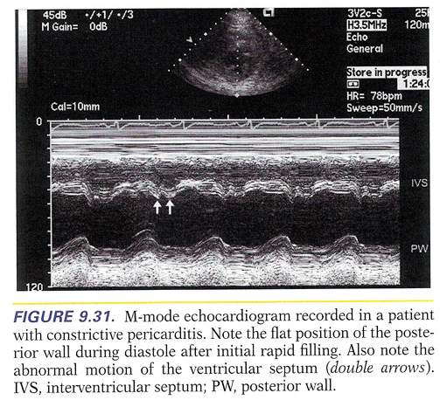

Slide 58
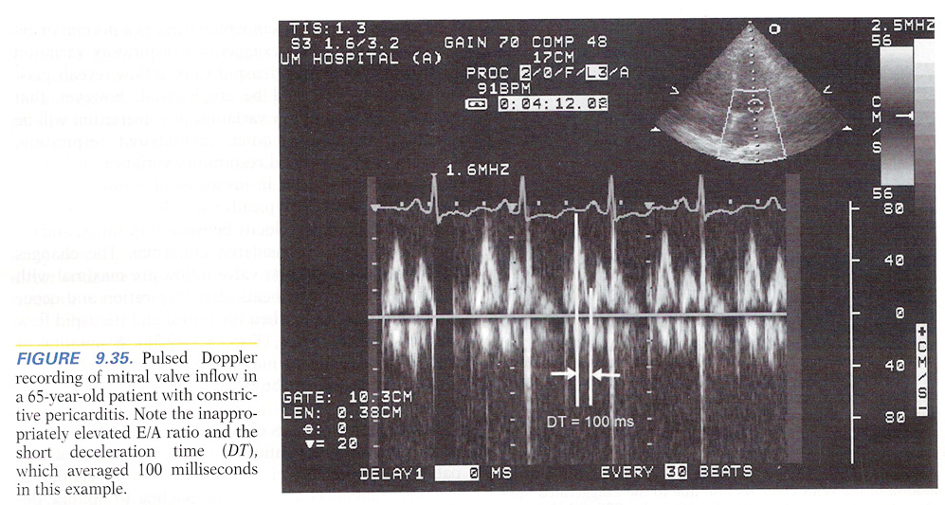

Slide 59
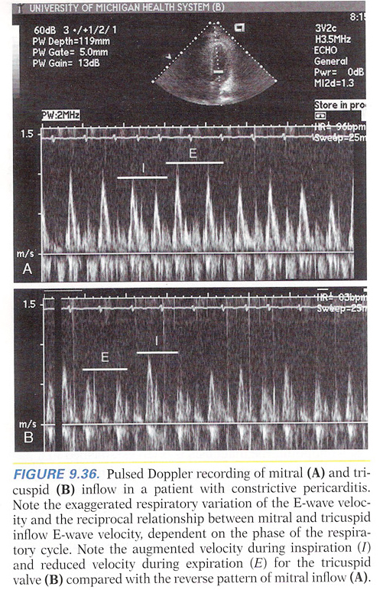

Slide 60
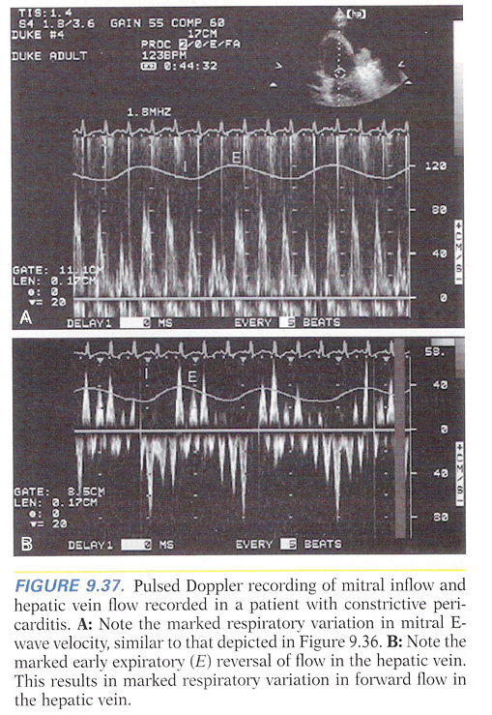

Slide 61
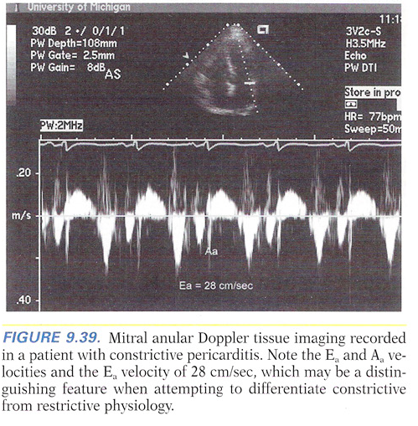

Slide 62
Constriction vs. Tamponade
TAMPONADE
Low cardiac output state
JVP↑
RA: blunted y descent
Prom X descent
NO Kussmaul’s sign
Equalized diastolic pressures
Decreased heart sounds
P Paradoxus
CONSTRICTION
Low cardiac output state
JVP↑
RA: rapid y descent
Kussmaul’s sign
Freidreich’s sign
Equalized diastolic pressures
Pericardial “knock”

Slide 63
 | Constriction | RCM
Prom Y in JVP | Present | Variable
Pulses paradoxus | ≈1/3 cases | Absent
Pericardial knock | Present | Absent
R = L filling pressures | Present | L 3-5 mm Hg >R
Filling pr >25 mm hg | Rare | common
RVEDP≥ 1/3rd RVSP | Present | < 1/3rd
PASP > 60 mm hg | Absent | common
Square root sign | Present | variable
Resp variation in L-R flows | Exaggerated | Normal
Vent wall thickness | Normal | +_↑
Atrial size | Possible LAE | BAE

Slide 64
 | Constriction | RCM
SEPTAL BOUNCE | Present | absent
Tissue doppler E’ velocity | increased | Reduced
Pericardial thickness | increased | normal

Slide 65
Effusive constrictive
Failure of RAP to decline by atleast 50% to a level ≤10 mm Hg after pericardial pressure reduced to 0mm by aspiration
Radiation or malignancy, TB
Often need pericardiectomy

Slide 66
THANK YOU

