Slide 1
Epidemiology, Pathophysiology of Tuberculosis
(white plague )
Dr. Arti Shah
Professor & HOD Respiratory medicine
S B K S M I & R C

Slide 2
Epidemiology of Tuberculosis
 | 2014 | 2021
NEW CASES | 9.6 Million | 10.6 Million
Cases in southeast Asia | 4 Million | 3 Million
INDIA | 2.2 Million | 2 Million
10th leading cause of global death
13th in terms of years of healthy life lost worldwide

Slide 3
History and Spread of TB
It is there since B C
European countries highest CASES in 15 and 16 th century ,
Increased again during world wars,
Now it is concentrated to poor countries,
Commonly affected people homeless, people with immunocompromised status and elderly.

Slide 4
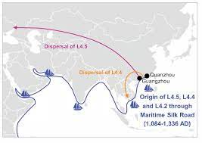

Slide 5
A Global Response
1993 – WHO - global health emergency
2000 – stop tb global Plan
2035 – eradication of Tb
2025 – for INDIA END TB STATERGY

Slide 6
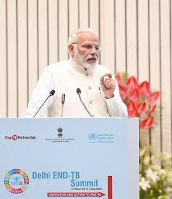
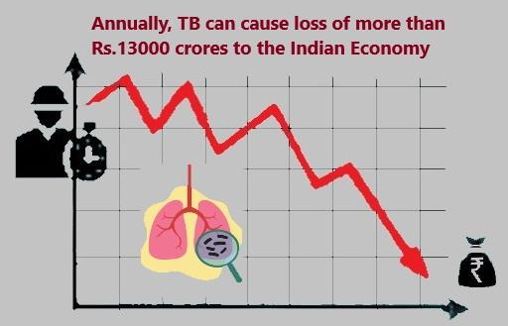
Empact on economy and work

Slide 7
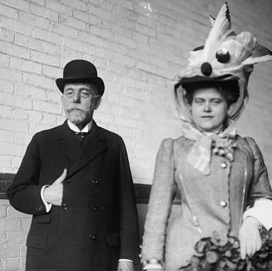
Microbiology of Tubercle Bacillus
24 /1882 – discovery of tb bacilli by Robert Koch

Slide 8
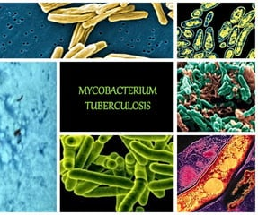

Slide 9
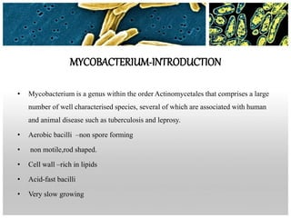
Mycobacterium
Notes:
A

Slide 10
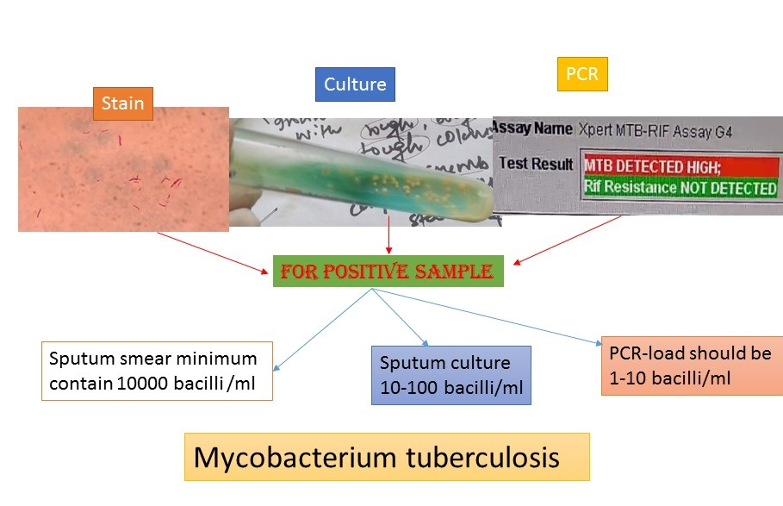

Slide 11
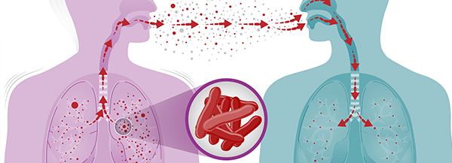
Transmission
AIR
INFECTED MILK

Slide 12
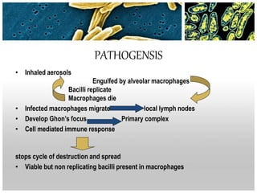

Slide 13
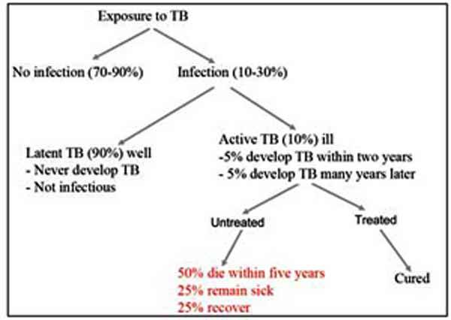
Natural history of tuberculosis

Slide 14
Primary infection
1st contact with bacilli
An acute exudative lesion develops and rapidly spreads to the lymphatics and regional lymph nodes .
Lymph nodes undergo massive caseation which generally heals by calcification
This primary infection can occur in elderly also
In primary infection any part of lung can be involved but mostly bases.
Notes:
P

Slide 15
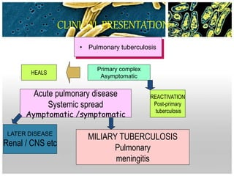

Slide 16
Diagnosis
Sputum, gastric washings , pleural fluid, urine , joint fluids, biopsy samples.
AFB STAING BY Z N METHOD AND AURAMINE RHODAMIN METHOD

Slide 17

TUBERCULIN TEST

Slide 18
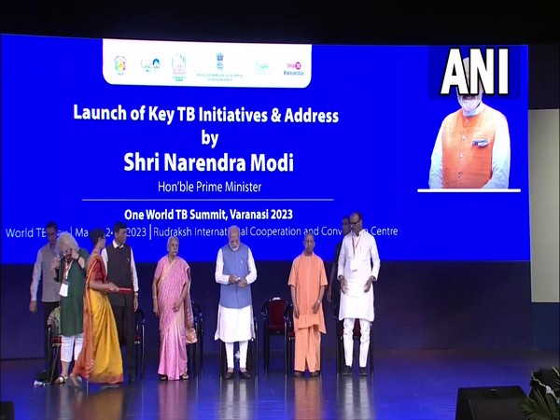
END TB BY 2025
Tuberculosis is one of the sustainable development targets to be achieved by 2030 by the world, India has set the target of 2025. The national strategic plan 2017-2025 sets the target of India reporting no more than 44 new TB cases or 65 total cases per lakh population by 2025

