Slide 1
Clinical hemodynamic correlation in mitral stenosis
Dr Cinosh Mathew
MD, DM(Cardiology), FACC
Professor & Head of Department
SBKS Medical Institute & Research Centre,
Sumandeep Vidyapeeth Deemed to be University, Vadodara

Slide 2
Grading of severity in MS
parameter | mild | moderate | severe
MVA(cm2) | >1.5 | 1.0-1.5 | <1.5
Mean gradient (mmHg) | <5 | 5-10 | >10
PASP(mmHg) | <30 | 30-50 | >50

Slide 3
Normal CSA of mitral valve – 4 to 5 cm2
No significant gradient across normal mitral valve during diastolic flow
Progressive narrowing of mitral orifice results in
  Pressure gradient b/w LA and LV
    Left ventricular end diastolic pressure remaining at 5 mm Hg,LA mean pressure rises gradually
    Reaches around 25 mmHg when MVA around 1 cm2
  Reduction of blood flow across mitral valve
    COP 3.0 L/min /m2 falls to around 2.5 L/min /m2 at MVA 1 cm2
Dependence of LV filling on LA pressure
Elevation of LA mean pressure-pulmonary venous hypertension

Slide 4
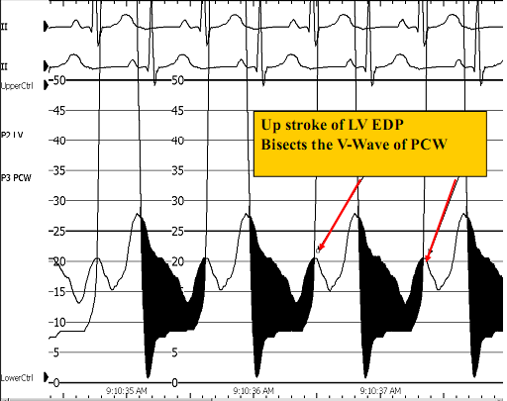

Slide 5
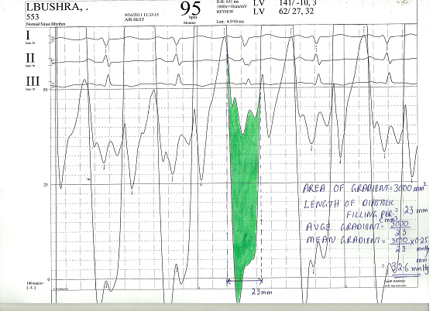

Slide 6
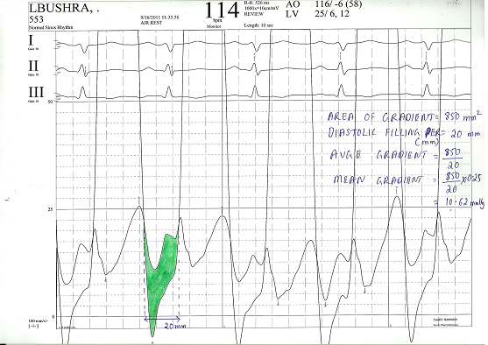

Slide 7
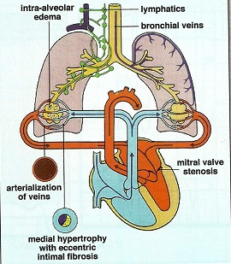

Slide 8
Factors affecting transmitral gradient
√mean grad∞ COP/DFP*MVA
Factors ↑ grad
  ↑ COP
    Exertion ,emotion,high output states
  ↓ DFP
    Increase HR
  ↓ MVA
    Progression of disease
    thrombus

Slide 9
Factors decreasing gradient
  ↓ COP
    Second stenosis
    RV failure
  ↑ DFP
    Slow HR
  ↑ MVA

Slide 10
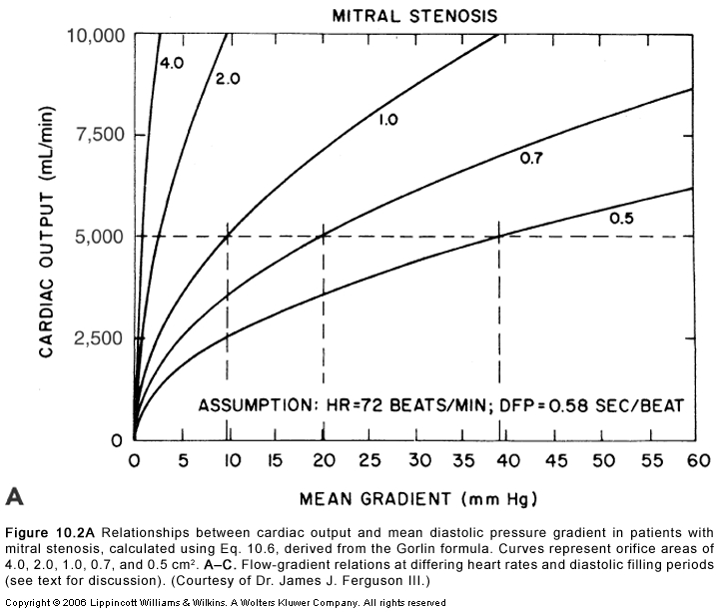
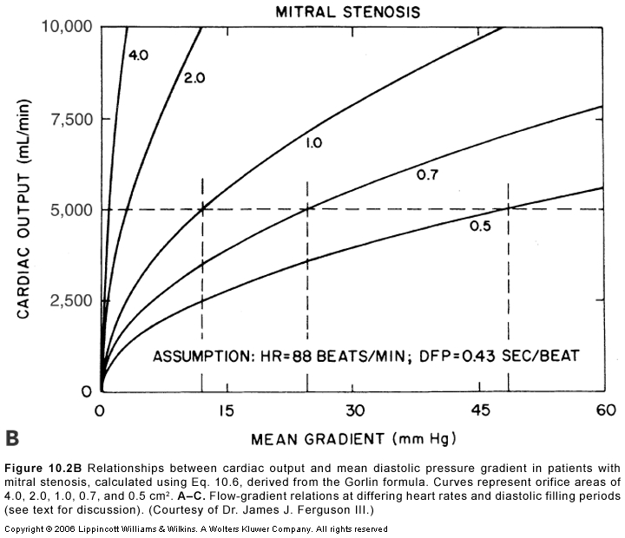

Slide 11
↑pul venous pressure
  Transudation of fluid into interstitium
    Initially lymphatic drainage increases to drain excess fluid-fails as venous pressure increases
    Transudate decrease lung compliance-increase work of breathing
    Bronchospasm,Alveolar hypoxia,vasoconstriction
    Symptoms-dyspnoea,orthopnoea,PND

Slide 12
a/c pulmonary edema
PCWP exceeds tissue oncotic pressure of 25 mmHg&lymphatics unable to decompress the transudate
Gradual in a tight MS or abrupt appearance in a moderate to severe MS a/w ↑HR or ↑ transvalvular flow
  Onset of AF
  tachycardia
  Fluid overload
  Pregnancy
  High output states

Slide 13
Hemoptysis
Pulmonary apoplexy
  Sudden,profuse,bright red
  Sudden increase in pulmonary venous pressure&rupture of bronchial vein collaterals
Pink frothy sputum of pulmonary edema
Blood stained sputum of PND
Blood streaked sputum a/w bronchitis
Pulmonary infarction

Slide 14
Winter bronchitis
Pulmonary venous hypertension-c/c passive congestion of lung-bronchial hyperemia
Hypersecretion of seromucinous glands –excessive mucus production
Symptoms of bronchitis

Slide 15
Effects of c/c elevation of pul venous pressure
  Increase in lymphatic drainage
  Engorged systemic bronchial veins
  Pulmonary arterial hypertension

Slide 16
Pulmonary HTN
Devt of pulmonary hypertension
  Passive
  Active
  Organic obliterative changes
Passive pulmonary HTN
  Obligatory increase in response to ↑PCWP to maintain gradient of 10 to 12 across pul vasc bed(PA mean-LA mean)
Active pulmonary HTN
  PA mean pressure –LA mean pressure >10 to 12

Slide 17
Cause of reactive pul HTN
Wood-pulmonary vasoconstriction
Doyle-↑pul venous pressure prominent in the lower lobes,produce reflex arterial constriction
Heath &Harris-↑ PA pressure causes reflex arteriolar constriction

Slide 18
Jordan-
  ↑pul venous pressure-transudation of fluid
  causes thickening and fibrosis of alveolar walls
  hypoventilation of lower lobes-hypoxemia in lower lobe vessels
  Sensed by chemoreceptors in pulmonary veins
  Pulmonary arteriolar vasoconstriction in regions supplying these alveoli
  Lower lobe perfusion decreases
  This process eventually involve middle and upper lobe

Slide 19
Anatomical changes in the pulmonary arterioles
  Medial hypertrophy
  Intimal proliferation
  Fibrosis
Decrease in CSA of pulmonary vascular bed
Increase PVR

Slide 20
Sequlae of reactive pul HTN
RV hypertrophy
Functional TR
RV failure

Slide 21
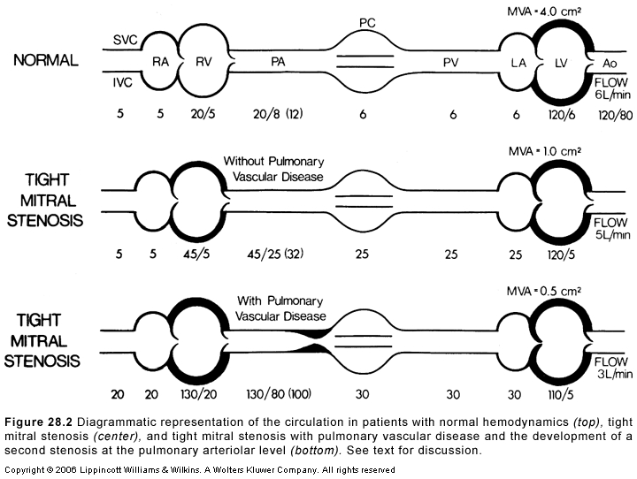
The second stenosis

Slide 22
Symptoms and hemodynamic correlation
Precapillary block
  Low cardiac output
  Right ventricular hypertrophy
  RV dysfunction
Postcapillary block
  Left sided failure

Slide 23
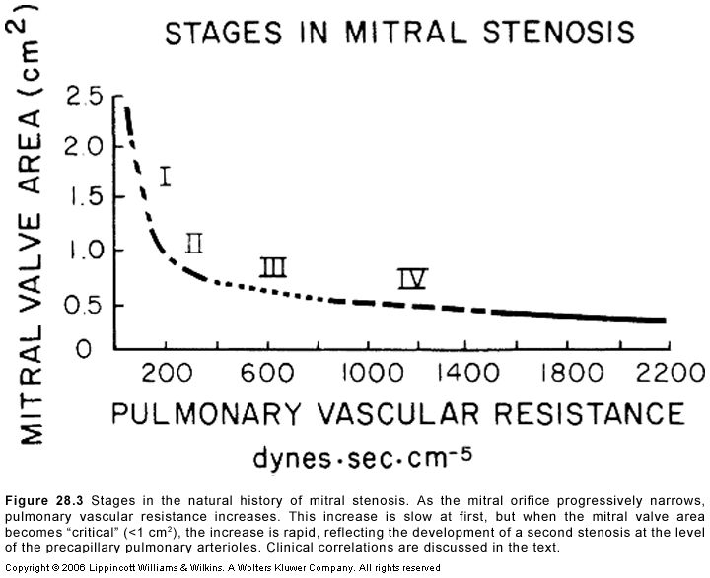
Four hemodynamic stages

Slide 24
Stage 1
  Asymptomatic at rest
Stage 2
  Symptomatic due to elevated LA pressure
  Normal pulmonary vasc resistance
Stage 3
  Increased pulmonary vascular resistance
  Relatively asymptomatic OR symptoms of low COP
Stage 4
  Both stenoses severe
  Extreme elevation of PVR-RV failure

Slide 25
Elevated precapillary resistance protects against devt of pulmonary congestion at cost of a reduced COP
Severe pulmonary HTN leads to right sided failure

Slide 26
Exercise hemodynamics-2 types of response
  Normal COP&high transvalvular gradient-symptomatic due to pulmonary congestion
  Reduced COP &low gradient-symptoms of low COP
Severe MS-combination of low output and pulmonary congestion symptoms

Slide 27
Role of LA compliance
Non compliant LA
  Severe elevation of LA pressure and congestive symptoms
Dilated compliant LA
  Decompress LA pressure
PHT =11 .6*Cn*√ MPG/(Cc*MVA)
  Cn-net compliance
  Thomas JD (circulation 1988)
Post BMV
  Reduction of LV compliance <improvement in LA compliance
  Net compliance increases-overestimate PHT
  MVA underestimated

Slide 28
Impact of AF in MS
↑HR,↓DFP-elevates transmitral gradient
Loss of atrial contribution to LV filling
  Normal contribution of LA contraction to LV filling 15%
  In MS,increases upto 25-30%
  Lost in AF
Loss of A wave in M-mode echo and in LA pressure tracing

Slide 29
Physical findings and correlation
Pulse-normal or low volume in ↓ COP
JVP-
  mean elevated in RV failure
  prominent a wave in PAH in SR
  Absent a wave in AF
Palpation
  Apical impulse
    Inconspicous LV
    Tapping S1
    RV apex in exreme RVH
  LPH in RVH
  Palpable P2

Slide 30
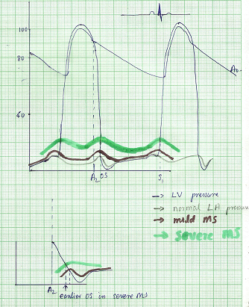

Slide 31
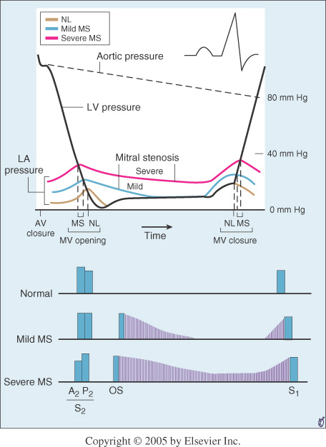

Slide 32
Loud S1
  Mitral valve closes at a higher Dp/dt of LV
    In MS closure of mitral valve is late due to elevated LA pressure
    LA –LV pressure crossover occurs after LV pressure has begun to rise
    Rapidity of pressure rise in LV contributes to closing of MV to produce a loud S1
  Wide closing excursion of leaflets
    Persistent LA-LV gradient in late diastole keeps valve open and at a lower position into late diastole
    Increased distance that traversed during closing motion contributes to loud S1
  Quality of valve tissue may affect amplitude of sound
    The diseased MV apparatus may resonate with a higher amplitude than normal tissue

Slide 33
Soft S1 &decreased intensity of OS in severe MS
  MV Calcification especially AML
  Severe PAH-reduced COP
  CCF-reduced COP
  Large RV
  AS-reduced LV compliance
  AR
  Predominant MR
  LV dysfunction

Slide 34
Q-S1 interval
Prolongation of Q-S1 interval
  As LA pressure rises,LA-LV pressure crossover occurs later
  Well’s index-
    Q-S1 interval-A2 OS interval expressed in units of 0.01 sec
    >2 unit correlate with MVA <1.2 cm2

Slide 35
S2
  Loud P2
  Narrow split as PAH increases
    Reduced compliance and earlier closure of pulmonary valve
RVS4
LVS3 rules out significant MS

Slide 37
A2-OS interval
OS-
  Sudden tensing of valve leaflets after the valve cusps have completed their opening excursion
  Movement of mitral dome into LV suddenly stops
  Follows LA LV pressure crossover in early diastole by 20-40 ms
A2 OS interval ranges from 40 -120 ms
As LA pressure rises,the crossover of LA and LV pressure occurs earlier –MV opening motion begins earlier- A2 OS interval shortens
Narrow A2 OS interval <80 ms-severe MS

Slide 38
Short A2 OS interval
  Severe MS
  Tachycardia
  Associated MR-Higher LA pressure –MV open earlier
Long A2-OS interval in severe MS
  Factors that affect MV opening –AR,MV calcification
  Factors that decrease LV compliance-AS,syst HTN,old age
  Decreased rate of pressure decline in LV during IVRT as in LV dysfunction
  Due to low LA pressure in a large compliant LA
In AF-shorter cycle length-LA pressure remains elevated-A2 OS narrows

Slide 39
Diastolic murmur of MS
Two components-
  early diastolic component that begins with the opening snap,when isovolumic LV pressure falls below LA pressure
  Late diastolic component
    Increase in LA-LV pressure gradient due to atrial systole
    Persistence of LA-LV gradient upto late diastole in severe MS
      closing excursion of mitral valve produces a decreasing orifice area
      velocity of flow increases as valve orifice narrows
      this cause turbulence to produce presystolic murmur

Slide 40
Duration of murmur correlates with severity
Murmur persists as long as transmitral gradient>3 mmHg
Mild MS-
  murmur in early diastole
  or in presystole with crescendo pattern
  or both murmurs present with a gap b/w components
Moderate to severe MS-
  murmur starts with OS and persists upto S1

Slide 41
Presystolic accentuation of murmur
Atrial contraction in patients in sinus rhythm
Reduction in mitral valve orifice by LV contraction
  Increase velocity of flow as long as there is a pressure gradient LA-LV
  Persistence of presystolic accentuation in AF in severe MS

Slide 42
Factors that decrease intensity of diastolic murmur of MS
Low flow states
  Severe MS
  Severe PAH
  CCF
  AF with rapid ventricular rate
Associated cardiac lesions
  Aortic stenosis-LVH,decreased compliance-decreased opening motion of mitral valve
  Aortic regurgitation
  ASD
  PHT with marked RV enlargement

Slide 43
Characteristics of mitral valve
  Extensive calcification
Others
  Apex formed by RV
  Inability to localise apex
    Obesity
    Muscular chest
    COPD

Slide 44
Factors increasing intensity of murmur
a/w MR-increased volume of LA blood-increased transvalvular flow
Tachycardia

Slide 45
Calculation of MVA
Toricelli’s law
  F=AVCc
  A=F/V Cc
  F-Flow rate,A-orifice area,V-velocity of flow
  Cc-coefficient of orifice contraction
Gradient and velocity of flow related by
  V ²=Cv²*2 g h
  G=gravitational constant,h=pressure gradient
  Cv=Coefficient of Velocity
  V=Cv*√2 g h
MVA=F/Cv*Cc* √2 g h =F/C*44.3*√h

Slide 46
Flow
  Total cardiac output divided by time in seconds during which flow occurs across the valve
  F=COP/DFP*HR

Slide 47
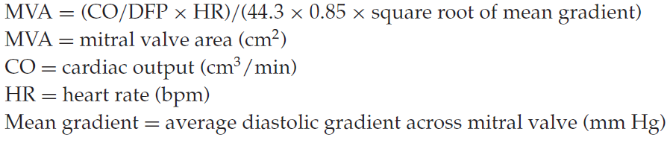

Slide 48
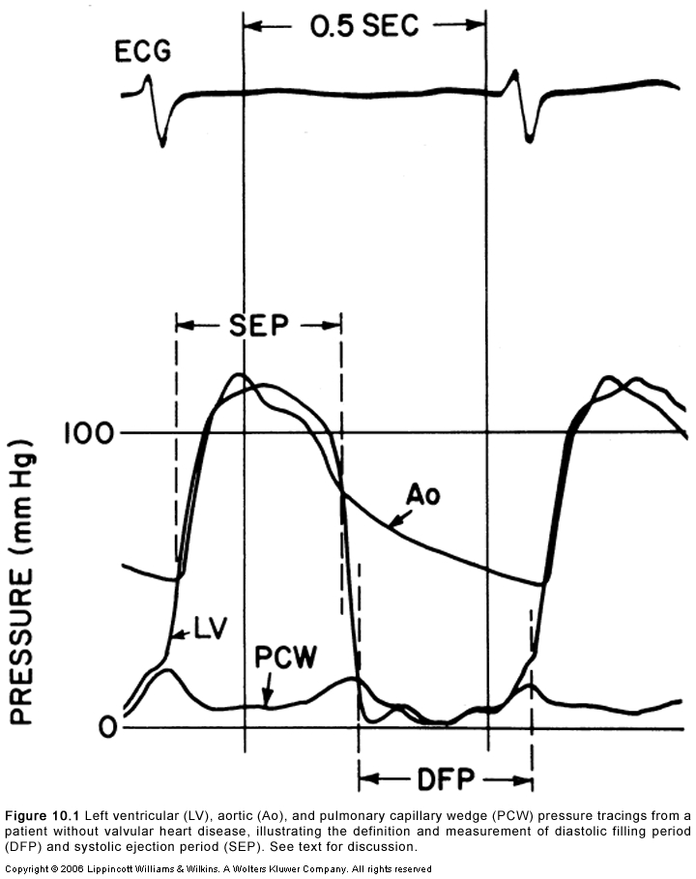

Slide 49
Steps
Average gradient=area(mm2)/length of diastole(mm)
Mean gradient=average gr * scale
Average diastolic period=length of DFP(mm)/paper speed(mm/s)
HR(bt/min),COP(ml/min)
MVA=cardiac output/HR×average diastolic period÷37.7×√mean gradient

Slide 51
Calculation of mean gradient-pre BMV
Area of gradient=30*10*6.5=1950 mm²
Diastolic filling period=23 mm
Avge gradient=1950/23=84.78 mm
Scale=25/65=0.38 mmHg/mm
Mean gradient=84.78*0.38=32.6 mmHg

Slide 52
Calculation of MVA-pre BMV
Mean gradient=32.6 mmHg
Diastolic filling period=23mm/100 mm/s=.23 s
HR=95/min
COP=4150 ml/min
MVA=4150/(0.23*95)÷(37.7*√32.6)
=0.88 cm2

Slide 54
Calculation of mean gradient –post BMV
Area of gradient=8.5*10*6.5=552.5 mm²
Diastolic filling period=20 mm
Avge gradient=552.5/20=27.62 mm
Mean gradient=27.62*0.38=10.49 mmHg

Slide 55
Calculation of MVA post BMV
Mean grad=10.49
DFP=0.2s
HR=114/min
COP=5000 ml/min
MVA=5000/(0.2*114)÷(37.7*√10.49)
=1.94 cm2

Slide 56
Alignment mismatch
In PCWP there is a delay in transmission of LA pressure through the pulmonary vascular bed
delayed by 50-70 ms
Realigned by shifting leftward
V wave peak bisected by or slightly to left of LV pressure tracing

Slide 57
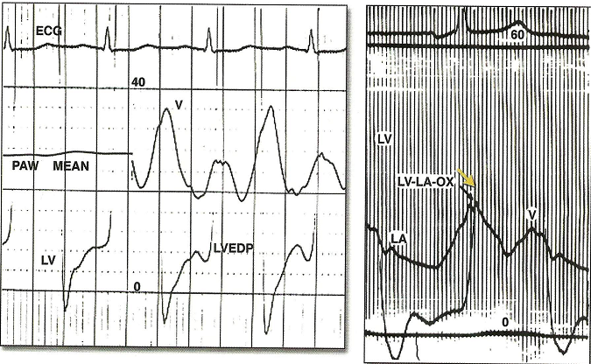
Wedge-LV Vs LA-LV

Slide 58
Damped wedge-LV Vs LA-LV
Overestimation of MV gradient can occur if a damped wedge pressure is used
Difficult to obtain proper wedge
  Severe PAH
Overestimation of gradient even after a proper wedge
  Prosthetic MV
  Elderly with severe mitral annular calcification

Slide 59
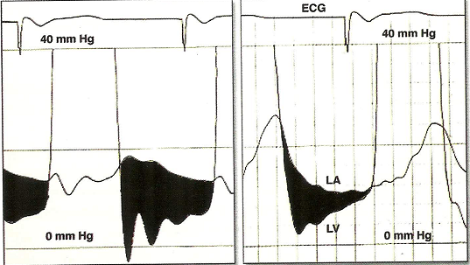

Slide 60
LA –LV gradient in AF
With long diastolic filling period ,progressive decrease in LA pressure
Increase with short diastole
Measure gradient in 3 to 4 diastolic complexes with nearly equal cycle length & take mean

Slide 61
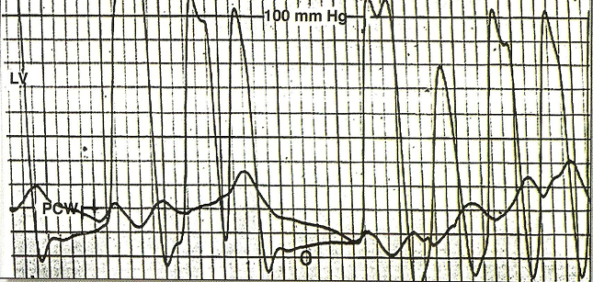

Slide 62
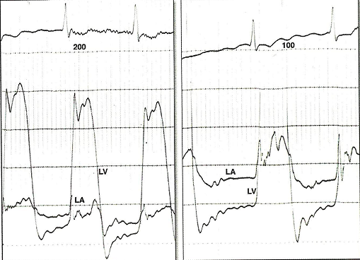

Slide 63
Pitfalls
PCWP overestimates LA pressure by 2-3 mmHg
If a/w MR,true mitral valve flow is underestimated-calculated MVA underestimated
Calculation of COP,HR,DFP,mean gradient must be simultaneous
If PCWP used ,wedge position must be confirmed by
  withdrawing blood sample&measure saturation
  Bright red blood on aspiration
  Contrast injection to visualise fern pattern

Slide 64
M-mode echo
Reduced mitral E-F slope
  Slope <15 mm/s-MVA<1.3 CM2
  Slope>35 mm/s-MVA >1.8 CM2
  low sensitivity &specificity
anterior motion of posterior mitral leaflet
Absence of A wave in mitral valve M-mode

Slide 65
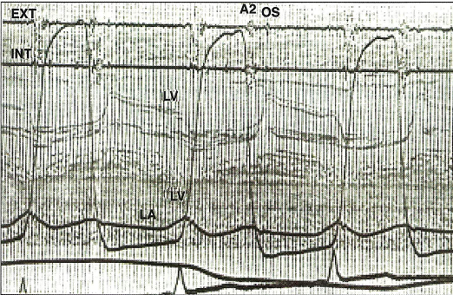

Slide 66
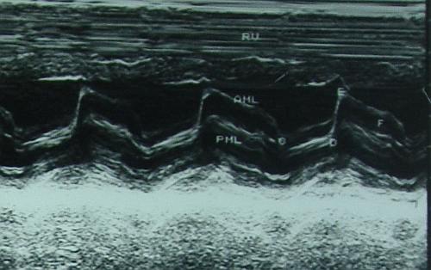

Slide 67
Doppler echo
Increase early diastolic peak velocity
Slower than normal rate of fall in velocity
Period of diastasis in mid diastole eliminated
LA –LV pressures do not equalise until onset of ventricular systole

Slide 68
PHT
Hatle &Agelson-PHT of 220 ms corresponded to MVA 1 CM2
MVA=220/PHT
Should be measured from slope with longer duration

Slide 69
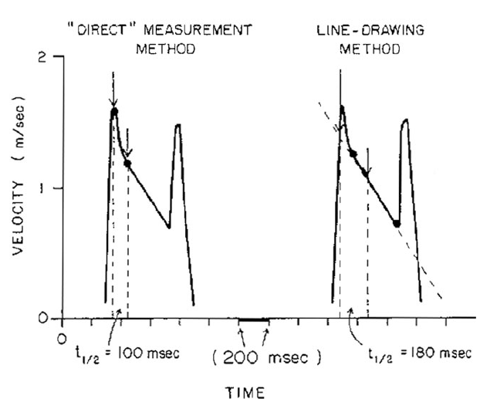

Slide 70
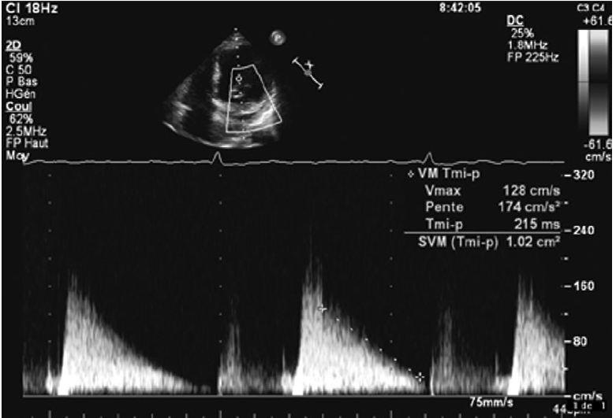

Slide 71
Advantages of PHT
Easy to obtain
Not affected by COP,MR

Slide 72
Pitfalls
Affected by gradient b/w LA and LV
Rate of rise of ventricular diastolic pressure will increase in a poorly compliant LV
Shorten the PHT-overestimate of MVA
Elevation of LVEDP due to significant AR or diastolic dysfunction alter PHT
Post BMV

Slide 73
MVA by PISA
MVA=6.28*r^{2*} Valiasing*/Vpeak*ἁ/180
R-radius of convergence hemisphere
V aliasing –aliasing velocity in cm/s
V peak-peak CW velocity of mitral inflow
ά-opening angle of mitral leaflets

Slide 74
Advantages
  Independent from flow conditions
Disadvantage
  Technically difficult

Slide 75
MVA by continuity equation
In the absence of valvular regurgitation or an intracardiac shunt,amount of blood flow across MV equals amt of blood flow across aortic valve
CSA(LVOT)*VTI (LVOT)=MVA*VTI(MV)

Slide 76
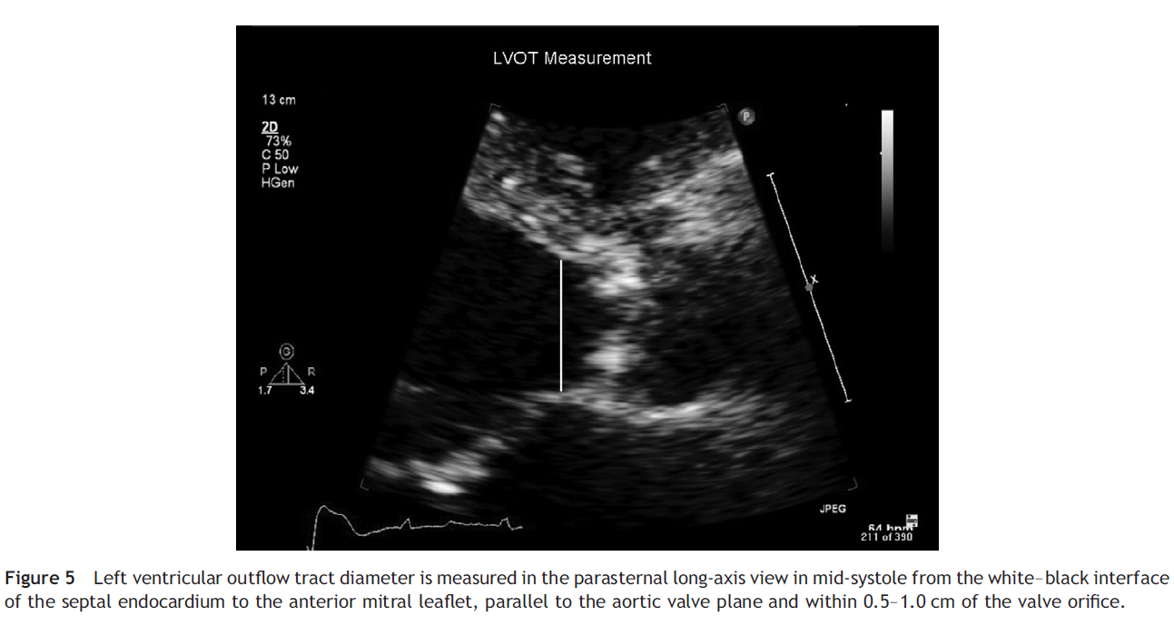

Slide 77
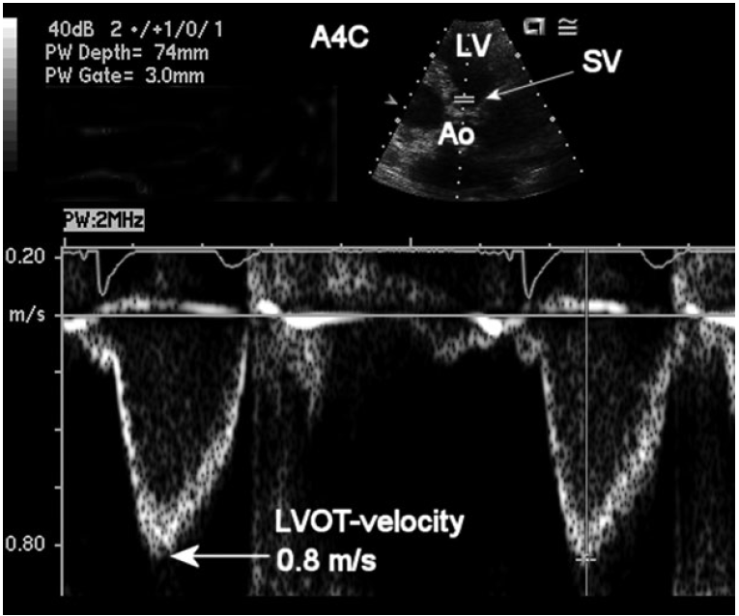

Slide 78
Advantage
  Not affected by transmitral gradient
  More accurate than PHT
Disadvantage
  Not accurate in presence of AR or MR

Slide 79
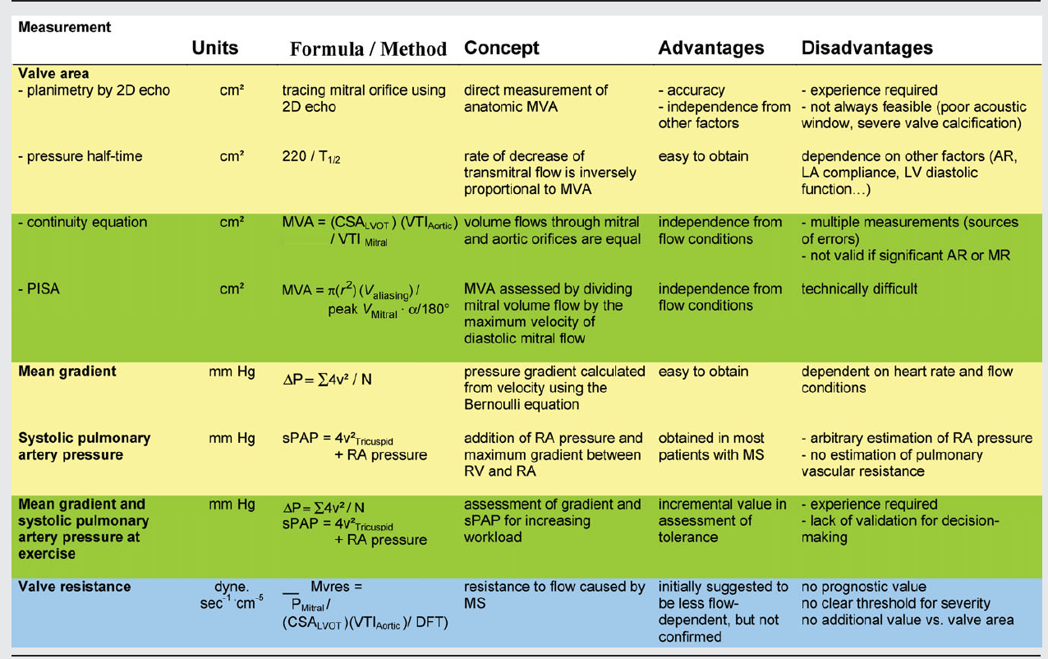

Slide 80
Thank you

