Slide 1




Abdominal Incisions
DR PRATIK SHAPARIA

Slide 2
Surgical Incision is a cut made through the skin to facilitate an operation or precedure.
It should be the aim of the surgeon to employ the type of incision considered to be the most suitable for that particular operation to be performed.
In doing so, three essentials should be achieved: 1.Accessibility
Extensibility
A reliable closure

Slide 3


Principles
Incision should be long enough for good exposure
Splitting is better than cutting
Avoid cutting of nerves and vessels
Retract muscle, abdominal organs towards neurovascular bundle
Insert DT through a separate incision
Transverse incisions better than vertical incisions
Close the wound layer by layer

Slide 4

Choice of incision
Depend upon
Type of surgery [elective/emergency]
Target organ
Surgeons own experience and preference and
Previous surgery.

Slide 5


The ideal incision allows:
ease of access to the desired structures
can be extended if needed
ideally muscles should be split rather than cut
heals quickly with minimal scarring

Slide 6

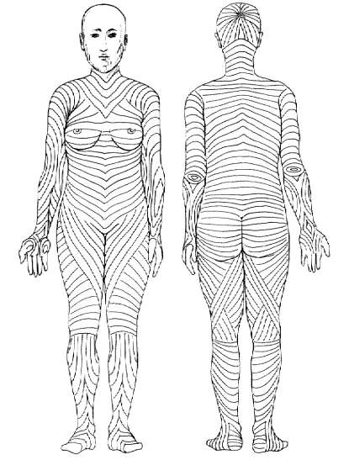
Langer’s Line
Langer’s Line correspond to the natural orientation of collagen fibers in the dermis, and are generally parallel to the orientation of the underlying muscle fibers
Incisions made parallel to Langer's lines may heal better and produce less scarring than those that cut across.

Slide 7

Abdominal & Pelvic incisions
VerticalIncisions
  Midline
  Paramedian
Transverse & Oblique Incisions
  Kochler Subcostal Incision
  Transverse Muscle Dividing
  McBurney Incisions
  Oblique Muscle cutting
  Pfannenstiel Incision
  Maylard Incision
Abdominothoracic Incisions
Retroperitoneal & extra-peritoneal approaches

Slide 8

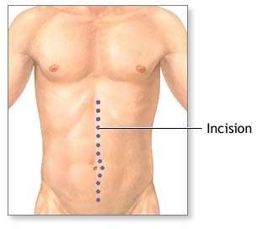
Vertical Incisions
1)Median Incision
vertical incision which follows the linea alba.
It may be,
upper midline incision;
lower midline incision
single incision.
SIGNIFICANCE-it is favored
In diagnostic laparotomy, as it allows wide access to abdominal Cavity.

Slide 9
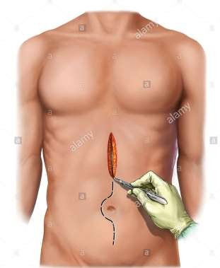
Advantages:
almost bloodless
no muscle fibers are divided
no nerves are injured
good access to upper abdominal viscera
very quick to make as well as to close
can be extended full lenght of abdomen curving around umblical scar.
Disadvantages
Care needs to be taken just above the
umbilicus where the falciform ligament is
Midline scar
Bladder injury

Slide 10

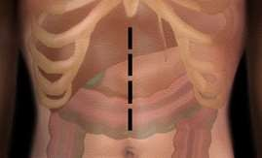
Upper midline incision
From xiphoid to above umbilicus.
Division of the peritoneum is best performed at the lower end of the incision,just above the umbilicus ,so that the falciform ligament can be seen and avoided

Slide 11

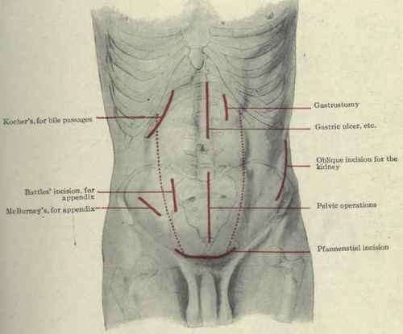
Lower midline incision
From the umbilicus superiorly to
the pubis symphysis inferiorly
Allow access to pelvic organs
the peritoneum should be opened in the uppermost area to avoid injury to the bladder

Slide 12

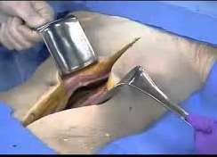
Full midline incision
 From xiphoid to pubis symphysis

Slide 13


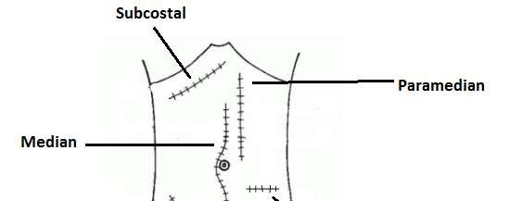
Paramedian Incisions
placed 2 to 5 cm lateral to midline over median aspect of bulging transverse convexity of rectus muscle.

Slide 14
 Advantages
Provides access to lateral structures
Avoids injury to nerves,limits trauma to rectus muscle.
Permits good restoration of abdominal wall function
Can be extended by slanting the upper end of the incision medially towards the xiphoid process if required
 Disadvantages
Time consuming.
Incision needs to be closed in layers
Difficult extension superiorly as limited by the costal margin
Tends to strip the muscles of their lateral blood and nerve supply resulting in atrophy of the muscle medial to the incision

Slide 15

Transverse Incisions
Advantages
better cosmetically
Stronger than vertical
Less painful
Good access to upper GI structures
More advantageous in children b/c of more transverse length of abdomen.
Disadvantages
Limited exposure to the organs

Slide 16
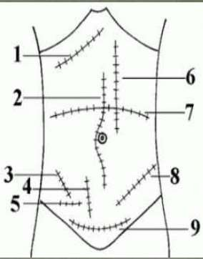
1)Kocher 2)Median 3)McBurny 4)Battle 5)Ianz 6)Paramedian 7)Transverse
8)Rutherford Morrison 9)Pfannensteil

Slide 17


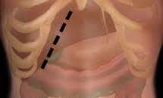
Kocher Subcostal Incision
It affords excellent exposure to gall bladder and biliary tract and can be made on left side to afford access to spleen.
İs started at midline ,2 to 5 cm below the xiphoid,and extends downwarda, outwards and paralel to and about 2.5 cm below costal margin
Especially used in cholecystectomy
  There are two modifications
Chevron (rooftop)modification Mercedes benz modification

Slide 18


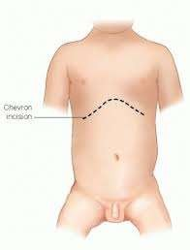
Chevron (rooftop) modification
The incision may be continued across the midline into double kocher’s incision or rooftop appearance which provide excellent access to upper abdomen particularly in those with broad costal margin
Uses-
total gastrectomy
total oesophagectomy
extensive hepatic resection
bilateral adrenectomy

Slide 19



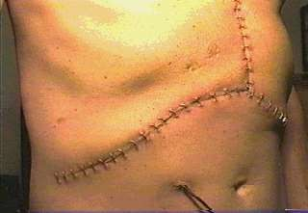
Mercedes benz modification
Consists of bilateral low kocher’s incision with upper midline
incision upto the xiphisternum.
Provides excellent access to the upper abdominal viscera mainly the diaphragmatic
hiatuses

Slide 20

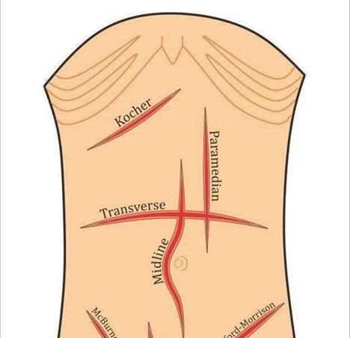
Transverse Muscle dividing
In newborn and infants, this incision is preferred bcs more abdominal exposure is gained per lenght of incision than with vertical exposure
Because infants’ abdomen longer transverse than vertical girth.
Also true of short, obese adult

Slide 21



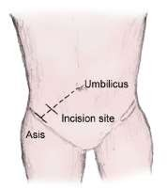
McBurney grid iron(muscle splitting)incision
İncision of choice most appendicectomies
The level and lenght of incision will vary according to thickness of abd. wall and suspected position of apendix.

Slide 22
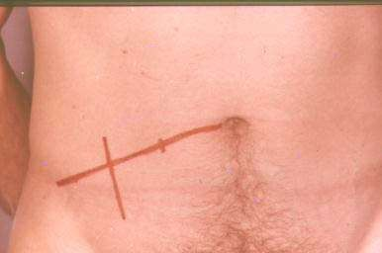
is made at the junction of middle third and outer third of a line running from umblicus to anterior superior iliac spine,McBurney point.
Originally placed the incision obliquely from above laterally to below medially.
Also used in left lower quadrant to deal with certain lesion of sigmoid colon such as drainage of diverticular abscess.
The level and length of the incision vary according to
Thickness of abdominal wall
Suspected position of the appendix

Slide 23


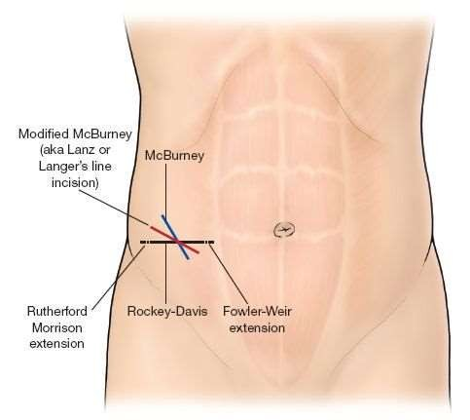
Lanz incision
It is a variation of McBurneys incision that is made the same point but in transverse plane.
It gives cosmetically good scar

Slide 24



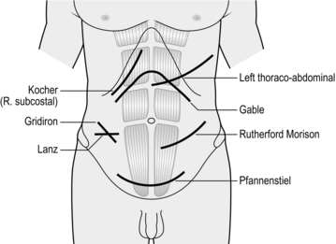
Rutherford-Morrison Incision
Oblique Muscle
Cutting Incision
Extension of McBurney incision by division of oblique fossa
Can be used for right and left sided colonic resection, caecostomy or sigmoid colostomy

Slide 25

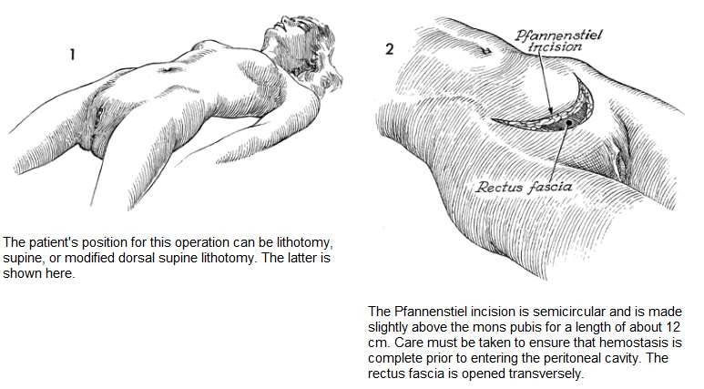
Pfannenstiel Incision

Slide 26
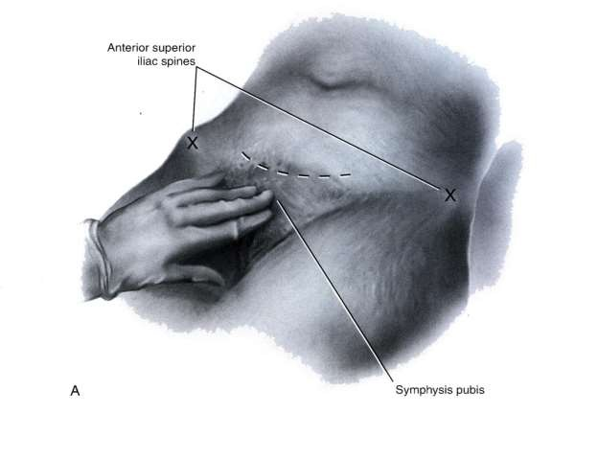
Used frequently by gynecologist and urologist for access to pelvic organ, bladder, prostate and for c- section.
is usually 12 cm long and is made in skin fold approximately 5 cm above symphysis pubis.

Slide 27


Maylard Transverse Muscle Cutting Incision
gives excellent exposure to pelvic organ
Skin incision is placed above but parallel to traditional placement of Pfannenstiel incision

Slide 28
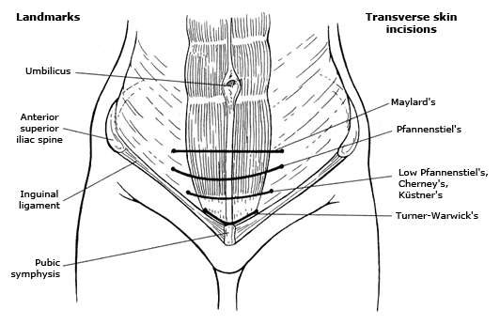

Slide 29

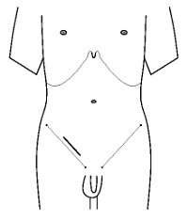
Inguinal incision
 Done for inguinal hernia’s, testicular cancer, cryptorchridism, hydrocele, varicocele.

Slide 30

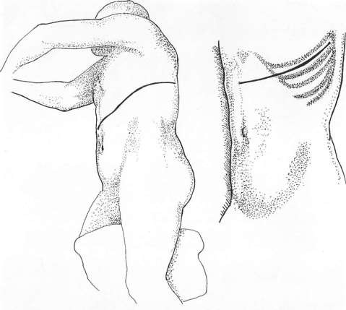
Thoracoabdominal Incisions
Either right or left
Converts pleural and peritoneal cavities into one common cavity
Thereby gives
excellent exposure

Slide 31
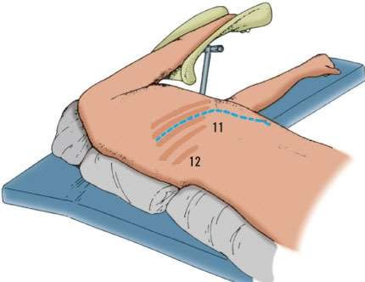
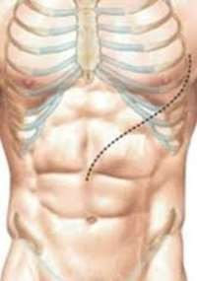
Right incision may be particularly useful in elective and emergency hepatic resections
Left incision may be used in resection of lower end of esophagus and proximal portion of stomach.
Incision is extended along line of 8th intercostal space,the space immediately distal to inferior pole of scapula.

Slide 32

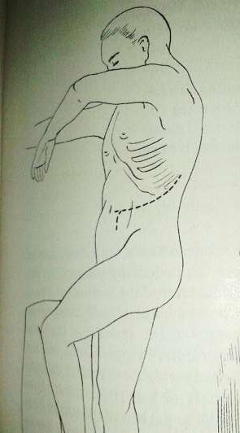

Retroperitoneal approach

Slide 33

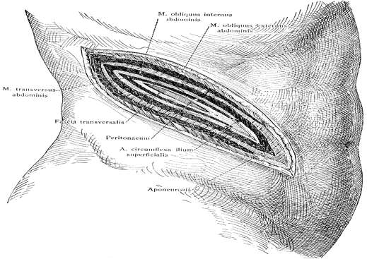
Oblique lumbar incision
 It commences 1.25cm below and lateral to renal angle and passes downwad towards the anterior superior iliac spine.

Slide 34





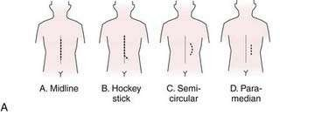
Incisions on posterior abdominal wall

Slide 35


Complications of abdominal incision
Hematoma, Stitch abscess, Wound infection
Wound dehiscence
Burst abdomen
Fistula formation
Wound pain
Incisional hernia
Adhesion and its complications
Unsightly scar

Slide 36


Factors affecting the strength of scar
Types of surgery(acute abdomen, surgery for malignancy, major surgery)
Types of incision
Obesity
Pregnancy
Straining
Cough
Ascites
Nutrition
Diabetes
Immunosuppression

Slide 37
