Slide 1
Clinical hemodynamic correlation in aortic regurgitation
Dr Cinosh Mathew
MD, DM(Cardiology), FACC
Professor & Head of Department
SBKS Medical Institute & Research Centre,
Sumandeep Vidyapeeth Deemed to be University, Vadodara

Slide 2
Etiology
Aortic root disease
  Aortopathy
  Aortitis
  Age related aortic dilatation
Valvular disease
  Calcific AS in older patients with AR
  Bicuspid aortic valve
  Cusp retraction or fibrosis
    c/c rheumatic
    Inflammatory
  Cusp perforation/tears
    Infective endocarditis
    Trauma
  Lack of cusp support
    Dissection of aorta
    VSD

Slide 3
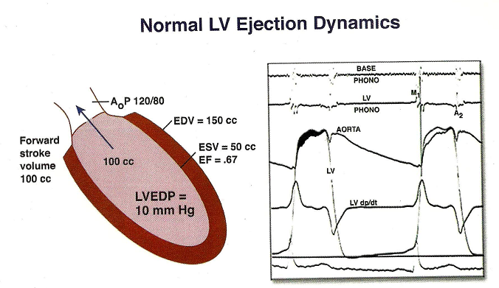

Slide 4
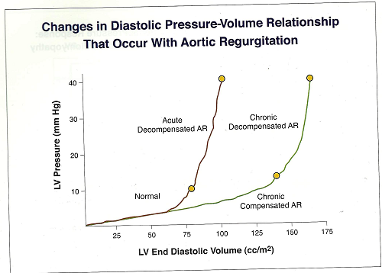

Slide 5
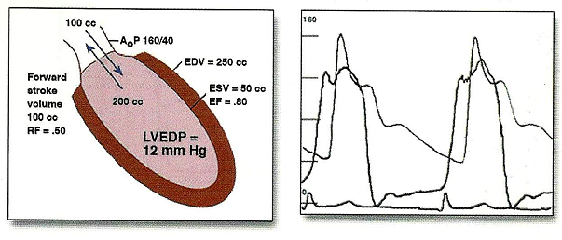
c/c compensated AR

Slide 6
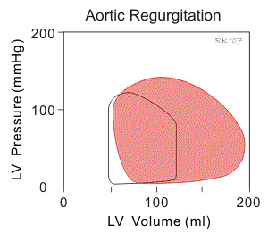

Slide 7
Volume overload –compensatory mechanisms
LV EDV increases without increase in diastolic pressure due to increased compliance
LV preload reserve is maintained initially
  Eccentric hypertrophy
  Sarcomeres laid in series
  Preload at sarcomere level is near normal
  Normal contractile performance of each unit contributes to enhanced stroke volume

Slide 8
Increased afterload
  Increased chamber volume,increased systolic pressure
  Increased systolic wall stress and afterload
  concentric LVH
Continued increase in chamber volume and afterload –matched by continued recruitment of preload reserve and compensatory hypertrophy

Slide 9
Decompensation
  Afterload mismatch-reversible
  Impaired LV contractility-irreversible

Slide 10
A/c AR-pathophysiology
Hemodynamically significant AR of sudden onset,into a LV not previously subjected to volume overload
Volume overload is poorly tolerated
  Ventricular compliance is normal
  LV operating on steep portion of diastolic P/V relation
  End diastolic LV pressure markedly increased approaching aortic diastolic pressure

Slide 11
  LV fails to increase stroke voume(not hypertrophied or dilated)-Decrease in COP
  Increase in LVEDP causes rise in mean LA pressure and PCWP-pulmonary edema
  Premature closure of MV –early crossover of pressures
  Diastolic MR
  Arterial BP-
    fall in syst pr
    Normal pulse pressure
    Diastolic pressure maintained by reflex increase in SVR in failure

Slide 12
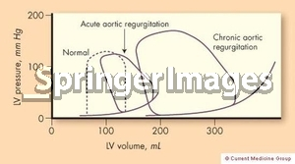

Slide 13
c/c Vs a/c AR-hemodynamic response
Variable | A/c AR | C/c AR | c/c AR decompensated
LVEDV | Slight ↑ | marked↑ | Marked ↑
LV compliance | normal | increase | Increased than normal
LVEDP | Marked ↑ | modest↑ | Marked increase
Forward stroke volume | decreased | normal | decreased
Aortic systolic presure | normal | increased | increased
Pulse pressure | normal | increased | normal
Peripheral vascular resistance | increased | decreased | increased

Slide 14
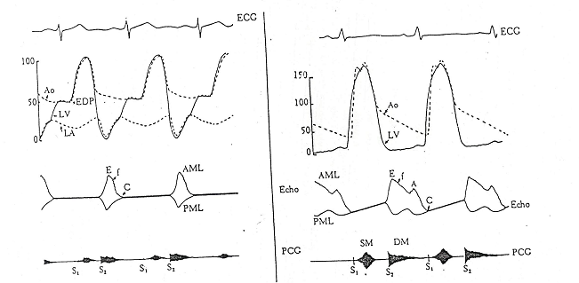
Hemodynamic-echo-PCG comparison

Slide 15
Hemodynamic assessment-c/c AR
Elevated Ao.syst pressure
Lowered Ao.diastolic pressure
modest rise of LV pressures in diastole
Premature closure of MV-when LV diastolic pressure exceeds LA pressure-common in a/c AR
Mean diastolic pressures rise with time and severity of leak-rise in mean LA &PCWP
Amplification of peak systolic pressure in peripheral arteries

Slide 16
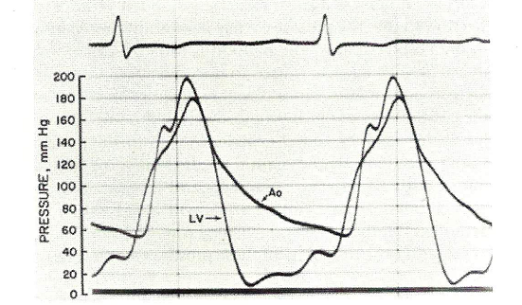

Slide 17
Acute AR
  Regurgitation into non compliant LV -diastolic rise of LV pressure&absence of A wave
  LV diastolic pressure exceeds LA pressure-premature closure of MV
  Aortic and LV pressures equalise in diastole and regurgitant flow &murmur ceases

Slide 18
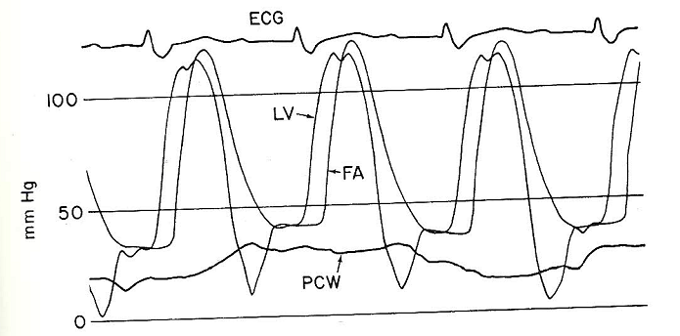

Slide 19
Angiographic assessment
Mild(1+)
  small amount of contrast
  never fills chamber
  cleared with each beat
Moderate(2+)
  more contrast
  faint opacification of entire chamber
Moderately severe(3+)
  LV well opacified
  equal in density with aorta
Severe(4+)
  complete dense opacification of LV in one beat
  LV more densely opacified than aorta

Slide 20
Clinical features
Asymptomatic phase longer
Dyspnoea most common symptom
Angina in 20% patients
  Decreased perfusion-low aortic diastolic pressure
  Increased myocardial oxygen demand
  Associated coronary atherosclerosis
  Osteal coronary invt.in syphilitic AR,takayasu arteritis
Palpitations-
  awareness of forceful ventricular contraction
  Ventricular arrhythmias in decompensated stage
Syncope-5 to 10%

Slide 21
Physical findings
Elevated systolic pressure
Low diastolic pressure
Peripheral signs of AR-large stroke volume in early systole with subsequent run off
Hill s sign-exaggeration of peripheral amplification
Carotid thrill or shudder-more common in AS,but also in AR
Displacement of apical impulse

Slide 22
S1-soft
  Increased LVEDP-earlier closure of MV
  Elevated diastolic pressure-less valve excursion
S2-
  Soft A2 –valve structurally abnormal
  Delayed A2-prolonged LV ejection time
  P2 may be obscured by murmur
S3 –
  in failure
S4-
  Suggest decreased LV compliance&increased LVEDP
  Long PR interval

Slide 23
Early diastolic murmur
  high pitched in mild to moderate,pitch decreases as severity increases
  Decrescendo-aortic LV pressure gradient tapers in diastole
  Duration
    correlates with severity in most cases
    Some patients with severe AR can have shorter murmur due to high LVEDP
    Murmur shorter in decompensation
  Murmur in 3rd RICS louder than 3rd LICS-Harvey s sign-AR is due to disease process involving aortic root-rightward and superior displacement of dilated proximal aorta
  Seagull murmur-eversion or perforation of a valve cusp
Notes:
Proctor Harvey

Slide 24
Systolic ejection murmur
  Increased LV stroke volume
  Abnormal Aortic valve

Slide 25
Austin Flint murmur
  low pitched,mid or late diastolic murmur
  Mechanism
    AR jet pushing AML
    Antegrade transmitral blood flow across a functionally narrowed MV
    Diastolic MR
    Low pitched components of AR murmur heard best at apex
  Severe AR-reg. fraction>50%
  Severity of AR and AFM
    Mild-absent
    Moderate-may be present in late diastole
    Severe-earlier in timing,extend into presystole
    Very severe AR-premature closure of MV-absent presystolic component

Slide 26
A/c AR
Rapid onset of symptoms –
  rapid rise of LA pressure
  abrupt reduction of COP
BP-
  Systolic pressure normal or slight fall
  elevated dia.pressure
  narrrow pulse pressure
Acute rt heart failure can occur-elevated JVP

Slide 27
Soft S1
Soft A2,loud P2
LV S3-rapid early diastolic filling
Absent LVS4
EDM
  Short -rapid diastolic equilibration of aortic and LV pressures in diastole
  Low or medium pitch-
    Low gradient
    a/w CCF
Austin Flint murmur presystolic component absent

Slide 28
Echocardiography
Increased LV End Diastolic Dimensions ,near normal end systolic dimensions and increased contractility-compensated phase
Increase in end systolic dimensions and depressed contractility-decompensation
M-Mode of MV
  Diastolic fluttering of AML in c/c AR
  Early closure of MV in a/c AR
M-mode of AV
  Diastolic non coaptation,diastolic fluttering in c/c AR
  Premature opening of AV in a/c AR

Slide 29
SEVERITY
1. Regurgitant jet width/LVOT diameter ratio greater than or equal to 60 percent
2. Vena contracta greater than 6 mm
3. Regurgitant jet area/LVOT area ratio greater than or equal to 60 percent
4. Aortic regurgitation pressure half-time less than or equal to 250 ms
5. Holodiastolic flow reversal in the descending thoracic or abdominal aorta
6. Regurgitant volume greater than or equal to 60 mL
7. Regurgitant fraction greater than or equal to 50 percent
8. Effective regurgitant orifice greater than or equal to 0.30cm2
9. Restrictive mitral flow pattern (usually in acute setting)

Slide 30
1. Regurgitant jet width/LVOT diameter ratio greater than or equal to 60 percent

Slide 31
2. Vena contracta greater than 6 mm

Slide 32
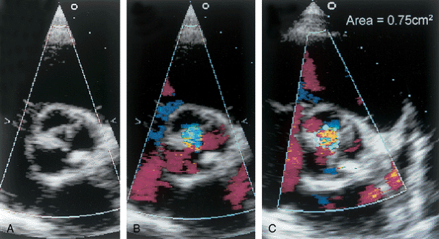
3. Regurgitant jet area/LVOT area ratio greater than or equal to 60 percent

Slide 34
CW doppler of AR jet
PHT and deceleration slope in severity assessment
  AR PHT <250 ms or deceleration slope >400 cm/s
  Overestimates AR in patients with high LVEDP due to other causes
  Depends on LV compliance
  PHT limited by technical factors-recording of peak velocity

Slide 35
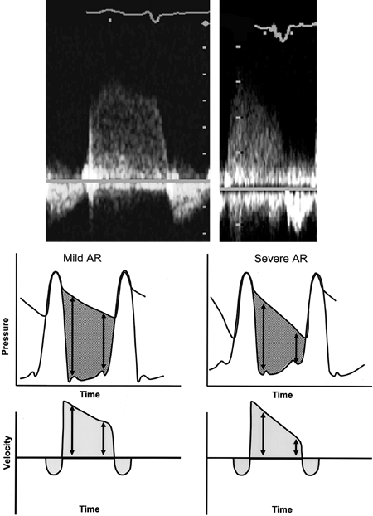

Slide 36
5. Holodiastolic flow reversal in the descending thoracic or abdominal aorta

Slide 37
Quantitative measurements
Regurgitant volume=SV lvot-SV mv/pv
Regurgitant fraction=reg volume/total stroke volume
ERO=reg.volume/VTI reg.
Advantage
  Measures independent of loading conditions or LV compliance
Limitations
  Small errors in annulus size measurements-large error in volume calculations
  Accuracy reduced outflow tract obstruction,shunts
  Forward stroke volume estimation affected by MR/PR

Slide 38
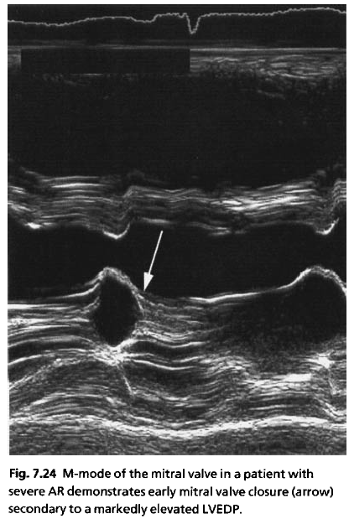

Slide 39
