Slide 1
PNEUMONIA
Dr Sunil Kumar

Slide 2
Definition
Grossly, inflammation of lung parenchyma
Pathologically, infection of alveoli, distal airways and interstitium of lung manifested by increased weight of lungs, replacement of the normal lung’s sponginess by consolidation and alveoli filled with WBC, RBC and fibrin
Clinically, symptoms and signs in combination with at least one opacity on chest radiography

Slide 3
Classification
Community-acquired pneumonia
Hospital-acquired (nosocomial)
-ventilator associated
-health care-associated
Pneumonia in long-term-care facilities
Aspiration pneumonia
Pneumonia in immunocompromised host

Slide 4
Community Acquired Pneumonia
Most common type of pneumonia
Spread usually by droplet infection & occur in previously healthy individuals.
Strep. Pneumoniae remains the most common infecting agent
In children viral infections are imp. cause

Slide 5
Etiology
Bacterial, viral, fungal, parasitic, atypical
Most common respiratory pathogen
-S.pneumoniae -H.influenza
-S.aureus -M.pneumoniae
-C.pneumoniae -M.catarhalis
-Legionella -Aerobic Gm-negative
-Influenza viruses -Adenoviruses
-Parainfluenza -RSV
S.pneumoniae account fora 50% of all cases of community acquired pneumonia

Slide 6
Risk factors
Old age, male gender
Smoking – strongest – active/passive
Alchoholism
Asthma, COPD and other chronic illnesses
Dementia, seizures, diabetes, CCF, CV stroke…
Previous hospital admission, antibiotic therapy
Aspiration in high risk individual

Slide 7
Host defence(Respiratory Defence)
Anatomical features of upper airways
-nasal turbinates
-mucocilliary clearance
-mucus which produces mucins
Spcific protective mechanisms
-secretory IgA
-alveolar macrophages
-epithelial cells
-various cytokines, chemokines, surfactants and inflammatory cells

Slide 8
Pathogenesis
Route of infection
-gross aspiration
-micro aspiration – most common
-hematogenous spread – from distant sites
-aerosolization
-direct spread through contagious sites
Microbial factors
each one has its own characteristics
-bacterial--viral -ricketssial-parasitic- fungal -atypical

Slide 9
Pathogenesis
Host factors – more prone to pneumonia
-hypogammaglobulinemia
-defects in phagocytosis, cilliary funtion
-neutropenia
-asplenia
-reduction in CD4+ cells
-HIV infection
-anatomical defects

Slide 10
Pathophysiology
Decreased lung volumes and capacity
Venitlation-perfusion mismatch
Intrapulmonary shunting

Slide 11
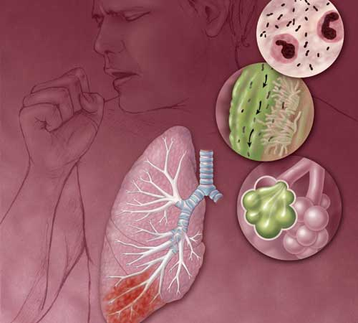
Pneumonia pathology
Pathophysiology
Notes:
Pneumonia is a serious infection causing inflammation to one or both lungs. The air sacs (alveoli) in the lungs fill with fluid and pus, making it difficult for the person affected to breathe. When the air sacs in the lungs' fill it impairs their main function, which is to get oxygen from the air into the bloodstream
organism reaches lower resp tract
Outpouring of inflammatory exudate and cells
WBCs phagocytize the organisms and release enzymes
Portions of the lungs fill with exudate and inflammatory cells - consolidation

Slide 12
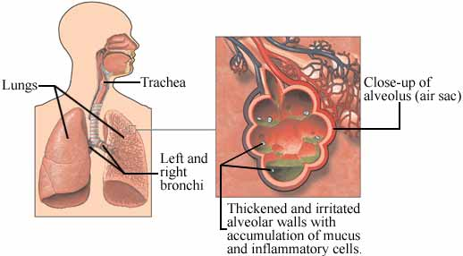
Pneumonia: Pathophysiology Cont.
Notes:
Inhalation of pathogens in air droplets
Aspiration of infected secretions from the upper respiratory tract
Aspiration of infected particles from gastric contents, food, or debris
Hematogenous spread

Slide 13
Pathology
Lobar pneumonia – homogeneous consolidation of one or more lobes
Often associated with pleural inflammation.
1)stage of congestion – during the first 24 hrs
-vascular congestion and alveolar edema
-few neutrophils
-fine crepitations
2)stage of red hepatization – 2-3 days
-red in colour with consistency like liver
-bronchial breathing
-many RBCs, neutrophils, desquamted epithelial cells, fibrin

Slide 14
3)stage of gray hepatization – 2-3 days
-dry, friable and grayish lung
-bronchial breathing
-fibrinopurulant exudates, hemosiderin,
macrophages
4)stage of resolution - restoration of architecture
-coarse crepitation, pleural rub
Bronchopneumonia
-patchy alveolar consolidation
-dependent lower and posterior portion of lung

Slide 15
Interstitial pneumonia
-mainly involves interstitium including alveolar walls and connective tissue around bronchovascular tree
Miliary pneumonia
-diffusely distributed 2-3 mm lesions of hematogenously spread tuberculosis
-also in histoplamosis, coccidioidomycosis, miliary herpesvirus, CMV, VZV
Notes:
What is this VZV?
Ans. Vericella Zoster Virus.

Slide 16
Symptoms
Usually present as an acute illness
Fever, rigors shivering & vomiting predominate.
Appetite lost & headache common.
Breathlessness & cough are imp pulmonary symptoms
Cough initially are short, painful & dry but later accompanied by expectoration of mucopurulent sputum

Slide 17
Rust colored sputum seen in pt with step. Pneumoniae infection.
Pleuritic chest pain may be a presenting feature.
Malaise fatigue bodyache myalgia also occur

Slide 18
Signs
1)Vitals and general examination
Hyper or hypo thermia
Tachycardia
Tachypnoea
Hypotension – in severe cases
Herpes labialis
2)Respiratory examination
Dullness to percussion
Decreased air entry
Bronchial breathing
crackles, wheezes, pleural rub

Slide 19
Severe pneumonia
British thoracic society rule
-confusion
-urea > 7 mmol/L
-respiratory rate > 30/min – most defining criteria
-blood pressure – diastolic < 60 or systolic < 90
Age > 65yrs

Slide 20
diagnosis
CBC
-TC -increased usually
-decreased in viral, immunocompromised
-ESR – increased in infective pathology, associated tuberculosis, malignancy
Chest radiography
-inhomogenous opacity with airbronchogram involving lobe or part of lung - classical
-patchy/diffuse involvement in viral pneumonia
-cavitating upper lobe – tuberculosis
-pneumoatocele – S.aureus pneumonia
-air-fluid level – polymicrobial
-crescent sign – aspergillosis
-air-space lesions – klebssiela

Slide 21
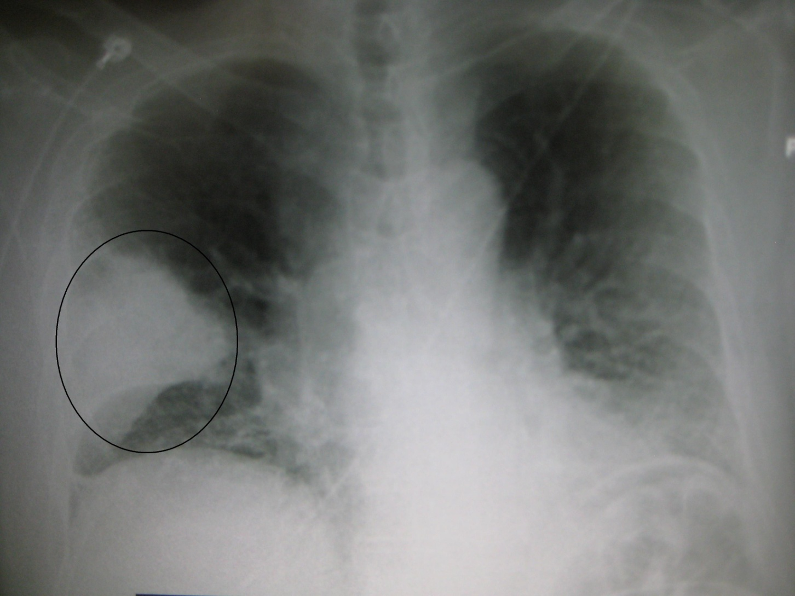

Slide 22
CT scan thorax – further aid in diagnosis
Etiological diagnosis
-Sputum Gm and Zn staining
-Sputum culture
*sputum sample with > 25 WBCs and < 10 squamous epithelial cells/LPF – are suitable
-Blood culture in case of hypo/hyperthermia, homelessness, alchohol abuse
-Special stains for fungus and P.carinii
-Antigen of lung pathogen in urine
*Legionnaires’ disease
*S.pneumoniae
-Serology – detection of IgM antibody or fourfold rise in the antibody titers
-Polymerase chain reaction

Slide 23
Management
1)First, assess the severity of pneumonia and then choose the site of care
Admission criteria:
-altered sensorium
-hypotension
-high respiratory rate
-high blood urea
-need for mechanical ventilation
-multilobar involvement
-associated comorbid condition
-hypoxemia
-plueral effusion having complicated features

Slide 24
2)Supportive treatment
-adequate rest,oxygenation and nutrition
-antipyretics, analgesics, anti-tussive/expectorant
-stop smoking, avoid alchohol, improve general condition of patient
-treat other morbid condition
3)Antibiotic therapy
-initially emprical therapy as per clinical situation and then according to etiological agents as found out through investigation

Slide 25
Specific antibiotics
1)Outpatient (uncomplicated) – Macrolides (azithromycin/clarithromycin) or Doxycycline
2)Outpatient (at risk) – (Quinolones/B-lactam) plus (Macrolides/Doxycycline/Telithromycin)
3)Hospital ward – (Cefuroxime/Ceftriaxone/Ampicillin-sulbactam) plus (Azithromycin/Quinilones)
4)ICU (no risk for Pseudomonas) – Azithromycin plus (Ceftriaxone/Cefotaxime/Quinilone)
5)ICU (risk for Pseudomonas) – (Imipenem/meropenem/piperacillin-tazobactam) plus Ciprofloxacin

Slide 26
6)Nursing home – Amoxicillin-clavulinic acid plus (Quinolones/Ceftriaxone) plus Macrolides
7)Aspiration pneumonia – (Metronidazole/Piperacillin-tazobectam/imipenem) plus (Quinolones/Ceftriaxone/Cefotaxime)

Slide 27
Duration of antibiotics
Standard duration for community acquired pneumonia is 10-14 days
For pseudomonas infection – atleast upto 21 days
Legionnaires’ diasease – 21 days
For ambulatory non complicated cases – 5 days will suffice

Slide 28
Feature of pneumonia exacerbation
Shortness of breath while walking on level ground
Fever inspite of 72 hours of antibiotic therapy
New onset confusion or pleuritic chest pain
hemoptysis

Slide 29
Improvement
Clinically, with 72 hours of antibiotic therapy
Radiologically, it may take upto 6 weeks for complete resolution of pneumonic patch

Slide 30
Differential diagnosis
Lung cancer
Pulmonary thromboembolic diseases with infarction
Collagen vascular diseases involving lungs
Hypersensitivity pneumonitis
Endocarditis
Infection with atypical pathogen

Slide 31
Complications
Complicated pleural effusion
Lung abscess
Recurrent pneumonia
Respiratory failure
ARDS
Shock
Septicemia
Renal insufficiency

Slide 32
MCQ
Most common infecting organism in community acquired pneumonia is:-
a) staph aureus b) legionella
c) strepto pneumoniae d)all
2) Breath sound in pneumonia is:-
a) vesicular b) bronchial
c) absent d) none
3) Protective mechanism for pneumonia is all except:-
a) secretory IgA b) Alveolar macrophages
c) Nasal turbinates d) diabetes

Slide 33
4) Severe pneumonia occur in all except:-
a) systolic BP >90 mm Hg
b) resp rate >30 c) confusion
d) age >65
5) Duration of treatment in pseudomonas infection is:-
a) 7 days b) 10 days
c)14 days d) 21 days

Slide 34
THANKS

