Slide 1
SGLT2 inhibitors:
Dual Attack On Heart Failure
And Diabetes Mellitus
Dr. Cinosh Mathew
MD, DM(Cardiology), FACC
Professor & Head of Department
Dept of Cardiology
SBKS Medical Institute & Research Centre,
Sumandeep Vidyapeeth Deemed to be University
12/07/23

Slide 2
SGLT-2 Inhibitors
Sodium Glucose Linked [Co] Transporter – 2 inhibitors
    Empa – glif - lozin
    Dapa – glif - lozin
    Cana – glif - lozin

Slide 3
What we will discuss..
SGLT2 inhibitors: History, Development & New Roles for a known drug?
Mechanism of action
CV outcome trials, Updated guidelines
Real world experience, side effects, when and when not to use them, how to use them in my practice

Slide 4
History and Development

Slide 5

An Apple A Day………………………

Slide 6
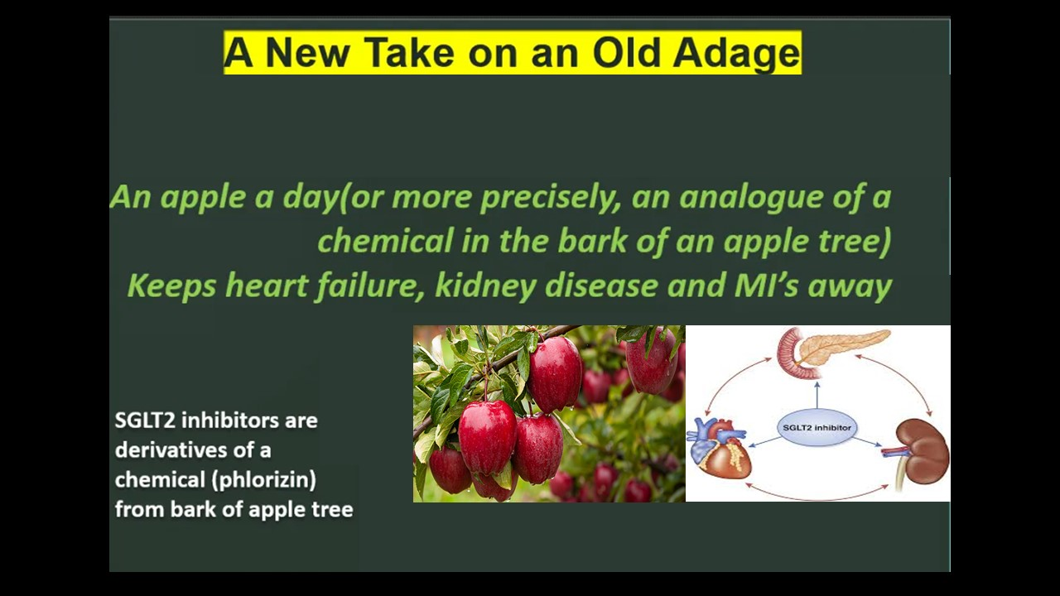
Notes:
1835→1960→2000→2012

Slide 7
A closer look at CV effects of 21st century
T2D agents
DPP4 inhibitors
SGLT2 inhibitors
← Older T2D agents
Newer T2D agents →
1950 | 1960 | 1970 | 1980 | 1990 | 2000 | 2010 | 2012 | 2013
GLP1 receptor agonists
Lente class of insulins produced
Recombinant human insulin produced
Glimepiride:
3rd generation SU
Insulin
degludec
SUs first used
2nd generation SUs available
Insulin glargine available²
Metformin introduced in the UK
Three new classes introduced:
α-glucosidase inhibitors, meglitinides and TZDs
Adapted from 1. Kirby. Br J Diabetes Vasc Dis 2012;12:315–20. 2. Lantus® SPC. FDA 2015.
Notes:
Notes
In Module C we looked at the CV effects of older T2D agents (pre-2000 – note that metformin wasn’t licensed in the USA until 1995). In this module, the CV effects of the newer GLP1 agonists, DPP4 inhibitors and SGLT2 inhibitors will be examined.
Abbreviations
CV, cardiovascular; DPP4, dipeptidyl peptidase 4; GLP1, glucagon-like peptide 1; SGLT2, sodium glucose cotransporter 2; SU, sulphonylurea; T2D, Type 2 Diabetes; TZD, thiazolidinedione.
Copyright
Kirby. Br J Diabetes Vasc Dis 2012;12:315–20. Figure 1

Slide 8

So How did an Antidiabetic drug came to be found to be so useful in heart failure…
Diabetes
EMPA/DAPA gliflozin
Heart Failure

Slide 9
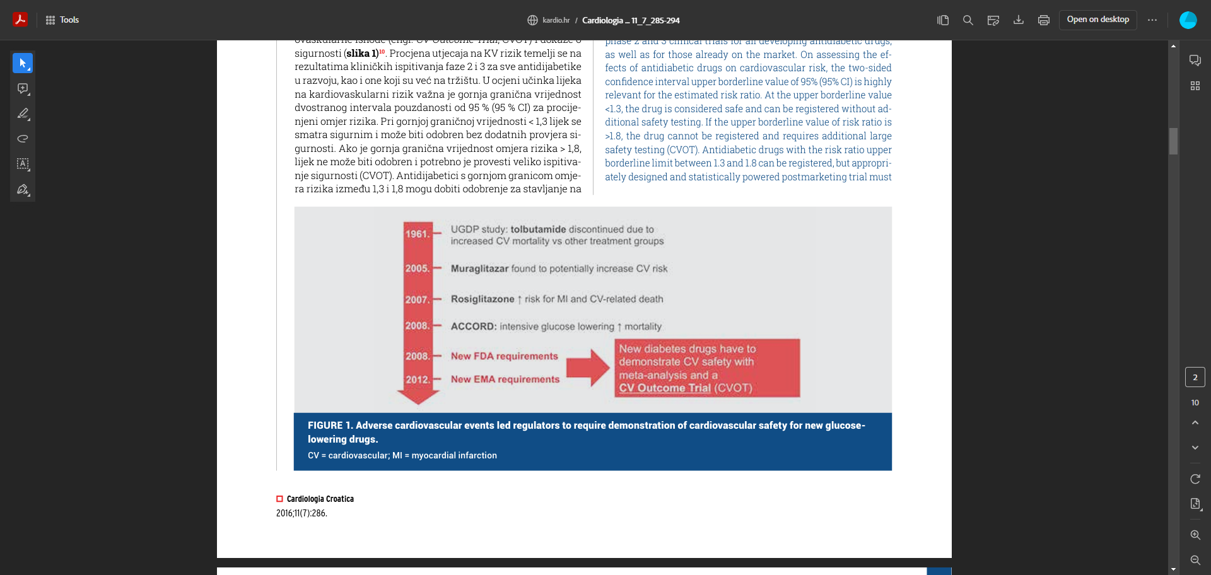
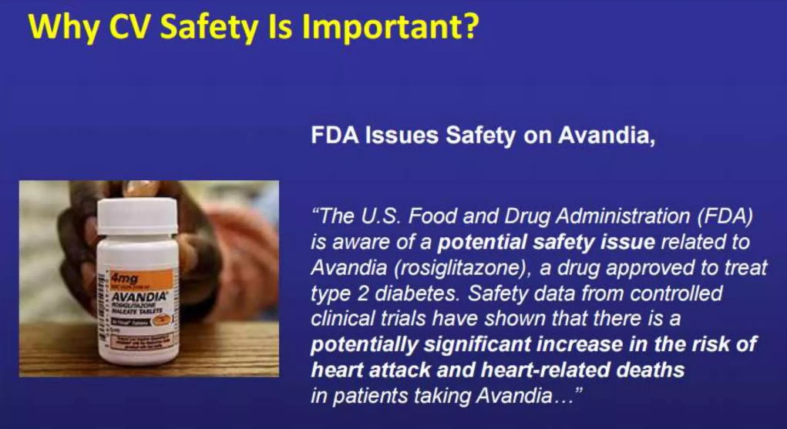
So How did an Antidiabetic drug came to be found to be so useful in heart failure…

Slide 10
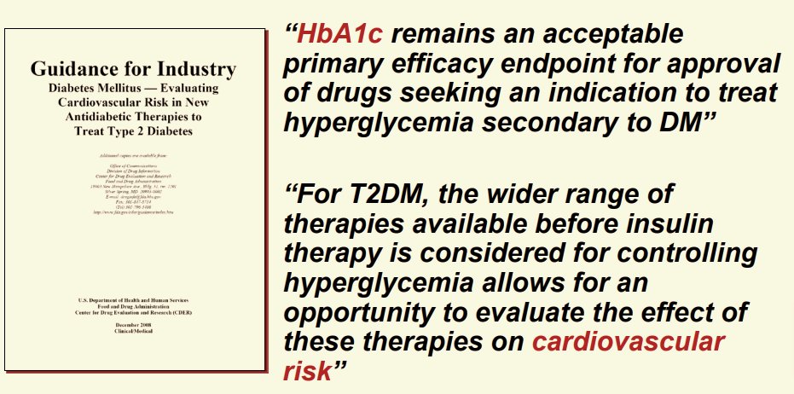
Regulatory Obligations for Anti DM post 2008

Slide 11
A closer look at CV effects of 21st century
T2D agents
DPP4 inhibitors
SGLT2 inhibitors
← Older T2D agents
Newer T2D agents →
1950 | 1960 | 1970 | 1980 | 1990 | 2000 | 2010 | 2012 | 2013
GLP1 receptor agonists
Lente class of insulins produced
Recombinant human insulin produced
Glimepiride:
3rd generation SU
Insulin
degludec
SUs first used
2nd generation SUs available
Insulin glargine available²
Metformin introduced in the UK
Three new classes introduced:
α-glucosidase inhibitors, meglitinides and TZDs
Adapted from 1. Kirby. Br J Diabetes Vasc Dis 2012;12:315–20. 2. Lantus® SPC. FDA 2015.
Notes:
Notes
In Module C we looked at the CV effects of older T2D agents (pre-2000 – note that metformin wasn’t licensed in the USA until 1995). In this module, the CV effects of the newer GLP1 agonists, DPP4 inhibitors and SGLT2 inhibitors will be examined.
Abbreviations
CV, cardiovascular; DPP4, dipeptidyl peptidase 4; GLP1, glucagon-like peptide 1; SGLT2, sodium glucose cotransporter 2; SU, sulphonylurea; T2D, Type 2 Diabetes; TZD, thiazolidinedione.
Copyright
Kirby. Br J Diabetes Vasc Dis 2012;12:315–20. Figure 1

Slide 12
CV safety trials are being conducted for each compound within the newer classes
SAVOR-TIMI 53¹
(n = 16,492)
1,222 3P-MACE
OMNEON¹³
(n = 4000)
4P-MACE
CAROLINA®¹¹
(n = 6000)
≥ 631 4P-MACE
EXAMINE²
(n = 5380)
621 3P-MACE
TECOS⁴
(n = 14,724)
≥ 1300 4P-MACE
CARMELINA¹²
(n = 8300)
4P-MACE + renal
2013
2014
2015
2016
2017
2018
2019
2021
ELIXA³
(n = 6068)
≥ 844 4P-MACE
SUSTAIN-6⁷
(n = 3297)
3P-MACE
EXSCEL¹⁴
(n = 14,000)
≥ 1591 3P-MACE
REWIND¹⁶
(n = 9622)
≥ 1067 3P-MACE
ITCA CVOT⁹
(n = 4000)
4P-MACE
DECLARE-TIMI 58¹⁵
(n = 17,150)
≥ 1390 3P-MACE
DPP4 inhibitor CVOTs
LEADER⁶
(n = 9340)
≥ 611 3P-MACE
CANVAS¹⁰
(n = 4365)
≥ 420 3P-MACE
CREDENCE¹⁷
(n = 3700)
Renal + 5P-MACE
SGLT2 inhibitor CVOTs
EMPA-REG OUTCOME®⁵
(n = 7034)
≥ 691 3P-MACE
GLP1 CVOTs
CANVAS-R⁸
(n = 5700)
Albuminuria
Ertugliflozin CVOT¹⁸
(n = 3900)
3P-MACE
HARMONY Outcomes¹⁹
(n = 9400) 3P-MACE
Timings represent estimated completion dates as per ClinicalTrials.gov.
Adapted from Johansen. World J Diabetes 2015;6:1092–96. (references 1–19 expanded in slide notes)
Notes:
Notes
This overview indicates all of the ongoing (and two completed – SAVOR-TIMI 53 and EXAMINE) CVOTs for the newer T2D agents.
The trial name, the estimated recruitment and the primary outcome are indicated
The timings indicate the estimated completion dates of the trial
Planned or actual event rates are indicated in some cases (e.g. EXAMINE, ELIXA etc)
Abbreviations
CANVAS, Canagliflozin Cardiovascular Assessment Study
CANVAS-R, Study of the Effects of Canagliflozin on Renal Endpoints in Adult Subjects with T2DM
CARMELINA®, Cardiovascular Safety & Renal Microvascular Outcome Study with Linagliptin
CAROLINA®, Cardiovascular Outcome Study of Linagliptin Versus Glimepiride in Patients With Type 2 Diabetes
CREDENCE, Evaluation of the Effects of Canagliflozin on Renal and Cardiovascular Outcomes in Participants With Diabetic Nephropathy
CVOT, cardiovascular outcomes trial
DPP4, dipeptidyl peptidase 4
DECLARE-TIMI, Multicenter Trial to Evaluate the Effect of Dapagliflozin on the Incidence of Cardiovascular Events
ELIXA, Evaluation of Lixisenatide in Acute Coronary Syndrome
EMPA-REG OUTCOME® [cardiovascular outcomes trial of empagliflozin]
EXAMINE, Examination of Cardiovascular Outcomes with Alogliptin versus Standard of Care
EXSCEL, The EXenatide Study of Cardiovascular Event Lowering
GLP1, glucagon-like peptide 1
LEADER®, Liraglutide Effect and Action in Diabetes: Evaluation of Cardiovascular Outcome Results
OMNEON™ [randomised, double-blind, placebo-controlled, multicenter study to assess cardiovascular outcomes following treatment]
REWIND, Researching Cardiovascular Events With a Weekly Incretin in Diabetes
SAVOR-TIMI, Saxagliptin Assessment of Vascular Outcomes Recorded in Patients with Diabetes Mellitus - Thrombolysis in Myocardial Infarction
SGLT2, sodium glucose cotransporter 2
SUSTAIN, Trial to Evaluate Cardiovascular and Other Longterm Outcomes With Semaglutide in Subjects With Type 2 Diabetes
T2D, Type 2 diabetes
TECOS, Trial Evaluating Cardiovascular Outcomes with Sitagliptin
3P-MACE, 3-point major adverse cardiovascular events (CV death, non-fatal myocardial infarction or non-fatal stroke)
4P-MACE, 4-point major adverse cardiovascular events (CV death, non-fatal myocardial infarction, non-fatal stroke or unstable angina requiring hospitalisation)
References
1. Scirica et al. N Engl J Med 2013;369:1317–26.
2. White et al. N Engl J Med 2013;369:1327–35
3. Bentley-Lewis et al. Am Heart J 2015;0:1–8.e7.
4. Bethel et al. Diabetes Obes Metab 2015;17:1395–402
5. Zinman et al. Cardiovasc Diabetol 2014;13:102
6. NCT01179048
7. NCT01720446
8. NCT01989754
9. NCT01455896
10. NCT01032629
11. NCT01243424
12. NCT01897532
13. NCT01703208
14. NCT01144338
15. NCT01730534
16. NCT01394952
17. NCT02065791
18. NCT01986881
19. NCT02465515
Copyright
Johansen. World J Diabetes 2015; 6:1092–96

Slide 13
What we will discuss..
SGLT2 inhibitors: history, development & New Roles for a known drug?
Mechanism of action
CV outcome trials, Updated guidelines
Real world experience, side effects, when and when not to use them, how to use them in my practice

Slide 14
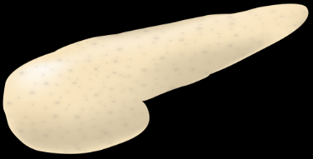
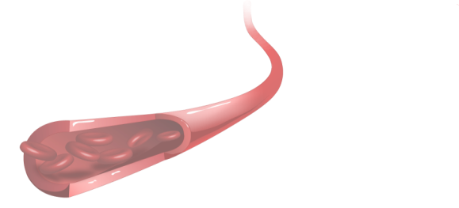

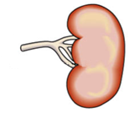

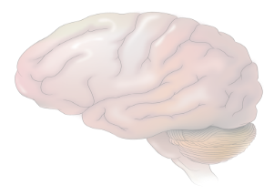

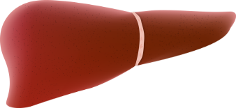
From the triumvirate to the ominous octet
Decreased
incretin effect
Increased
lipolysis
Decreased
insulin secretion
Increased
glucose
re-absorption
Islet α-cell
Hyperglycaemia
Increased glucagon secretion
Decreased
glucose
uptake
Increased hepatic glucose production
Neurotransmitter dysfunction
Notes:
Although the centrality of hyperglycaemia, impaired β‐cell function and insulin resistance is undebated, the list of pathological derangement has expanded in recent years from a triad, to become an ‘ominous octet’. In short, in addition to the muscle, β‐cell and liver dysfunction discussed above, the fat cell (accelerated lipolysis), gastrointestinal tract (incretin resistance), α‐cell (hyperglucagonaemia), kidney (increased glucose reabsorption) and brain (insulin resistance) can all play important roles in the development of glucose intolerance in Type 2 diabetic individuals. Collectively, these eight factors comprise the ominous octet.
Please keep in mind when dicsussing the “octet”. The increase in glucose reabsorption, due to upregulation of SGLT2 is surely not one of the major players in this octet leading to Hyperglycemia but surely play a certain role. The MOA of SGLT2-inhibition is supra-physiological and is not a correction of something which is pathophysiological disturbed in Type 2

Slide 15
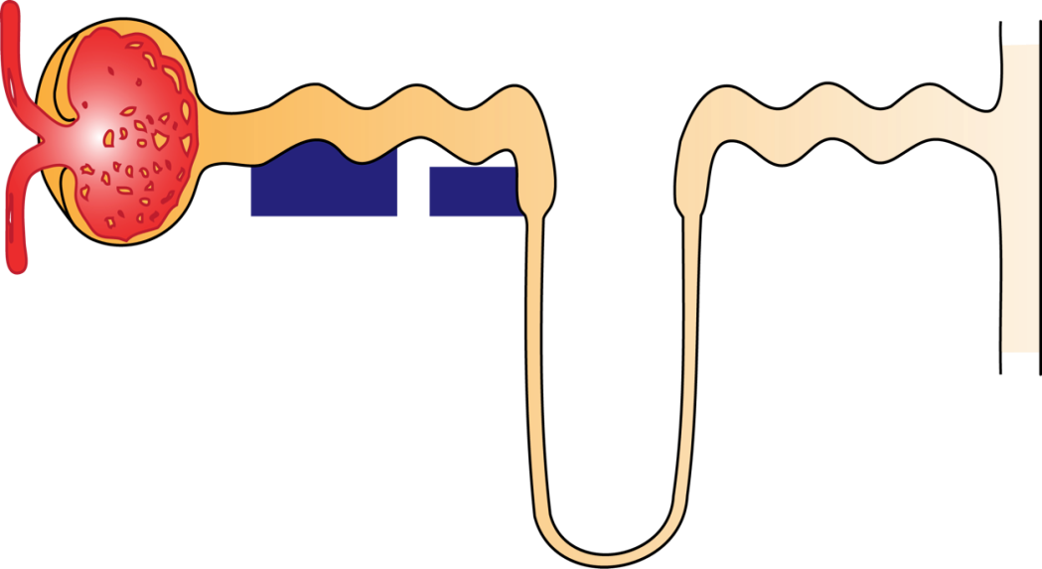
Renal glucose handling in the nephron of the healthy individual
Glomerulus
Proximal tubule
Distal tubule
Collecting duct
Glucose filtration
SGLT2
SGLT1
90%
10%
Glucose reabsorption
Loop of
Henle
Plasma glucose concentration: 90-100mg/dl
Plasma filtered: 180 L/day
Glucose filtered: 160–180 g/day
Glucose excreted: Minimal
Minimal glucose excretion
SGLT: sodium–glucose co-transporter.
Figure adapted from: Bailey CJ. Trends Pharmacol Sci. 2011;32:63–71.

Slide 16
SGLT2 inhibition lowers the elevated renal threshold for glucose in type 2 diabetes
Glomerulus
Proximal tubule
Distal tubule
Collecting duct
Glucose filtration
SGLT2
SGLT1
Glucose reabsorption
SGLT2
inhibitor
Marked
increase in
glucose
excretion
Loop of
Henle
Plasma glucose concentration: 180 mg/dl
Plasma filtered: 180 L/day
Glucose filtered: ~320 g/day
Glucose excreted: ~70–119 g/day (equivalent to ~280–476 kcal/day)²⁻⁴
SGLT: sodium–glucose co-transporter.
Figure adapted from: Bailey CJ. Trends Pharmacol Sci. 2011;32:63–71.
1. DeFronzo RA et al. Diabetes Obes Metab. 2012;14:5–14; 2. Invokana (canagliflozin). Summary of Product Characteristics; 3. Jardiance (empagliflozin). Summary of Product Characteristics;
4. Forxiga (dapagliflozin). Summary of Product Characteristics. All SmPCs available at: https://www.medicines.org.uk/emc/ (accessed April 2018).

Slide 17
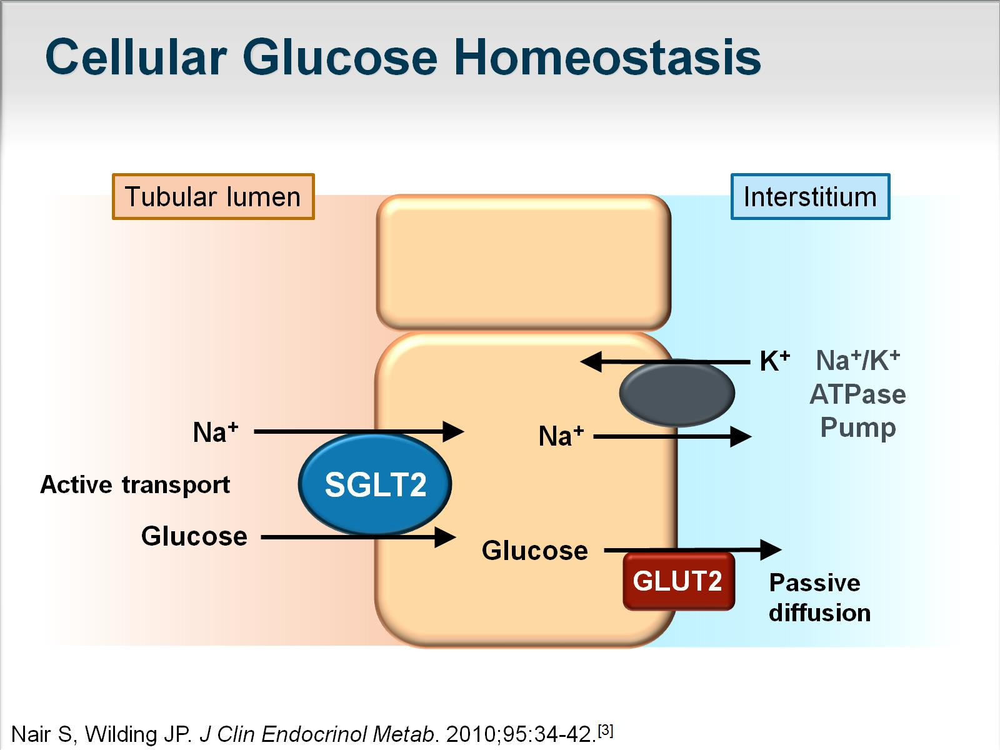
Cellular Glucose Homeostasis

Slide 18
SGLT2 inhibitors lead to dual inhibition
Glomerulus
Proximal tubule
G
G
Na+
G
G
G
Na+
Na+
Na+
G
G
SGLT2 inhibitor
G
G
Glycosuria
Na+
Natriuresis
SGLT: sodium–glucose co-transporter.
1. Figure adapted from: Bailey CJ. Trends Pharmacol Sci. 2011;32:63–71; 2. Heerspink HJL, et al. Circulation 2016;134:752–772.

Slide 19
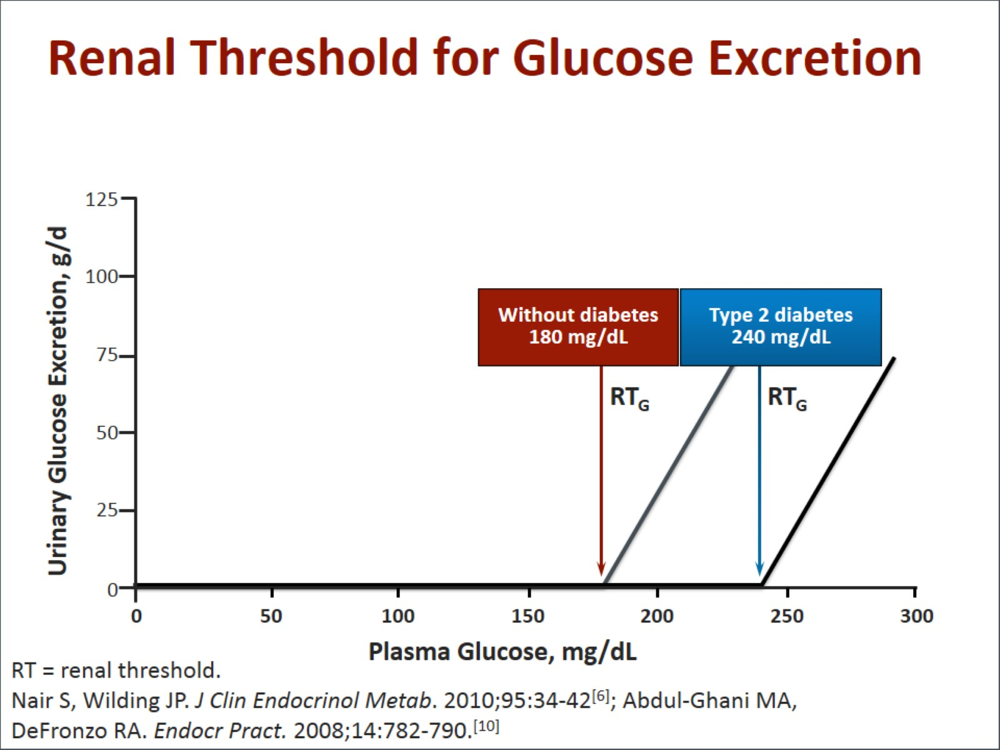
Renal Threshold for Glucose Excretion
Kidney is an ‘active player’ in Hyperglycemia- Up-regulation of SGLT-2 protein is a Mal-adaptive response to body perceiving lose of glucose as a risk for insufficient glucose for brain function

Slide 20
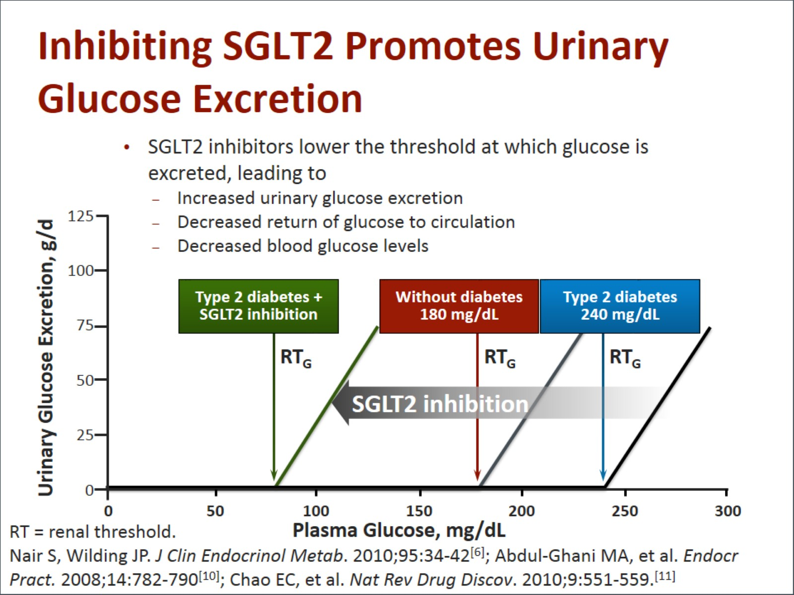
Inhibiting SGLT2 Promotes Urinary Glucose Excretion

Slide 21
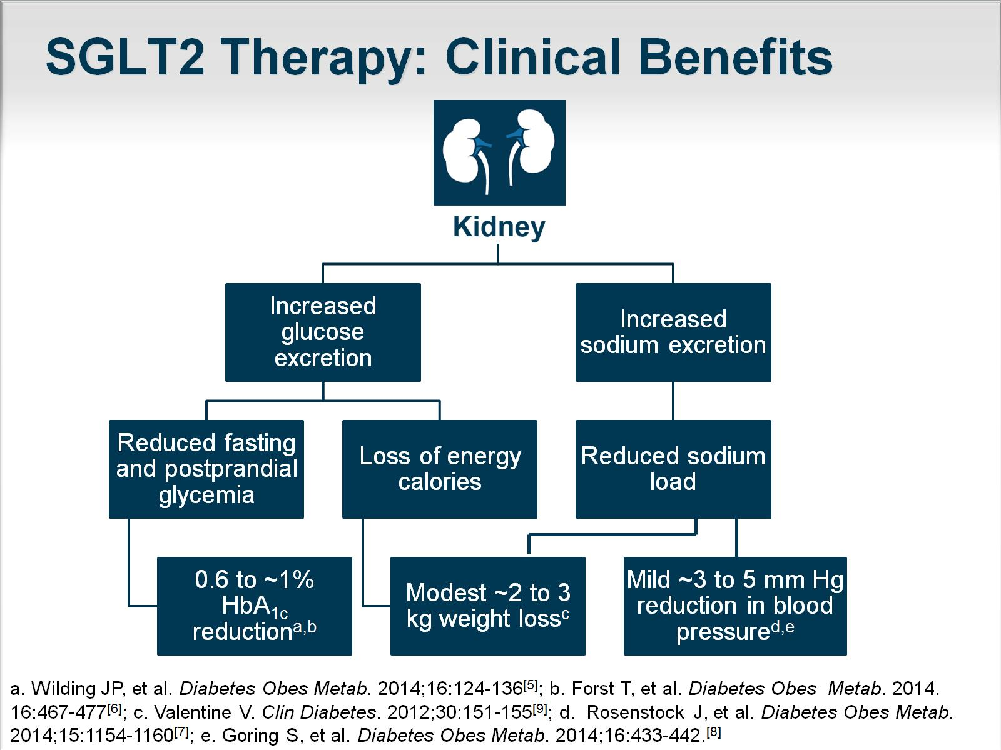
SGLT2 Therapy: Clinical Benefits

Slide 22
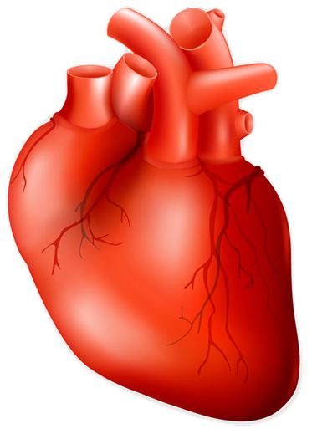
Multiple mechanisms may contribute to CV benefits with SGLT2 inhibitors
SGL2
inhibitors
Glycosuria¹
Natriuresis¹
Na⁺/H⁺
exchanger²
Reduced
HbA_{1c}
Reduced
total
body fat
Increased
uricosuria
Reduced
plasma
volume
Reduced
blood
pressure
Tubuloglo-
merular
feedback
Increased
mitochondrial
calcium
Reduce
oxidative
stress
Reduced
glucotoxicity
& inflammation
Ketone
utilisation
Reduce
oxidative
stress
Increased
haematocrit
Reduced
preload
Reduced
arterial
stiffness
Reduced
renal
damage
Increased
oxygen
delivery
Reduced
myocardial
wall stretch
Additional CV benefits
1. Heerspink HJL, et al. Circulation 2016;134:752–72; 2. Baartscheer A, et al. Diabetologia 2017;60:568–73.

Slide 23
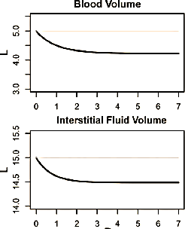
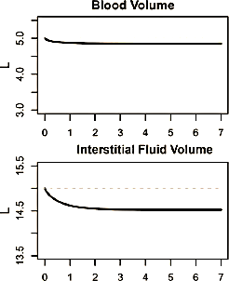
SGLT2-i agent Effect
Loop Diuretic Effect
SGLT2-i agent ↓^{ses} IF volume by 2-fold greater than blood volume
Loop diuretic ↓^{ses} IF volume by only 78% of reduction in blood volume
Loop diuretics exacerbate low blood volume leading to lower cardiac output and worsening heart failure

Slide 24
What we will discuss..
SGLT2 inhibitors: history, development & New Roles for a known drug?
Mechanism of action
CV outcome trials, Updated guidelines
Real world experience, side effects, when and when not to use them, how to use them in my practice

Slide 25
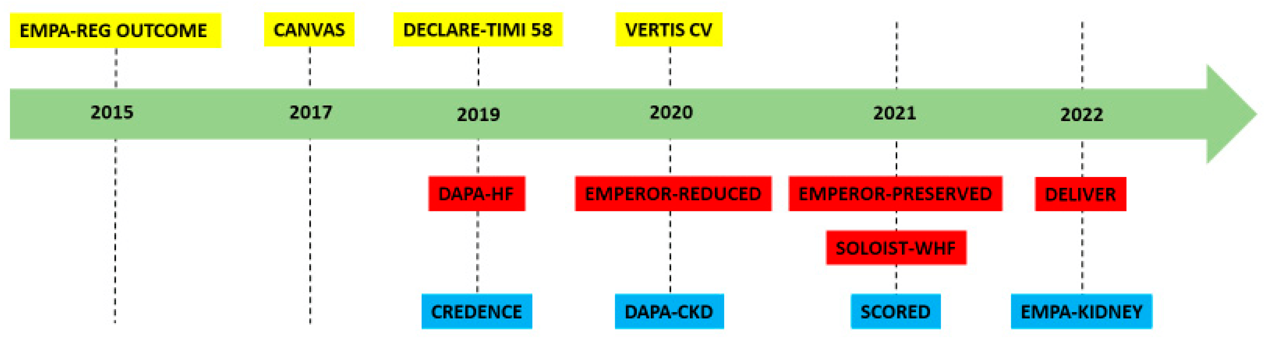
ALL MAJOR TRIALS

Slide 26
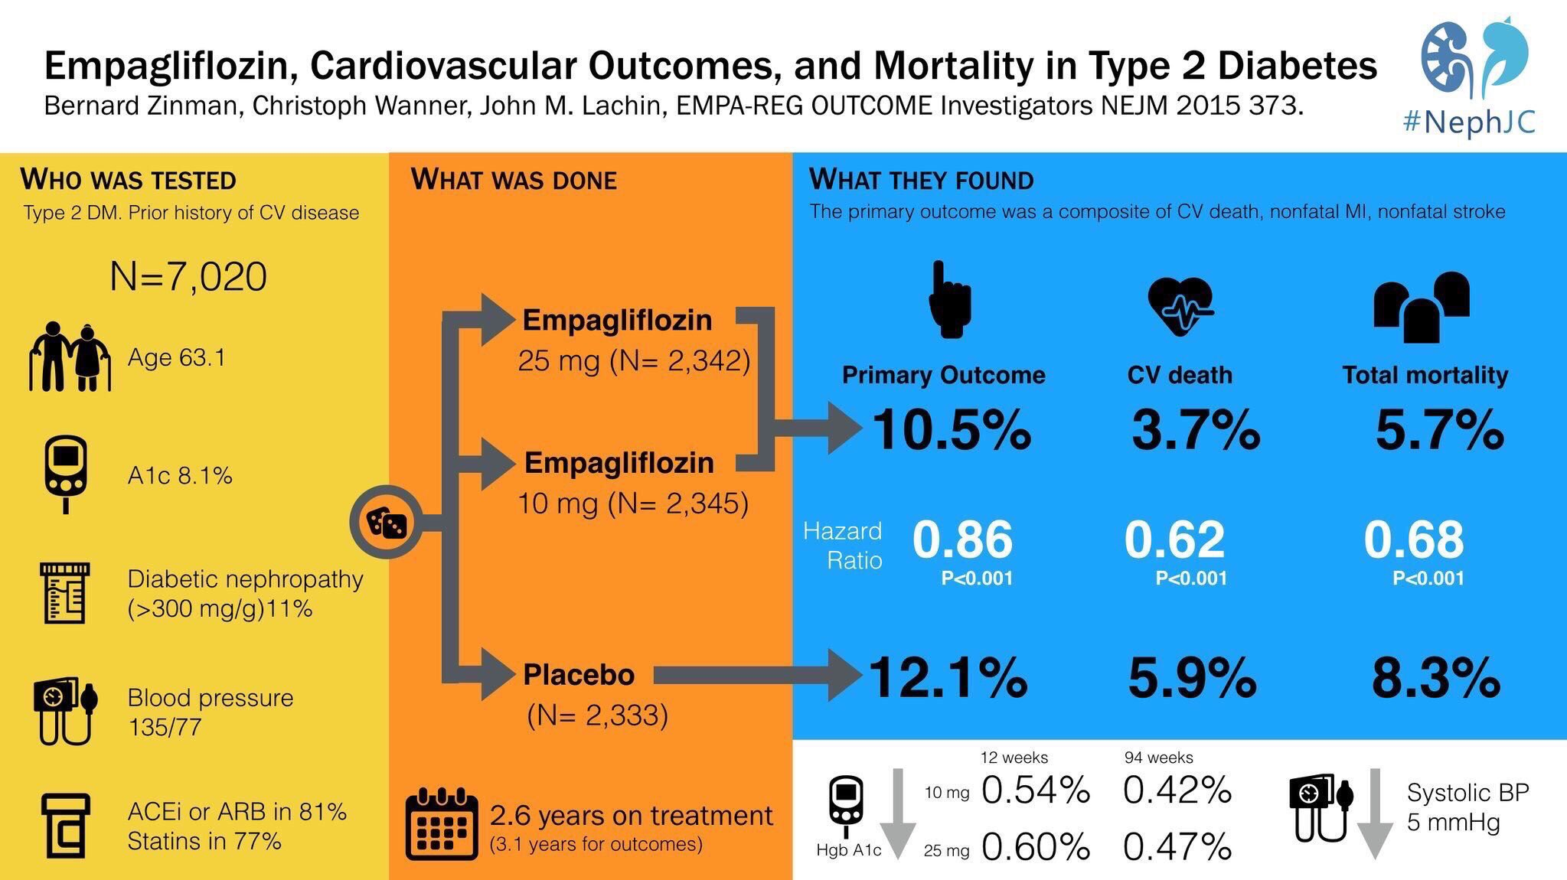

Slide 27
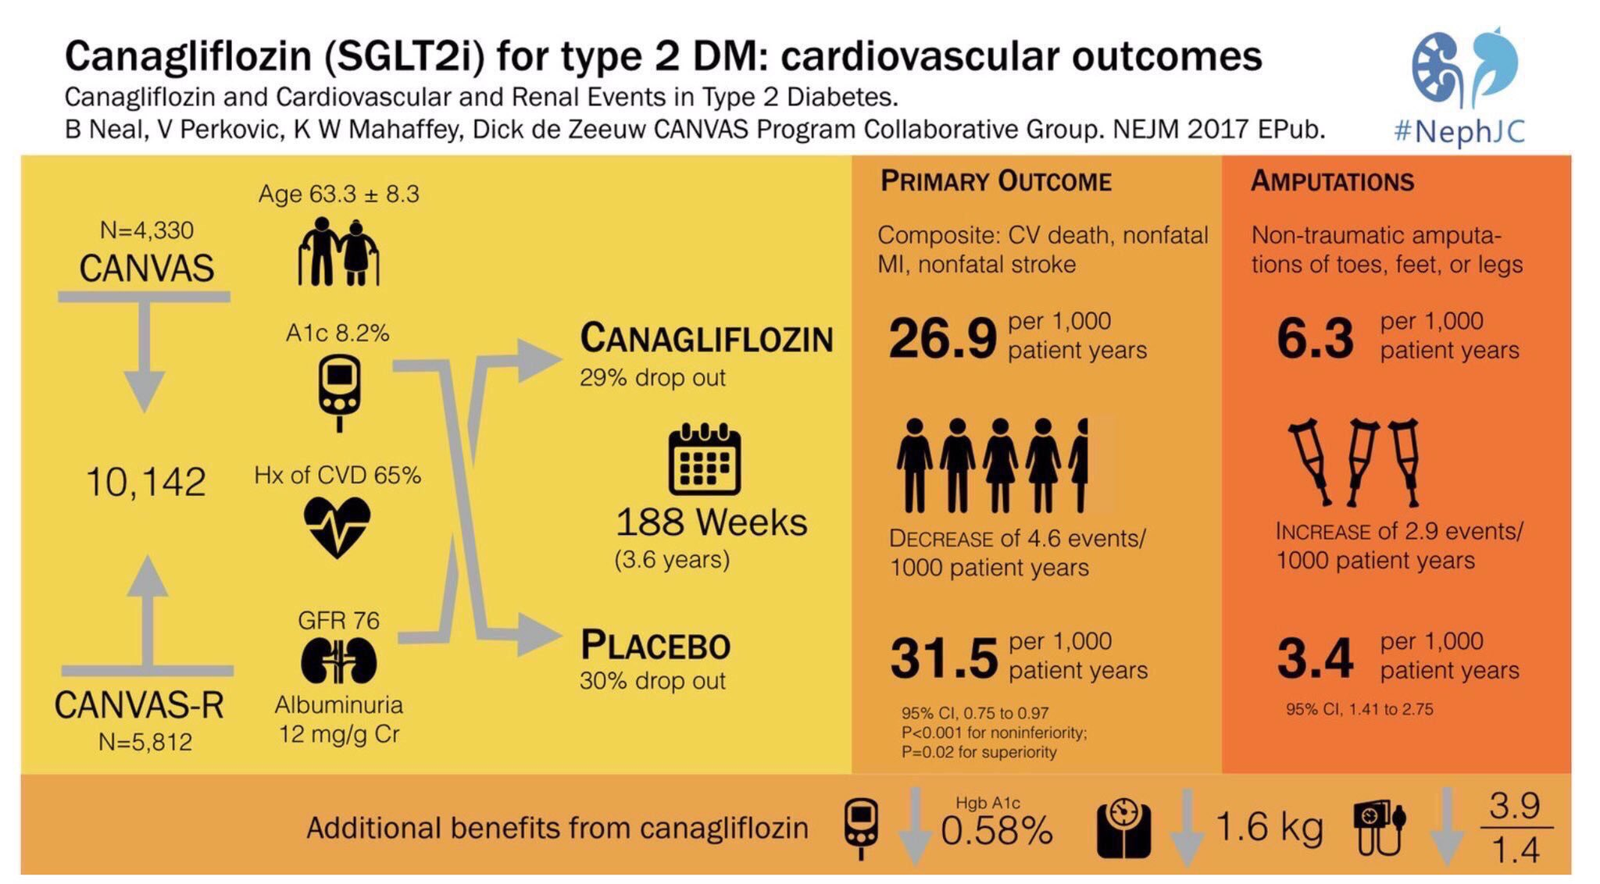

Slide 28
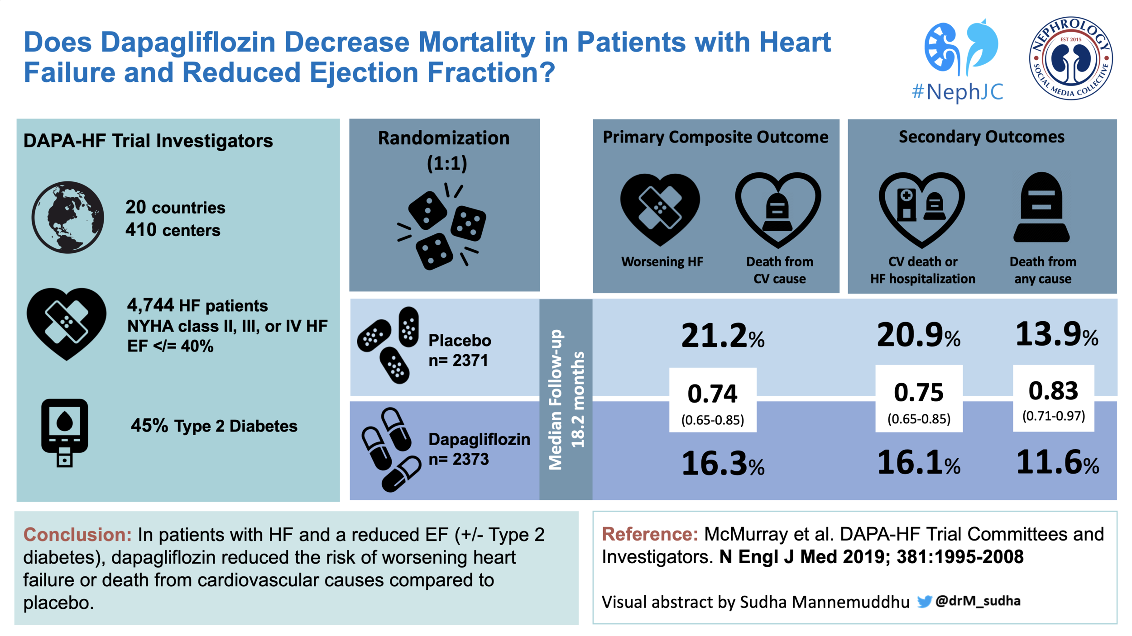

Slide 30
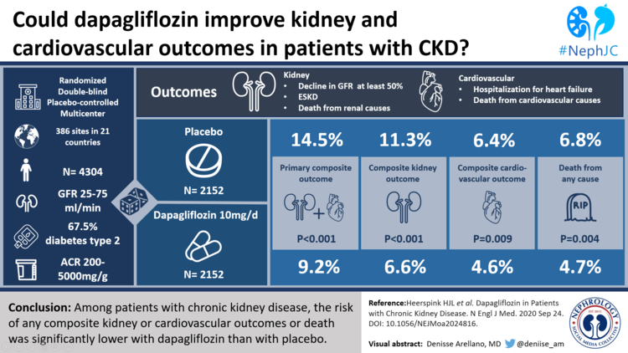

Slide 31



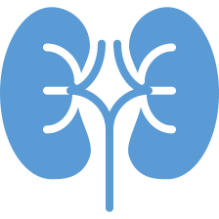
SGLT2 Inhibition With Empagliflozin Is Effective in Heart Failure
With a Reduced Ejection Fraction With or Without Diabetes
Primary Endpoint Composite of cardiovascular death or heart failure hospitalization | 25% in risk P < 0.001
First Secondary Endpoint Total (first and recurrent heart failure hospitalizations) | 30% in risk P < 0.001
Second Secondary Endpoint Slope of decline in glomerular filtration rate over time | P < 0.001 (50% in renal events)
Also achieved success on composite renal endpoint, KCCQ clinical summary score,
and total number of hospitalizations for any reason (all nominal P < 0.01)

Slide 32
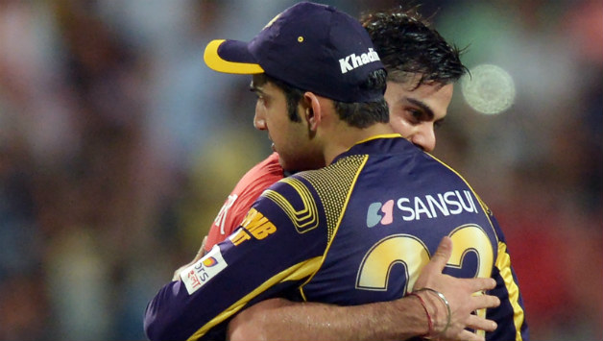
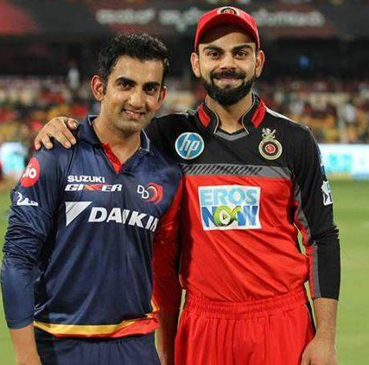
Key Outcome of EMPA-REG (but not to be Found in the Published Papers)
One major outcome of these trials
(not found in any journals or articles )
Cardio and Nephro fighting over diuretics and other medications causing increasing S. Creatinine
Now we are friends with a common drug both would like to prescribe

Slide 34
Barriers to Prescribe SGLT2i
What We doctors say (or don’t say)
  My patient is stable on current treatment (asymptomatic)
  Patient is in Mild heart failure, doesn’t need 4 medications, will add when disease progresses
  Pill burden/ Cost burden
  Inconvenience for doctors to monitor all therapies and side effects
  General hesitation to start new and unknown therapy till it becomes main stream
  Patients outlook- Morbidity due to disease acceptable>>> side effects due to treatment

Slide 35

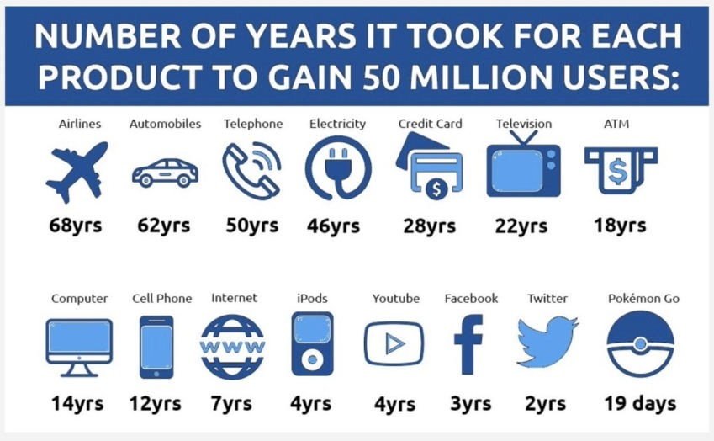
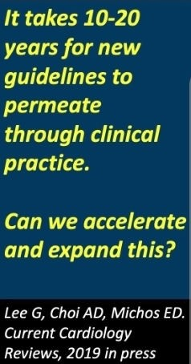
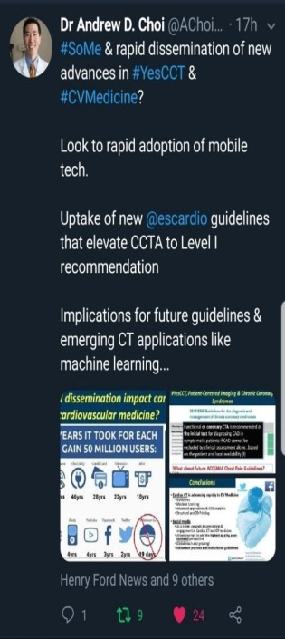

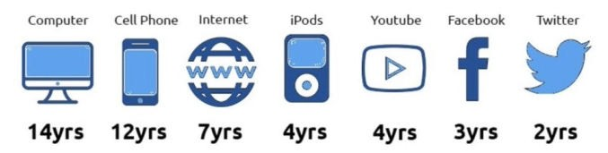

Can we accelerate the adoption of new guidelines in clinical practice?
50 million
24 hours

Slide 36
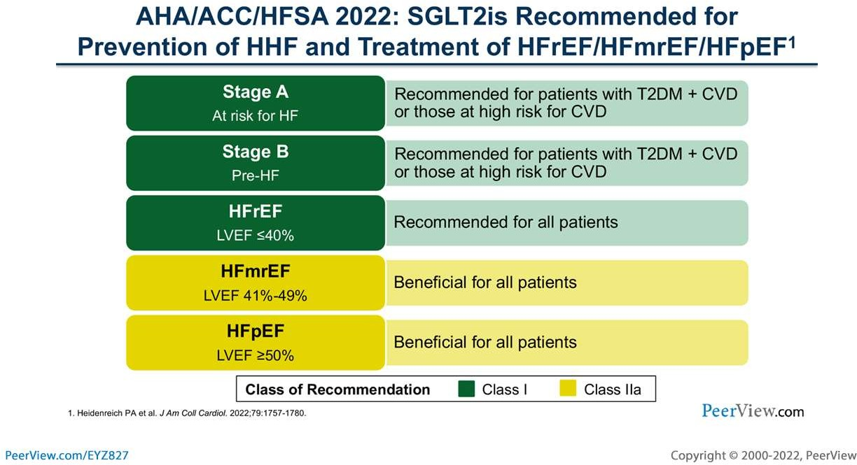

Slide 37
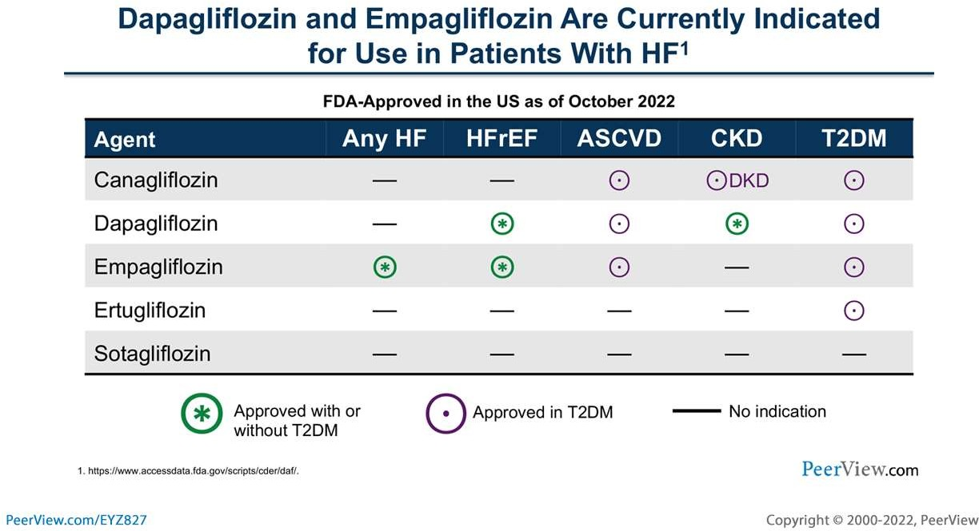

Slide 38
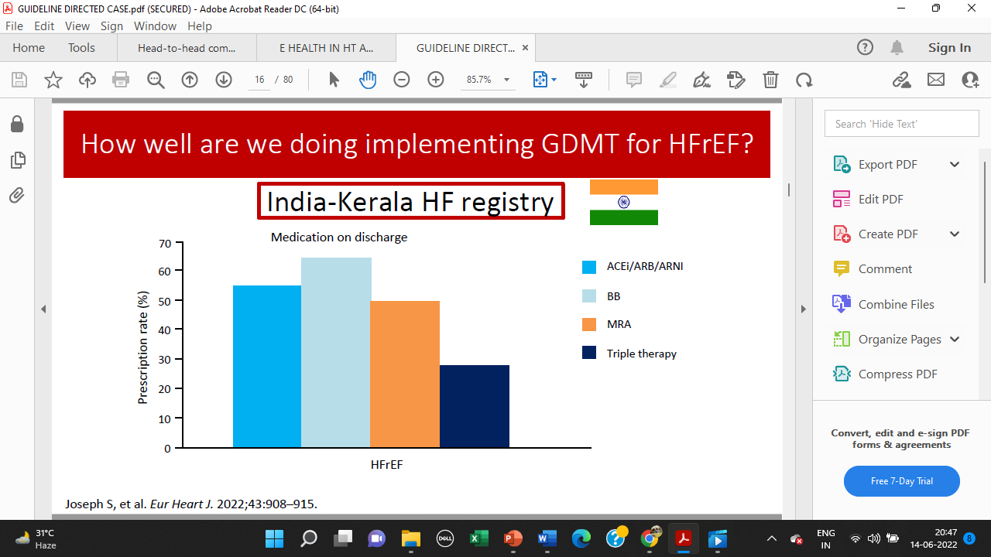

Slide 39
What we will discuss..
SGLT2 inhibitors: history, development & New Roles for a known drug?
Mechanism of action
CV outcome trials, Updated guidelines
Real world experience, side effects, when and when not to use them, how to use them in my practice

Slide 40
Side effects of SGLT2i
Volume depletion/dehydration
Genital infections
Euglycemic Ketoacidosis
Hypoglycemia

Slide 41
Volume depletion/dehydration
Mechanism - Diuretic
Transient :1st Month→ Not Kidney Injury.
↓ CKD Progression

Slide 42
Volume depletion/dehydration
Advise to patients :
Drink adequate amount of water
nephrotoxic medications, ACEi/ARB, NSAIDS
reducing the diuretic dose
Do not discontinue

Slide 43
Genital and Urinary tract infections
  Glucosuria, ↓ immunity and altered genital microflora.
  Genital mycotic infections,
  Candida, →local Anti-fungal
  UTIs, Urosepsis Pyelonephritis Fournier gangrene RARE

Slide 44
Genital and Urinary tract infections
Advise to patients :
  genital area hygiene
  Washing genital area
  symptoms of fever, burning micturition etc

Slide 45
Euglycemic ketoacidosis
Euglycemic DKA (EDKA) is defined as
  pH less than 7.3, or
  serum bicarbonate less than 18
  with near normal plasma glucose.
Overall incidence is 0.1%.
Notes:
AACE/ACE reported that incidence of DKA in clinical trials of SGLT2i in T2DM was low and majority of the reported cases were in TIDM in whom SGLT2i use is not approved.

Slide 46
Euglycemic ketoacidosis
Diagnosis: beta hydroxybutyrate level in blood and acidemia.
urine ketones on dipstick ( which assesses acetoacetate) may be deceiving.
Stop SGLT2 inhibitors
Fluid resuscitation.
After volume expansion, a combination of dextrose and insulin infusions

Slide 47
Hypoglycemia
Insulin-independent mechanism of action
Low risk when used as monotherapy as SGLT1 mechanism is intact
Comparable to that of metformin or DPP4-inhibitor
Increased risk with insulin and insulin secretagogues

Slide 48
How to use in practice:
What do we tell our patients
Effective Glycemic Control
CAD, HF, CKD
Weight Loss, Modest BP reduction
Minimal side effects
No undue risk for hypoglycemia
Durable
Additive benefits with incretins, esp. GLP-RA’s
OD, fixed dose
Works with FIRST DOSE- patients love to see QUICK benefit

Slide 49
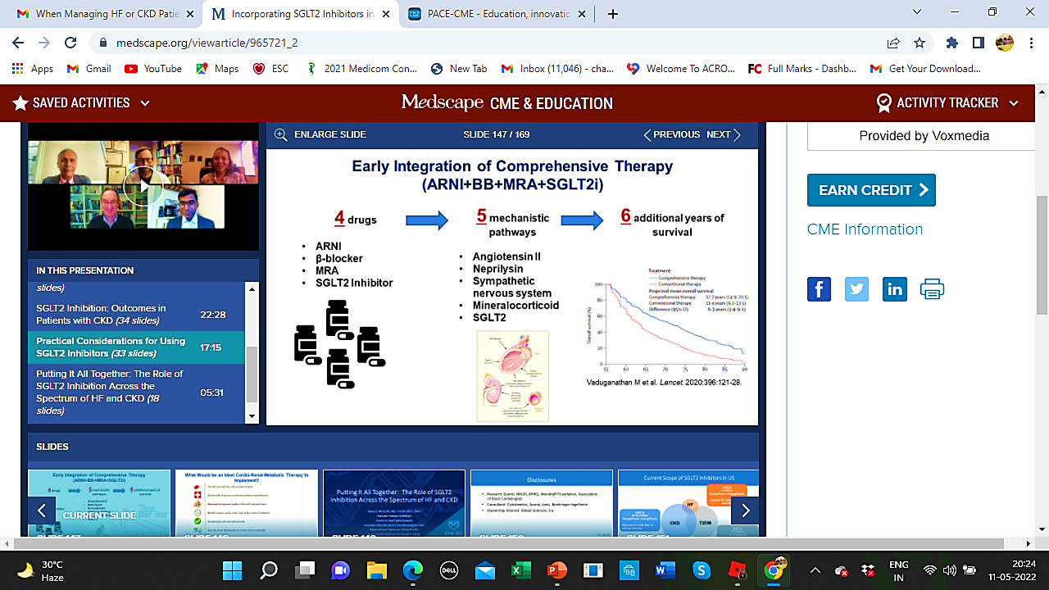

Slide 50
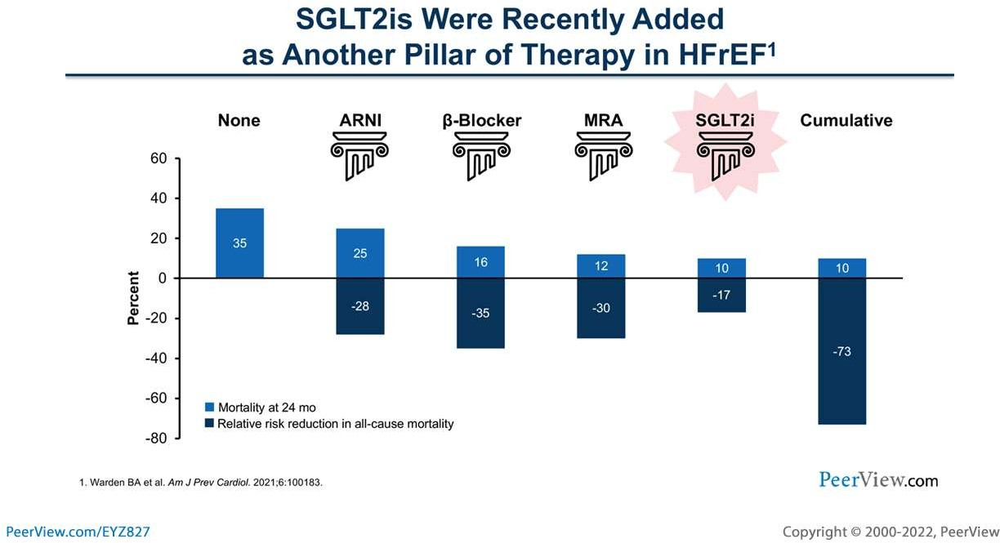

Slide 51
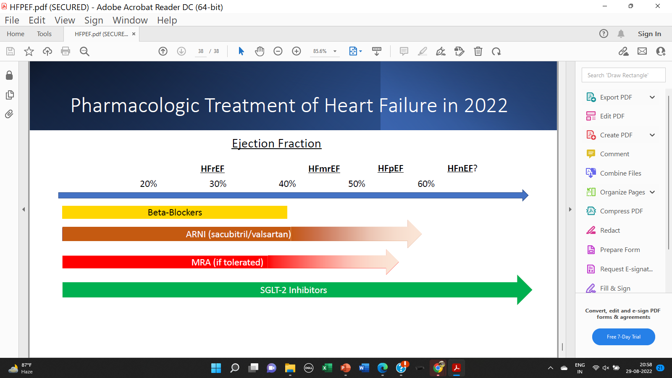
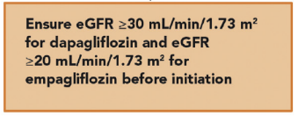
2023

Slide 52
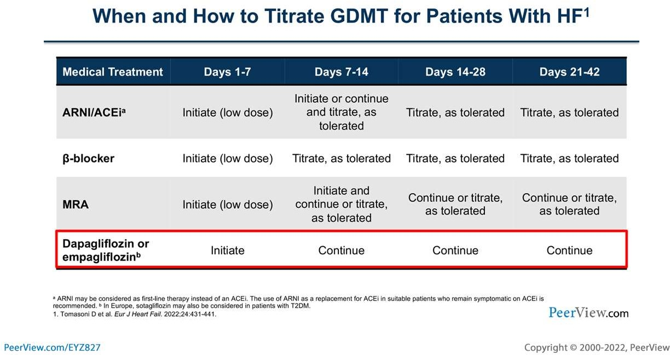

Slide 53
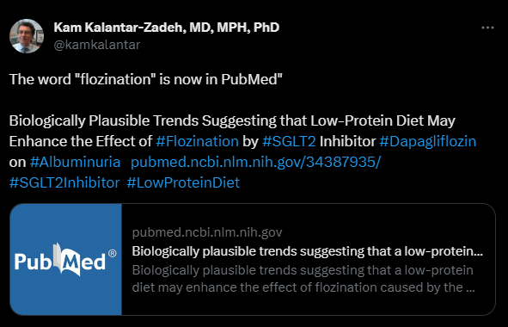
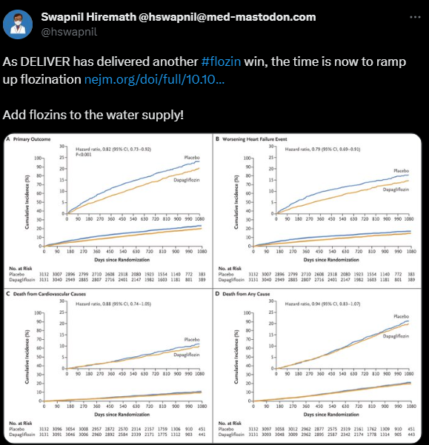

Slide 54
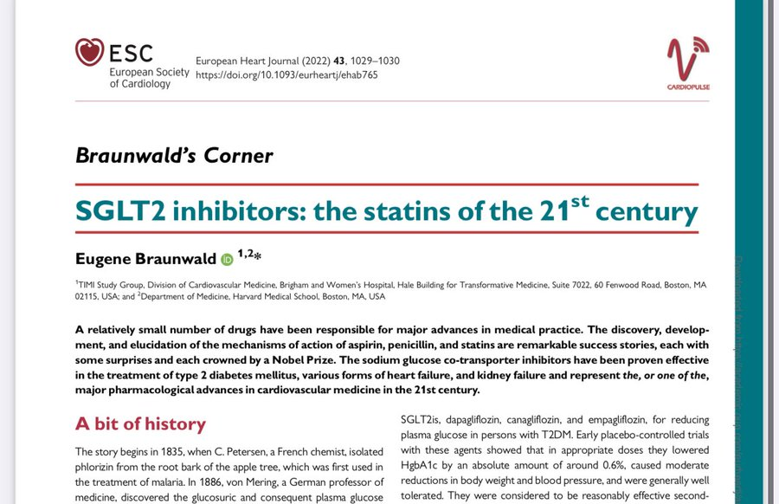

Slide 55




drcinosh@gmail.com
9646500159
@DrCMathew

