Slide 1
CORONARY ANGIOGRAPHY and LESION QUANTIFICATION
Dr Cinosh Mathew
MD, DM(Cardiology), FACC
Professor & Head of Department
SBKS Medical Institute & Research Centre,
Sumandeep Vidyapeeth Deemed to be University, Vadodara

Slide 2
NUMBERS
estimated 2,000,000 procedures
30 minutes
with a procedure-related major complication rate (death, stroke, myocardial infarction) of <0.1%.

Slide 3
HISTORY
Forssman
SONES AND SHIREY
Gruentzig

Slide 4
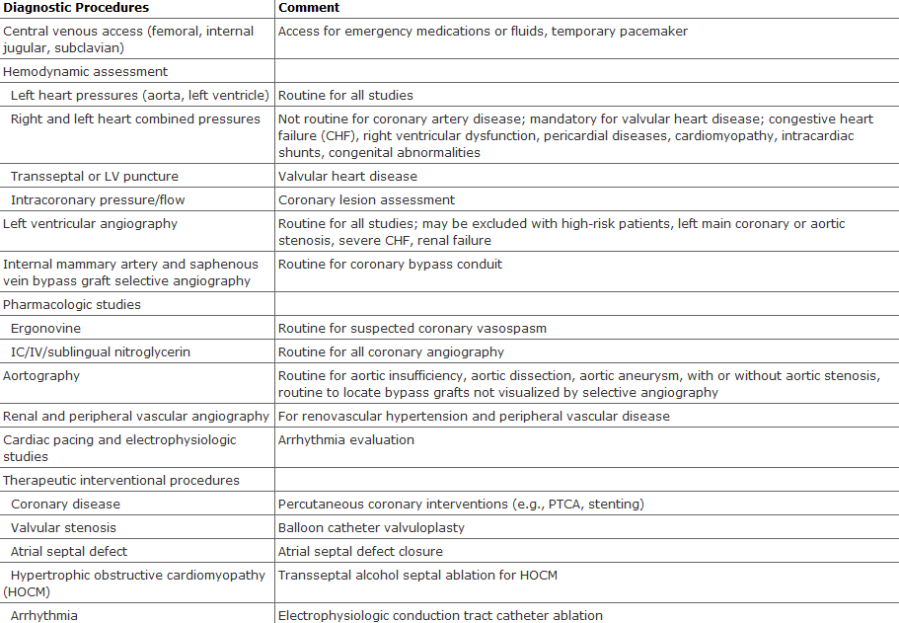

Slide 5
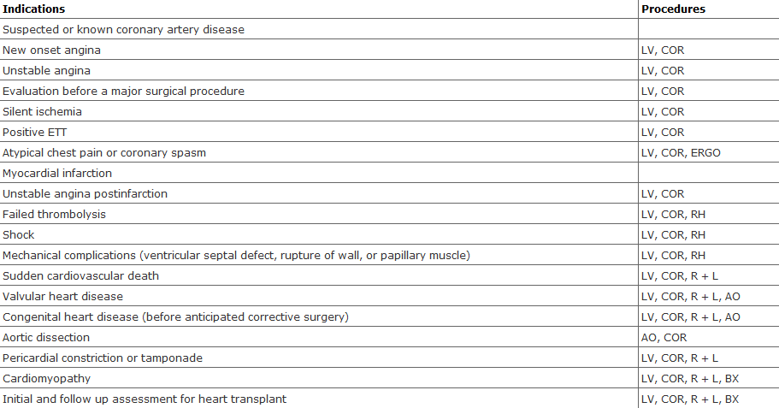

Slide 6
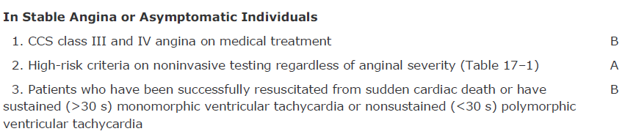
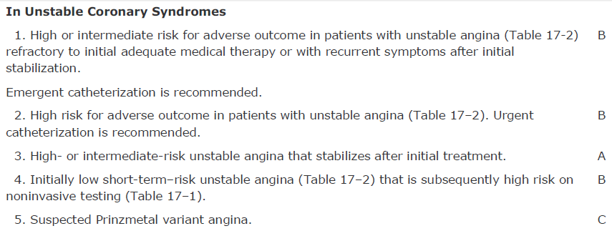
INDICATIONS FOR CORONARY ANGIO

Slide 7
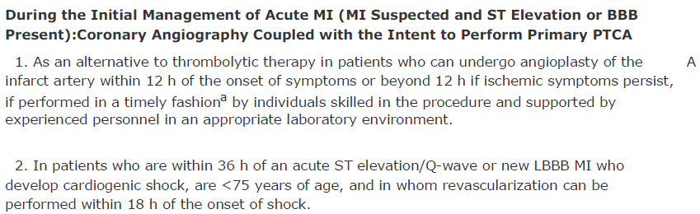
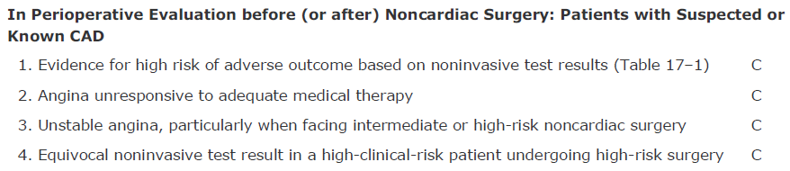
INDICATIONS FOR CORONARY ANGIO

Slide 8
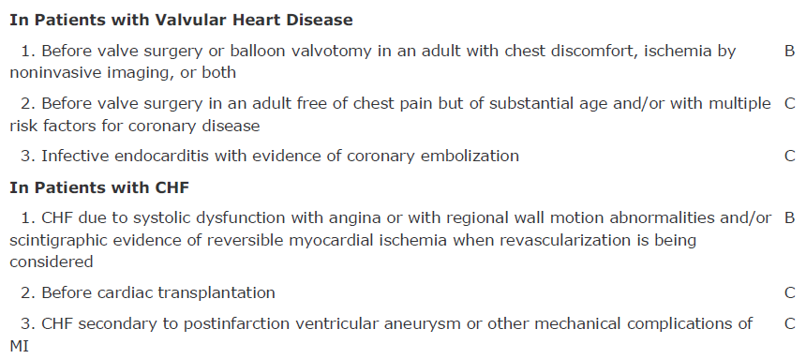
INDICATIONS FOR CORONARY ANGIO

Slide 9
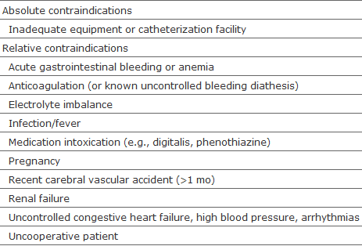

Slide 10
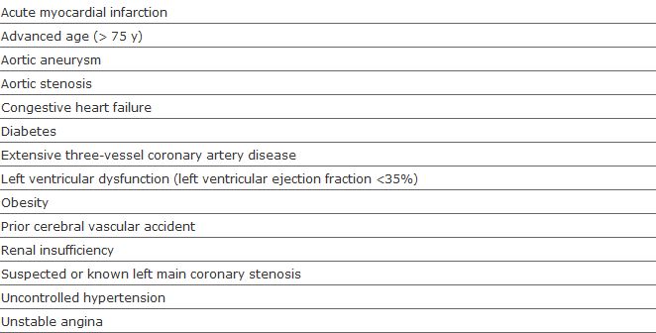

Slide 11
PRE PROCEEDURE
Mild Sedation
Hospitalization
Outpatient CAG

Slide 12
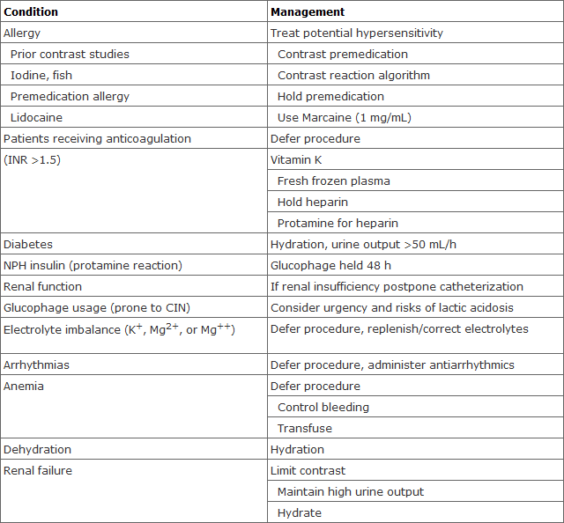
PRE PROCEEDURE

Slide 13
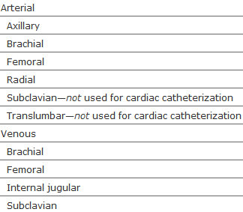
Routes of Vascular access

Slide 14
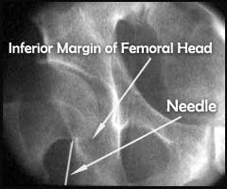
PROCEEDURE
The inguinal ligament usually crosses the superior edge of the femoral head.
The common femoral artery usually bifurcates into the profunda and superficial branches
The target entry site of the needle is the superior half of the femoral head.
Low puncture sites may result in entering one of the bifurcation branches of the common femoral artery.
In such cases, compression, post removal of the sheath is more difficult.
Also, the incidence of a pseudo-aneurysm and femoral artery thrombosis is slightly increased.
Puncture at the arterial bifurcation point may make it more difficult to secure hemostasis with compression or a sealing device.
In some cases surgical repair may be needed.
A high puncture→becomes difficult to compress the artery against a bony structure and the risk of a retro-peritoneal hematoma is increased.

Slide 15
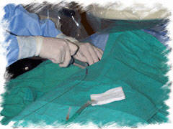
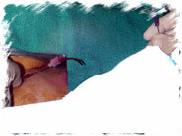
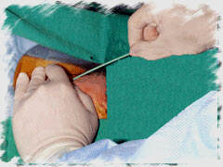
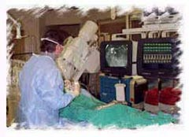
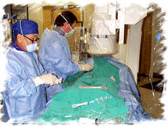

Slide 16
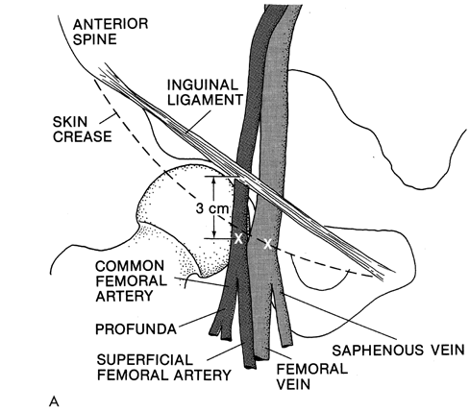

Slide 17
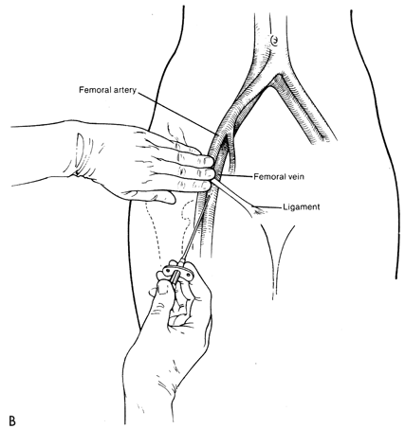

Slide 18
STARTING THE PROCEEDURE
Catheters
  Polythene /polyurethane
  Steel braid/Kevlar
  Soft distal tip

Slide 19
Inserting and flushing
After insertion of catheter,
  Double flush catheter
  Site
Before and after each catheter insertionand every 5 min of proceedure

Slide 20
CARRYING ON…
Connect to the Manifold
Measure the Pressure and confirm the Zero prior .
Fill lumen with the contrast
Watch the waveform
Advance in to the aortic root

Slide 21
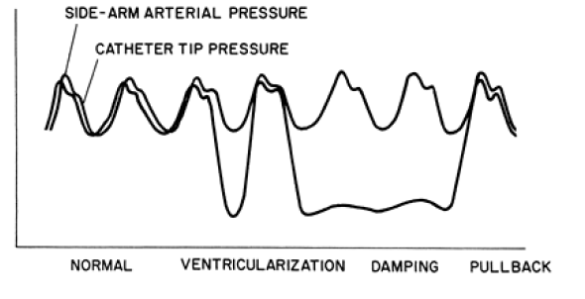
Waveform change

Slide 22
Damping and Ventricularisation
Arterial wall/Ostial stenosis
Withdraw catheter
Reinject
Ostial stenosis:No dye reflux,mid/prox dye collection
Avoid vigorous catheter injections
  Dissection
  VF

Slide 23
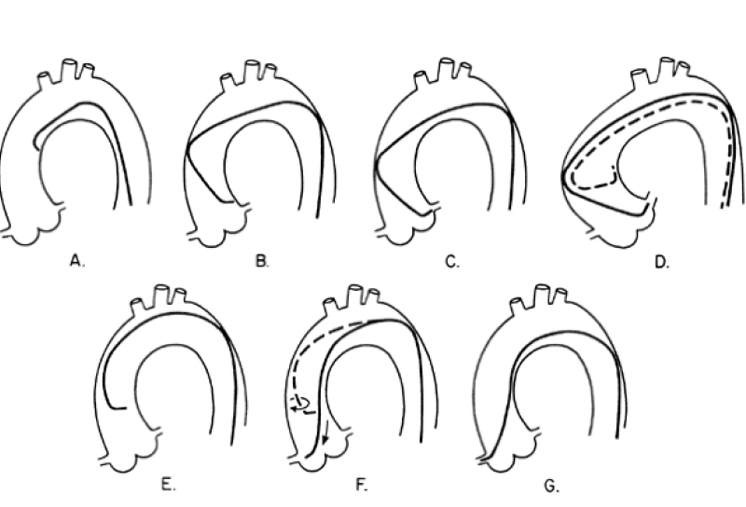

Slide 24
LEFT CORONARY OSTIUM
Short aorta
  Smaller judkins
  Push the catheter in to aortic cusp more deeply
  Deep breath ---- vertical heart
Large aorta
  Larger Judkins
Posterior origin
  RAO position with CC rotation
  Larger Judkins
  Left Amplatz

Slide 25
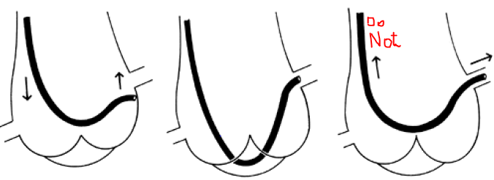
LEFT CORONARY OSTIUM

Slide 27
Right Coronary ostium
LAO position
Face the Left side
180 ̊ rotation
Dropping phenomenon
  Begin above
  Withdraw the catheter
Avoid over rotation
  CC torque as we enter the RCA ostium

Slide 28
Right Coronary ostium
High anterior RCA ostium
  Non Selective injection
  Amplatz 0.75/1
RCA damping
  Smaller vs
  Ostial spasm
  Conal catheterization
  Ostial stenosis
    Side hole catheter

Slide 29
SVG and arterial grafts
3-12% occlude within 1 m.
Veins occlude within 1 yr d/t neointimal hyperplasia
>1 yr is Diffuse SVG atherosclerosis
Free radial grafts-→ intermediate patency
Progression of native disease→pain →20%

Slide 30
Graft location
Operative report/technique practised
LCA/Diagonal from Left side of the aorta and the Cx slightly higher up
RCA/Distal dominant Cx grafts from the Rt side and anterior surface of aorta.
LCA graft:JR 4/AL 1
RCA graft : MPA/Wexler/JR 3.5
Take catheter to area,and withdraw injecting.
Notes:
WEXLEr is also used for posterior /left sided aorta

Slide 31
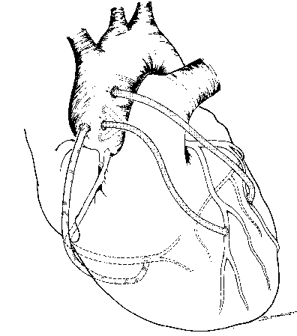
Graft location
Notes:
WEXLEr is also used for posterior /left sided aorta

Slide 32
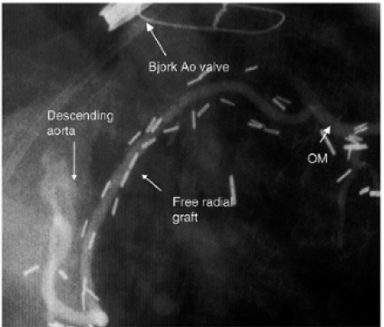
Graft location
Notes:
WEXLEr is also used for posterior /left sided aorta

Slide 33
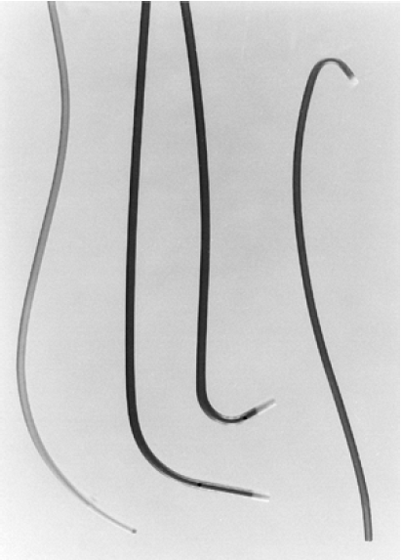
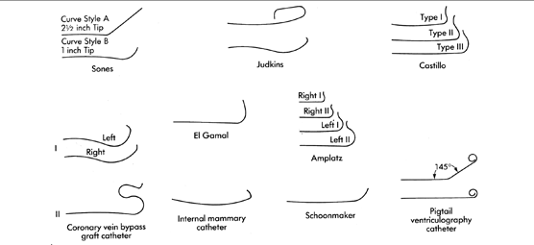

Slide 34
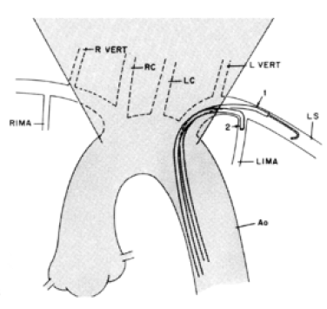
IMA Graft catheterization
Notes:
Variants is common trunk with thyrocervical and origin from the vertical subclavian. Closure point is the junction with the native artery.
Flow limitation at the origin/mid shaft/native coronaries/

Slide 35
IMA Graft catheterization
LAO projection to enter the Subclavian A
AP projection counterclockwise rotation with tip anteriorly.
Intermittent gentle puffs
Low osmolar contrast agents
Selective cannulation with non specific injections
    Blood pressure cuff
    Improve opacification
    Attach a Y connector and advance a 0.014 in pTCA guidewire
Notes:
Variants is common trunk with thyrocervical and origin from the vertical subclavian. Closure point is the junction with the native artery.
Flow limitation at the origin/mid shaft/native coronaries/

Slide 36
IMA Graft catheterization
RIMA
  LAO projection to show the Brachiocephalic trunk
  CC rotation to enter it
  Inject dye to opacify the Common Carotid
  RAO-caudal is the best spatial resolution to d/b SC and the Rcc.
  Use WHOLEY guidewire
  Tip rotation is anti clockwise.
Notes:
Variants is common trunk with thyrocervical and origin from the vertical subclavian. Closure point is the junction with the native artery.
Flow limitation at the origin/mid shaft/native coronaries/

Slide 37
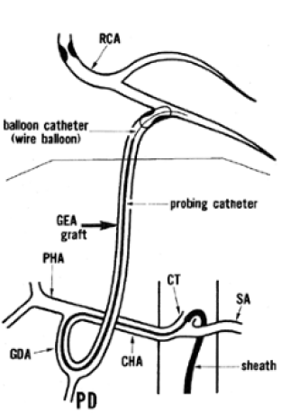
Gastroepiploic Graft Catheterisation
Left and right IMA
Radial free grafts not very successful(spasm)
R GE artery to the PD or others on the inferior surface.

Slide 38
RADIAL ARTERY TECHNIQUE
Dr Sones
Side holes within 7 mm at distal end
80,100,125 cm length and 6-8 F
Catheter tip pressure to be monitored
Use of deep inspiration
Use of soft J-tipped guidewire of 0.035 in .
Asc Aorta removal of guidewire

Slide 39
RADIAL ARTERY TECHNIQUE
Specially coated hydrophilic sheaths reduce spasm on sheath insertion and removal.
Arterial puncture using a short 20-gauge needle, a 0.025-in. guidewire, and a radial artery sheath system (24 cm) is performed in a manner similar to FA puncture.
The point of puncture is over the radial artery pulsation on the wrist. After puncture, the small guidewire is inserted followed by a long arterial sheath.
5000 U of heparin, 2 mL of 1 percent lidocaine, and 200 g of nitroglycerin are often given.
Additional intraarteriolar vasodilator—such as diltiazem,—may be necessary to minimize spasm

Slide 40
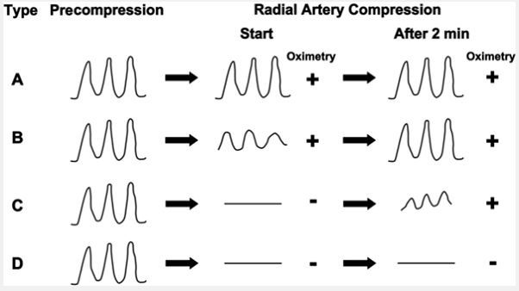
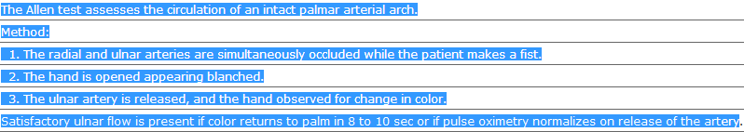
RADIAL ARTERY TECHNIQUE

Slide 41
RADIAL ARTERY TECHNIQUE
LAO position with non coronary cusp posteriorly.
Pressure in to the aortic cusp /slight CC rotation with push.
Deep inspiration
Grossman method: inching up→ cobra head
  High takeoff: inject dye and opacify the coronaries.
RCA proceedure is the same :Clockwise rotn with withdrawal with release of the torque upon canulating the RCA.

Slide 42
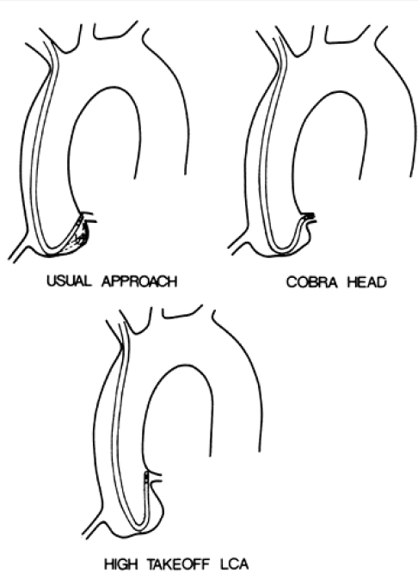
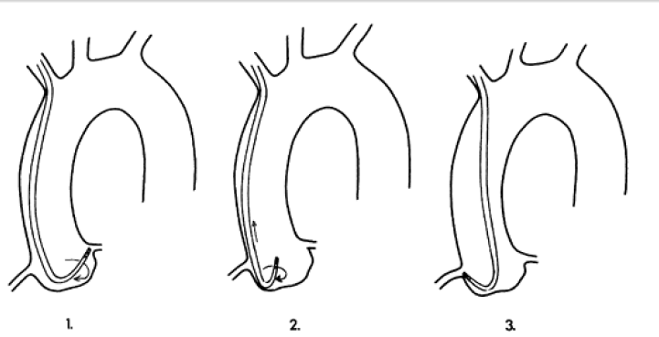
RADIAL ARTERY TECHNIQUE

Slide 43
RADIAL ARTERY TECHNIQUE
Alternate technique of canulation of the RCA
  Catheter to Rt aortic cusp
  Gradual withdrawal of the catheter
  Injection of puffs of contrast with canulation of the vessel.

Slide 44
ACCESS SITE HEMOSTASIS
Heparin after catheter removal guided by Activated clotting time.
>200s → protamine sulphate
Femoral sheath: pressure for 15-30 mins
  Vascular occlusion devices
Radial sheath removal:plastic bracelet with pressure pad
  Withdraw the sheath and simultaneously tighten the bracelet.

Slide 45
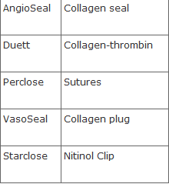
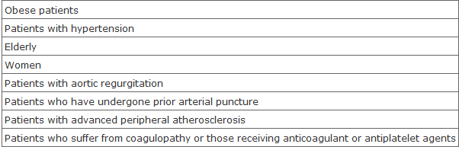
ACCESS SITE HEMOSTASIS

Slide 46
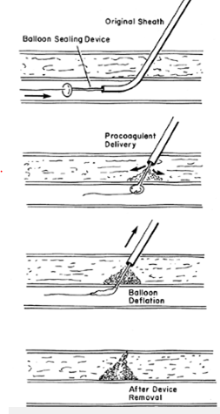
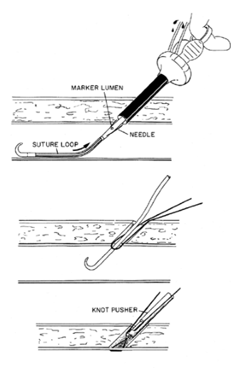

Slide 47
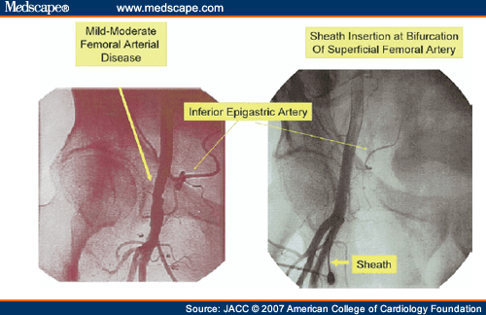
ACCESS SITE HEMOSTASIS
Notes:
ACCESS CLOSURE

Slide 48
INJECTION TECHNIQUE
Transient replacing of blood in the vessel with slight,but continuous reflux in to the aortic root.
Myocardial blushing or dissection
Speed is 7ml at 2.1ml/s and 4.8 ml at 1.7ml/s
Occlusion with much lower rates AND WITH HOCM/LVH higher volumes and rates.

Slide 49
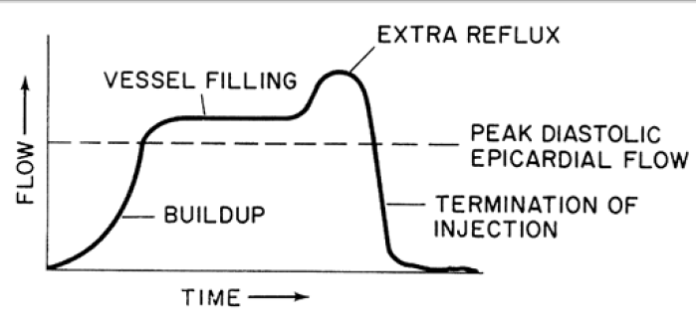
INJECTION TECHNIQUE
POWER INJECTORS with 2-3ml/s for rt and 3-4 ml/s for the left

Slide 50
SEQUENCE OF VIEWS
1. RAO-caudal to visualize the left main, proximal LAD, and proximal circumflex
2. RAO-cranial to visualize the mid and distal LAD without overlap of septal or diagonal branches
3. LAO-cranial to visualize the mid and distal LAD in an orthogonal projection
4. LAO-caudal to visualize the left main and proximal circumflex.

Slide 51
SEQUENCE OF VIEWS
1. LAO to visualize the proximal right coronary artery (RCA)
2. RAO-cranial to visualize the posterior descending and posterolateral branches
3. Lateral to visualize the mid-RCA

Slide 52
LESION QUANTIFICATION
Seen in profile
Eccentric lesion
Perpendicular lesion when there is visualization of lucency d/t thin contrast column.
MACH effect
LUMEN-o- GRAM

Slide 53
Normal vessel sizes
RCA:3.9 +/- 0.6 for dominant
    2.8+/- 0.5 for non dominant
LCA: 3.7 +/- 0.4
LCx : 4.2 +/- 0.2 for dominant
    3.4+/- 0.5 for non dominant
Left main : 4.5 +/- 0.5

Slide 54
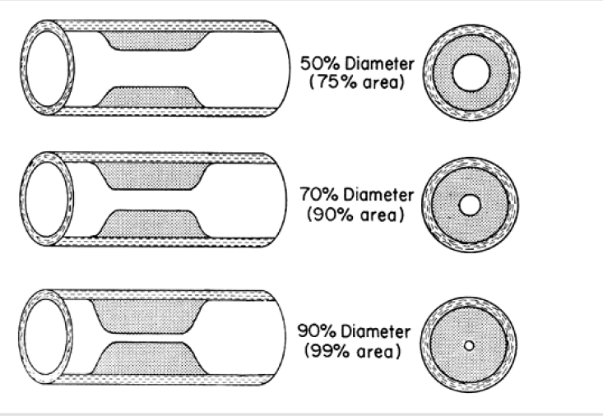

Slide 55
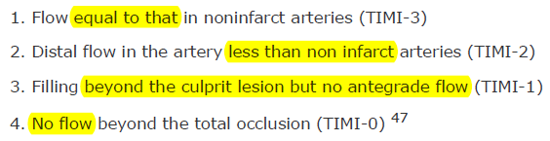
SCORING SYSTEMS
TIMI FLOW:

Slide 56
SCORING SYSTEMS
TIMI FRAME COUNT:
  6 F catheters and 30 fps.
  first frame is always the opacified artery frame.
    LAD distal bifurcation
    RCA first branch of the PLV
    LCx distal bifurcation
Corrected TIMI frame count
  LAD 14.7/RCA9.8/Lcx 9.3
  Divide the absolute frame count in the LAD by 1.7

Slide 57
SCORING SYSTEMS
Corrected TIMI frame count
  TFC is 36 for LAD,22 for the CFX,20 for the RCA
  CTFC for the LAD is 21.
  HIGH TFC is S/o microvascular injury is there is no apparent stenosis.
  <20 CTFC is good prognostic factor.

Slide 58
SCORING SYSTEMS
  EDGE DETECTION
  PERCENTAGE STENOSIS=
        100-{reference dia- Stenosis dia/reference Dia}

Slide 59
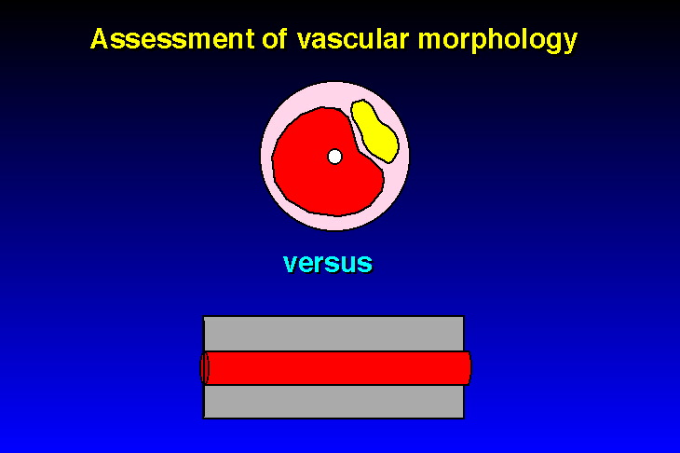
Pitfall: lesion eccentricity

Slide 60
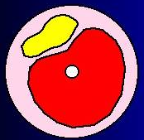
Pitfall: lesion eccentricity

Slide 61
Vascular Remodelling
(Glagov’s phenomenon)

Slide 62
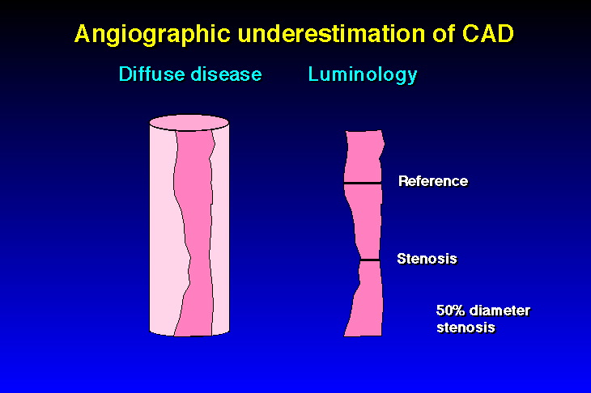

Slide 63
SHORTFALLS OF THE METHOD
Double ostium of the Left sided arteries
Ostial lesions
  Tangential view
  Catheter pressure damping
  Reflux minimally form the orifices
Myocardial bridging

Slide 64
SHORTFALLS OF THE METHOD
Myocardial bridging
  Territory of the LAD and it’s diagonals.
  Classification scheme
    class A – Having clinical symptoms but no objective signs of ischemia.
    class B – Having clinical symptoms and objective signs of ischemia by non-invasive stress tests.
    class C – Having clinical symptoms and objective altered intracoronary hemodynamics, based on angiography and intracoronary Doppler – with or without signs of ischemia by noninvasive stress tests

Slide 65
SHORTFALLS OF THE METHOD
Myocardial bridging
  Management
    Type A: No further diagnostic work or therapy is needed. Nitrates should be avoided. In rare cases, betablockers might be considered temporarily to relieve symptoms
    Type B: Initiate beta-blockers or calcium channel blockers. If symptoms are not relieved, quantitative coronary angioplasty or invasive blood-flow studies should be performed, after which stenting may be considered if there is objective evidence of reduced blood flow to the heart muscle.
    Type C: Initiate beta-blockers or calcium channel blockers. If symptoms are refractory, consider stenting of the bridged segment

Slide 66
SHORTFALLS OF THE METHOD
Foreshortening
  Use tangential views
Coronary Spasm
  Use NTG 100-200µg
Totally occluded vessels
  Distal vasculature visualisation via collaterals

Slide 67
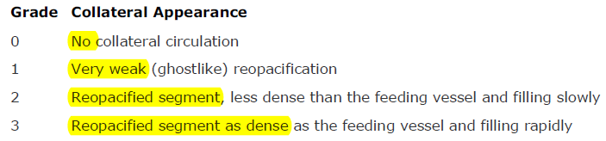
COLLATERAL CIRCULATION

Slide 68
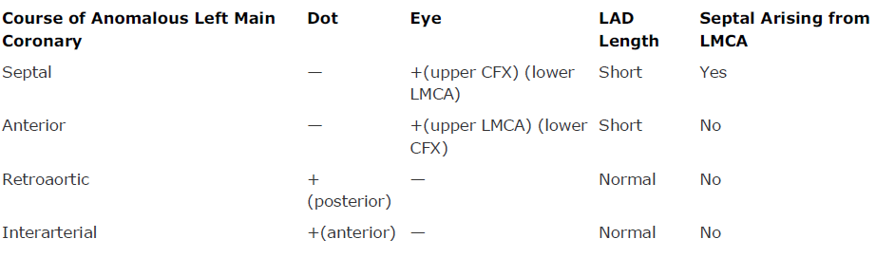
SHORTFALLS OF THE METHOD
ABNORMAL VASCULATURE ORIGIN

Slide 69
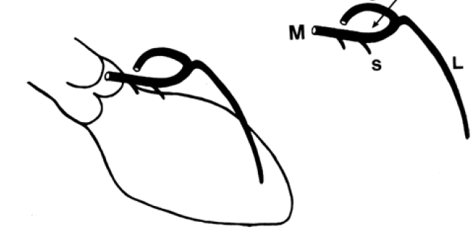
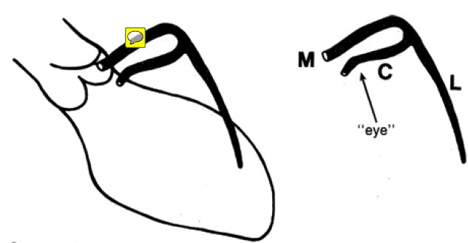
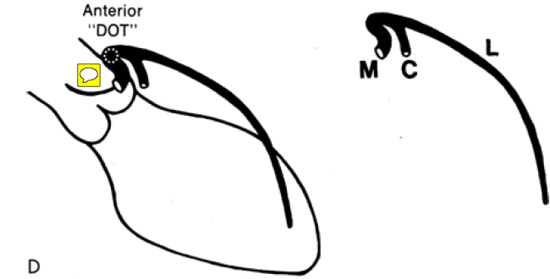
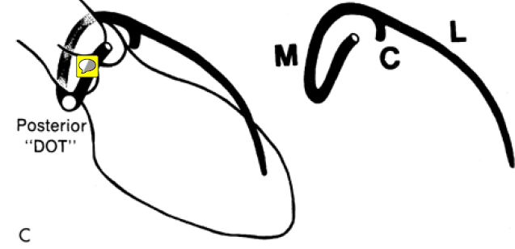
SHORTFALLS OF THE METHOD

Slide 70
OTHER CAUSES OF CORONARY ABNORMALITIES
Coronary aneurysms
Coronary fistulae
Saw toothing in HOCM
Cardiac allograft vasculopathy
  Immune medated difuse vasc proliferative response
  Catheter revasc
Ostial lesions--- fibrotic contraction

Slide 71
OTHER CAUSES OF CORONARY ABNORMALITIES
CORONARY VASOSPASTIC DISEASE
  Off CCBs for 24 h/off nitrates for 12 hrs
  Ergonovine/methyl ergonovine
  Look for vasospasm/ECG changes or clinical s/s
  Acetylcholine intracoronary
  Hyperventilation
  Always positive in k/c/o Var angina1/3rd of clinically suspected Var angina and <5% of those w/o s/s
Notes:
0.4 mg dil in 8ml saline given in doses of 1 ml/2ml and 5 ml
100-200µg/ml NTG shd be ready.Intracoronary doses of 5-10 µg or 10 microgram/min are given
Ach 20-50-100/20-50-80 are noted

Slide 72
OTHER CAUSES OF CORONARY ABNORMALITIES
Takutsubo syndrome
  Epicardial multivessel and microvasculature spasm
    No specific coronary arterial territory dyskinsia noted
Pleating

Slide 73
Interpretation abnormalities
Poor equipment
Inadequate projection number
Inadequate contrast
Superselective injections
  LAD missed CC rotation or smaller Judkins
  Lcx missed clockwise rotation or larger Judkins
  Coronary vessel reflux to demonstrate ostium.

Slide 74
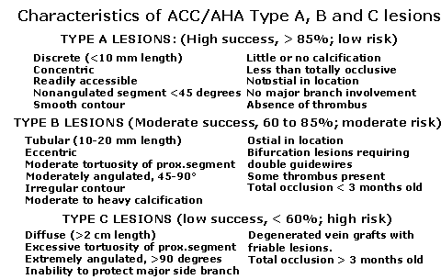
LESION QUALIFICATION
Krone et al

Slide 75


LESION QUALIFICATION
Krone et al

Slide 76


LESION QUALIFICATION

Slide 77
SIGNIFICANCE OF LESIONS
The ratio of maximal-to-basal flow is coronary flow reserve (CFR), or coronary vasodilatory reserve (CVR).
Resistance to flow increase occurs at three levels: epicardial conduits (R1), precapillary arterioles (R2), and intramyocardial resistance (R3).
In response to the loss of perfusion pressure and flow to the distal microcirculation bed, precapillary resistance vessels (R2) dilate to maintain satisfactory basal flow appropriate for myocardial oxygen demand.

Slide 78

SIGNIFICANCE OF LESIONS
As blood flow increases ,the difference in pressure increases in lesion A while Lesion B maintains a relatively similar change in pressure .
Thus similarly stenotic lesions behave differently when exposed to higher blood flows.

Slide 79

SIGNIFICANCE OF LESIONS
CVR is the ratio of maximal hyperemic-to-basal mean flow velocity in the target vessel obtained distal to the stenosis.
CVR is dependent on R1 and R2
Relative CVR compares it to a reference
Vessel
Normal : 0.8- 1.0

Slide 80
SIGNIFICANCE OF LESIONS
Myocardial FFR
FFR coronary
FFR collateral
    FFR normal value is 1
    High reproducibility
    Non dependent on gender ,associated factors
    FFR cor can be calculated only with PTCA
    Since max hyperemia is there,no dependence on basal factors.

Slide 81
Proceedure
GUIDEWIRE upto Ostium
Via Y connector,connect the pressure sensor catheter and correspond the pressure at the ostium
Pass the guidewire beyond the lesion and record baseline.
Introduce hyperemia with adenosine
Measure simultaneous pressures
Notes:
Bradycardia,spasm and VF pre rx with NTG 200 micro gram f/b papverine 8-12 mg or Adenosine 20-30 micro gram in RCA and 40-60 microgram in the LCA

Slide 82

APPLICATIONS
CLINICAL DECISION MAKING
In exercise stress testing similar accuracy levels of nearly 88% sensitivity and 100%
specificity was noted with the FFR measurements.

Slide 83
APPLICATIONS
Deferral of PCI:
  If >0.75, FFR deferral of PCI if the patient has no s/o ischemia has a similar result as that in whom it has been performed.
Post PCI physiology:
  If altered ,then s/o poor prognosis at 6 months
  Also if PTCA delivers a normal PCI ,no additional advantage with stenting.
SIDE BRANCHES and OSTIAL LESIONS
AMI: in patients with 6 days after MI,significance of the lesions needs to be determined.

