Slide 1
Pharmacology of various anti-tuberculous agents, their indications, contraindications, interactions and adverse reactions
DR ARTI D SHAH
DEPARTMENT OF RESPIRATORY MEDICINE

Slide 2
INTRODUCTION
MECHANISM OF ANTITUBERCULOSIS DRUG INDUCE LIVER INJURY
CLINICAL SIGNIFICANCE AND MANIFESTATION OF HEPATOTOXICITY
RISK FACTORS
REGIMEN SELECTION

Slide 3
Isoniazid is a prototypical drug for causing hepatic dysfunction, other first and second-line antibiotics in TB treatment may also affect the liver.
Co-morbidities such as alcohol abuse, human immunodeficiency virus [HIV], and the burgeoning epidemics of viral hepatitis, complicate treatment and the potential for hepatotoxicity.

Slide 4
MECHANISM OF ANTITUBERCULAR DRUG
A broad range of hepatic abnormalities may occur during anti-TB treatment, related or unrelated to the medications used.
Liver dysfunction associated with anti-TB treatment ranges from asymptomatic elevation of transaminases to rare, fulminant liver failure.
Low-grade transaminase elevations due to a particular medication and that do not progress to severe injury constitute hepatic adaptation to the drug.
.

Slide 5
Stress on the liver, generally in the form of an administered drug or toxin, induces minor hepatocellular injury, an array of hepatic enzymes, and can be manifested as aminotransferase elevation.
A progressive rise in liver transaminases, generally accompanied by hepatitis symptoms of nausea, vomiting, abdominal pain, or unexplained fatigue, and eventual jaundice are indicative of DILI

Slide 6
Glutathione S-transferase [GST] gene polymorphisms at loci and alleles have shown to be associated with hepatotoxicity , likely through increased generation of free radicals. Hepatic injury is accompanied by decreased glutathione [GSH] and thiols, with increased lipid peroxidation, resulting in hepatocellular injury.

Slide 7
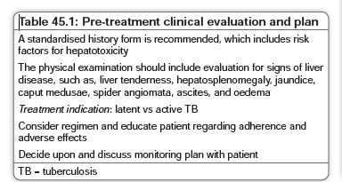
PRE TREATMENT EVALUATION

Slide 8
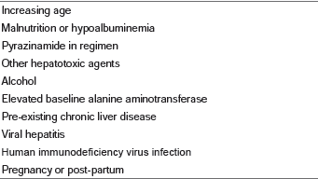
RISK FACTORS

Slide 9
LATENT TUBERCULOSIS
LTBI treatment is undertaken in such individuals, they should have close monitoring and a lower risk regimen should be selected,such as 3HP or rifampicin alone.

Slide 10
RISK MITIGATION AND
MONITORING DURING TUBERCULOSIS
TREATMENT
Include patient education, discontinuation
of other potentially hepatotoxic substances, modified
regimens, intensive monitoring, daily directly observed
therapy [DOTS], and clear and prompt communication among patients and staff.
Alcohol intake should be stopped, as well as any potentially hepatotoxic drugs, illicit or over the counter, such as acetaminophen or related drugs. Prescribed concomitant medications with hepatotoxic potential that cannot be replaced or discontinued are indications for close monitoring.

Slide 11
TREATMENT INTERRUPTION, EVALUATION,
AND SUBSEQUENT MANAGEMENT
Patients who develop symptoms of nausea, vomiting, and
Abdominal pain, or who develop jaundice should stop
medication and be evaluated for possible hepatotoxicity as
soon as possible.
A careful history should be obtained for ingestion of the proper doses of TB medications, concomitant
prescribed or over the counter hepatotoxic medications,
alcohol and illicit drug consumption, and for risk factors
for viral hepatitis.
Serum transaminase and total bilirubin levels should be measured, as well as any other laboratory tests pertinent to the patient.

Slide 12
If the symptomatic patient has transaminases elevated beyond 3 times upper limit of normal , TB and other hepatotoxic medications should be held.
For asymptomatic patients who are found
through scheduled monitoring to have ALT at least 5 times upper limit of normal , TB medications should be held.

Slide 13
Once the ALT has decreased to level usually less than 2 times ULN, TB medication may be reinstituted.

Slide 14
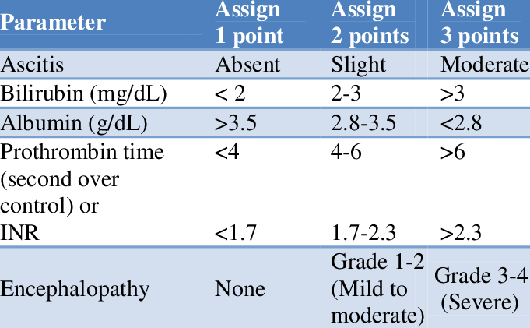
CHILD PUGH SCORE

Slide 15
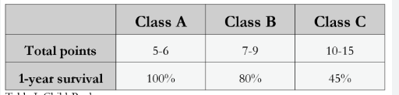

Slide 16
Evidence based study
Antituberculosis drug-related liver dysfunction in chronic hepatitis B infection
Type of study -2

Slide 17
Liver toxicity is a common side effect of antituberculosis (anti-TB) drugs. We studied the differences in liver dysfunction observed during anti-TB treatment between hepatitis B virus carriers (HBV) and noncarriers.
Three hundred twenty-four patients on anti-TB drugs were recruited and followed up for 1 year.
Forty-three patients with HBV and 276 non-HBV patients were included for analysis. Liver function tests and viral markers were monitored monthly. Liver biopsy was requested whenever the alanine transaminase (ALT) was persistently abnormal.

Slide 18
Eighty-six HBV carriers who were not given anti-TB drugs were chosen as a second control and evaluated prospectively

Slide 19
Conclusion
The incidence of liver dysfunction was significantly higher in HBV carriers given anti-TB drugs (34.9%) when compared to noncarriers and with HBV carriers not given anti-TB drugs
For patients given anti-TB drugs, HBV carriers who developed liver dysfunction were younger and had more severe liver injury compared with noncarriers . By multiple logistic regression analysis, age and hepatitis B infection were the only 2 significant risk factors for hepatotoxicity related to anti-TB therapy

Slide 20


