Slide 1
Neuromuscular Junction

Slide 2
Neuromuscular junction
Neuromuscular junction : the synapse between motor neuron and muscle fiber is called the neuromuscular junction
Motor neurons : are the nerves that innervate muscle fibers
Motor unit : single motor neuron and the muscle fibers it innervate

Slide 3
NEUROMUSCULAR JUNCTION
By: Dr. Deep Divanshu Lall

Slide 4
Physiologic anatomy of N.M junction (continued)
As axon approaches muscle , it divides into many terminal branches and loses its myelin sheath
Each of these axon terminal forms special junction ,a neuromuscular junction with one or more muscle fiber
The axon terminal is enlarged into a knoblike structure

Slide 5
The Neuromuscular Junction Is a Well-Studied Example of Directly Gated Synaptic Transmission
Eric R. Kandel,Steven A. Siegelbaum. Signaling at the Nerve-Muscle Synapse: Directly Gated Transmission
The axon of the motor neuron innervates the muscle at a specialized region of the muscle membrane called the end-plate
At the region where the motor axon approaches the muscle fiber, the axon loses its myelin sheath and splits into several fine branches
The ends of the fine branches form multiple expansions or varicosities, called synaptic boutons, from which the motor neuron releases its transmitter. Each bouton is positioned over a junctional fold, a deep depression in the surface of the postsynaptic muscle fiber that contains the transmitter receptors. The transmitter released by the axon terminal is acetylcholine (ACh), and the receptor on the muscle membrane

Slide 6
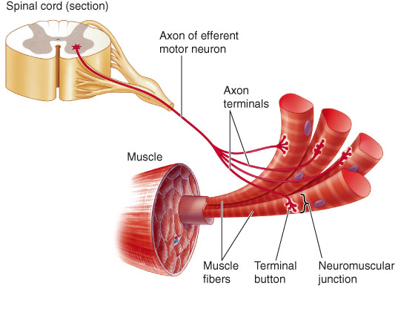

Slide 7
Sequence Of Events At Neuromuscular Junction
Action potentials arriving at the presynaptic terminal cause voltage-gated Ca²⁺ channels to open.

Slide 8
Sequence Of Events At Neuromuscular Junction (continued)
Ca2+ uptake into the terminal causes release of the neurotransmitter acetylcholine into synaptic cleft , which has been synthesized and stored into synaptic vesicles

Slide 9
Sequence Of Events At Neuromuscular Junction (continued)
Ach travels across the synaptic cleft to postsynaptic membrane which is also known as motor end plate.

Slide 10
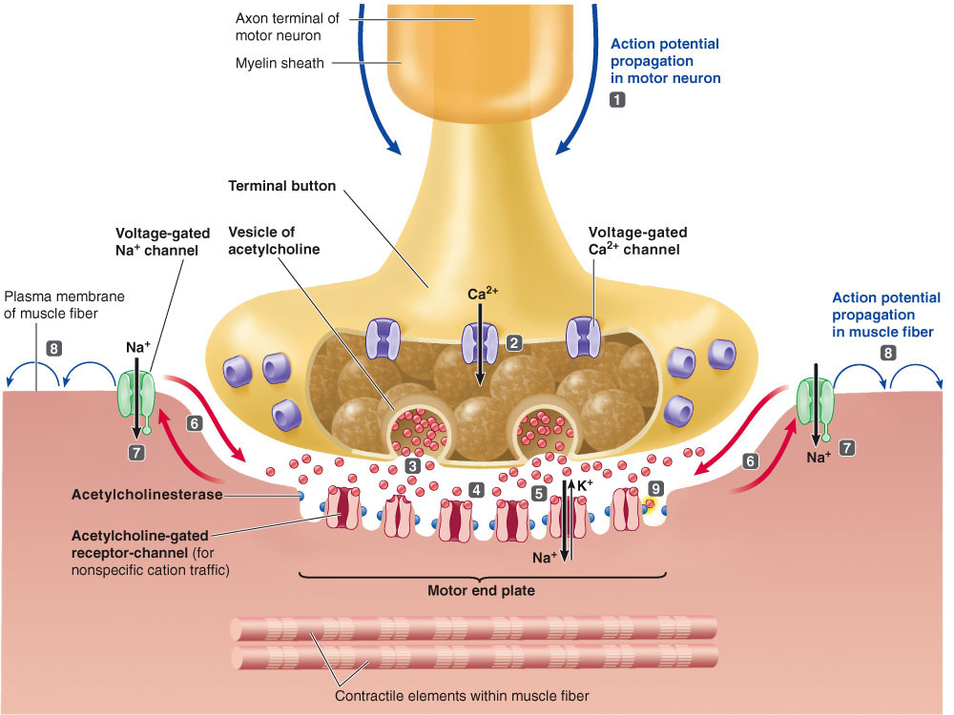

Slide 11
Sequence Of Events At Neuromuscular Junction (continued)
Motor end plate contains nicotinic receptors for Ach , which are ligand gated ion channels
Ach binds to the nicotinic receptors and causes conformational change.
When conformational changes occurs ,the central core of channels opens & permeability of motor end plate to Na⁺ & K⁺ increases

Slide 12
End plate potential
When the ion channel on post synaptic membrane opens both Na⁺ & K⁺ flow down their concentration gradient.
At resting potential net driving force for Na⁺ is much greater than K⁺ ,when Ach triggers opening of these channels more Na⁺ moves inwards than K⁺ out wards, depolarizing the end plate.this potential change is called end plate potential (EPP).
EPP is not an action potential but it is simply depolarization of specialized motor end plate

Slide 13
End plate potential (continued)
Small quanta (packets) of Ach are released randomly from nerve cell at rest, each producing smallest possible change in membrane potential of motor end plate, the MINIATURE EPP.
When nerve impulse reaches the ending, the number of quanta release increases by several folds and result in large EPP.
EPP than spread by local current to adjacent muscle fibers which r depolarized to threshold & fire action potential

Slide 14
Acetyl cholinesterase ends Ach activity at N.M junction
To ensure purposeful movement ,muscle cell electrical response is turned off by acetylcholinestrase(AchE), which degrade Ach to choline & acetate
Now muscle fiber can relax ,if sustained contraction is needed for the desired movement another motor neuron AP leads to release of more Ach

Slide 15
The Neuromuscular Junction Is a Well-Studied Example of Directly Gated Synaptic Transmission
The presynaptic and postsynaptic membranes are separated by a synaptic cleft around 100 nm wide. Within the cleft is a basement membrane composed of collagen and other extracellular matrix proteins. The enzyme acetylcholinesterase, which rapidly hydrolyzes ACh, is anchored to the collagen fibrils of the basement membranes. In the muscle cell, in the region below the crest of the junctional fold and extending into the fold, the membrane is rich in voltage-gated Na⁺ channels.
Each presynaptic bouton contains all the machinery required to release neurotransmitter. This includes the synaptic vesicles, which contain the transmitter ACh, and the active zone, a part of the membrane specialized for vesicular release of transmitter. Every active zone in the presynaptic membrane is positioned opposite a junctional fold in the postsynaptic cell. At the crest of each fold the receptors for ACh are clustered in a lattice, with a density of about 10,000 receptors per square micrometer. In addition, each active zone contains voltage-gated Ca²⁺ channels that permit Ca²⁺ to enter the terminal with each action potential. This influx of Ca²⁺ triggers fusion of the synaptic vesicles in the active zones with the plasma membrane, and fusion leads to release of the vesicle's content into the synaptic cleft.

Slide 16
The Motor Neuron Excites the Muscle by Opening Ion Channels at the End-Plate
Upon release of ACh from the motor nerve terminal, the membrane at the end-plate depolarizes rapidly. The excitatory postsynaptic potential in the muscle cell is called the end-plate potential. The amplitude of the end-plate potential is very large; stimulation of a single motor cell produces a synaptic potential of about 70 mV. This change in potential usually is large enough to rapidly activate the voltage-gated Na⁺ channels in the junctional folds. This converts the end-plate potential into an action potential, which propagates along the muscle fiber.

Slide 17
Agents &disease that alters the function of N.M junction
Black widow spider venom: Triggers explosive release of Ach from the storage vesicles. All cholinergic sites undergoes prolong depolarization leading to respiratory failure.
Botulinum toxin: Botulinum toxin exerts its lethal effect by blocking the release of Ach .

Slide 18
Myasthenia gravis
A disease involving N.M junction is characterized by the extreme muscular weakness, by producing antibodies against its own end plate ach receptor and thus damage the ach receptor site
As a results ,AchE destroys much of Ach before it ever has a chance to interact with receptor site.
Treated with Pyridostigmine or neostigmine. Which maintains the Ach levels at N.M junction at high levels thus prolonging the time available for Ach to activate its receptors.

Slide 19
REFERENCE
Signaling at the Nerve-Muscle Synapse: Directly Gated Transmission
Eric R. Kandel
Steven A. Siegelbaum

Slide 20
[Best Evidence] Zinman L, Ng E, Bril V. Neurology. Mar 13 2007;68(11):837-41. [Medline]. | a randomized controlled trial. |  | IV immunoglobulin in patients with myasthenia gravis: | Immunoglobulines are benificial nd provides faster recovery

Slide 21
References
Strauss AJL, Seigal BC, Hsu KC. Immunofluorescence demonstration of a muscle binding complement fixing serum globulin fraction in Myasthenia Gravis. Proc Soc Exp Biol. 1960;105:184.
Patric J, Lindstrom JM. Autoimmune response to acetylcholine receptor. Science. 1973;180:871.
Liew WK, Powell CA, Sloan SR, et al. Comparison of plasmapheresis and intravenous immunoglobulin as maintenance therapies for juvenile myasthenia gravis. JAMA Neurol. Mar 3 2014;[Medline].
Brooks M. PLEX and IVIG both effective maintenance options in juvenile MG. Reuters Health Information [serial online]. March 6, 2014;Accessed March 7, 2014. Available at http://www.medscape.com/viewarticle/821509.
Jaretzki A 3rd, Barohn RJ, Ernstoff RM, et al. Myasthenia gravis: recommendations for clinical research standards. Task Force of the Medical Scientific Advisory Board of the Myasthenia Gravis Foundation of America. Neurology. Jul 12 2000;55(1):16-23. [Medline].
Padua L, Stalberg E, LoMonaco M, Evoli A, Batocchi A, Tonali P. SFEMG in ocular myasthenia gravis diagnosis. Clin Neurophysiol. Jul 2000;111(7):1203-7. [Medline].
Keesey JC. Clinical evaluation and management of myasthenia gravis. Muscle Nerve. Apr 2004;29(4):484-505. [Medline].
Saperstein DS, Barohn RJ. Management of myasthenia gravis. Semin Neurol. Mar 2004;24(1):41-8. [Medline].
[Best Evidence] Zinman L, Ng E, Bril V. IV immunoglobulin in patients with myasthenia gravis: a randomized controlled trial. Neurology. Mar 13 2007;68(11):837-41. [Medline].

