Slide 1
FLUID MANAGEMENT IN PEDIATRIC PATIENTS

Slide 2
INTRODUCTION
Fluid requirements in children correlate with their increased metabolism and therefore their maintenance requirements are much higher than those in adults.
Maintenance fluid is the fluid required for maintaining body functions at a basal rate and is required for four basic reasons:
1. Evaporation from the skin, an essential part of thermoregulation
2. Excretion of waste products from the kidney and the stool
3. Water loss from the respiratory tract
4. Growth
Resuscitation/replacement fluid is fluid which replaces abnormal losses of fluids such as blood, sweat, gastrointestinal fluid or urine.F

Slide 3
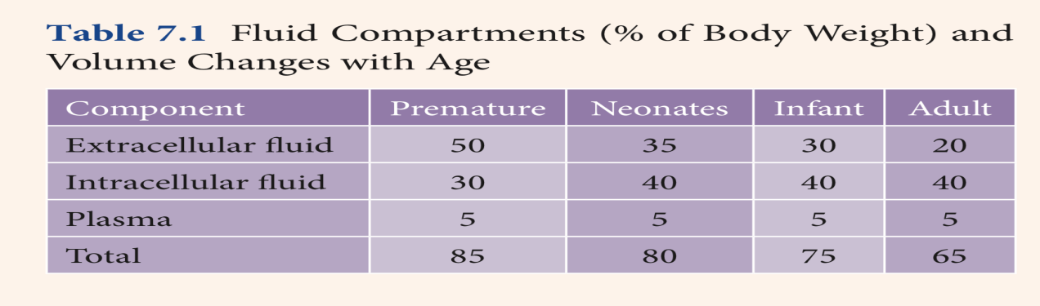
COMPOSITION OF BODY FLUIDS
About 50–80% of human body is composed of water, the content varying with type of tissue. Total body water (TBW) is 80% of body weight (BW) in preterm neonate and it is 60% of BW in children after 6 months of age.
Total body water decreases with age because of loss of water, mainly from ECF compartment.
ECF accounts for 1/3rd of TBW and is larger in children than adults. It is made up of 3 compartments (plasma, interstitial fluid and transcellular fluid). The ICF compartment represents 2/3rd of TBW [Figure 1]

Slide 4
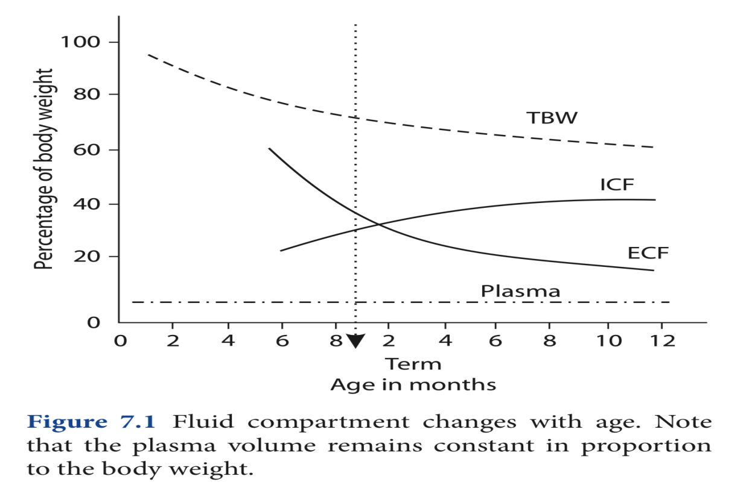
Total body water according to age

Slide 5
Incomplete development of the myocardium and immature sympathetic nervous system in young children and babies makes these children more sensitive to hypovolaemia.
Myocardial contractility, ventricular compliance and vascular tone are lower and less variable making tachycardia the primary compensatory mechanism during volume depletion. Cardiac output decreases when the limits of tachycardia are reached.
Anaesthetic ‘depression’ further accentuates hypovolaemia and may limit the compensatory sympathetic response and thus the tachycardia. Therefore, the maintenance of effective vascular volume (with replenishment of the ECF) is essential to maintain circulatory function and vital organ perfusion.

Slide 6
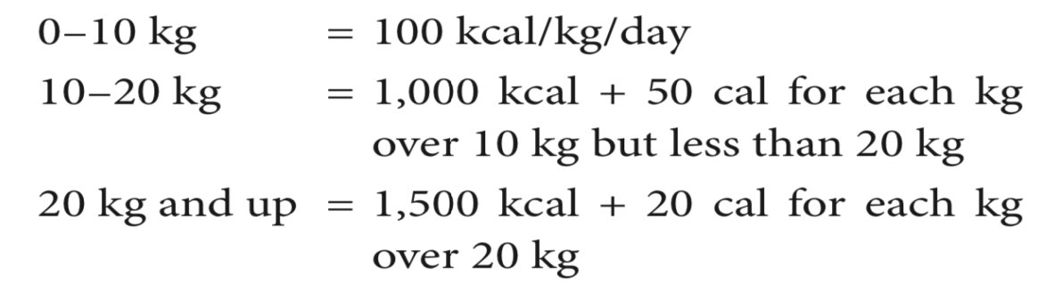
DETERMINING FLUID REQUIREMENTS
Howland in 1911 measured energy consumption in children and concluded that children under 1 year of age (3–10 kg) metabolise 100 kcal/day and older children 75 kcal/day, while adults metabolise only 35 kcal/day.
In 1957, Holliday and Segar reviewed data which correlated calorie requirements with basal metabolism and active energy needs. They concluded that infants in hospital required half their calories for basal metabolism and half for growth. In the infant, the growth requirement is more than that in the older child. Therefore, they suggested that the caloric requirement is

Slide 7
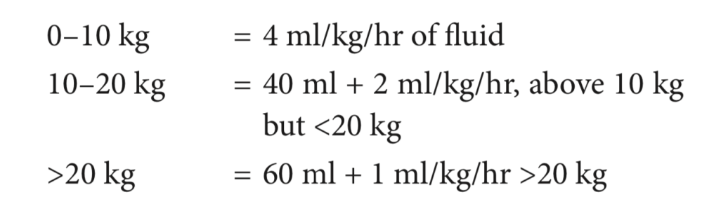
Metabolism of 1 calorie produces 0.2 ml of water and consumes 1.2 ml of water, so calorie and water consumption are considered equal. For example, a 1-year-old child weighing 10 kg requires 100 kcal/kg/day of energy and 100 ml/kg/day of water.
On transposing this calculation to an hourly basis:

Slide 8
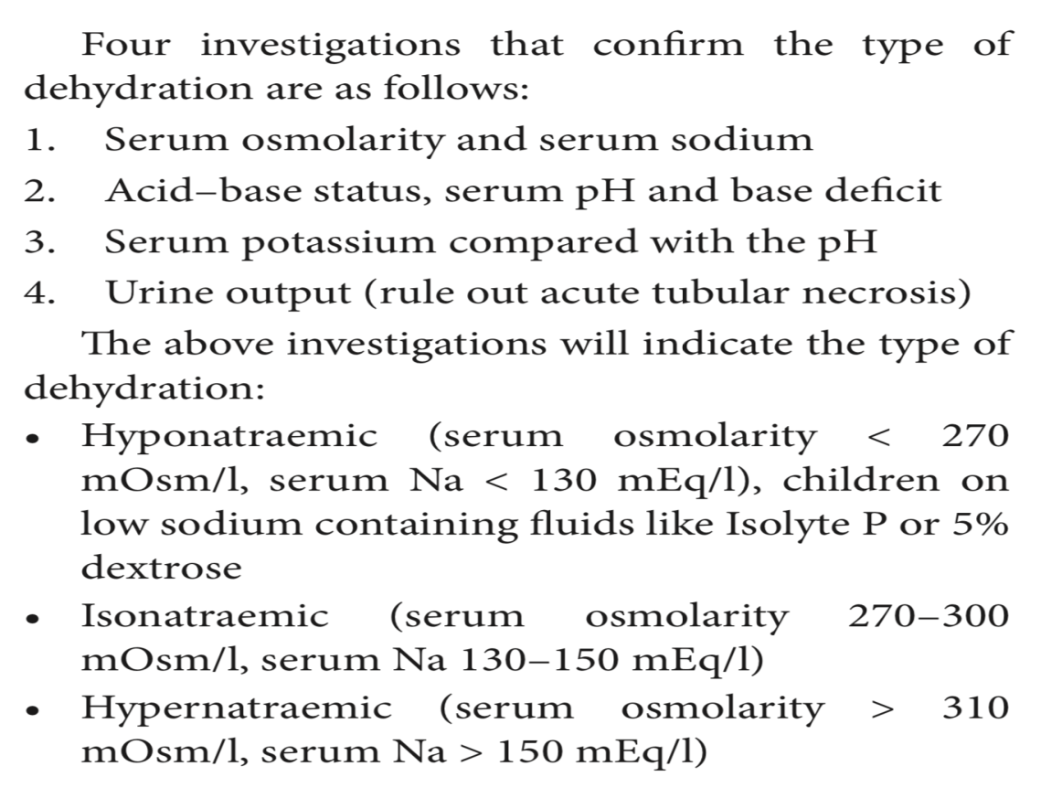
PRE-OPERATIVE ASSESSMENT AND PREPARATION FOR SURGERY

Slide 9
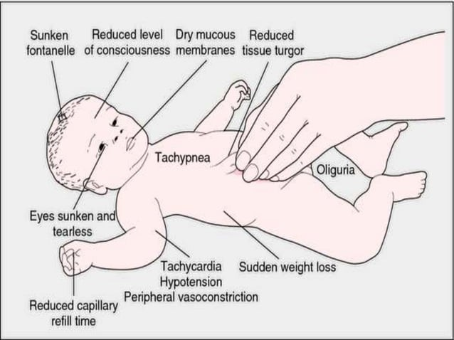

Slide 10
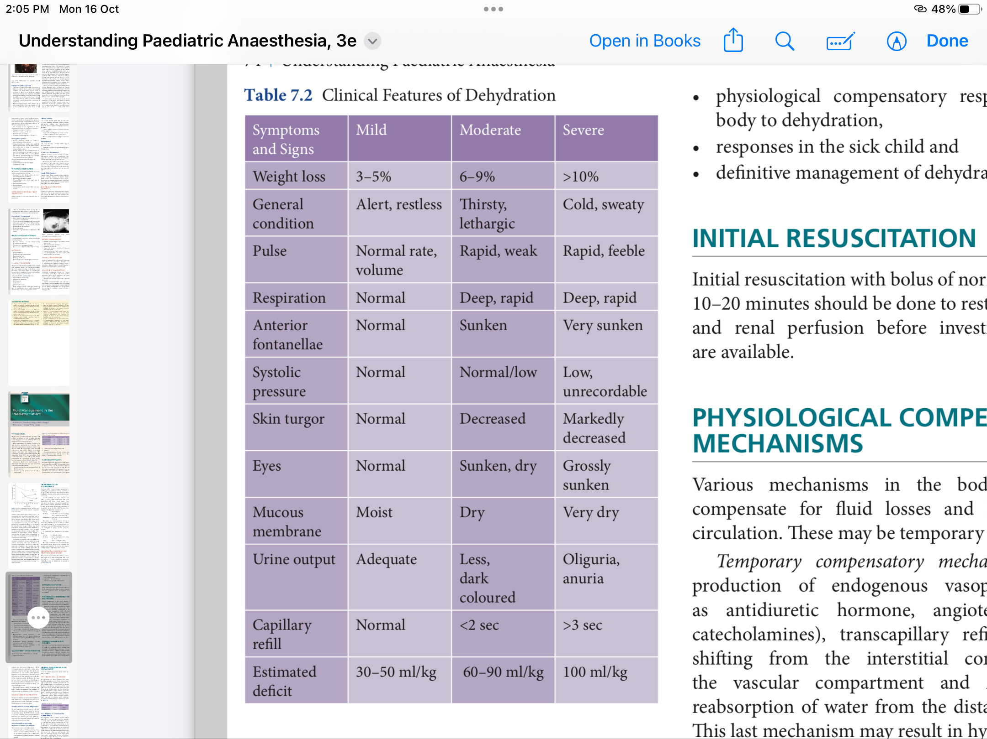

Slide 11
MANAGEMENT OF DEHYDRATION
In the management of dehydration, we consider
initial resuscitation
physiological compensatory responses by the body to dehydration:
Temporary compensatory mechanisms include production of endogenous vasopressors (such as antidiuretic hormone, angiotensin II and catecholamines), transcapillary refill with fluids.
definitive compensatory mechanisms are through the renal system.
responses in the sick child

Slide 12
Definitive management
Mild dehydration is managed by oral rehydration while moderate-to-severe dehydration is managed by administration of intravenous fluids.
Oral Rehydration for Mild Dehydration:
The WHO-UNICEF formula is a package containing glucose (20 g/l water) and three basic salts: NaCl (3.5 g/l water), KCl (1.5 g/l water) and either trisodium citrate (2.9 g/l water) or sodium bicarbonate (2.5 g/l water).

Slide 13
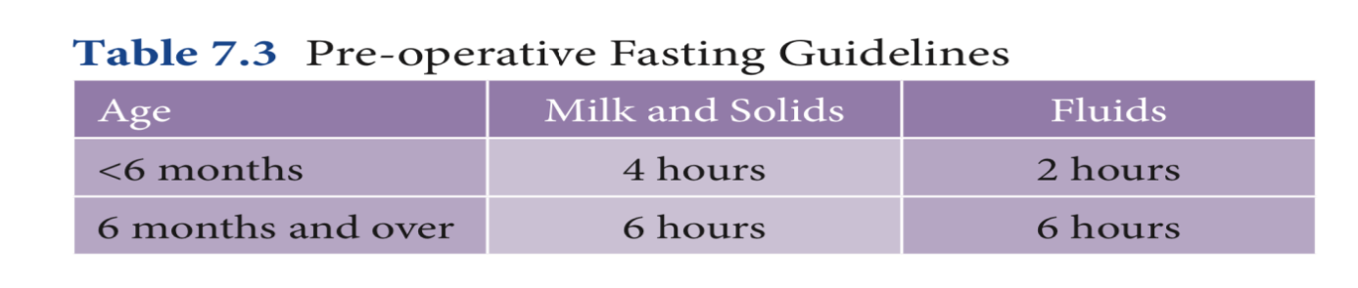
Correction of Fluid Deficits in Moderate-to-Severe Dehydration
This correction can be done in three phases:
Emergency phase: Initial resuscitation with a bolus of isotonic crystalloid 20–30 ml/kg over 10–20 minutes should restore circulation and renal perfusion even before laboratory tests are available
Repletion phase I: 25–50 ml/kg (or half the deficit) over 6–8 hours
Repletion phase II: Remainder of deficit over 24 hours

Slide 14
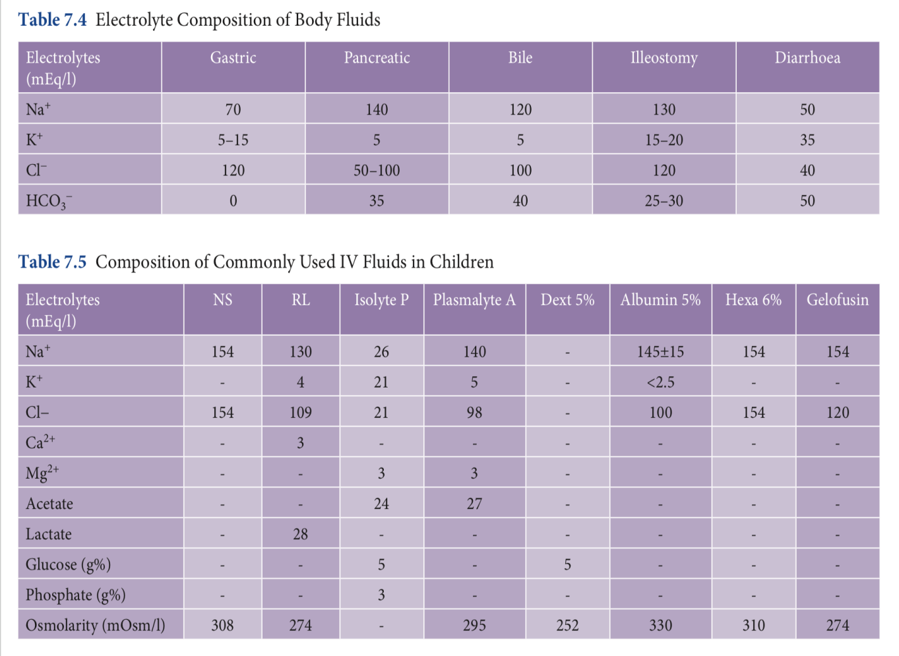

Slide 15
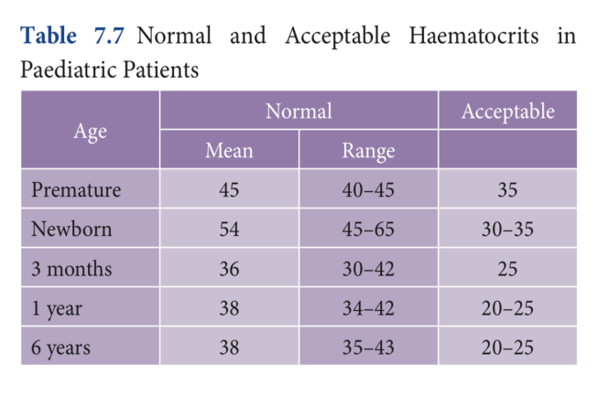
MONITORING FLUID LOSS AND REPLACEMENT
In general, routine monitoring (pulse oximetry, ECG, precordial stethoscope and non-invasive blood pressure monitoring) is sufficient for blood losses up to 15–20%.
If the blood loss is going to equal or exceed 20% of blood volume or if the blood loss is potentially uncontrollable, then consider using an intra-arterial line and central venous pressure line for monitoring of blood pressure, Hct, electrolytes and arterial blood gases. Urine output should also be measured.
HAEMATOCRITS

Slide 16
GLUCOSE
The addition of glucose to intraoperative resuscitation and maintenance fluids is not usually necessary, particularly if glucose containing clear fluids has been given up to 2 hours prior to surgery.
One percent glucose may be used in all children below 1 month and in those undergoing prolonged surgery.
In post-operative patients, who are nil by mouth, a fluid with 4–5% glucose will prevent hypoglycaemia and ketosis.

Slide 17
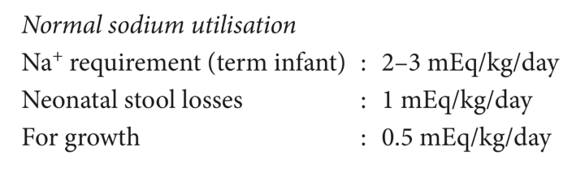
ELECTROLYTE IMBALANCE IN THE PERIOPERATIVE PERIOD
SODIUM
HYPONATREMIA(<130 mEq/l)
Hyponatraemia is the most frequent electrolyte disorder in the post-operative period. It is usually caused by the stress response of surgery and resultant ADH release.
Altered consciousness and seizures occur if Na is <120 mEq/l. (Beware of the drowsy patient.) Cardiac symptoms are seen if Na is <100 mEq/l.
Chronic hyponatremia-This condition is seen in patients on long-term diuretics with varying nutritional problems and such patients should be managed conservatively as rapid correction may cause an osmotic demyelination syndrome.

Slide 18
MANAGEMENT
The rate of correction should be rapid enough to reverse the manifestation of hypotonicity but, if corrected too rapidly, may lead to demyelination. Correction is by infusion of saline. (Infusate Na+ for 5% saline is 855 mEq/l, 3% saline is 513 mEq/l and 0.9% saline is 154 mEq/l.)
Change in serum Na = (Infusate Na – serum Na)/ TBW + 1 (TBW = BW × 0.6)
The above formula estimates the effect of 1 litre of any infusate on serum Na+. Half the deficit is corrected over 12–14 hours and the remaining deficit over next 1–3 days.
The Na+ level in serum is targeted at 125–130 mEq/l and its correction target should not exceed 8 mEq/l on any day.

Slide 19
Hypernatraemia (>160 mEq/l)
Hypernatraemia represents water deficit in relation to the body stores of Na+. It manifests as muscle weakness, hyperpnoea, restlessness, insomnia, lethargy and coma. Brain shrinkage can lead to cerebral haemorrhage.
Management:
Identify and control the underlying cause, that is, gastrointestinal losses or hyperglycaemia-induced diuresis.
Only in this case are hypotonic fluids preferred. These include 5% dextrose (infusate Na = 0), 0.45% NS (infusate Na = 77 mEq/l) and 0.2% NS in 5% dextrose (infusate Na = 34 mEq/l)
Rapid correction leads to cerebral oedema and convulsions. Hence, correction should not be more than 10 mEq/day.

Slide 20
POTASSIUM
The daily requirement of K+ is 2–4 mEq/kg/day.
Hypokalaemia (<3.5 mEq/l)
Clinical symptoms include lethargy, muscle weakness, ECG changes and ventricular arrhythmias. A decrease in 1 mEq itself is very significant.
Management
Correction is indicated when associated with cardiac arrhythmias. The rate of intravenous correction should not exceed 0.2–0.5 mEq/kg/hr and it is preferably administered through a central line. Deficits are calculated as follows:
K+ deficits (mEq/l) = Body weight × (Expected serum K+ observed serum K+) × 0.3
The ECG should be monitored during potassium correction and serum K+ levels should be measured at regular intervals.

Slide 21
Hyperkalaemia (>6 mEq/l)
Hyperkalaemia requires immediate treatment as it may be fatal. The most common causes include acute renal failure, metabolic acidosis (for every 0.1 unit decrease in serum pH, the serum K+ increases by 0.2–0.4 mEq/l), exogenous K+ administration, stored blood transfusions, extensive tissue necrosis and use of succinylcholine (increase serum K+ by 0.5–1 mEq/l).
Management
If ECG changes are present in a patient, Kcontaining fluids should be replaced with saline. Intravenous calcium chloride 10–20 mg/kg or calcium gluconate 60 mg/kg will stabilise the myocardium (antagonises the cardiac effects of potassium but does not correct hyperkalaemia). Correction of any metabolic acidosis with sodium bicarbonate will shift the potassium intracellularly. IV glucose-insulin (0.1 U/kg of insulin with 0.5 g/kg of glucose) will have a similar effect.
kayexalate, an ion exchange resin, may be given orally or rectally in a dose of 0.5–1 g/kg/dose. This will bind the potassium intraluminally. The onset of action takes several hours. If hyperkalaemia is not controlled, then dialysis is indicated.

Slide 22
REFERENCES
Understanding paediatric anaesthesia by Rebecca Jacob
Article on peri operative fluid therapy & intraoperative blood loss in childern in IJA
Sanjay Pandya

Slide 23
Thank you

