Slide 1
Monitoring in Anaesthesia

Slide 2
Monitoring is intended to measure and record deviations from normal values and warn of adverse events.
It is necessary to monitor both the patient and the anaesthesia delivery system.
Standards for basic anaesthetic monitoring have been established by the American Society Of Anaesthesiologist (ASA)
Standard 1 requires qualified personnel to be present in the operation room during general,regional anaesthesia and monitored anaesthesia care to monitor the patient continuously and to modify anaesthesia care based on clinical obversation and responses of the patient to dynamic changes resulting from surgery or drug therapy
Standard 2 focuses attention on continually evaluating the patient’s oxygenation,ventilation,circulation and temperature.

Slide 3
Monitoring
1)Clinical 2)Instrumental
1)Clinical Monitoring-
The experienced Anaesthetist will monitor-
a)Circulation-The pulse rate,rhythm and quality,vein filling,skin
elasticity,temperature and urine output.
b)Respiration-effort,pattern,tidal volume,frequency,reservoir bag movement.
c)Oxygenation-skin,mucous membrane and blood colour.
d)Depth of anaesthesia-pupillary signs,lacrimation,sweating,muscle movement.

Slide 4
2)Instrumental monitoring
a)Circulation- NIBP, ECG ,Pulse Oximetry, CVP, IBP, Pulmonary artery catheterization
b)Respiration- Capnography,Lung Volumes,Blood gas analysis and pressure monitor
c)Neuromuscular- Neuromuscular junction monitoring
d)Temperature Monitoring
e)Monitoring depth of anaesthesia and EEG
f)Monitoring Blood loss

Slide 5
Circulation
1)NIBP
Measures blood pressure at set intervals automatically by automated oscillometry.Oscillometry uses a single cuff which allows the process to be automated using microprocessor technology.Automated controlled hydraulics allow the cuff to be inflated above the systolic pressure and then deflated in a stepwise pattern.On deflation of the cuff,arterial pulsations are detected by the cuff as the systolic value is reached.As mean pressure is reached,these pulsations reach max amplitude.At diastolic pressure these pulsations diminish and disappear.
These signals are digitized and electronically processed to display systolic ,mean and diastolic pressure.
Dimensions of the cuff are imp in determining the accuracy of measurement.

Slide 6
Recommended cuff widths are-
Neonate 2.5cm
1-4 years-6cm
4-8 years-9cm
Adult 12-14cm
(15cm for adult leg)

Slide 7
ECG
The ECG is a noninvasive monitor of cardiac rate and rhythm and especially of unexpected cardiac events.
It also monitors R-R interval variability,which is a useful index of autonomic activity.
The ECG is a surface reflection of the depolarizing and repolarizing electrical activity of various parts of heart.
For routine operating room monitoring,three electrodes are placed on the chest,as near to the heart as convenient to increase the signal to noise ratio.
Conductive gel lowers the skins electrical resistance,which can be further decreased by cleansing the site with alcohol.

Slide 8
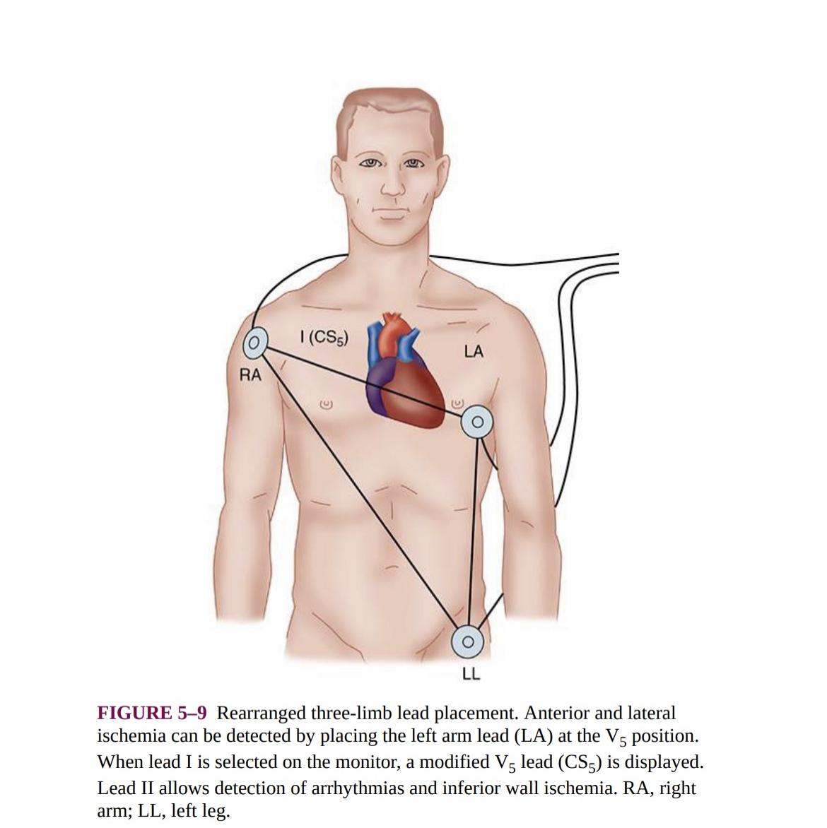

Slide 9
Pulse Oximeter
It’s a device to monitor oxygenation.
Oxygen saturation is determined by spectrophotometry which is based on beer lambert law.At a constant light intensity and a Hb concentration,the intensity of light transmitted through a tissue is logarithmic function of o2 saturation of Hb.
The pulse oximeter probe consist of light source on one side,capable of delivering both red and infrared light and a photodetector on other side.The probe is placed either on a digit or earlobe.
The light source emits alternating red and infrared light separated by a time gap at a frequency of 400Hz.The wavelengths used are 600nm and 940nm,these being wavelengths on the absorbtion spectra of reduced and oxygenated haemoglobin are, respectively,widely separated and nearly equal.
This allows the device to take account of the total amount of haemoglobin present as well as the proportion of the oxygenated haemoglobin present.
The software contains a calibration curve which calculates arterial oxygen saturation from the data.

Slide 10
Sources of error in pulse oximetry
A poorly fitting probe
Poor pulsatile arterial flow(vasoconstriction)
Pulsatile venous flow(TR)
Electrical or mechanical interference
Presence of other Hb variants like Carboxyhaemoglobin,Methhaemoglobin or Sulphaemoglobin
Dyes and nail polish

Slide 11
CVP
Central venous catheterization is indicated for monitoring CVP or central venous pressure.
Indications of central venous catheterization include-
a)Monitoring CVP
b)Administration of fluid to treat hypovolemia and shock
c)Infusion of drugs and Total parenteral nutrition
d)Aspiration of air emboli
e)Gaining venous access in patients with poor peripheral veins

Slide 12
Central venous cannulation includes introducing a catheter into a vein so that the catheters tip lies with a venous system within the thorax.Generally the optimum location of the catheter tip is just superior to or at junction of SVC and RA.When the catheter tip is located within the thorax,inspiration will decrease or increase CVP.
Measurement of CVP is made with the water column or an electronic transducer.
The pressure should be measured during end expiration.
Problems with CVP measurement are-
a)The catheter is too short and does not reach the thoracic cavity
b)The catheter is too long and therefore in the right ventricle,where it may cause arrhythmia.
c)Catheter is being used to deliver fluids
d)Compression of intrathoracic veins by IPPV especially if PEEP is applied.

Slide 13
Invasive BP
Direct measurement of BP using an arterial cannula allows a continuous real time arterial wave form to be obtained. It is potentially the most accurate method and indicated in following circumstances-
a)Critically ill patients
b)Where cvs system may be compromised
c)In patients who require physiological or pharmacological manipulation of BP eg cardiopulmonary bypass or hypotensive anaesthesia
d)As a convenient means for analyzing blood gases

Slide 14
The radial artery is usually cannulated using a 20g or 22g cannula connected to a transducer system.Other choices include brachial and dorsalis pedis artery.
A fluid filled catheter connects the arterial cannula to the transducer and a means of processing and displaying the resulting electronic signal.
The pressure transducer consist of a diaphragm separating the catheter connecting system from the electronic measuring system.The diaphragm usually contains four strain gauges,which transduce the mechanical movement of diaphragm into electrical signals
Complications include-
Haematoma
Bleeding
Vasospasm
Arterial thrombosis
Embolization

Slide 15
Pulmonary Artery Catheterization
When more precise knowledge of Left ventricular function is needed,a pulmonary artery catheter may be used,introduced via a central vein usually the jugular vein.
The catheter is advanced through the right ventricle and into the pulmonary artery wedging the tip of the catheter and measuring the mean pressure can give an estimate of left arterial pressure.
PA catheter allows more precise estimation of left ventricular preload than CVP pr physical examination

Slide 16
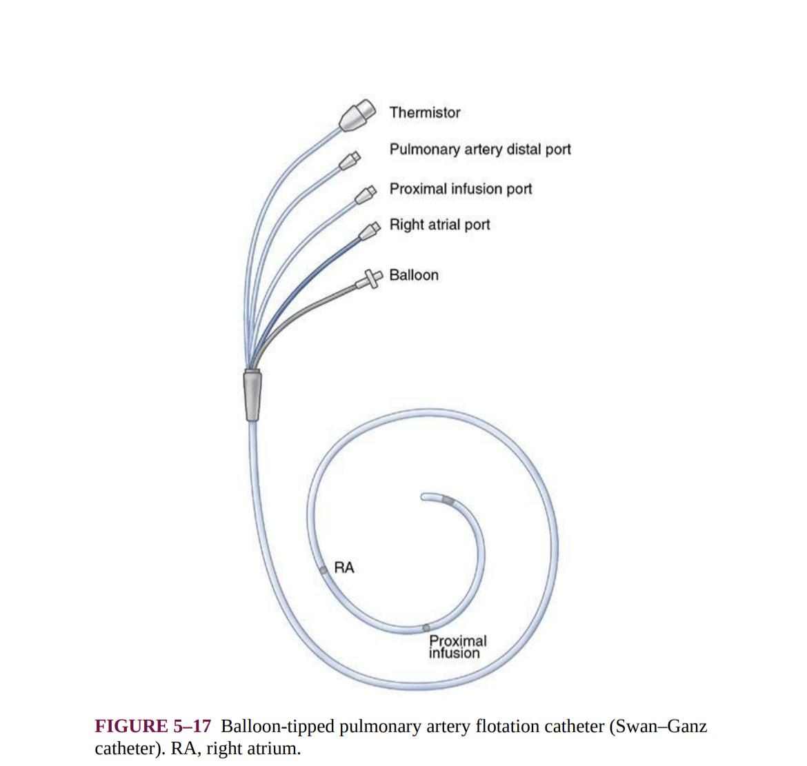

Slide 17
Complications
Arrhythmia
Damage to PA,lung tissue and right ventricle
Infection and thromboembolism
Obstruction of venous return during bypass
Balloon rupture,knotting or migration of Catheter

Slide 18
Respiration
Capnography
Determination of end tidal co2 concentration to confirm adequate ventilation is mandatory during all anaesthetic procedures particularly for GA.
Increases in alveolar dead space ventilation(eg pulmonary thromboembolism,venous air embolism,decreased pulmonary perfusion) produce a decrease in ETCO2 compared with arterial CO2.
Capnography rely on the absorbtion of infrared light by CO2.As with the oximetry,absorbtion of infrared light by CO2 is governed by beer lamberts law.
Capnographs rapidly and reliably detect esophageal intubation but do not reliably detect mainstem bronchial intubation.
Sudden cessation of CO2 during the expiratory phase may indicate circuit disconnection.
The increased metabolic rate caused by malignant hyperthermia causes marked rise in ETCO2

Slide 19
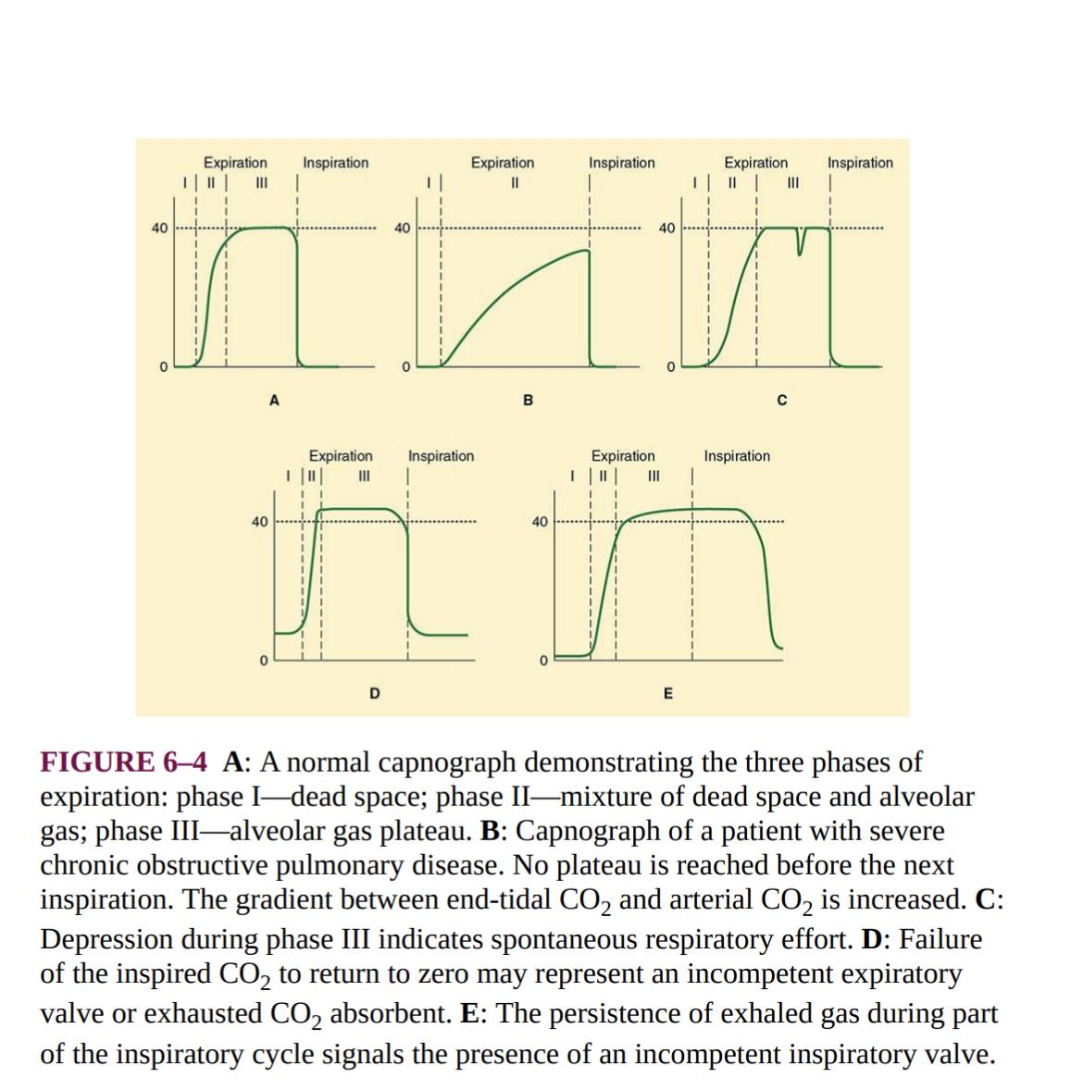

Slide 20
Anaesthetic gas analysis and pressure monitor
Analysis of anaesthetic gases is essential during any procedure requiring inhalational anaesthesia. These devices are all based on beer lamberts law, which provides a formula for measuring an unknown gas within inspired gas because the absorbtion of infrared light passing through a solvent is proportional to the amount of unknown gas.Oxygen and Nitrogen do not absorb infrared light.
Because o2 molecules do not absorb infrared light,their concentration cannot be measured with monitors that rely on infrared technology. These are-
a)Galvanic cell-These contain lead anode and gold cathode bathed in KCl.At the gold terminal hydroxyl ions are formed that react with the lead electrode to produce lead oxide causing current which is proportional to the amount of o2 being measured

Slide 21
Paramagnetic analysis-Oxygen is a non polar gas,but is a paramagnetic and when placed in a magnetic field,the gas will expand,contracting when the magnet is turned off.By switching the field on and off and comparing the resulting change in volume to a known standard,the amount of o2 can be measured.
Polographic Electrode-A polographic electrode has a gold cathode and a silver anode both bathed in an electrolyte separated from a gas to be measured by a semipermeable membrane.When voltage is applied to the cathode,electrons combine with o2 to form hydroxide ion.The amount of current that flows between the anode and cathode is proportional to the amount of o2 present
Spirometry and pressure measurements-Contemporary anaesthesia machines measure airway pressure,volume and flow to calculate resistance and compliance.Measurements of flow and volume are made by the mechanical devices often placed in the inspiratory limb of anaesthesia circuits.Spirometric loops are usually displayed as flow versus volume and volume versus pressure.If a normal loop is observed shortly after induction and subsequent loop is different,the observant is alerted to the fact that pulomonary or airway compliance may be changed.

Slide 22
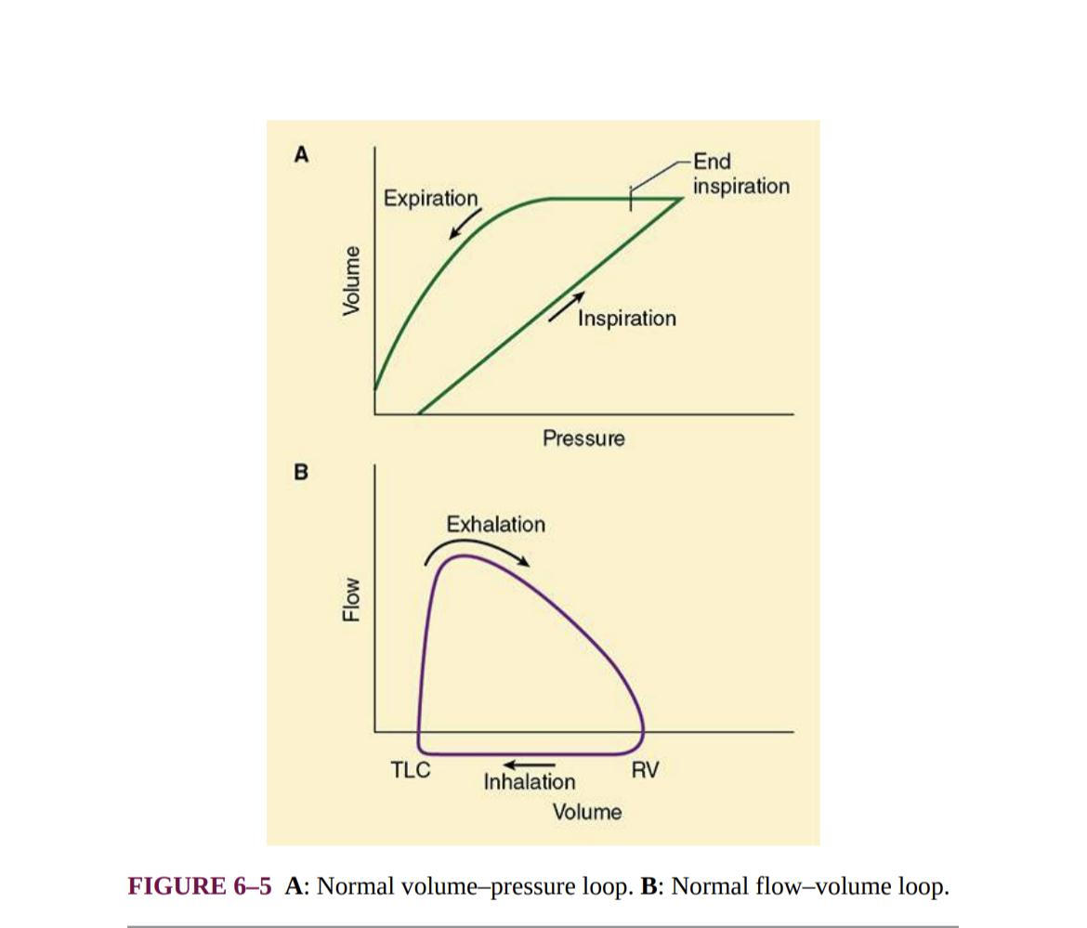

Slide 23
Blood gas analysis-A heparinized blood sample,100-300uL is passed through 4 electrodes simultaneously.Partial pressure of blood o2 is measured using a clarkr electrode.CO2 using a severinghaus electrode and a ph with a conventional glass electrode.The fourth is a reference electrode.The sample is taken from an artery.
A blood gas analyzer frequently measures hb concentration and biochemical parameters such as o2 saturation and content,bicarbonate,base excess and total co2.

Slide 24
Neuromuscular
Neuromuscular junction monitoring-
A supramaximal electrical stimulus of between 10mA and 50mA is applied to an accessible peripheral motor nerve eg Ulnar nerve and the response of the appropriate muscle group is assessed.The stimulus may be delivered as a single stimulus,a train of four stimuli at 2hz,a tetanic stimuli at 50hz or a double burst stimuli which is two 40ms tetanic burst 750ms apart.The stimulus has a square waveform of width 0.2ms.The nerve stimulator must have a constant current output.
Assessment of the responding muscle group is usually visual(eg levator palpebrae superioris in case of facial nerve or abductor pollicis longus in case of ulnar nerve)
Electromyographic assessment is now more commonly available.

Slide 25
Temperature monitoring
Perioperative hypothermia predisposes patient to increases in metabolic rate(shivering) and cardiac work,decreases in drug metabolism and cutaneous blood flow and created impairment of coagulation.Anaesthetist frequently monitor temp and attempt to maintain central core temperature at near normal values in all patients undergoing anaesthesia.
Central core temperature can be estimated using probes that can be placed into the bladder,distal esophagus,ear canal,trachea,nasopharynx or rectum.
Pulomary artery blood temperature is also a good estimate of central core temp
Mean body temp is 0.85Tcore + 0.15Tskin
Formerly temp was measured using a glass thermometer containing either mercury or alcohol.
A thermistor is a semiconductor device whose electrical resistance changes with temperature and is basis of nasopharyngeal temp probe

Slide 26
The infrared tympanic thermometer consist of a thermopile,a series of thermocouples that detect the infrared radiation from the tympanic membrane.The thermopile generates a potential difference proportional to a tympanic membrane temperature.

Slide 27
Monitoring depth of anaesthesia and EEG
Electroencephalography is a surface recording of cortical neuronal activity and is made up of frequencies upto around 40hz commonly divided into 4 frequency bands.
Delta<4Hz,Gamma(4-7Hz),Alpha(8-13Hz)and Beta (13-40Hz)
More recently EEG monitoring has begun to gain acceptance as a mean of estimating depth of anaesthesia.
The 2 most commonly used processed signal monitors are Bispectral index and Sedline.
Both devices display a unitless number in a range of 0-100,which is derived from the measured EEG data by the device’s algorithm. A value of 100 corresponds to the EEG activity seen in fully awake and alert individual.
The algorithms used in the devices specify a differing optimal range for general anaesthesia For BIS-40-60 and for Sedline25-50.

Slide 28
Dissociative iv agents such as ketamine can actively confound processed eeg monitors through paradoxical cortical excitation,the monitor tends to misread the increased cortical activity as a sign of lessened anaesthesia.Propofol and remifentanil are often used for Tiva but processed EEG monitors can be insensitive to the administration of even high doses of opioids.
The Bispectral index monitors examine four components within the EEG that are associated with the anaesthetic state
1)Low freq as found during deep anaesthesia
2)High freq beta activation during light anaesthesia
3)Supressed EEG waves
4)Burst suppression
The BIS is derived from the weighed sum of three EEG parameters-relative alpha/beta ratio,biocoherance of the EEG waves and burst suppression.The relative contribution of these parameters correlate with the degree of sedation produced.
It ranges from 0-100

Slide 29
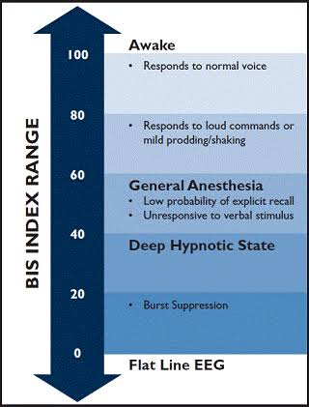

Slide 30
Monitoring Blood Loss
The estimation of blood loss is done by weighing blood soaked swabs,sponges and estimation of blood loss in suction bottle.
Estimated blood volume is calculated by following formula- Wt in Kg into average blood volume (ml/kg)
Average blood volumes-
Premature neonates 95ml/kg
Full term neonates 85ml/kg
Infants 80ml/kg
Adult men 75ml/kg
Adult woman 65ml/kg

Slide 31
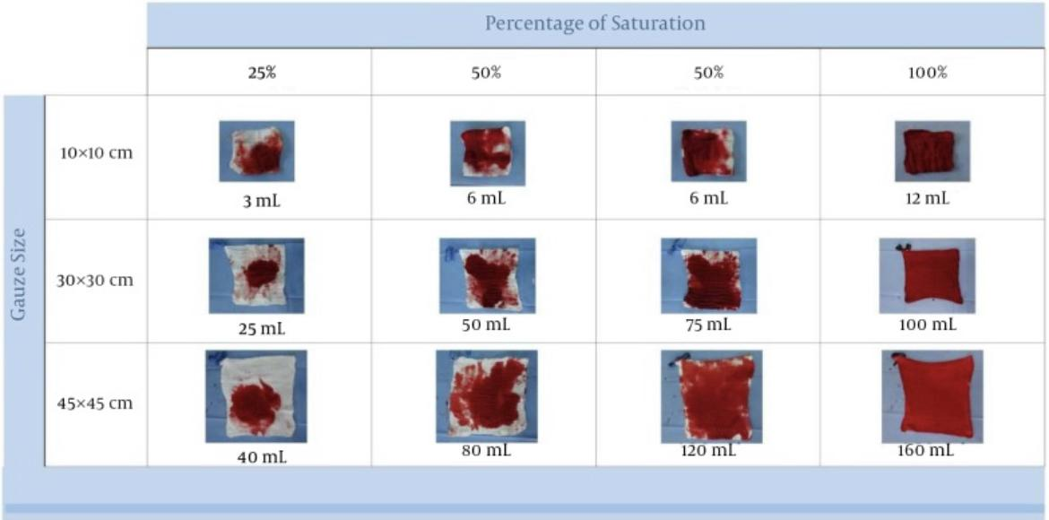
Allowable blood loss = (EBV into (Hi-Hf) divided by Hi
Where Hi is initial hemoglobin and Hf is final hemoglobin

Slide 32
THANK YOU

