Slide 1
- Describe and discuss the genetics of alpha 1 antitrypsin deficiency in emphysema
- Describe the role of the environment in the cause and exacerbation of obstructive airway disease
DR .ARTI D SHAH
DEPARTMENT OF RESPIRATORY MEDICINE

Slide 2
TOPICS
RISK FACTOR
PATHOPHYSIOLOGY
SYSTEMIC MANIFESTATION AND CO -MORBIDITIES

Slide 3
COPD is a disease characterised by persistent air flow limitation that is usually progressive and associated with an enchanced chronic inflammatory response in the airway and the lung to noxious particles or gases

Slide 4
It is chronic
Progressive
Fixed airway obstruction
Non reversible by bronchodilators
Exposure to noxious agent
Two entities in COPD – namely
(1) Chronic bronchitis
(2) Emphysema

Slide 5
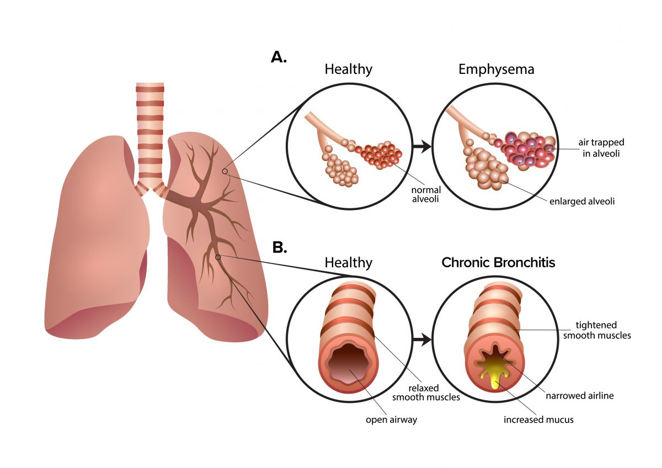

Slide 6
CAUSES
Smoking
Occupational exposure – coal mining ,gold mining , cotton textile industry and chemicals – cadmium , isocyaniates , fumes of welding
Air pollution
Sudden airway constriction inresponse to inhaled irritants
Low socioeconomic status (houshold allergens and deficient medical care )

Slide 7
(6) Genetics – mutation in TNS1 , FAM 13A , HTR4 , AGER THSD4

Slide 8
PATHOPHYSIOLOGY
Abnormal inflamatory response of the lung due to toxic gases
Response occurs in the airways parenchyma and pulmonary vasculature
Narrowing of the airways take place
Destruction of parenchyma leads to emphysema

Slide 9
Destruction of lung parenchyma leads to an imbalance of proteinsases /antiproteinases (this protienases inhibitors prevent the destructive process )
Pulmonary vascular changes
Thickening of vessels
Collagen deposits

Slide 10
Destruction of capillary
Mucus hypersecretion (cilia dysfunction airflow limitation ,corpulmonale (RVF)
Chronic cough and sputum production

Slide 11
Alveoli adjacent to the bronchioles may become damage and fibrosed
Alter function of alveolar macrophages
Infection

Slide 12
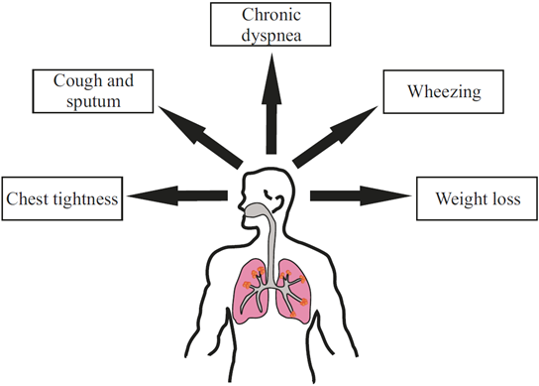
Symptoms

Slide 13
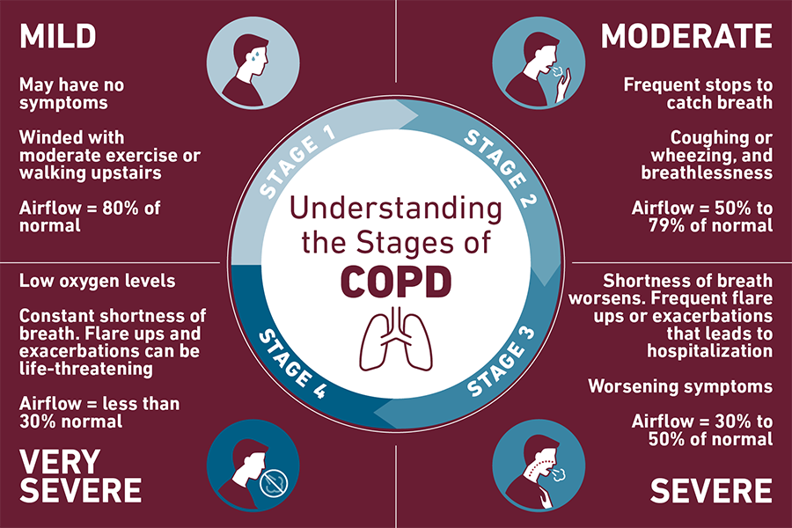

Slide 14
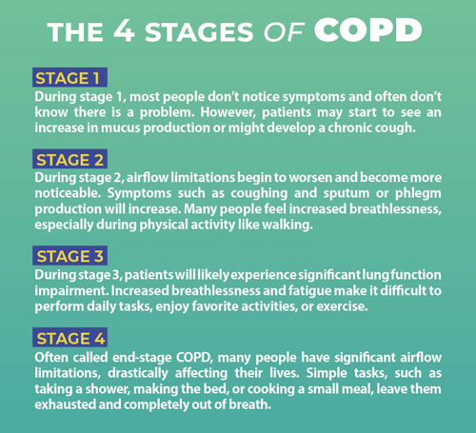

Slide 15
EMPHYSEMA
It is characterized by abnormal permanent enlargement of air spaces distal to the terminal bronchiole accompanied by destruction of the walls and without obivious fibrosis
Changes in
Inflamatory cell recruitment
Proteinase –antiproteinase imbalance
Oxidant –antioxidant imbalance
Humoral and cellular immunity

Slide 16
Proteinase &antiproteinase hypothesis
There is constant or episodic release of proteinase at neutral PH into lung parenchyma
Proteinase come primarily from inflammatory cells
Proteinase inhibitors –alpha 1 –AT prevent proteinase from digesting structural protein of lung
Imbalance may result into emphysema

Slide 17
ALPHA 1 ANTITRYPSIN DEFICIENCY
Alpha 1 AT is glycoprotein of 52 kDA from hepatocytes
Alpha 1 AT present on Chromosome14
Alpha 1 AT deficiency leads to COPD
Mostly in adults or younger age
c/f wheezing , coughing and sputum
Main finding – radiological approch

Slide 18
Clinical assesment of alpha 1 –AT status
Early onset COPD (AGE OF 45 yr or less )
Early onset emphysema (45)
Emphysema in absence of risk factors
Asthma with airflow obstruction (irreversible)
Bronchiactesis without etiology
Family history of emphysema

Slide 19
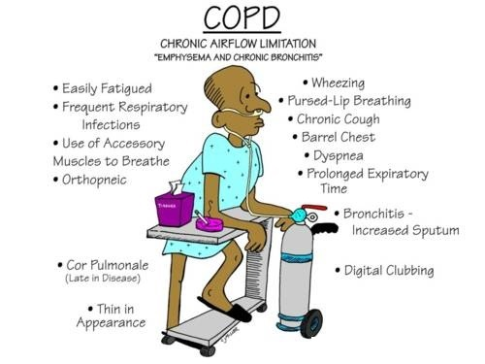
SUMMARY

Slide 21
Prevalence and characteristics of chronic obstructive pulmonary disease in non-smokers
TYPE OF STUDY | METHOD | RESULTS | CONCLUSION
TYPE 1 | 512 patients older than 40 years with COPD from Primary Care Centre with a spirometry FEV₁/FVC ratio <0.7) to the beginning of the STUDY. The dependent variable was de COPD in non-smokers and the independents were variables collected from the information on the respiratory clinical history, the risk factors of the patients and on quality of life. | 33.2% of COPD patients had never been smokers, 59.4% of whom were women. The average FEV₁ for non-smokers was 70.5 ,higher than 62.6 for smokers/former smokers. The coverage of pneumococcal vaccination 23V was better in non-smokers (75.3%). COPD in non-smokers (compared to smokers/former smokers) were: mostly women , older, with better FEV₁ , better perception of quality, EuroQoL-5D , with lower prevalence of diabetes, lower level of studies , and with fewer previous hospitalizations | The study evidences a high proportion of non-smokers in COPD patients. Our study aims that older women with less severity would be associated with an increased risk of COPD in non-smokers. It seems to indicate that COPD in non-smokers would appear at later ages and would be milder than smoking-related COPD

Slide 22
REFERENCE – FISHMAN 4 th edition

Slide 23
