Slide 1
Pre-anaesthetic Medication

Slide 2
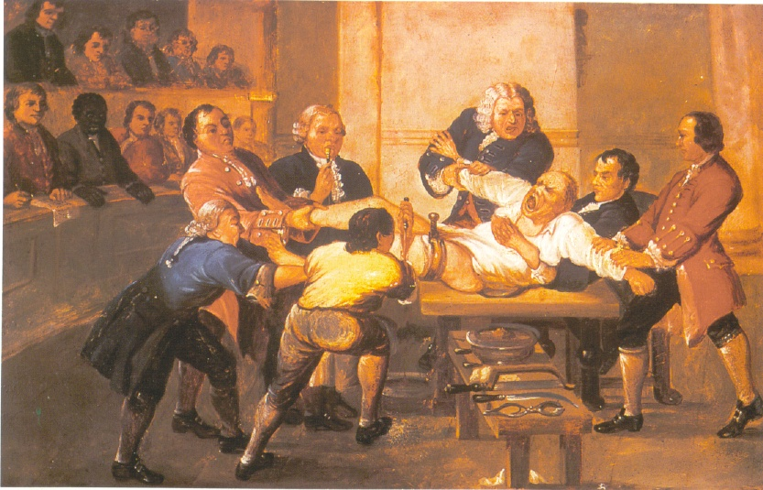

Slide 3
Anaesthesia
    Loss of sensation

Slide 4
General Anaesthetics
General anaesthetics are the drugs used to produce general anaesthesia resulting in loss of all modalities of sensation, particularly pain, alongwith controlled reversible loss of consciousness, adequate muscular relaxation and loss of reflex activity to carry out operative procedures safely on a patient

Slide 5

The goal of general anesthesia is to create a reversible condition of comfort, quiescence, and physiological stability before, during, and after a surgical procedure

Slide 6
Local Anaesthetics
Local anaesthetics as distinguished from general anaesthetics as they abolish the pain and other sensations in localized areas without affecting the degree of consciousness of the patient

Slide 7
Anaesthesia requirements
loss of all modalities of sensation, particularly pain
controlled reversible loss of consciousness
adequate muscular relaxation
loss of reflex activity
GAs are not safer drugs
(resp & cardiac depression)

Slide 8
Definition –
Pre-anaesthetic Medication
Use of the drugs prior to the administration of a general anaesthetic agent, with the important object of making anaesthesia safer & more agreeable to the patient

Slide 9
Ideally, drugs used for premedication should be: 1)
easily administered at a small volume; 2) have a reliable
onset and duration of action with dose-dependent desirable
effects; 3) have analgesic actions; 4) have minimal to no
local or systemic toxicity; 5) have no adverse physiologic
effects; and 6) be reversible.
Anesthesia Premedication
Anesthesia Module 3 / Dr. Khursheed Mama

Slide 10
OBJECTIVES
Pre-anaesthetic Medication
Sedation - anxiety & apprehension
Relief of Pre-operative & Post-operative Pain
Inhibition of Parasympathetic NS:
(i) To decrease salivary & bronchial secretions
prevent reflex laryngospasm
(ii) To prevent cardiac arrest due to
vagal stimulation (Halothane)

Slide 11
OBJECTIVES
Pre-anaesthetic Medication…
d. Synergic effect with GAs smooth & rapid induction with reduced GA dose
e. Anti-emetic effect
f. To decrease gastric acid secretion
g. To counteract certain adverse effects of the anaesthetic agents

Slide 12
OBJECTIVES
Pre-anaesthetic Medication…
No drug can achieve all these objectives
combination of drugs used
Premedicating the patient with the proper drugs should be a routine procedure before a general anesthetic is administered. Adequate sedation prior to anesthesia will not only relax the patient for the particular procedure, but will make him more receptive to future anesthetics.
Premedication Prior to General Anesthesia ,Stanford Stark, D.D.S.

Slide 13
Drugs used to achieve these objectives
Sedatives / Anxiolytics
Opioid Analgesics
Anticholinergic Drugs
Antiemetics
Other Drugs
Reference-oxford handbook of anaesthesia

Slide 14
CLASSIFICATION –
Pre-anaesthetic Medication
Sedatives / Anxiolytics
    Benzodiazepines
    Barbiturates
    Butyrophenones
    Phenothiazines
    Chloral hydrate & Paraldehyde
Opioid Analgesics
    Morphine
    Pethidine
    Buprenorphine

Slide 15
CLASSIFICATION –
Pre-anaesthetic Medication
Anticholinergic Drugs
      Atropine SO₄
      Scopolamine (Hyoscine)
      Synthetic Anticholinergics – Glycopyrrolate
Antiemetics
      Phenothiazins (Promethazine and Trimeprazine)
      Cyclizine
      Trimethobenzamide
      Benzquinamide
      Metoclopramide

Slide 16
CLASSIFICATION –
Pre-anaesthetic Medication
Other Drugs
    Antibiotics
    H₂ Receptor Antagonists, Gastric Antacids & Omeprazole
    Other drugs for special problems

Slide 17
Sedatives / Anxiolytics
…. anxiety & apprehension
Benzodiazepines
Barbiturates
Butyrophenones
Phenothiazines
Chloral hydrate & Paraldehyde
Notes:
Pt is naturally apprehensive as is undergoing surgery; fear of pain, fear of life, fear of results / outcomes / complications etc. This anxiety can definitely reduced by explanation, sympathetic discussion with the pt about the coming events itself have a high therapeutic value. It is kind to reduce his/her anxiety by explanation, reassurance & with drugs.
As we know that apprehension/anxiety lead to discharge of adrenaline from the suprarenal medulla and increase metabolic rate which results in more difficulty in anesthetising the pt and increase chances of dysrythmias.

Slide 18
Sedatives / Anxiolytics
…. anxiety & apprehension
Benzodiazepines
    Most widely used
    Safety, muscle relaxant & less respiratory depression & amnesic effect
    Useful for pt as well for the facilitation of anesthetic state
    Diazepam Most widely used – 5 to 10mg orally or parenterally
    Nitrazepam, Lorazepam, Midazolam

Slide 19
Sedatives / Anxiolytics
…. anxiety & apprehension
Phenothiazines
    Antipsychotic drugs
    Possess sedative, antiarrhythmic, antiemetic & antihistaminic properties
    MOA: blockade of D₂ receptors, other effects (blockade of alpha adrenoceptors, hitaminic (H₁) & 5-HT₂ receptors)
    Adverse effects: Potentiate the effects of barbiturates & morphine ➔ respiratory depression & arterial hypotension
    Promethazine & trimeprazine (H₁antagonists) are commonly employed

Slide 20
Sedatives / Anxiolytics
…. anxiety & apprehension
Butyrophenones
    Antipsychotic drugs
    Droperidol & Haloperidol
    Similar actions like phenothiazine
    Barbiturates
      Low Therapeutic Index
      Potent Enzyme Inducers : Drug Interactions
      Risk of Physical Dependence
      Severe withdrawal Syndrome

Slide 21
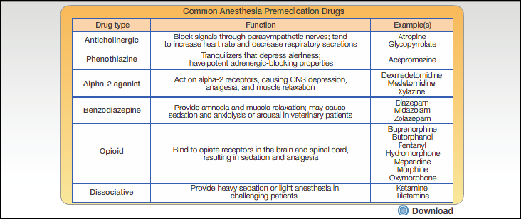
Anesthesia Premedication
Anesthesia Module 3 / Dr. Khursheed Mama

Slide 22
MIDAZOLAM
It is a benzodizapine
Has anxiolytic,amnestic,hypotonic,
ant convulsant,skeletal muscle relaxant and sedative property
Flumezenil is an antidot so it is more safer
Comes in 10 ml vial containing 1mg/cc
Oral midazolam has been considered the gold standard for premedication in children. In a study conducted in US, more than 80% of anesthesiologists preferred midazolam as a premedication It has many desirable properties such as early onset and better level of sedation with no delay in recovery. Although it has a number of beneficial effects, midazolam is far from an ideal premedication, especially with regards to confusion, long-term behavioral changes, and respiratory depression. Department of Anaesthesia and Critical Care, JPNA Trauma Centre, All India Institute of Medical Sciences, New Delhi, India
ORIGINAL ARTICLE Year : 2012 | Volume : 28 | Issue : 1 | Page : 32-35

Slide 23
Opioid Analgesics-
Relief of Pre-operative & Post-operative Pain
Commonly employed drugs
tramadol hydrochloride is commonly used drug in todays setup.
Others are-
    Morphine (10 – 15mg IM)
    Pethidine (50 – 100mg IM)
    Buprenorphine (0.3mg IM)

Slide 24

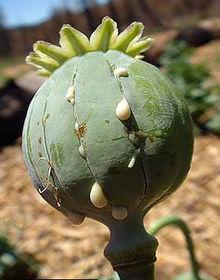

Slide 25
Opioid Analgesics-
Relief of Pre-operative & Post-operative Pain
Have sedative & analgesic properties
Buprenorphine has longer DOA than Morphine & Pethidine
⬇ the amount of GA required
Needed whenever there is existing pain or as an supplement to an anesthetic agent
Can be given before or at end of operation – without waiting for the pt to complain of pain
Opoids creduce the required dose of anaesthetic agent and improve patient comfort in the immediate postoperative period. also cause variable sedation and cardiorespiratory depression. All opioids cause nausea and vomiting and this may outweigh any beneficial effects. Opioids may also precipitate bronchospasm or anaphylaxis
Steeds C, Orme R; Premedication. Anaesthesia and intensive care medicine; Volume 7, Issue 11, Pages 393-396 (November 2006).

Slide 26
Opioid Analgesics-
Relief of Pre-operative & Post-operative Pain
Disadvantages
  Depress respiration ➔ resp arrest
  Morphine the tone of smooth muscle such as bronchial muscles ➔ worsen the condition of pt having pulmonary insufficiency (emphysema , kyphoscoliosis)
  Cause vasomotor depression, they ⬇ the ability of circulation to respond to stress, often delays awakening

Slide 27
Opioid Analgesics-
Relief of Pre-operative & Post-operative Pain
Disadvantages
  Morphine – induces vomiting & has an antidiueretic effect
  Morphine – interfere with pupillary reactions, stages of anesthesia cannot be distinguished
  Pethidine – produce tachycardia by its vagolytic action
  Morphine & Pethidine are histamine liberators

Slide 28
TRAMADOL HYDROCHLORIDE
It is an opioid analgesic used to treat moderate to severe pain
It is weak u opioid receptor agonist,seretonin releasing agent,norepinephrin reuptake inhibitor,5ht2 receptor antagonist.
It is commonly used in 2ml amp.
Which contains 50mg/cc trmadol
Tramadol is associated with drug dependence if used for long period

Slide 29
Anticholinergic Drugs-
Inhibition of Parasympathetic NS
Bronchial & salivary secretions can collect in the lungs and can predispose the pt infection & reflex laryngospasm
Atropine SO₄ - an hr before operation (I/V or I/M-0.6 mg)
Scopolamine (Hyoscine) - generally combined with morphine to block the vagal actions

Slide 30
Anticholinergic Drugs-
Inhibition of Parasympathetic NS
⬇ salivary & resp secretions and also prevent reflex parasympathetically induced hypotension, bradycardia, reflex laryngospasm and even cardiac arrest (Lessen the possibility of cardiac arrhythmias during the induction stage)
due to blockade of cardiac vagal action tachycardia

Slide 31
Anticholinergic Drugs-
Inhibition of Parasympathetic NS
Synthetic Anticholinergics – Glycopyrrolate
Long acting quaternary amine
Less central actions
Less tendency to cause excessive tachycardia
preferred

Slide 32
Glycopyrrolate
It is a muscaranic anticholinergic drug
It does not cross blood brain barrier
It prevents bradycardia ,hypotension , reflex laryngospasm
It comes in 1 ml amp.
Which contains 0.2mg/cc of glycopyrol

Slide 33
Antiemetics –
Anti-emetic effect
Phenothiazines such as Promethazine and Trimeprazine ➔ help to prevent post operative N & V (central dopaminergic blockade & antimuscarinic effects)
Other drugs such as Cyclizine (antihistaminic effect) 50 mg,
Trimethobenzamide 200mg (Substituted Benzamide
Antiemetic like Metoclopramide, possesses D₂ Antagonist &
mild anti- histaminic activity)
Benzquinamide 25 – 50 mg (dopaminergic receptor blockade)

Slide 34
Antiemetics –
Anti-emetic effect
Metoclopramide – dual MOA
As Antiemetic
  It has potent Antiemetic & antinausea effect
  Blocks D₂ receptors in CTZ of the medulla (area postrema)
As Prokinetic agent
  It can selectively stimulate gut motor function
  Blocks D₂ receptor in GIT & blocks the normal inhibitory effect of Dopamine on cholinergic smooth muscle stimulation--- ↑ motility.

Slide 35
ONDANSETRON
  It is serotonine 5-ht 3 receprotor antagonist
  It decreases vagal stimulation,which deactivates vomitting centre in medulla oblongata
  Comes in 2 ml amp.
  Which contains 2mg./cc ondansetron

Slide 36
Other Drugs
Antibiotics (Cephalosporins)
H₂ Receptor Antagonists (Ranitidine)and Gastric Antacids (sodium citrate)
PPIs (Omeprazole).
to prevent acid aspiration pneumonitis and Mendelson’s syndrome

Slide 37
Ranitidine
It is histamine h2 receptor antagonist-inhibits stomach acid secretion and prevents gastric reflux
But has to be used carefully as reduces mucosal perfusion in patients with renal or cardiac failure
Comes in 2 ml amp.
Contains 25mg/cc

Slide 38
Other Drugs
drugs for special problems
such as Chronic Lung Diseases, Emphysema, Chronic Heart Diseases, Diabetes Mellitus, Hypertension, Under nutrition, debilitated & old people
Reference-stolting-book of pharmacology

Slide 39
Preanesthetic Agents
Drug Classification | Generic Name | Desired Effect
Benzodiazepines | Diazepam Midazolam | Reduce anxiety, Sedation, Amnesia, “Conscious sedation”
Antihistamines | Hydroxyzine | Sedation
Opioid analgesics | Morphine Meperidine Fentanyl tramadol HCL | Sedation to decrease tension, anxiety, and provide analgesia
Phenothiazines | Promethazine | Sedation, antihistaminic, antiemetic, decreased motor activity
Anticholinergics | Atropine Glycopyrollate | Inhibit secretion, bradycardia, vomiting, and laryngospasms
GI Drugs | Ondansetron Cimetidine Metoclopramide | Antiemetic Decrease gastric acidity Decrease stomach contents

Slide 40
Preanesthetics
Preanesthetic medications – drugs given generally prior to anesthesia (may be given during or after, as well) in order to:
  Decrease anxiety without producing excessive drowsiness
  Facilitate a rapid, smooth induction without prolonging emergence
  Provide amnesia for the perioperative period
  Relieve pre-and post-operative pain
  Minimize undesirable side effects of anesthetics

Slide 41
Thank You !

