Slide 1
ALLERGIC AND NON-ALLERGIC PRECIPITANTS OF OBSTRUCTIVE AIRWAY DISEASE
- DR . BHAVESH PATEL
ASSOCIATE PROFESSOR
SBKS MI&RC
PIPARIA,VADODARA

Slide 2
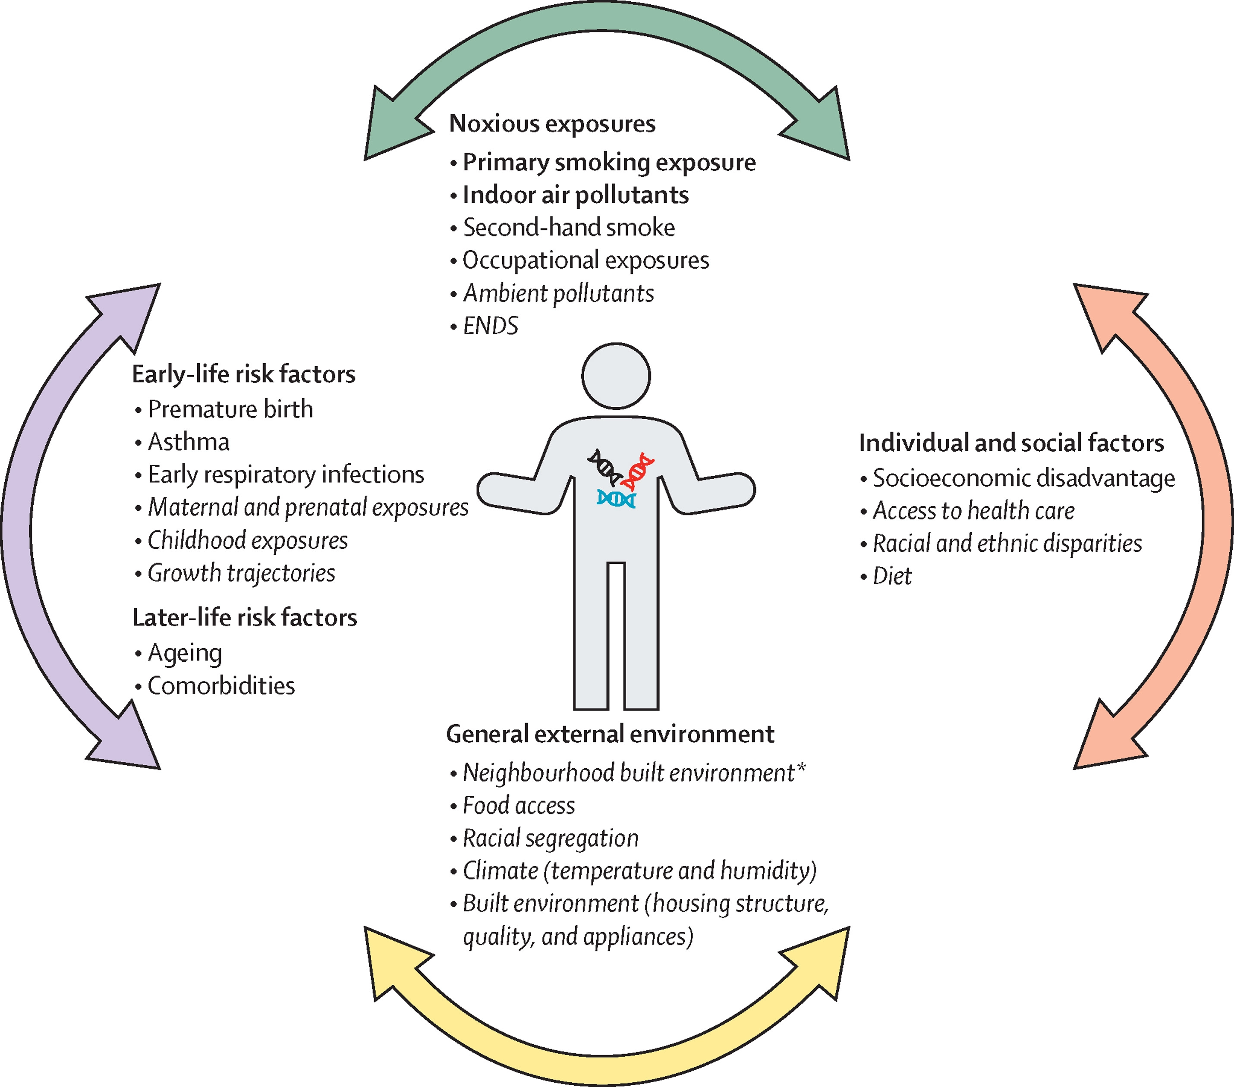

Slide 3
SMOKING
most significant risk factor
Pipe smokers, cigar smokers and marijuana smokers - second-hand smoke
Nicotine stimulates sympathetic system -Decreased ciliary activity & ciliary loss
Decreased oxygen carrying capacity
Cellular hyperplasia
Increased Production of mucus
Reduction in airway diameter
Increased difficulty in clearing secretions

Slide 4
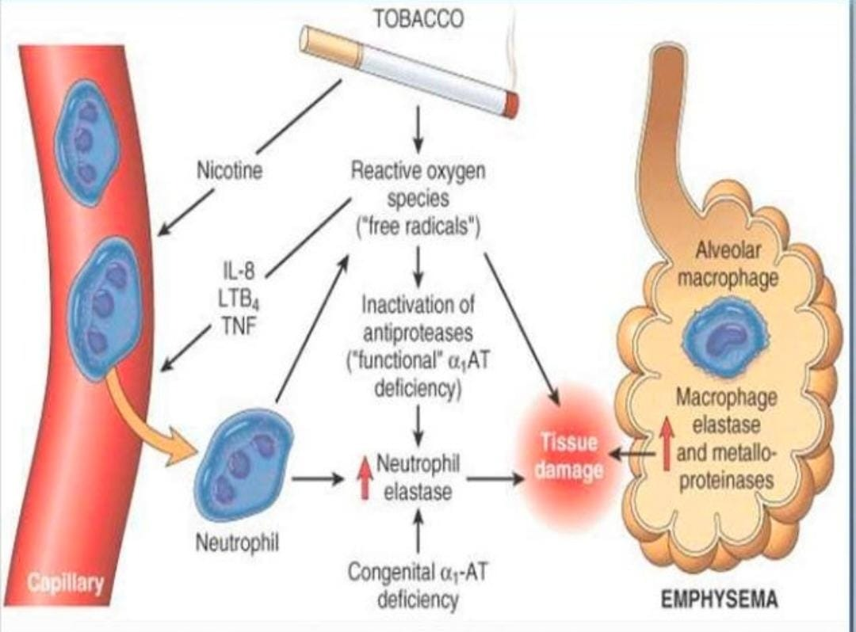

Slide 5
Environmental Tobacco Smoke Exposure or Second-Hand Smoke
Environmental tobacco smoke exposure (ETS) is implicated in loss of many years of life of adults and children
ETS at levels comparable to those in real-life situations have effects on serum cytokine levels and pulmonary function that if recurrent or chronic might translate into COPD. However, when smoking and other risk factors are controlled both workplace and home ETS but not prenatal ETS increase the risk of development of COPD

Slide 6
Data regarding in utero effects of maternal smoking on lung growth and subsequent risk of childhood wheezing or asthma are becoming evident.
However, doubt exists regarding the quantitative impact on the development of COPD in individuals with only prenatal exposure.
It seems likely that similar to cystic fibrosis, individuals with enhanced genetic risk factors could be adversely modulated by ETS,but to date no definitive proof of gene-by-environment interactions for ETS have been demonstrated.

Slide 7
The data does not suggest that ETS is harmless but rather it is less definitively causal of COPD as an independent risk than chronic smoking or occupational exposures.
Avoidance in individuals with existing lung disease is clearly indicated given the association with exacerbation.

Slide 8
Indoor Air Pollution
As stated above, indoor air pollution from burning solid fuels such as wood and animal dung for cooking and heating is widespread in parts of the world.
This practice exposes women and children to high concentrations of smoke containing respirable particles and complex gas mixtures for many hours daily and thus the risk of COPD.
It compounds the risk of COPD in smokers who are more likely to be men in these settings.
Cough and sputum occur among those exposed to indoor air pollution and an association with COPD is evident.

Slide 9
Abatement of bronchitic symptoms coincident with measures that reduce the levels of smoke strongly implicates the indoor air pollution.
The World Health Organization estimates that more than 1 million people a year die of COPD precipitated by
indoor air pollution.
International advocacy organizations such as the Global Alliance for Clean Cook-stoves seek to curb indoor air pollution.

Slide 10
Allergens:
a. Ingested (fish, nuts, strawberries)
b. Inhaled (dust, pollen, house dust mite)
c. Food additives (tartrazine, metabisulfite preservatives, monosodium glutamate or ajinomoto)
d. Occupational allergens (grain-dust, wood-dust)

Slide 11
Occupation
The possibility that occupation-related inhalation of particulates and gases carries a risk for COPD was slow in gaining acceptance, but acceptance is widespread now.
The delay was understandable since smoking among workers in certain occupations was a confounding factor.
Also, workers beginning jobs with a high risk of causing lung disease typically have better lung function than normal (the “healthy worker” phenomenon), obscuring work-related effects among relatively young workers.
In addition, among cohorts of workers, those with COPD may drop out, causing an underestimate of risk in follow-up studies of individuals still working.

Slide 12
Despite these problems, studies from different groups around the world, urban and rural, workforce-based and community-based,clearly implicate occupations producing exposures to dusts, gases, and fumes as risk factors for COPD.
The American Thoracic Society has estimated that the occupational contribution to the population burden of COPD is 15%.
Apart from the well-recognized risk of occupations involving exposure to organic and inorganic dusts, less obviously “risky” occupations, such as construction, plastics manufacturing, and utility work may carry an increased risk of COPD.
The risk of adverse occupational exposure is particularly important in workers who smoke or have other factors that raise their risk for COPD, such as α1-antitrypsin deficiency

Slide 13
Childhood Lower Respiratory Tract Infections
Since the status of lung function in very early childhood predicts ventilatory function many years later,48 it is plausible that lower respiratory tract infections (LRIs) during childhood might adversely affect lung development and increase the risk of developing COPD later in life.
However, lung function in children who had pneumonia up to age 2 infrequently had reduced lung function 10 years after the infection.

Slide 14
If there was a ventilatory defect, it was most often restrictive. Where reduced airflow was observed, an adenovirus was the predominant class of pathogens responsible for the pneumonia.
It is notable that COPD exacerbations may leave only a minor lasting effect on airflow.
Continued smokers enrolled in the Lung Health Study had only an additional loss of 7 mL of FEV1 per year for those having one exacerbation per year, while among those who had quit smoking, exacerbations had no permanent effect on the FEV1.

Slide 15
Low Socioeconomic Status
A low socioeconomic status is a risk factor for COPD.
The relationship may be linked to an increased amount of smoking and other factors, including deficient medical care for respiratory infections, occupational exposure to inhaled particulates, and increased exposure to household allergens.
The importance of smoking is evident.
In the United States in 2011, 45% of adults with a General Education Diploma (GED) were smokers compared to 10% of individuals with a college degree, and among adults living below the poverty level, 33% were smokers in contrast to 20% of individuals living above the poverty level.

Slide 16
HUMAN IMMUNODEFICIENCY VIRUS
INFECTION
Individuals with human immunodeficiency virus (HIV) who smoke have an increased risk of COPD or more specifically emphysema development.
The risk appears to be modulated by activation of alveolar macrophages with evidence of enhanced production of matrix metalloproteinases (MMPs) in these individuals.
The occurrence of COPD and pulmonary hypertension in smokers with HIV appears to be more common in individuals with a high viral load and lower CD4 cell counts and not an adverse consequence of antiretroviral therapy.
However, emphysema is not reversible and relation to viral load or recovery of CD4 cell counts is not straightforward.
Other health issues like malnutrition may contribute.

Slide 17
GENETICS
The field of COPD genetics is moving rapidly so that capturing this subject is aiming at a moving target. Aggregation of COPD in families and concordance of pulmonary function in twin studies have established a role for genetic predisposition to COPD
individuals with an identified genetic risk factor, wide, unexplained variability in the occurrence of COPD exists.

Slide 18
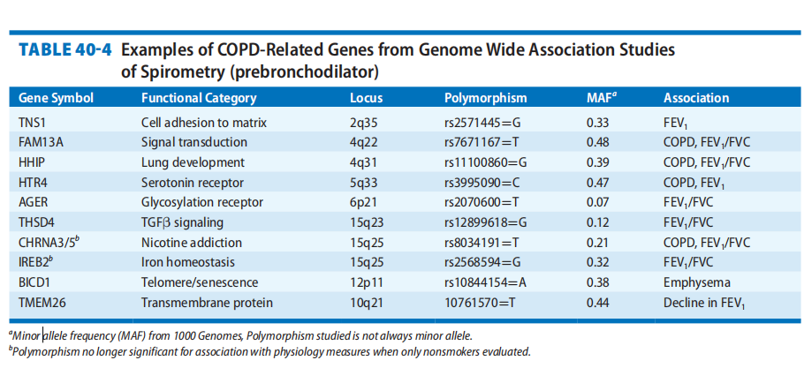

Slide 19
Drugs
i. NSAIDs especially *aspirin
ii. BETA-blockers
Note: *In aspirin sensitive asthma, patients have a triad of asthma, nasal polyps and aspirin sensitivity and it can be life threatening.
Acetaminophen, sodium salicylate, choline
salicylate, salicylamide and propoxyphene are well-tolerated.
• Chemicals -Sulfiting agents like Na or K bisulfite, sulphur dioxide

Slide 20
THANK YOU

