Slide 1
HYPERPARATHYROIDISM
Dr. Bhavin Shah

Slide 2
Anatomy and basics
Size-3*3*2 mm
Weight -50 mg approximately
Shape-oval,kidney shaped
Number-4,supenumerary
Colour-varying shades of yellow,orange to brown
Site-superior pair behind superior pole of thyroid in fat above inf.thyroid artery,inferior pair at inf.pole+upper horn of thymus

Slide 3
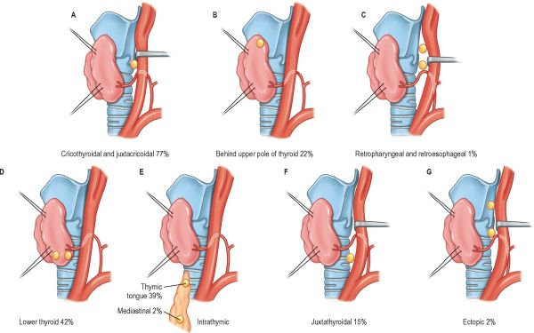
Sites

Slide 4
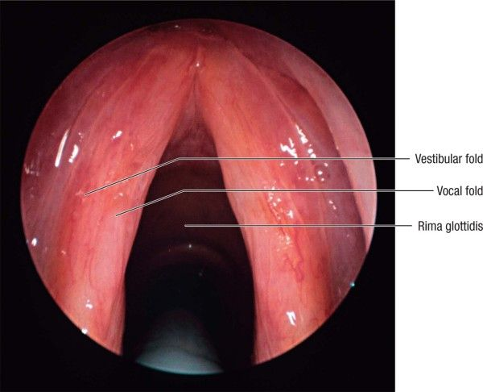

Slide 5
parathormone
Function-secrets parathormone ,a single chain polypeptide of 84 amino acids
Functions of PTH
1.increase in s.calcium & decrease in s.phosp.
2.increase osteoclast &blast activity
3.increase GI absorption of calcium
4.increase renal bicarbonate excretion
5.increase in renal hydroxylation of 25-hydroxy vitamin D

Slide 6
Blood chemistry-s.calcium-9 to 11 mg/dl
-s.phosphate-3 to 4.5 mg /dl
cal*pho= around 40.slightly higher in children

Slide 7
etiopathology
adenoma | Female:male 3:1 Size 2 to 4 cm | usually one gland af fected,in 2% multiple | 90 | Spontaneous loss of ca.sensing receptors
hyperplasia | Size 2 to 4 cm ,CRF | All 4 glands affected | 9
carcinoma |  |  | 1
cysts | Aspiration show water clear fluid with high PTH in fluid
genetic | MEN -1,MEN-2 and familal isolated HPT

Slide 8
Symptoms
Stones 35%
Bones 15%
Psychic moans
Abdominal
groans
Parathyroid
crisis

Slide 9
A disease of elderly,2 years duration,1:1000 to 2500 incidence
Bones-osteomalacia,osteoporosis,arthritis,bone pain &pathological fractures
Stones-5% of total stones,do s.calcium ,nephrocalcinosis
Groans-nausea,vomiting,anorexia,weakness,acute pancreatitis,peptic ulceration
Moans-lethary,fatigue,depression,memory loss,psychosis,ataxia,delirium,coma

Slide 10
Parathyroid crisis
Confusion,nausea,abd.pain
Cardiac arrythmia,hypotension
Acute renal failure
Treatment- 4 to 6 litres of NS,IV PAMIDRONATE

Slide 11
SIGNS
NO SIGNS

Slide 12
DIAGNOSIS
DEMONSTRATE
^
S.Cal & PTH
Exclude other
Caueses of
hypercalcaemia
Drugs like
Thiazides
lithium
X-ray chest for
Sarcoidosis,
Small cell lung ca.
IVP for
Renal cell ca.
stones
s.Protien
Electrophoresis
Multiple myeloma
24-hr.u.cal. For
Familal hypo-
Calciuric hypocal.
Evaluate for
MEN by
Family histroy

Slide 13
Lab.test and x-rays
X-ray hand-subperiosteal resorption of bone,middle phalanges,tufts of terminal phalanges
X-ray tooth sockets-lamina dura
X-ray skull-granular decreased density
Other bones-small clear cystic spaces(osteitis fibrosa cystica),soft tissue calcification

Slide 14
Blood- s.cal ^ upto 20 mg/dl
-s.pho decrease than 3 mg/dl
-^ alkaline phosphatase
Urine -^ calc.,phos.
-sulkowitch test-125 mg/day calcium diet for 3 days,u.cal. >200 mg/day

Slide 15
treatment
Conservative thoughts
mild disease can be managed by measures like
1.low calc. diet
2.withdraw lithium,diuretics
3.calc. reducing agents biphosphonates
4. ca.receptor agonists-cinacalcet

Slide 16
Surgery indications
Many believe that symptoms are so diverse that diagnosis itself is an indication of surgery
Age<50 yrs
Decrease in creat. Clearance by 30%
A of >2.5 SD bone density from peak bone mass in hip,lumbar spine,distal radius
24 hr u.calc.>400 mg
Urinary tract calculi,high s.calc,symptomatic hypercal,

Slide 17
Two approaches
CONVENTIONAL
expirienced surgeon most effective locator
All 4 glands are sought
Adenomatous gland resemble mini kidney,diseased gland removed ,2% multiple
Hyperplasia 3.5 gland excision leaving 80 to 100 mg or total excision with 60 to 70 mg forearm impl.
Transcervical thymectomy sos
QPTH
Half life 3 to 5 min,immunochemiluminescent tech. can be done in 8 to 30 mins
Pre-op dual phese SESTAMIBI SCAN with SPECT(single photon emission ct),7.3 MHz real time sonography
Pre-incision,pre-excision,5 mins and 10 mins after excision
> 50% reduction from highest level after excision of all hyperfunctioning glands

Slide 18
Secondary hyperparathyroidism
ETIOLOGY
Physiologic response to low s.calcium
Low s.calc.,high PTH,in primary both elevated
CRF-1.decrease production of calctriol >decrease int. absorption of calc.>hypocalcaemia 2.decrease excretion of phosph.>^ blood phos.>decrease calcitriol production=vicious cycle

Slide 19
Intestinal malabsorption like sprue
Chronic vitamin D deficiency

Slide 20
Surgery indications&treatment
1.failure of medical therapy
2.severe symptoms like bone pain,muscle pain and intractable pruritus during hemodialysis
3.renal osteodystrophy-bone pain,osteomalcia,fractures ,brown tumors of bone
4.calciphylaxis-deposition of calc. in skin leading to pain and ulceration, 50% motality

Slide 21
Parathyroid remnant size of a normal parathyroid will suffice

Slide 22
Tertiary hyperparathyroidism
ETIOLOGY
Prolonged secondary HPT leads to loss of calc. sensing receptors in parathyroid tissue
Increase in PTH and s.calc.
Distinguished from primary by medical histroy and much more elevated PTH

Slide 23
Surgery indication and treatment
Diagnosis alone is indication
Remnant of size of 4 normal parathyroid is kept,

Slide 24
Complications of surgery
Persistent hyperparthyroidism
Recurrent laryngeal nerve injury
Haemorrohage
Recurrent hyperparthyroidism- after 6 months of normality
Permanent hypoparathyroidismv
reduce compli. By preop 5 mg/kg iv methelyne blue in 500 ml DNS,MIBI &Gama probe

Slide 25
hypoparathyroidism
ETIOLOGY
Thyroid surgery – if 2 or more glands inadverently removed or blood supply geopardized
digeorge syndrome
Autoimmune polyglandular syndrome type 1
Haemochromatosis, wilson disease

Slide 26
symptoms
1 to 5 days after surgery
Tingling and numbness of nose,lips and extrimities
Spasm of muscles of the body 1.hands & feet cramps ,carpo pedal spasm 2.respiratory muscles-dyspnoea,suffocation 3.intraocular muscles-blurring of vision,cataract
Generalized convulsions

Slide 27
signs
Circum oral pallor
Chovstek sign-tap on facial nerve
Trossaeu sign- 200 mm/hg for 3-5 mins,obstetrician hand
Prolonged QT interval and QRS complex changes

Slide 28
Investigations and d.d.
s.calcium
epilelpsy
Alkalosis due to loss of HCL from stomach

Slide 29
treatment
PROPHYLACTIC
If inadverently removed ,implant in sternomastoid
IMMEDIATE
10 ml of 10% ca. gluconate iv followed by im
10 ml of 10% mag.sulf may also needed
Spasm-5 to 10 ml paraldehyde im 20 mins before ca.gluconate
Soluble ca.aspirin orally

Slide 30
treatment
MAINTAINANCE
Low phos. Diet-avoid fish, oral aludrox
50000 to 200000 units cholecalciferol,calcium lactate or soluble cal.aspirin daily
Parathyroid extract 30 units im twice daily+8 gm calc.lactate daily

