Slide 1
PREPARATION OF PATIENT FOR BARIUM STUDIES
DR. RAJESH RATHORE

Slide 2
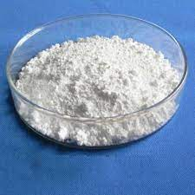
BARIUM POWDER

Slide 3
Barium studies are a group of diagnostic tests used to detect abnormalities of the gastro-intestinal tract using X-ray imaging. The radio-opaque contrast used is Barium Sulphate. It coats the lining of the digestive tract, allowing accurate X-ray imaging of the part that is being examined. Barium sulphate is mixed with water and swallowed. Following this, a series of x-rays are taken.

Slide 4
Barium studies are mainly classified into two: the upper gastro-intestinal series and the lower gastro-intestinal series.
The upper gastro-intestinal series includes: barium swallow examination, barium meal examination, barium follow through examination and enteroclysis (small bowel enema). The lower gastro-intestinal series includes barium enema examination.
The procedure for the study consists of the medical history of the patient, their clinical status, their informed consent and the barium study itself.

Slide 5
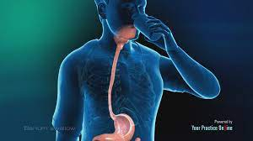
For a barium swallow, no special preparations are required. The larynx, pharynx and the esophagus are studied. A thick barium mixture of approximately 350- 450 ml is swallowed in supine position. Fluoroscopic images of the swallowing process are made. The procedure is repeated several times with the examination table tilted at various angles. Normally, 90% of the ingested fluid should have passed into the stomach after 15seconds.

Slide 6
For a barium meal or barium follow-through examinations, a 6-hour period of fasting is observed prior to the studies. Barium is administered orally, sometimes mixed with drugs to reduce transit time in the bowel and to enhance gastric emptying. X-ray images are then taken in a supine position at intervals of 20-30 minutes. Real-time fluoroscopy is used to assess bowel motility. The radiologist may press or palpate the abdomen during images to separate intestinal loops. The total time necessary for the test depends on the speed of bowel motility or transit time and may vary between 1 and 3 hours.

Slide 7
For Enteroclysis, also known as small bowel enema, fasting for 8 hours prior to examination is required. A laxative is also required for bowel preparation and cleansing. Infusion of thin barium sulphate suspension (500 - 1000 ml) into the bowel is done through a duodenal tube. Fluoroscopy is done or standard radiographs are taken at frequent intervals to view the bowels. The technique is a double-contrast procedure that allows detailed imaging of the entire small intestine. It usually takes 6 hours or longer to complete.

Slide 8
For Barium Enema, thorough cleaning of the large intestine is necessary for accurate pictures. A laxative may be used or warm water enema may be performed. The patient should be NPO before 8-10 hours. The patient is asked to lie on their side while a well lubricated enema tube is inserted into the rectum.
Barium sulphate suspension is then infused and x-ray examination is done.

Slide 9
The indications for performing a barium enema include:
Enteritis
Volvulus
Varices
Ulcers
Tumors
Gastrointestinal dysmotility
To detect foreign bodies.
To diagnose and monitor esophageal reflux
Dysphagia
Hiatus hernia
Strictures
Diverticula
Pyloric stenosis
Gastritis

Slide 10
The contraindications for performing a barium enema include:
Suspected Bowel Perforation
Hypersensitivity to barium
Pregnancy
Recent biopsy

Slide 11
INTRAVENOUS PYELOGRAM
Dr. Rajesh Rathore

Slide 12
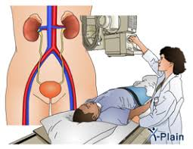

Slide 13
An intravenous pyelogram (IVP) is a special x-ray examination of the kidneys, bladder, and ureters. It is also called Intravenous Urogram. It can show the size, shape and position of the urinary tract, and can evaluate the collecting system inside the kidneys. Intravenous Pyelogram can be done as an emergency procedure without any preparation.

Slide 14
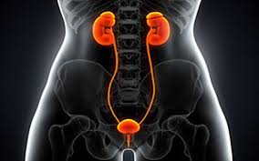
An Intravenous Pyelogram can be used to evaluate:
An abdominal injury.
Bladder and kidney infections.
Blood in the urine.
Flank pain (possibly due to kidney stones).
Tumors.

Slide 15
During Intravenous Pyelogram, a contrast material is injected into a vein into the patient’s arm. A series of X- ray pictures are then taken at timed intervals.
An ultrasound or a computed tomography (CT) scan may be combined with an Intravenous Pyelogram if more details about the urinary tract are needed. In patients with kidney failure or suspected renal failure the contrast can damage the kidneys further.
The test should be done in the X-ray Department where a doctor is available, as on occasions the contrast can cause severe reactions which may lead to medical emergencies.

Slide 16
The preparation required for this examination is- the patient may need to be fasting for 8 to 12 hours before the Intravenous Pyelogram. The Patient also may need to take a laxative the evening before the test and possibly have an enema the morning of the test to make sure that the bowels are empty.

Slide 17
THANK YOU!

