Slide 1
Nutrition enteral and parenteral
Dr. Pratik Shaparia

Slide 2
Why nutrition imp. In surgery
Very important in outcome of surgery
Recovery from surgery is bad in malnourished
50% of surgical patient malnourished on admission
Metabolic and nutritional needs of injured and septic pt. is different from healthy person

Slide 3
Malnutrition increases mortality and morbidity (albumin < 3 gm/dl)
Prevents wound healing
Increases sepsis and respiratory complication
Decreases efficacy and tolerance of radiotherapy and chemotherapy
Over nutrition will cause hyperglycemia and increase chance of infection
Immunity decreases

Slide 4
Routes of administration
Enteral
oral
nasogastric
gastrostomy
jejunostomy
As and when possible enteral route is preferred
because

Slide 5
Advantage of enteral feeding
It’s more physiological
Prevents complication like thrombophlebitis
Gastric acid prevents infection
Less expensive and easy to administer
Digested food pass through liver-detoxification

Slide 6
Advantage of enteral feeding
Integrity of intestinal mucosa maintained, no bacterial transmigration
No cholestasis, preserves digestive enzymes
Provides glutamine and alanine non essential amino acids
Digestion of starch in colon provides nutrition for clonocytes, helps defecation and prevent colonic diseases

Slide 7
Contra indication for enteral nutrition
Facial injury, head injury , comatose pt.
Loss of gag reflex
Intestinal obstruction, g.i. bleeding, paralytic ileus, severe diarrhea-vomiting, high output fistula, severe pancreatitis
Shock, major abdominal operation
Safe access to enteral feeding is not present, in cooperative pt.

Slide 8
Normal caloric requirement
Neonatal 100 kcal/kg/day
Adult 20-25 kcal/kg/day, i.e. 1800-2000
Adult with
Catabolism 40-60 kcal/kg/day i.e. 2500-3000
It should come from
Carbohydrate 50%
Fat 20-25%
Protein 25-30% or 1 gm/kg/day

Slide 9
Calorie value
Carbohydrate 4 kcal/gm
Fat 9 kcal/gm
Protein 4 kcal/gm
An egg 70 kcal

Slide 10
Effects of starvation
It’s the partial or total cessation of energy intake.
A short fast of 12 hours will utilize all the food taken in last meal.
Then insulin level will fall and glucagon will rise
This converts liver glycogen (200 gm) to glucose by glycogenolysis

Slide 11
Next glycogen store is in skeletal muscle which is converted to glycogen (500gm), transported to liver and converted to glucose (CORI CYCLE). This stock will last up to 24-48 hours. After that if fasting cont. then
neoglucogenesis will take place in liver by utilizing amino acid precursor (glutamine and alanine) derived from catabolism of muscle protein.

Slide 12
starvation
SIMPLE STARVATION: cessation of energy intake is different from STRESS STARVATION which is seen in critically
ill patient as its due to stress such as
post operative states
trauma
burns
shock
infection, sepsis and its sequel

Slide 13
Stress starvation is characterized by hypoalbuminemia( due marked catabolism )and resulting edema
Severe acute inflammatory process is the main underlying pathophysiology in all above condition.
Cytokines induced vascular permeability - fluid extravasation with albumin in extra vascular space – edema - hemodynamic instability and hypovolemia

Slide 14
Physiological impact of starvation versus stress
Category starvation stress
Catabolism + +++
Glycogenolysis + +++
Glucogenolysis + +++
Lypolysis and ketosis +++ ++
Serum albumin no change decreased
Edema mild marked

Slide 15
Adaptive process
Normally brain utilizes glucose as fuel for its metabolic needs.
After 4-5 days of starvation the brain starts using ketones and glycerol as its fuel by adaptive process of the body. So oxidation of fat stores supplies basal metabolic needs of body.
only after depletion of fat , again muscle breakdown starts.

Slide 16
INDICATION FOR NUTRITIOMAL SUPPORT
Un intentional Loss of 10% or more body weight in last 6 months
Standard wt. of adult male 65 kg, female 50 kg
History of not taken orally or parenteral adequate intake for more than 7 days
Serum albumin : less than 3 gm/dl (SEPSIS)
Stress level : mild, moderate, severe

Slide 17
Expected time delay for oral feeds > 7 days
intestinal perforation, high g.i. fistula, severe burns etc may take 2 weeks
Ideal way is to use APACHE II SCORE system i. g. temp, pulse, RR, A-Apo2, arterial ph, serum. NaHCO3, Potassium, creatinine, etc., wbc count
Widely used classification for organ failure

Slide 18
Nutritional status of patient
Body weight
B.M.I ( <15 increases mortality, <18.5 is malnutrition )
Triceps skin fold thickness by calipers
Mid arm circumference( muscle & fat mass)
Hand grip strength (functional impairment)
Serum albumin <3 gm/dl– poor outcome
Lymphocyte count—defective immune function

Slide 19
Methods of nutritional support
ENTERAL
PARENTERAL

Slide 20
ENTERAL NUTRITIONAL SUPPORT
ORALLY
RYLE’S TUBE FEEDING stomach, jejunum
GASTROSTOMY , p.e.g.,,(percutaneous endoscopic gastrostomy) is more popular now.
JEJUNOSTMY, OR p.e.g. JEJUNOSTOMY TUBE

Slide 21
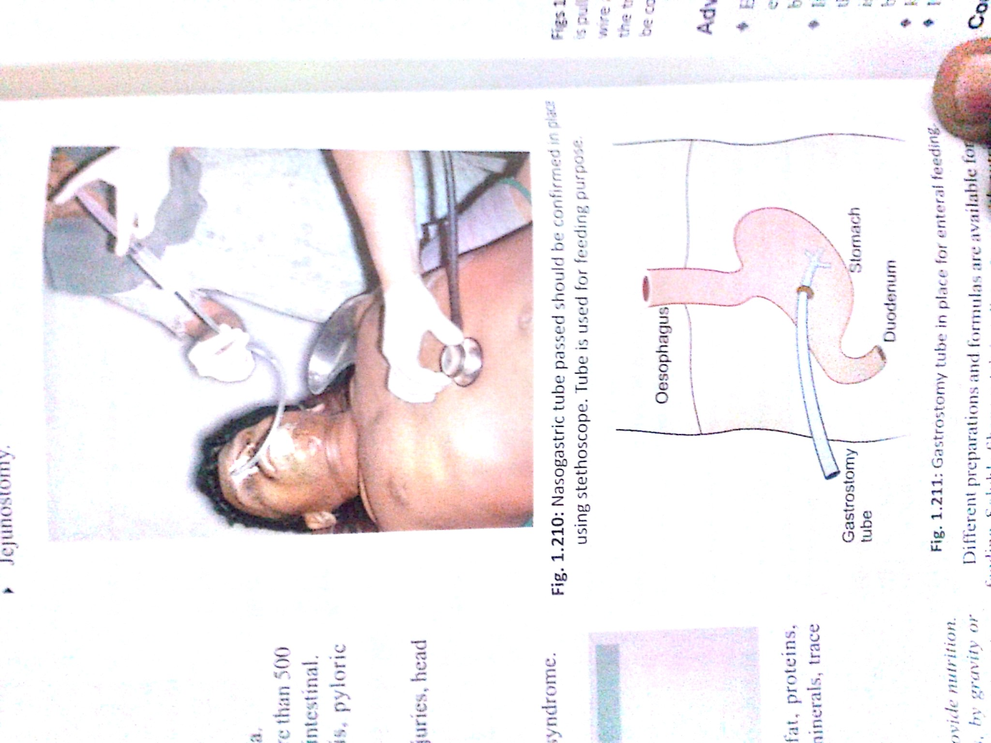

Slide 22
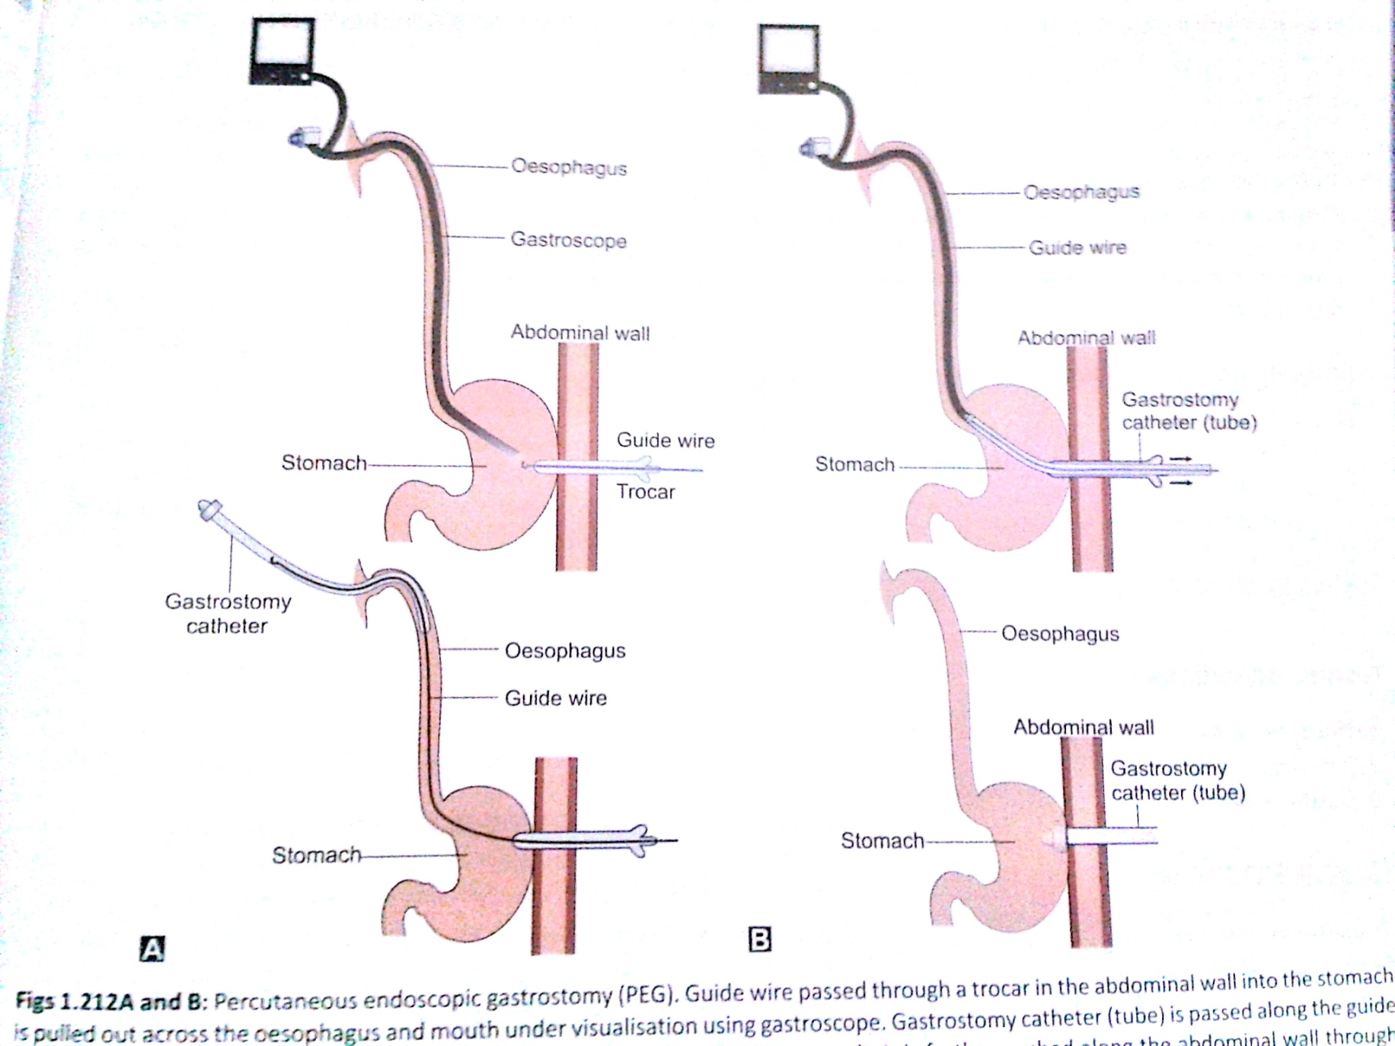

Slide 23
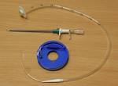

Slide 24


Slide 25
ORAL INTAKE
Normal swallowing
Spontaneous oral intake is less
Small bowel function normal
No obstruction or paralytic ileus
No high intestinal fistula

Slide 26
ORAL SUPPLIMENTS
House hold cereals, grinded foods, soups , crushed fruits or juices mixed with soya powder and vegetable oils containing high calories, proteins, milk, vitamins, trace elements minerals like cu, mg, fe.
1 gm/kg/day protein , (65 gm=260 kcal) 1800 kcal/day , cho 900 kcal=225 gm , fat 750 kcal=80 gm

Slide 27
Commercial oral supplements
Ready made oral sip feeds by nasogastric or nasoenteric tube
1kcal/ml (standard feed) or 2 kcal/ml (high calorie density) contains enough protein to prevent catabolism and soluble fiber or insoluble fiber for constipated pt.

Slide 28
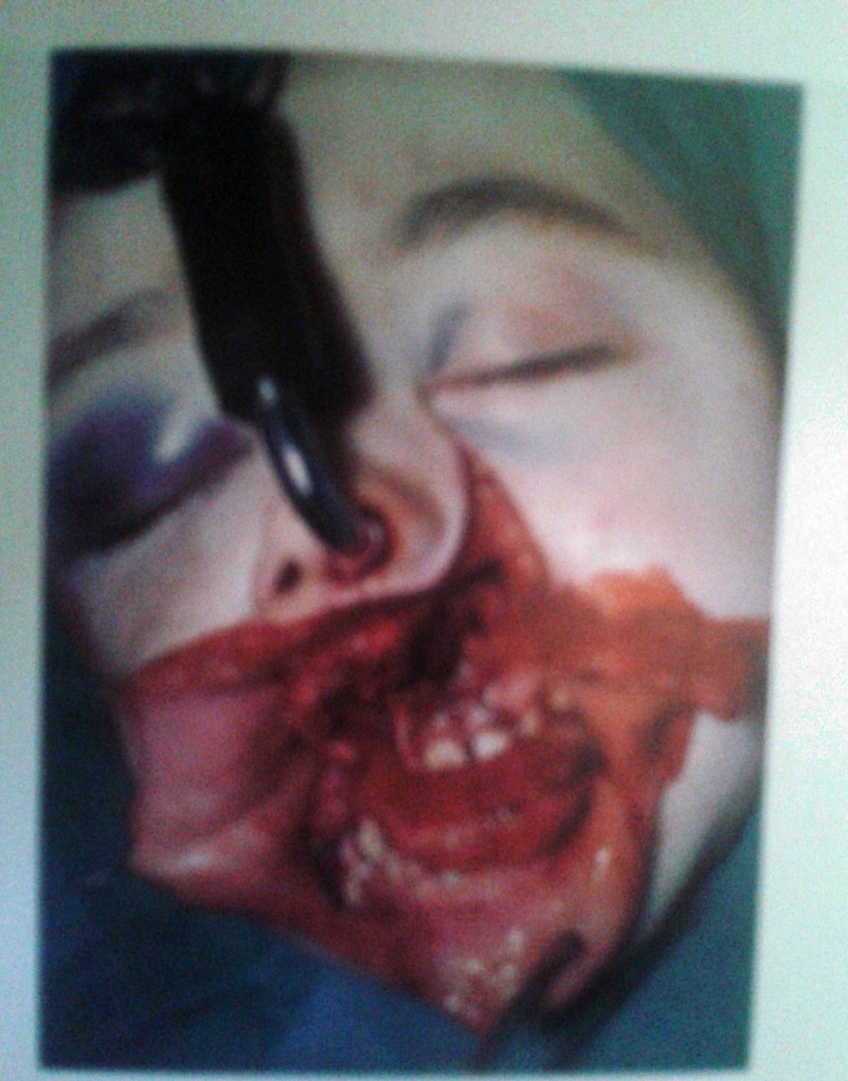

Slide 29
High lipid 55% formula prevents CO2 retention in respiratory failure pt.
Immunomodulator feeds containing arginine, glutamine (essential for cell proliferation) omega 3 fatty acids from fish oil. Not proved superior to normal feeds.
Fiber enriched formula to reduce diarrhea

Slide 30
BUTTER MILK DIET
Critically ill pt. Do not require expensive and special commercial feeds.
Severe burn pt. Is treated sometimes with simple blenderised diet- B.M.D.
1000 ml butter milk+ 4 eggs + 4 bananas+ 1 table spoonful of sugar ==
1700 ml vlume+60 gm proteins+350 gm cho.= 1 kcal/ml energy.

Slide 31
RATE OF FEEDING
Started slowly and gradually increased to maximum 300 ml/ 3 hours.
No feeds between 12 mid night. To 6 am
Aspirate before feed, if > 150 ml reduce feed, if less than 150 return feed and continue feeding. If >300 ml, stop feeding, reduce feeding rate 50% and add partial parenteral, or prokinetics

Slide 32
COMPLICATIONS OF ENTERAL FEEDS
Diarrhea, vomiting, nausea, colic's
Esophageal reflux
Aspiration pneumonia
Tube positioning In trachea
Perforation
Nasal cartilage trauma
Sinusitis, parotitis

Slide 33
Irrigate tube after every feed with 30 ml water and after 12 hours with 10 ml soda bi carb.
Weigh pt. Alternate day
Vitals 6 hurly, i/o charts
RBS, creatinine, S.G.P.T., C.B.C. twice weekly
Change tube weekly or bi weekly

Slide 34
TOTAL PARENTERAL NUTRITION TPN
All nutritional requirement is given by i.v. route only.
Usually via a central venous catheter e.g. subclavian, internal jugular, femoral (Less preferred) where the tip of catheter is in distal vena cava
Peripheral parenteral nutrition-PPN- by peripherally inserted central catheter or formal peripheral venous line.

Slide 35
INDICATION OF TPN
Failure or contra indication enteral route
High out put g.I. Fistula > 500 ml/day
Major abdominal surgeries, intestinal anastomosis
Septicemia, multiple trauma
Short bowel syndrome , severe pancreatitis, peritonitis

Slide 36
Massive g.I. Bleeding,
Haemodynamicaly unstable pt.
Pt.On ventilator
High risk of aspiration
About 5% hospital admission needs tpn

Slide 37
TECHNIQUE
Speciallised central vein cathater available for each central vein
Special wide bore intracath, guide wire used for insertion of cathater and fixed with suture
Aseptic tecnic is essential for cathater and feed

Slide 38


Slide 39
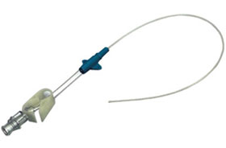
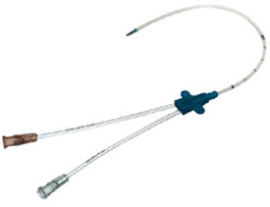
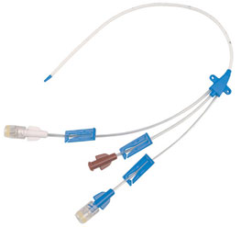

Slide 40
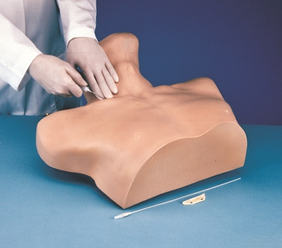

Slide 41
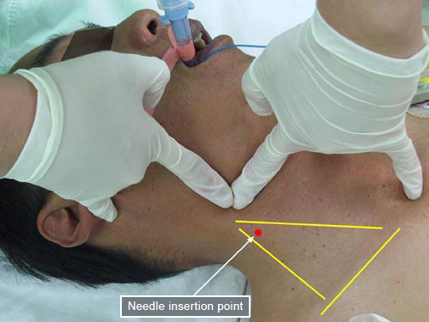

Slide 42
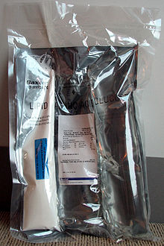

Slide 43
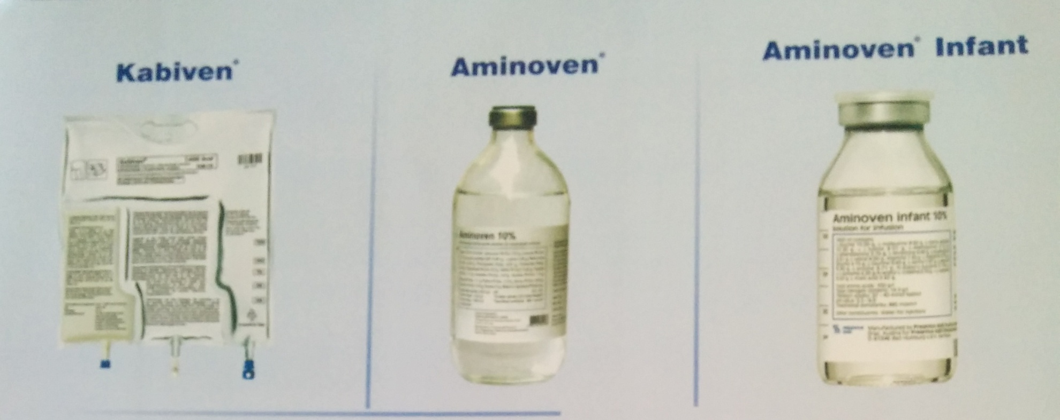

Slide 44
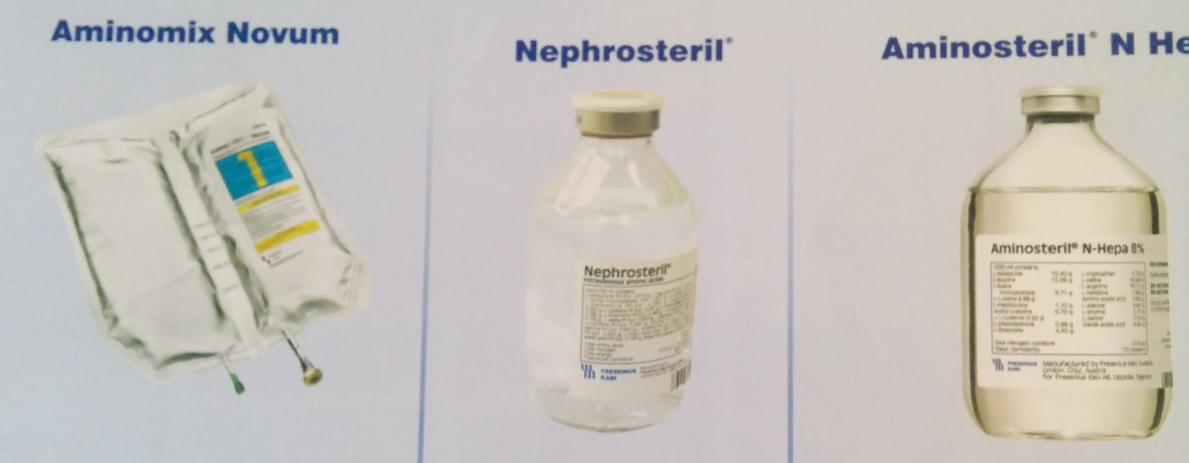

Slide 45
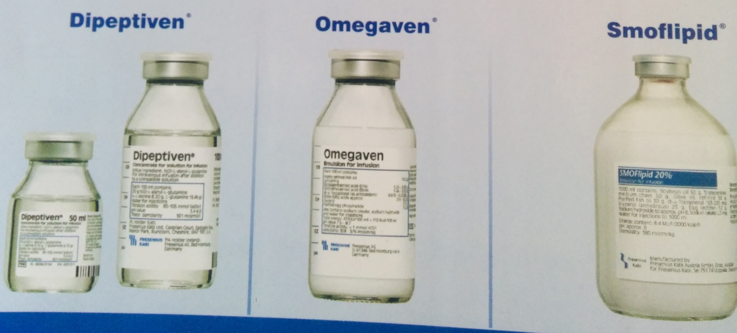

Slide 46
GOALS OF TPN
                Decrease catabolism, increase protein synthesis, decrease protein break down, prevent weight loss
Support metabolism
Improve immune function
Maintain water and electrolyte balance, acid-base balance.
Asess fluid and calories required

Slide 47
COMPONENTS USED FOR TPN
Carbohydrate 50%
5% ,10%,25,% 50% , 70% dextrose solution
Fat (30%)and amino acids(20%)
Minerals and vitamins, electrolytes, trace elements like iron, zinc, selenium, manganese, iodine, copper,
Chromium,

Slide 48
CARBOHYDRATES
5%- 50% dextrose available.
Cheap
Prevents protein break down, stimulates insulin secretion, glucose oxidation
Nitrogen sparing ability
BUT
Low calorie value , so needs more fluids

Slide 49
Cause hyperglycemia
Produce more CO2
Cause thrombophlebitis due to high osmolality with 10% or higher concentration

Slide 50
FATS
Total calories about 30%
Provides essential fatty acids
Given as emulsion 10%, 20%, 30% solution
High calorie value 9 kcal/gm

Slide 51
CMPLICATION OF FAT IN TPN
Hypertriglyceridemia
Fat embolism
Sepsis (good culture media for bacteria-fungi)
Fat overload
Pancreatitis
Hepatic dysfunction-fatty liver

Slide 52
AMINO ACIDS
Source of protein
Maintains nitrogen balance ( 6.25 gm protein has 1 gm nitrogen)
20% energy in TPN should be from amino acids and rest from fat and carbohydrate
Its restricted in C.R.F. and HEPATIC FAILURE because it increases urea level and risk of hepatic encephalopathy

Slide 53
Vitamins, minerals, trace elements, electrolytes
Inj. M.V.I. 10 ml ampoule in glucose drip will provide most of the vitamins water and fat soluble
Electrolytes can be given by Isolyte e and K+
AMP.

Slide 54
COMPLICATION
Air embolism
Pneumothorax
Bleeding
Catheter blockage, sepsis, thrombophlebitis (use heparin small doses repeatedly.)
Usually needs in patient treatment., but now home parenteral nutrition is possible by pt. himself as advised by doctor.

Slide 55
REFEEDING SYNDROME
Severe fluid and electrolyte imbalance occur in severely malnourished pt after starting enteral or parenteral nutrition. More in TPN
Hypo calcium ,magnesium and phosphatemia
Leading to myocardial dysfunction, respiratory changes, liver dysfunction, ultered consciousness, convulsion and even death
Gradual feeding and correction of electrolytes

Slide 56
and correction of calcium, magnesium and phosphates is important
This complication is common in chronic starvation, alcoholism, severe anorexia

Slide 57
Thank u
iti vartaha

Slide 58
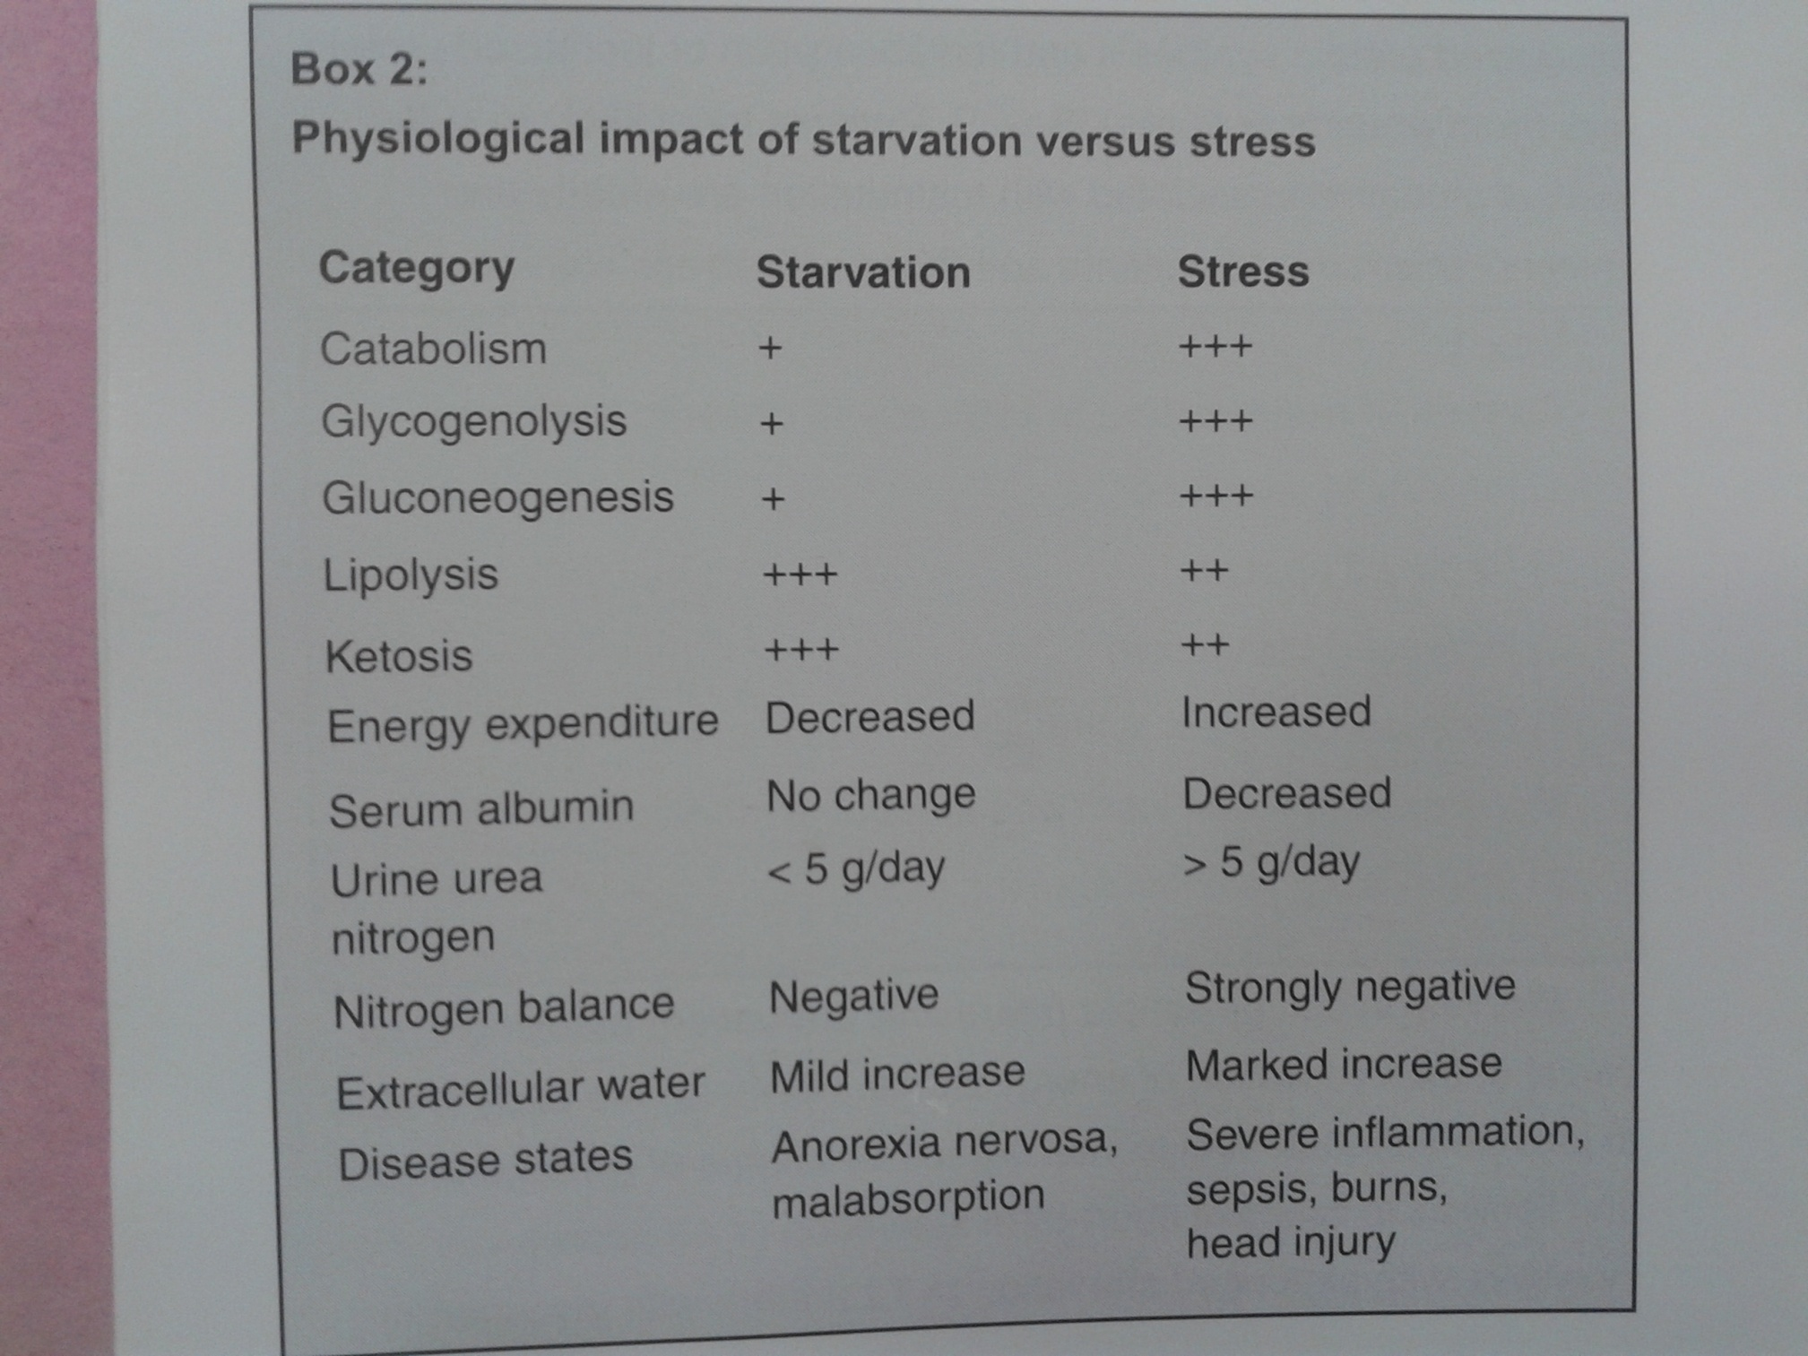

Slide 59
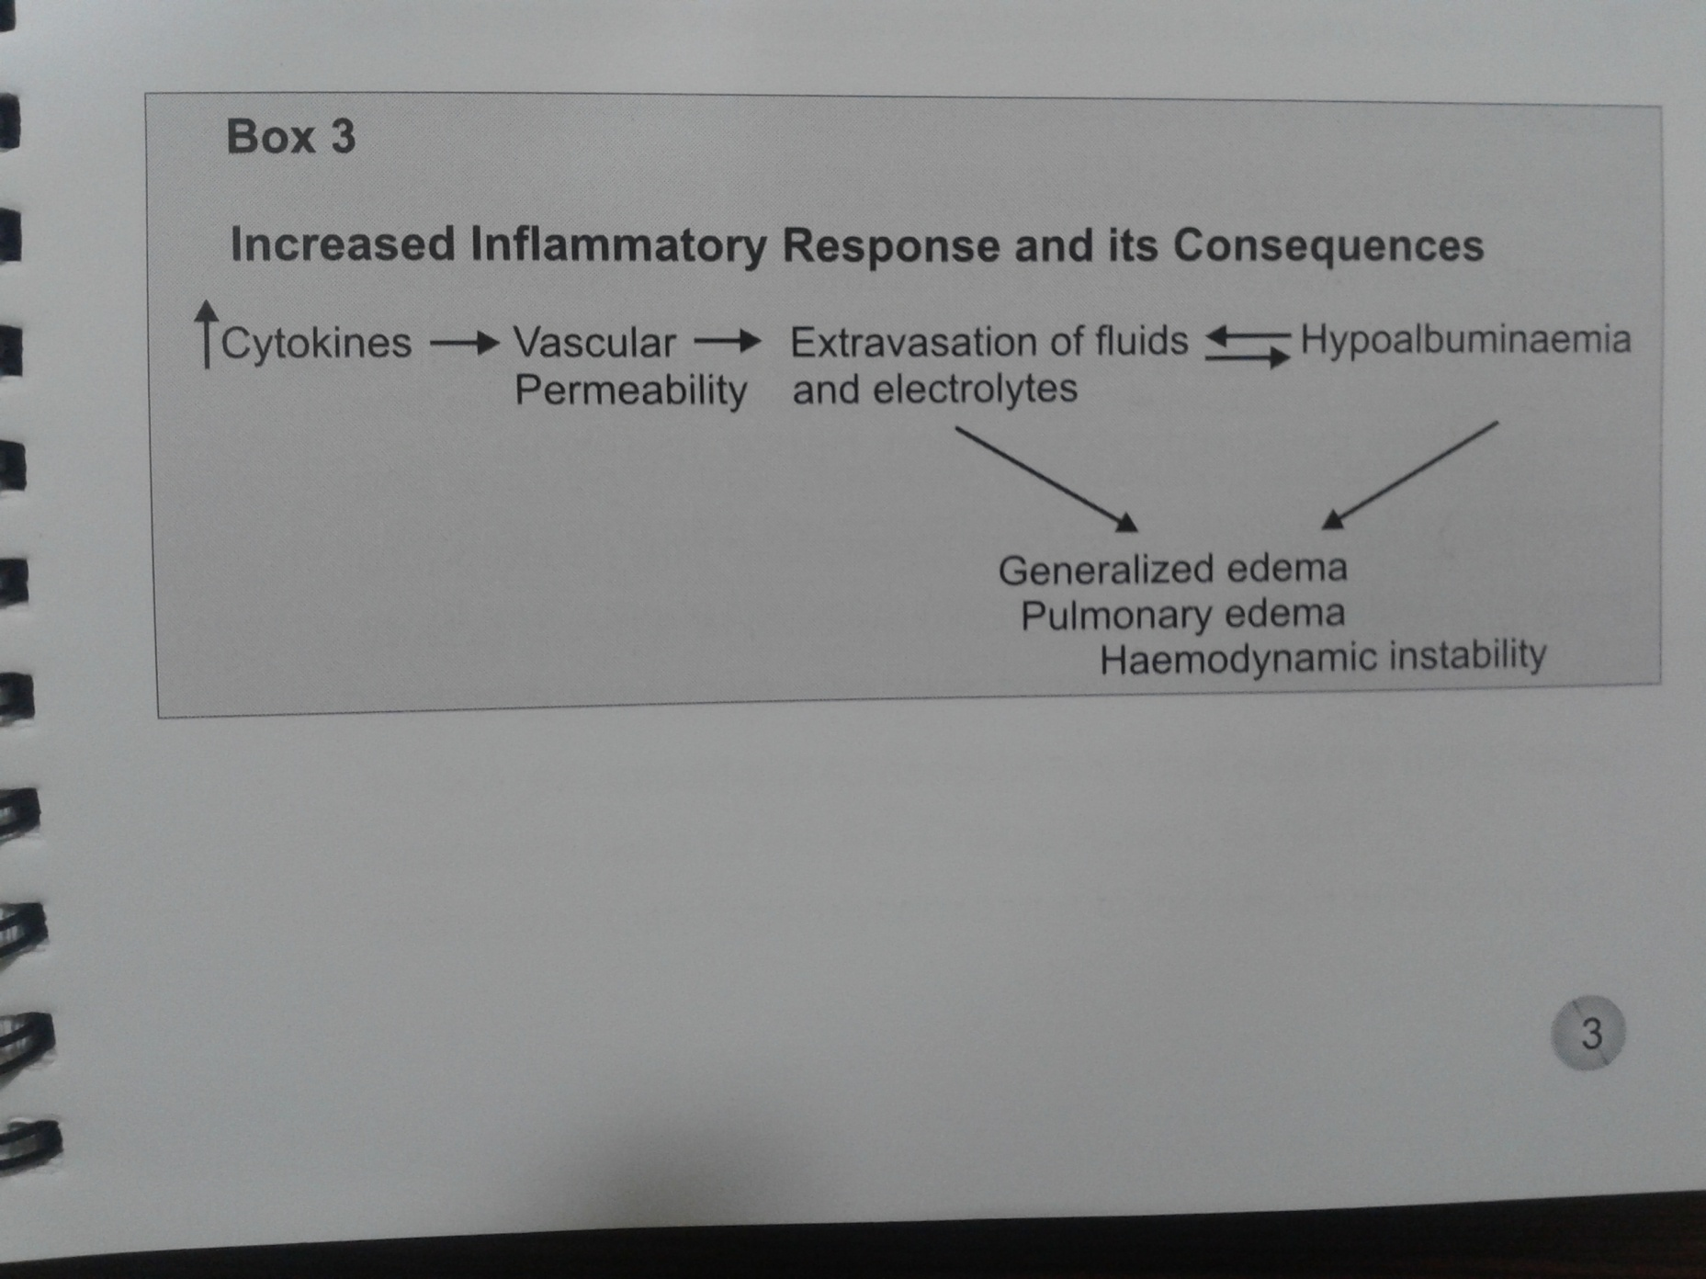

Slide 60
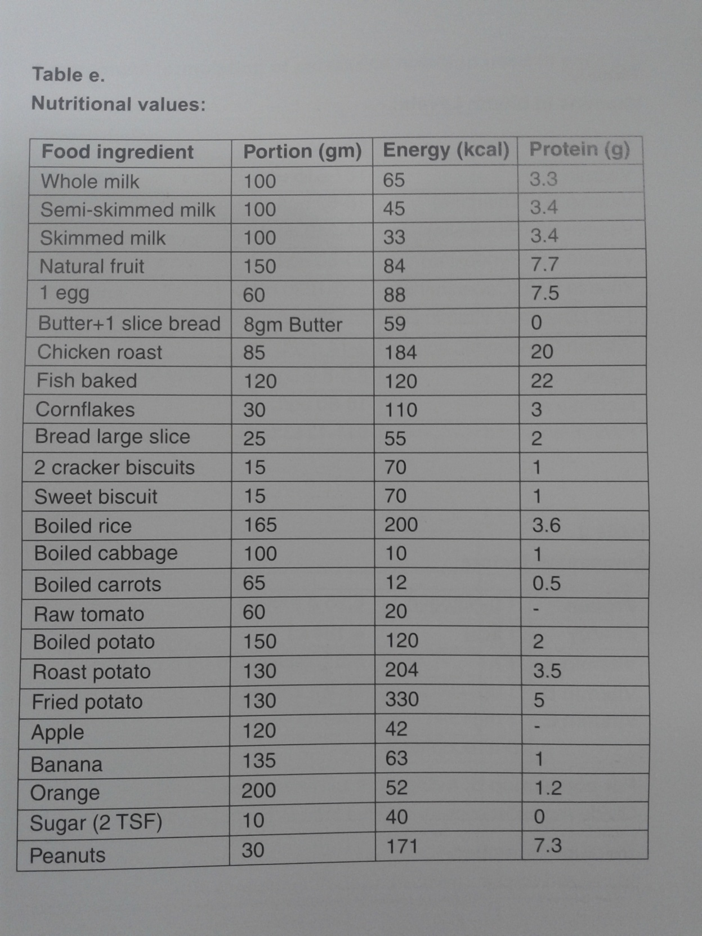

Slide 61
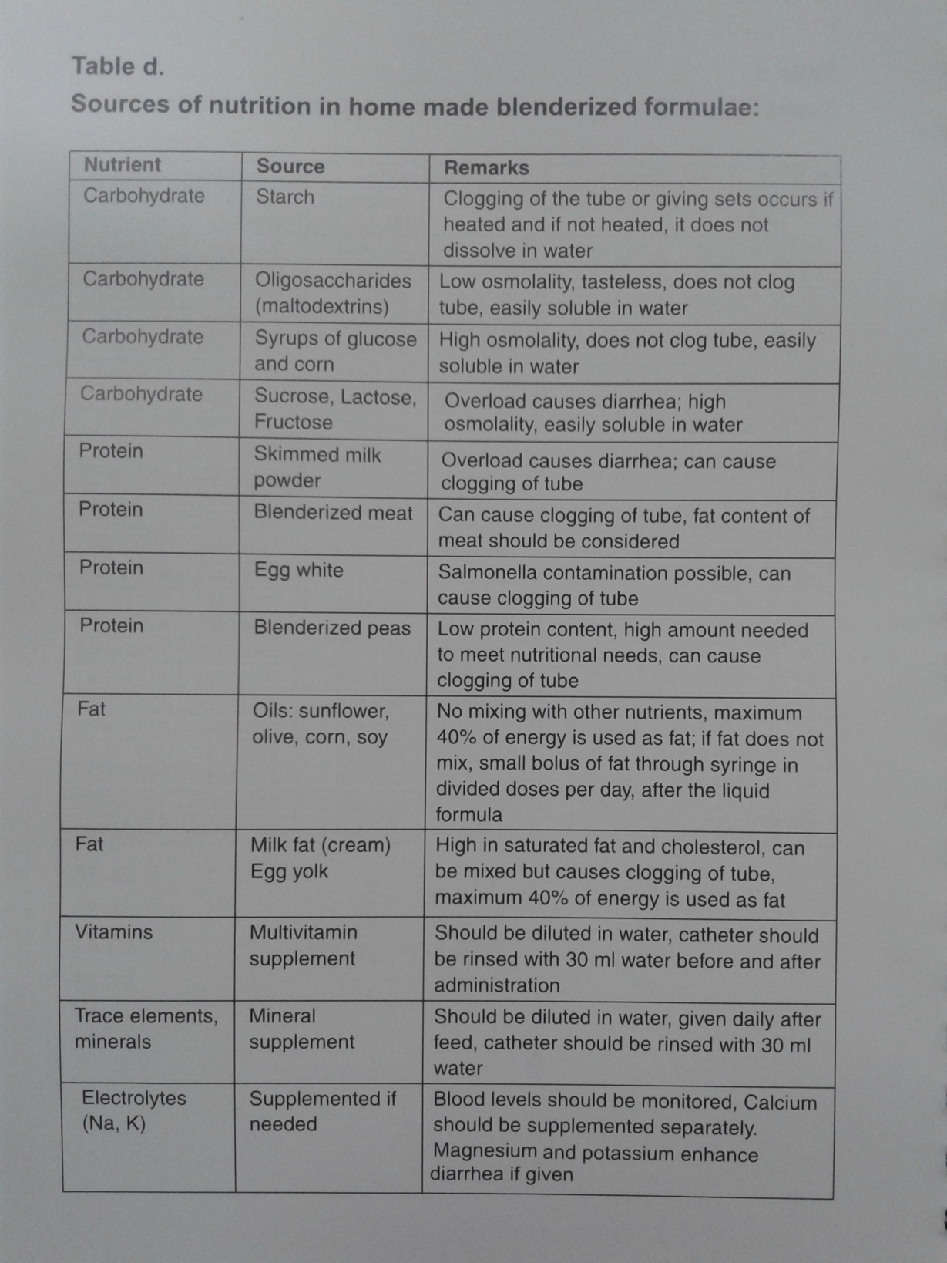

Slide 62
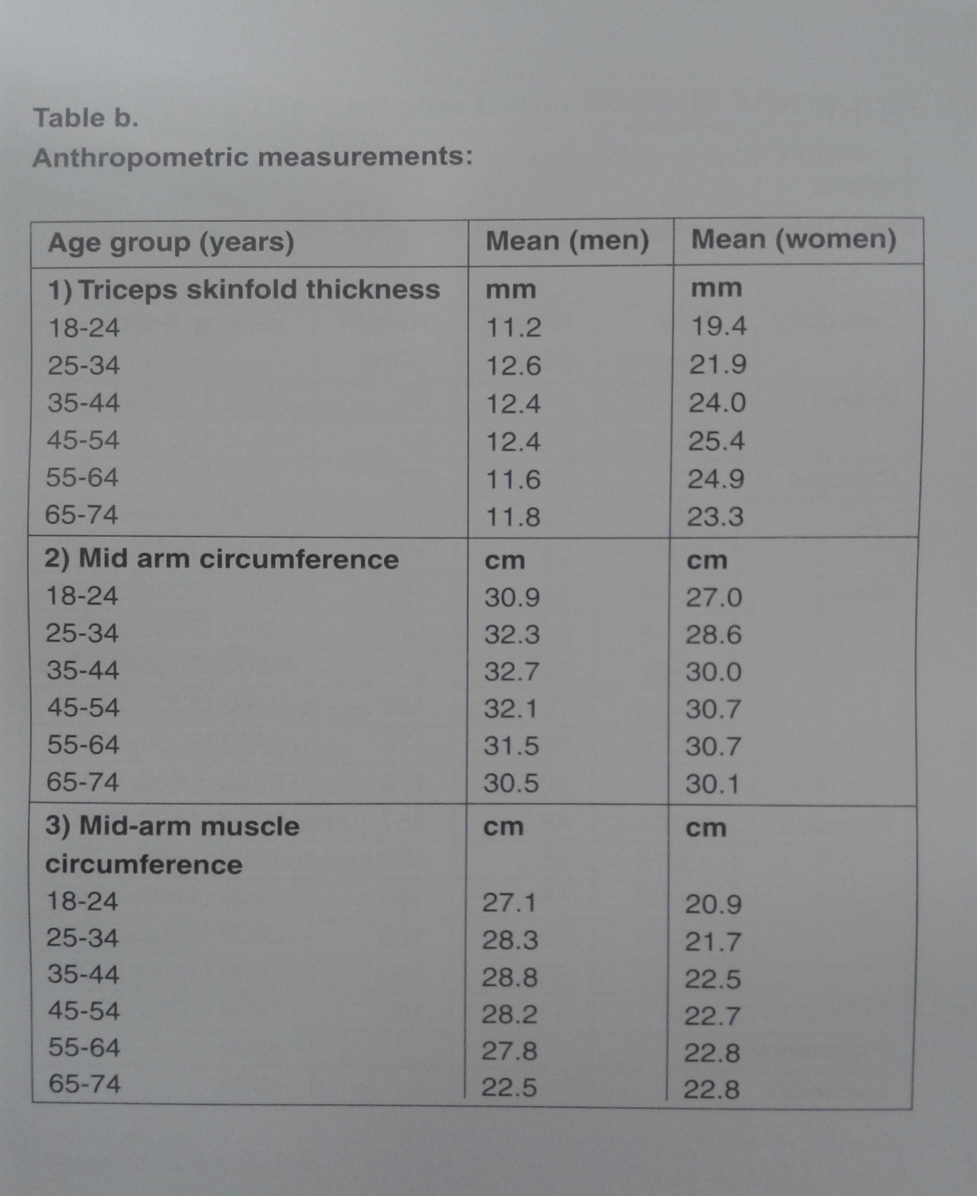

Slide 63
