Slide 1
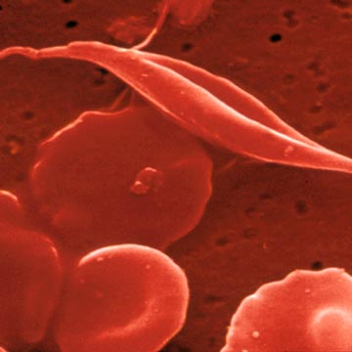
Management and Diagnosis of Sickle Cell Anemia
Sickle Cell Anemia
Dr. Mukund Vaja
Assistant Professor
Department Of Pediatrics
SBKSMIRC, Dhiraj General Hospital

Slide 2
Definition
Sickle cell disease (SCD) is a generic term for a group of disorders that includes
  Homozygous sickle cell anemia (Hb-SS),
  Sickle cell hemoglobin C disease (Hb-SC),
  Sickle cell thalassemia disease (S/thal) and
  Other compound heterozygous conditions.
Corrina Mcmahon et al,Pediatric Hematology, Third Edition., 2006;P-213

Slide 3
Sickle cell trait
Sickle cell trait is a benign condition produced when a gene containing the HbS mutation is inherited along with a normal β-globin gene, and is described as HbAS.

Slide 4
Frequency in India- Sickle cell
Lohars- Orrisa | 22.2%
Mahars – M. P. | 20 %
Irulas – T.N. | 20 %
Karmakars – Assam | 19.3%
Pradhans – A. P. | 18.3%
Garnits, Bariya, Rathwa – Gujarat | 15.7%
Pradhans – Maka | 15.4
Tribals – Kerala | 15 %

Slide 5
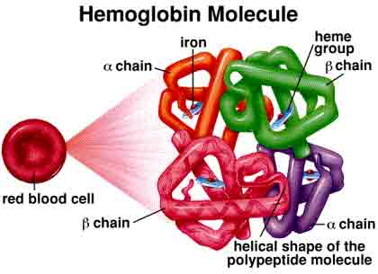

Slide 6
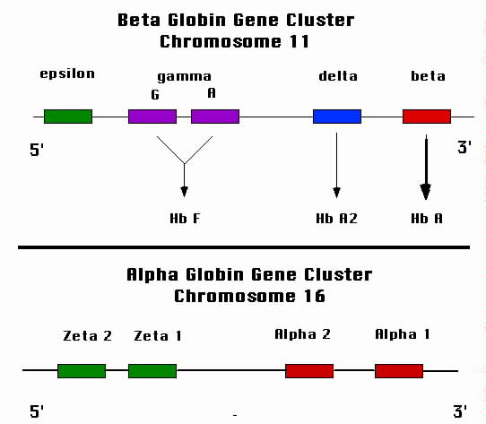

Slide 7
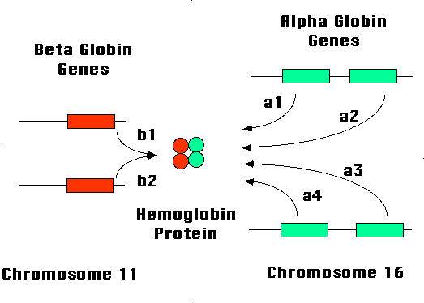

Slide 8
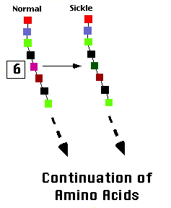
Sickle cell anemia Genetics
The mutation causing sickle cell anemia is a single nucleotide substitution (A to T) in the codon for amino acid 6.
The change converts a glutamic acid codon (GAG) to a valine codon (GTG)

Slide 9
Pathophysiology
β-globin gene
Hemoglobin S
Polymerization
Sickling of RBCs shortened RBC survival
RBC adhesion to the endothelium Vaso- Occlusion
point mutation at codon 6
Deoxygenation Dehydration Infection Pyrexia Change in temperature
Acidosis Exercise

Slide 10
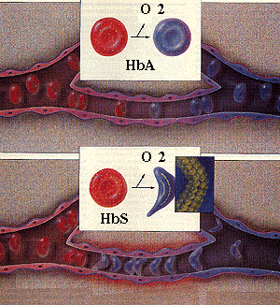

Slide 11
Pathophysiology
Shortened RBC survival | Vaso- occlusion
Anemia Jaundice Gallstones Cardiomegaly; CHF Leg ulcers Marrow hyperplasia Poor physical development Delayed maturation Subjective symptoms | Painful crisis of bone, muscle, Abdomen Psychological dysfunction Acute chest syndrome Strokes Eye damage Functional hyposplenism and autosplenectomy Susceptibility to bacterial infections Chronic organ failure

Slide 12
Factors leading to Vaso- occlusive crisis
HbS polymerization
An increase in red cell dehydration
Disruption of the red cell membrane bilayer
Upregulation of endothelial adhesion molecules
  Leukocyte activation and adherence to the endothelium
  Adherence of the red cell to the endothelium
Nitric oxide depletion by free heme
  Loss of NO associated vasodilatation
  Up-regulation of adhesion molecules

Slide 13
Factors contributing to Sickle Cell crisis
Deoxygenation
Dehydration
Infection
Pyrexia
Change in temperature
Acidosis
Exercise

Slide 14
Clinical Presentation
Fever and Bacteremia
Aplastic Crisis
Splenic Sequestration
Hepatic and Gallbladder Involvement
Sickle Cell Pain
Avascular Necrosis
Priapism
Neurologic Complications
Pulmonary Complications
Renal Disease and Enuresis
Cognitive and Psychological Complications

Slide 15
Lab investigations
CBC
  Anemia
  Reticulocytosis
Peripheral smear
  Polychromasia,
  Red cell fragments, and
  A variable number of hypochromic or target cells.
  Dense sickled cells seen in variable amounts.
  Howell–Jolly bodies may indicate hyposplenism
Evidence of hemolysis such as elevated LDH and bilirubin levels and low haptoglobin levels.

Slide 16
Definitive test
Methodologies used for hemoglobin identification
  Hemoglobin electrophoresis
  High-performance liquid chromatography(HPLC)
  Isoelectric focusing
  Mass spectrometry
  DNA testing

Slide 17
Neonatal screening
Early diagnosis facilitates parental education and the introduction of preventive vaccination and antibiotic programs.
Universal neonatal screening is performed using a blood spot technique from a heel-prick
Blood can be taken by direct venipuncture or by umbilical cord blood sampling.

Slide 18
Types of sickle events.
Hyposplenism/infection
  Anemia –
    Hemolytic,
    Aplastic,
    Anemia of chronic disease (e.g., renal failure)
Vasoocclusive
  Bone
  Abdominal-
    Splenic sequestration ,
    Bowel infarction,
    Hepatic sequestration
    Hepatic infarction
    Gallstones
  Heart
  Eye

Slide 19
Types of sickle events
  Chest –
    Acute chest syndrome,
    Chronic lung disease
    pulmonary hypertension
  Kidney-
    Acute renal failure,
    Chronic renal failure

Slide 20
Types of sickle events
  Priapism
  Leg ulcers
  Cerebral-
    Stroke,
    Silent infarction,
    Neurocognitive disorders

Slide 21
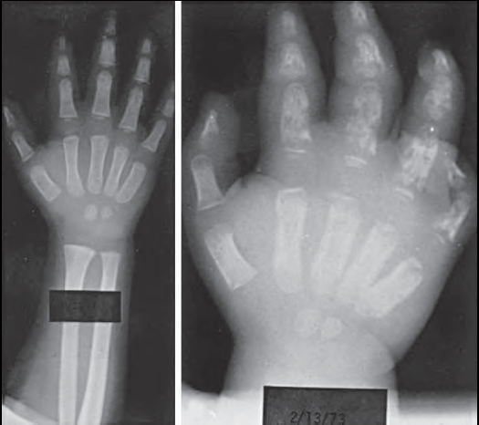
Dactilitis initial and 2 weeks later

Slide 22
Diagnosis
Clinical
Hemolytic anemia
Vaso oclussion
Infection
Laboratory
CBC
Peripheral Smear
Reticulocyte count
Sickling test
Genetic mutation
Imaging

Slide 23
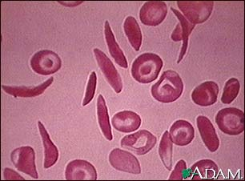

Slide 24
Complications
Anemia
Infections
Vaso-occlusive pain events
Sequestration crisis
Avascular necrosis
Aplastic crisis
Acute chest syndrome
Neurological complications
Renal complications
Cholelithiasis
Ophthalmic complications

Slide 25
Author | Journal | LOE | Result | Conclusion
Ana Paula dos Santos Gumiero et al. | Arq. Gastroenterol. vol.45 no.4 São Paulo Oct./Dec. 2008 | III | The prevalence of cholelithiasis was 45% and half the patients were asymptomatic. The mean age at the time of diagnosis of cholelithiasis and surgical treatment was 12.5 years (SD= 5) and 14 years (SD= 5.4), respectively. The prevalence of cholelithiasis was higher in patients with SS homozygous and Sb heterozygous thalassemia when compared to patients with SCD. In 50% of symptomatic patients RAP was the single or predominant symptom 39of 44 patients submitted to surgery reported symptom relief after the surgical procedure. Asymptomatic individuals who did not undergo surgical treatment were followed up for 7 years ( SD = 4.8), and none of them presented complications related to cholelithiasis during this period. | The frequency of cholelithiasis in the study population was 45%. 1/3 of the patients were diagnosed before 10 years of age. Patients with the SS homozygous or Sb heterozygous phenotype were at a higher risk for the development of cholelithiasis than patients with sickle cell disease. About 50% of patients with gallstones were asymptomatic and did not present complications during a 7-year follow-up period. Cholecystectomy must be considered in symptomatic patients.

Slide 26
Infections
Spleen
Infarcts
Functional asplenia
Encapsulated organisms - Streptococcus Pneumoniae, Salmonella, H. influenza

Slide 27
Routine Health care
Regular Hb, Reticulocyte, WBC count
Physical examination for icterus, cardiomegaly, murmurs and splenomegaly
Education of parents, genetic counseling.
Immunization pneumococcal, HIB
Penicillin prophylaxis.
Early detection and treatment of infection
Ophthalmologic examination for retinopathy.
Growth assessment – delayed puberty by 2 yrs.

Slide 28
Evaluation of febrile child
CBC
Retic Count
Blood culture, Urine culture
Chest- X- ray
Urine Routine
Ceftriaxone I.V. / oral antibiotics
Hospitalization

Slide 29
Penicillin prophylaxis
Oral/Injectable Prophylaxis
PROPS – Prophylaxis Penicillin Study showed that oral Penicillin twice a day, decreased pneumococcal bacteremia by 84%
Fever > 38.5ºC or Temperatures between 38.0ºC-38.5ºC
Double the dose of penicillin

Slide 30
Penicillin prophylaxis
All children < 5 years with SCD take daily prophylaxis.
All newborns , positive for SCD should be given prophylactic penicillin
Children <5 years of age should receive oral penicillin 125 mg twice daily, and for >5 years 250 mg twice daily
Amoxicillin 20 mg/kg/day is an alterative to penicillin.
Penicillin-allergic patients : Give Erythromycin 125 mg twice daily (< 5 years of age) or 250 mg twice daily (≥5 years of age).
Children with recurrent invasive pneumococcal infections should receive penicillin prophylaxis indefinitely
J Pediatr Pharmacol Ther. 2010 Jul-Sep; 15(3): 152–159

Slide 31
Vaccines in sickle cell disease
Pneumococcal
H. influenzae – b
Meningococcal
Enteric fever

Slide 32
Instructions for patients
Well balanced diet.
Fluid intake, 8-10 glasses of liquids,
Adequate rest and sleep 8 hours a night.
Avoiding extreme heat, cold and high altitudes.

Slide 33
Blood Transfusion
Episodic transfusion
  Management of severe anemia
  Management of sudden severe illness
Chronic transfusion therapy
  Primary stroke prevention
  Prevention of recurrent stroke
  Prevention of PAH and chronic lung disease
  Vital organ failure
Chronic debilitating pain

Slide 34
Specific indications
Blood transfusion –10 – 15 ml /kg PRBC
Exchange Transfusions – Stroke
CNS crisis
BMT –
HLA matched sibs
85% cure rate

Slide 35
Hydroxyurea
Increase HbF
Increases RBC hydration
Decreases RBC adhesion
Dose – 10-15 mg/kg/day
Bi monthly CBC, reticulocyte count
Measurement of HbF
> 3 crisis /yr

Slide 36
Author | Journal | LOE | Result | Conclusion
Samuel Charache, M.D., Michael L. Terrin, M.D., | N Engl J Med 1995; 332:1317-1322May 18, 1995 | II | Among 148 men and 151 women studied at 21 clinics, the 152 patients assigned to HU treatment had lower annual rates of crises than the 147 patients given placebo (median, 2.5 vs. 4.5 crises per year, P<0.001). The median times to the first crisis (3.0 vs. 1.5 months, P = 0.01) and the second crisis (8.8 vs. 4.6 months, P<0.001) were longer with HU treatment. Fewer patients assigned to HU had chest syndrome (25 vs. 51, P<0.001), and fewer underwent transfusions (48 vs. 73, P = 0.001). At the end of the study, the doses of HU ranged from 0 to 35 mg/kg/ day. Treatment with HU did not cause any important adverse effects. | Hydroxyurea(HU) therapy can ameliorate the clinical course of SCA in some adults with >3 painful crises / year. Maximal tolerated doses of HU may not be necessary to achieve a therapeutic effect. The beneficial effects of HU do not become manifest for several months, and its use must be carefully monitored. The long-term safety of HU in patients with SCA is uncertain.

Slide 37
MCQ’S

Slide 38
1) Sickle cell disease is
  Hemoglobinopathy
  RBC membrane defect
  Enzyme Defect
  Capillary Defect

Slide 39
2) Sickle cell disease occurs due to
  Mutation in chromosome 11
  Mutation in chromosome 12
  Mutation in chromosome 14
  Mutation in chromosome 16

Slide 40
3) Factors contributing to Sickle Cell crisis include all except
  Deoxygenation
  Dehydration
  Infection
  Rest

Slide 41
  4) Anemia in sickle cell disease occurs due to all except –
    Hemolysis,
    Hemorrhage
    Aplastic crisis
    Anemia of chronic disease (e.g., renal failure)

Slide 42
  5) Definitive test to diagnose sickle cell disease are all except
    Hemoglobin electrophoresis
    High-performance liquid chromatography(HPLC)
    Sickle solubility test
    Mass spectrometry

Slide 43
ANSWERS

Slide 44
Question no. | Answer
1 | A
2 | A
3 | D
4 | B
5 | C

Slide 45
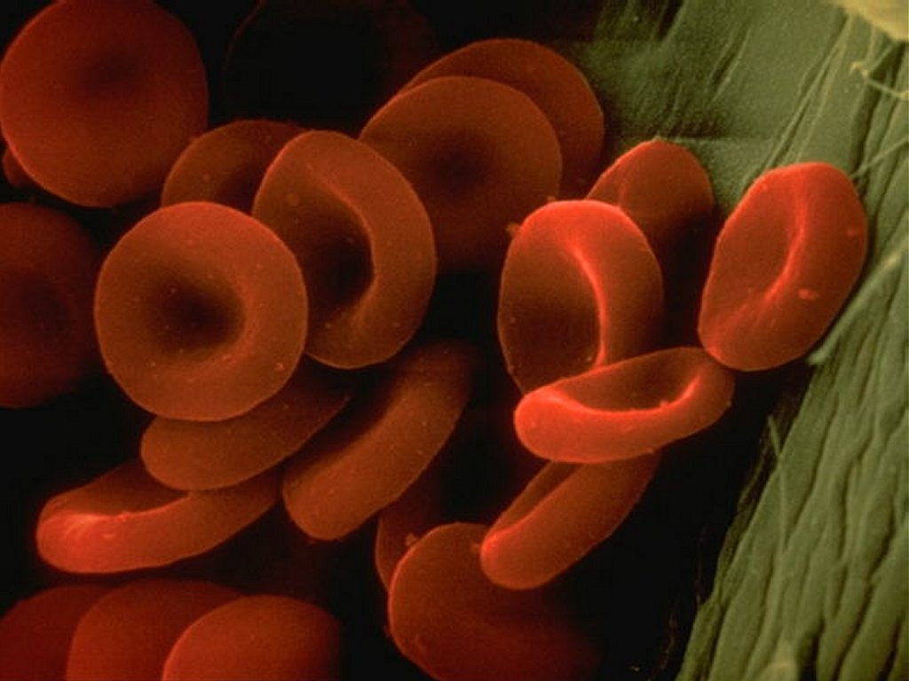
Thank You

