Slide 1
National TB Elimination Program
    Dr. Pradhyumn Pamecha
    Asst. Professor, Dept of Pediatrics
    Dr. Nidhi Shah
    Senior Resident, Dept of Pediatrics

Slide 2
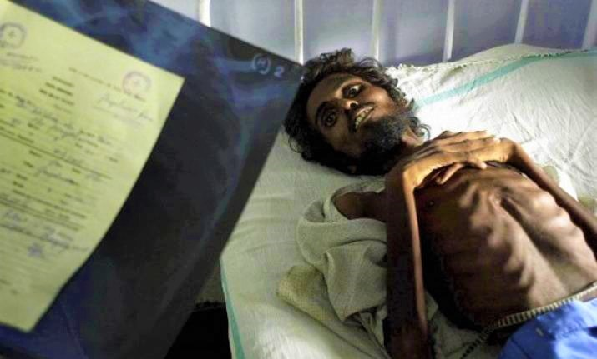
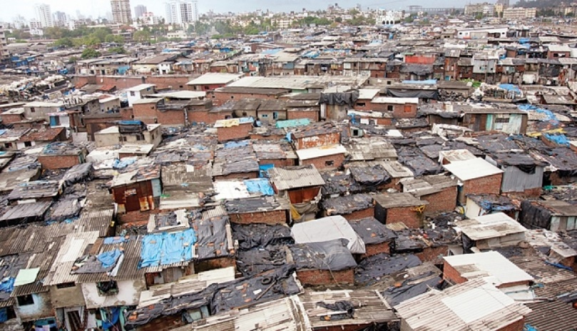
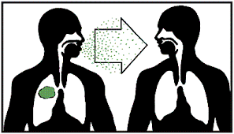
Tuberculosis (TB) is an infectious disease caused by the bacterium Mycobacterium tuberculosis (MTB) which generally affects the lungs, but can also affect other organs of the body
Risk factors:
  Malnutrition
  Diabetes
  HIV infection
  Poor immunity
  Severe kidney disease
  Other lung diseases
  e.g. silicosis
  Substance abuse etc.
  Overcrowding
  Inadequate ventilation
  Enclosed living/
  working conditions
  Occupational risks
One patient with infectious pulmonary TB if untreated can infect 10-15 persons in a year

Slide 3

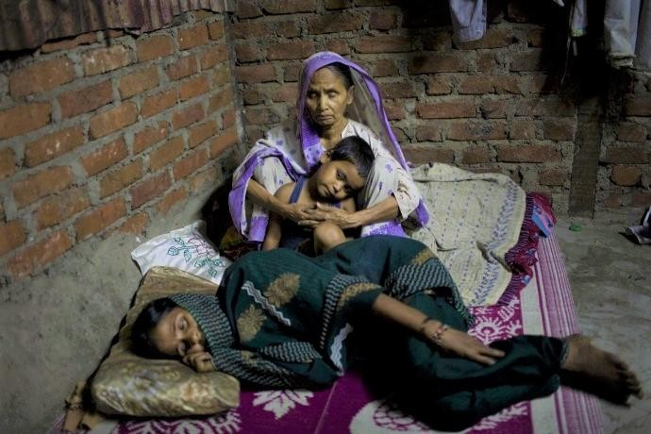
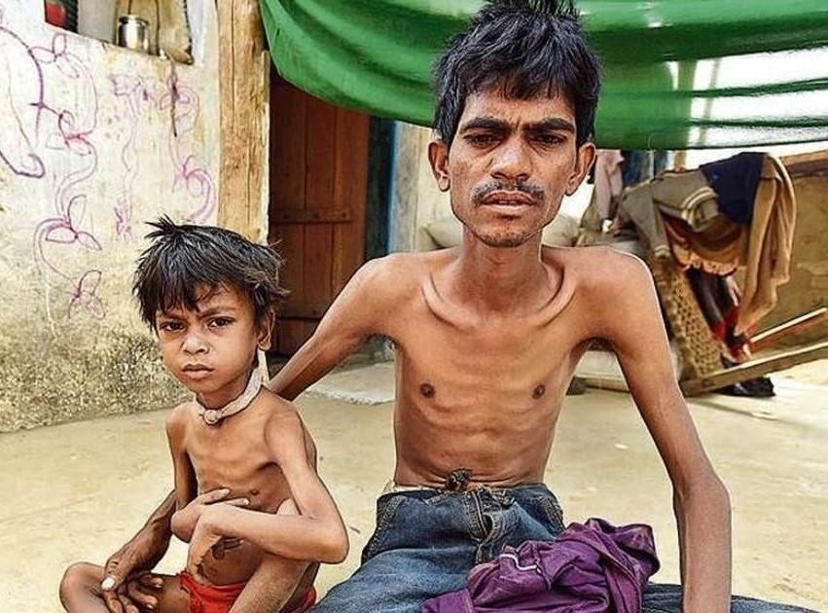
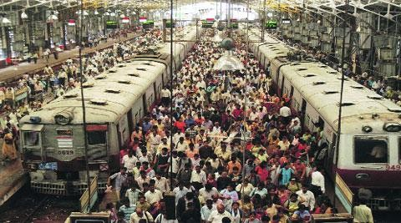
TB – A SOCIAL DISEASE
Vulnerable
Poor housing
Elderly, children & women
Malnutrition
Overcrowding

Slide 4
WHO announced End TB Strategy
Target – Reducing deaths by 90% and 95%
Reducing incidence by 80% and 90%
by 2030 and 2035
GOI aims TB elimination by 2025

Slide 5
EVOLUTION OF NTEP
2021
TB Mukt Bharat Abhiyaan
2020
In January 2020, GoI revised RNTCP to National TB Elimination Program (NTEP)
2017 – 25
NSP (2017 – 25) – patient centric care for TB elimination
2012 -17
National Strategic Plan (2012 -17) - mandatory notification of TB, rapid molecular testing, active case finding and integration of the program with National Health Mission
2005 – 11
Second phase of RNTCP – Pan India coverage and improved quality and scale up of services
1997
GoI revised NTP to RNTCP – introduction of DOTS (Directly Observed Treatment Short course)
1993
WHO declares TB as a global
1962
Govt. of India launched the National TB Program and set up District TB Centres
emergency

Slide 6


NATIONAL STRATEGIC PLAN (2017-2025)
Find all TB cases with an emphasis on reaching every TB patient in the private sector
Detect
Treat
Treat all TB cases with high quality anti TB drugs
Preve nt
Prevent the emergence of TB in susceptible populations and stop catastrophic expenditure due to TB by all
Build
Build & strengthen supportive systems including enabling policies, empowered institutions & human resources

Slide 7
TB Notification under NTEP

Slide 8
Sustainable Development Goals (SDG)
Vision: A world free of TB
Zero TB deaths, Zero TB disease, and Zero TB suffering
Goal: End the Global TB Epidemic (<10 cases per 100,000 population)
INDICATORS | TARGETS
 | SDG 2030
Reduction in number of TB deaths compared with 2015 (%) | 90%
Reduction in TB incidence (new case) rate compared with 2015 (%) | 80%
TB-affected families facing catastrophic expenditures due to TB (%) | Zero

Slide 9

TB Free India
India has committed to End TB by 2025, 5 years ahead of the global SDG target
The campaign calls for a social movement focused on patient-centric and holistic care driven by integrated actions for TB Free India

Slide 10
National Strategic Plan (2017-25)
Strategies
Private sector engagement
Active Case Finding
ICT Tools for adherence and monitoring
Preventive Measures
TB
Co-morbidities
Drug Resistant TB
Multi-sectoral response
Community Engagement

Slide 11
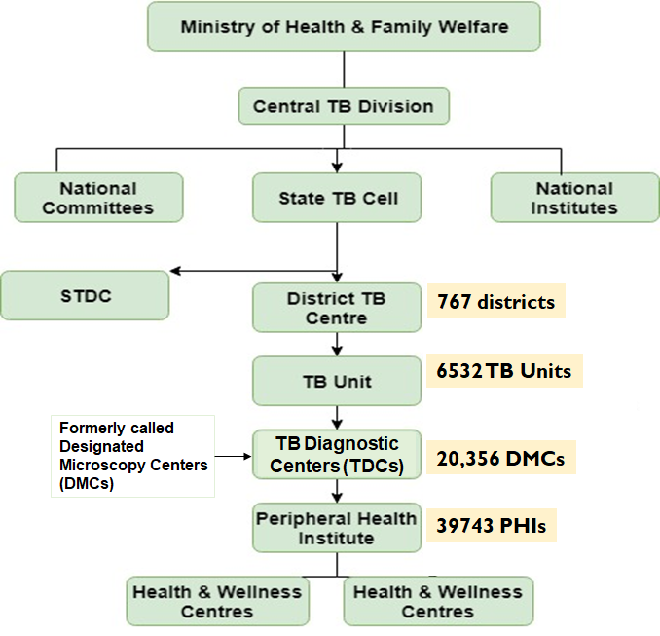
Organizational structure
Supporting Facilities
National Reference Laboratories (6) Intermediate Reference Laboratories (31) Culture and DST Laboratories (81 including IRL/NRL) CBNAAT Laboratories (1268) DRTB Centres- 703

Slide 12
Key Services
Free diagnosis and treatment for TB patient
Public health action- contact tracing, testing for co-morbidities etc.
Treatment adherence support
Nutrition assistance to TB patients (DBT-Nikshay Poshan Yojana)
Preventive measures

Slide 13
Direct Benefit Transfer (DBT) schemes
  Honorarium to Treatment Supporters – For provision of treatment support to TB patients (Adherence, ADR monitoring, counselling @Rs.1000/- to Rs.5000/-)
  Patient Support to Tribal TB Patients (Financial Patient Support @Rs750/-)
  Nutritional Support to All TB patients (Financial Support to Patients @Rs.500/-month)
  Incentives to Private Providers (Rs.500/- for Notification & Rs.500/- for reporting of Treatment Outcome
  Incentives to Informant (Rs. 500/- is given on diagnosis of TB among referrals from community to public sector health facility)
Notes:
In RNTCP, one of the first health programs to move to DBT, will be using it to transfer monetary benefits to eligible patients and providers. We would be using Nikshay to identify the beneficiaries and the transfer of funds will be through the Public Financial Management System or PFMS

Slide 14
Prevent
Air borne infection control measures
Strengthen Contact Investigation
Preventive treatment in high risk groups
Manage Latent TB Infection
Address determinants of disease

Slide 15
Diagnostic tools
Sputum smear microscopy for AFB
  ZN Staining
  Flourescent staining
Culture
  Solid (LJ) media
  Liquid culture system
Rapid molecular diagnostic testing
  Line probe assay
  CB NAAT/ TrueNat/ Ultra NAAT

Slide 16
Persistent fever >2wk, without a known cause and/or
Unremitting cough for >2wk and/or
Weight loss of 5%; or, no weight gain in past 3 mo despite adequate nutrition; or, failure of nutritional rehabilitation in babies with severe acute malnutrition
With or without contact with patient with pulmonary TB in past 2 years
HIV testing should be offered to all children diagnosed with TB
↓
Chest X-ray (CXR)
↓
↓
CXR Normal
CXR highly suggestive
CXR Non-specific shadows
↓
←
↓
Expectorated sputum/GA/IS for NTEP approved rapid NAAT for Mtb
NAAT + ve
Check for extra-pulmonary TB (EPTB)
Needs detailed investigation for TB or an alternate cause for the symptoms. May require CECT chest or other investigations depending on symptoms.
Consider referral to a higher center for further investigations
↓
Microbiologically confirmed TB Case
Give course of appropriate antibiotics Skip this step if already received an appropriate antibiotic course
↓
↓
RIF resistance detected.
Re-confirm and follow the DRTB pathway
RIF resistance not detected. Treat with first line drugs
↓
Persistent shadow and symptoms
↓
NAAT -ve
↓
Look for any other site like a significantly enlarged peripheral enlarged lymph node and test the lymph node aspirate for Mtb
Consider repeat NAAT from a better quality specimen or alternative specimen like bronchoalveolar lavage or aspirate depending upon the availability and feasibility
May seek review from a higher centre
Algorithm for pediatric intrathoracic tuberculosis (TB) among children with no risk factors for drug resistance.
No other likely alternative diagnosis Treat as clinically diagnosed probable TB case
↓ ↓
NAAT -ve
or repeat test not indicated or feasible
NAAT +ve
→

Slide 17
NTEP has introduced daily therapy with dispersible tablets in fixed dose combinations (FDC) for children
Younger children get 3-drug FDCs (HRZ) along with 100 mg ethambutol tablets.
Older children can also get, in addition, 4-drug FDCs (RHZE) to meet their drug dosages.
Isoniazid and rifampicin are in a ratio of 2:3 and the average dose of isoniazid is around 10 mg/kg/day. These drugs are given free of cost in public sector and the private sector can also access these drugs for free through various partnership schemes that the program offers.
Experts now also recommend addition of pyridoxine (10 mg/day) with isoniazid containing regimens because of the risk of peripheral neuropathy due to higher dosages

Slide 18
Drug Regimen for Rifampicin-Sensitive Tuberculosis as per IAP-NTEP Guidelines, 2020
Type of patient* Regimens
New microbiologically confirmed pulmonary TB 2HRZE + 4HRE#
New clinically diagnosed pulmonary TB
New microbiologically confirmed extra-pulmonary TB
New clinically diagnosed extra-pulmonary TB
Previously treated TB ^
(recurrence, treatment after loss to follow up, treatment after failure)

Slide 19
Tuberculosis Drug Formulations and Dosages for Children As per IAP NTEP Guidelines, 2020
Weight band (kg) Dose from 0-18 y*
4-7
8-11
12-15
16-24
25-29
30-39 2P+2E+2A
1P + 1E
2P + 2E
3P + 3E
4P + 4E
3P+3E+1A
H-Isoniazid, R-Rifampicin; Z-Pyrazinamide, E-Ethambutol; *number preceding the letter denotes number of pediatric or adult formulations;
Pediatric formulation (P) H50, R75, Z150 + E 100 (E separate tab);
adult formulation (A) H75, R150, Z400, E275;
Children (aged 0-18 y) upto the weight of 39 kg should be managed as per this table; children (aged 0-18 y) ≥40 kg would be managed as per the various weight bands described for adults.

Slide 20
All presumed cases with DRTB
↓
Source’s sample of contacts subjected to DST, if child’s specimen not available
NAAT/MGIT culture
↓
↑
↓
RR TB
For discordance on LPA for RR-
TB – repeat CBNAAT at LPA lab
RS TB
↓
↓
SL – LPA#
FL-LPA*
RR-TB among new patients – repeat
CBNAAT in fresh sample‡
↓
↓
↓ ↓
↓ ↓
FQ and SLI Sensitive
FQ and/or SLI Resistance
H Sensitive
H Resistant
Algorithm for evaluation of children with suspected drug resistant tuberculosis (DR TB)

Slide 21
Table II Drug Regimen for Pediatric Drug-Resistant Tuberculosis as per IAP NTEP Guidelines, 2020
Type of tuberculosis | Treatment regimen | Special considerations
RR/MDR-TB without additional drug | Intensive phase | Recommended for pulmonary cases or
resistance to FQ and/or SLI* | (4-6) Mfx^{h} Km Eto Cfz Z H^{h} E | non severe forms of EPTB like isolated
(Conventional Short Regimen – Initial | Continuation phase | lymph node disease or pleural effusion,
regime for pulmonary TB & isolated | (5) Mfx^{h} Cfz Z E | etc.
pleural effusion or lymph node TB) |  | Not exposed to reserve drugs
 |  | Send tests for SLI and FQ class
 |  | resistance, continue this regimen only if
 |  | sensitive to these two drug classes
MDR TB / MDR TB + FQ resistance / | Intensive phase | Not for severe EPTB like intracranial TB
XDR – TB#, $, ‡ | 6-8 Dlm (Bdq) Lfx (Mfx^{h}) Lzd Cfz Cs | or disseminated TB
(All oral regime for children above 6 y) | Continuation phase 12 Lfx (Mfx^{h}) Lzd (l) Cfz Cs | Not for children <6 y Bdq to be replaced by Dlm in 6-17y age Lfx to be replaced by Mfx^{h} if FQ class
 |  | resistance
MDR TB(EP)/ | Intensive phase | Disseminated or severe extra-pulmonary
Or | (6-9) Amika Mfx^{h} Lzd Cfz Eto Cs | disease
MDR TB + FQ resistance/XDR - TB And | Continuation phase (18) Mfx^{h} Lzd (l) Cfz Cs
Not eligible for all oral regime above
Resistance to INH (with or without any | Uniphasic regime | Can be extended to 9-12 mo in extensive
non-rifampicin first line drug resistance) ^ | (6) Lfx R E Z | pulmonary disease and extrapulmonary
 |  | disease like bone or intracranial
RR: Rifampicin resistant; MDR: Multidrug resistant; XDR: Extensively drug resistant; EPTB: Extrapulmonary TB; FQ: Flouroquinolones; SLI: Second line injectables; Mfxh: High dose moxifloxacin; Km: Kanamycin; Eto: Ethionamide; Cfz: Clofazimine; Z: Pyrazinamide; Hh: High dose isoniazid; E: Ethambutol; Dlm: Delaminid; Bdq: Bedaquline; Lzd: Linezolid; Cs: Cycloserine; Lfx: Levofloxacin; *Shorter MDR TB regimen is of 9- 11 mo with 4-6 mo of IP containing injectables and 5 months of CP. If the IP is prolonged, the injectable is only given three times a week in the extended intensive phase; #All oral longer MDR TB regimen is of 18-20 months; $New drugs like Bdq and Dlm would be given for 6 months duration while the dose of Lzd will be tapered to 10mg/kg/d (max 300 mg) after the initial 6-8 mo of treatment; ‡This regimen will also be used for treatment of XDR TB patients with 20 mo duration; ^All oral H mono/poly DR TB regimen is of 6 mo with no separate IP/CP.

Slide 22
Q1) Target of End TB Strategy by WHO
(a) Reducing incidence by 80% and 90% by 2030 and 2035
(b) Reducing incidence by 50% and 70% by 2030 and 2035
(c) Reducing incidence by 10% and 20% by 2030 and 2035
(d) Reducing incidence by 90% and 95% by 2030 and 2035

Slide 23
Q2) Which of the following is not the first line drug for TB
(a) Ethambutol
(b) Ethionemide
(c) Isoniazide
(d) Pyrizinamide

Slide 24
Q3) Incentive to private sector providers for notification of TB patients
(a) Rs. 500 as a one-time payment on notification & Rs. 500 to private practitioner or hospital for updating the patient’s treatment outcome
(b) Rs. 500 as a one-time payment on notification
(c) Rs. 500 to private practitioner or hospital for updating the patient’s treatment outcome
(d) None

Slide 25
Q4) Addition of Pyridoxin with Isoniazide reduces risk of
Hepatitis
Reanal toxicity
Peripheral Neuropathy
All of the above

Slide 26
Q5) Dose of Rifampicin for paediatric patient
(a) 10 mg/kg/day
(b) 15 mg/kg/day
(c) 20 mg/kg/day
(d) 30 mg/kg/day

Slide 27
Thankyou

