Slide 1


LABORATORY SAFETY & BIO-MEDICAL WASTE
Dr. Navneet Kumar Singh

Slide 2
CONTENT
CONTENTS
DEFINITION
SOURCES
CLASSIFICATION
NEED FOR MANAGEMENT
HOW IT CAME INTO EXISTANCE?
OBJECTIVE
PROCESS
AWARENESS AND EDUCATION
CONCLUSION

Slide 3
WHAT IS A
BIO-MEDICAL WASTE??

Slide 4
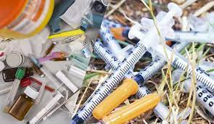
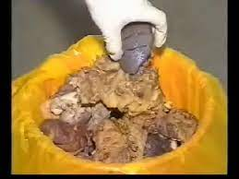
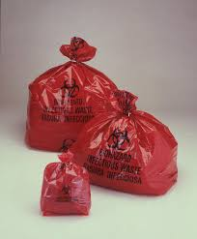
Definition
Biomedical waste is defined as any waste, which is generated during the diagnosis, treatment or immunisation of human beings or animals, or in research activities pertaining thereto, or in the production or testing of biologicals.

Slide 5
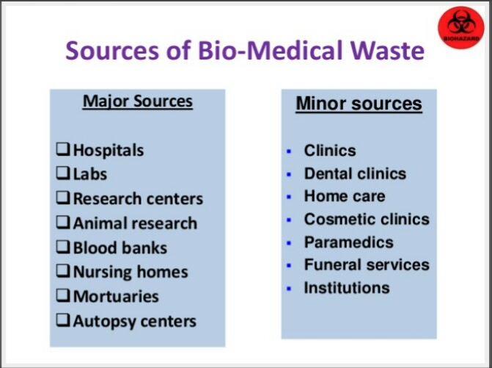
SOURCES

Slide 6
Categories of Biomedical Waste
1. Human anatomical waste: (tissues, organs, body parts)
2. Animal waste: (including animals used in research and waste originating from veterinary hospitals and animal houses).
3. Microbiological and biotechnology waste: (including waste from lab cultures, stocks or specimens of microorganisms, live or attenuated vaccines, wastes from production of biologicals, etc.)
4. Waste sharps: (used/unused needles, syringes, lancets, scalpels, blades, glass etc.)
5. Discarded medicines and cytotoxic drugs.

Slide 7
Categories of Biomedical Waste
6.Soiled wastes: (items contaminated with blood and body fluids, including cotton dressings, linen, plaster casts, bedding etc.)
7. Solid wastes: (wastes generated from disposable items other than waste sharps such as tubing, catheters, i.v. sets, etc.)
8. Liquid waste: (waste generated from washing, cleaning, house keeping and disinfection activities including these activities in labs).
9. Incineration ash: (from incineration of any biomedical waste)
10. Chemical waste: (chemicals used in production of biologicals and disinfection).

Slide 8
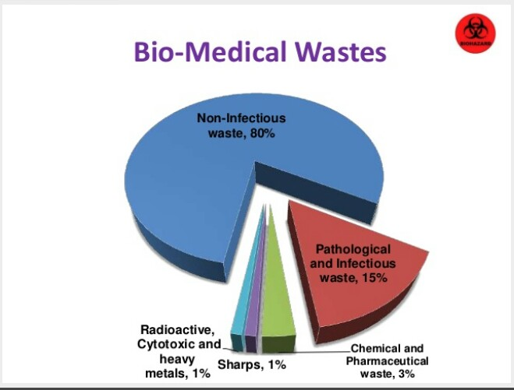
CLASSIFICATION

Slide 9
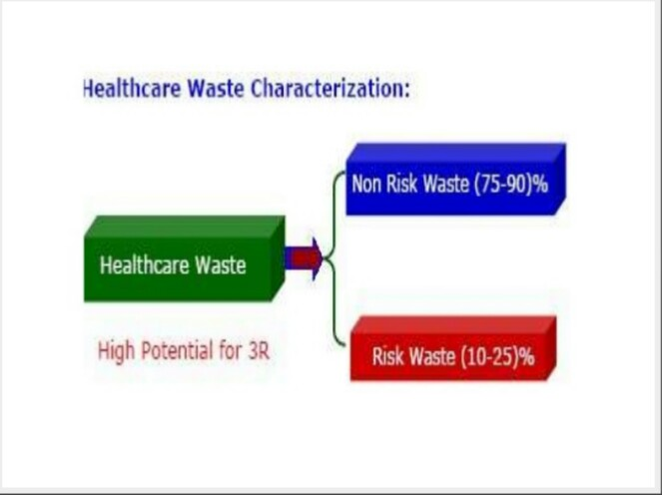

Slide 10
Biohazard
Biological hazards, also known as biohazards, refer to biological substances that pose a threat to the health of living organisms, primarily that of humans. This can include medical waste or samples of a microorganism, viruses, or toxins (from a biological source) that can affect human health.
4 categories of Biohazard are:
Solid Biohazardous Waste
Liquid Biohazardous Waste
Sharp Biohazardous Waste
Pathological Biohazardous Waste

Slide 11
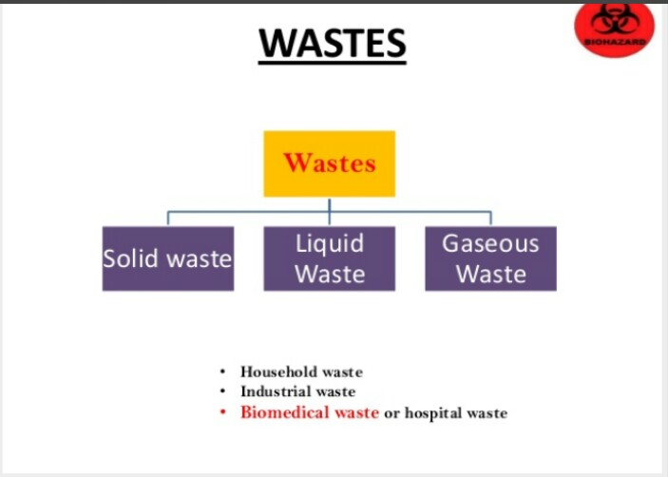

Slide 12
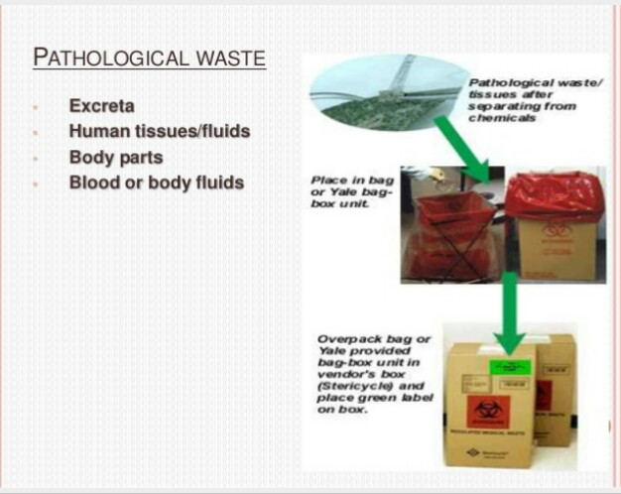

Slide 13
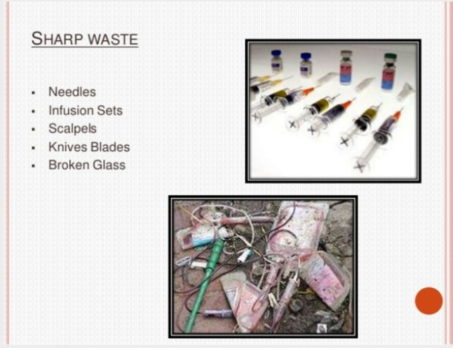

Slide 14
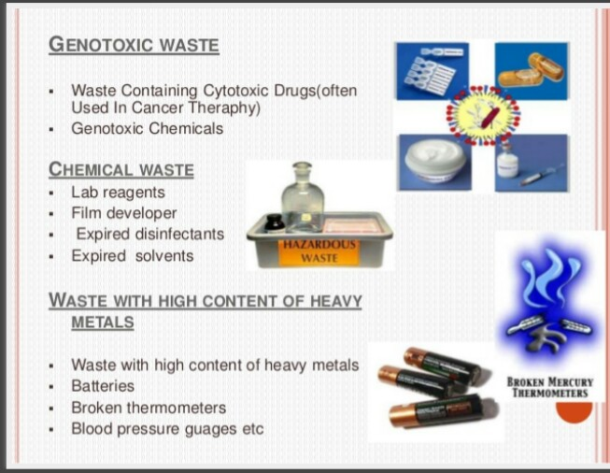

Slide 15
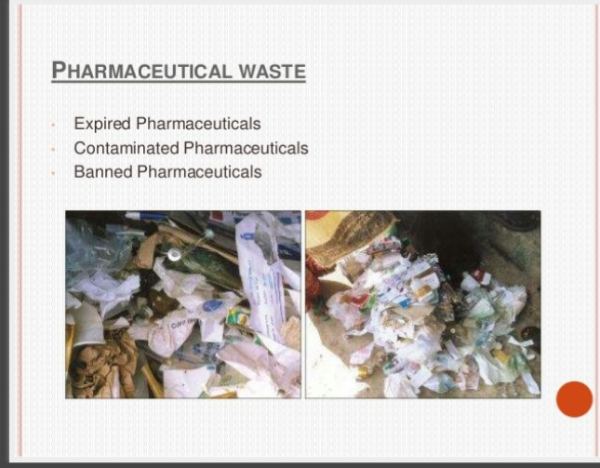

Slide 16
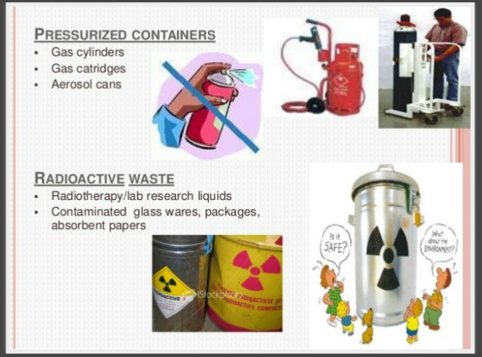

Slide 17
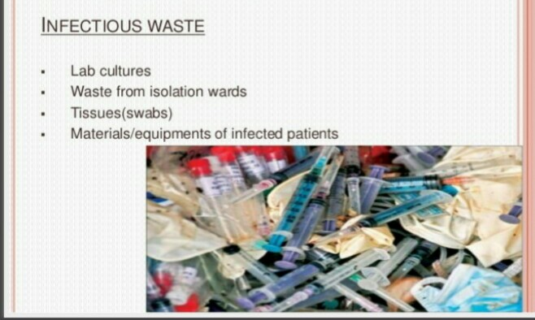

Slide 18
NEED FOR BMW MANAGEMENT

Slide 19
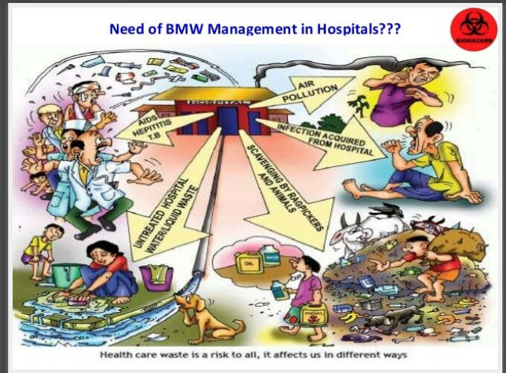

Slide 20
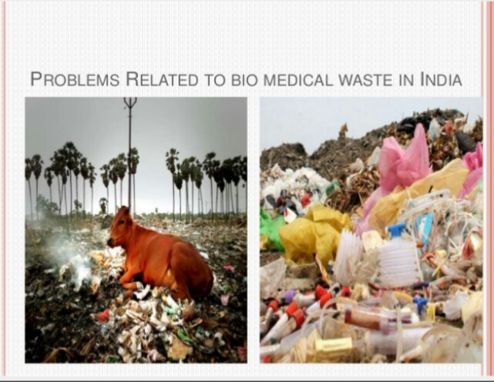

Slide 21
HOW IT CAME INTO EXISTANCE

Slide 22
In late 1980’s
Items such as used syringes were washed up on several East Coast beaches
Concern about HIV and HBV virus infection
Lead to development of biomedical waste management law in USA
Howerer in INDIA the seriousness about the management came into limelight only after 1990’s

Slide 23
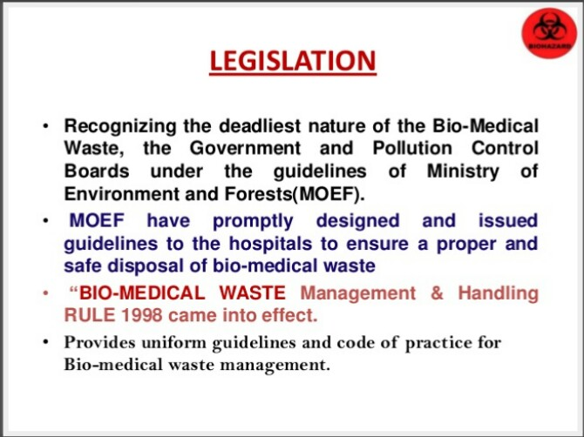

Slide 24
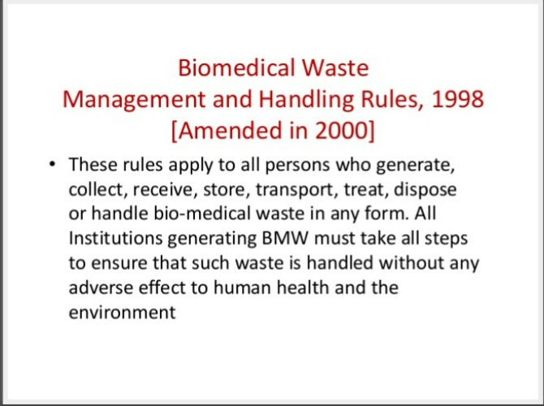

Slide 25
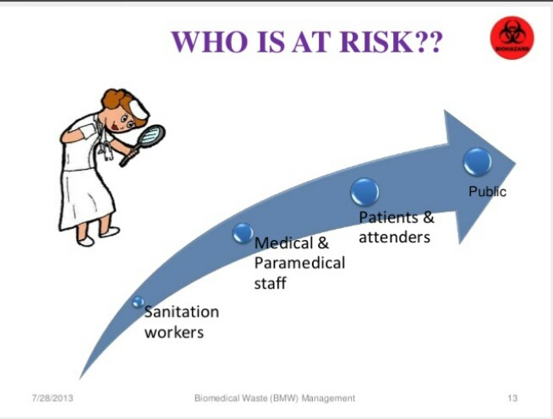

Slide 26
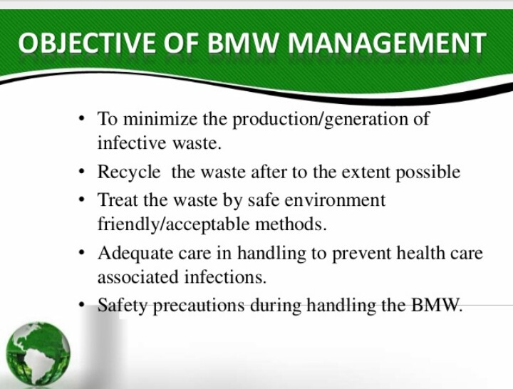

Slide 27
BMW MANAGEMENT PROCESS
HOSPITALS
IN HOUSE SEGREGATION
COMMON STORAGE POINT
TRANSPORTATION
UNLOADING AND TEMPERATURE STORAGE AT CBWTF
TREATMENT
DISPOSAL

Slide 28
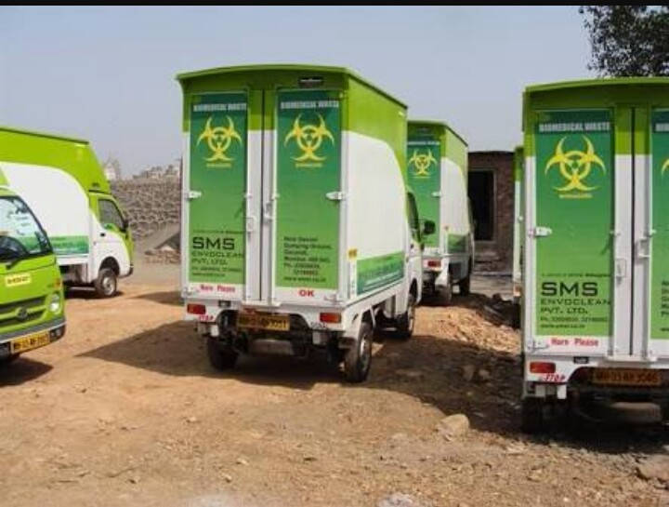
VEHICLE USED FOR TRANSPORTATION

Slide 29
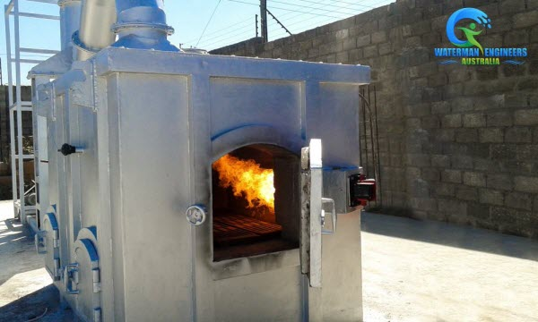
Incinerator

Slide 30
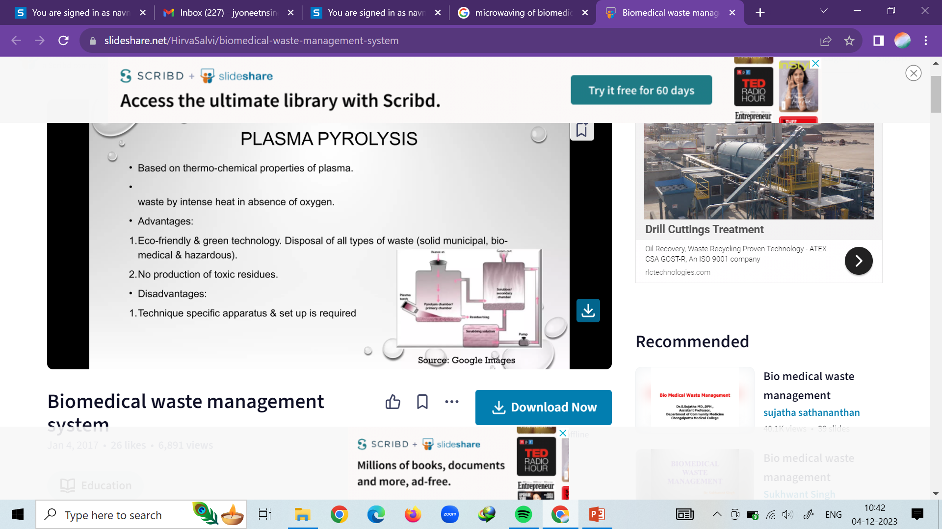
Plasma pyrolysis technology is a non-incineration thermal process that uses extremely high temperature in an oxygen starved environment to completely dissociate waste in to their elemental constituents. It uses heat generated by graphite electrode based plasma arc system.

Slide 31
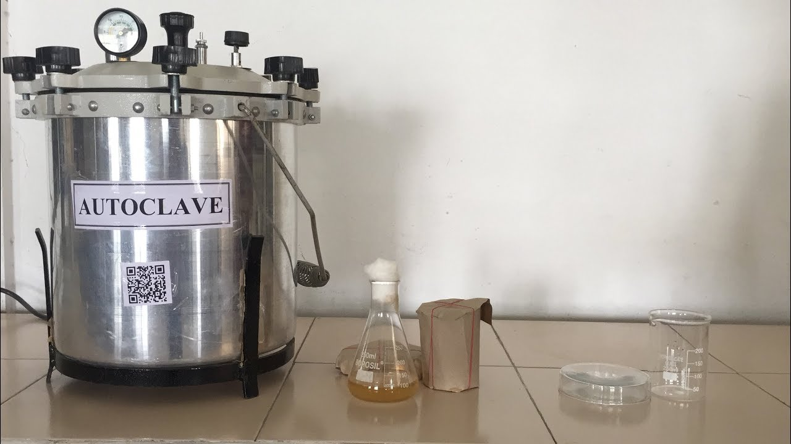
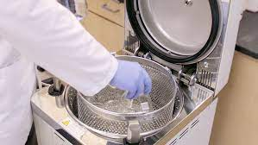
Autoclaving

Slide 32
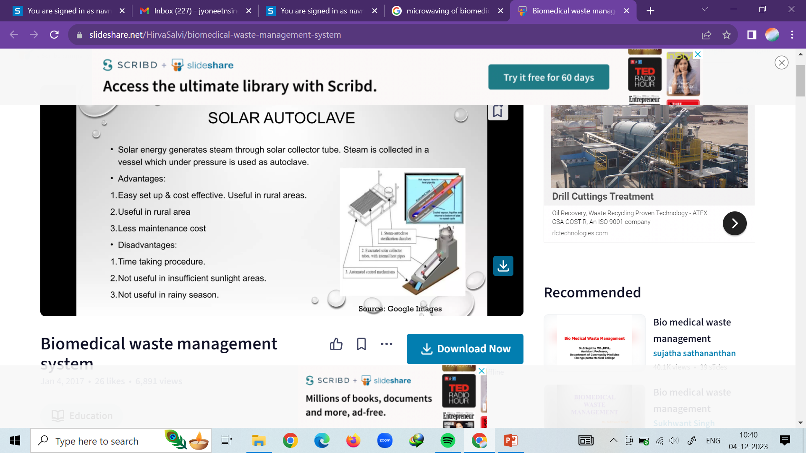

Slide 33
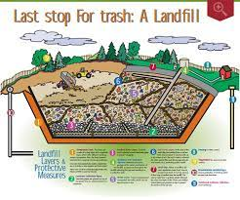
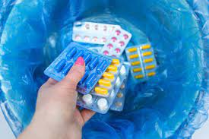
Landfill

Slide 34
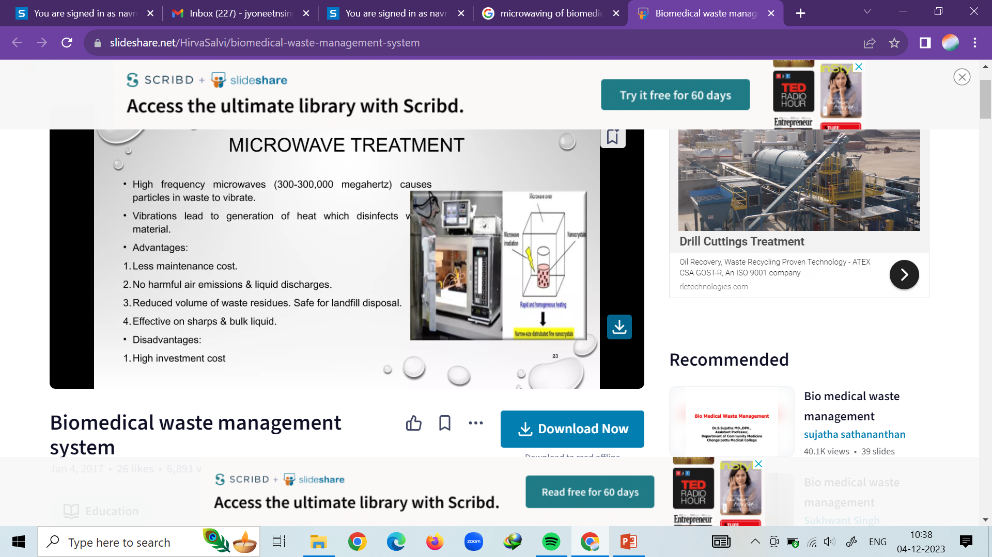
Microwaving

Slide 35
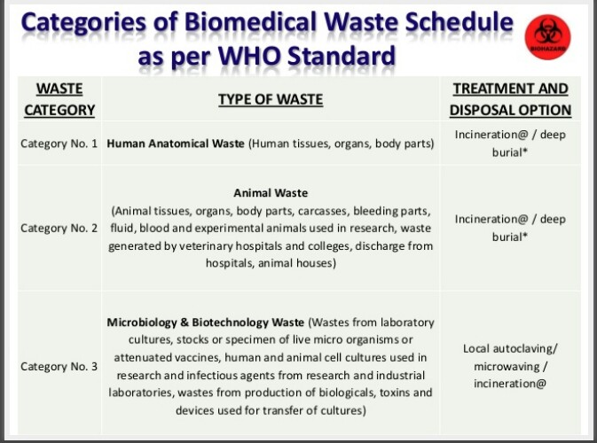

Slide 36
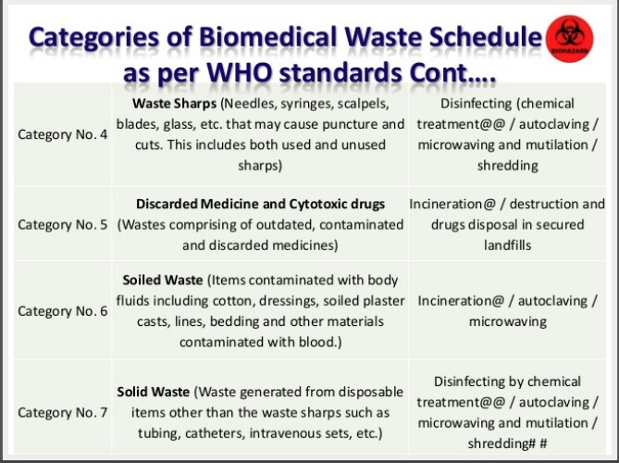

Slide 37
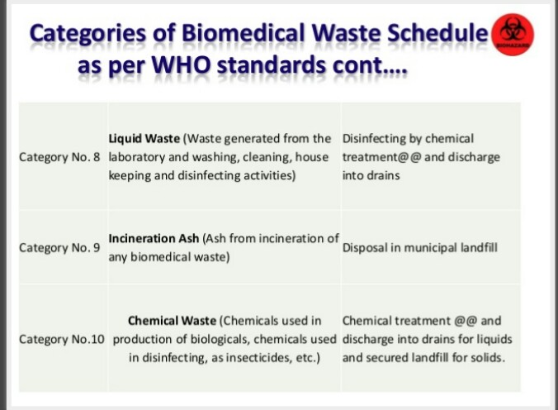

Slide 38
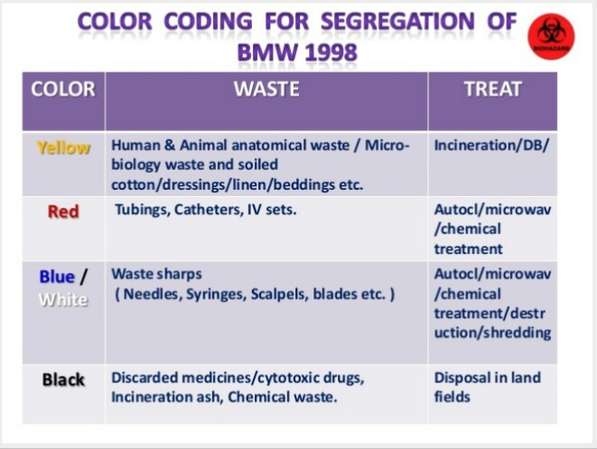

Slide 39
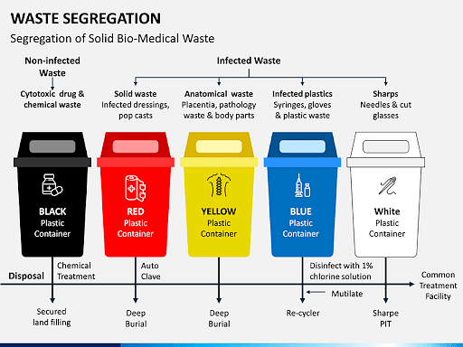

Slide 40
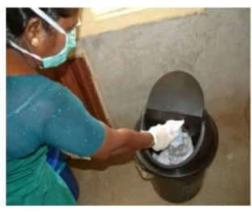
AWARENESS AND EDUCATION
Organizing seminars
Workshops
Practical demonstrations
Group disscusions
Lectures

Slide 41
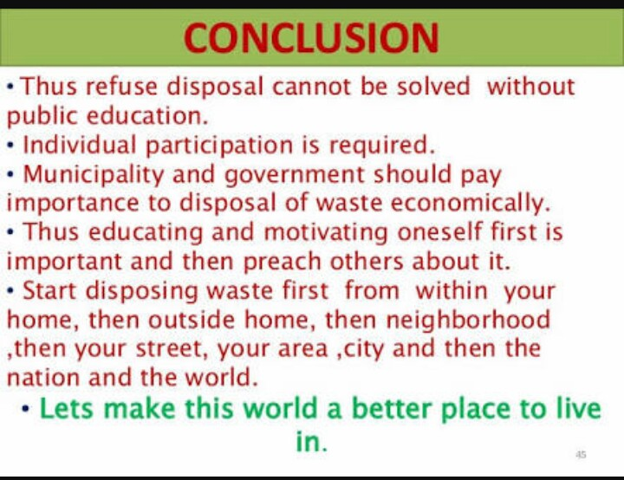

Slide 42


Slide 43


Slide 44

