Slide 1
Electromagnetic Spectrum
and
Radiation
Dr. Jayapandiyan
Dept. of Paramedical Science
SVDU, Vadodara,
Gujarat

Slide 2
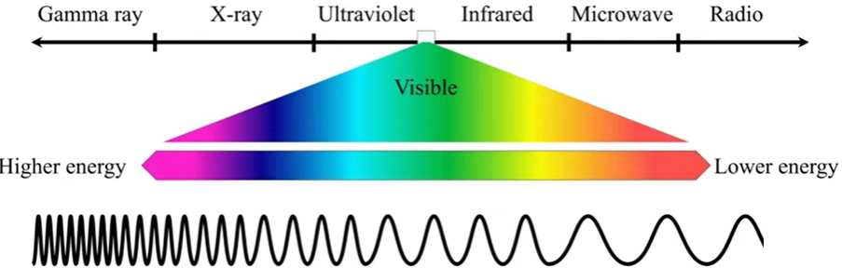
Electromagnetic Spectrum
The electromagnetic spectrum is defined as the range of all types of electromagnetic radiation. Radiation is energy that travels and spreads out energy as it travels.
[ OR]
The electromagnetic spectrum (EM spectrum) has different range of frequencies, wavelengths, and photon of energies.

Slide 3
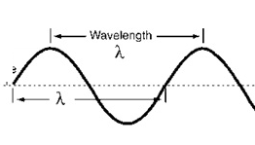
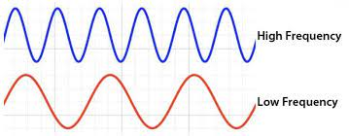
Wavelength (λ) : It describes how long the wave is. OR length of one complete wave. It is measured in metre (m)
Frequency( f) : It is no of waves produced in 1 second. It is measured in hertz (Hz)
Relation between Frequency and Wavelength
The shorter the wavelength, the higher the frequency and vise versa.
So, frequency and wavelength are inversely proportional to each other, λ = 1/ f
Period (T) which can be used to describe a wave. It is defined as the time taken to complete one oscillation.
f = 1 / T
Wave speed (v) is defined as the distance travelled by a wave per unit of time.
ν = λ/T
since, T = 1/f,
V = f λ

Slide 4
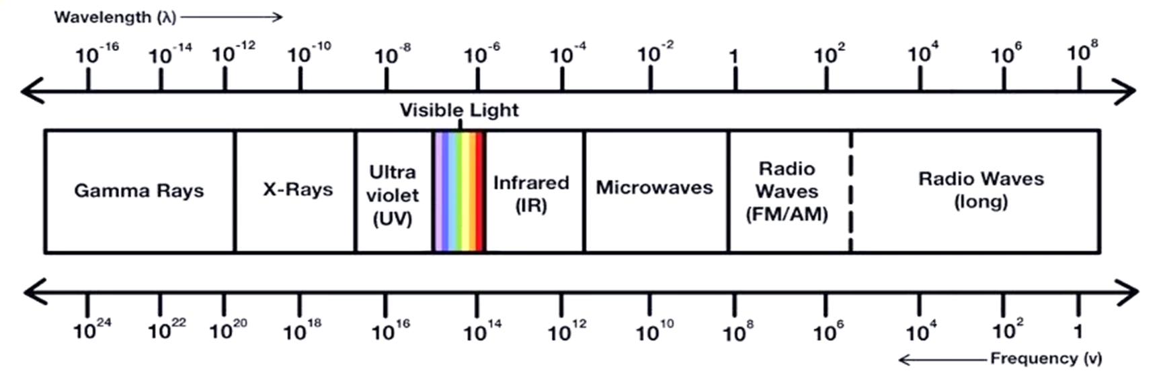
Properties
Electromagnetic waves are propagated by oscillating electric fields and magnetic field oscillation at right angles to each other.
They are transverse waves.
They travel with the speed of light in vacuum.
They are not deflected by electric or magnetic field.
They can show interference or diffraction.
No medium is required for propagation.

Slide 5
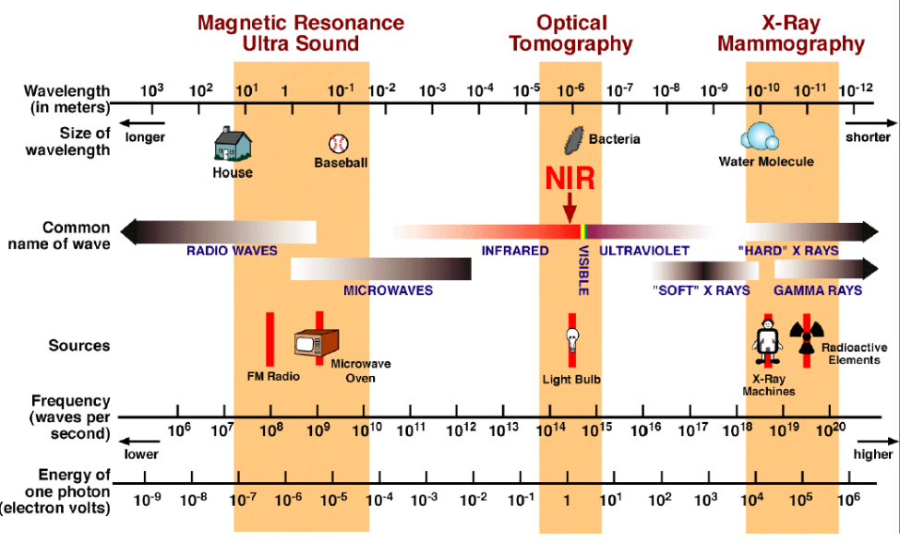

Slide 6
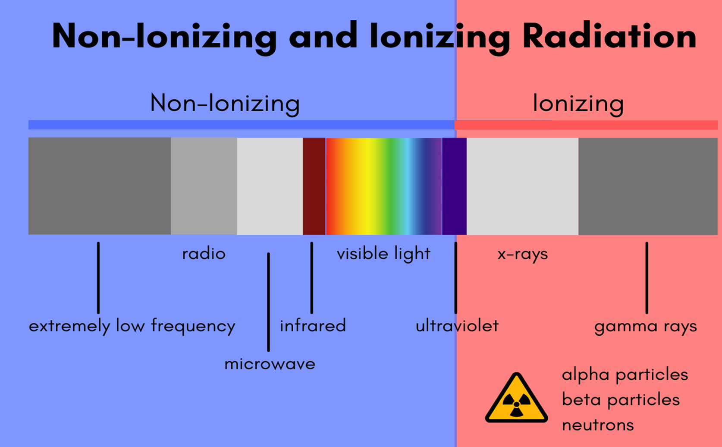

Slide 7
Electromagnetic Wave | Frequency (Hz) | Wavelength (meters) | Source | Common Uses
Radio Waves | < 3x10¹¹ | > 1 mm | Transmitters Antennas | Broadcasting, wireless communication
Microwaves | 3x10¹¹ - 10¹³ | 1 mm - 25 μm | Microwave ovens Communication | Cooking, radar, wireless networks
Infrared Waves | 10¹³ - 10¹⁴ | 25 μm - 2.5 μm | Hot objects Thermal radiation | Remote controls, thermography
Visible Light | 4 - 7.5x10¹⁴ | 750 nm - 400 nm | Natural and artificial light sources | Vision, optical communication
Ultraviolet Waves | 10¹⁵ - 10¹⁷ | 400 nm - 1 nm | Sun Special lamps | Germicidal lamps, forensics
X-Rays | 10¹⁷ - 10²⁰ | 1 nm - 1 pm | X-ray machines particle reactions | Medical imaging, materials testing
Gamma Rays | 10²⁰ - 10²⁴ | < 10⁻¹² m | Nuclear reactions cosmic sources | Medical therapy, gamma-ray astronomy

Slide 8
Thank you

