Slide 1
INTERACTIONS OF
X-RAYS
GAMMA RAYS
AND
BETA RAYS
WITH MATTER
Dr. Jayapandiyan
Dept. of Paramedical Science
SVDU, Vadodara,
Gujarat

Slide 2
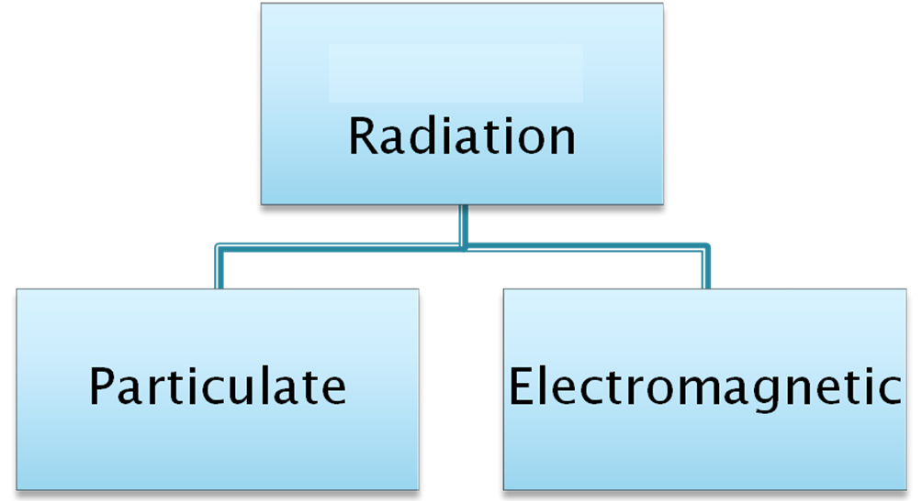
The term radiation applies to the emission and propagation of energy through space or material.
RADIATION

Slide 3
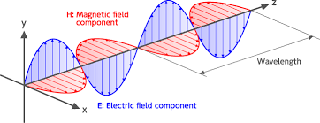
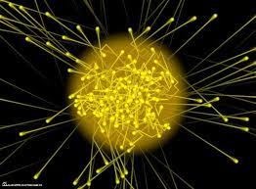
Wave: continuously changing E and M fields
Nature of Electro Magnetic Radiation
energy travels as sine WAVE
macroscopic level
Particle: photon or quanta
small packet of energy acting as a PARTICLE
microscopic level

Slide 4
Characteristics of Electro Magnetic Radiation
Travel at speed of light (c) in a vacuum (or air) that is c = 3 x 10⁸ m/s
Travel in a straight line (linear path)
Unaffected by electric or magnetic field and gravity
When passing through the matter, the intensity is reduced (attenuation), because of absorption & scattering.
Obeys the inverse square law that is I α d²

Slide 5
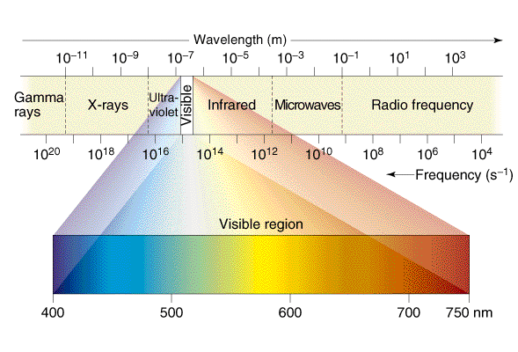
Electro Magnetic Spectrum
Ionizing
Non-Ionizing

Slide 6
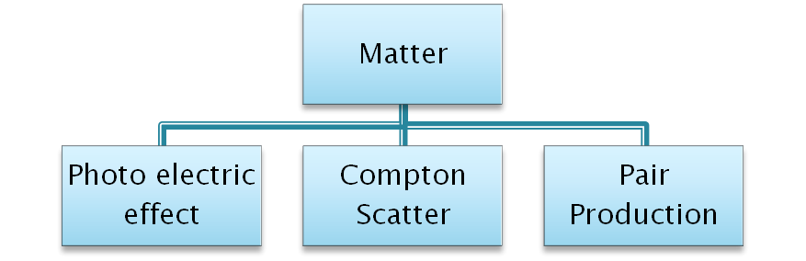
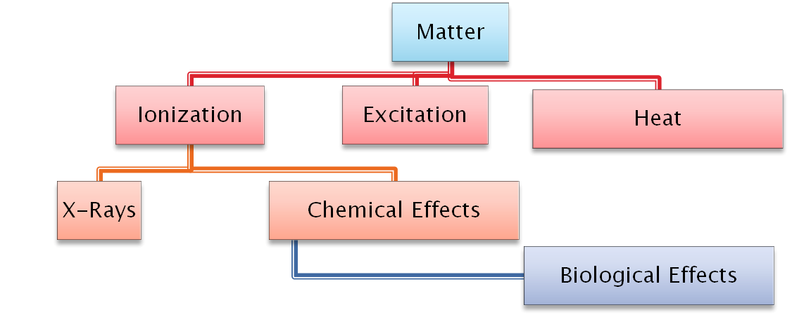
Photon
Interaction of Photons
High Speed Electrons

Slide 7
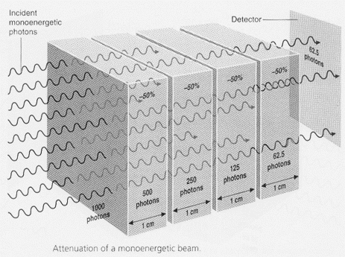
Interaction of Photons with Matter
Three possible occurrences when x or gamma photons in the primary beam pass through matter:
  No interaction at all - Known as transmission
  Absorption
  Scatter
    Absorption and Scattering are methods of attenuation
Attenuation Of X-Ray Photon

Slide 8
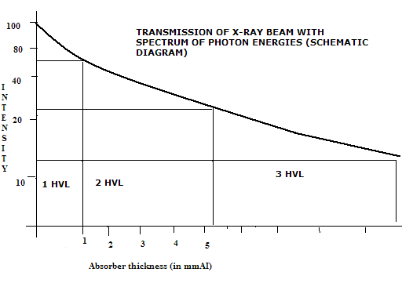
Attenuation
When mono-energetic radiation passes through any material, a reduction in the intensity of the beam occurs and this is known as attenuation.
Attenuation occurs exponentially, i.e. a given fraction of the photons is removed for a given thickness of the attenuating material.
Half-value-layer (HVL) : The thickness of the absorber material required to decrease (attenuate) the intensity of a monoenergetic photon beam to half its original value.
This shows the quality or the penetrating power of an x-ray beam.

Slide 9
Attenuation Coefficient
Linear attenuation coefficient (μ) : The fractional reduction (in any monoenergetic photon beam) for any given material per unit thickness.
μ is the probability of the photon being removed by a given material.
μ = 0.693 / HVL
The linear attenuation coefficient depends upon the density of the material.

Slide 10
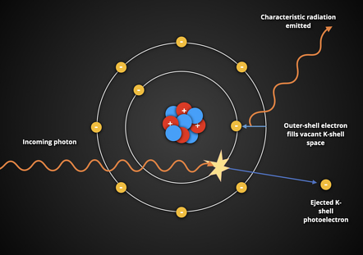
Three main interactions of X and gamma rays with matter are
Photoelectric effect - Very important in diagnostic radiology
Compton scatter - Very important in diagnostic radiology
Pair production - Very important in therapeutic & diagnostic radiology
Photoelectric Effect
The photoelectric effect is a phenomenon in which a photon interacts with an atom and ejects one of the orbital electrons from the atom.
The photon transfers all its energy to the atom. This is used to overcome the binding energy as well as to provide kinetic energy to the photo-electron.
The incoming photon interacts with an orbital electron in an inner shell – usually K

Slide 11
The incoming photon gives up all its energy and ceases to exist
The ejected electron is now a photoelectron
This photoelectron now contains the energy of the incoming photon minus the binding energy of the electron shell
This photoelectron can interact with other atoms until all its energy is spent
A vacancy now exists in the inner shell
To fill this gap, an electron from an outer shell drops down to fill the gap
Once the gap is filled, the electron releases its energy in the form of a characteristic photon
This process continues, with each electron-emitting characteristic photons, until the atom is stable
The characteristic photon produces relatively low energies and is generally absorbed in tissue

Slide 12
The by products of the Photoelectric Effect
Photoelectrons
Characteristic photons ( discrete energies of X rays)
Photoelectric Effect depends on the following:
  the energy of the incident photon(E)
  the atomic number Z of the irradiated object increases as the photon energy decreases

Slide 13
In imaging
Bones are more likely to absorb radiation(Higher Z)
  - This is why they appear white on the film
Soft tissue allows more radiation to pass through than bone (Lower Z)
  - These structures will appear gray on the film
Air-containing structures allow more radiation to pass through
  - These structures will appear black on the film

Slide 14
Compton Effect
The effect was discovered in 1923 by Arthur Holly Compton
Compton effect or Compton scatter is one of principle forms of photon interaction.
It is the main cause of scattered radiation in a material.
It occurs due to the interaction of the photon (x-ray or gamma) with free electrons (unattached to atoms) or loosely bound valence shell (outer shell) electrons.
The resultant incident photon is scattered (changes direction) and imparts energy to the electron (recoil electron).
The scattered photon will have a different wavelength (observed phenomenon) and thus a different energy (E=hc/λ).
Energy and momentum are conserved in this process.

Slide 15
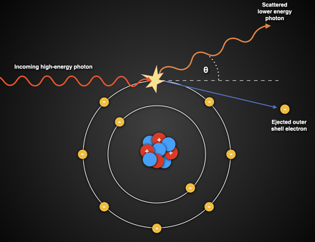
The Compton effect is a partial absorption process and as the original photon has lost energy, known as Compton shift (i.e. a shift of wavelength/frequency).
The wavelength change of the scattered photon can be determined by 0.024 (1- cos θ), where θ is scattered photon angle.
The energy of the scattered photon decreases with increasing scattered photon angle .
The higher incident photon energy will cause a greater percentage loss of their energy during Compton scatter while lower energy photons will lose a smaller percentage of their energy .

Slide 16
The Compton effect results in both attenuation and absorption.
The attenuation caused here is dependent upon the electron density and is practically the same for all substances except hydrogenous material, like water and soft tissue, where the Compton effect is greater (because of the higher electron density).
It does not depend on Atomic Number.
It is measured as mass scattering coefficient (σ/ρ)
Compton Effect depends
directly proportional to
  number of outer shell electrons, i.e. the electron density
  physical density of the material
very weakly dependent on
  photon energy; relatively constant over the range 10-600keV
does not depend on
  atomic number (unlike photoelectric effect and pair production)

Slide 17
Differences between Compton Effect and Photoelectric Effect
Compton effect | Photoelectric effect
This is the effect caused by the inelastic scattering of high-energy photons that are bound to free electrons. | This is the effect caused by the weakly bound electrons that are ejected from the surface of the material when electromagnetic radiation interacts with the electrons.
Arthur Compton explained the effect. | Albert Einstein explained the effect.
The energy associated with the free electrons is mid-energy. | The energy associated with the electrons is low-energy.
The wavelength of the scattered photon is higher than that of the incident photon. | The wavelength is not observed as the photon disappears after interacting with the electrons.

Slide 18
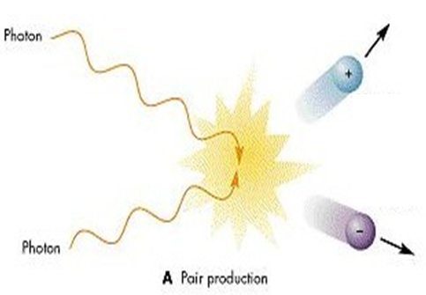
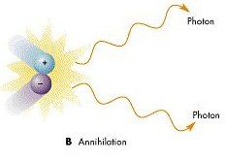
Pair Production and Annihilation
Pair Production: When the photon with energy in excess of 1.02 MeV passes close to the nucleus of an atom, the photon disappears, and a positron and an electron is produced.
Pair production results from an interaction with the electromagnetic field of the nucleus and as such the probability of this process increases rapidly with the atomic number (Z ²).
Annihilation: These two particles collide, converting to 2 photons with equal energy of 511 Kev.

Slide 19
Practical Aspects of Radiation Absorption and Transmission
There are three main types of ionizing radiation: alpha particles, beta particles, and gamma rays.
Alpha particles are the least penetrating, as they can be stopped by a sheet of paper or the outer layer of skin.
Beta particles can penetrate a bit deeper, but can still be stopped by a few millimeters of aluminum or plastic.
Gamma rays are the most penetrating, and can only be stopped by several centimeters of lead or concrete.

Slide 20
When ionizing radiation interacts with body tissue, it can cause damage to the cells and DNA, potentially leading to mutations or cancer.
However, the extent of the damage depends on the type of radiation, the energy of the radiation, and the amount of radiation that is absorbed by the tissue.
In general, radiation is more likely to be absorbed by denser tissues, such as bone or muscle, than by less dense tissues, such as fat or air.
The thickness of the tissue and the angle of incidence of the radiation
also affect absorption. (example: radiation that passes through tissue at an oblique
angle is more likely to be absorbed than radiation that passes straight through)
The transmission of radiation through the body can also be affected by the presence of other materials, such as contrast agents or implanted medical devices.(example: metal implants can cause scattering of radiation, leading to higher doses in the surrounding tissue)

Slide 21
THANK YOU

