Slide 1
RADIO PHARMACEUTICALS
By Nagaraju B
Dr. Jayapandiyan
Dept. of Paramedical Science
SVDU, Vadodara,
Gujarat

Slide 2
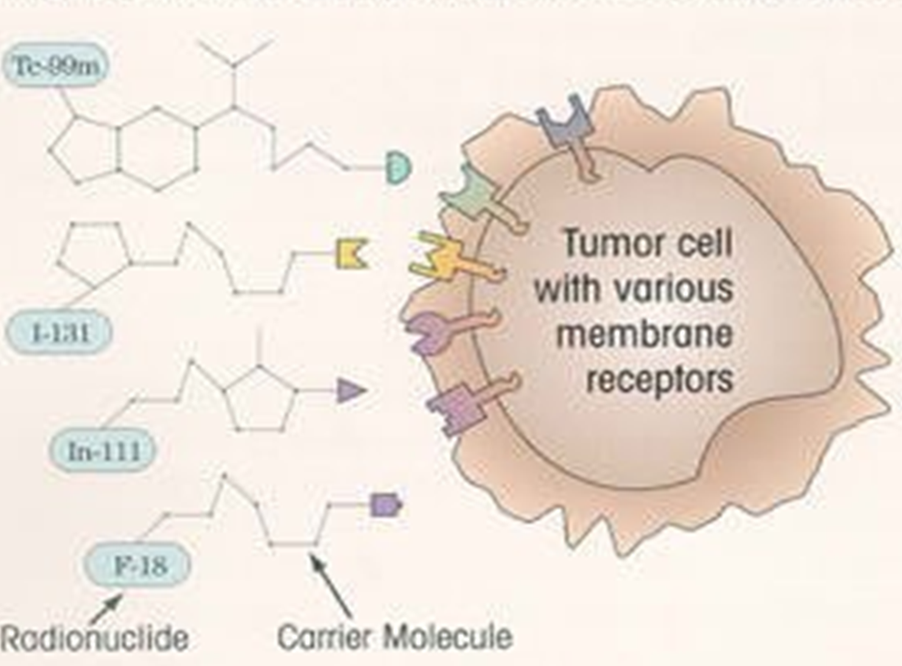
DEFINITION
Radiopharmaceuticals are radioactive substances or radioactive drugs for diagnostic or
therapeutic interventions
COMPOSITION
A radioactive isotope that can be injected safely into the body, and
A carrier molecule that delivers the isotope to the area to be treated or examined.

Slide 3
Radioisotope
A version of a chemical element that has an unstable nucleus and emits radiation during its decay to a stable form.
All isotopes are not radioisotopes
.
How does it work?
The main difference between nuclear medicine imaging and other radiologic tests is that nuclear medicine imaging evaluates how organs function, whereas other imaging methods assess anatomy
For most diagnostic studies in nuclear medicine, the radioactive tracer is administered to a patient by intravenous injection. Also by inhalation, by oral ingestion, or by direct injection into an organ
These tracers aren’t dyes or medicines, and they have no side effects.
The amount of radiation a patient receives in a typical nuclear medicine scan tends to be very low.

Slide 4
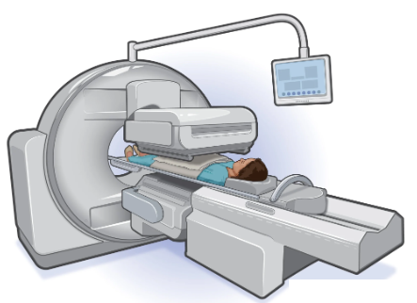
Uses
Therapeutic
Diagnosing
Conditions diagnosed by nuclear medicine imaging are
Blood disorders.
Thyroid disease, including hypothyroidism.
Heart disease.
Gallbladder disease.
Lung problems.
Bone problems, including infections or breaks.
Kidney disease, including infections, scars or blockages.
Cancer.

Slide 5
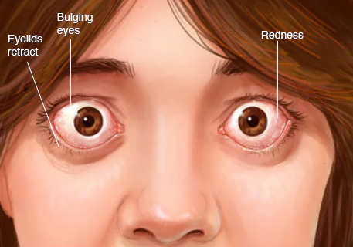
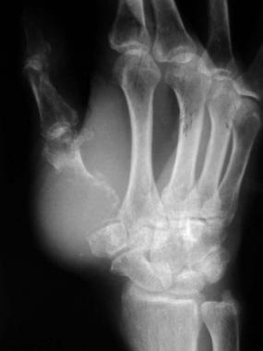
Therapeutic
Designed to deliver a therapeutic dose of ionizing radiation to the specific disease site, such as cancerous tumors, with high specificity in the body.
Historically, used to treat Thyroid cancer, Graves’ disease, hyperthyroidism, and bone pain palliation associated with skeletal metastasis.

Slide 6
Advantages
It can be used as the diagnosis and treatment of patients
It is the common cure for cancers
Can treat multiple disease sites
Widely available mode of treatment
Directly treats tumors, especially useful for bone metastasis
Can provide fast onset of pain relief
Single dose is effective for some patients
Nuclear medicine tests can be performed on children
Nuclear medicine procedures are cost effective and painless
Nuclear medicine procedures have no side effects and are completely safe

Slide 7
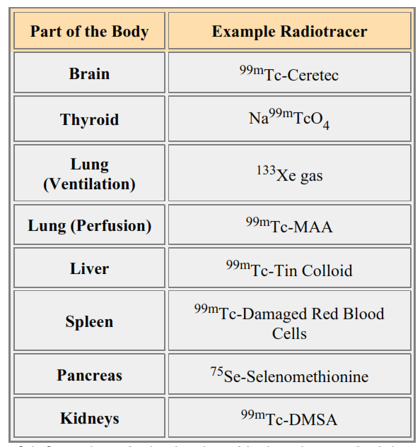
Different radiopharmaceuticals are used to produce images from almost all regions of the body

Slide 8
Disadvantages
Nuclear medicine tests are not recommended for pregnant women because unborn babies have a greater sensitivity to radiation than children or adults.
Filling in patients' teeth, dental braces and permanent bridges may cause some distortion around the mouth area.

Slide 9
Radionuclide production
In general ways of manufacturing radionuclides for use in radiopharmaceutical preparations is Nuclear fission.
Nuclear fission Nuclides with high atomic numbers are fissionable and a common reaction is the fission of uranium-235 by neutrons in a nuclear reactor.
For example,
Iodine-131, molybdenum-99, and xenon-133 can be produced in this way. Radionuclides from such a process must be carefully controlled in order to minimize the Radio nuclidic impurities.
Radio nuclidic purity is defined as "the ratio of the radioactivity of the desired radionuclide to the total radioactivity of the source".
Radio nuclidic purity is important in radio pharmacy since any radio nuclidic impurities may increase the radiation dose received by the patient and may also degrade the quality of any imaging procedure performed.
.

Slide 10
Manufacturing
The manufacturing process for radiopharmaceutical preparations should meet the requirements of Good Manufacturing Practice.
The manufacturer is responsible for ensuring the quality of his products, and especially for examining preparations of short-lived radionuclides for long-lived impurities after a suitable period of decay.
The manufacturer ensures that the manufacturing processes are producing appropriate materials.
Charged particle bombardment Radionuclides may be produced by bombarding target materials with charged particles in particle accelerators such as cyclotrons.
Neutron bombardment Radionuclides may be produced by bombarding target materials with neutrons in nuclear reactors.

Slide 11
The radionuclide composition of certain preparations is determined by the chemical and isotopic composition of the target material.
Trial preparations are advisable when new batches of the target material are employed.
When a batch of radiopharmaceutical preparation size is limited to one or a few units, the product manufactured should be fully validated.
Formulation of radio pharmaceuticals is therefore a bit more complex than normal pharmaceuticals.
Good Radiation Practices (GRPs) and Good Manufacturing Practices (GMPs) should be strictly followed during manufacturing and dispensing operations.

Slide 12
Good Manufacturing Practice (GMP) for radiopharmaceuticals refers to the set of guidelines and regulations that ensure the quality, safety, and efficacy of radiopharmaceutical products throughout their entire lifecycle, from development and manufacturing to distribution and use.
1. Facility Design and Maintenance:
  Facilities must be designed and maintained to minimize the risk of contamination and cross-contamination.
  Adequate measures should be in place to control environmental conditions such as temperature, humidity, and cleanliness.

Slide 13
2. Personnel Training:
  Personnel involved in the manufacturing process should be adequately trained and qualified.
  Training should cover specific aspects related to handling radioactive materials, radiation safety, and quality control.
3. Documentation and Record keeping:
  Comprehensive documentation, including standard operating procedures (SOPs), batch records, and quality control records, must be maintained.
  Records should be clear, complete, and traceable to ensure accountability and facilitate quality assurance.

Slide 14
4. Quality Control:
  Rigorous quality control measures are essential to ensure the radiopharmaceutical's identity, purity, and potency.
  Analytical methods should be validated, and regular testing of raw materials, intermediates, and finished products should be performed.
5. Radiation Safety:
  Facilities must comply with radiation safety regulations to protect both personnel and the environment.
  Adequate shielding, monitoring, and control measures should be in place to minimize radiation exposure.

Slide 15
6. Equipment Qualification and Maintenance:
  Equipment used in the production of radiopharmaceuticals should be qualified and regularly maintained to ensure proper functioning and reliability.
7. Risk Management:
  A risk management system should be implemented to identify, assess, and control risks associated with radiopharmaceutical manufacturing processes.
8. Supply Chain Control:
  Strict control measures should be in place for the procurement and testing of raw materials, including radioisotopes and chemical components.

Slide 16
9. Labeling and Packaging:
  Radiopharmaceuticals should be labeled accurately, and packaging should be designed to protect the product during transportation and storage.
10. Regulatory Compliance:
  Manufacturers must comply with applicable regulatory requirements and obtain necessary approvals and licenses.
Compliance with GMP for radiopharmaceuticals is crucial to ensure patient safety, product quality, and regulatory approval. It is important for manufacturers to stay informed about the latest regulatory developments and adhere to industry best practices.

Slide 17
Code of Good Radiation Practices (GRP)
Strict personnel hygiene
Avoidance of risk methodology
Operations only in the recommended zones of the lab
Proper techniques of distance and shielding
Isolated storage , refrigeration of radionuclides and labelled compounds
Trial run using dummy or inactive source
Proper in service training of qualified personnel

Slide 18
Formulation(preparing) Issues
Radiopharmaceuticals have a very short usable life of radioactive products compared with injectable pharmaceuticals.
In contrast to ordinary pharmaceuticals many radiopharmaceuticals have to be manufactured and quality tested and then administered to the patient within a short period of time, often within the same working day from dispensing point of view the presence of radioactivity in a pharmaceutical has the following qualities.
A) the radioactive properties must be specified on the label
B) in controlling the conventional pharmaceutical qualities

Slide 19
Drawing out a manual of standardized procedures of safe handling and step by step processing , testing and waste disposal of radio active compounds .
Facilities of minimizing radiation levels , removal of surface and air borne contaminants , calibration and maintenance of instruments for radioactivity measurements
Provision of appropriate personnel monitoring and protective devices
Periodic inspection of protective devices for wear and tear and performance
Establishment of well understood emergency procedures
Proper documentation system is required by law

Slide 20
Dispensing of Radiopharmaceuticals
The dispensing of radiopharmaceuticals should be safe,straight forward and reliable
An important factor in radiopharmaceutical dispensing has been the production of ready to use kits or cold kits which provide individual/ multiple doses and can be reconstituted by the addition of the radionuclide at the time of intended use.
Chemical reagents are prepared in a sterile environment using apyrogenic (very pure or bacteria free) raw materials and dispensed into single/multiple unit dose containers .
The preparation of individual doses can be carried out rapidly and safely when required with minimum handle or use.
Radio pharmaceuticals never go directly to the patient. They are provided to trained health care professionals at the hospital or clinic and then administered to the patient
•

Slide 21
Procurement and Storage
Because of the short life of the radiopharmaceuticals the nuclear pharmacist will order the drug directly from the manufacturer usually through overnight delivery
In addition knowledge of calibration time shipping/ delivery schedules and radioactive decay associated with the ordered radio pharmaceutical weigh heavily in the ordering process
Isotope storage areas should be as per the rules. There should be a separate lab for the manipulation and preparation of radiopharmaceutical dosage and another for the calibration of doses. The treatment room must also be different.

Slide 22
Labelling
All products should be clearly identified by label which must remain permanently
attached to the containers under all storage condition.
The label on the container should show the;
Name of the drug product and product code,
The name of radio nuclide,
The name of manufacturer or the company,
The radioactivity per unit dose,
The route of administration,
The expiry date,
The amount of radioactivity at dispatch time
The radiation dose that the patient would receive

Slide 23
Quality Assurance
Radiopharmaceuticals are generally expected to confirm to specifications under the following heading:
  Radionuclide concentration
  Radiochemical purity
  Chemical purity
  Sterility
  Apyrogenicity (materials that cause a rise in temperature)
  Absence of foreign particulate matter
  Particle size (if appropriate)
  pH
  Biological distribution

Slide 24
Production and Distribution Records
The processing records of regular production batches must provide a complete account of the manufacturing history of each batch of a radio pharmaceutical, showing that it has been manufactured, tested, dispersed into containers and distributed in accordance.
Separate records for the recent storage, use and disposal of radio active products must be maintained.
Distribution records should be kept since the return of radioactive products is not practical, the purpose of recall procedures for such products is to prevent their use rather than actual return.

Slide 25
WASTE STORAGE AND DISPOSAL
Radioactive materials no longer required must be disposed to avoid an environmental hazard.
Avoid practice that produces large volume of waste.
Dilute and dispense for low level solid, liquid and gaseous waste.
Segregate waste according to half-lives, delay and decay for waste that contain short lived nuclides.
Label the waste before storing.
Release into sewage system depending on water flow .
Longer T1/2 radionuclides should be incinerated or deeply burnt in soil in a separately marked area.

Slide 26
HEALTH & SAFETY
Allergies -Pregnancy
Radiopharmaceuticals usually are not recommended for use during pregnancy. This is to avoid exposing the foetus to radiation.
This is especially important with radiopharmaceuticals that contain radioactive iodine, which can go to the baby's thyroid gland and, in high enough amounts, may cause thyroid damage.
Breast- Feeding
Some radiopharmaceuticals pass into the breast milk and may expose the baby to radiation. If you must receive a radiopharmaceutical, it may be necessary for you to stop breast-feeding for some time after receiving it.

Slide 27
Children
For most radiopharmaceuticals, the amount of radiation used for a diagnostic test is very low and considered safe.
Side Effects / Reactions
When radiopharmaceuticals are used in very small doses to study an organ of the body, side effects are rare and usually involve an allergic reaction. These effects may occur almost immediately or a few minutes after the radiopharmaceutical is given.
Are radiopharmaceuticals safe?
Absolutely, like any medicine, with great care before they are tested carefully.
The quantity of the pharmaceutical part of the radiopharmaceutical is very small, generally 1/10th of a millionth of an ounce. The risk of a reaction is 2-3 incidents per 100,000 injections, over 50% of which are rashes, as compared to 2000-3000 per 100,000 injections of x-ray contrast media.

Slide 28
THANK YOU

