Slide 1
Radioactivity
Dr. Jayapandiyan
Dept. of Paramedical Science
SVDU, Vadodara,
Gujarat

Slide 2
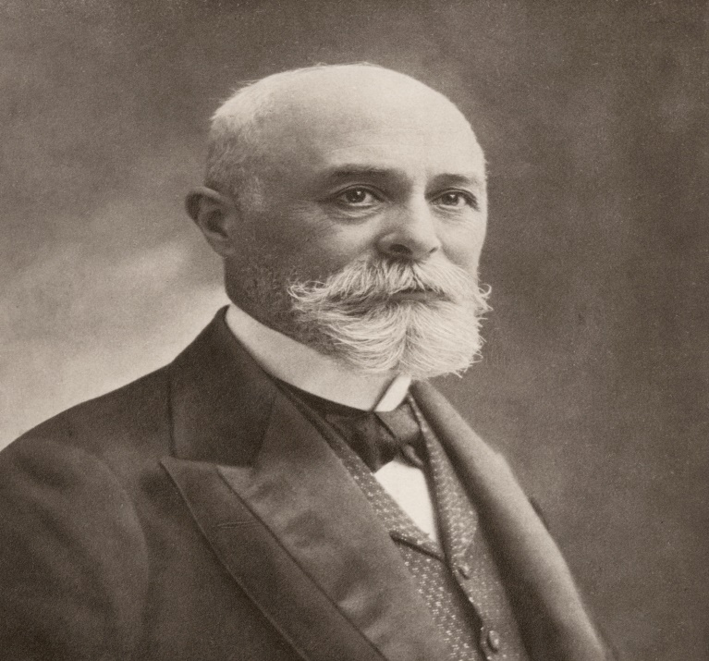
Radioactivity
The phenomenon of radioactivity was discovered by Henri Becquerel in 1896.
He found that a photographic plate wrapped
in a black paper was affected by certain penetrating radiations emitted by
uranium salt.
The phenomenon of spontaneous emission of highly penetrating radiations such as α, β and γ rays by the nucleus of heavy elements having atomic number greater than 82 is called radioactivity .
The substances which emit these radiations are called radioactive elements.
The radioactive phenomenon is spontaneous and is unaffected by any external agent like temperature, pressure, electric and magnetic fields etc.

Slide 3
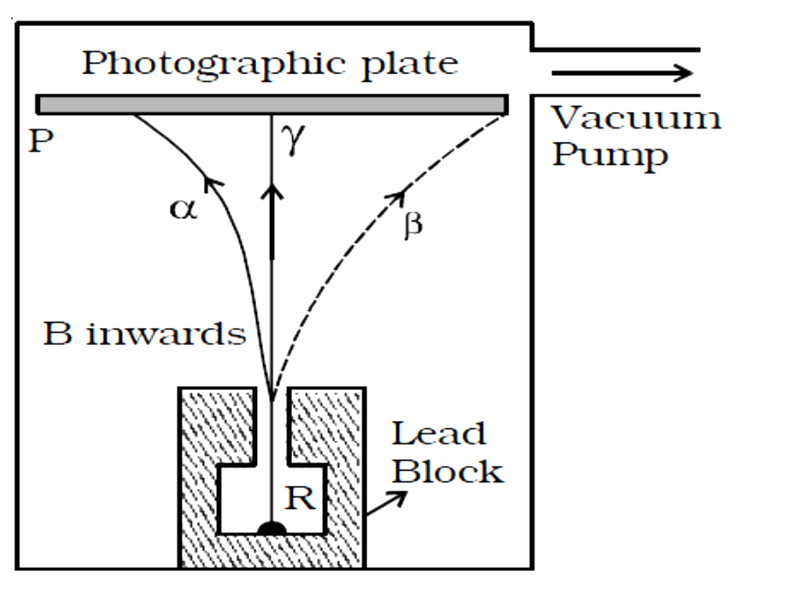
Nuclear Transformations
When the atomic nucleus undergoes the spontaneous transformation, called radioactive decay, particles/radiation is emitted.
If the daughter nucleus is stable, this spontaneous transformation ends.
If the daughter is unstable (i.e., radioactive), the process continues until a stable nuclide is reached.
Radionuclides Decay methods are
alpha decay,
(b) beta minus emission,
(c) beta-plus (positron) emission,
(d) electron capture, or isomeric transition.

Slide 4


Alpha (α) Decay
Alpha decay is the spontaneous emission of an alpha particle (identical to a
helium nucleus consisting of two protons and two neutrons) from the nucleus.
Alpha decay typically occurs with heavy nuclides (A> 150) and is often followed by gamma and characteristic x-ray emission.
Alpha particles are the heaviest and least penetrating form of radiation .
They are emitted from the atomic nucleus with discrete energies in the range of 2 to 10 MeV.
Alpha particles are not used in medical imaging because their penetrating ranges are limited to approximately 1 cm/MeV in air and typically less than 100 μm in tissue.
Even the most energetic alpha particles cannot penetrate the dead layer of the skin.
Example:

Slide 5
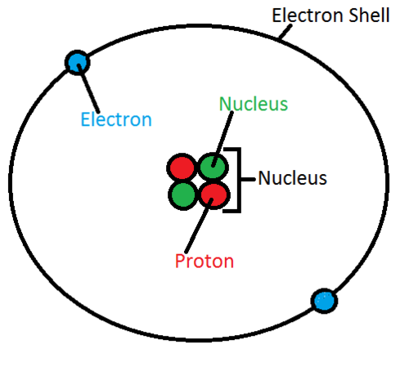
Properties of α–rays
An α - particle is a helium nucleus consisting of two
protons and two neutrons. It carries two units of positive
charge.
They move along straight lines with high velocities.
They are deflected by electric and magnetic fields.
They produce intense ionization in the gas through which they pass. The ionising power is 100 times greater than that of β-rays and 10,000 times greater than that of γ−rays.
They affect photographic plates.
They are scattered by heavy elements like gold.
They produce fluorescence when they fall on substances like zinc sulfide or barium platinocyanide.

Slide 6


Beta [(β)Electron] Decay
In this, a neutron is converted to a proton by the ejection of a negatively charged beta (β) particle called a electron (β–). The decay results in the conversion of a neutron into a proton with the simultaneous ejection of a negatively charged beta particle (β-) and an anti neutrino (ν).
Mass number is unchanged (because a neutron changed into a proton) and that the atomic number has gone up by one (it has gained a proton)
Beta particles are identical to that of an ordinary electrons.
The antineutrino (lepton) is an electrically neutral subatomic particle (also known as elementary particles like proton, electron)whose mass is much smaller than that of an electron.
Example

Slide 7


Beta [(β+) positron] Decay
A proton inside a radionuclide nucleus is converted into a neutron while releasing a positron( a positively charged electron) and a neutrino.
Positron decay decreases the number of protons (atomic number) by 1 and thereby transforms the atom into a different element with an atomic number of Z-1 .The number of neutrons is increased by 1
A neutrino is a subatomic particle that is very similar to an electron, but has no electrical charge and a very small mass, which might even be zero.
Example

Slide 8


Electron Capture Decay
This is a third form of beta decay in which an inner orbiting electron is attracted into an unstable nucleus and it combines with a proton to form a neutron.
This process is also known as K-capture since the electron is often attracted from the K-shell of the atom.
Electron capture can be described by the following equation:
Example:
The capture of an orbital electron creates a vacancy in the electron shell, which
is filled by an electron from a higher-energy shell.
This electron transition results in the emission of characteristic x-rays.
Electron capture radio nuclides used in medical imaging decay to atoms in excited states that subsequently emit externally detectable x-rays or gamma rays or both.
A neutrino is a subatomic particle that is very similar to an electron, but has no electrical charge and a very small mass, which might even be zero.

Slide 9
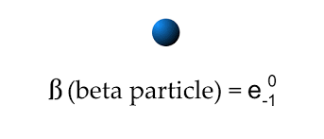
Properties of β – rays
β–particles carry one unit of negative charge and mass equal to that of electron. Therefore, they are nothing but electrons.
The β–particles emitted from a source have velocities over the range of 0.3 c to 0.99 c, where c is the velocity of light.
They are deflected by electric and magnetic fields.
The ionisation power is comparatively low
They affect photographic plates.
They penetrate through thin metal foils and their penetrating power is greater than that of α−rays
They produce fluorescence when they fall on substances like barium platinocyanide.

Slide 10
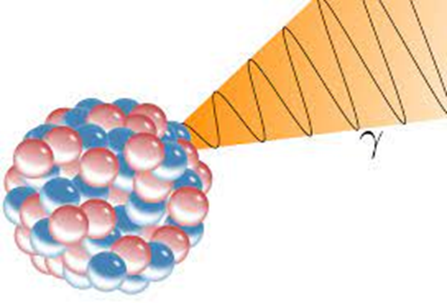
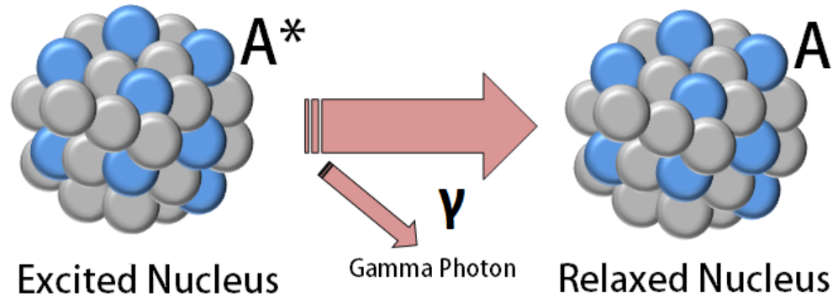
Gamma Decay
Gamma decay involves the emission of energy from an
unstable nucleus in the form of electromagnetic radiation.
There are two common forms of gamma decay:
(a) Isomeric Transition
A nucleus in an excited state may reach its ground or unexcited state by the emission of a gamma ray.
An example is technetium-99m - which by the way is the most common radioisotope used for diagnostic purposes today in medicine.

Slide 11

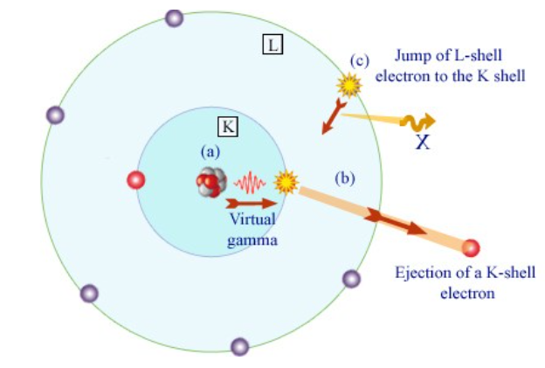
The nucleus of technetium-99 is in an excited state, that is it has excess energy.
The excited state in this case is called a metastable state and the nucleus is therefore called technetium-99m (m for metastable).
The reaction can be expressed as:
The excited nucleus looses its excess energy by emitting a gamma-ray to become technetium-99.
(b) Internal Conversion
In this the excess energy of an excited nucleus is given to an atomic electron, e.g. a K-shell electron.

Slide 12
Properties of γ – rays
They are electromagnetic waves of very short wavelength.
They are not deflected by electric and magnetic fields.
They travel with the velocity of light.
They produce very less ionisation.
They affect photographic plates.
They have a very high penetrating power,
greater than that of β-rays.
They produce fluorescence.
They are diffracted by crystals in the same way like X−rays are diffracted.

Slide 13

Radioactive law of disintegration
Rutherford and Soddy found that the rate of disintegration is independent of physical and chemical conditions.
The rate of disintegration at any instant is directly proportional to the number of atoms of the element present at that instant. This is known as radioactive law of disintegration.
Let N₀ be the number of radioactive atoms present initially and N, the number of atoms at a given instant t.
λ – decay constant or disintegration constant or radioactive constant
The number of atoms of a radioactive substance decreases exponentially with increase in time

Slide 14
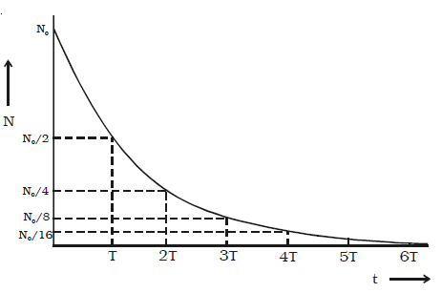
Initially the disintegration takes place at a faster rate. As time increases, N gradually decreases exponentially.
Theoretically, an infinite time is required for the complete disintegration of all the atoms.

Slide 15

Half Life Period
Since all the radioactive elements have infinite life period, in order to distinguish the activity of one element with another, half life period and mean life period are introduced.
The half life period of a radioactive element is defined as the time taken for one half of the radioactive element to undergo disintegration.
For a radioactive substance, at the end of T_{½}, 50% of the material remain unchanged. After another T_{½} i.e., at the end of 2 T_{½}, 25% remain unchanged.
At the end of 3 T_{½}, 12.5% remain unchanged and so on.

Slide 16
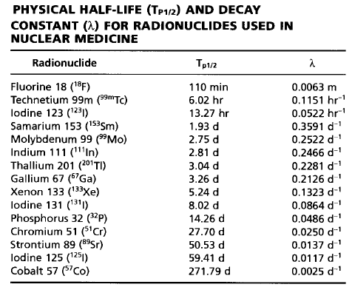

Slide 17

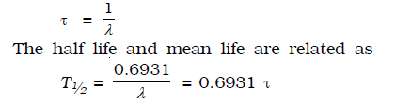
Mean Life (τ)
The mean life of a radioactive substance is defined as the ratio of total life time of all the radioactive atoms to the total number of atoms in it.
The mean life is the reciprocal of the decay constant.

Slide 18
Thank you

