Slide 1
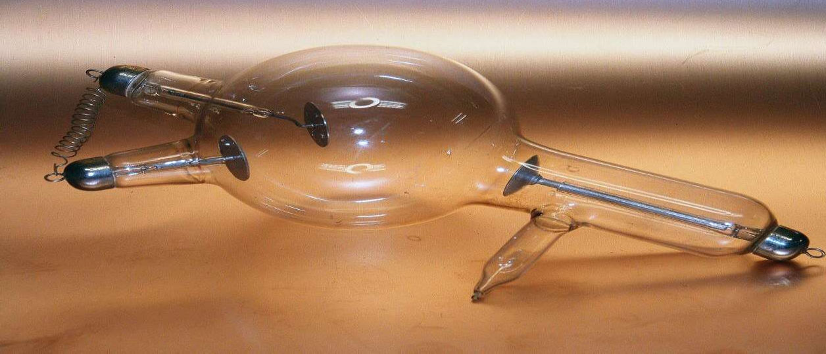
X-RAY - TUBE
Dr. Jayapandiyan
Dept. of Paramedical Science
SVDU, Vadodara,
Gujarat

Slide 2
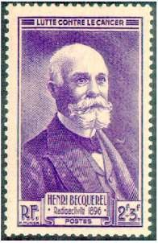

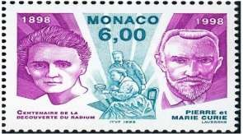
INTRODUCTION
The study and use of ionizing radiation in medicine started with three important discoveries
X rays by Wilhelm Roentgen in 1895.
Natural radioactivity by Henri Becquerel in 1896.
Radium-226 by Pierre and Marie Curie in 1898.

Slide 3
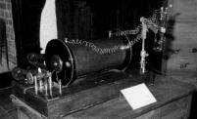
History
Roentgen discovered x rays in 1895 while experimenting with a Crookes “cold cathode” tube.
Crookes tube is a sealed glass cylinder with two embedded electrodes operated with rarefied gas.
The potential difference between the two electrodes produces discharge in the rarefied gas causing ionization of gas molecules.
Electrons (cathode rays) are accelerated toward the positive electrode producing x rays upon striking it.
Photograph of Roentgen’s apparatus

Slide 4
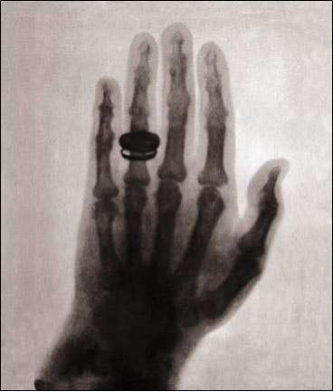
The first x-ray photograph:
Roentgen’s wife Bertha’s hand
4

Slide 5
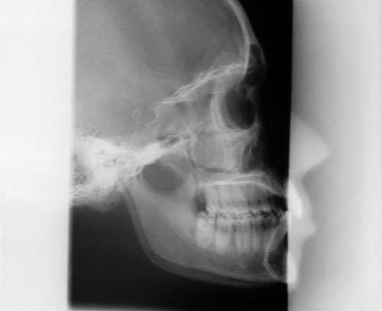
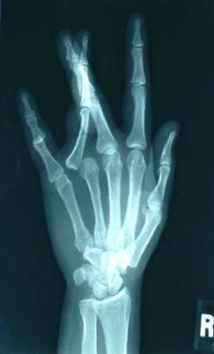
Current estimates show that there are approximately
650 medical and dental X-ray examinations per
1000 patients per year
X-rays are one of the main diagnostical tools in medicine since its discovery by Wilhelm Roentgen in 1895

Slide 6
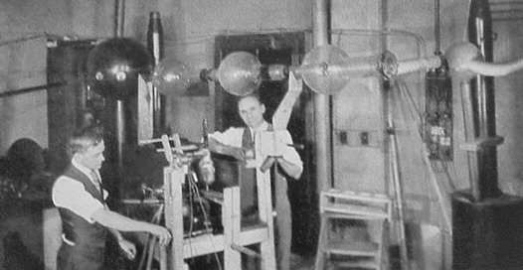
Old Memories ………….

Slide 7
X-rays characteristics
What are X Rays?
X-rays are a type of electromagnetic radiation that can pass through most objects, including the body.
They are similar to radio waves, microwaves, visible light, and gamma rays.
Highly penetrating, invisible rays
Electrically neutral( No charged particles)
Travel in straight lines.
Travel with the speed of light in vaccum: 3,00,000 km/sec
Ionize matter through which they pass.
Induce fluorescense in some substances.
Can't be focused by lenses nor by collimators.

Slide 8
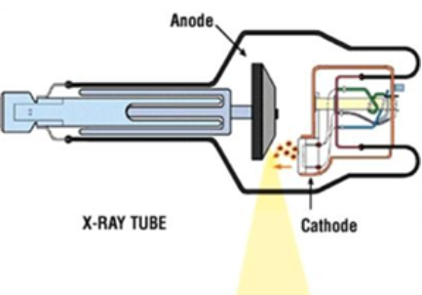
X-ray Parts
The three main parts of the x-ray imaging system are
X-ray tube
Operating console
High voltage generator
X Ray Tube
Major components of the X ray Tube are
Cathode
Anode
Glass Envelope

Slide 9
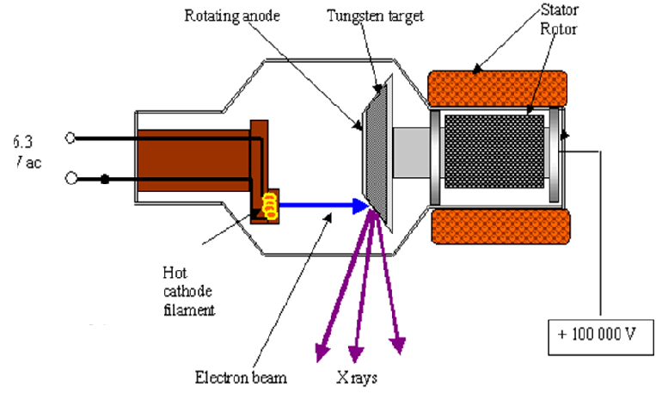
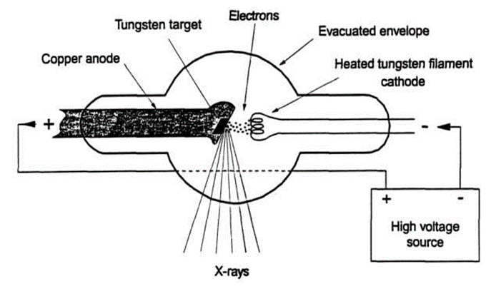
X-ray Tube

Slide 10
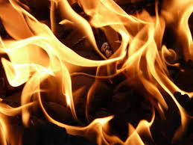
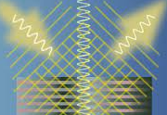
X – Ray Principle
When highly energetic electrons interact with matter and convert their kinetic energy into x-rays.
When the electrons from the cathode are accelerated at high voltage to the anode:
99% of the energy is dissipated as heat
and
  1% is given off as x-rays
Methods of X-ray Production
Bremsstrahlung Radiation
Characteristic Radiation

Slide 11

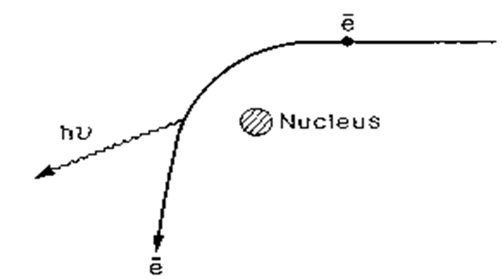
Bremsstrahlung Radiation
If an incoming free electron gets close to the nucleus of a target atom the strong electric field of the nucleus will attract the electron and changes the direction & speed of the electron.
Electron looses energy which will be emitted as an X-ray photon
Energy of this photon depend on the interaction between nucleus and electron
X-rays originating from this process are called bremsstrahlung.
Bremsstrahlung is a German word "Strahlung" means “radiation” "Bremse" means “brake”

Slide 12
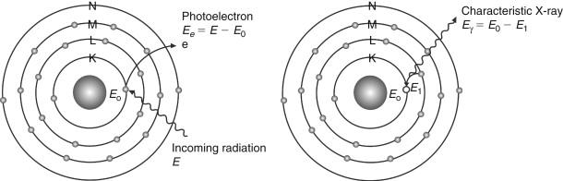
Characteristic X-rays
The high energy electron can also cause an electron close to the nucleus in a metal atom to be knocked out from its place.
This vacancy is filled by an electron further out from the nucleus.
The well defined difference in binding energy is emitted as a monoenergetic photon.
This photon gives rise to a characteristic X-ray line in the energy spectrum.
Characteristic radiation are emitted at discrete energies

Slide 13
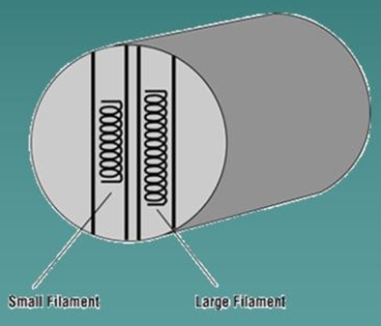
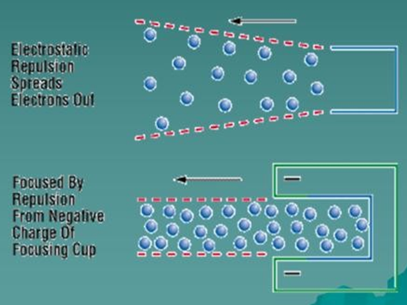
Cathode
The cathode structure is electrically negative with one or two filaments.
Only one filament at a time will work.
The small filament is designed to be used with relatively small parts while the large filament is used when larger body parts are being x-rayed.
The structure which supports the filaments is known as the “focusing cup”.
It is designed and shaped so that when the x-ray machine is started, electrons will be emitted from the filament by the process of Thermionic emission.
The actual shape of the focusing cup, designed such that it will “concentrate” the electron stream on an area on the Anode target area, that is known as a “focal spot”.

Slide 14
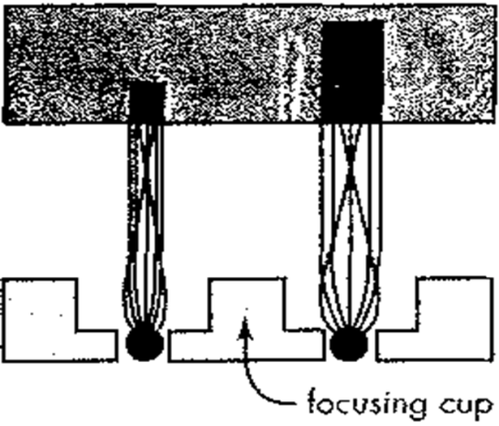
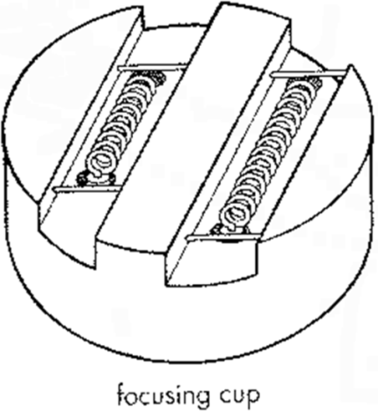
Focusing Cup
A filament small coil of thin thoriated tungsten wire 2 mm dia. & 1 to 2 cm long.
(A trace of thorium in the tungsten wire increases the efficiency of the electron
emission and prolongs the life of filament)
Other materials : Molybdenum , Rhenium
The filament metal is heated to a temperature (about 2500 degree Celsius) to enable the free electrons to leave the filament surface.
The number of electrons emitted depends upon the temperature. The higher the temperature, the greater is the emission of electrons.
The filament is embedded in a metal shroud called the focusing cup.
The focusing cup is negatively charged so that it condenses the electron beam to a small area of the anode.

Slide 15
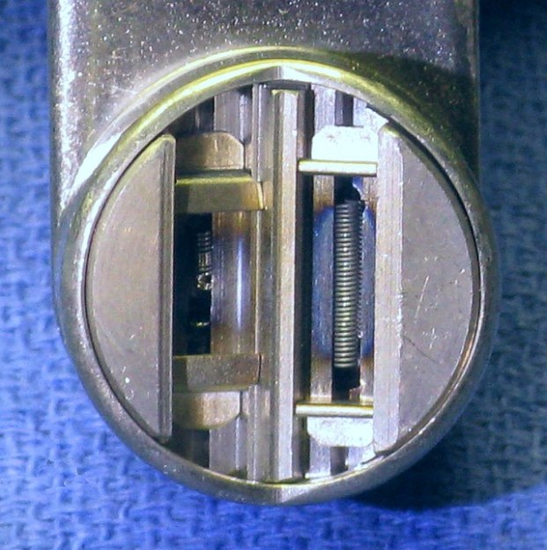
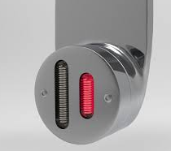
Focusing Cup
Cathode design determines the size of focal spot
Factors determining the size of focus
Size and shape of filament
Dimension of focusing cup
Depth at which the coil is kept in the slot
Electric field associated with focusing cup
Focal spot size determines amount of x-rays falling on image receptor and resolution ( definition) of image

Slide 16
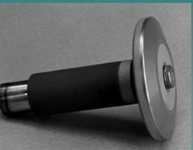
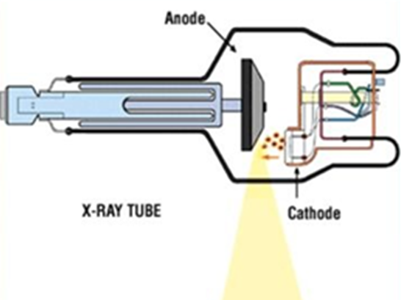
Anode
The anode has a positive electrical charge and attracts electrons from cathode.
The anode is actually a disc made of Tungsten because of its thermal qualities.
Functions of Anode
It serves as a target surface for the highly energetic electrons thereby becoming the source of X-rays.
Serves as the electrical Conductor. ie, receives electrons emitted by the cathode and conducts them through the tube to the connecting cables and back to the high- voltage section of the x-ray machine.
Provides mechanical support for the target.
Serves as the primary thermal conductor.

Slide 17
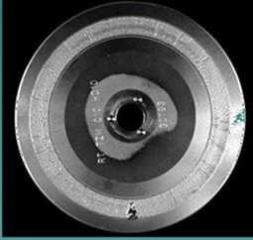
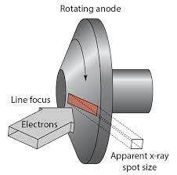
TARGET
The area or place of electron bombardment on the anode where the both heat and X-rays are produced.
So it should be made of a metal that is able to withstand high temperatures without melting and is efficient in the production of X-rays.
Materials: Tungsten, molybdenum
Tungsten is chosen as efficient target material because it has
High melting point (3360⁰ C)
High Z element (more bremsstrahlung yield)
Fairly a good conductor of heat. So heat can be passed reasonably quickly away from the small area where it is produced and the rise in temperature at that area is prevented from being too great.
It does not vaporize easily. The presence of metal vapour inside an X-ray tube would spoil the vacuum which essential for its proper operation

Slide 18
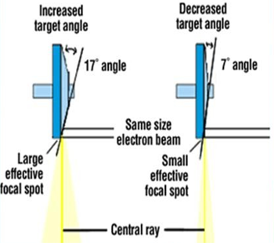
Focal Spot
Focal spot is a area on the anode, which is bombarded by the electrons.
The focal spot becomes the source of the X-ray in an X-ray tube.
The electron beam produced from an helical filament in a rectangular slot,
covers rectangular area.
That is focal spot is rectangular. The x-ray tube with rectangular focal spot is
described as LINE FOCUS TYPE
Focal spot size depends upon the following factors:
The size and shape of the filament
The dimension of the focusing cup and the depth of filament in it
Electric field associated with the focusing cup
The spacing between anode and cathode.
Target angle

Slide 19
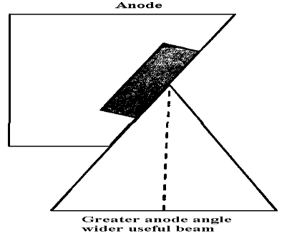
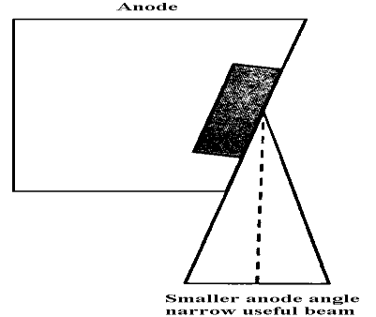
Importance of Focal Spot
Smaller focal spot X rays produce radiographic images with sharp edges
Smaller the focal spot size better the spatial resolution of the image.
But as the size of the focal spot decreases, the heating of the target is concentrated in a small area and damages the target area of X-ray production.

Slide 20
Cathode
Cathode: filament + focusing cup
Two electrical currents flow in an x-ray tube.
The filament current : It is the flow of electrons through the filament to raise its temperature and release electrons.
The electrical current: It is the flow of released electrons from the filament to the anode across the x- ray tube. This current, referred to as the tube current, varies from a few to several hundred mill amperes
To obtain high tube currents and x-ray energies useful for diagnosis, high filament currents and voltages between 40 and 140 kV must be used.

Slide 21
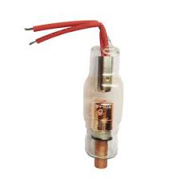
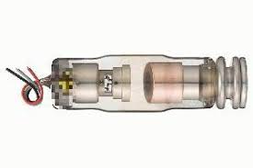
Types of anodes
Stationary Anode : The simplest type of x-ray tube has a stationary (i.e., fixed) anode.
It consists of a tungsten insert embedded in a copper block. The copper serves a dual role:
  It supports the tungsten target
  It removes heat efficiently from the tungsten target . Heat must be conducted away quickly before it can melt the anode.
Dental x-ray and portable x-ray machines use fixed anode tube x-ray tubes.

Slide 22
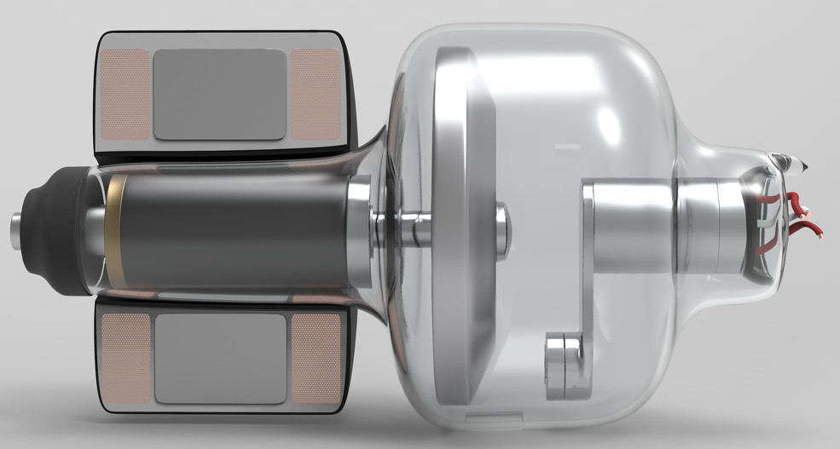
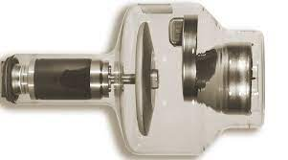
2. Rotating Anode
For most of the diagnostic x-ray application, the rotating anode is used.
In rotating-anode tubes the entire rotating disc is the target.
The rotating anode is a heavy disc mounted on a Molybdenum stem, which functions as its support.
Disc is made up of tungsten-Rh alloy, or Tungsten followed by graphite or Molybdenum base.
The purpose of the rotating anode is to spread the heat
produced during an exposure over a large area of the
anode
Higher x-ray output capabilities.

Slide 23
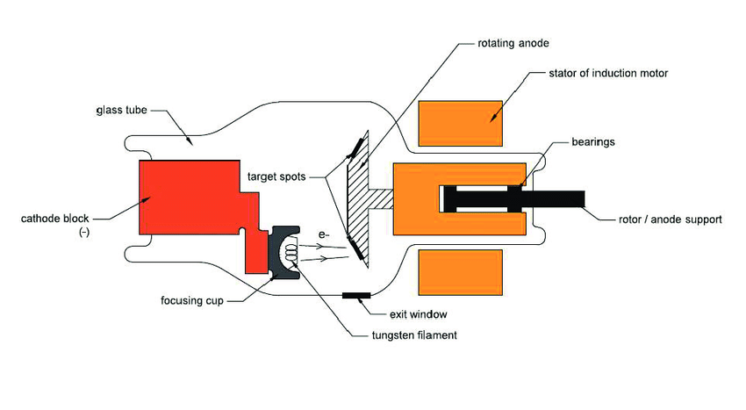
Advantage of Rotating Anode
Higher tube currents and shorter exposure times are possible with rotating anode.
The rotating-anode x-ray tube allows the electron beam to interact with a much larger target area, and therefore the heating of the anode is not confined to one small spot as in a stationary-anode tube.
Less geometric un-sharpness and movement un-sharpness in the image due to smaller focal spot and shorter exposure timings.
Used in most of all the diagnostic and therapeutic X ray productions

Slide 24
Factors affecting x-ray beam Quality , and Quantity
The energy carried by the X ray Photons is known as Quality.
The amount of energy present per unit time per unit area perpendicular to the beam direction at the location of interest is known as Intensity
The amount of X ray photons produced is known as Quantity
The quality and quantity depends on
Anode material
Voltage applied (kVp)
Tube Current (mA)
Filters used

Slide 25
1. Anode material
Different anode materials will produce different characteristic x-ray spectra and different amounts of bremsstrahlung radiation.
2. Voltage (kVp)
Increasing the applied voltage or kVp will increase the maximal energy, the average energy and the intensity of the x-rays. Characteristic x rays do not change with a change in kVp
3. Tube current (mA)
Increasing the current (i.e mA) will not change energy of the beam only the intensity (i.e. the amount) of x-rays. The quantity of x-rays is directly proportional to the tube current.

Slide 26
Extra tips……..
Increasing kVp, increases the penetrating ability of the x-rays photons.
More x-ray photons get through to darken film.
High kv produces darker images but poor contrast.
Increasing the mA and mAs, increases the number of x-rays production.
It does not affect the penetrating power of the photons.
Increase mA will increase overall blackness of the film.

Slide 27
THANK YOU

