Slide 1
Chest Radiography
By Passang D. Sherpa
Course Coordinator of
Radio-imaging Technology
Dpt. Of paramedical science

Slide 2
INTRODUCTION
PRIME IMAGING INVESTIGSTION IN RESPIRATORY MEDICINE
NOT CHANGED OVER LAST 100 YEARS

Slide 3
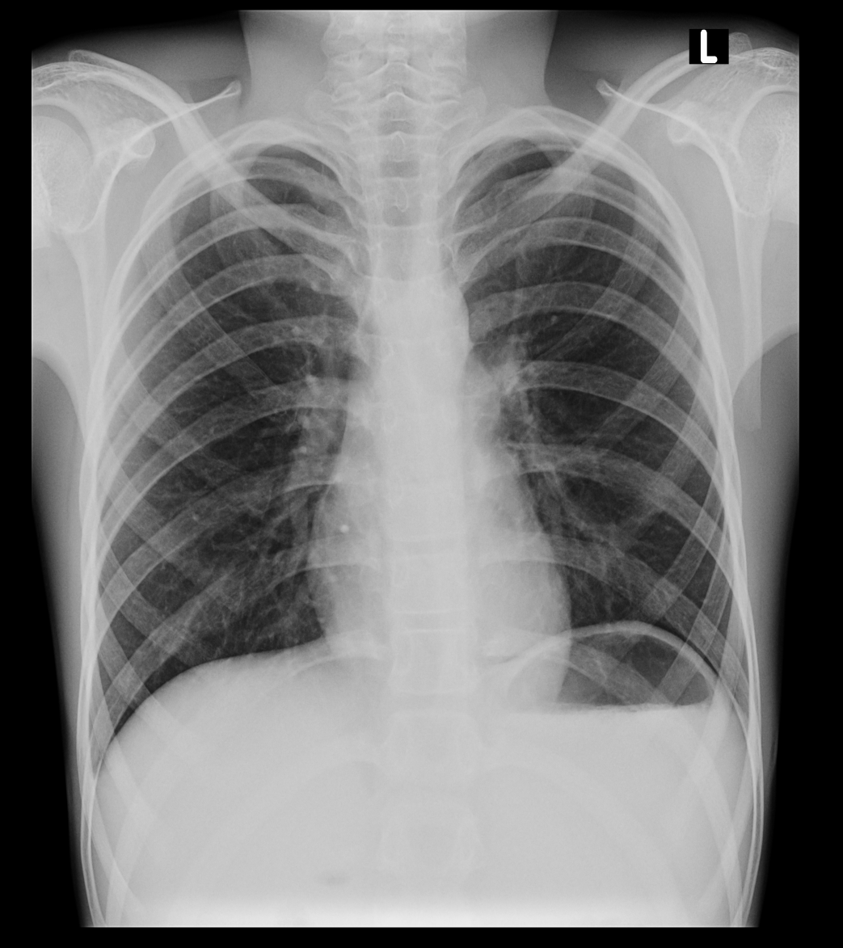
APPROACH..
Name, age, sex, date, clinical information.
Technical aspects:
  Adequate inspiration,
  Centering (patient position/ rotation)
  Side markers
  Exposure/ adequate penetration

Slide 4
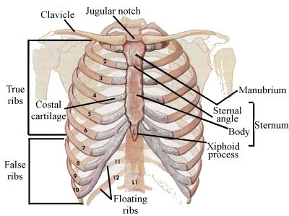
ANATOMY
Sternal notch : T2-T3
Sternal angle : T4-T5
Nipple : T7-T8
Xiphoid tip : T10

Slide 5
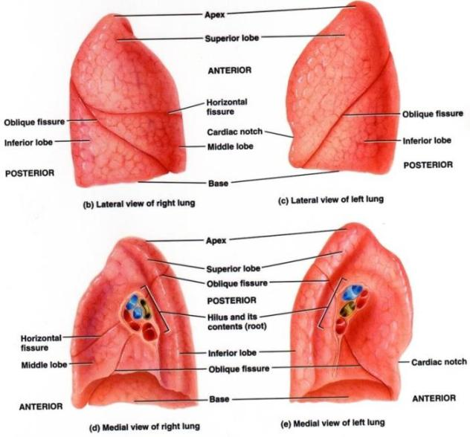
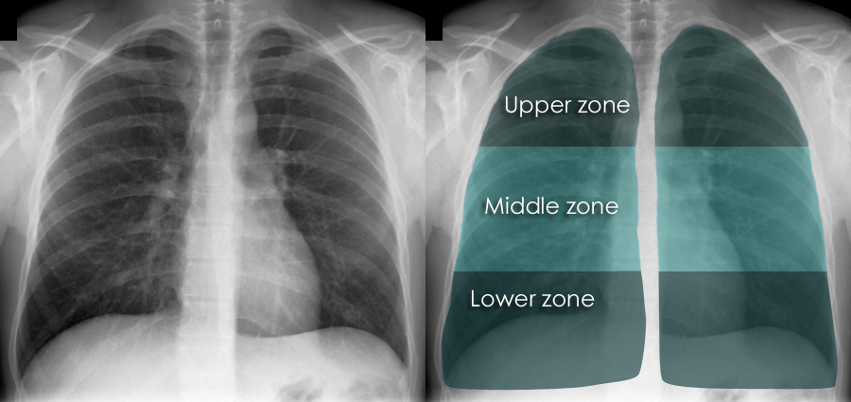
LUNGS
The Lung zones:
  Upper
  Middle
  Lower

Slide 6
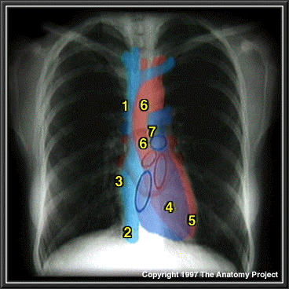
HEART & AORTA
Aorta
Aorta
Superior vena cava
Superior vena cava
Pulmonary trunk
Pulmonary trunk
Right atrium
Right atrium
Right ventricle
Right ventricle
Left ventricle
Left ventricle
Inferior vena cava
Inferior vena cava

Slide 7
PROJECTIONS FOR CHEST
Standard views
Special views
Postero Anterior
Antero Posterior
Lateral
LAO
RAO
Expiratory view
Supine
Lordotic view
Apicogram
Lateral Decubitus

Slide 8
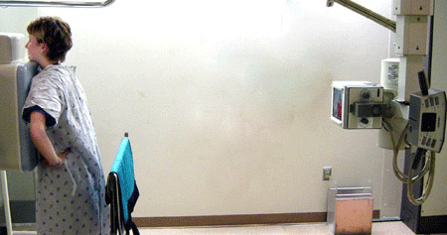
POSTERO ANTERIOR PROJECTION
6 feet

Slide 9
Technique…
FFD : 180cm
MAS : 8 – 12
MA : 300
GRID : NO
CASSETTE : 14X14, 14X17
KV : 50 – 65
INSTRUCTION : ARRESTED INSPIRATION

Slide 10
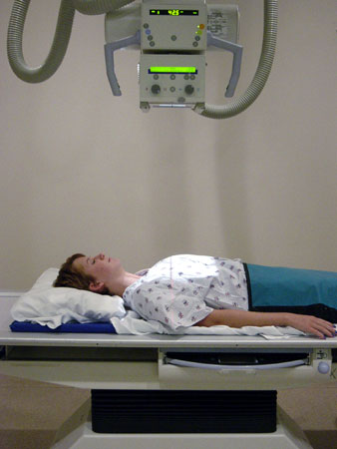
ANTERO POSTERIOR PROJECTION

Slide 11
POSTERO-ANTERIOR VIEW | ANTERO-POSTERIOR VIEW
Patient in standing/sitting position | Patient in supine position
No overlapping of scapulae on lung fields | Scapulae overlap lung fields
Clavicle is not foreshortened | Clavicle is foreshortened
Ribs course obliquely | Ribs assume a horizontal course
No Cardiac magnification | Cardiac magnification
Lower lobe vessels are more prominent compared to upper lobe vessels | More equalization of the pulmonary vasculature when the size of the lower lobe vessels are compared to the upper.
Fundic air seen | Fundic air not seen

Slide 12
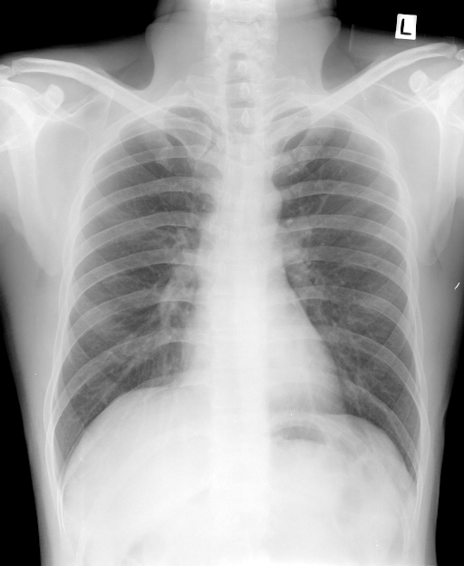
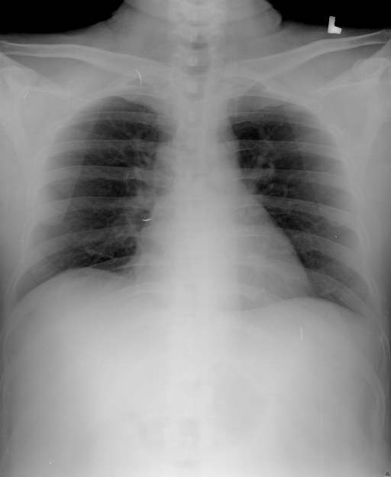
PA AP

Slide 13
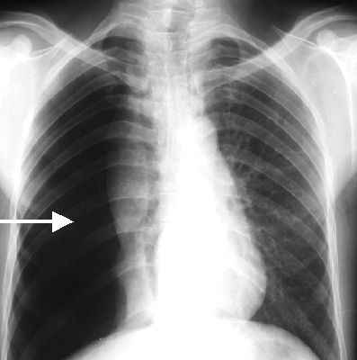
EXPIRATION

Slide 14
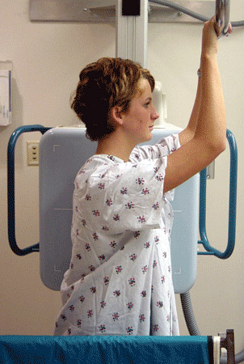
LATERAL PROJECTION

Slide 15
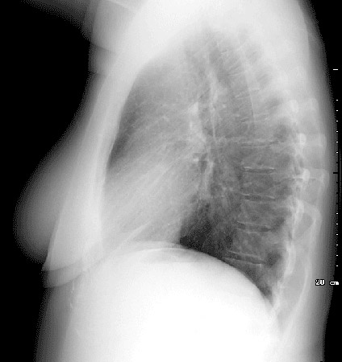
LEFT LATERAL PROJECTION
Demonstrate the mediastinal mass or localize the position of lesion.
Central ray to the mid line of the cassette through mid axillary line

Slide 16
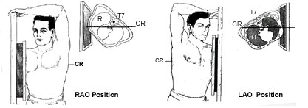
RAO LAO

Slide 17
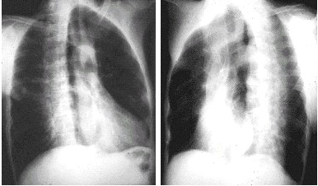
RAO LAO
The diaphragm and heart borders should be sharp with no motion

Slide 18
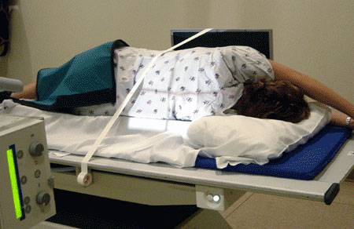
LATERAL DECUBITUS PROJECTION

Slide 19
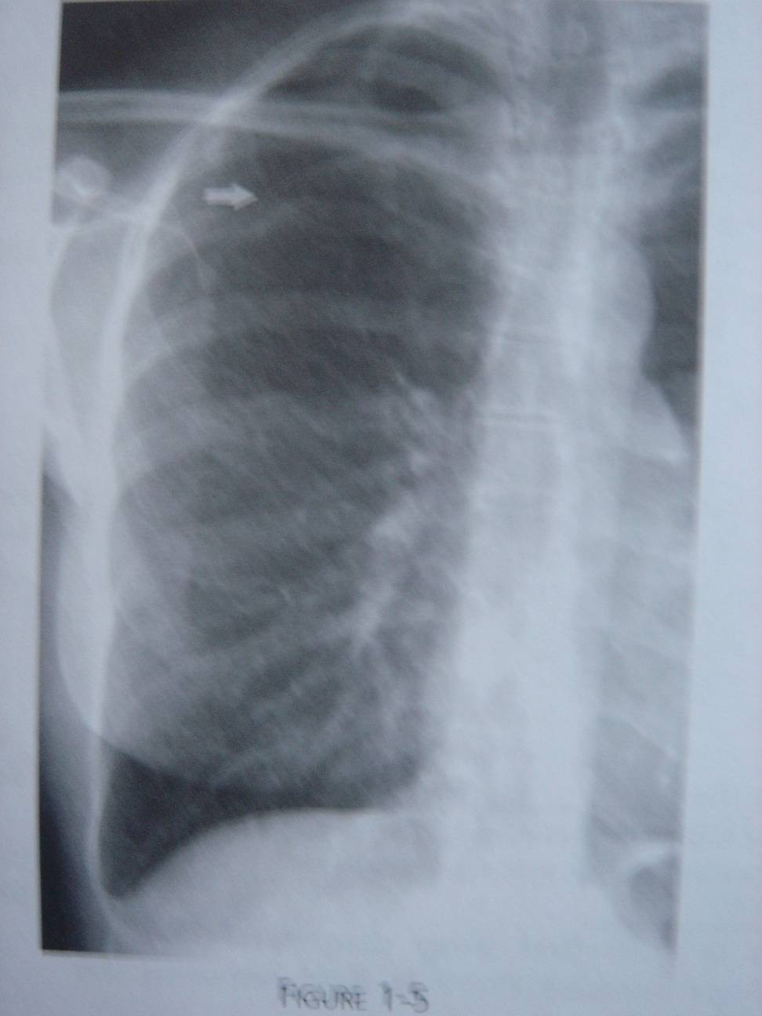
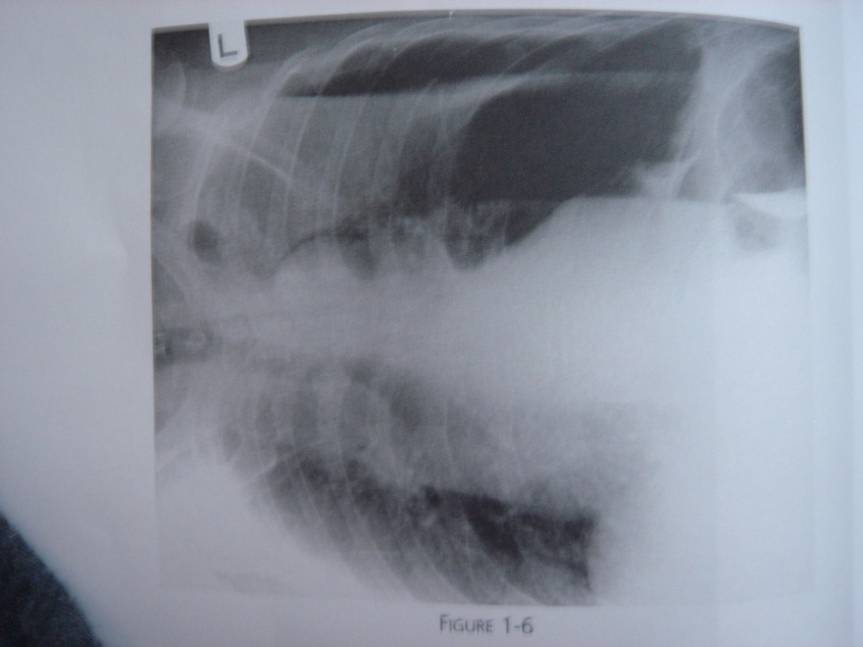
ERECT DECUBITUS

Slide 20
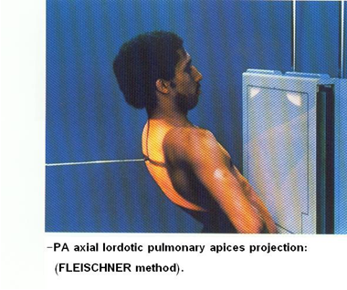
LORDOTIC PROJECTTION

Slide 21
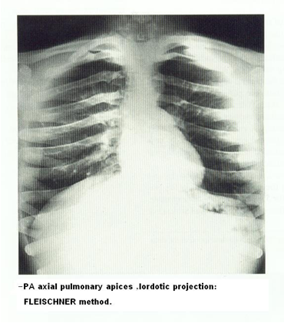
LORDOTIC PROJECTTION
INDICATION
This technique is used to demonstrate right middle – lobe collapse or an inter – lobar pleural effusion
The patient is positioned to bring the middle lobe fissure to bring horizontal

Slide 22
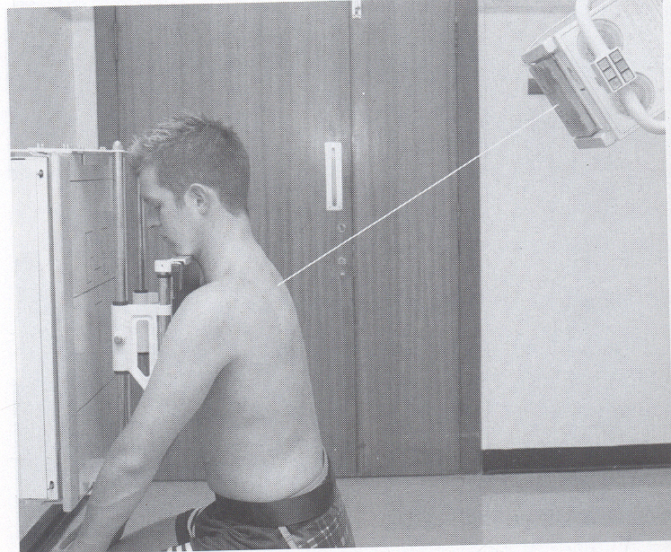
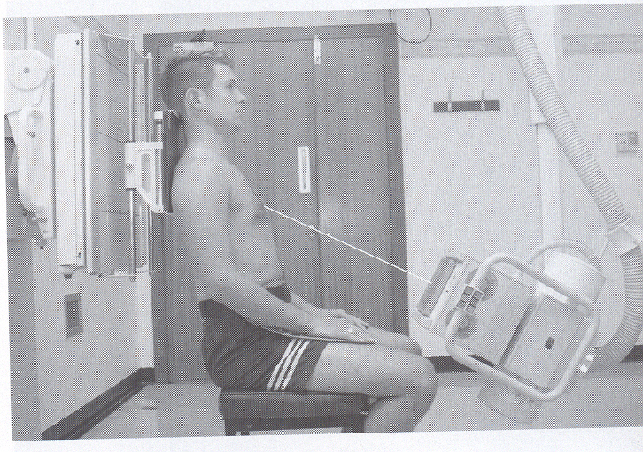
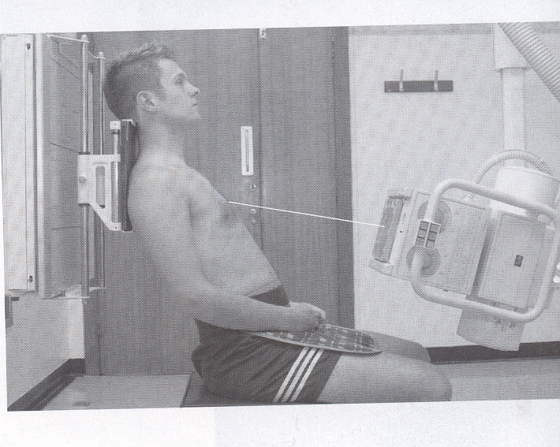
APICOGRAM

Slide 23
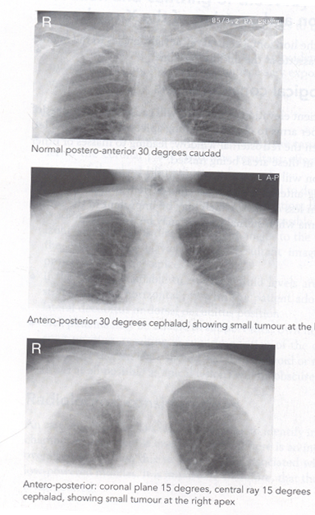
APICOGRAM
To demonstrate the apices, opacities obscured by the overlying ribs or clavicle shadow.
POSTERO – ANTERIOR with x ray tube30 degree cauded tilt.
ANTERO – POSTERIOR with x ray tube 30 degree cephelad tilt
ANTERO – POSTERIOR with coronal plane angled 15 degree with cassette and x ray tube tilted 15 degree cephalad.

Slide 24
TECHIQUES
Low kVp (45-55 kVp)
  High contrast radiograph
Intermediate (55 – 65)kVp
High kVp (90-120 kVp)
  Low contrast radiograph

Slide 25
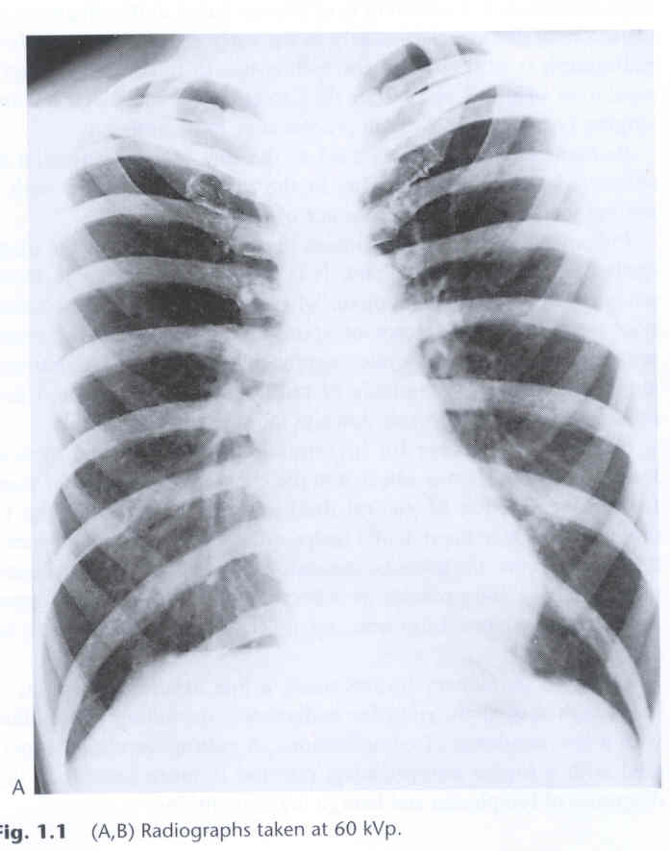
LOW KVp
HIGH CONTRAST
RADIOGRAPH
Miliary shadowing and
calcification more clearly seen

Slide 26
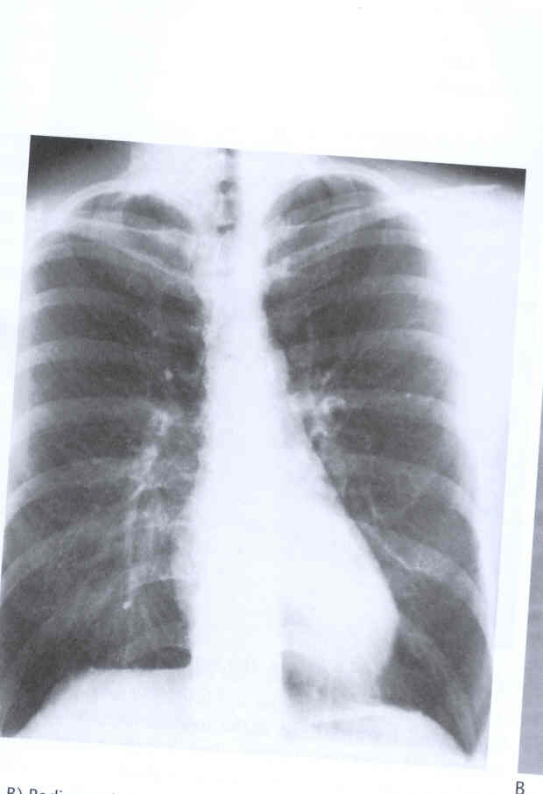
HIGH KVp
LOW CONTRAST
RADIOGRAPH
Increased visualization of hidden areas of the lung

Slide 27
NORMAL KVp
NORMAL CONTRAST
RADIOGRAPH

Slide 28
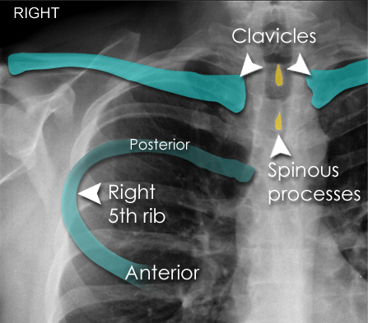
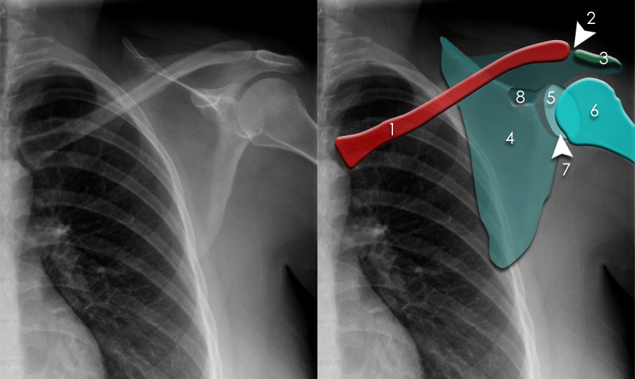
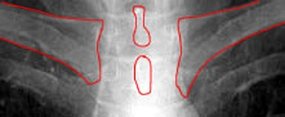
IDEAL POSITIONING

Slide 29
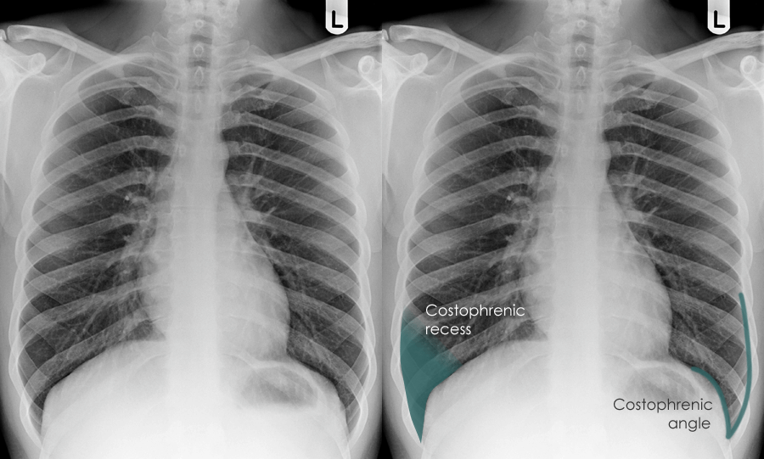
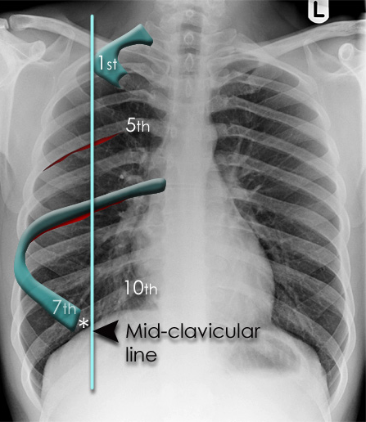
IDEAL POSITIONING
1
2
3
4
5
6
7
8
9
10

Slide 30
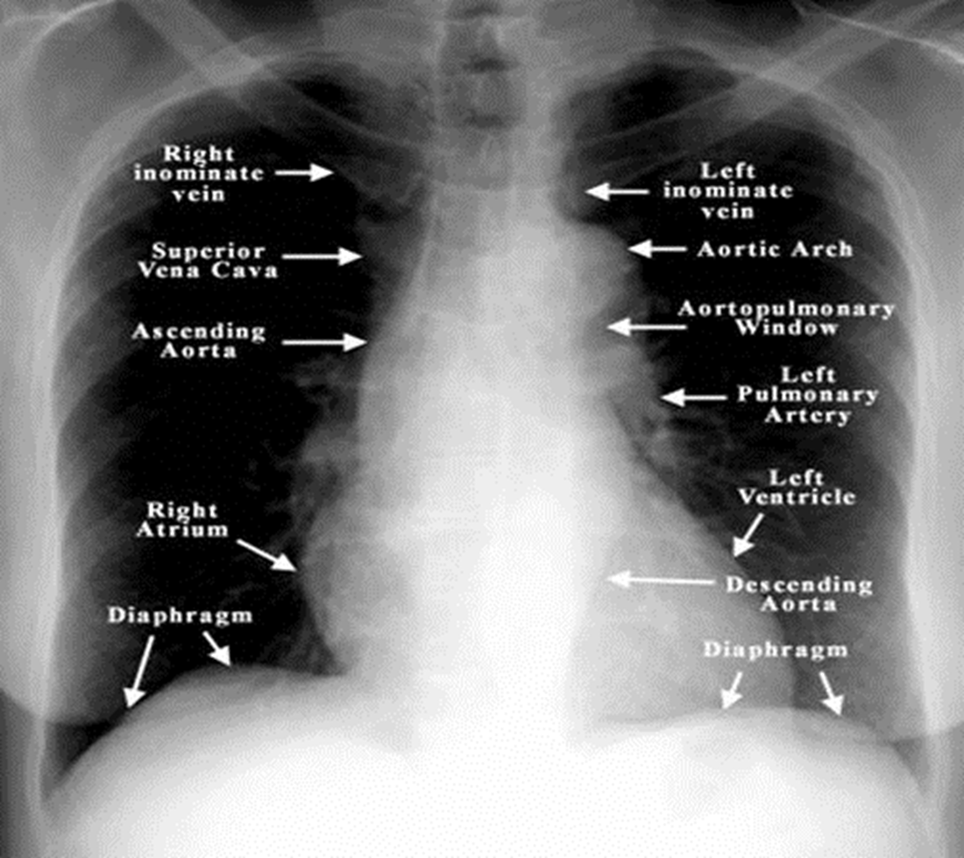
READING OF CHEST

Slide 31
LUNG FIELD
Lung field should be transradiancy and one should not be whiter or darker than the other
Try to identify the horizontal fissure check its position it should run from hilum to the sixth rib if it is displaced then this may be a sign of lung collapse

Slide 32
HEART
Check that heart is of normal shape
Maximum diameter is less than half of thoracic diameter
Check that there is no abnormally dense area of the heart shadow

Slide 33
DIAPHRAGMS
The right diaphragm should be higher than left
The highest of right diaphragm should be in the middle of the right lung

Slide 34
OTHER AREAS
COSTO PHRENIC & CARDIOPHRENIC ANGLES
TRACHIEA
BONES AND RIBS
SOFT TISSUE

Slide 35
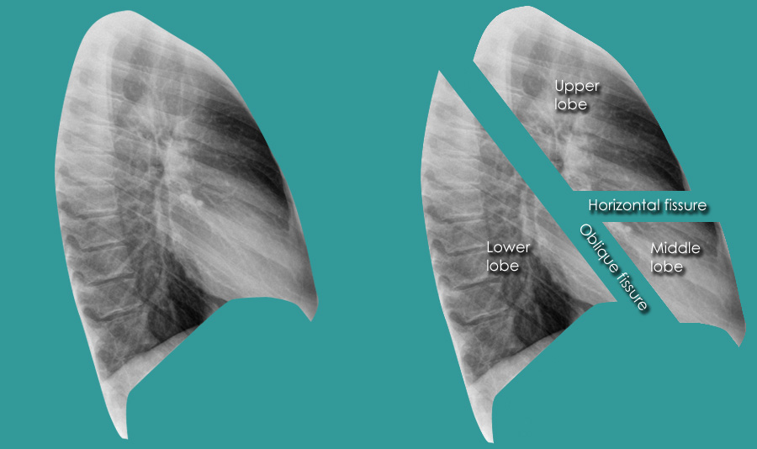
LATERAL RADIOGRAPH

Slide 36
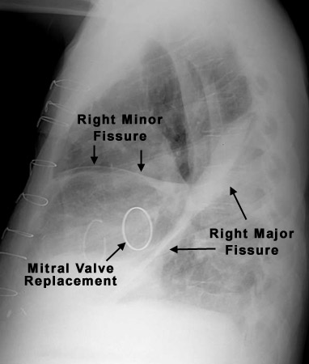
LATERAL RADIOGRAPH

Slide 37
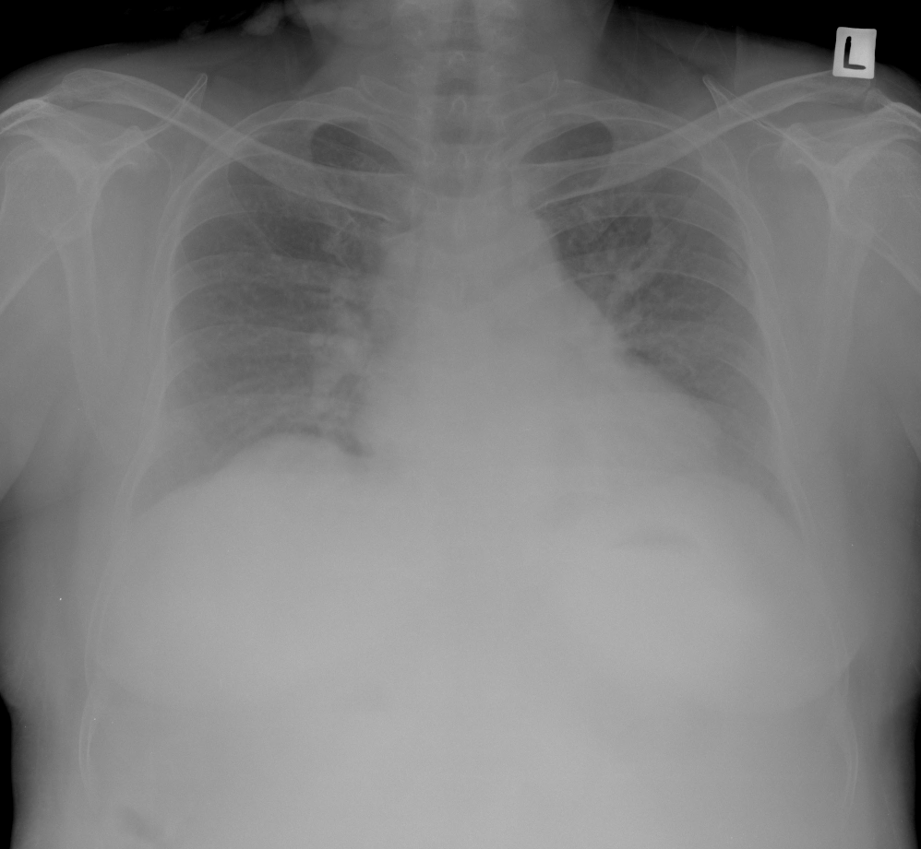
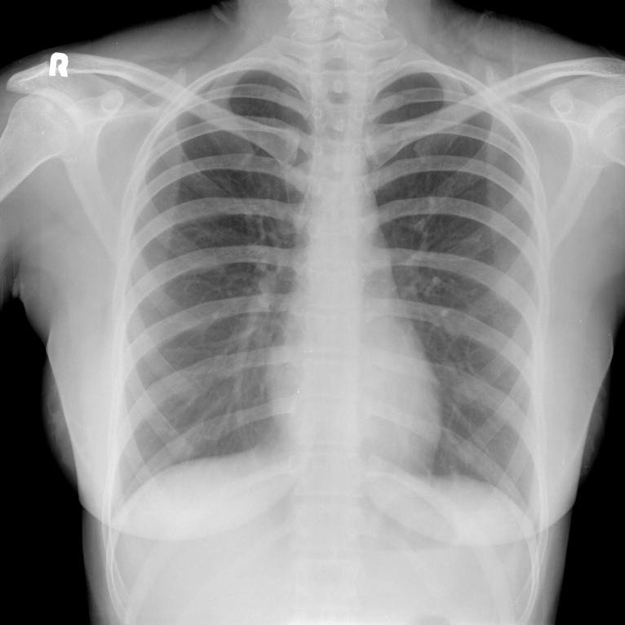
ADEQUATE INSPIRATION
EXPIRATION
INSPIRATION

Slide 38
RADIOGRAPHIC DENSITIES
Air – Black
Water (fluid, blood and soft tissue) – Grey
Fat – Intermediate between air and soft tissue
Metal (Calcium, contrast, metallic) – White

Slide 39
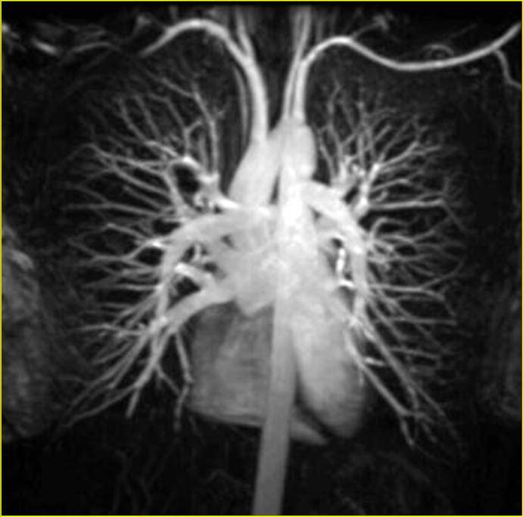
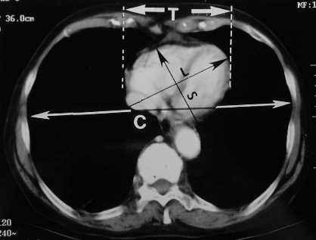
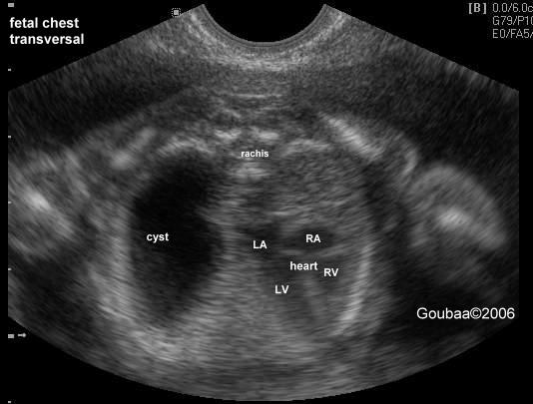
NEW IMAGING TOOLS
MRI
CT
US

Slide 40
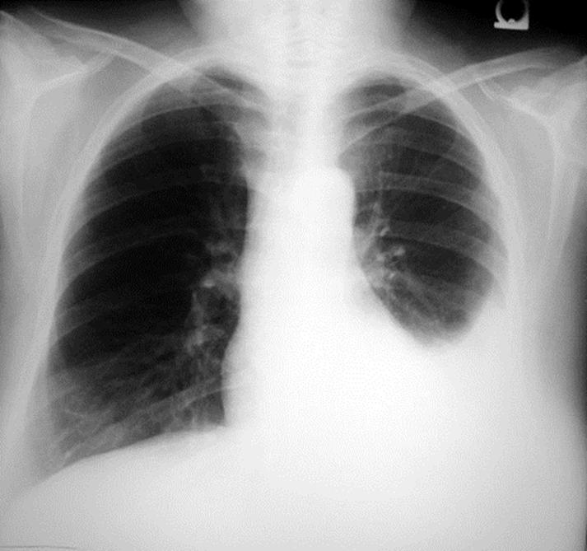
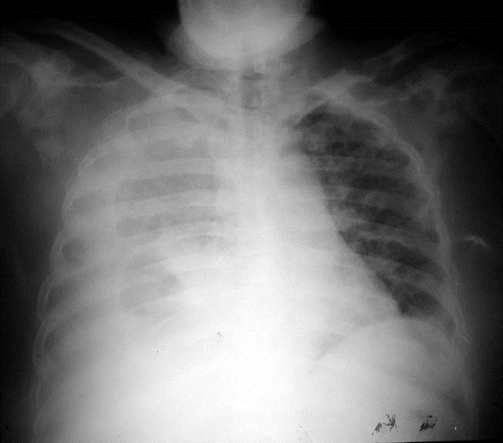
Pleural Effusion

Slide 41
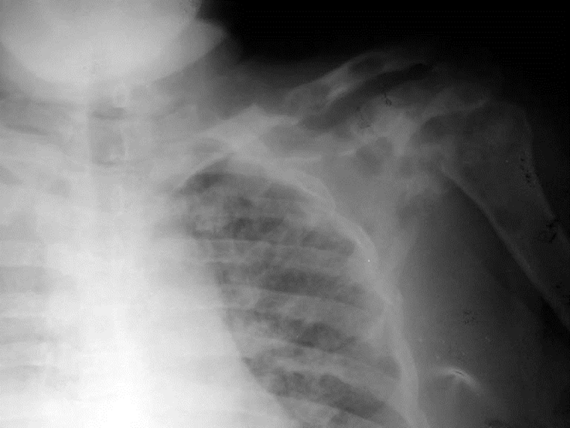
Lesions in Clavicle and Scapula

Slide 42
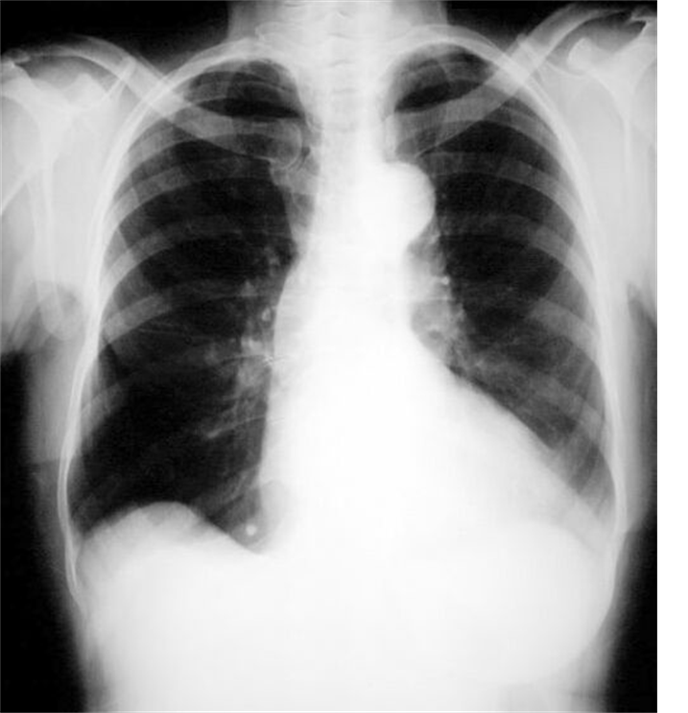
Absent Right Breast

Slide 43
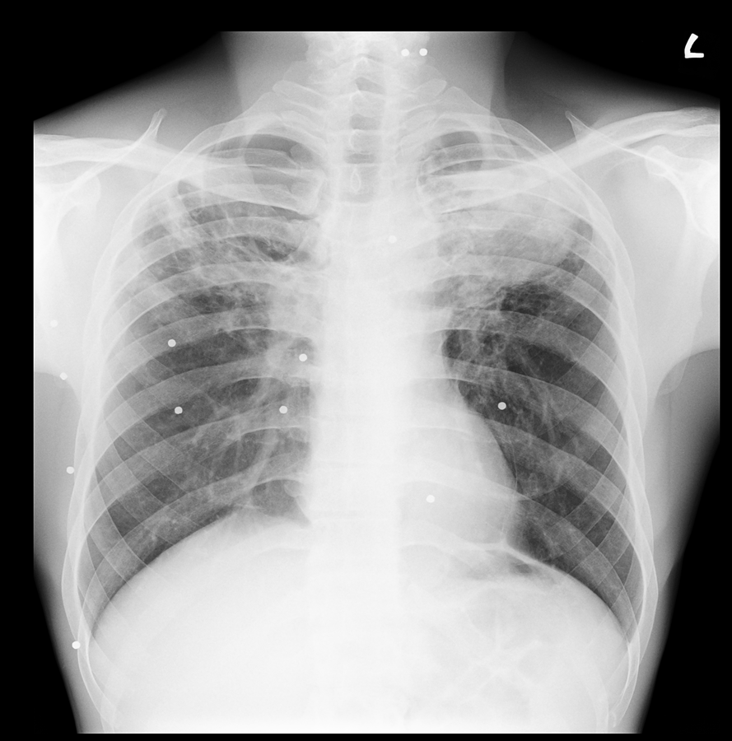
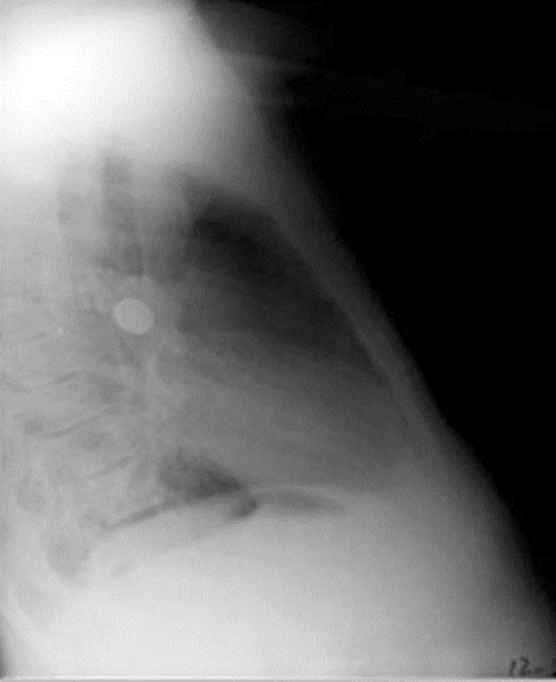
Foreign body

Slide 44
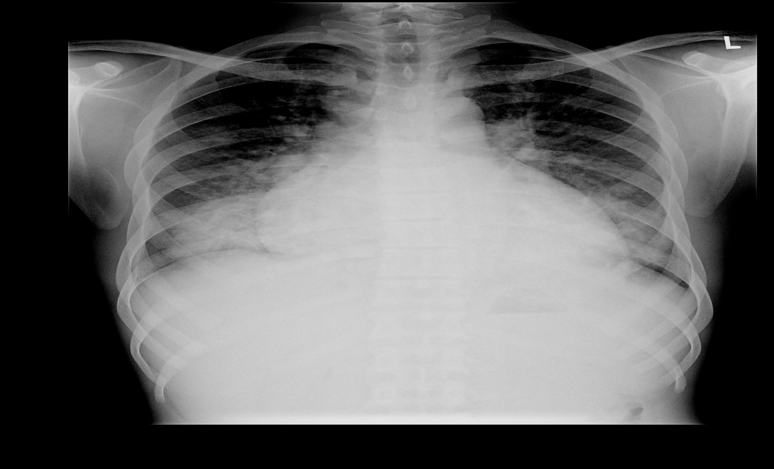
Cardiomegaly with Pulmonary edema

Slide 45
THANK U

