Slide 1
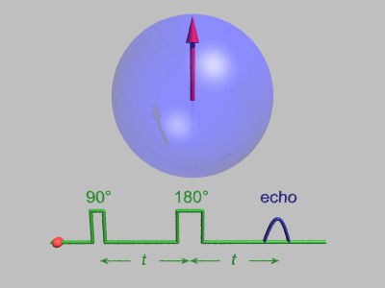
SPIN ECHO PULSE SEQUENCE
By Passang D. Sherpa
Course Coordinator of
Radio-imaging Technology
Dpt. Of paramedical science

Slide 2
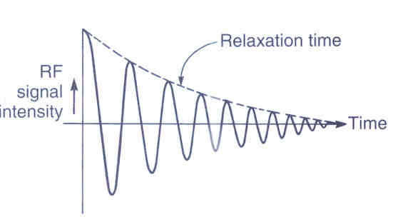
What is a FID
FID: Free Induction Decay.
An NMR Signal in the absence of any magnetic gradients.
It is a oscillating decaying signal.

Slide 3
PULSE SEQUENCES
Carefully co- ordinated & timed sequence of events to generate a particular type of contrast.
SPIN ECHO SEQUENCE
GRADIENT ECHO.

Slide 4
CONTRAST PARAMETERS
Two key parameters : repetition time (TR) and echo time (TE) - are key to the creation of image contrast.
  TR (in milliseconds) is the time between the application of an RF excitation pulse and the start of the next RF pulse
  TE (in milliseconds) is the time between the application of the RF pulse and the peak of the echo detected
Notes:
From MR pulse sequence page 4
Both parameters affect contrast on MR images because they provide varying levels of sensitivity to differences in relaxation time between various tissues. At short TRs, the difference in relaxation time between fat and water can be detected (longitudinal magnetization recovers more quickly in fat than in water); at long TRs, it cannot be detected. Therefore, TR relates to T1 (Fig 4b) and affects contrast on T1-weighted images. At short TEs, differences in the T2 signal decay in fat and water cannot be detected; at long TEs, they can be detected. Therefore, TE relates to T2 (Fig 4b) and affects contrast on T2-weighted images.
When the TR is long and the TE is short, the differences in magnetization recovery and in signal decay between fat and water are not distinguishable (Fig 4b); therefore, the contrast observed on the resultant MR images is predominantly due to the difference in proton density between the two tissue types.

Slide 5
EFFECT OF TR AND TE ON MR IMAGE CONTRAST
Imaging technique | TR | TE
T1 weighting | Short | Short
T2 weighting | Long | Long
PD weighting | Long | Short
* Short TR & long TE produces very low SNR and should be avoided

Slide 6
 | TR (in ms) |  | TE (in ms)
Sequence | Short | Long | Short | Long
SE | 250-700 | >2000 | 10-25 | >60
GRE | <50 | >100 | 5-10 | >10

Slide 7
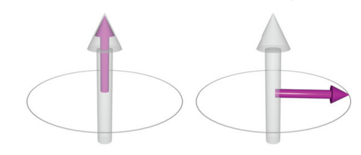
RF rephasing
90° RF excitation pulse to flip the NMV fully into the transverse plane.
NMV precesses in the transverse plane inducing a voltage in the receiver coil.
A FID occurs when the 90° RF excitation pulse switches off.
T2* dephasing from inhomogeneities
Another 180° RF pulse is used to refocus or rephase the magnetic moments of hydrogen nuclei

Slide 8
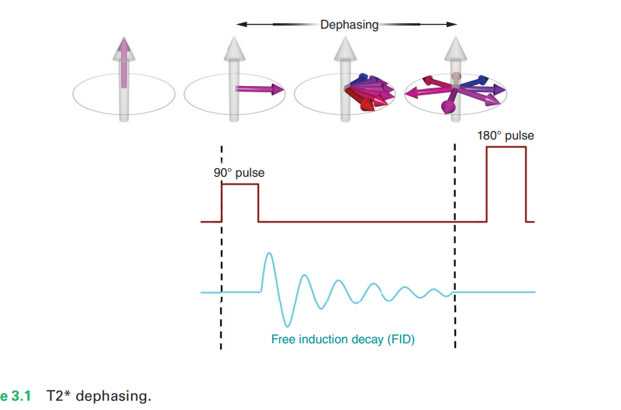

Slide 9
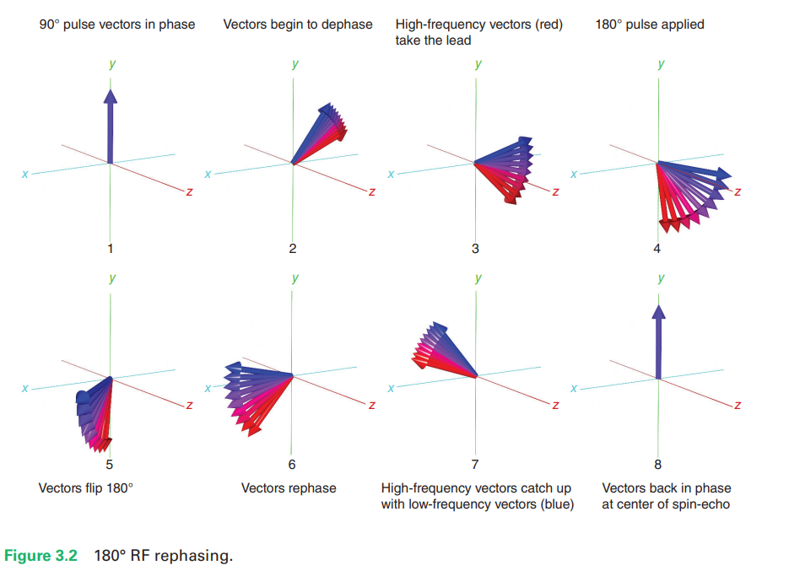
SPIN ECHO SEQUENCE
T2* dephasing causes the hydrogen nuclei to dephase in transverse plane→out of phase→nuclei in different position of precesional path.
Magnetic moment that slow down→trailing edge.
Magnetic moment that speed up→leading edge
180°RF pulse is then applied

Slide 10
The 180° RF rephasing pulse flips the individual magnetic moments through 180°
Magnetic moments that formed the trailing edge before the 180° RF rephasing pulse →leading edge. Conversely, magnetic moments that formed the leading edge before the 180° RF rephasing pulse→Trailing edge
Trailing edge begins to catch up with the leading edge→ two edges are superimposed
Magnetic moments of hydrogen nuclei are momentarily in phase because they are all at the same place on the precessional path→in-phase transverse magnetization→ maximum signal is induced in the receiver coil.
This signal is called a spin-echo.

Slide 11
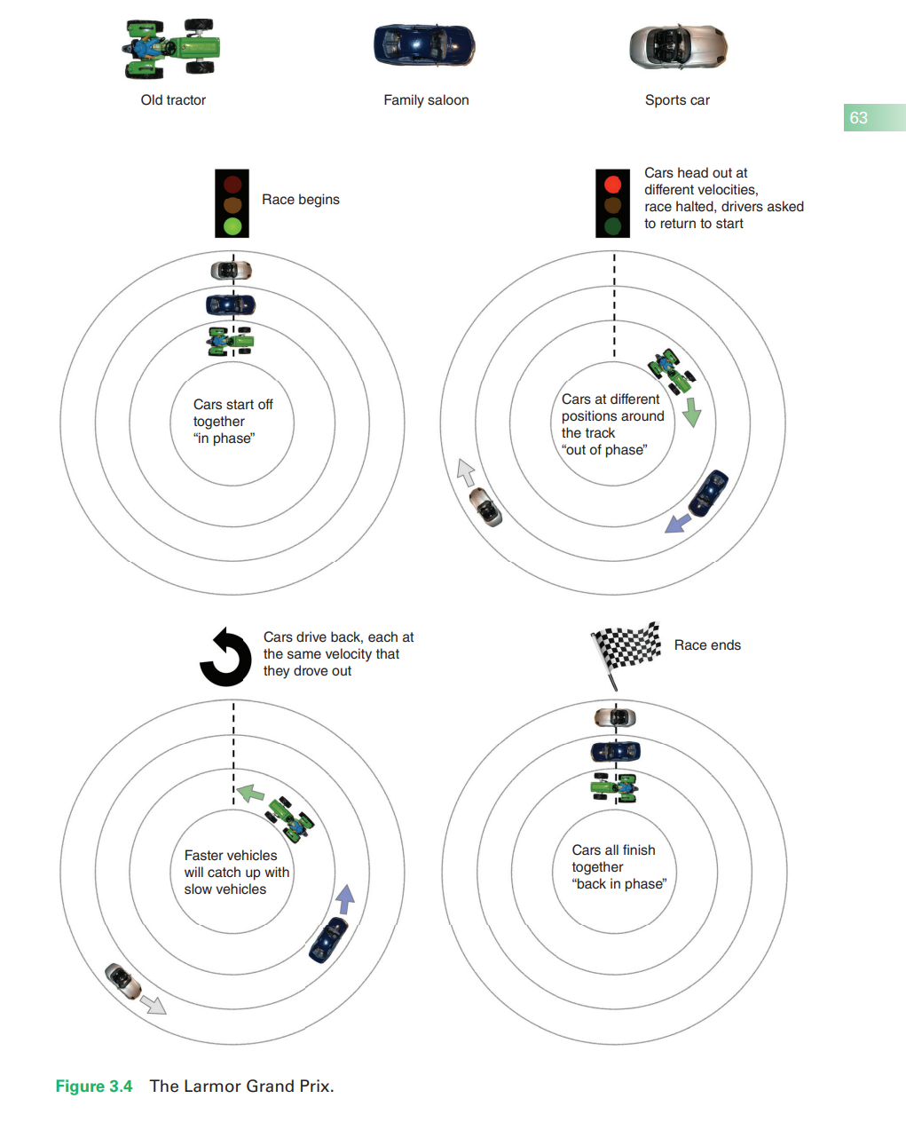

Slide 12
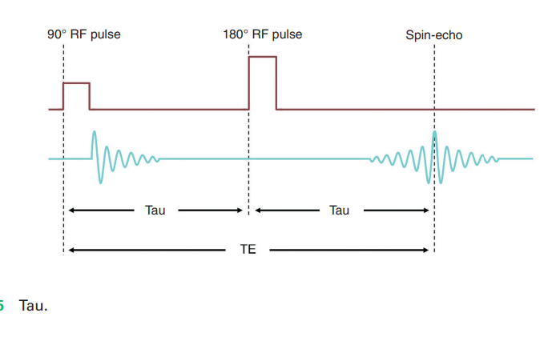
TR is the time between each 90° RF excitation pulse for each slice.
The TE is the time between the 90° RF excitation pulse and the peak of the spin-echo
The time taken to rephase after the 180° RF rephasing pulse equals the time to dephase when the 90° RF excitation pulse is withdrawn. This time is called tau.

Slide 13
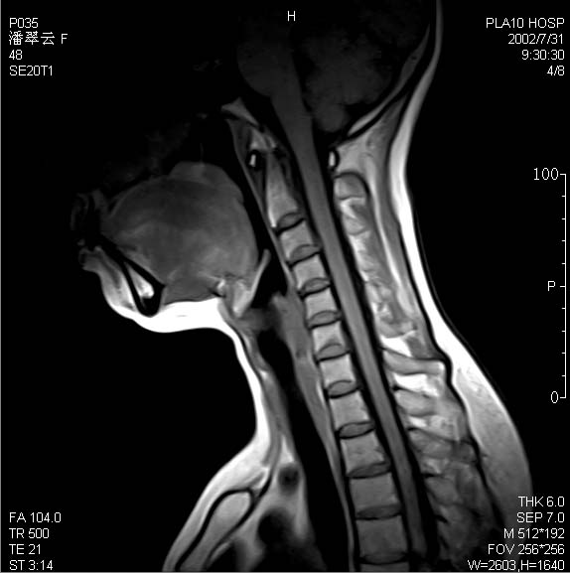
SPIN ECHO SEQUENCE
Sequences that uses a 180° RF rephasing pulse to generate an echo called spin-echo pulse sequences
3 types-
Conventional spin echo
Fast/ Turbo spin echo
Inversion recovery

Slide 14
CONVENTIONAL SPIN ECHO
Uses a 90º RF pulse followed by one or more 180º rephaging pulses to generate a spin echo
Each 180° RF rephasing pulse generates a separate spin-echo →received by a coil →create an image
spin-echo sequences typically generate either one or two echoes
Gold standard for most imaging.
If only one rephaging pulse is used- T1 w
image is obtained using short TR, Short TE
If Two rephaging pulses are used- T2-w
or PD-w image.

Slide 15
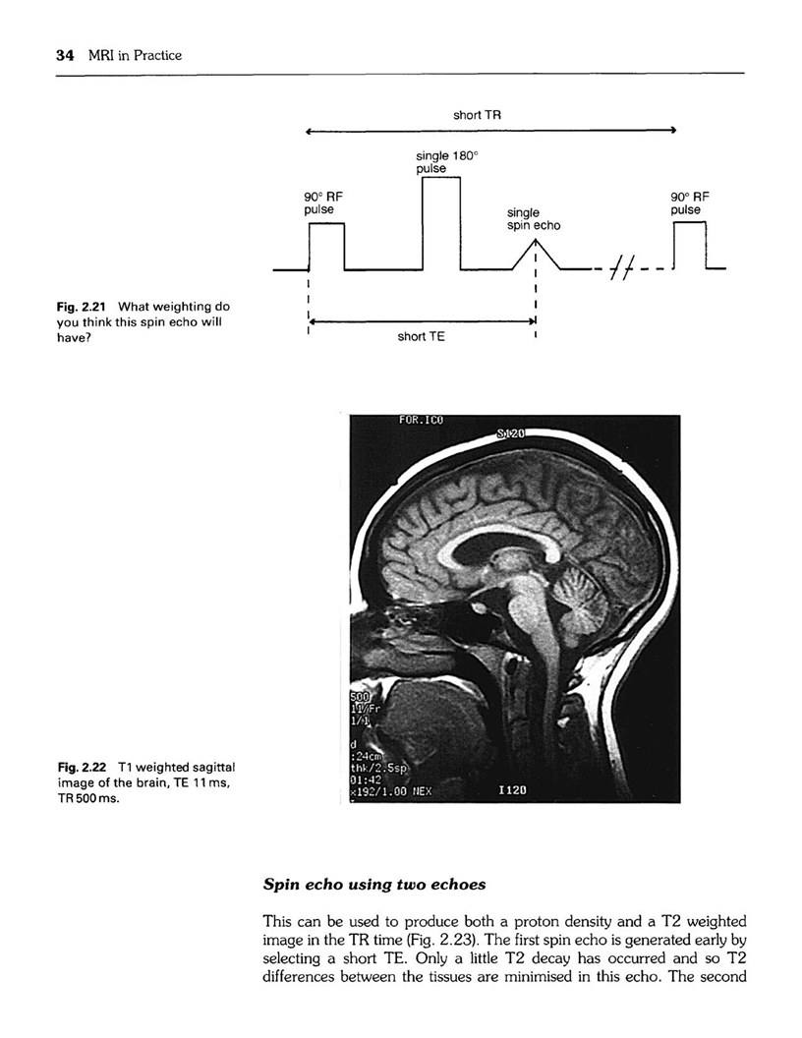
Single echo- T1 weighting image

Slide 16
Spin-echo using two echoes
Used to produce both a proton density and a T2-weighted image in the TR period
first spin-echo is generated early by selecting a short TE.
The first spin-echo has short TE and long TR, and produce PD-weighted
The second spin-echo is generated much later by selecting a long TE
long TE and long TR, and produce T2-weighted

Slide 17
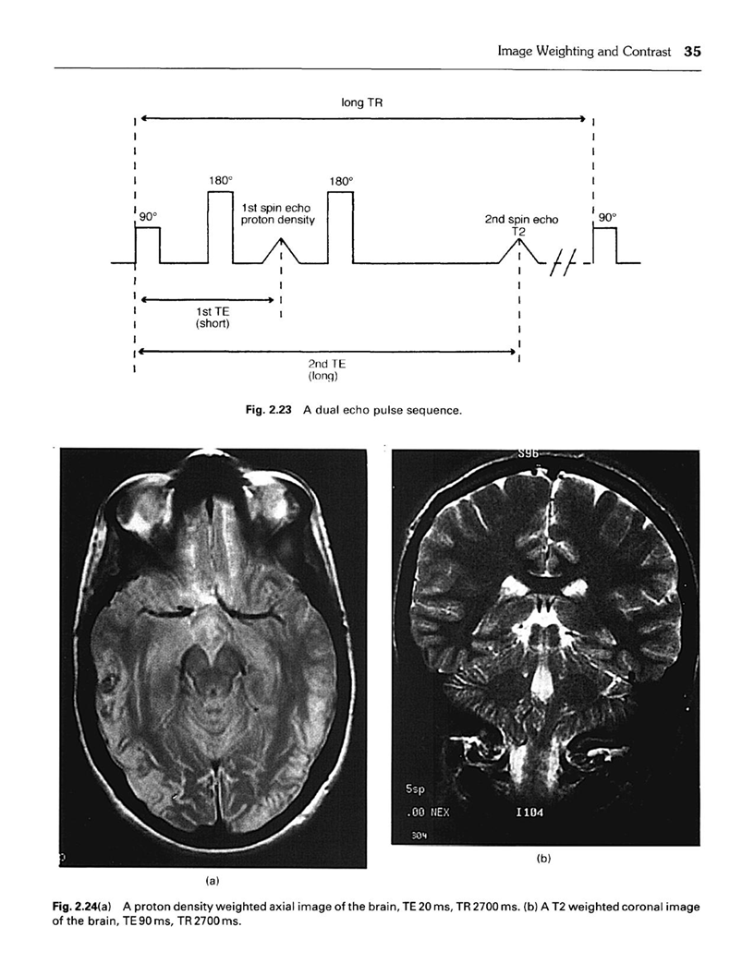
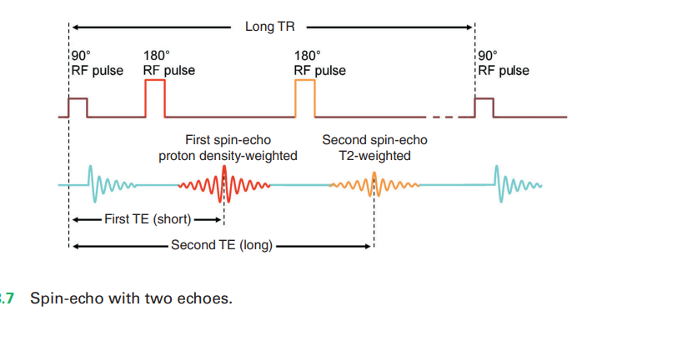

Slide 18
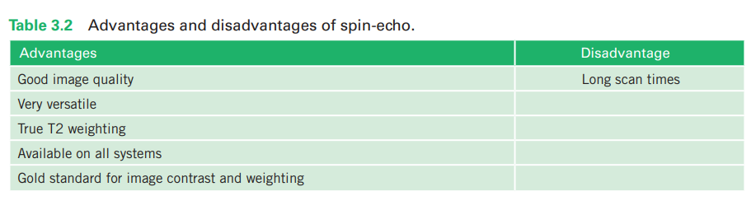

Slide 19
PARAMETERS
T1 weighting
PD/T2 weighting
Short TE- 10-20 ms
Short TR- 300-700 ms
Typical scan time 4-6 min
Short TE- 20ms/long TE 80ms+
Long TR 2000+
Typical scan time – 7-15 min

Slide 20
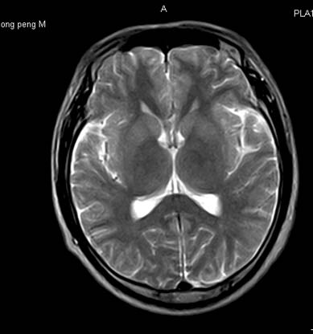
FAST SPIN ECHO
Pulse sequence much faster than
conventional Spin echo.
It is also known as RARE (Rapid Acquisition with Relaxation Enhancement)
Scan time depends on- TR, number of signal averages (NSA) , No. of phase encoding Steps
Time is reduced by increasing no. of phase encoding steps per TR.
An echo train of 180º Rephasing pulses is used to produce echoes.

Slide 21
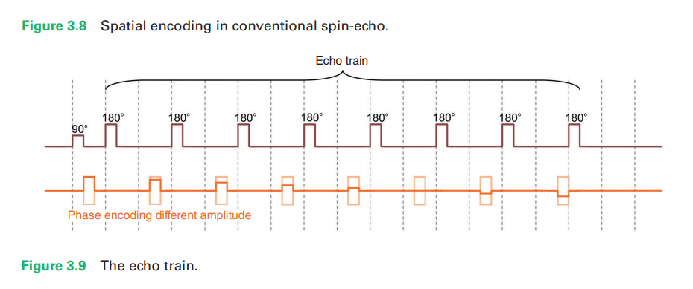
Data from each echo are placed into one image.
No. of rephasing pulses performed per TR corresponds to the no. of echoes produced & no. of k-lines filled.
This no. is called Turbo factor/ Echo train length.
Higher the turbo factor, shorter the scan time.

Slide 22
Uses
Central nervous system
Pelvis
Musculoskeletal region

Slide 23
Echo Train Length
Refers to the no. of echoes used in FSE.
ETL can be even (GE scanner) or odd (Siemens scanner) & ranges typically from 3-32.
Time between successive echoes is called the ‘echo spacing’(ESP).

Slide 24
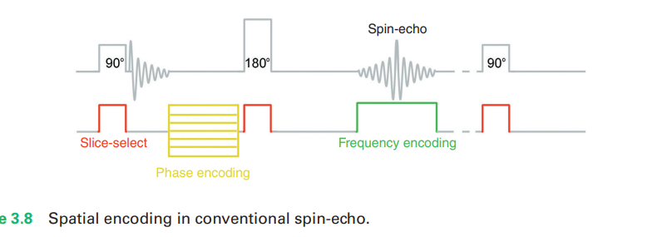
In conventional spin-echo, one phase-encoding step is applied per TR on each slice, and therefore only one line of k-space is filled per TR
If a 256 phase matrix is selected, 256 phase encodings are performed. Assuming 1 NSA is also selected, 256 TR periods must elapse to complete the scan

Slide 25
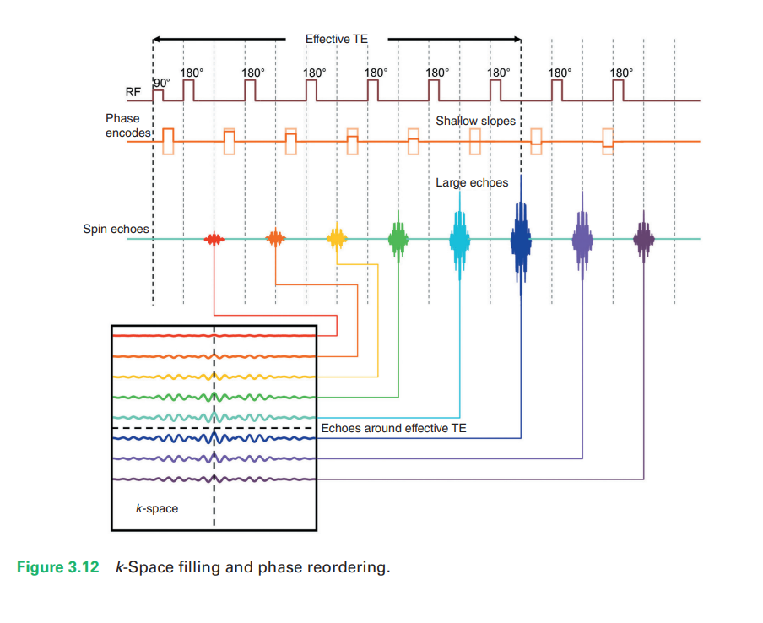
In TSE-scan time is reduced by performing more than one phase-encoding step and subsequently filling more than one line of k-space per TR.
Achieved by using several 180° RF rephasing pulses to produce several spin-echoes to form an echo train
Selecting a turbo factor of 16, 16 phase-encoding steps are performed every TR. Therefore 256 ÷ 16 (i.e. 16) TR periods must elapse to complete the scan.

Slide 26
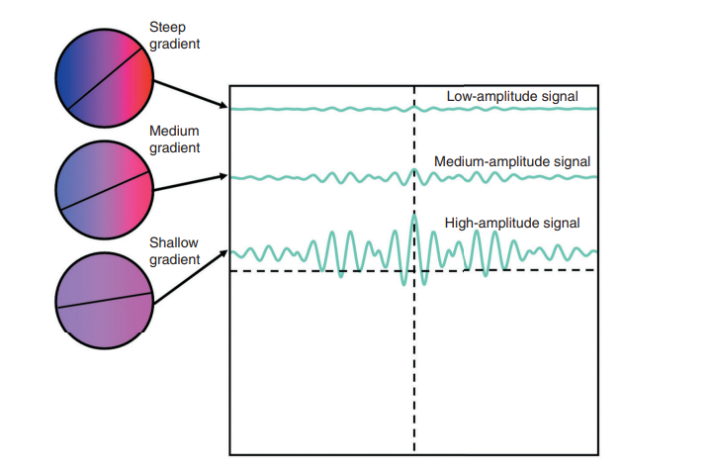
Weighting in TSE
To achieve this weighting, the system organizes where to place data from each spin-echo in k-space
TE of the spin-echo from which the data are collected matches the effective TE
Shallow slopes, which allow maximum signal, are centered on spin-echoes that have a TE at or near the effective TE.
Steep slopes, which allow less signal, are placed on spin-echoes that have a TE away from the effective TE

Slide 27
Data from spin-echoes collected around the effective TE have more impact on image weighting, as they fill the central lines of k-space that contribute signal and contrast to the image
Data from spin-echoes collected at the “wrong” weighting (other TEs) have much less of an effect, as they fill the outer lines of k-space and therefore make less contribution to the signal and contrast of the image

Slide 29
Parameters
T1 weighting
T2 weighting
PD weighting
TR- 300-700 ms
Effective TE- minimum
Turbo factor- 2-8
TR- 3,000-10,000ms
Effective TE- 80-140ms
Turbo factor- 12-30
TR- 3,000-10,000ms
Effective TE- minimum
Turbo factor- 2-8

Slide 30
Advantages of FSE
Faster scan time
SNR maintained, because we still have 256 phase encoding steps.
Motion artifacts are less severe.
Rephasing from the multiple 180⁰ pulses leads to less distortion from metallic objects on FSE.

Slide 31
Disadvantages of FSE
Some flow artifacts increased
Some contrast interpretation problems
Image blurring possible
Normal intervertebral discs are not as bright on T2-W FSE image as CSE.

Slide 32
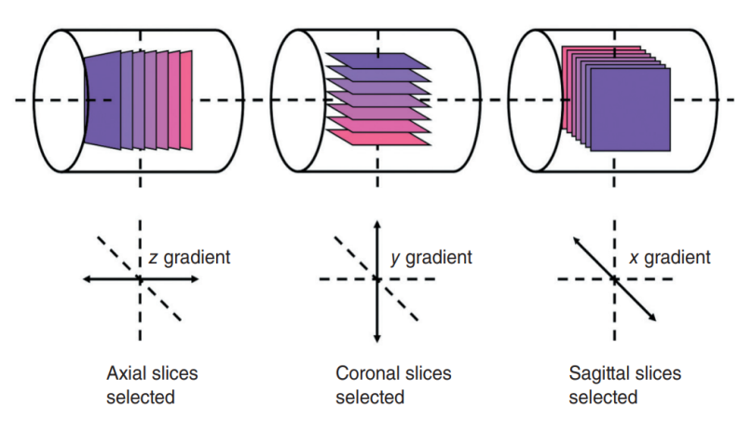
3D FSE
Possible with the advent of high performance gradients ( Crusher Gradients).
Useful for brain, C-spine & L-spine where bright CSF(T2-W) images are required in more than one plane.
Basic idea in 3D imaging is to have a phase- encoding gradient not only in the Y direction but also in Z direction.
Multiple slices in 2D FSE are replaced by multiple slabs.
Notes:
Crusher Gradients: is a correction gradient that preserves the desired signal pathways while eliminating unwanted ones by manipulating the phase of the signals

Slide 33
GRASE (Gradient & Spin echo technique)
Fast scanning technique , hybrid of GRE & FSE.
Also called turbo GSE or TGSE.
In this tech. some of the spin echoes are replaced by gradient echoes.
Contrast in GRASE reflects the relative number of gradient & spin echo.

Slide 34
This contrast leads to greater gradient echo contrast & increased sensitivity to susceptibility effects
This technique has particular applicability to 3T magnets where SAR ,i.e., RF tissue heating is greater.
Notes:
The magnetic field distortions created by susceptibility effects result in variations in precessional frequency across the patient and even within individual voxels

Slide 35
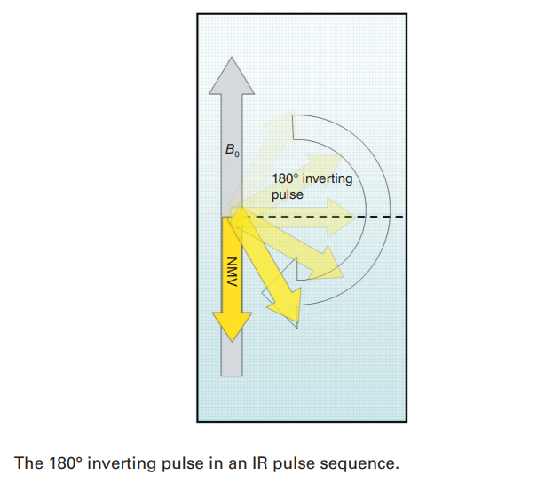
INVERSION RECOVERY
Developed in the early days of MRI to provide good contrast.
Used to suppress the signals from certain tissues in conjunction with long TEs & T2-w.
RF pulse inverts the NMV through 180° ,NMV still lies in the longitudinal plane but in the opposite direction to B0.

Slide 36
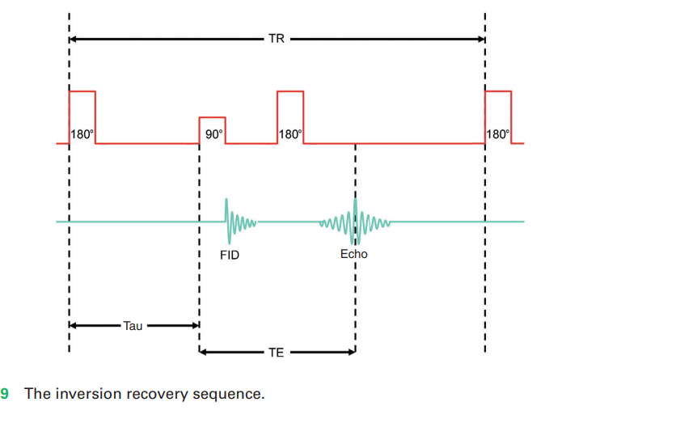
RF inverting pulse is removed, the NMV relaxes back to B0 because of T1 recovery processes.
At a certain time-point during this recovery, a 90° RF excitation pulse is applied and then switched off.
Resuls, FID is then rephased by another 180° RF rephasing pulse to produce a spin echo at time TE
Time from the 180° RF inverting pulse to the 90° RF excitation pulse is known as the TI (time from inversion).

Slide 37
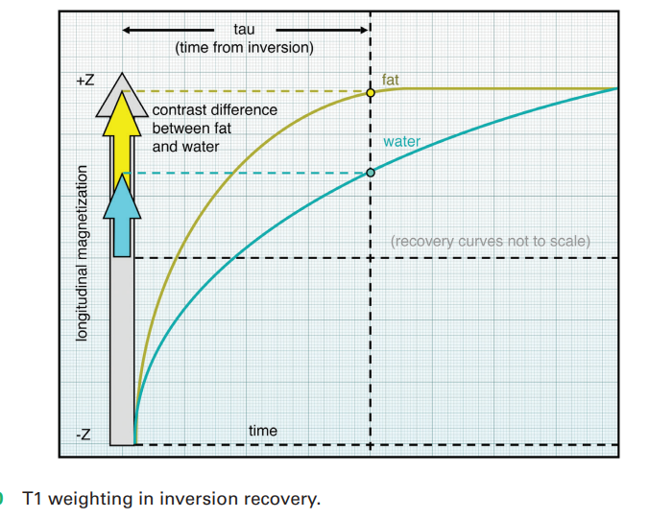
Image contrast depends primarily on the TI
If the 90° RF excitation pulse is applied after the NMV has relaxed back through the transverse plane, image contrast depends on the amount of longitudinal recovery of each vector (as in spin-echo).
The resultant image is T1-weighted

Slide 38
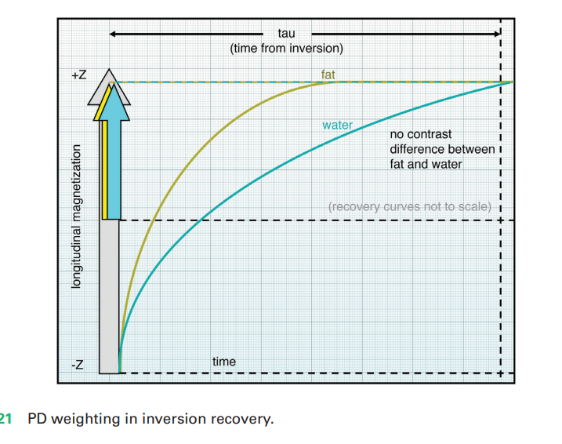
If the 90° RF excitation pulse is not applied until the NMV has reached full recovery, a PD-weighted image is produced, as both fat and water are fully relaxed

Slide 39
Fast inversion recovery
180° RF inverting pulse is followed at time TI by the 90° RF excitation pulse and a train of 180° RF rephasing pulses to fill out multiple lines of k-space as in TSE
Reduces the scan time compared to conventional IR
Fast IR is used to suppress signal from certain tissues in conjunction with T2 weighting so that water and pathology return a high signal.
Two main sequences in this category are STIR and FLAIR

Slide 40
Short tau inversion recovery (STIR)
IR pulse sequence that uses TI that corresponds to the time it takes the fat vector to recover from full inversion to the transverse plane so that there is no longitudinal magnetization corresponding to fat. This is called the null point
There is no longitudinal component of fat when the 90° RF excitation pulse is applied, there is no transverse component after excitation, and signal from fat is nulled.
TI of 100–175 ms usually achieves fat suppression

Slide 41
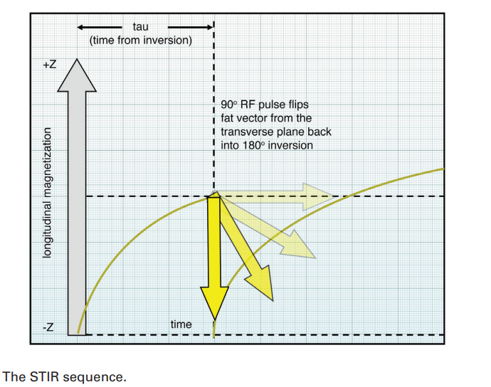
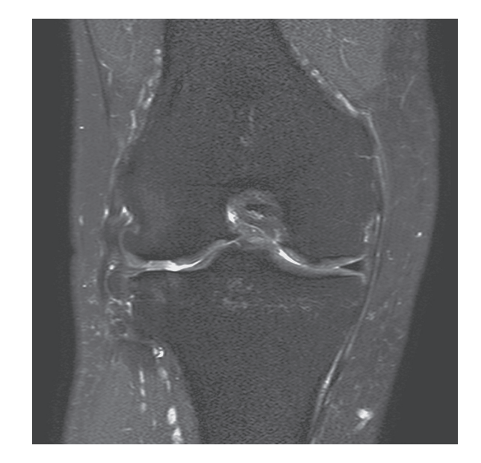

Slide 42
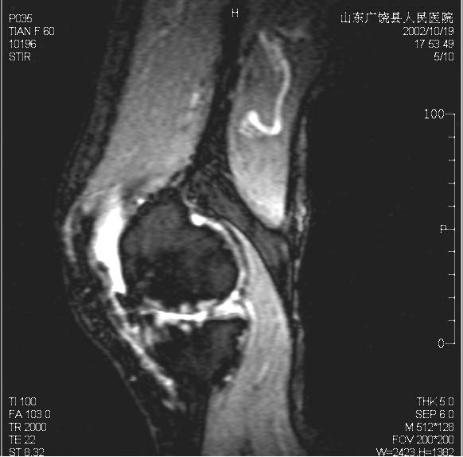
Uses
Important sequence in musculoskeletal system.
Used to suppress the marrow of bone to detect bone pathology. E.g. Bon Bruising & Tumors.
Useful for suppressing fat in general MR imaging.

Slide 43
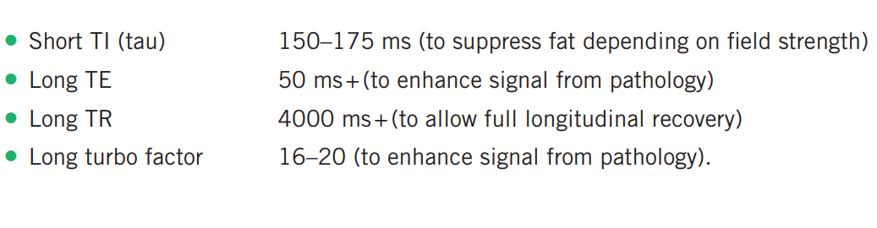
Parameters
Average scan time - 5-15 min

Slide 44
Fluid attenuated inversion recovery (FLAIR)
Longitudinal mag.
Transverse mag.
TI- time of recovery of CSF from 180 to transverse plane.
Before applying 90 excitation pulse if there is no longitudinal magnetization, so after excitation there will be no transverse magnetization for CSF.
CSF is nulled
TI of 1700–2200 ms usually achieves CSF suppression

Slide 45
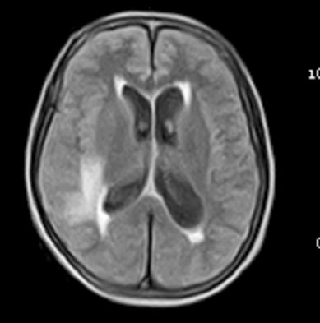
Uses
Suppress free water.
Infarct displayed clear.
Used to suppress the high CSF signal in T2-w image so that pathology adjacent to CSF is seen more clearly.
Used in brain/spine imaging to see periventricular & Cord lesion.
It is especially useful in visualizing multiple sclerosis plaques, acute subarachnoid hemorrhage, and meningitis

Slide 46
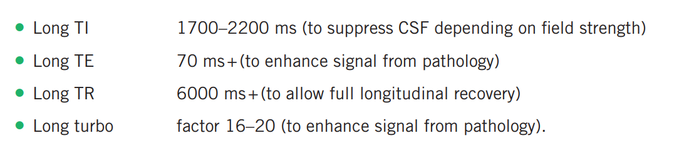
Parameters
Average scan time - 13-20 min

Slide 47
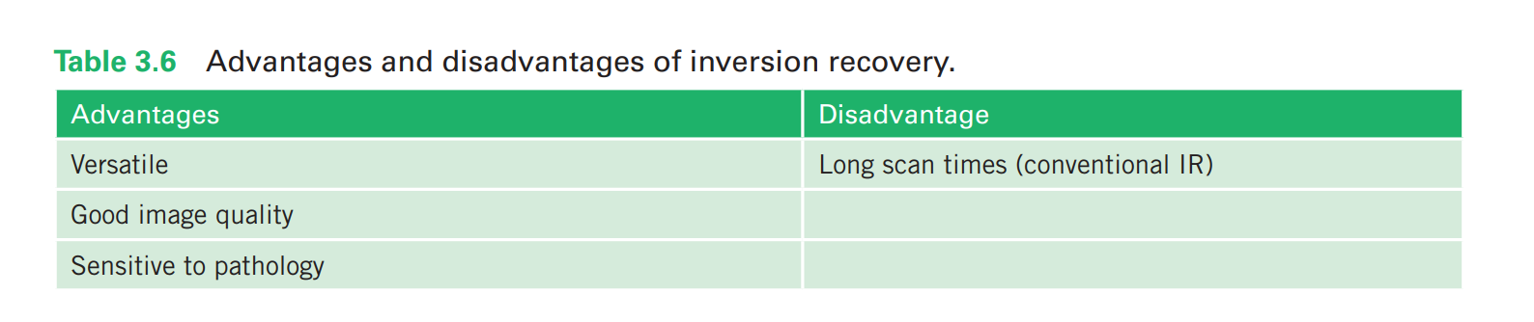

Slide 48
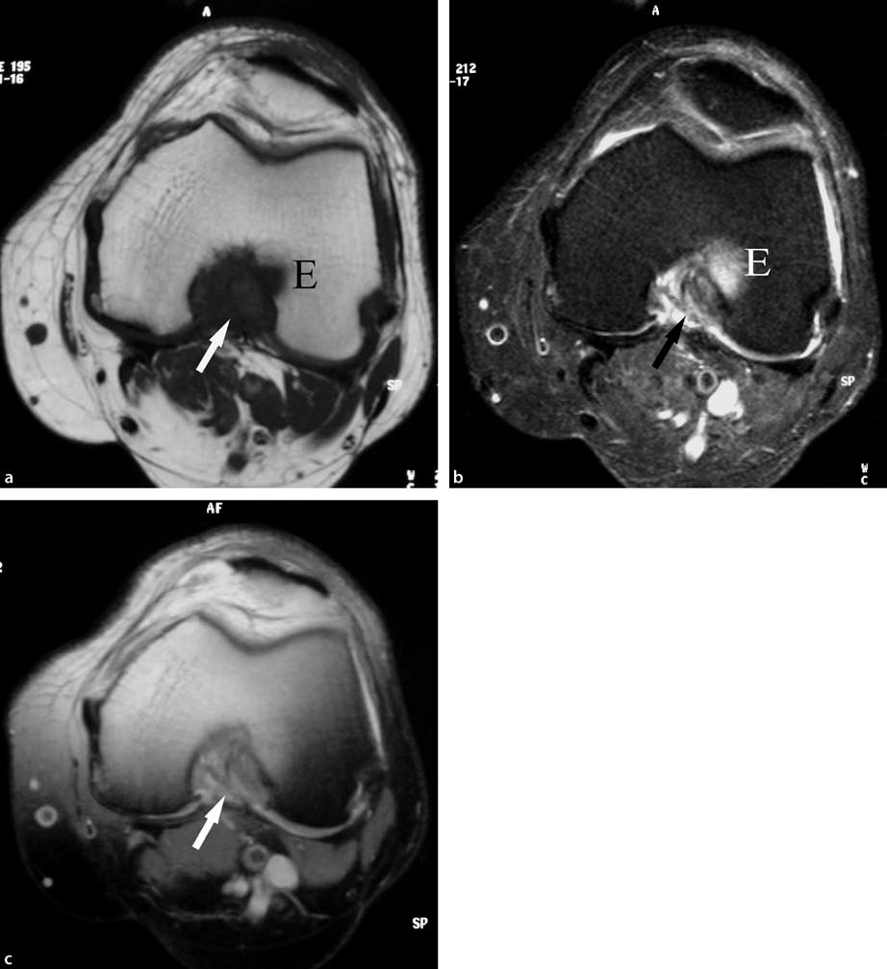
(A) T1-w SE (B) STIR
(C) fat-suppressed PD
a T1-w SE b STIR
and c fat-suppressed PD
images.

Slide 49
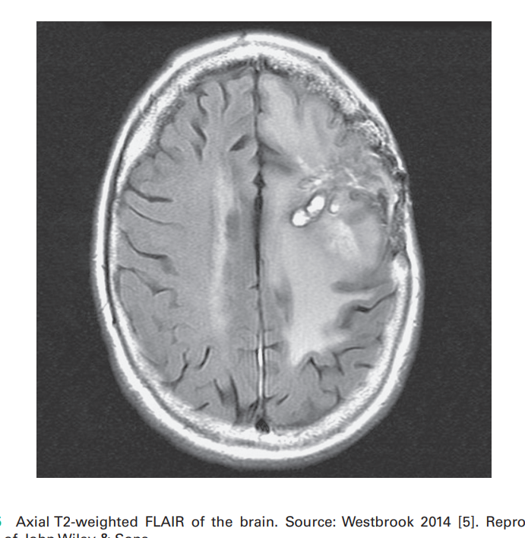

Slide 50
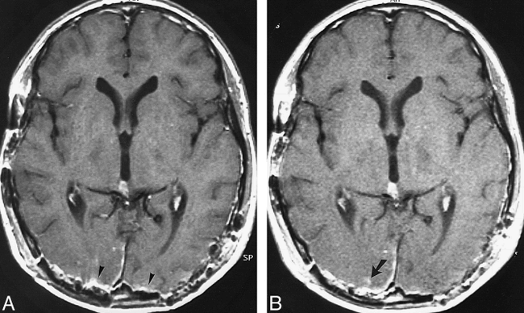
16-year-old boy with germ cell tumor after surgery. The T1-FSE sequence was performed after the T1-SE sequence.
A, Metal artifacts (arrowheads) associated with surgery are present bilaterally in the occipital region on the T1-SE image.
B, Minimal intraparechymal enhancement, which was difficult to identify on the T1-SE image, is clearly depicted on the T1-FSE image (arrow)

Slide 51
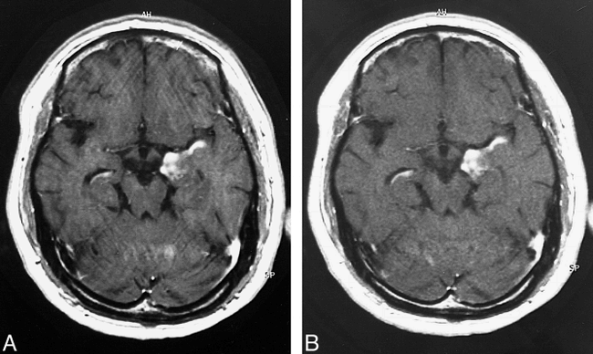
45-year-old man with glioblastoma. The T1-FSE sequence was performed after the T1-SE sequence.
A and B, The T1-SE image (A) has more severe motion artifacts than does the T1-FSE image (B).

Slide 52
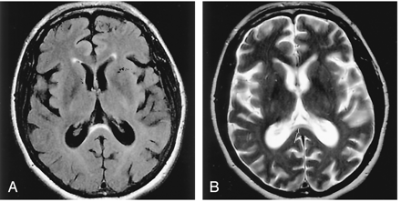
Suppression of ventricular fluid signal by using the FLAIR sequence unmasked the abnormality hidden by the conventional T2-weighted sequence.
A, Axial FLAIR image, revealing a discrete thin band of signal intensity hyperintensity in the anterior subependymal region of the splenium.
B, T2-weighted image, showing that CSF signal intensity obscured assessment of the anterior splenium (arrow)

Slide 53
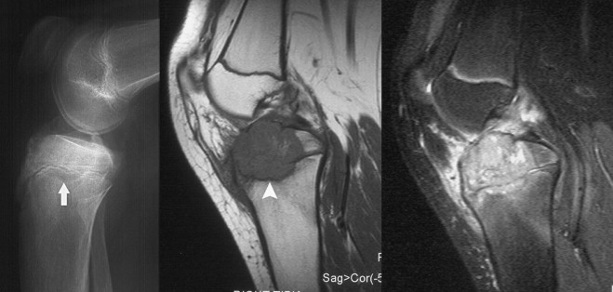
Chondroblastoma – Lateral radiograph of the knee demonstrates a lytic lesion in the proximal tibial epiphysis (arrow).
Sagittal T1 and STIR sequences was taken for the patient showing;
A lobulated mass of intermediate signal on T1 and,
High signal on STIR sequences.
There is extensive bone marrow and soft tissue oedema surrounding the lesion.
A low signal rim (arrowhead) can be seen inferiorly which corresponds to the sclerotic rim identified on radiographs
Notes:
Chondroblastoma (kon-dro-BLAST-oma) is a rare type of benign (noncancerous) tumor that grows at the ends of the body's long bones, close to the joints.

Slide 54
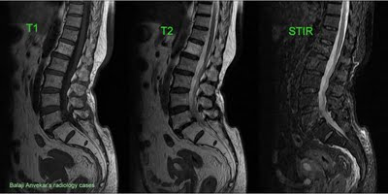
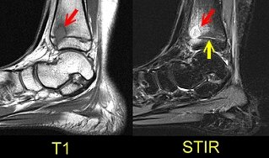
Sagittal T1-weighted and STIR images depict an oval lesion (red arrows) in the distal tibial metaphysis. The lesion crosses the physis (yellow arrow), to involve the epiphysis as well.
Diffuse homogeneously high marrow signals involving L5 and all sacral vertebral bodies on T1 and T2- W images with complete signal suppression on STIR implies to fatty marrow,

Slide 55
SPIN ECHO (SE) SEQUENCES
Manufacturer | Single echo SE | Multiple echo SE | Echo train SE
Siemens | Single SE | SE Double echo | Turbo spin echo (TSE) Half Fourier acquisition turbo SE (HASTE)
GE | SE | Multiecho multiplanar (MEMP) Variable echo multiplanar (VEMP) | Fast SE (FSE) Single shot FSE (SSFSE)
Philips | SE, Modified SE | Multiple SE (MSE) | Turbo spin echo (TSE) Ultra fast Spin echo (UFSE)

Slide 56


