Slide 1
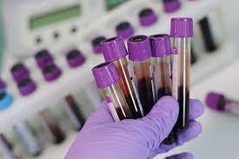
Introduction to Medical Laboratory Technology
PRESENTATION BY:
Ms. Pooja Shashikant Chavan (2023-24)
F Y Microbiology for B. Sc /Diploma
Medical Laboratory Technology

Slide 2
Introduction
A medical laboratory or clinical laboratory is a laboratory where test are carried out on clinical specimens to obtain information about the health of a patient to support the processes of diagnosis, treatment, and disease preventions.
For the laboratory services network to be optimally utilized and make meaningful contribution to health care and disease prevention, every member of its workforce must:
Understanding the laboratory’s function and its contribution to the nations health services is essential.
Appreciate the need to involve all members in the provision of health services.
Follow professional ethics and code of conduct.
Experience job satisfaction and have professional loyalty.

Slide 3
Unit of medical laboratory and responsibilities
Unit | responsibilities
Reception | Sample collection, handling, registration, and final report releasing.
Haematology | CBC, Blood film, ESR, Hb electrophoresis, fluids etc.
Microbiology | Diagnosis of pathogenic bacteria, fungi, parasite's etc.
Serology & Immunology | Evaluate antibodies and antigen(that may be indicative of many types of infectious diseases or other immune disorders).
Biochemistry | Lipid profile . TFTs, RFTs,LFTs, PRL, FSH, BLOOD GASES.
Virology | Screening for viral infections(HIV, Hbs-Ag, HCV.)
Histopathology | Examination of biopsies and autopsies.
Cytology | FNA, fine needle aspiration biopsy(FNAB), needle aspiration biopsy cytology(NABC)
Medical genetics | Cytogenetics and molecular analysis

Slide 4
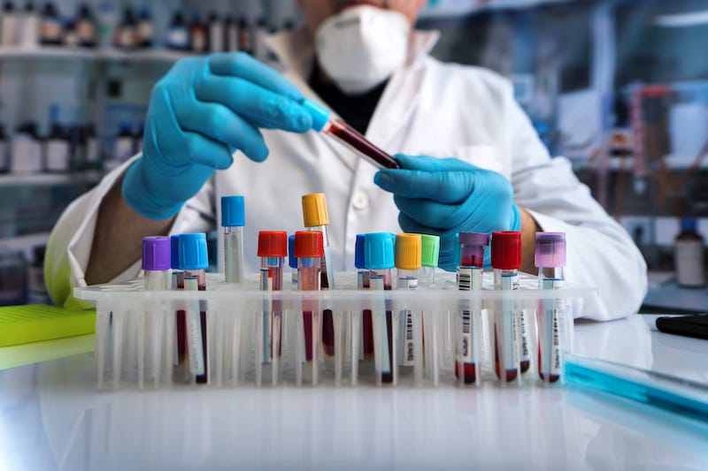
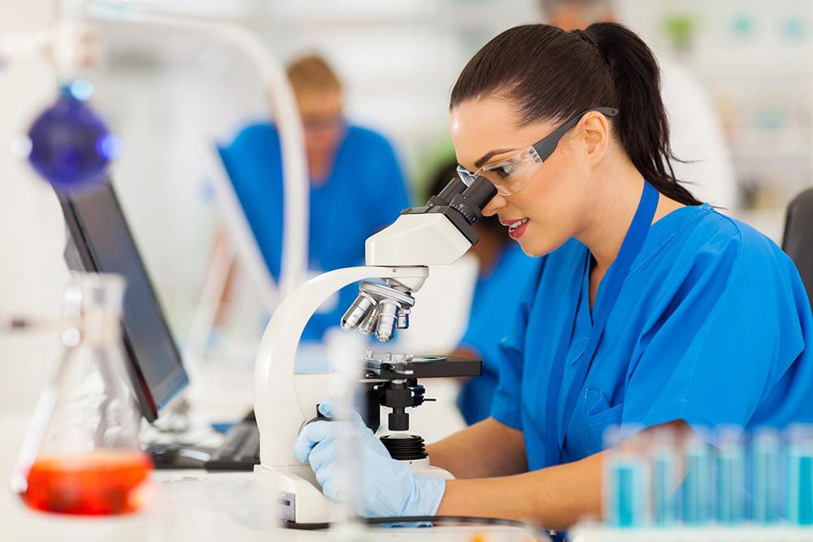

Slide 5
GENERAL TEST OF DIAGNOSTIC LAB
Simple test: basic principle with simple requirements like glassware, microscope, lancets, syringes, test tubes(blood groups, Hb conc..)
Advanced Test: Need advanced principles and techniques like RIA,ELISA,PCR, FISH(E.g. PRL, leukopoietin.)

Slide 6
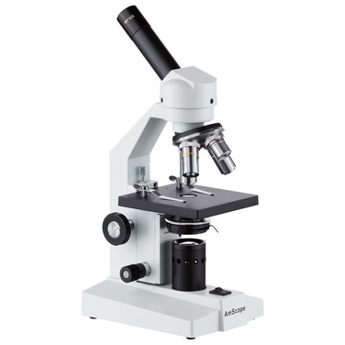
MACHINE AND DEVICES
A microscope is an instrument used to see objects that are too small to be seen by the naked eye.
Microscopy is the science of investigating small objects and structures using such an instrument.
The most common microscope is the Optical microscope , which uses light to pass through a sample to produce an image.
Other major types of microscopes are the fluorescence microscope, the electron microscope (both the transmission electron microscope and the scanning electron microscope) and the various types of scanning probe microscopes.

Slide 7
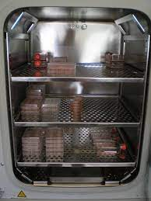
Incubator is a device used to grow and maintain microbiological cultures or cell cultures.
The Incubator maintains optimal temperature, humidity and other conditions such as the CO2 and oxygen content of the atmosphere inside.
The temperature inside the incubator is mostly at 37◦C

Slide 8
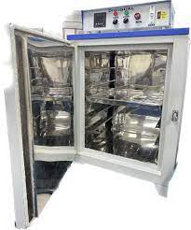
Hot Air Ovens are electrical devices which use dry heat to sterilize.
They are originally developed by louis Pasteur.
Hot air oven works on the principle of the dry air sterilization process through convection, conduction and radiation.
It generally kills microorganisms and bacterial spores at extremely high temperature over several hours and sterilizes items.

Slide 9
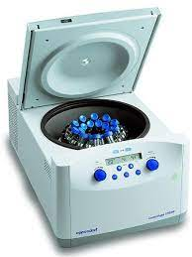
Centrifuge is a laboratory device that is used for the separation of fluids, gas, or liquid, based on density.
Separation is achieved by spinning a vessels containing material at high speed ; the centrifugal force pushes heavier materials to outside of the vessel.

Slide 10
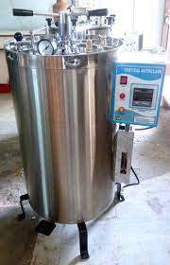
Autoclave is a machine that uses steam under pressure to kill harmful bacteria, viruses, fungi, and spores on items that are placed inside a pressure vessel.
The items are heated to an appropriate sterilization temperature for a given amount of time.
To be effective , the autoclave must reach and maintain a temperature of 121 Celsius for at least 30 minutes by using saturated steam under at east 15 psi of pressure.

Slide 11
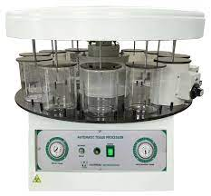
Automatic Tissue Processor : is a compact and sturdy instrument designed with latest technology for complete automatic dehydration and filtration of human , animal and plant’s tissues, up to final fixing in wax.
The tissue processor finds application in histopathology laboratories to automatically prepare tissue sample for testing by fixing, dehydration, cleaning, and infiltrating them with paraffin wax.

Slide 12
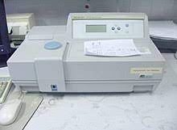
Spectrophotometer: is a machine used to measure how much a chemical substance absorbs light by measuring the intensity of light as a beam of light passes through sample solution.
The basic principle is that each compound absorbs or transmits light over a certain range of wavelength.
In biochemistry lab it is used to measure blood sugar, lipid profile tests…etc.

Slide 13
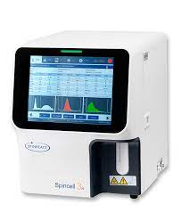
Haematology(CBC) Analyzer : is used to count and identify blood cells at high speed and accuracy.
A CBC analyser machine is an automated system designed keeping in mind the need foe efficient counting of the red blood cells, leukocytes, and the platelets in blood samples it also can detect the haemoglobin and hematocrit.
In CBC report the result included RBC count , Hb concentration, HCT, MCV, MCH, MCHC, RDW, WBC count, PLT count ,pct and MPV.

Slide 14
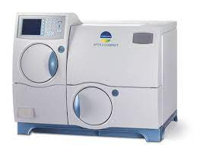
VITEK 2 : is a new automated bacterial identification and susceptibility testing system that uses fluorescence based technology.
The VITEK 2 compact system identifies the majority of microorganisms that contaminate production areas and finished products in a minimal amount of time.
USES :
1. microbial Identification : bacteria and yeast identification.
2. Antibiotic Susceptibility Testing and resistance mechanism detection.
3.Epidemiologic trending and reporting.

Slide 15
ELISA : Enzyme-Linked Immunosorbent Assay is used to identify peptides, proteins, antibodies, and hormones.
Also called as enzyme immunoassay(EIA) , ELISA finds use in the fields of biotechnology and medicine as a diagnostic tool.
Mainly, antibodies and colour changes are used to identify target substances.
ELISA can be divided into four major types: DIRECT, INDIRECT, SANDWICH and COMPETITIVE.

Slide 16
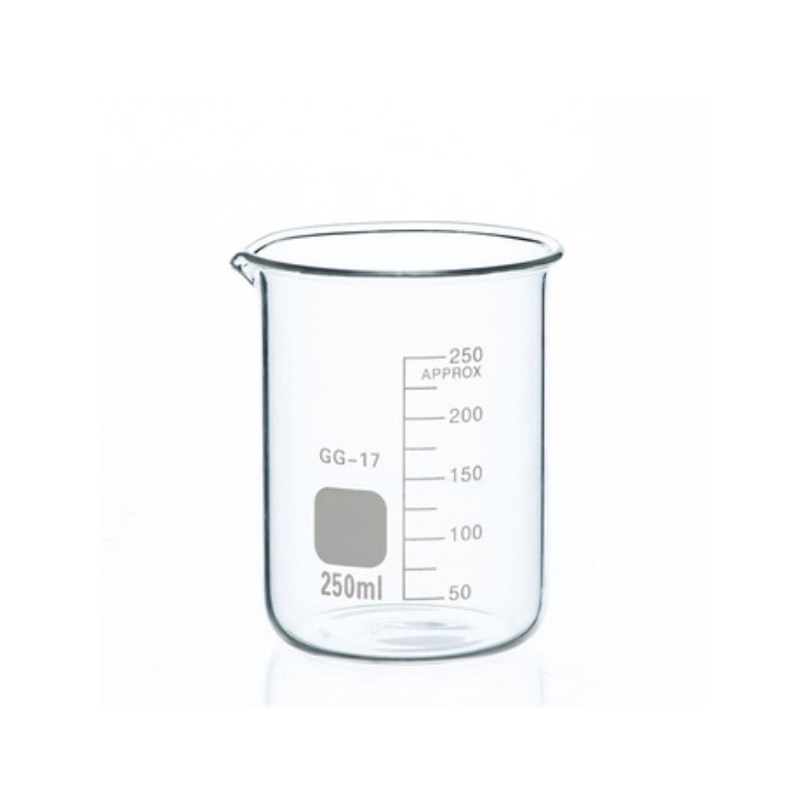
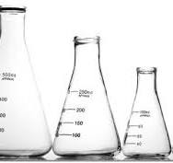
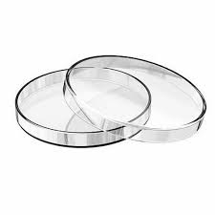
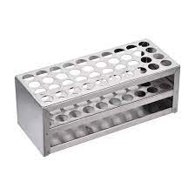
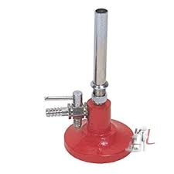
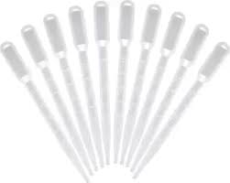
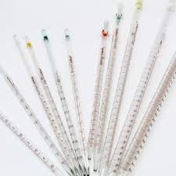
Tools and Glasswere
Test-tube racks
Beaker
Conical flask
Petri dish
Bunsen burner
Glass pipette
Droppers

Slide 17
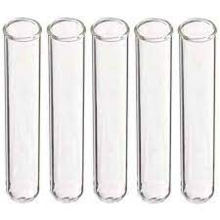
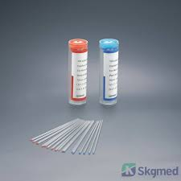
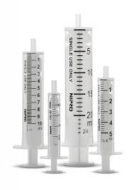
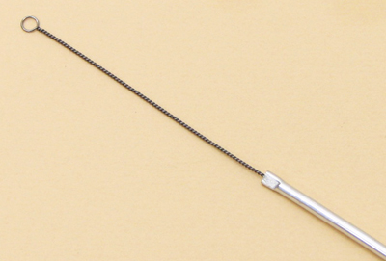
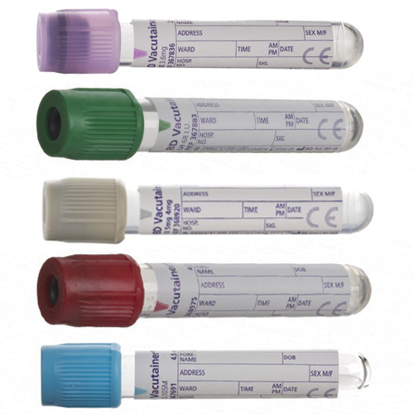
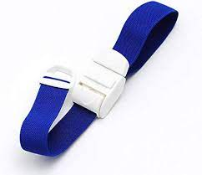
Tools and Glassware
Test tubes
Capillary tube
syringes
Streaking loop
vacutainer
Tourniquet

Slide 18
INSTRUCTIONS INSIDE LAB
The laboratory usually contains unsafe substances or tools and your full attention is required.
For both safety reasons and to avoid disturb lab activities.(must silence mobile phone and their use is prohibited)
All persons in laboratories, including student’s, staff, and visitors shall wear safety glasses , goggles or face shields at all times potential eye hazards exist.
Eating , Drinking, Chewing gum and applying cosmetics are prohibited in the laboratories.
Do not store food in same refrigerators or freezer with chemicals, biohazards, and radioactive materials.
Appropriate gloves are essential when working with hazardous substances like blood.

Slide 19
INSTRUCTIONS INSIDE LAB
Wear appropriate clothing in particular you must wear closed toed shoes( no sandals or flipflop) in the laboratory to avoid wearing your best clothes and if you have long hair tie it back.
Wearing an iPod , Bluetooth or any other device that interferes with hearing is not allowed.
Never pipette anything by mouth.
The work area must be kept clean.
All chemical should be labelled and stored properly.
Remove contaminated gloves before touching to common use devices (doorknobs equipment) discard gloves before leaving the laboratory.

Slide 20
INSTRUCTIONS INSIDE LAB
Always wash hands with soap and water before leaving the laboratory.
No smoking.
stay focus and aware of your surrounding in lab.
Keeping personals items separate from lab work.

Slide 21
ROLE OF MEDICAL LABORATORY TECHNOLOGIST
The medical laboratory scientist has the best of both worlds with challenges and rewards of medicine and sciences.
The medical laboratory scientist perform a full range of laboratory tests from simple pre- merital blood test to more complex test To uncover disease such as AIDS, diabetes, and cancer.
The medical technologist is also responsible for conforming the accuracy of test results and reporting laboratory finding to the pathologist and other Docters.
Medical laboratory technicians work in five major areas of the laboratory:
BLOOD BANKING
BIOCHEMISTRY
HAEMATOLOGY
IMMUNOLOGY
MICROBIOLOGY

Slide 22
ROLE OF MEDICAL LABORATORY TECHNOLOGIST
Some of the major role of medical laboratory technology are to:
Carry out routine and advanced laboratory test using standard laboratory method.
Apply problem solving strategies to administrative technical and research problem.
Conduct community-based researches in collaboration with other categories of health professionals.
Provide professionals consultancy on matter related to the establishment, renovation, upgrading, and reorganization of medical laboratories of intermediate level.

Slide 23
ROLE OF MEDICAL LABORATORY TECHNOLOGIST
Receiving, processing analysing samples depend on work seating the sample may consist of blood and tissue.
Conducting test on new product experimental processes.
Using cleaning and maintaining various type of equipment.
Handling and storing chemicals and other materials.

Slide 24


