Slide 1
SPUTUM
AND ITS ANALYSIS
PRESENTATION BY:
Ms. Pooja Shashikant Chavan (2023-24)
F Y Microbiology for B. Sc Cardiac/Perfusion
Radio Imaging/Medical Laboratory Technology/Renal Dialysis Technology/OT Technician

Slide 2
CONTENTS
WHAT IS SPUTUM?
PHYSICAL DESCRIPTION OF SPUTUM
DIFFERENT COLOURS OF SPUTUM
WHEN IS SPUTUM ORDERED?
WHAT DOES TEST RESULTS MEANS?
SPUTUM COLLECTION PROCEDURE
OTHER METHODS OF COLLECTION
PREPARATION OF SPUTUM SMEAR
APPEARANCE OF SPUTUM SMEAR UNDER MICROSCOPE
INTERPRETATION

Slide 3
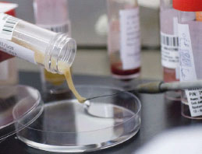
WHAT IS SPUTUM?
SPUTUM is a mucus that is coughed up from the lower airways.
It is also called “phlegm”.
The process of coughing out sputum is called “sputilization”.
Sputum samples are generally used for microbial investigations of respiratory systems.

Slide 4
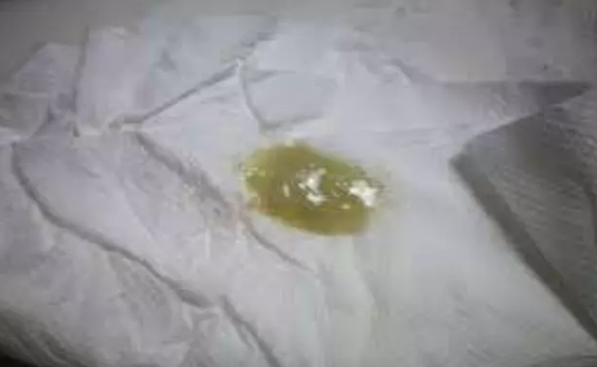
Physical description of sputum
Sputum contains pus, composed of white blood cells (WBCS), cellular debris, dead tissues, serous fluid and viscous liquid(mucus).
It is typically Yellow. It is seen in case of Bronchitis or acute upper respiratory tract infection.

Slide 5
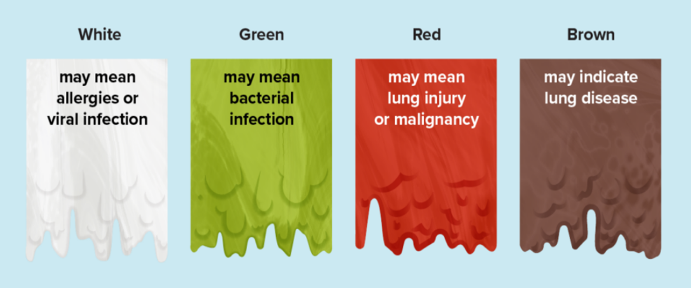
Different colours of sputum

Slide 6
When IS SPUTUM ORDERED?
A sputum test is ordered when a health practitioner suspects that someone has a bacterial infection of lungs or airways.
Symptoms may include :
  Cough
  Fever
  Muscle Aches
  Fatigue
  Trouble breathing
  Chest Pain

Slide 7
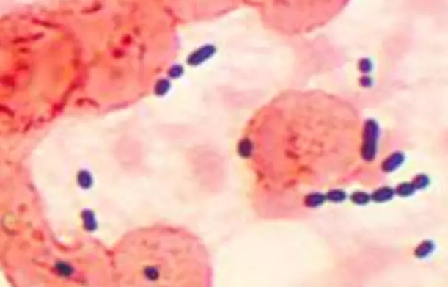
What does test results mean?
Microbiological Sputum samples are generally used to detect for infections by :
  Moraxella caterrhalis (Otitis Media)
  Mycobacterium tuberculosis (Tuberculosis)
  Streptococcus pneumoniae (Pneumonia)
  Haemophilus influenza (Influenza/Flu)
Streptococcus pneumoniae

Slide 8
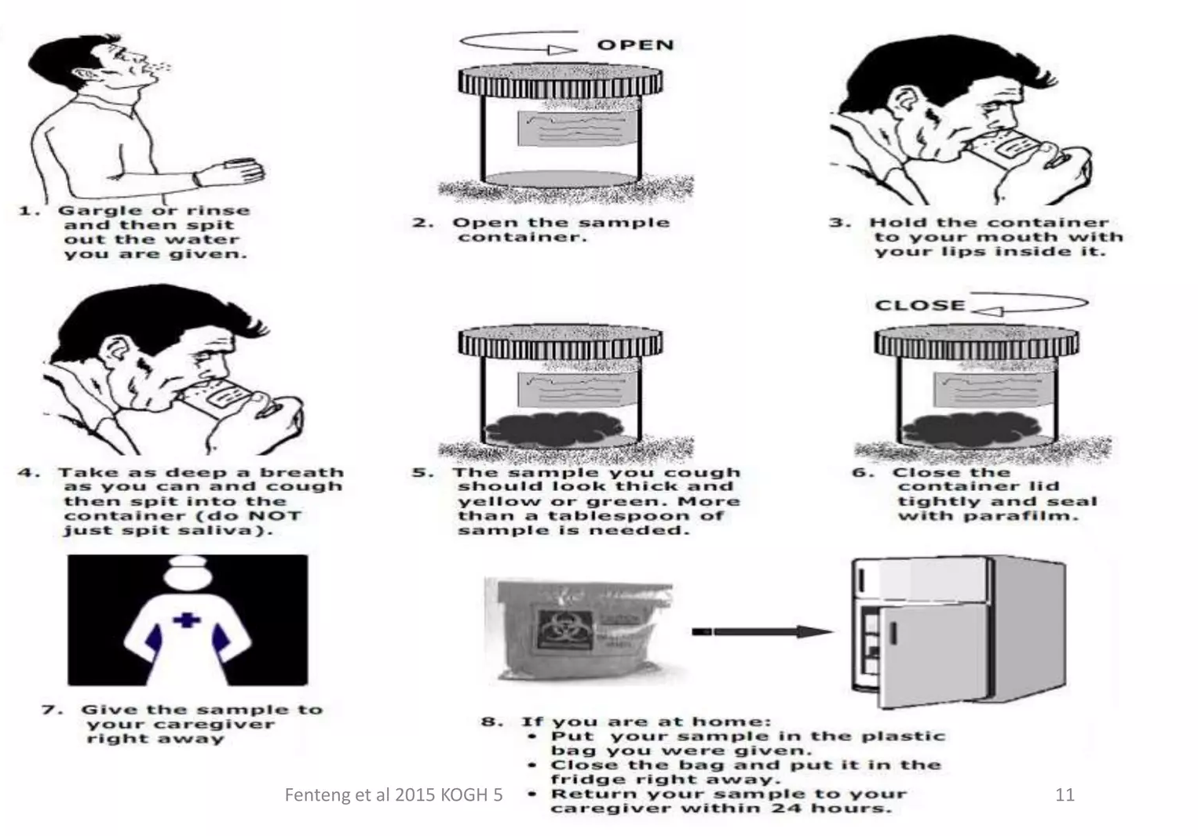
Sputum collection procedure

Slide 9
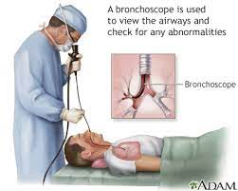
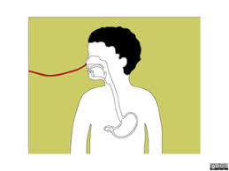
Other methods
BRONCHOSCOPY : Bronchoscope is passed directly through the mouth or nose directly into the diseased portion of the lungs, and sputum or lung tissue is removed.
GASTRIC WASHING : Tube is inserted through patients mouth or nose and passed into the stomach to get a sample of gastric secretions that contains sputum that had been coughed into the throat and then swallowed.

Slide 10
Preparation of sputum smear
The following steps must be considered for preparation of sputum smear :
Number the slides as 1, 2, 3 and 4 respectively.
Break the wooden stick applicator into two pieces to make one end rough. The length of the stick must be at least 10 cm.
Pick up sputum from the wooden applicator.
Gently spread the sputum in the center of the slide in a uniform manner.

Slide 11
PREPARATION OF SPUTUM SMEAR
Allow the smear to dry completely.
With a foreceps, hold the slide and pass it over the flame 2-3 times.
Do not overheat or burn the smear.
Arrange slides on stainy bridge with smear up.
Apply 0.1% auramine and keep it for atleast 25 minutes.
Rinse with water and drain.
Apply 0.5% HCl decolourizing solution for 3 minutes.

Slide 12
PREPARATION OF SPUTUM SMEAR
Rinse with water and drain.
Apply 0.5% potassium permanganate (KMnO4) for 1 minute.
Rinse with water and drain.
Air dry on slide rack.
The sputum smear is now ready to be examined.

Slide 13
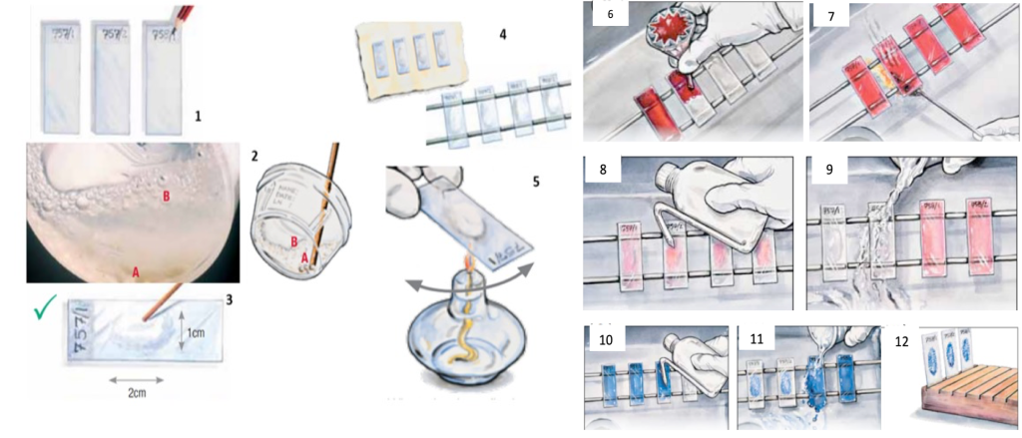
PREPARATION OF SPUTUM SMEAR

Slide 14
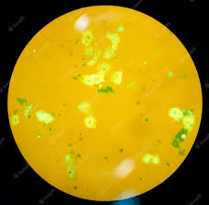
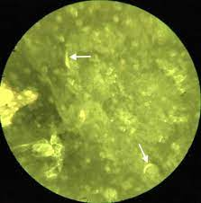
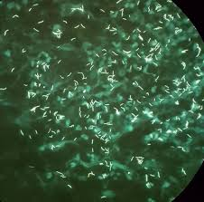
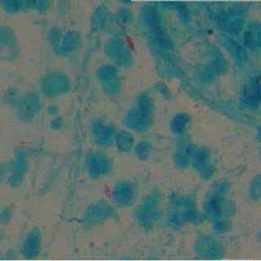
HOW DOES SPUTUM LOOKS UNDER MICROSCOPE?

Slide 15
Interpretation
Sputum is not sterile so when a person has an infection, there will typically a pathogenic bacteria present.
Specific techniques are carried out to identify such bacteria so that appropriate antibiotics can be prescribed.

Slide 16
QUESTIONS

Slide 17
1. WHAT IS SPUTUM ALSO KNOWN AS?
MUCUS
PHELGM
COUGH
ANSWER : B

Slide 18
2. FROM WHERE IS SPUTUM COUGHED UP?
UPPER RESPIRATORY TRACT
LOWER RESPIRATORY TRACT
MIDDLE RESPIRATORY TRACT
ANSWER : B

Slide 19
3. SPUTUM CONSISTS OF :
WBCs
Cellular Debris
Dead tissues
All of the Above
ANSWER : D

Slide 20
4. WHITE COLOUR OF SPUTUM INDICATES :
BACTERIAL INFECTION
ALLERGIES
LUNG DISEASES
LUNG INFECTIONS
ANSWER : B

Slide 21
5. RED COLOUR OF SPUTUM INDICATES :
LUNG DISEASES
VIRAL INFECTION
LUNG INFECTION
BACTERIAL INFECTION
ANSWER : C

Slide 22
6. IN WHICH SYMPTOM IS SPUTUM TEST NOT REQUIRED?
BODY PAIN
MUSCLE ACHE
COUGH
FEVER
ANSWER : A

Slide 23
7. WHATSHOULD BE PERCENTAGE OF AURAMINE STAIN USED?
1%
2%
0.1%
0.2%
ANSWER : C

Slide 24
8. WHAT SHOULD BE PERCENTAGE OF DECOLOURISING HCl USED?
0.3%
0.4%
0.5%
0.6%
ANSWER : C

Slide 25
9. WHAT SHOULD BE PERCENTAGE OF potassium permanganate solution used?
0.5%
0.6%
0.7%
0.8%
ANSWER : A

Slide 26
10. WHAT IS COLOUR OF SPUTUM IF INFECTED BY BRONCHITIS?
BROWN
RED
GREEN
YELLOW
ANSWER : D

Slide 27
THANK YOU

