Slide 1
Popular and trendy diets
Neha Soni
Clinical dietician & tutor
Dept. of clinical nutrition and dietetics
Paramedical sciences
svdu

Slide 2
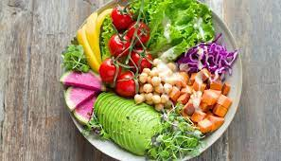
Raw food diet
The raw food diet, which is also called raw foodism or raw veganism, mostly focuses on raw and unprocessed foods.
These foods should not undergo processing, not be refined, pasteurized, or treated with pesticides.
Instead, the diet allows several other alternative preparation methods, such as juicing, blending, dehydrating, soaking and sprouting.
So basically, this diet includes lots and lots of fresh fruits and vegetables.
Raw fruits and vegetables have a high fiber and mineral content which has positive benefits on health.

Slide 3
Raw food diet
The diet aids weight loss and limits intake of processed and junk food that are the main cause of diabetes and other lifestyle diseases. However cooking makes digestion easier and if too much uncooked food it consumed it can cause bloating and gas. Further it helps to destroy pathogens present in the food thus cooking prevents us from having various food borne diseases."

Slide 4
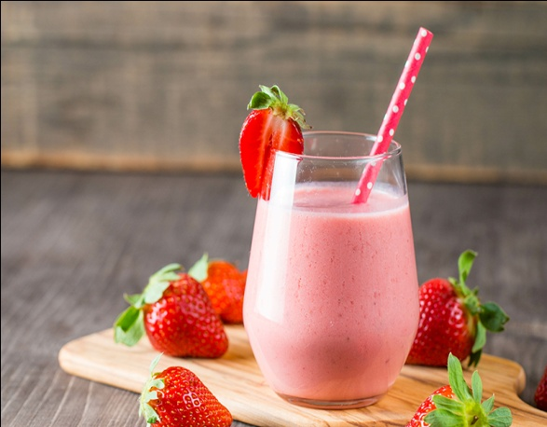


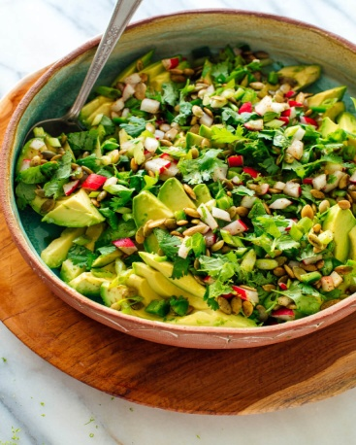

Recipes
Strawberry smoothie
Beetroot pomogranate juice
Mango smoothie
Cabbage salad
Sprouts salad

Slide 5
Ketogenic diet – what it is?
The ketogenic or “keto” diet is a low-carbohydrate, fat-rich eating plan that has been used for centuries to treat specific medical conditions.
The ketogenic diet has also been tested and used in closely monitored settings for cancer, diabetes, polycystic ovary syndrome, and Alzheimer’s disease.
However, this diet is gaining considerable attention as a potential weight-loss strategy due to the low-carb diet craze, which started in the 1970s with the Atkins diet (a very low-carbohydrate, high-protein diet, which was a commercial success and popularized low-carb diets to a new level).

Slide 6
The diet
There is not one “standard” ketogenic diet with a specific ratio of macronutrients (carbohydrates,proteins,fat).
Generally, popular ketogenic resources suggest an average of 70-80% fat from total daily calories, 5-10% carbohydrate, and 10-20% protein. For a 2000-calorie diet, this translates to about 165 grams fat, 40 grams carbohydrate, and 75 grams protein.

Slide 7
The following foods are permitted on the diet
Strong emphasis on fats at each meal and snack to meet the high-fat requirement. Cocoa butter, lard, poultry fat, and most plant fats (olive, palm, coconut oil) are allowed, as well as foods high in fat, such as avocado, certain nuts (walnuts, almonds), and seeds (sunflower, pumpkin, sesame).
Some dairy foods may be allowed. Although dairy can be a significant source of fat, some are high in natural lactose sugar such as cream, ice cream, and full-fat milk so they are restricted.

Slide 8
The following foods are permitted on the diet
Most non-starchy vegetables are included: Leafy greens (kale, spinach, lettuces), cauliflower, broccoli, Brussels sprouts, asparagus, bell peppers, onions, garlic, mushrooms, cucumber, celery, summer squashes.
Certain fruits in small portions like berries. Despite containing carbohydrate, they are lower in “net carbs”* than other fruits. Other: Dark chocolate (90% or higher cocoa solids), cocoa powder, unsweetened coffee and tea, unsweetened vinegars and mustards, herbs, and spices.

Slide 9
The following foods are not permitted
All whole and refined grains and flour products, added and natural sugars in food and beverages, starchy vegetables like potatoes, corn.
Fruits other than from the allowed list, unless factored into designated carbohydrate restriction. All fruit juices.
Legumes including beans, lentils, and peanuts.

Slide 10
The research so far
The ketogenic diet has been shown to produce beneficial metabolic changes in the short-term.
Along with weight loss, health parameters associated with carrying excess weight have improved, such as insulin resistance, high blood pressure, and elevated cholesterol and triglycerides.
There is also growing interest in the use of low-carbohydrate diets, including the ketogenic diet, for type 2 diabetes.

Slide 11
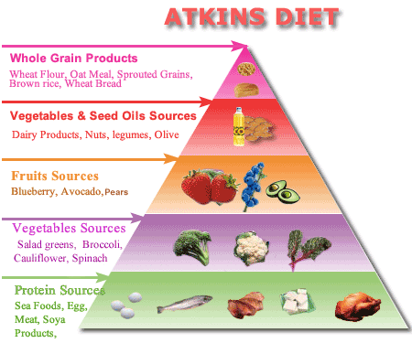
Atkins diet
The Atkins Diet is a popular low-carbohydrate eating plan developed in the 1960s by cardiologist Robert C. Atkins. The Atkins Diet restricts carbs (carbohydrates) while emphasizing protein and fats.

Slide 12
PURPOSE
The purpose of the Atkins Diet is to change your eating habits to help you lose weight and keep it off.
The Atkins Diet also says it's a healthy lifelong approach to eating, whether you want to lose weight, boost your energy or help improve certain health problems, such as high blood pressure or metabolic syndrome.

Slide 13
DIET DETAILS
The main dietary focus of the Atkins Diet is eating the right balance of carbohydrates, protein and fats for optimal weight loss and health.
According to the Atkins Diet, obesity and related health problems, such as type 2 diabetes and heart disease, are the fault of the typical low-fat, high-carbohydrate American diet. The Atkins Diet says that you don't need to avoid fatty cuts of meat or trim off excess fat. Rather, controlling carbs is what's important.
The Atkins Diet holds that eating too many carbohydrates — especially sugar, white flour and other refined carbs — leads to blood sugar imbalances, weight gain and cardiovascular problems. To that end, the Atkins Diet restricts carbohydrates and encourages eating more protein and fat.
Like many diet plans, the Atkins Diet continues to evolve. Now, it encourages eating more high-fiber vegetables, accommodates vegetarian and vegan needs, and addresses health problems that may arise when beginning a low-carb diet.

Slide 14
PHASES OF Atkins Diet
Phase 1: Induction.
In this strict phase, you cut out almost all carbohydrates from your diet, eating just 20 grams of net carbs a day, mainly from vegetables.
Instead of getting 45 to 65 percent of your daily calories from carbohydrates, as recommended by most nutrition guidelines, you get only about 10 percent.
"Foundation" vegetables, such as asparagus, broccoli, celery, cucumber, green beans and peppers, should account for 12 to 15 grams of your daily net carbs.
To eat protein, such as fish and shellfish, poultry, meat, eggs, and cheese, at every meal. You don't need to restrict oils and fats, but you can't have most fruits, sugary baked goods, breads, pastas, grains, nuts or alcohol. You should drink eight glasses of water a day. You stay in this phase for at least two weeks, depending on your weight loss.

Slide 15
PHASES OF Atkins Diet
Phase 2: Balancing.
In this phase, you continue to eat a minimum of 12 to 15 grams of net carbs as foundation vegetables.
One also continue to avoid foods with added sugar.
One can slowly add back in some nutrient-rich carbs, such as more vegetables and berries, nuts, and seeds, as they continue to lose weight.
One can stay in this phase until they are about 4.5 kilograms from there goal weight.

Slide 16
PHASES OF Atkins Diet
Phase 3: Pre-maintenance. In this phase, one may continue to gradually increase the range of foods they can eat, including fruits, starchy vegetables and whole grains.
One can add about 10 grams of carbs to your diet each week, but you must cut back if there weight loss stops.
One can stay in this phase until they reach goal weight.

Slide 17
PHASES OF Atkins Diet
Phase 4: Lifetime maintenance.
One may move into this phase when they reach goal weight, and then continue this way of eating for life.

Slide 18
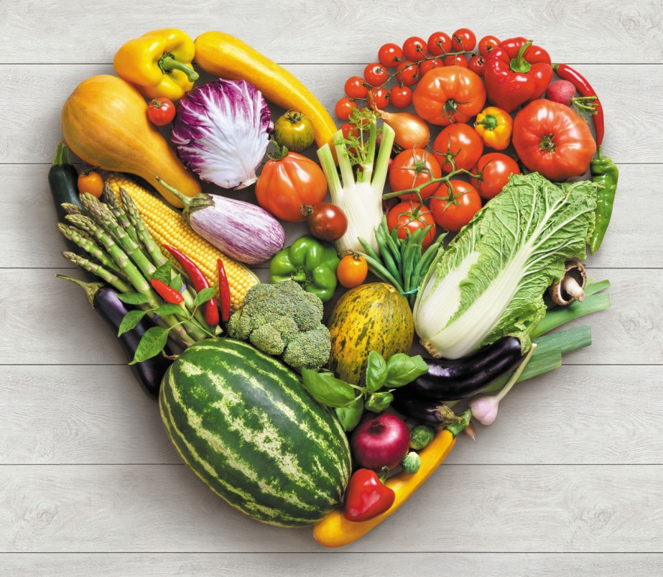
Plant-based diet
As the name suggests, plant-based diet focuses on foods primarily from plants. This includes not only fruits and vegetables, but also healthy nuts and seeds, oils, whole grains, legumes, and beans.

Slide 19
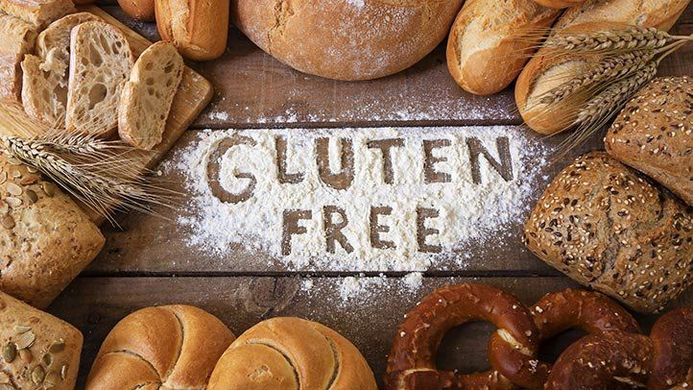
Gluten free diet
A gluten-free diet is an eating plan that excludes foods containing gluten. Gluten is a protein found in wheat, barley, rye and triticale (a cross between wheat and rye).

Slide 20
Purpose
A gluten-free diet is essential for managing signs and symptoms of celiac disease and other medical conditions associated with gluten.
Celiac disease is a condition in which gluten triggers immune system activity that damages the lining of the small intestine. Over time this damage prevents the absorption of nutrients from food. Celiac disease is an autoimmune disorder.
Wheat allergy, like other food allergies, is the result of the immune system mistaking gluten or some other protein found in wheat as a disease-causing agent, such as a virus or bacterium. The immune system creates an antibody to the protein, prompting an immune system response that may result in congestion, breathing difficulties and other symptoms.

Slide 21
Diet details
Allowed fresh foods
Many naturally gluten-free foods can be a part of a healthy diet:
Fruits and vegetables
Beans, seeds, legumes and nuts in their natural, unprocessed forms
Eggs
Lean, non processed meats, fish and poultry
Most low-fat dairy products
Grains, starches or flours that can be part of a gluten-free diet include:
Amaranth
Arrowroot
Buckwheat
Corn — cornmeal, grits and polenta labeled gluten-free
Gluten-free flours — rice, soy, corn, potato and bean flours
Millet
Quinoa
Rice, including wild rice
Sorghum
Soy
Tapioca (cassava root)

Slide 22
Diet details
Grains not allowed
Avoid all foods and drinks containing the following:
Wheat
Barley
Rye
Triticale — a cross between wheat and rye
Oats, in some cases

Slide 23
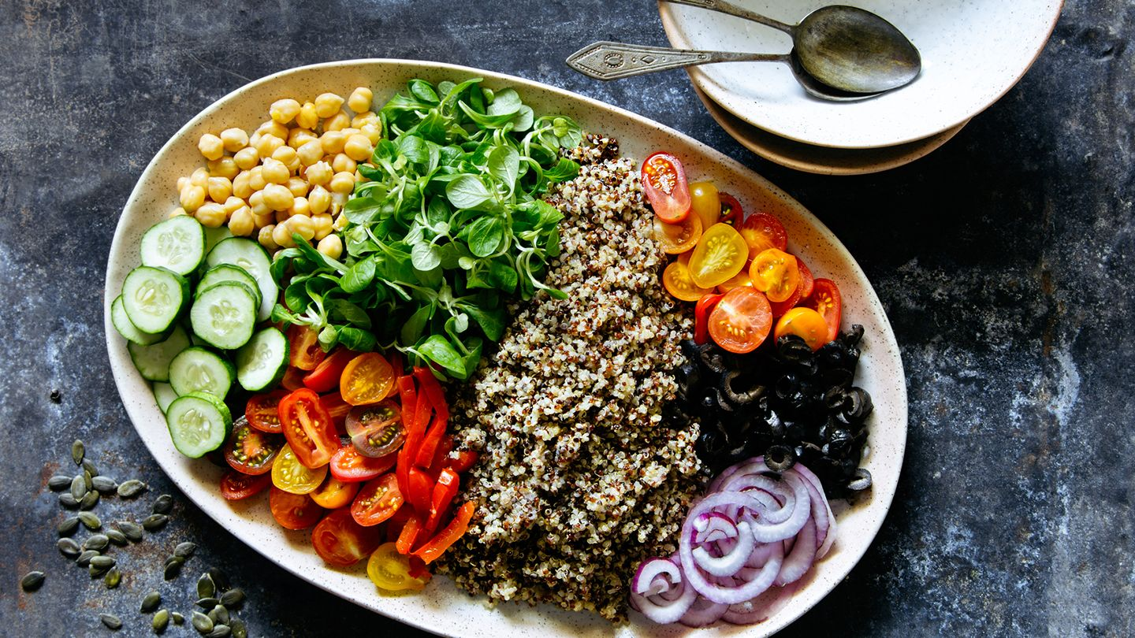
Mediterranean diet
The Mediterranean diet apart from weight loss is most famous for its benefit to heart health, decreasing the risk of heart disease and lowers the cholesterol level. The diet also reduces the risk of certain cancers, like breast cancer, as well as some mental conditions like Parkinson's disease and Alzheimer's disease.

Slide 24
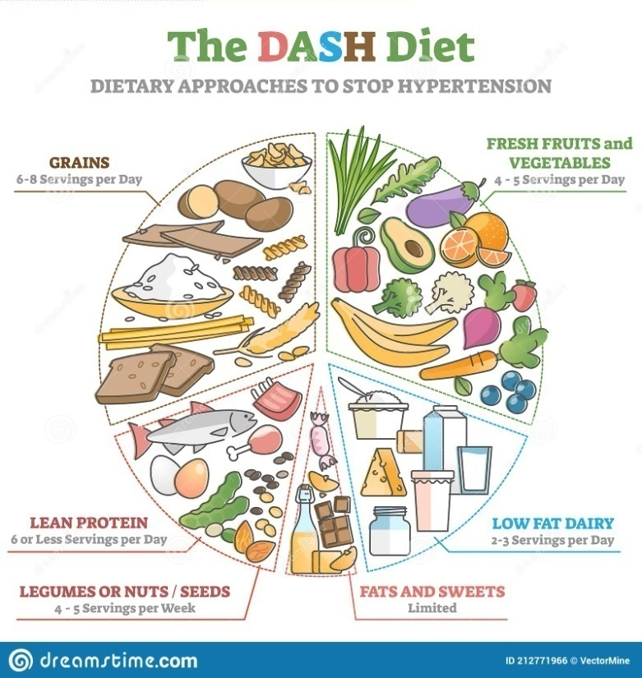
DASH DIET
The DASH diet is a healthy-eating plan designed to help treat or prevent high blood pressure (hypertension).
The DASH diet includes foods that are rich in potassium, calcium and magnesium. These nutrients help control blood pressure. The diet limits foods that are high in sodium, saturated fat and added sugars.

Slide 25
DASH DIET AND SODIUM
The standard DASH diet limits sodium to 2,300 mg a day. It meets the recommendation from the Dietary Guidelines for Americans to keep daily sodium intake to less than 2,300 mg a day. That's roughly the amount of sodium in 1 teaspoon of table salt.
A lower sodium version of DASH restricts sodium to 1,500 mg a day.

Slide 26
RECOMMENDED SERVINGS
Here's a look at the recommended servings from each food group for a 2,000-calorie-a-day DASH diet:
Grains: 6 to 8 servings a day. One serving is one slice bread, 1/2 cup cooked cereal, rice or pasta.
Vegetables: 4 to 5 servings a day. One serving is 1 cup raw leafy green vegetable, 1/2 cup cut-up raw or cooked vegetables, or 1/2 cup vegetable juice.
Fruits: 4 to 5 servings a day. One serving is one medium fruit, 1/2 cup fresh, frozen or canned fruit, or 1/2 cup fruit juice.
Fat-free or low-fat dairy products: 2 to 3 servings a day. One serving is 1 cup milk or yogurt.
Lean meats, poultry and fish: six servings or fewer a day. One serving is 1 cooked meat, poultry or fish, or 1 egg.
Nuts, seeds and legumes: 4 to 5 servings a week. One serving is 1/3 cup nuts, 2 tablespoons peanut butter, 2 tablespoons seeds, or 1/2 cup cooked legumes (dried beans or peas).
Fats and oils: 2 to 3 servings a day. One serving is 1 teaspoon soft margarine, 1 teaspoon vegetable oil, 1 tablespoon mayonnaise or 2 tablespoons salad dressing.
Sweets and added sugars: 5 servings or fewer a week. One serving is 1 tablespoon sugar, jelly or jam, 1/2 cup sorbet, or 1 cup lemonade.

Slide 27
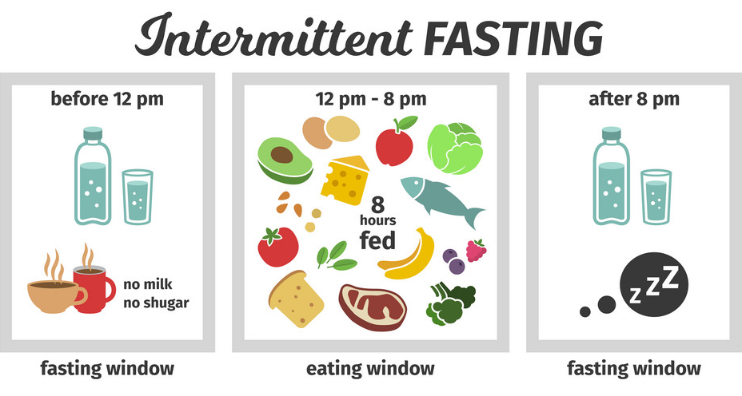
Fast Diet
Intermittent fasting is another diet plan that was trending this year. The idea behind this diet is to cycle between periods of regular eating and fasting, during which you eliminate all the calories or do not consume any food at all. Some people fast for a few hours, while some may fast for a longer time, even a day. The benefits of this fasting might just go beyond weight loss. It helps in better metabolism and stable blood sugar levels.

Slide 28
Fast Diet
The benefits of the diet are that it helps in weight loss, insulin resistance and in inflammation. However the diet does not specify what needs to be eaten. If you consume a well balanced diet that is rich protein in vitamins and minerals this diet could be beneficial for you. However an excess of junk, fat and processed food will show its side effects on your overall health. The main drawback of this is that it can cause excessive acidity who are already prone to it."

Slide 29
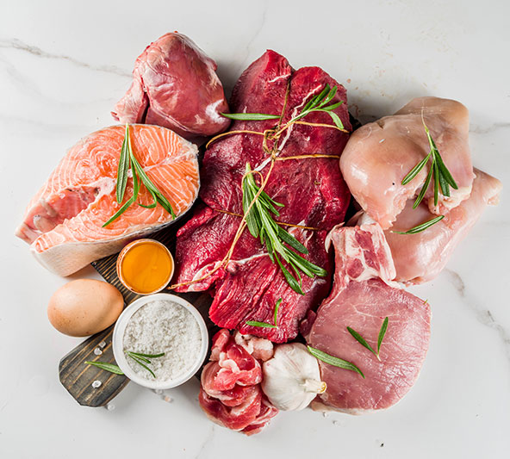
Carnivore diet
The carnivore includes only meat. No carbs, no fruit or vegetables. As it focuses on one food group it can lead to nutritional deficiencies. A diet devoid of certain nutrients can be harmful for your overall health.

Slide 30
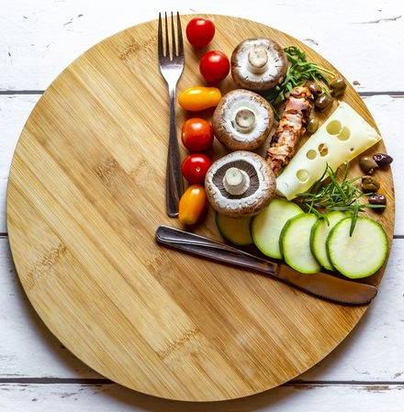
Dubrow diet
This diet sticks to time-restricted fasting which means you eat only during a certain time of the day and fast during rest of the time. The diet also focuses on how long you should fast and what you should eat.

Slide 31
Referances
Paoli A. Ketogenic diet for obesity: friend or foe?. Int J Environ Res Public Health. 2014 Feb 19;11(2):2092-107.
Schwingshackl L, Hoffmann G. Comparison of effects of long-term low-fat vs high-fat diets on blood lipid levels in overweight or obese patients: a systematic review and meta-analysis. J Acad Nutr Diet. 2013 Dec 1;113(12):1640-61.
Gupta L, Khandelwal D, Kalra S, Gupta P, Dutta D, Aggarwal S. Ketogenic diet in endocrine disorders: Current perspectives. J Postgrad Med. 2017 Oct;63(4):242.
· https://www.healthline.com/nutrition/gluten-free-diet
· https://www.webmd.com/diet/a-z/the-mediterranean-diet
· https://www.healthline.com/nutrition/dubrow-diet

Slide 32
Thank you

