Slide 1
Food Adulteration
Neha Soni
Tutor and Dietician
Dept. of Clinical Nutrition and Dietetics

Slide 2
Food Adulteration
Food Adulteration refers to the process by which the quality or the nature of a given food is reduced through addition of adulterants or removal of vital substance.
Food adulterants refer to the foreign and usually inferior chemical substance present in food that cause harm or is unwanted in the food.
Basically, during food adulteration, small quantity of non-nutritious substances are added intentionally to improve the appearance, texture or storage properties of the food.
Food adulteration is quite common in the developing countries.

Slide 3
Continued…
“Adulterant” means any material which is or could be employed for making the food unsafe/substandard/mis-branded/containing extraneous matter.
Adulterated food is dangerous because it may be toxic and can affect health and it could deprive nutrients essential for proper growth and development

Slide 4
FOOD IS ADULTERATED IF:
The food sold does not meet the nature of the substance or quality as per the demand of consumer.
2. The food contains inferior or cheaper substance
3. The food has been prepared, packed or kept under unclean conditions leading to contamination.
4. Food contains substances that depreciates or injuriously affects the health.
5. If the food’s original nature is substituted wholly or partially by abstracting a portion of vital substance from food.
6. If it is an imitation of some other food substance.

Slide 5
TYPES OF ADULT-ERANTS
INTENTIONAL ADULTERANTS
INCIDENTAL ADULTERANTS
METALLIC CONTAMINANTS
.
TYPES OF FOOD ADULTERATION:
1. Intentional adulteration: The adulterants are added as a deliberate act with intention to increase profit. Eg. sand, marble chips, stones, chalk powder, etc.
2. Incidental Adulteration: Adulterants are found in food due to negligence, ignorance or lack of proper facilities. Eg. Packaging hazards like larvae of insects, droppings, pesticide residues, etc.
3. Metallic adulteration: When the metallic substances are added intentionally or accidentally. Eg: arsenic, pesticides, lead from water, mercury from effluents, tins from cans, etc.

Slide 6
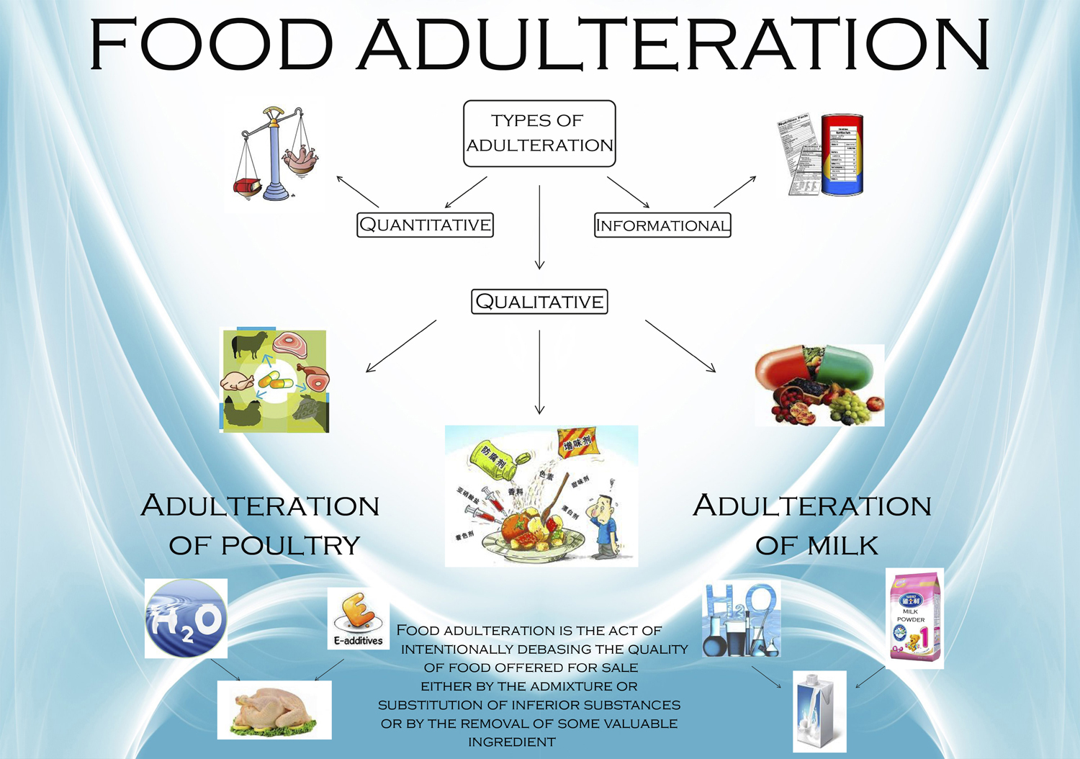

Slide 7
INDIAN REGULATIONS
The government has set certain standards to be followed mandatorily by the food companies to cause no harm to the consumer.
PFA Act, 1954
Objectives:
1. To protect the public from harmful and poisonous foods.
2. To prevent the sale of substandard foods.
3. To protect the interests of the consumer by eliminating fraudulent practices.

Slide 8
Fruit products order,1955
This order regulates the manufacturer and distribution of fruits and vegetable products, ready to serve beverages, aerated water and synthetic syrups.
Every manufacturer of fruit and vegetable oil products should adhere to the standards mentioned in the order.

Slide 9
Important provisions in the Act
Sale of kesari daal is prohibited.
From the labels, the blending composition should be clear to the consumer.
Sale of food colours without license is prohibited.
No insecticides should be sprayed on the food item.
Milk powder or condensed milk can be sold with an ISI mark.
Addition of artificial sweetener should be mentioned on the label.

Slide 10
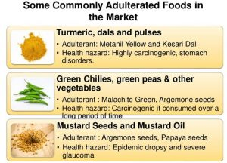

Slide 11
Sr. No | Adulterant | Foods Commonly Involved | Diseases or Health Effects
 | Adulterants in food
1 | Argemone seeds Argemone oil | Mustard seeds Edible oils and fats | Epidemic dropsy, Glaucoma, Cardiac arrest
2 | Artificially coloured foreign seeds | As a substitute for cumin seed, Poppy seed, black pepper | Injurious to health
3 | Foreign leaves or exhausted tea leaves, saw dust artificially coloured | Tea | Injurious to health, cancer
4 | Rancid oil | Oils | Destroys vitamin A and E
5 | Sand, marble chips, stones, filth | Food grains, pulses etc. | Damage digestive tract
6 | Lathyrus sativus | Khesari dal alone or Mixed in other pulses | Lathyrism (crippling spastic paraplegia)
 | Chemical Contamination
7 | Lead chromate | Turmeric whole and powdered, mixed spices | Anemia, abortion, paralysis, brain damage
8 | Methanol | Alcoholic liquors | Blurred vision, blindness, death

Slide 12
Continued…
9 | Arsenic | Fruits such as apples sprayed over with lead arsenate | Dizziness, chills, cramps, paralysis, death
10 | Barium | Foods contaminated by rat poisons (Barium carbonate) | Violent peristalisis, arterial hypertension, muscular twitching, convulsions, cardiac disturbances
11 | Cadmium | Fruit juices, soft drinks, etc. in contact with cadmium plated vessels or equipment. Cadmium contaminated water and shell-fish | ‘Itai-itai (ouch-ouch) disease, Increased salivation, acute gastritis, liver and kidney damage, prostrate cancer
12 | Cobalt | Water, liquors | Cardiac insufficiency and myocardial failure
13 | Lead | Water, natural and processed food | Lead poisoning (foot-drop, insomnia, anemia, constipation, mental retardation, brain damage)
14 | Mercury | Mercury fungicide treated seed grains or mercury contaminated fish | Brain damage, paralysis, death
NOTE : Safe limits have been prescribed for above metals in different food. Continuous use of food contaminated with these metals beyond safe limits may cause these diseases

Slide 13
 | Bacterial contamination
15 | Bacillus cereus | Cereal products, custards, puddings, sauces | Food infection (nausea, vomiting, abdominal pain, diarrhoea)
16 | Salmonella spp. | Meat and meat products, raw vegetables, salads, shell-fish, eggs and egg products, warmed-up leftovers | Salmonellosis (food infection usually with fever and chills)
17 | Shigella sonnei | Milk, potato, beans, poultry, tuna, shrimp, moist mixed foods | Shigellosis (bacillary dysentery)
18 | Staphylococcus aureus Entero-toxins-A,B,C,D or E | Dairy products, baked foods especially custard or cream-filled foods, meat and meat products, low-acid frozen foods, salads, cream sauces, etc. | Increased salivation, vomiting, abdominal cramp, diarrhoea, severe thirst, cold sweats, prostration
19 | Clostridium botulinus toxins A,B,E or F | Defectively canned low or medium-acid foods; meats, sausages, smoked vacuum-packed fish, fermented food etc. | Botulism (double vision, muscular paralysis, death due to respiratory failure)
20 | Clostridium.perfringens (Welchii) type A | Milk improperly processed or canned meats, fish and gravy stocks | Nausea, abdominal pains, diarrhoea, gas formation

Slide 14
21 | Non-permitted colour or permitted food colour beyond safe limit | Coloured food | Mental retardation, cancer and other toxic effect.
22 | Monosodium glutamate(flour) (beyond safe limit) | Chinese food, meat and meat products | Brain damage, mental retardation in infants
23 | Food flavours beyond safe limit | Flavoured food | Chances of liver cancer
24 | Sulphur dioxide and sulphite beyond safe limit | In variety of food as preservative | Acute irritation of the gastro-intestinal tracts etc.
25 | Artificial sweetners beyond safe limit | Sweet foods | Chances of cancer
 | Fungal contamination
26 | Aflatoxins | Aspergillus flavus-contaminated foods such as groundnuts, cottonseed, etc. | Liver damage and cancer
27 | Ergot alkaloids from Claviceps purpurea Toxic alkaloids, ergotamine, ergotoxin and ergometrine groups | Ergot-infested bajra, rye meal or bread | Ergotism (St.Anthony’s fire-burning sensation in extremities, itching of skin, peripheral gangrene)

Slide 15
Continued…
28 | Entamoeba histolytica Viral | Raw vegetables and fruits | Amoebic dysentery
29 | Virus of infectious Hepatitis (virus A) | Shell-fish, milk, unheated foods contaminated with faeces, urine and blood of infected human | Infectious hepatitis
30 | Machupo virus | Foods contaminated with rodents urine, such as cereals | Bolivian haemorrhagic fever
 | Natural Contamination
31 | Flouride | Drinking water, sea foods, tea, etc. | Excess fluoride causes fluorosis (mottling of teeth, skeletal and neurological disorders)
32 | Oxalic acid | Spinach, amaranth, etc. | Renal calculi, cramps, failure of blood to clot

Slide 16
COMMON FOOD ADULTERANTS
1 | Vegetable oil | Castor oil
2 | Ghee | Mashed Potato Sweet Potato, etc.
 |  | Vanaspati
 |  | Rancid stuff (old ghee)
 |  | Synthetic Colouring Matter
3 | Honey | Invert sugar/jaggery
4 | Pulses/Besan | Kesari dal(Lathyrus sativus)
5 | Pulses | Metanil Yellow(dye)
6 | Bajra | Ergot infested Bajra
7 | Wheat flour | Excessive sand & dirt
 |  | Excessive bran
 |  | Chalk powder
8 | Common spices like Turmeric, chilly, curry powder,etc. | Colour
9 | Black Pepper | Papaya seeds/light berries, etc.
10 | Spices(Ground) | Powdered bran and saw dust
11 | Coriander powder | Dung powder

Slide 17
Continued…
12 | Chilies | Brick powder grit, sand, dirt, filth, etc.
13 | Turmeric Powder | Starch of maize, wheat, tapioca, rice
14 | Turmeric | Lead Chromate
 |  | Metanil Yellow
15 | Cumin seeds (Black jeera) | Grass seeds coloured with charcoal dust
16 | Asafoetida (Heeng) | Soap stone, other earthy matter
 |  | Chalk
17 | Foodgrains | Hidden insect infestation

Slide 18
Thank you

