Slide 1
Food Allergies and Food Intolerances
Course: Masters Nutrition and Dietetics
Subject: Advanced Nutrition

Slide 2
Definition of Terms
European Academy of Allergy and Clinical Immunology 2001
Allergy is a hypersensitivity reaction initiated by immunologic mechanisms
An adverse reaction to food should be called food hypersensitivity
  When immunologic mechanisms have been demonstrated, the appropriate term is food allergy
  If the role of IgE is highlighted, the correct term is IgE-mediated food allergy
All other reactions, previously sometimes referred to as “food intolerance”, should be referred to as nonallergic food hypersensitivity

Slide 3
Definition of Terms
European Academy of Allergy and Clinical Immunology 2001
Severe, generalized allergic reactions to food can be classified as anaphylaxis
Anaphylaxis is a severe, life-threatening, generalized or systemic hypersensitivity reaction.
Atopy is a personal or familial tendency:
  to produce IgE antibodies in response to low doses of allergens, usually proteins
  and to develop typical symptoms such as asthma, rhinoconjunctivitis (hay fever) or eczema/atopic dermatitis

Slide 4
Food Allergy & Food Intolerance
DEFINITIONS:
Food Intolerance
A generic term
describing an abnormal
physiological response
to an ingested food or
food additive which is
not immunogenic
Food Allergy
An immunologic
reaction resulting
from the ingestion
of a food or
food additive

Slide 5
Symptoms of Food Allergy
Controversy among practitioners because there are no definitive tests for food allergy
Symptoms appear in diverse organ systems:
  Skin and mucous membranes
  Digestive tract
  Respiratory tract
  Systemic (anaphylaxis)
Symptoms in nervous system are considered more subjective and sometimes may be dismissed as fictitious or psychosomatic

Slide 6
The Allergic Diathesis
Atopic dermatitis
(Eczema)
.
Nervous system:
Headaches
Irritability
Gastrointestinal
symptoms
Food Allergy
Muscle pain
Allergic rhinoconjunctivitis
(hay fever)
Asthma
(cough;
wheeze)
Anaphylaxis

Slide 7
Examples of Allergic Conditions and Symptoms
Skin and Mucous Membranes
  Atopic dermatitis (eczema)
  Urticaria (hives)
  Angioedema (swelling of tissues, especially mouth and face)
  Pruritus (itching)
  Contact dermatitis (rash in contact with allergen)
  Oral symptoms (irritation and swelling of tissues around and inside the mouth)
  Oral allergy syndrome

Slide 8
Examples of Allergic Conditions and Symptoms
Digestive Tract
  Diarrhea
  Constipation
  Nausea and Vomiting
  Abdominal bloating and distension
  Abdominal pain
  Indigestion (heartburn)
  Belching

Slide 9
Examples of Allergic Conditions and Symptoms
Respiratory Tract
  Seasonal or perennial rhinitis (hayfever)
  Rhinorrhea (runny nose)
  Allergic conjunctivitis (itchy, watery, reddened eyes)
  Serous otitis media (earache with effusion) [“gum ear”; “glue ear”]
  Asthma
  Laryngeal oedema (throat tightening due to swelling of tissues)

Slide 10
Examples of Allergic Conditions and Symptoms
Nervous System
  Migraine
  Other headaches
  Spots before the eyes
  Listlessness
  Hyperactivity
  Lack of concentration
  Tension-fatigue syndrome
  Irritability
  Chilliness
  Dizziness

Slide 11
Examples of Allergic Conditions and Symptoms
Other
  Urinary frequency
  Bed-wetting
  Hoarseness
  Muscle aches
  Low-grade fever
  Excessive sweating
  Pallor
  Dark circles around the eyes

Slide 12
Anaphylaxis
Severe reaction of rapid onset, involving most organ systems, which results in circulatory collapse and drop in blood pressure
In the most extreme cases the reaction progresses to anaphylactic shock with cardiovascular collapse
This can be fatal

Slide 13
Anaphylaxis
Usual progress of reaction
  Burning, itching and irritation of mouth and oral tissues and throat
  Nausea, vomiting, abdominal pain, diarrhea
  Feeling of malaise, anxiety, generalized itching, faintness, body feels warm
  Nasal irritation and sneezing, irritated eyes
  Hives, swelling of facial tissues, reddening
  Chest tightness, bronchospasm, hoarseness
  Pulse is rapid, weak, irregular, difficult to detect
  Loss of consciousness
  Death may result from suffocation, cardiac arrhythmia, or shock

Slide 14
Anaphylaxis
Up to a third of cases of anaphylaxis occur in response to foods
Not all symptoms occur in each case
Symptoms may appear in any order
Severe reactions occur within minutes to up to an hour of ingestion of allergen
Onset can be delayed for up to two hours
The later the onset of symptoms after eating the food, the less severe the reaction
In majority of cases of fatal anaphylactic reaction to food, patient was asthmatic
Potential for anaphylaxis increases when patient is receiving desensitization injections and is allergic to wasp and bee venom

Slide 15
Anaphylaxis
Almost any food can cause anaphylactic reaction
Some foods more common than others:
    Peanut
    Tree nuts
    Shellfish
    Fish
    Egg
  In children under three years
    Cow’s milk
    Egg
    Wheat
    Chicken

Slide 16
Exercise-induced Anaphylaxis
Usually occurs within two hours of eating the allergenic food
Onset during physical activity
Foods most frequently reported to have induced exercise-induced anaphylaxis:
  Wheat (omega-5-gliadin) and other grains
  Celery and other vegetables
  Shellfish (shrimp; oysters)
  Chicken
  Squid
  Peaches and other fruits
  Nuts especially hazelnut
  Peanuts and soy beans
May be associated with aspirin ingestion

Slide 17
Emergency Treatment for
Anaphylactic Reaction
Injectable adrenalin (epinephrine)
Fast-acting antihistamine (e.g. Benadryl)
Transport to hospital immediately
Second phase of reaction is sometimes fatal, especially in an asthmatic
  Patient may appear to be recovering, but 2-4 hours later symptoms increase in severity and reaction progresses rapidly

Slide 18
Immunologically Mediated Reactions
IgE-mediated
Non-IgE-mediated
Mixed reactions
Eosinophilic gastrointestinal diseases
Food protein-sensitive enteropathies
Gluten-sensitive enteropathy (coeliac disease)

Slide 19
IgE-Mediated Hypersensitivity
Stage 1: Antigen Recognition
The first stage of an immune response is recognition of a foreign antigen
T cell lymphocytes are the controllers of the immune response
T helper cells (CD4+ subclass) identify the foreign protein as a potential threat
Cytokines are released
The types of cytokines produced control the resulting immune response

Slide 20
T- Cell Lymphocytes in IgE-Mediated Reactions
There are two major classes of T cells, differentiated on the basis of their cell surface receptors:
  Helper T cells (Th)
    Express CD4 receptor (CD4+)
    Act in conjunction with MHC class II molecules
    (major histocompatibility complex)
  Cytotoxic (Tc) and Suppressor (Ts) T cells
    Express CD8 receptor (CD8+)
    Act in conjunction with MHC class I molecules

Slide 21
T-helper Cell Subclasses
There are two subclasses of T-helper cells, differentiated according to the cytokines they release:
      Th1
      Th2
  Each subclass produces a different set of cytokines

Slide 22
Significant Cytokines of the T-Cell Subclasses
    Th1 subclass produces:
        Interferon-gamma (IFN-γ)
        Interleukin-2 (IL-2)
        Tumor necrosis factor alpha (TNFα)
        IL-12
    Th2 subclass produces:
        Interleukin-4 (IL-4)
        Interleukin-5 (IL-5)
        Interleukin-6 (IL-6)
        Interleukin-8 (IL-8)
        Interleukin-10 (IL-10)
        Interleukin-13 (IL-13)

Slide 23
T-helper cell Subtypes
Th1 triggers the protective response to a pathogen such as a virus or bacterium
  IgM, IgG, IgA antibodies are produced
Th2 is responsible for the IgE-mediated (formerly Type I hypersensitivity) reaction
  IgE antibodies are produced

Slide 24
T-Cells in the Immune and Allergic Response
Stage 1:
Antigen (protein) enters body
It is taken up by an antigen-presenting cell (APC)
  Examples of APCs:
    Dendritic cells
    Monocytes and macrophages
    B cell lymphocytes
Partial activation of the T-cell occurs

Slide 25
T-Cells in the Immune and Allergic Response continued
Stage 2: To respond or not?
The new antigen is recognized by T-helper cells (CD4+)
The antigen is compared to “self-antigens” and is identified as “self” or “foreign”
If foreign, a second signal is supplied by the T-cells via the CD28/CD8 or CD40/CD40 receptor-ligand complex which leads to:
ACTIVATION OF THE IMMUNE RESPONSE
accompanied by cytokine and antibody production
If self, no second signal is conveyed and the T-cells assume a temporary state of unresponsiveness

Slide 26
B cell Maturation and Production of Antibody
IgM is formed first
Specific antibodies are then produced in a process of class switching, driven by exposure to specific antigens
In the presence of antigen, B cells expressing specific antibodies are selected
Class switching occurs at this stage
The direction of switching is regulated by cytokines secreted by the Th cells

Slide 27
Control of IgE Production
Th2 cells produce IL-4, and to a lesser extent IL-13
Causes switching to IgE
Production of IgE leads to hypersensitivity
IgE mediates the release of inflammatory mediators from mast cells
Mediators act on tissues resulting in symptoms

Slide 28
Conditions that may Induce T-cell Response in Food Allergy
Inherited allergic potential
Inflammatory conditions in the gut that interfere with the normal antigen processing pathway
Immaturity of the digestive mucosa leading to hyperpermeability
Increased uptake of antigens
Immaturity of the immune system: the TH2 response predominates in the neonate

Slide 29
T cells in Foetal Life
Neonates with and without a family history of atopy display Th2 activity
  various combinations of IL-4; IL-5; IL-9 are detectable
  IFNγ below level of detection
Rationale:
In a successful pregnancy the foetus is embedded in a Th2 cocktail:
A Th1 environment may predispose to foetal rejection
High levels of IL-4, IL-10, PGE₂ and progesterone maintains a barrier to Th1 response at the maternal-foetal interface

Slide 30
Maturing of the Immune System
Postnatally, Th1 response progressively increases with age
However, remains deficient relative to adult levels for varying periods during childhood
Deficit seems to be at the level of APCs, especially dendritic cells
APC fails to provide appropriate immune-deviating signals during T cell activation
This deficit is more pronounced in atopic individuals

Slide 31
Progress of the Immune Response in Allergy:
Early Response
Allergic responses are biphasic
  Cytokines regulate each stage of the immune response
Early Response
  T and B cell activation leads to allergen-specific IgE
  IgE initiates degranulation of mast cells
  Release of inflammatory mediators

Slide 32
IgE-mediated hypersensitivity
Intracellular Granules are Released

Slide 33
Action of Inflammatory Mediators
➢ Histamine 
Vasodilatation
  Flushing
  Reddening
  Hypotension (drop in blood pressure)
  Tachycardia (increased heart rate)
Increased vascular permeability
  angioedema (swelling)
  rhinitis (stuffy nose)
  rhinorrhea (runny nose)
  urticaria (hives)
  otitis media (earache)
Pruritus (itching)

Slide 34
Action of Inflammatory Mediators
Enzymes
Act directly on tissues:
  Tryptase
  Chymase
  Carboxypeptidase
  Cathepsin G
Phospholipase A2
  Acts on cell membrane and releases arachidonic acid
  Leads to production of secondary inflammatory
  mediators

Slide 35
Secondary Mediator Release
Arachidonic acid
Cyclo-oxygenase
Lipoxygenase
LEUKOTRIENES
LTA₄
PROSTAGLANDINS (PG₂)
+
PROSTACYCLIN (PGI₂)
+
THROMBOXANE (TX)
LTC₄
LTE₄
LTD₄
LTB4

Slide 36

Prostaglandins:
Some important functions
Cause smooth muscle constriction or dilatation leading to bronchoconstriction or bronchodilation
Cause aggregation or disaggregation of blood platelets
Sensitize spinal neurons to pain
Regulate inflammatory mediation
Regulate vascular permeability and calcium movement into cells
Control hormone regulation
Control cell growth
Act on thermoregulatory centre of hypothalamus to produce fever
PGD₂ acts as a chemoattractant

Slide 37
Leukotrienes
Some important functions
LTB₄ : Chemotaxin:
  Attracts more leukocytes to reaction site
  Augments allergic reaction
LTC₄; LTD₄; LTE₄:
  Smooth muscle contraction
  Responsible for bronchospasm of asthma
  Involved in inflammatory process in eczema

Slide 38
Immune Response in Allergy:
Late Response
Late Response
  Mediated by chemotactic factors (chemokines; LTB₄; PGD₂) from early phase
  Move lymphocytes, monocytes, neutrophils, basophils, eosinophils to reactive tissues
  These new granulocytes release their own battery of inflammatory mediators
  The allergic response is augmented

Slide 39
Clinical Effects of Release of Mediators
Upper respiratory tract:
Histamine
  Sneezing
  Itching
  Rhinitis
  Rhinorrhoea
  Rhinoconjunctivitis
  Throat tightening
Lungs:
Histamine; Leukotrienes; Prostaglandins
  Bronchoconstriction
  Dyspnoea
  Wheezing
  Cough
Antidote: Antihistamines
Block histamine receptors
(H₁; H₂) on reactive cells
Antidote:
Antileukotrienes
Symptomatic control:
Bronchodilators

Slide 40
Clinical Effects of Release of Mediators
Skin:
Histamine; Leukotrienes
  Urticaria
  Angioedema
  Pruritus
  Wheal and flare (skin test)
  Flushing and reddening
  Atopic dermatitis (eczema)
Control:
Prevent release of inflammatory mediators
Mast cell stabilizers:
  Ketotifen
  Cromolyn sodium
Corticosteroids (oral and topical)

Slide 41
Oral Tolerance
A Crucial Response in all Aspects of Nutrition

Slide 42
Development of Tolerance
Food comprises material from a huge variety of plants and animals, all foreign to the human body
This material is intimately integrated as structural and functional elements in the body
At the same time potential pathogens taken in with the food are excluded

Slide 43
Tolerance (continued)
In addition, micro-organisms of the resident microflora are tolerated:
  Estimated 10¹² – 10¹⁴ microorganisms per mL in the bowel of the healthy human
  Essential for:
    Exclusion of potential pathogens
    Synthesis of essential vitamins (Vitamin K; some B vitamins)
    Interaction with mucosal epithelium to maintain health

Slide 44
Immune System of the Gut
GALT is located mainly in the lamina propria
It is present in the small intestine:
  Diffusely (distributed throughout the tissue)
  Solitary nodules
  Aggregated nodules: Peyer’s patches

Slide 45
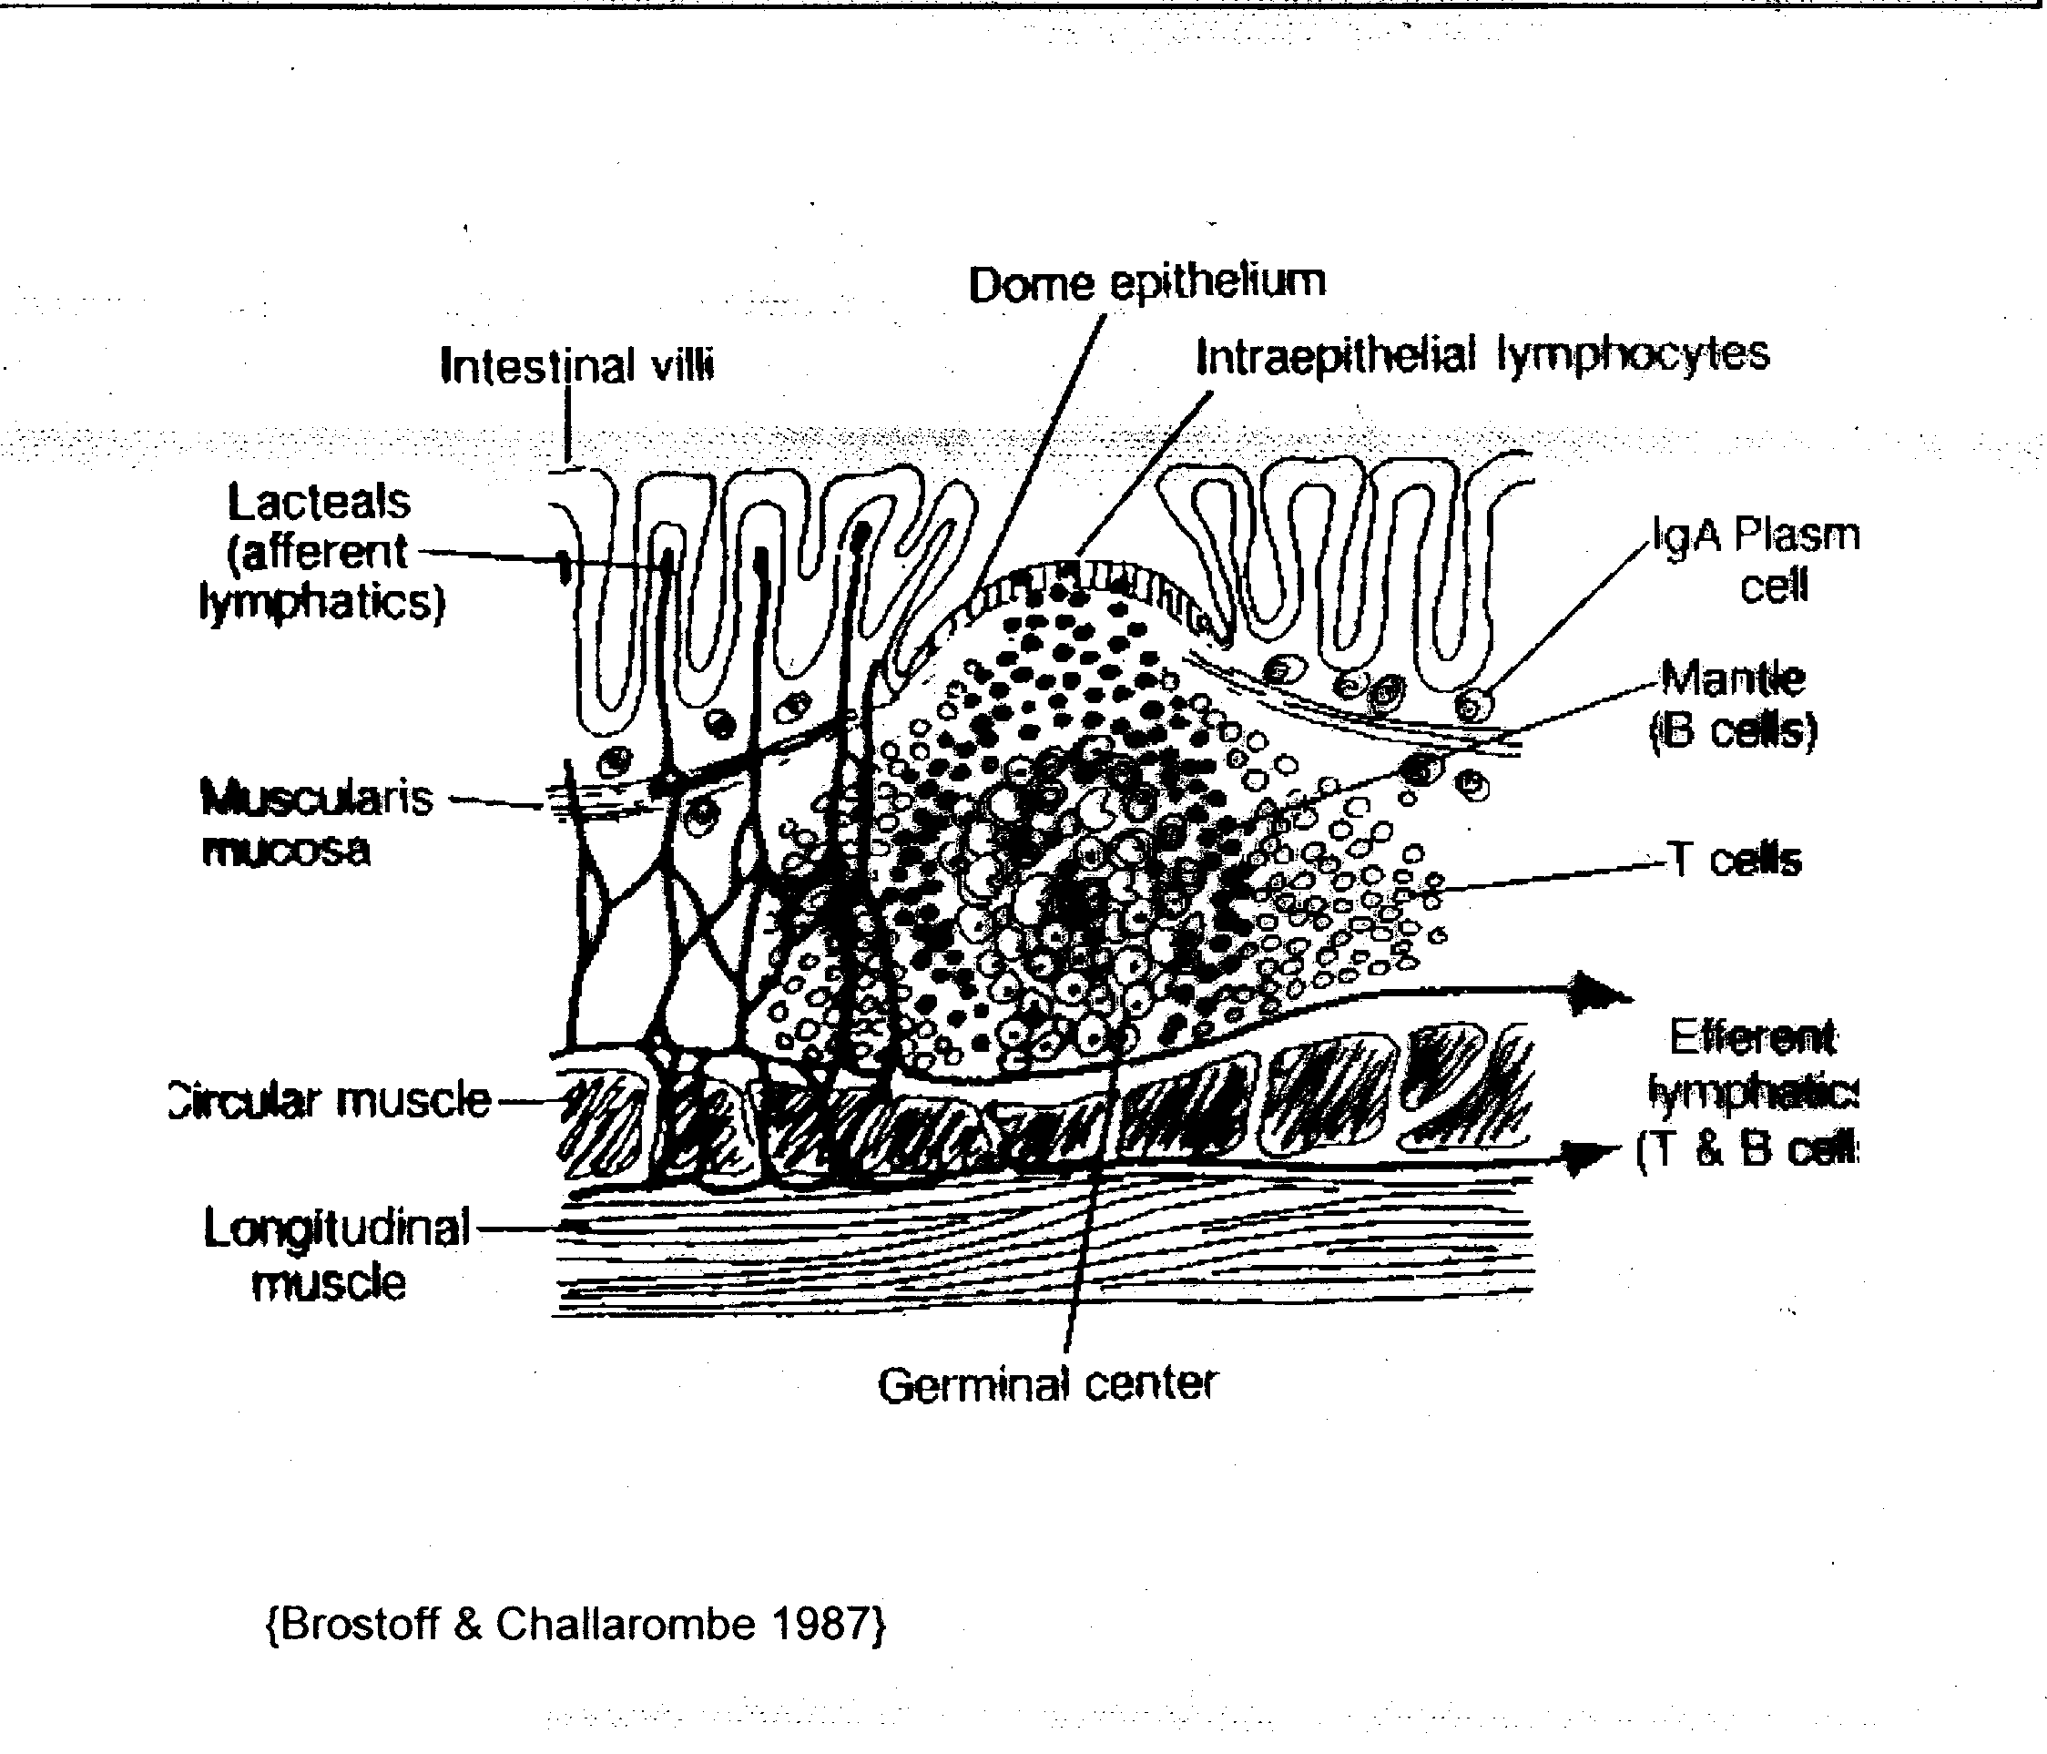
Lamina Propria
Peyer’s Patch

Slide 46
Immune System of the Gut
Lymphocytes are found both in the lamina propria
  Mostly CD4+ T helper cells
And between the epithelial cells
  Mostly CD8+ T suppressor cells
T cells migrate out of the epithelium to mesenteric lymph nodes, proliferate, and enter the systemic circulation
Return to mucosa as memory T cells

Slide 47
Immune Processing in the Gut
Antigen-presenting cells are found predominantly in Peyer’s patches
Also as scattered cells in lamina propria
Most efficient sampling occurs in the flattened epithelial cells overlying Peyer’s patches

Slide 48
Immune System of the Gut
Other haematopoietic cells in the GI tissue include:
  Eosinophilic granulocytes (4-6% of lamina propria cells)
  Neutrophilic granulocytes (rare in non-inflamed tissue)
  Monocytes
  Mast cells (2-3% of lamina propria cells)

Slide 49
Immune Activation in GALT
Particulate Antigens
Particulate antigens, such as intact bacteria, viruses, parasites are processed through M (microfold) cells, specialised epithelial cells that overlie Peyer’s patches
Sequence of Events:
  M cell endocytoses macromolecule at the apical end of the cell
  Transports it across cell to the basolateral surface
  Antigen encounters intra-epithelial lymphocytes
  Lymphocytes (T and B cells) are activated to generate antigen-specific IgM and IgA

Slide 50
Immune Activation in GALT
Particulate Antigens (continued)
  IgA and IgM molecules pass through mucosal epithelial cell and link to receptor on cell surface
  Expelled into the gut lumen, together with receptor
  Receptor forms the secretory component that protects the antibody from digestion by enzymes in the gut lumen
  Secretory IgM (sIgM) and secretory IgA (sIgA) function as first line defence agents in mucous secretions

Slide 51
Development of Tolerance in GALT:
Soluble Protein
Intestinal epithelial cells (IEC) appear to be the major antigen presenting cells involved in immunosuppression in the GALT
Events leading to tolerance:
  IEC express MHC class II molecules
  Take up soluble protein
  Transport it through the cell
  T and B cell lymphocytes at the basolateral interface may be activated
  May result in generation of low levels of antigen-specific IgG

Slide 52
Lamina Propria
Soluble Antigen
Particulate Antigen
sIgA and sIgM
Nutrients
e.g. Microorganisms
Antigens may enter via weakened tight junctions in epithelium
Peyer’s Patch

Slide 53
Development of Tolerance
  Antibody production against foods is a universal phenomenon in adults and children
  Most antibodies to foods in non-reactive humans are IgG, but do not trigger the complement cascade
  Such antibodies are not associated with allergy
  CD8+ suppressor cells at basolateral surface are activated
  In conjunction with MHC class I molecules
  Suppressor cytokines generated (e.g. TGF-β)
  Results in lymphocyte anergy or deletion

Slide 54
Development of Tolerance
Normal tolerance to dietary proteins is partly due to generation of CD8+ T suppressor cells
These are at first located in the GALT, and after prolonged exposure to the same antigen can be detected in the spleen
Activation depends on several factors including:
  antigen characteristics
  dose
  frequency of exposure

Slide 55
Development of Tolerance (continued)
In addition, regulatory T cells (T_{reg}) in the thymus stop further action
  Probably mediated by TGF-β
Possibly regulatory T cells named inducible T reg (TrI) generate IL-10, which also has an immuno-suppressive function

Slide 56
Development of Tolerance continued
Other factors that might influence tolerance include:
  Individual’s age
  Nature of intestinal microflora
    Microbial lipopolysaccharide from Gram-negative Enterobacteria in the colon might act as an immunological adjuvant

Slide 57
Food Allergy is Failure of Tolerance
Food allergens reach the intestinal mucosa intact
Antigen (allergen) by-passes normal route of APC sampling and processing by GALT
Suggested to by-pass gut GALT by moving through weakened tight junction between epithelial cells
Tight junction weakened by:
  Immaturity (in infants)
  Alcohol ingestion
  Inflammation in the gut epithelium and associated tissues
May also result from immaturity or failure of APC

Slide 58
Factors Influencing Tolerance
Tolerance to food antigens after early Th2 response may be due to a “diverting” pathway
  Children outgrow their early food allergies usually between 2 and 7 years of age
Suggested may be due to maturation of APC and antigen processing in the GALT
Evidence indicates that low dose, continuous exposure to antigen is important in T cell tolerance
Large dose, infrequent exposure may promote sensitisation

Slide 59
Additional Factors influencing Th2 cell polarization
Female hormones appear to play a significant role in allergic disease, with oestrogen effects being most well studied
Oestrogen’s influences on immune cells favor the allergic response:
  promoting Th2 polarization
  encouraging class switching of B cells to IgE production and
  prompting mast cell and basophil degranulation

Slide 60
Effects of Oestrogen in Allergy
Mechanism by which it acts may be quite complex, with effects dependent on:
  the concentrations of hormone present
  the concomitant presence or absence of other factors such as progesterone
May be evident at:
  Menarche
  Stages of oestrogen surge in the menstrual cycle

