Slide 1

Medical Nutrition Therapy for Disorders of the Lower Gastrointestinal Tract
Course: Masters Nutrition and Dietetics
Subject: Medical Nutrition Therapy

Slide 2
Normal Function of Lower GI
Digestion
Absorption
Excretion

Slide 3
Normal Function of Lower GI
Digestion
  Begins in mouth & stomach
  Continues in duodenum & jejunum
  Secretions:
    Liver
    Pancreas
    Small intestine

Slide 4
Normal Function of Lower GI
Absorption
  Most nutrients absorbed in jejunum
  Small amounts of nutrients absorbed in ileum
  Bile salts & B₁₂ absorbed in terminal ileum
  Residual water absorbed in colon

Slide 5
Principles of Nutritional Care
Intestinal disorders & symptoms:
  Motility
  Secretion
  Absorption
  Excretion

Slide 6
Principles of Nutritional Care
Dietary modifications
  To alleviate symptoms
  Correct nutritional deficiencies
  Address primary problem
  Must be individualized

Slide 7
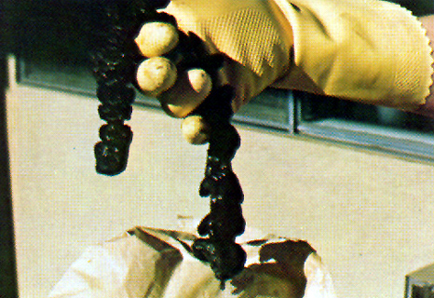
Common Intestinal Problems
Intestinal gas or flatulence
Constipation
Diarrhea
Steatorrhea
Photo courtesy http://www.drnatura.com/

Slide 8
Constipation
Defined as hard stools, straining with defecation, infrequent bowel movements
Normal frequency ranges from one stool q 3 days to 3 times a day
Occurs in 5% to more than 25% of the population, depending on how defined

Slide 9
Causes of Constipation - Systemic
Side effect of medication, esp narcotics
Metabolic Endocrine abnormalities, such as hypothyroidism, uremia and hypercalcemia
Lack of exercise
Ignoring the urge to defecate
Vascular disease of the large bowel
Systemic neuromuscular disease leading to deficiency of voluntary muscles
Poor diet, low in fiber
Pregnancy

Slide 10
Causes of Constipation - Gastrointestinal
Diseases of the upper gastrointestinal tract
  Celiac Disease
  Duodenal ulcer
Diseases of the large bowel resulting in:
  Failure of propulsion along the colon
  (colonic inertia)
  Failure of passage though anorectal structures (outlet obstruction)
Irritable bowel syndrome
Anal fissures or hemorrhoids
Laxative abuse
  – Gastric cancer
  – Cystic fibrosis

Slide 11
Treatment of Constipation
Encourage physical activity as possible
Bowel training: encourage patient to respond to urge to defecate
Change drug regimen if possible if it is contributory
Use laxatives and stool softeners judiciously
Use stool bulking agents such as psyllium (metamucil) and pectin

Slide 12
MNT for Constipation
Depends on cause
Use high fiber or high residue diet as appropriate
If caused by medication, may be refractory to diet treatment

Slide 13
Fiber, roughage, and residue
Fiber or roughage
    From plant foods
    Not digestible by human enzymes
Residue
    Fecal contents, including bacteria and the net remains after ingestion of food, secretions into the GI tract, and absorption

Slide 14
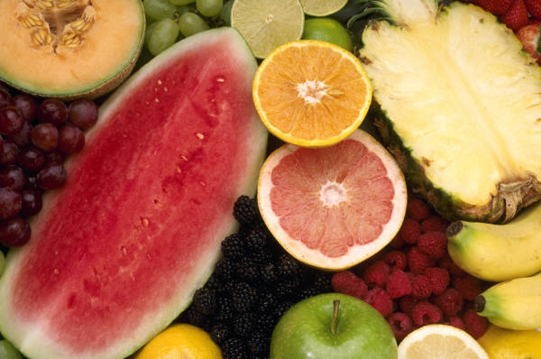
High-Fiber Diets
Most Americans = 10 – 15 g/day
Recommended = 25 g/day
More than 50g/day = no added benefit, may cause problems

Slide 15
High-Fiber Diet
Increase consumption of whole-grain breads, cereals, flours, other whole-grain products
Increase consumption of vegetables, especially legumes, and fruits, edible skins, seeds, hulls
Consume high-fiber cereals, granolas, legumes to increase fiber to 25 g/day
Increase consumption of water to at least 2 qts (eight 8 oz cups)

Slide 16
High-Fiber Diets: cautions
Gastric obstruction, fecal impaction may occur when insufficient fluid consumed
With GI strictures, motility problems, increase fiber slowly (~1mo.)
Unpleasant side effects
  Increased flatulence
  Borborygmus
  Cramps, diarrhea

Slide 17
Diarrhea
Characterized by frequent evacuation of liquid stools
Accompanied by loss of fluid and electrolytes, especially sodium and potassium
Occurs when there is excessively rapid transit of intestinal contents through the small intestine, decreased absorption of fluids, increased secretion of fluids into the GI tract

Slide 18
Diarrhea Etiology
Inflammatory disease
Infections with fungal, bacterial, or viral agents
Medications (antibiotics, elixirs)
Overconsumption of sugars
Insufficient or damaged mucosal absorptive surface
Malnutrition

Slide 19
Diarrhea Treatment for Adults
Identify and treat the underlying problem
Manage fluid and electrolyte replacement using oral glucose electrolyte solutions (see WHO guidelines)
Initiate minimum-residue diet
Avoid large amounts of sugars and sugar alcohols
Prebiotics in modest amounts including pectin, oligosaccharides, inulin, oats, banana flakes
Probiotics, cultured foods and supplements that are sources of beneficial gut flora

Slide 20
Low- or Minimum Residue Diet
Foods completely digested, well absorbed
Foods that do not increase GI secretions
Used in:
  Maldigestion
  Malabsorption
  Diarrhea
  Temporarily after some surgeries, e.g. hemorrhoidectomy

Slide 21
Foods to Limit in a Low- or Minimum Residue Diet
Lactose (in lactose malabsorbers)
Fiber >20 g/day
Resistant starches
  Raffinose, stachyose in legumes
Sorbitol, mannitol, xylitol >10g/day
Caffeine
Alcohol, esp. wine, beer

Slide 22
Restricted-Fiber Diets
Uses:
  When reduced fecal output is necessary
  When GI tract is restricted or obstructed
  When reduced fecal residue is desired

Slide 23
Restricted-Fiber Diets
Restricts fruits, vegs, coarse grains
<10 g fiber/day
Phytobezoars
  Obstructions in stomach resulting from ingestion of plant foods
  Common in edentulous pts, poor dentition, with dentures
  Potato skins, oranges, grapefruit

Slide 24
MNT for Infants and Children
Acute diarrhea most dangerous in infants and children
Aggressive replacement of fluid/ electrolytes
WHO/AAP recommend 2% glucose (20g/L) 45-90 mEq sodium, 20 mEq/L potassium, citrate base
Newer solutions (Pedialyte, Infalyte, Lytren, Equalyte, Rehydralyte) contain less glucose and less salt, available without prescription

Slide 25
MNT for Infants and Children
Continue a liquid or semisolid diet during bouts of acute diarrhea for children 9 to 20 months
Intestine absorbs up to 60% of food even during diarrhea
Early refeeding helpful; gut rest harmful
Clear liquid diet (hyperosmolar, high in sugar) is inappropriate
Access American Academy of Pediatrics Clinical Guidelines http://aappolicy.aappublications.org/cgi/reprint/pediatrics;97/3/424.pdf

Slide 26
Diseases of Small Intestine
Celiac disease
Brush border enzyme deficiencies
Crohn’s disease

Slide 27
Celiac Disease
Also called Gluten-Sensitive Enteropathy and Non-tropical Sprue
Caused by inappropriate autoimmune reaction to gliadin (found in gluten)
Much more common than formerly believed (prevalence 1 in 133 persons in the US)
Frequently goes undiagnosed

Slide 28
Celiac Disease
Results in damage to villi of intestinal mucosa – atrophy, flattening
Potential or actual malabsorption of all nutrients
May be accompanied by dermatitis herpetiformis, anemia, bone loss, muscle weakness, polyneuropathy, follicular hyperkeratosis
Increased risk of Type 1 diabetes, lymphomas and other malignancies

Slide 29
Celiac Disease Symptoms
Early presentation: diarrhea, steatorrhea, malodorous stools, abdominal bloating, poor weight gain
Later presentation: other autoimmune disorders, failure to maintain weight, fatigue, consequences of nutrient malabsorption (anemias, osteoporosis, coagulopathy)
Often misdiagnosed as irritable bowel disease or other disorders

Slide 30
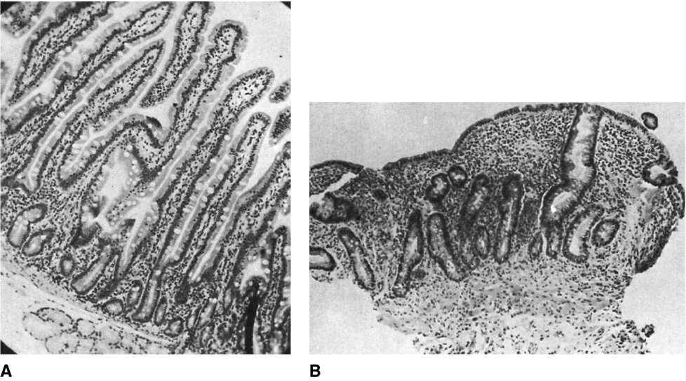
Normal human duodenal mucosa and peroral small bowel biopsy specimen from a patient with gluten enteropathy.
(From Floch MH. Nutrition and Diet Therapy in Gastrointestinal Disease. New York: Menum Medical Book Co., 1981.)
Fig. 31-1. p. 673.
Back
MENU
Forward

Slide 31
Celiac Disease Diagnosis
Positive family history
Pattern of symptoms
Serologic tests: antiendomysial antibodies (AEAs), immunoglobulin A (IgA), antigliadin antibodies (AgG-AGA) or IgA tissue transglutaminase
Gold standard is intestinal mucosal biopsy
Evaluation should be done before gluten-containing foods are withdrawn

Slide 32
Celiac Disease: Diet IS the Therapy
Electrolyte and fluid replacement (acute phase)
Vitamin and mineral supplementation as needed (calcium, vitamin D, vitamin K, iron, folate, B12, A & E)
Delete gluten sources from diet (wheat, rye, barley, oats)
Substitute corn, potato, rice, soybean, tapioca, and arrowroot
Patients should see a dietitian who is familiar with this disease and its treatment

Slide 33
Celiac Disease
Read labels carefully for problem ingredients
Even trace amounts of gliadin are problematic
Common problem additives include fillers, thickeners, seasonings, sauces, gravies, coatings, vegetable protein

Slide 34
Tropical Sprue
Cause unknown; possible infectious process
Imitates celiac disease
Results in atrophy and inflammation of villi
Sx: diarrhea, anorexia, abdominal distention
Rx: tetracycline, folate 5 mg/d, B₁₂ IM

Slide 35
Intestinal Brush Border Enzyme Deficiencies
Deficiency of brush border disaccharidases
Disaccharides not hydrolyzed at mucosal cell membrane

Slide 36
Intestinal Brush Border Enzyme Deficiencies
May occur as
  Rare congenital defects
    Lack of sucrase, isomaltase, lactase in newborns
  Secondary to diseases that damage intestinal epithelium
    Crohn’s disease, celiac disease
  Genetic form
    Lactase deficiency

Slide 37
Lactase “Deficiency”
70% of adults worldwide are lactase deficient, especially Africans, South Americans, and Asians
Maintenance of lactase into adulthood is probably the result of a genetic mutation

Slide 38
Lactase “deficiency)
Diagnosed based on history of GI intolerance to dairy products
Hydrogen breath test
Abnormal lactose tolerance test (failure of blood glucose response to lactose load, along with GI symptoms)

Slide 39
MNT for Lactase Deficiency
Most lactase deficient individuals can tolerate small amounts of lactose without symptoms, particularly with meals or as cultured products (yogurt or cheese)
Can use lactase enzyme or lactase treated foods, e.g. Lactaid milk
Distinct from milk protein allergy; allergy requires milk free diet

Slide 40
Inflammatory Bowel Disease
Crohn’s Disease and Ulcerative Colitis
Autoimmune diseases of unknown origin
Genetic component and environmental factors
Onset usually between 15 to 30 years of age

Slide 41
Inflammatory Bowel Diseases (IBD)
Clinical features
  Food intolerances
  Diarrhea, fever
  Weight loss
  Malnutrition
  Growth failure
  Extraintestinal manifestations
    Arthritic, dermatologic, hepatic

Slide 42
Inflammatory Bowel Disease
Crohn’s Disease
Involves any part of the GI tract
Segmental
Involves all layers of mucosa
Steatorrhea frequent
Strictures and fistulas common
Slowly progressive
Malignancy rare
Ulcerative Colitis
Involves the colon, extends from rectum
Continuous
Involves mucosa and submucosa
Steatorrhea absent
Strictures and fistulas rare
Remissions and relapses
Malignancy common

Slide 43
Crohn’s Disease
May involve any part of GI: mouth –anus
Typically involves small & large intestine in segmental manner with skipped areas – healthy areas separate inflamed areas
Affects all layers of mucosa
Inflammation, ulceration, abcesses, fistulas

Slide 44
Crohn’s Disease
Fibrosis, submucosal thickening, scarring result in narrowed segments, strictures, partial or complete obstruction
Multiple surgeries common with major resection of intestine
  Malabsorption of fluids, nutrients
  May need parenteral nutrition to maintain adequate nutrient intake, hydration

Slide 45
Ulcerative Colitis
Involves only colon, extends from rectum
Continuous disease, no skipped areas
Inflamed mucosa, small ulcers, but not through mucosa
Strictures, significant narrowing not usual
Rectal bleeding, bloody diarrhea common
Often, colon removed

Slide 46
IBD Medical Management
To induce and maintain remission
To maintain nutritional status
During acute stages:
    Corticosteroids
    Anti-inflammatory agents
    Immunosuppressive agents
    Antibiotics

Slide 47
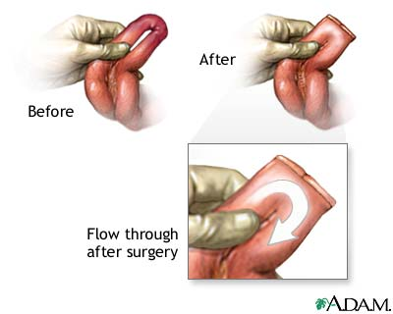
IBS: Surgical Treatment

Slide 48
IBD Nutritional Management (acute)
Low-residue, low-fiber liquid diet
“Bowel rest” with parenteral nutrition
Enteral nutrition may have better success at inducing remission
Diet tailored to individual pt:
    Minimal residue for reducing diarrhea
    Limited fiber to prevent obstruction
    Small, frequent feedings
    Supplements , MCT with fat malabsorption

Slide 49
IBD Nutritional Management (chronic)
High protein, high calorie diet with oral supplements
Monitor vitamin-mineral status of iron, calcium, selenium, folate, thiamin, riboflavin, pyridoxine, vitamin B12, zinc, magnesium, vitamins A, D, E
High fiber diet as tolerated
Avoid unnecessary restrictions

Slide 50
Diseases of Large Intestine
Irritable Bowel Syndrome
Diverticular Disease
Colon Cancer and Polyps

Slide 51
Irritable Bowel Syndrome (IBS)
Not a disease – syndrome
Abdominal pain, bloating, abnormal bowel movements
  Alternating diarrhea, constipation
  Abdominal pain, relieved by defecation
  Bloating w/ feeling of excess flatulence
  Feeling of incomplete evacuation
  Rectal pain, mucus in the stool

Slide 52
IBS: Incidence in U.S.
20% of women
~10 – 15% of men
20 – 40% of visits to gastroenterologists
One of the most common reason pts first seek medical care
Increased absenteeism, decreased productivity

Slide 53
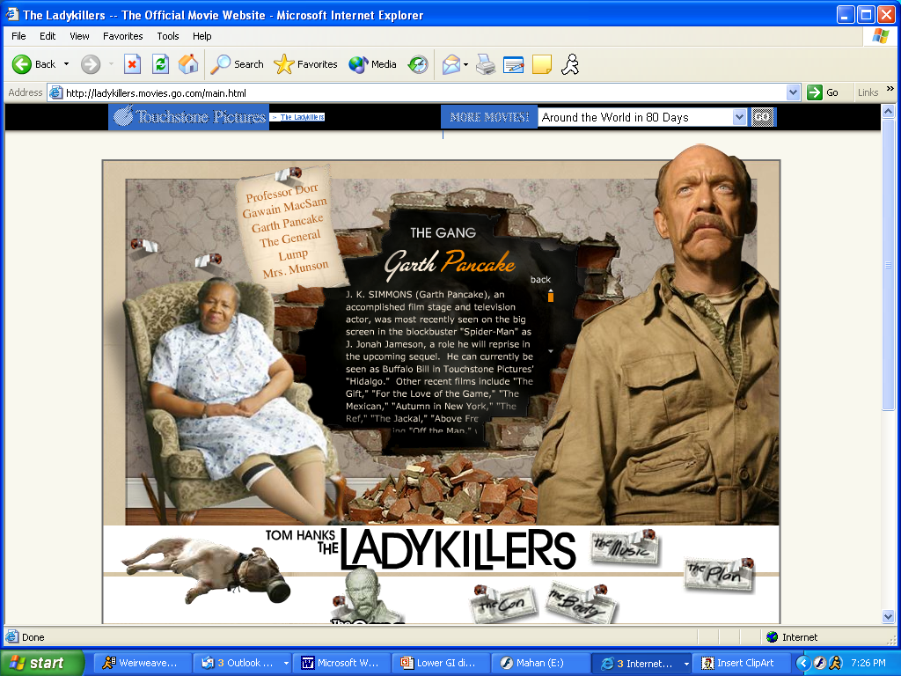

Slide 54
IBS: Etiology
Increased visceral sensitivity and motility in response to GI and environmental stimuli
React more to:
    Intestinal distention
    Dietary indiscretions
    Psychosocial factors
    Life stressors
May have psych/social component (history of physical or sexual abuse)

Slide 55
IBS: Diagnosis
Symptoms for 3 months or longer
Positive family history
Rule out other med/surg conditions

Slide 56
Irritable Bowel Syndrome
Problem factors other than stress and diet:
  Excess use of laxatives, OTC meds
  Antibiotics
  Caffeine
  Previous GI illness
  Lack of regular sleep, rest patterns
  Inadequate fluid intake

Slide 57
IBS: Medications
Antispasmodics
Anticholinergics
Antidiarrheals
Prokinetics
Antidepressants

Slide 58
IBS: Nutritional Care
ID individual food intolerances
    Keep food record, include symptoms, time they occur in relation to meals
Avoid offending foods, substances
    Milk, milk products (lactose) only in presence of lactose deficiency
    Fatty foods
    Gas-forming foods, beverages
    Caffeine, alcohol
    Foods w/ ↑ fructose or sorbitol

Slide 59
IBS: Nutritional Care
Eat small frequent meals at relaxed pace, regular times
Gradually add dietary fiber to diet
  20 – 30 g
  Fiber supplements may help (psyllium)
Fluids – 2 – 3 qts w/ fiber supp.
Regular physical activity to reduce stress

Slide 60
Diverticulosis
Sac-like herniations or outpouches of the colon wall
Caused by long-term increased colonic pressures
Believed to result from low fiber diet, constipation

Slide 61
Diverticulitis
Caused when bacteria or other irritants are trapped in diverticular pouches
Inflammation
Abscess formation
Acute perforation
Acute bleeding
Obstruction
Sepsis

Slide 62
Diverticulitis: MNT for acute disease
Use elemental diet if patient is acutely ill. Progress to clear liquids
Initiate soft diet with no excess spices or fiber. Avoid nuts, seeds, popcorn, fibrous vegetables
Ensure adequate intake of protein and iron
Progress to normal fiber intake as inflammation decreases
Low fat diet may also be beneficial

Slide 63
Diverticulosis: MNT for chronic disease
High fiber diet (increase gradually)
Supplement with psyllium, methylcellulose may be helpful
2 – 3 qt water daily with high fiber intake
Low fat diet may be helpful
? Avoid seeds, nuts, skins of plants

Slide 64
Colon Cancer
Second most common cancer in adults
Second most common cause of death
Factors that increase risk:
    Family history
    Occurrence of IBD – Crohn’s, ulcerative colitis
    Polyps
    Diet

Slide 65
Colon Cancer/Polyps: dietary risk factors
Increased meat intake, esp. red meats
Increased fat intake
Low intakes of vegetables, high fiber grains, carotenoids
Low intakes of vits D, E, folate
Low intakes of calcium, zinc, selenium
Some food preparation methods (chargrilling)

Slide 66
Colon Cancer/Polyps: possible dietary protective factors
Omega-3 fatty acids –fish oils, flaxseed, etc
Wheat bran
Legumes
Some phytochemicals (plants)
Butyric acid – dairy fats, bacterial fermentation of fiber in colon
Calcium

Slide 67
Short-bowel syndrome (SBS)
Consequence of significant resections of small intestine
    Jejunal resections
    Ileal resections
40 – 50% small bowel resected
Crohn’s, radiation enteritis, mesenteric infarct, malignant disease, volvulus

Slide 68
SBS Complications
Malabsorption of micronutrients, macronutrients
Fluid, electrolyte imbalances
Wt loss
Growth failure in children
Gastric hypersecretion
Kidney stones, gallstones

Slide 69
SBS: Predictors of Malabsorption, Complications, Need for PN
Length of remaining small intestine
Loss of ileum, especially distal one third
Loss of ileocecal valve
Loss of colon
Disease in remaining segments(s) of gastrointestinal tract
Radiation enteritis
Coexisting malnutrition
Older age surgery

Slide 70
Jejunal Resection
Most digestion, absorption in first 100 cm of small intestine
After period of adaptation, ileum can perform functions of jejunum
With loss of jejunum, less digestive, absorptive surface

Slide 71
Ileal Resections
May produce major nutritional, medical problems
Distal ileum:
  Site for absorption of vit B₁₂/intrinsic factor complex, bile salts, fluid
  Impaired bile salt absorption results in malabsorption of fats, fat-sol vits, minerals (“soaps”)
  Increased absorption of oxalates = renal stones

Slide 72
Small Bowel Surgery – Nutritional Care
Initially may require TPN
2 general principles for resuming enteral nutrition:
  Start enteral feedings early
  Increase feeding concentration, volume gradually

Slide 73
Small Bowel Surgery – Nutritional Care
Small frequent mini-meals (6 – 10)
Transition to more normal foods, meals may take weeks to months
Some pts never tolerate normal concentrations or volumes of food
Maximal adaptation of GI tract may take up to 1 yr after surgery

Slide 74
Ileostomy or Colostomy
Surgical creation of an opening from the body surface to the intestinal tract = “stoma”
Permits defecation from intact portion of intestine
“ileostomy” = removal of entire colon, rectum, anus with stoma into ileum
“colostomy” = removal of rectum, anus with stoma into colon

Slide 75
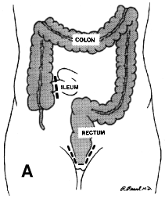
Ileostomy or Colostomy
Sometimes temporary
Output from stoma depends on location
  Ileostomy output will
  be liquid
  Colostomy output more
  solid, more odorous

Slide 76
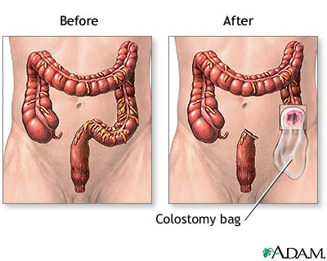
Colostomy Illustration

Slide 77
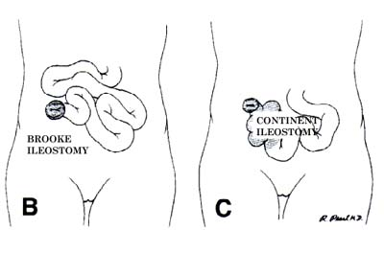
Types of ileostomies

Slide 78
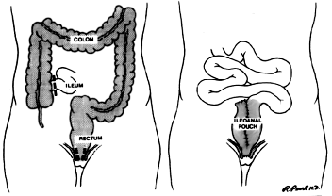
Ileoanal Pouch

Slide 79
Ileostomy or Colostomy – Nutr. Care
Increase water, salt with ileostomies
Pt w/ normal, well-functioning ileostomy usually does not become nutritionally depleted –no higher energy intake needed
W/ resection of terminal ileum need B₁₂ supplement

Slide 80
Ileostomy or Colostomy – Nutr. Care
May restrict fruits & vegetables so may need vit C
May need to avoid very fibrous vegs, chew well
Individual tolerances: address issues such as odor or gas individually
For high output ileostomy may need to follow dumping recommendations; use soluble fiber (oatmeal, applesauce, banana, rice); monitor fat soluble vits

Slide 81
Rectal Surgery
Low residue to allow wound repair, prevent infection
Chemically defined diets may be used to reduce stool volume and frequency

Slide 82
Lower GI Disorders Summary
Food intolerances should be dealt with individually
Patients should be encouraged to follow the least restrictive diet possible
Patients should be re-evaluated frequently and the diet advanced as appropriate

