Slide 1




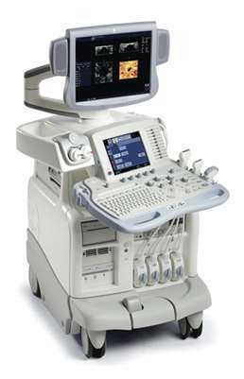
BASIC ECHOCARDIOGRAPHY

Slide 2

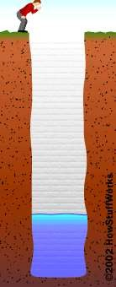
Echo
Echo is something you experience all the time. If you shout into a well, the echo comes back a moment later. The echo occurs because some of the sound waves in your shout reflect off a surface (either the water at the bottom of the well or the wall on the far side) and travel back to your ears. A similar principle applies in cardiac ultrasound.
2

Slide 3

History
In 1842, Christian Johann Doppler (1803-1853) noted that the pitch of a sound wave varied if the source of the sound was moving.
The ability to create ultrasonic waves came in 1880 with the discovery of piezoelectricity by Curie and Curie.
Dr. Helmut Hertz of Sweden in 1953 obtained a commercial ultrasonoscope, which was being used for nondestructive testing. He then collaborated with Dr. Inge Edler who was a practicing cardiologist in Sweden. The two of them began to use this commercial ultrasonoscope to examine the heart. This collaboration is commonly accepted as the beginning of clinical echocardiography as we know it today.
3

Slide 4

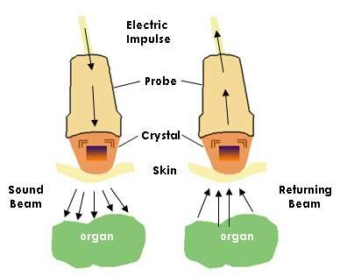
Generation Of An Ultrasound Image
Echocardiography (echo or echocardiogram) is a type of ultrasound test that uses high-pitched sound waves to produce an image of the heart.
The sound waves are sent through a device called a transducer and are reflected off the various structures of the heart. These echoes are converted into pictures of the heart that can be seen on a video monitor.
There is no special preparation for the test.
4

Slide 5

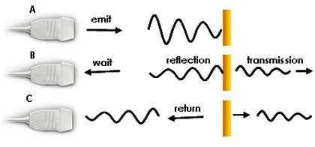
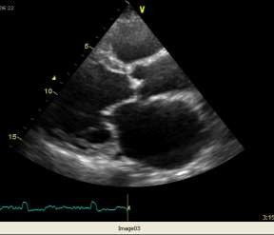
Ultrasound gel is applied to the transducer to allow transmission of the sound waves from the transducer to the skin
The transducer transforms the echo (mechanical energy) into an electrical signal which is processed and displayed as an image on the screen.
The conversion of sound to electrical energy is called the piezoelectric effect
5

Slide 6
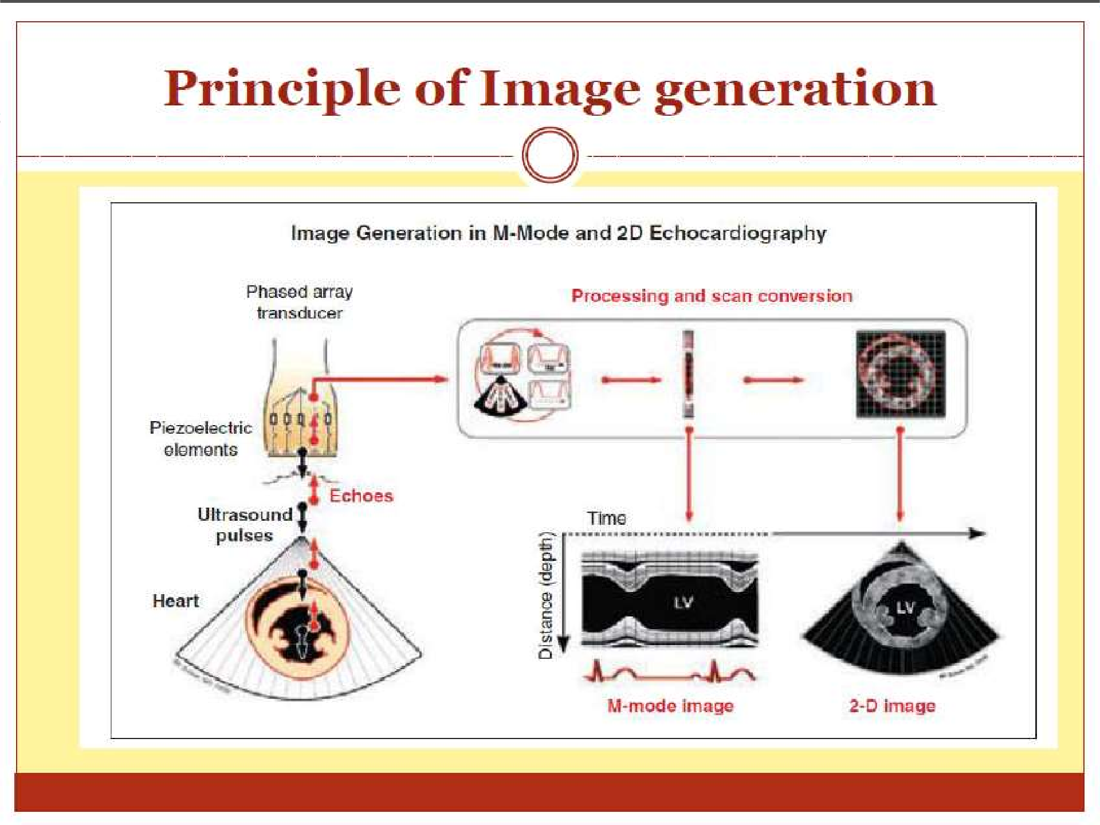


Slide 7

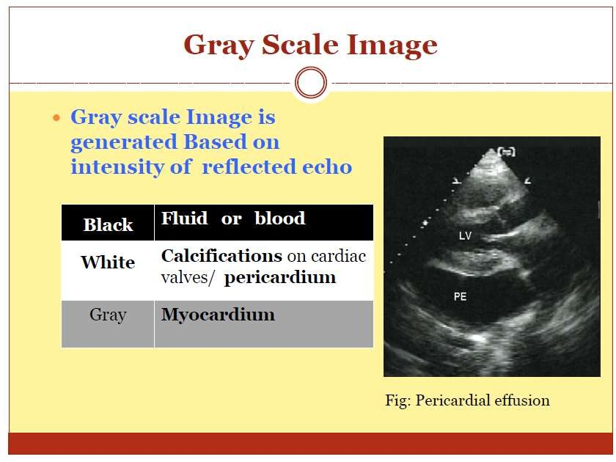

Slide 8



Machines
There are 5 basic components of an ultrasound scanner that are required for
generation, display and storage of an ultrasound image.
Pulse generator - applies high amplitude voltage to energize the crystals
Transducer - converts electrical energy to mechanical (ultrasound) energy and vice versa
Receiver - detects and amplifies weak signals
Display - displays ultrasound signals in a variety of modes
Memory - stores video display
8

Slide 9

THE TRANSDUCER
The transducer is responsible for both transmitting and receiving the ultrasound signal.
The transducer consist of a electrode and a piezo-electric crystal whose ionic structure results in deformation of shape when exposed to an electric current.
Piezo electric(PE) crystals are composed of synthetic material such as barium titanate which when exposed to electric current from the electrodes, alternately expand and contract to create sound waves. When subjected to the mechanical energy of sound from a returning surface, the same PE element change the shape thereby generating an electrical signal detected by the electrodes.

Slide 10
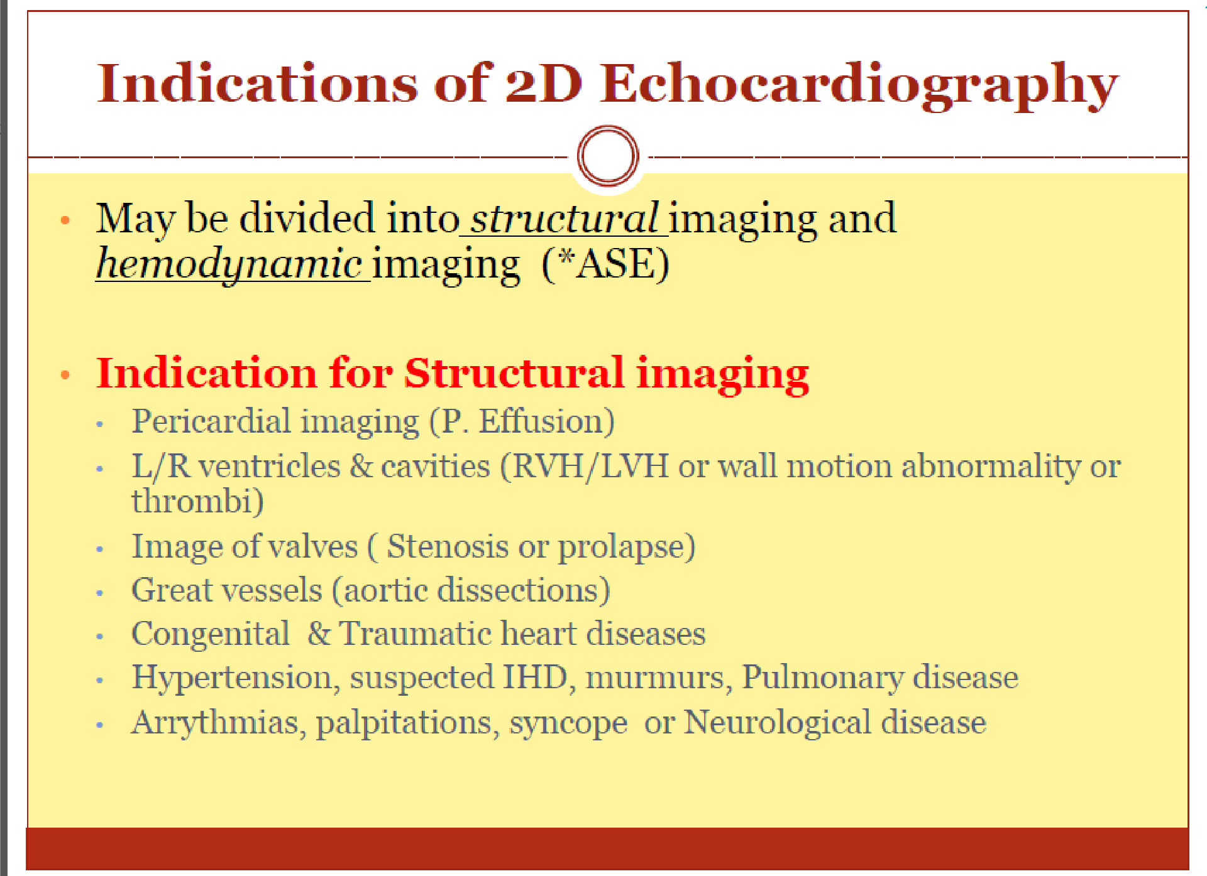


Slide 11
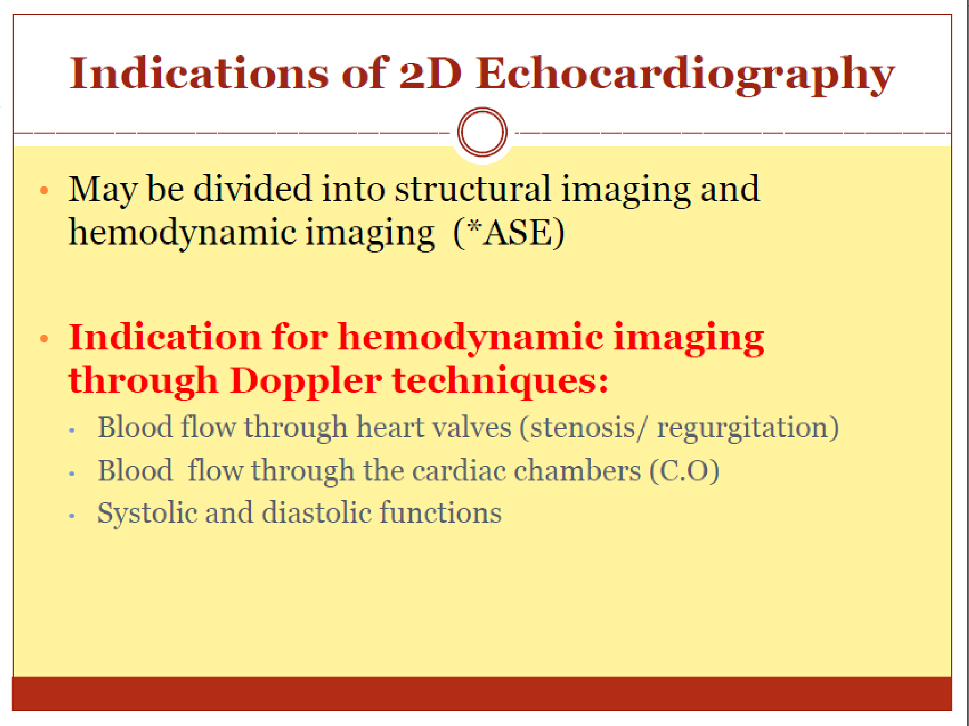


Slide 12

TYPES
Transthoracic(standard echo) Left parasternal
Apical Subcostal Suprasternal
Transesophageal
Intracardiac
12

Slide 13

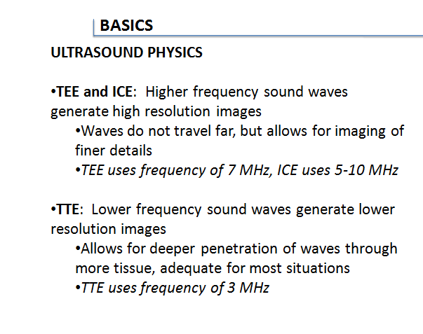
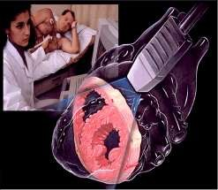
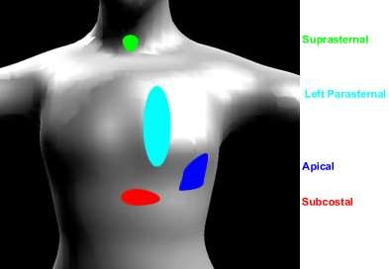
Transthoracic Echo
A standard echocardiogram is also known as a
transthoracic echocardiogram (TTE), or cardiac
ultrasound.
The subject is asked to lie in the semi recumbent position on his or her left side with the head elevated.
The left arm is tucked under the head and the right arm
lies along the right side of the body
Standard positions on the chest wall are used for
placement of the transducer called “echo windows”
13

Slide 14

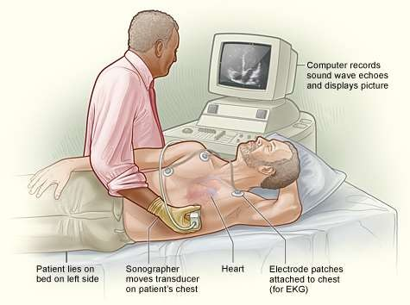
14

Slide 15

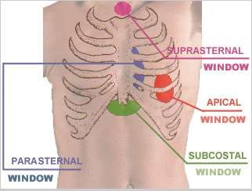
Standard positions on the chest wall are used for placement of the transducer called “ echo windows”
15

Slide 16
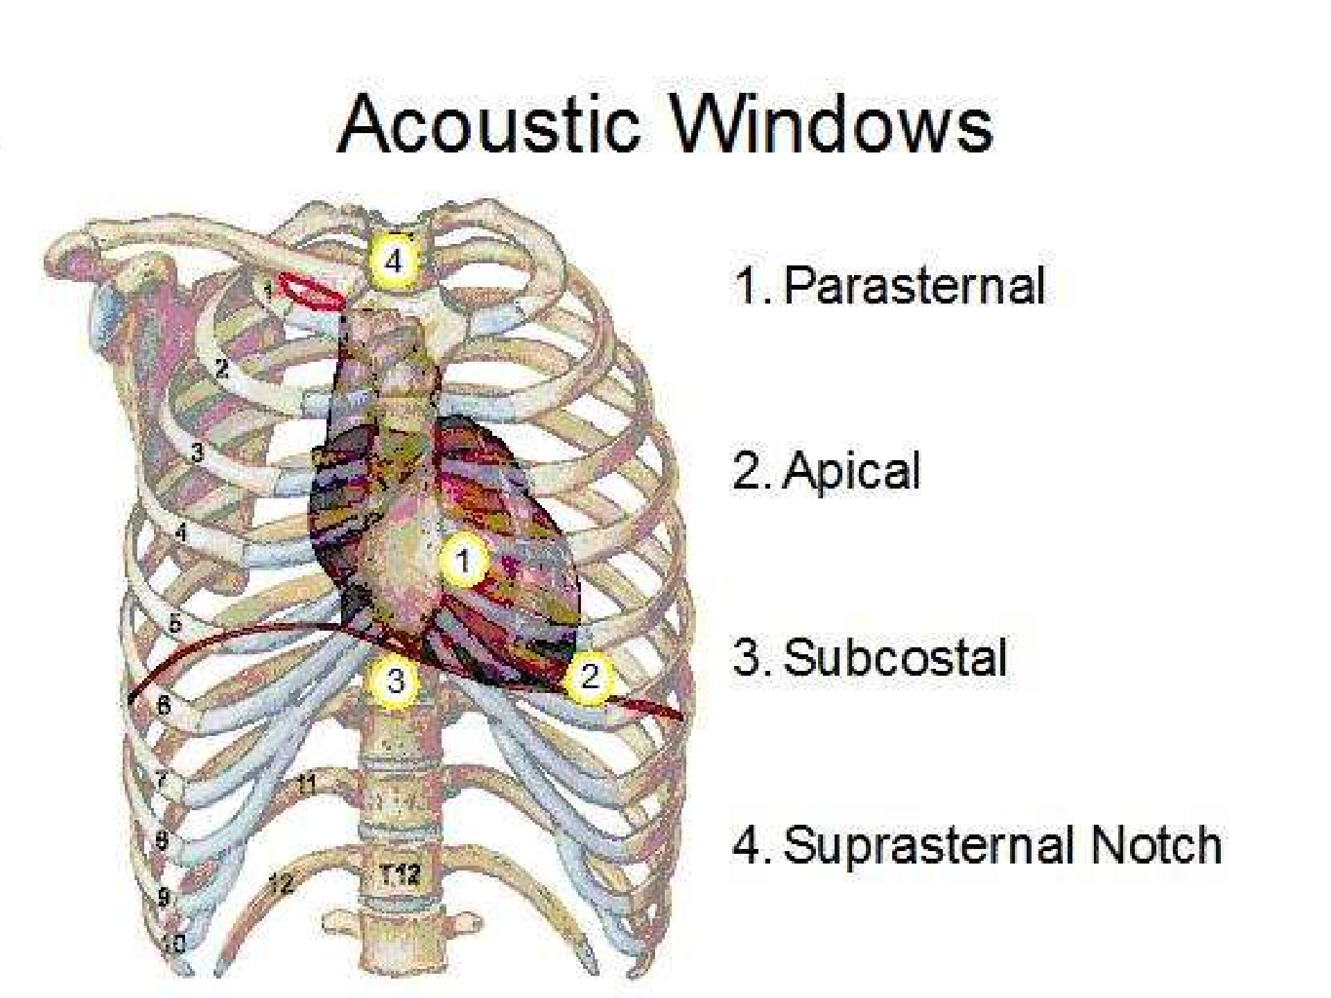

16

Slide 17

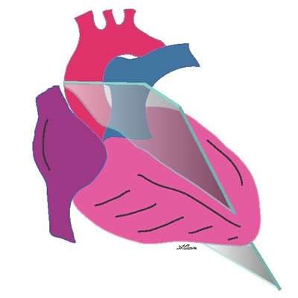
1.Parasternal Long-Axis View (PLAX)
Transducer position: left sternal edge;
2nd – 4th intercostal space
Marker dot direction: points towards right shoulder
Most echo studies begin with this view
It sets the stage for subsequent echo views
Many structures seen from this view
17

Slide 18

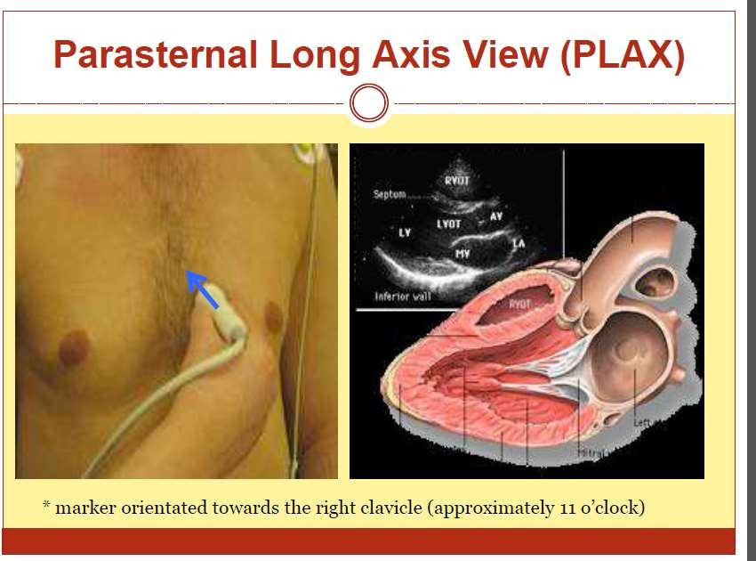

Slide 19

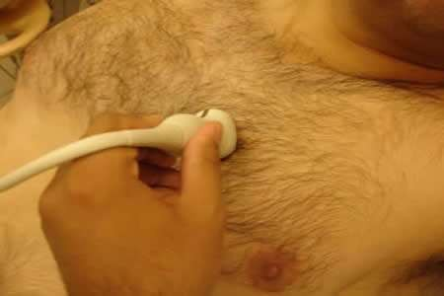
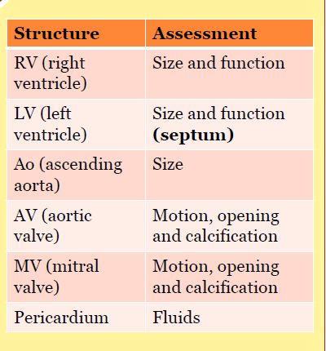
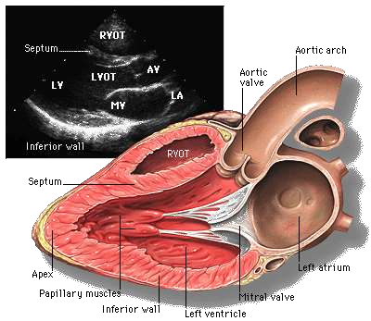
PARASTERNAL LONG AXIS VIEW

Slide 20

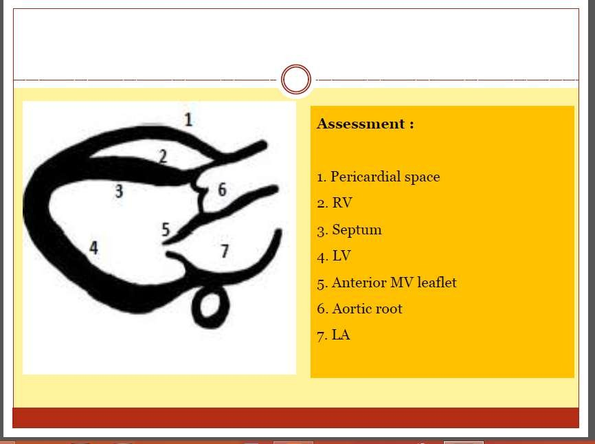

Slide 21

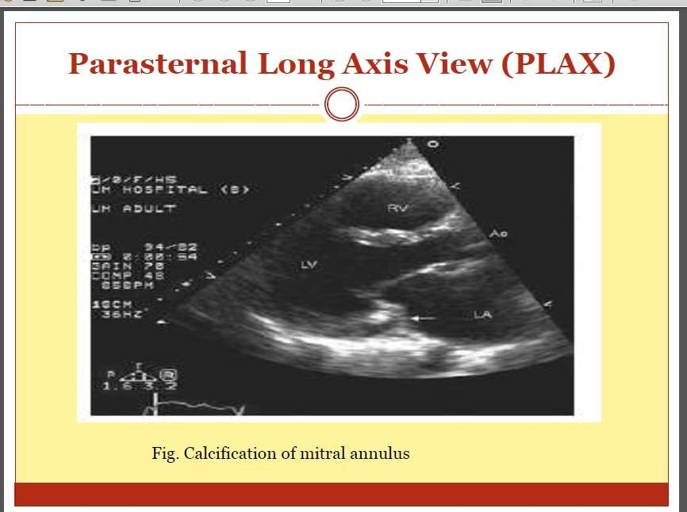

Slide 22

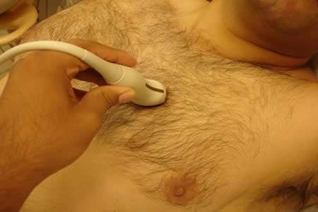
Parasternal Short Axis View (PSAX)
Transducer position: left sternal edge; 2nd – 4th intercostal space
Marker dot direction: points towards left shoulder(90⁰ clockwise from PLAX view)
By tilting transducer on an axis between the left hip and right shoulder, short axis views are obtained at different levels, from the aorta to the LV apex.
Many structures seen
22

Slide 23

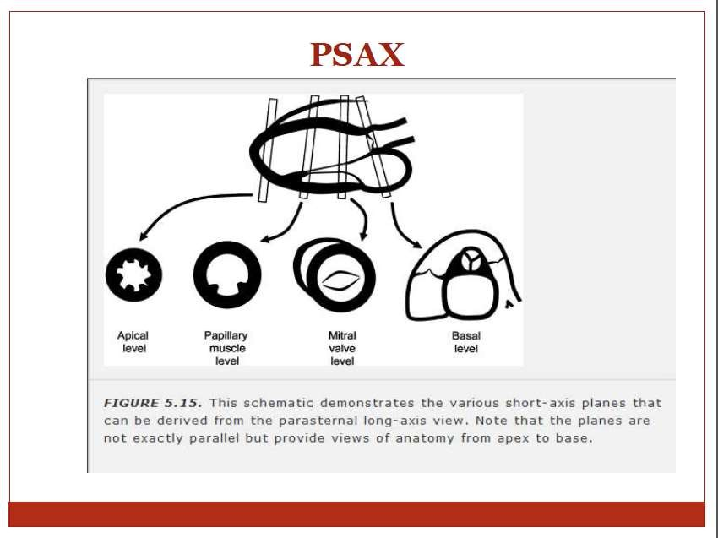

Slide 24

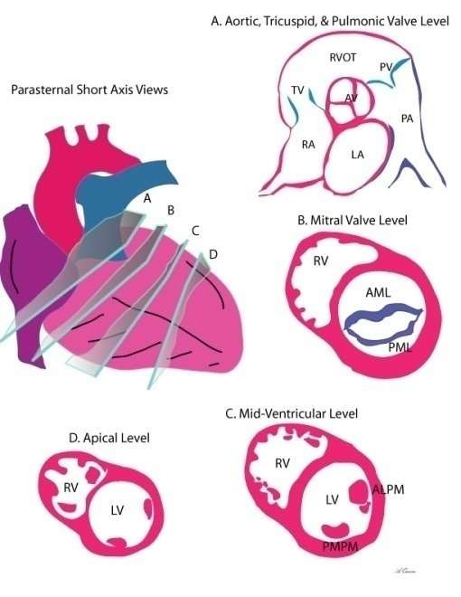

Slide 25

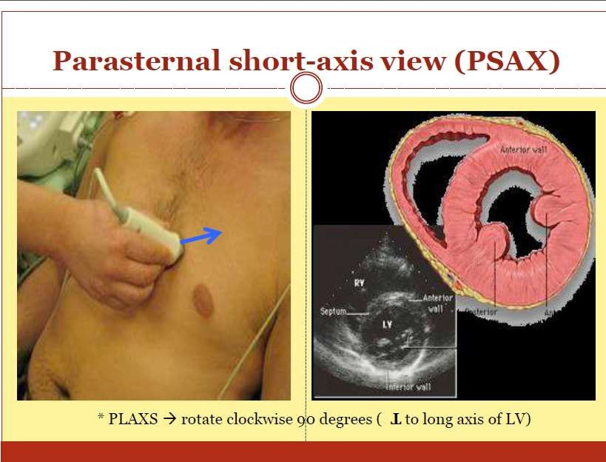

Slide 26

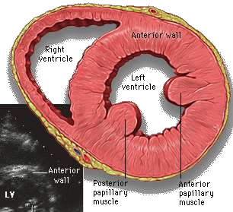
Papillary Muscle (PM)level
PSAX at the level of the papillary muscles showing how the respective LV segments are identified, usually for the purposes of describing abnormal LV wall motion
LV wall thickness can also be assessed
26

Slide 27

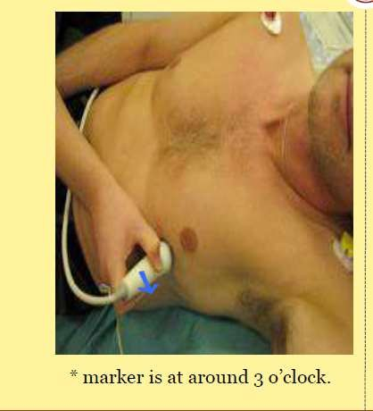
2. Apical 4-Chamber View (AP4CH)
Transducer position: apex of heart
Marker dot direction: points towards left shoulder
27

Slide 28

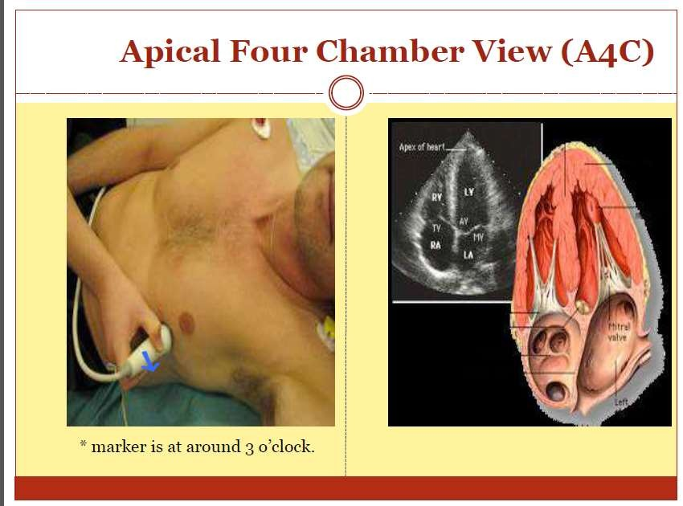

Slide 29

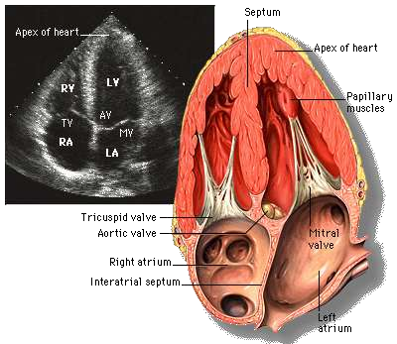
Apical 4-Chamber View (AP4CH)

Slide 30

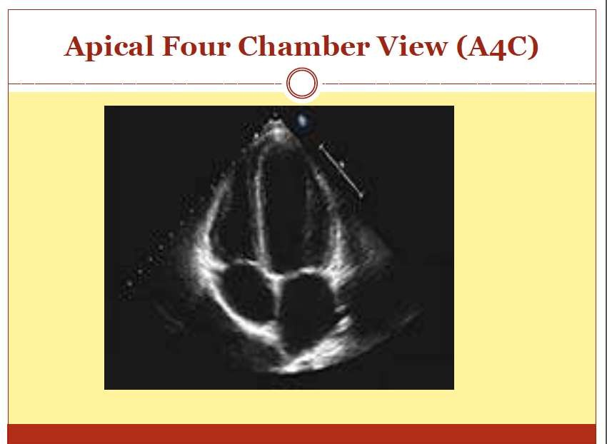

Slide 31

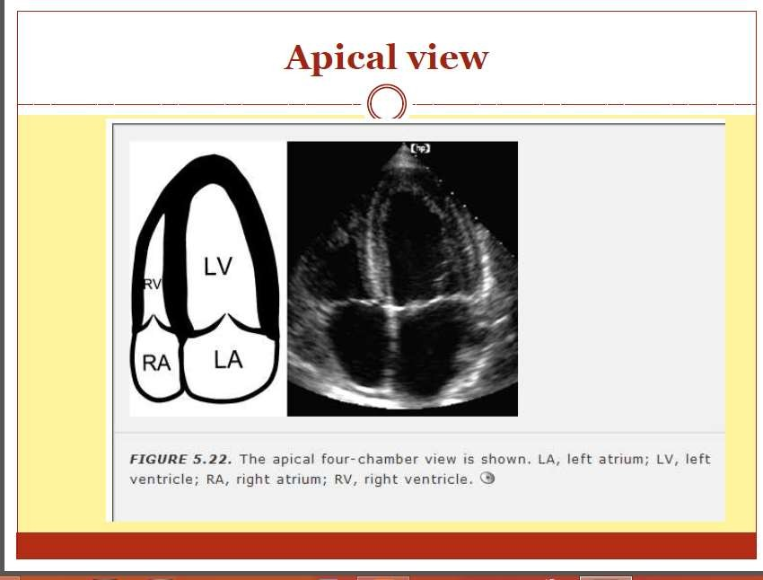

Slide 32

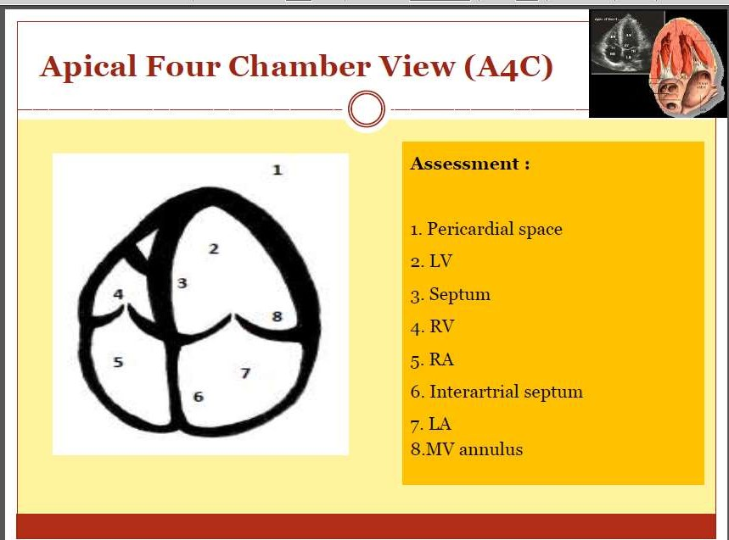

Slide 33

The AP5CH view
The AP5CH view is obtained from this view by slight anterior angulation of the transducer towards the chest wall.
The LVOT can then be visualised

Slide 34

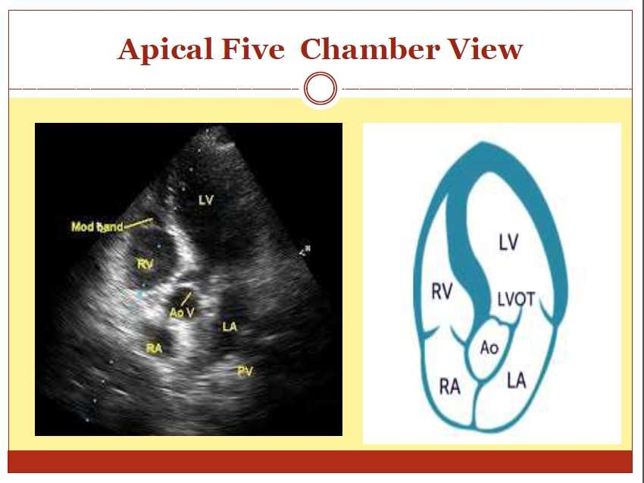

Slide 35

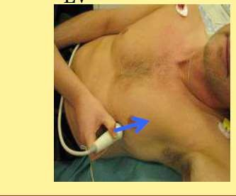
Apical 2-Chamber View (AP2CH)
Transducer position: apex of the heart
Marker dot direction: points towards left side of neck (45⁰ anticlockwise from AP4CH view)
Good for assessment of LV anterior wall
LV inferior wall
35

Slide 36

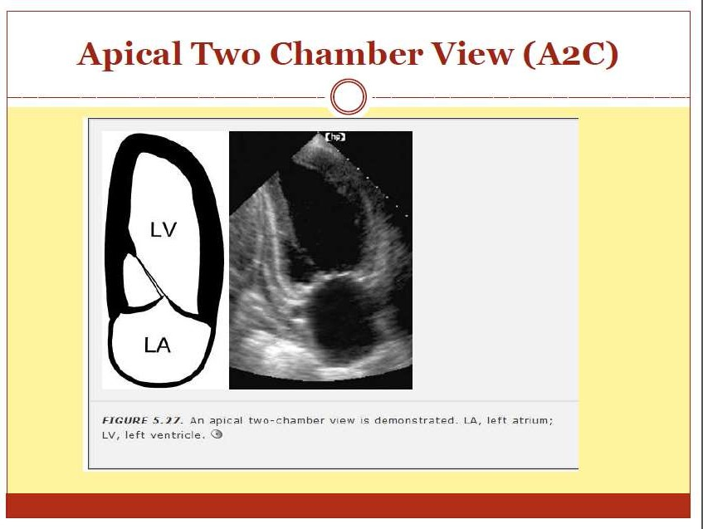

Slide 37

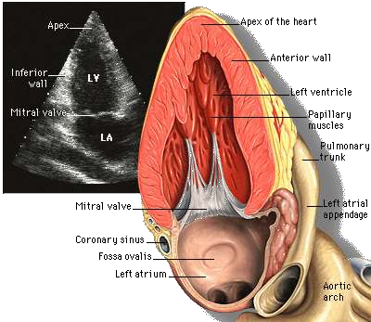
Apical 2-Chamber View (AP2CH)

Slide 38

3. Sub–Costal 4 Chamber View(SC4CH)
Transducer position: under the xiphisternum Marker dot position: points towards left shoulder
The subject lies supine with head slightly low (no pillow). With feet on
the bed, the knees are slightly elevated
Better images are obtained with the abdomen relaxed and during inspiration
Interatrial septum, pericardial effusion, desc abdominal aorta
38

Slide 39

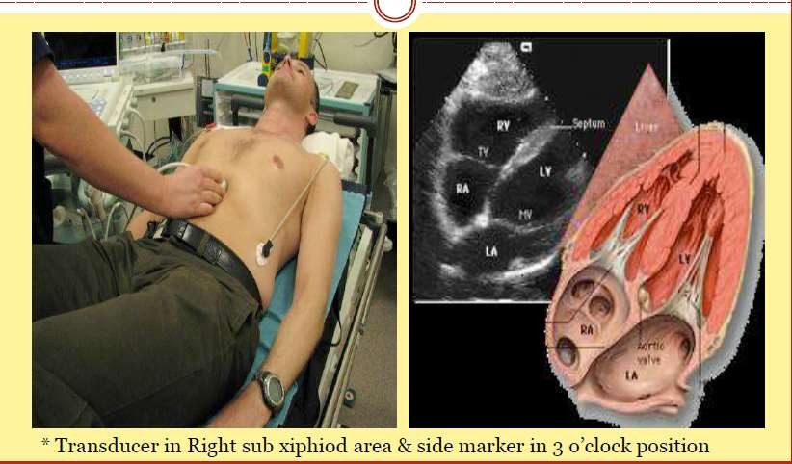

Slide 40

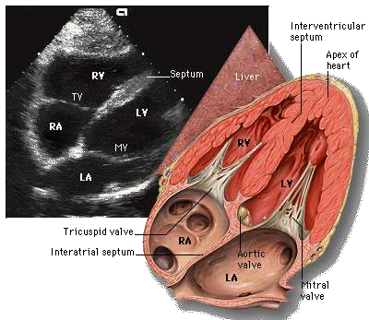
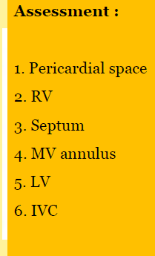
Sub–Costal 4 Chamber View(SC4CH)

Slide 41

4.Suprasternal View
Transducer position: suprasternal notch
Marker dot direction: points towards left jaw
The subject lies supine with the neck hyperexrended. The head is rotated slightly towards the left
The position of arms or legs and the phase of respiration have no bearing on this echo window
Arch of aorta
41

Slide 42


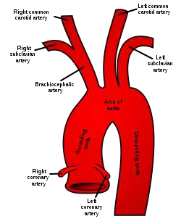

Slide 43

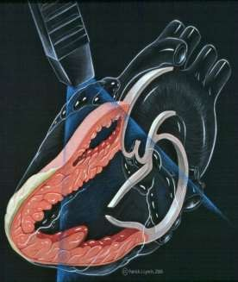
The Modalities of Echo
The following modalities of echo are used clinically:
Conventional echo
Two-Dimensional echo (2-D echo) Motion- mode echo (M-mode echo)
Doppler Echo
Continuous wave (CW) Doppler Pulsed wave (PW) Doppler Colour flow(CF) Doppler
All modalities follow the same principle of ultrasound
Differ in how reflected sound waves are collected
and analysed
43

Slide 44

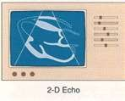
1. Two-Dimensional Echo (2-D echo)
This technique is used to "see" the actual structures and motion of the heart structures at work.
Ultrasound is transmitted along several scan lines(90-120), over a wide arc(about 90⁰) and many times per second.
The combination of reflected ultrasound signals builds up an image on the display screen.
A 2-D echo view appears cone shaped on the monitor.
44

Slide 45

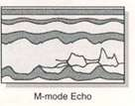
2. M-Mode echocardiography
An M- mode echocardiogram is not a "picture" of the heart, but rather a diagram that shows how the positions of its structures change during the course of the cardiac cycle.
M-mode recordings permit measurement of cardiac dimensions and motion patterns.
Also facilitate analysis of time relationships with other physiological variables such as ECG, and heart sounds.
45

Slide 46

Modes of ECHO
A mode: basic mode - single scan line is passed through heart
B mode: repetative scan lines
M mode: movement of the heart can be obtained as a time- motion or M mode recording providing dynamic cardiac images.
2D echo: acquires multiple B mode scan lines that are alligned in the appropriate anatomic location to form a wedge shaped sector image that provides additional spatial information in either superoinferior or mediolateral directions.

Slide 47

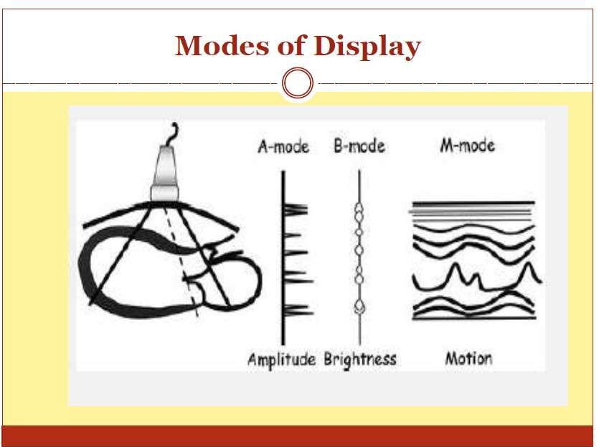

Slide 48

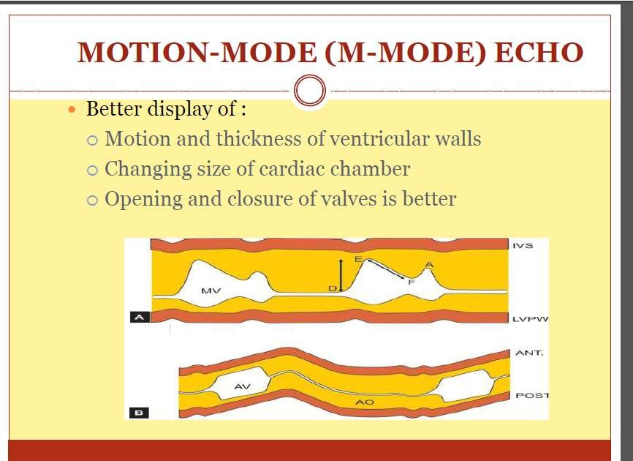

Slide 49

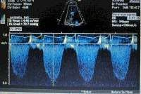
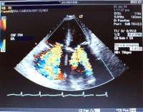
3. Doppler echocardiography
Doppler echocardiography is a method for detecting the direction and velocity of moving blood within the heart.
Pulsed Wave (PW) useful for low velocity flow e.g. MV flow
Continuous Wave (CW) useful for high
velocity flow e.g aortic stenosis
Color Flow (CF) Different colors are used to designate the direction of blood flow. red is flow toward, and blue is flow away from the transducer with turbulent flow shown as a mosaic pattern.
49

Slide 50

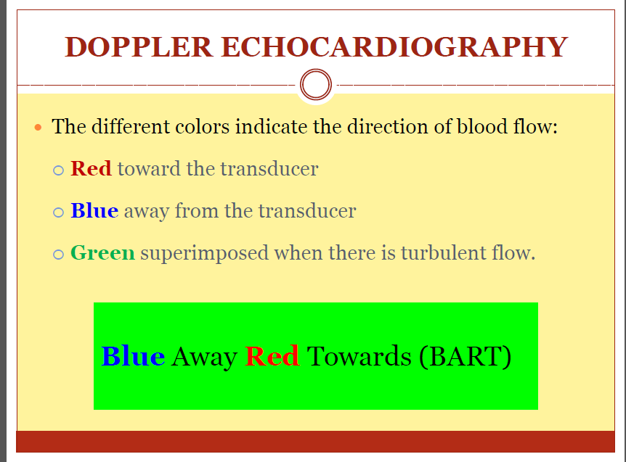

Slide 51

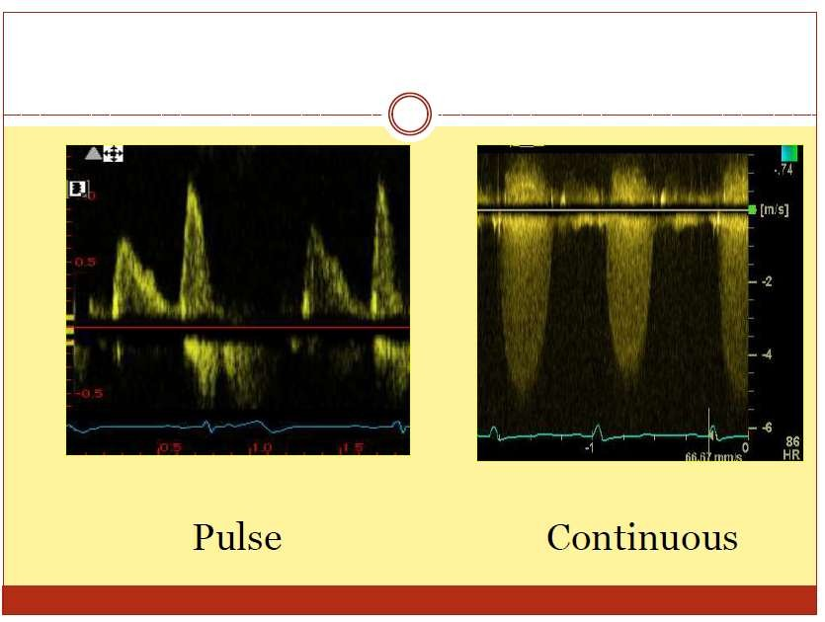

Slide 52



Slide 53

Transesophageal echocardiogram (TEE)
Used to assess posterior structures likeLA or Aorta Clinical success of transesophageal echocardiography:-
First, the close proximity of the esophagus to the posterior wall of the heart makes this approach ideal for examining several important structures.
Second, the ability to position the transducer in the esophagus or stomach for extended periods provides an opportunity to monitor the heart over time, such as during cardiac surgery.
Third, although more invasive than other forms of echocardiography, the technique has proven to be extremely safe and well tolerated so that it can be performed in critically ill patients and very small infants.
53

Slide 54



Slide 55

Contraindications to Transesophageal Echocardiography
Esophageal pathology Severe dysphagia Esophageal stricture Esophageal diverticul Bleeding esophageal varices
Esophageal cancer
Cervical spine disorders
Severe atlantoaxial joint disorders
Orthopedic conditions that prevent neck flexion

Slide 56

Epicardial Imaging
Application of an ultrasound probe directly to the cardiac structures provides a high-resolution, non obstructive view of cardiac structures.
Because these probes are placed directly on the beating heart or vasculature, they must be either sterilized or more commonly placed in a sterile insulating sheath before use.

Slide 57

Intracardiac Echocardiography
Intracardiac echocardiography involves a single-plane, high- frequency transducer (typically 10 MHz) on the tip of a steerable intravascular catheter, typically 9 to 13 French in size.
Intravascular Ultrasound (IVUS)
these are ultraminiaturized ultrasound transducers mounted on modified intracoronary catheters. Both phased-array and mechanical rotational devices have been developed. These devices operate at frequencies of 10 to 30 MHz and provide circumferential 360-degree imaging.

Slide 58




STRESS ECHO
Stress echo is a family of examinations in which 2D echocardiographic monitoring is undertaken before , during & after cardiovascular stress
Cardiovascular stress → exercise
→pharmacological agents

Slide 59

BASIC PRINCIPLES OF STRESS ECHO
↑ Cardiac work load - ↑O2 demands- demand supply mismatch- ischemia
Impairment of myocardial thickening and endocardial motion

Slide 60



Slide 61


Conclusion
Echocardiography provides a substantial amount of structural and functional information about the heart.
Still frames provide anatomical detail.
Dynamic images tell us about physiological function
The quality of an echo is highly operator dependent and proportional to experience and skill, therefore the value of information derived depends heavily upon who has performed it

Slide 62

THANK YOU

Slide 63


Slide 64



Slide 65

Indications for Echo
Assessment of LV function
  Most common reason an echo is ordered
  Most useful measurement is Ejection Fraction
    Difference in LV volume at end-systole and end-diastole
    Normal range is 55%-65%
  Wall motion abnomalities (WMA) can be described
    Hypokinesis- LV contraction is diminished
    Akinesis- no contraction
    Dyskinesis- uncoordinated contraction

Slide 66

Murmurs
  Abnormal heart sounds caused by abnormal blood flow through the heart
    Valvular heart disease
    Increased flow across normal valve
    Shunts due to congenital or acquired defects
    Tumors
Aortic Valve Disease
  Aortic Stenosis
    Assess valve opening and mobility of cusps
      Note presence of calcium or thickening
    Measure velocity of blood flow across valve
    Calculate valve area
  Aortic Regurgitation
    Assessed using Doppler

Slide 67

Mitral Valve Disease
  Mitral Regurgitation
    Assess closure of valve leaflets
    Assess with Doppler
  Mitral Stenosis
    Caused by rheumatic heart disease
    Check for abnormal thickening and opening of leaflets
Atrial Fibrillation
  Can be related to valvular disease, CAD, diastolic dysfunction, or
cardiomyopathy
  Echos can assess any underlying problems and guide treatment
  Best to control rate before study
  Patients with major structural abnormalities, significant LV systolic dysfunction, or LA diameter >4.5 cm are less likely to maintain SR after CV

Slide 68

Stroke/TIA
  Up to 20% of CVA’s may be caused by cardiac emboli
  TTE rarely shows a direct source of emboli (such as thrombus, vegetations, or tumors)
  Shows abnormalities which predispose a patient to embolization (such as MV disease, PFO, or LV aneurysm)
  TEE is an effective screening tool to detect LAA thrombus before CV of AF and AF ablation procedures
Infective Endocarditis
  Bacterial infection of heart valves
    Established bacteria is called a vegetation
  Damaged and abnormal valves are at higher risk
  Acute (staph) versus subacute (strep)
  Symptoms: fever, murmur, emboli, stroke
  IV drug abuse can increase risk of bacterial endocarditis
  Can also be used in setting of suspected device system infection

Slide 69

Assessment of Artificial Valves
  Can be used for tissue and mechanical valves
  Check for regurgitation and leaking of blood around
valve annulus
  Check velocity of blood flow through the valve

Slide 70

Assessment of Artificial Valves
  Can be used for tissue and mechanical valves
  Check for regurgitation and leaking of blood around
valve annulus
  Check velocity of blood flow through the valve

Slide 71


