Slide 1
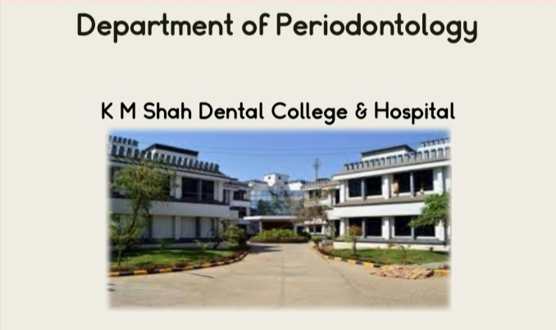




Slide 2
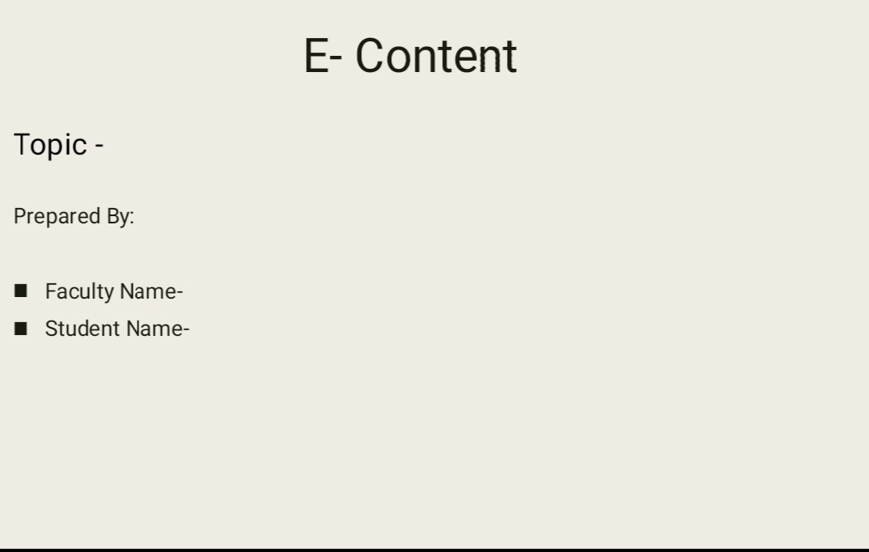
Gingival Inflammation
Dr. Jasuma Rai
Kenik Gohel Intern (2021/2022)

Slide 3
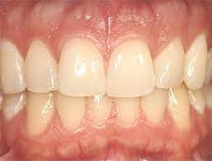
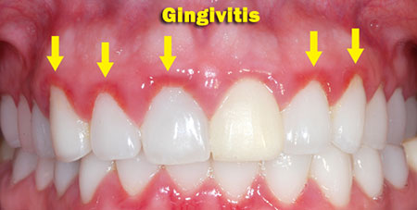
INTRODUCTION
Gingivitis means inflammation o gum or gingiva.
It commonly occurs because a film of plaque or bacteria, accumulates on the teeth. Gingivitis is a non destructive type of periodontal disease, but untreated gingivitis can progress to periodontitis. This is more serious & can eventually lead to loss of teeth.

Slide 4
Stage I Gingivitis (Initial lesion)
Stage II Gingivitis (Early lesion)
Stage III Gingivitis (Established lesion)
Stage IV Gingivitis(Advanced lesion)

Slide 5
STAGE I GINGIVITIS (INITIAL LESION) :
First manifestation Vascular changes
Dilated capillaries Blood flow increased
Initial inflammatory changes due to microbial activation of resident leukocytes & subsequent stimulation of endothelial cells
Subclinical gingivitis

Slide 6
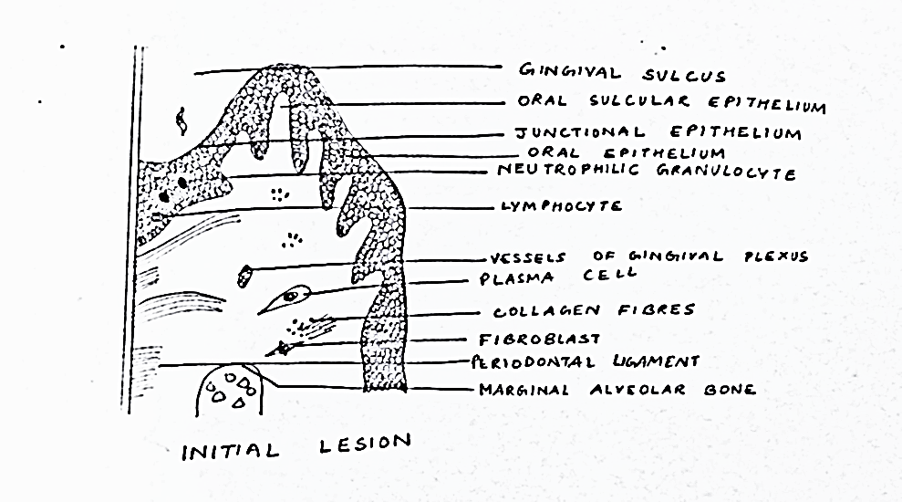
STAGE I GINGIVITIS (INITIAL LESION) Contd… :
Microscopically:
-widening of small capillaries/venules
-adherence of neutrophils to vessel wall (margination)-1wk/early as 2 days after plaque accumulation
-PMNs (diapedesis , emigration) – CT, JE & GS
-Exudation of fluid from GS & extravascular protein are present

Slide 7
STAGE II GINGIVITIS (EARLY LESION) :
Evolves from the initial lesion
After 1wk of plaque accumulation
Erythema
Bleeding on Probing
Gingival fluid flow
Transmigrating leukocyte maximum – 6 &12 days

Slide 8
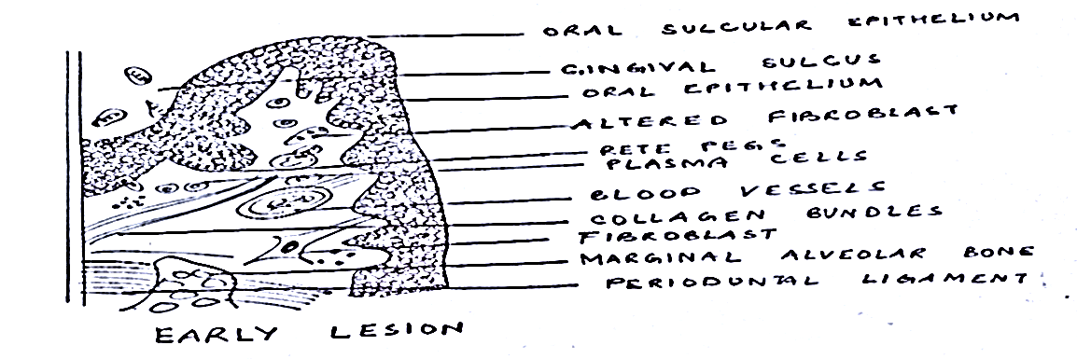
STAGE II GINGIVITIS (EARLY LESION)Contd… :
Microscopic examination:
Leucocyte (mainly Lymphocyte-75% T Cells)
infiltrate in CT below JE
Some neutrophils, macrophages,
plasma cells & mast cells.
JE densely infilterated with neutrophils
& show development of rete pegs/ridges.

Slide 9
STAGE II GINGIVITIS (EARLY LESION)Contd. :
70% collagen destruction around cellular infilterate
Circular & Dentogingival group fibers mostly affected
PMNs reach in to pocket (chemotactic stimuli)
PMNs-phagocytosis (release of lysosomes to engulf bacteria)
MMPs-extracellular matrix remodeling (7days)

Slide 10
STAGE III GINGIVITIS (ESTABLISHED LESION) :
2/3 week after accumulation of plaque
Predominance of plasma cells & B lymphocyte
Creation of small gingival pocket lined with pocket epithelium
B cells predominantly IgG1& IgG3 subclasses
Vessels engorged, congested & venous return impaired & blood flow sluggish
Result localized gingival anoxemia-bluish hue on the reddened gingiva

Slide 11
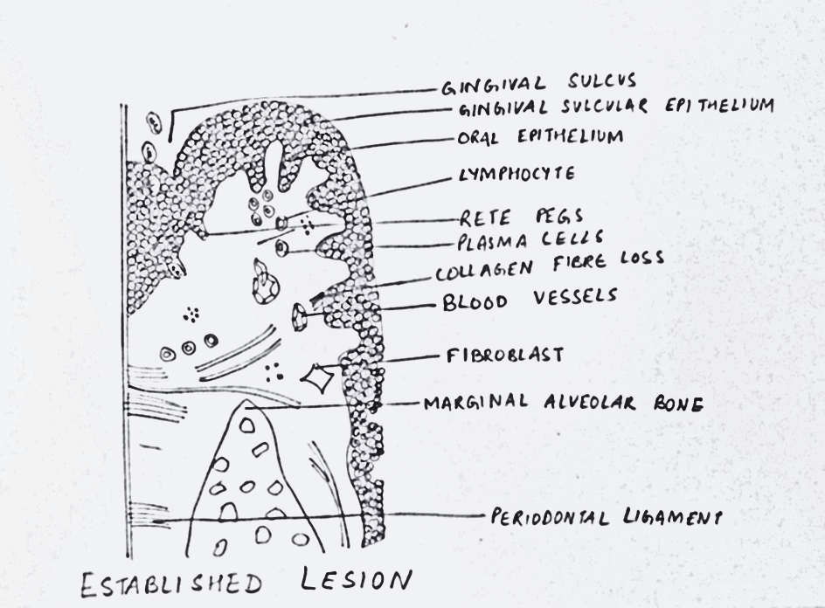
STAGE III GINGIVITIS (ESTABLISHED LESION contd.. :
Extravasation of erythrocyte in to CT & breakdown in to component pigments can deepen the color of inflamed gingiva
Collagenolytic activity increased in inflamed gingival tissue
Increase level of ALP, β-glucuronidase, glactosidase, glucocidase, esterase, aminopeptidase & cytochrome oxidase
Decreased neutral mucopolysaccharide

Slide 12
STAGE III GINGIVITIS (ESTABLISHED LESION contd.. :
Microscopically:
Increased number of Plasma cells
Junctional epithelium widened intercellular spaces & granular cellular debris including lysosomes
Junctional epithelium develop ridges/rete pegs protrudes in CT
Collagen fibers destroyed
This lesion is reversible after successful Periodontal therapy

Slide 13
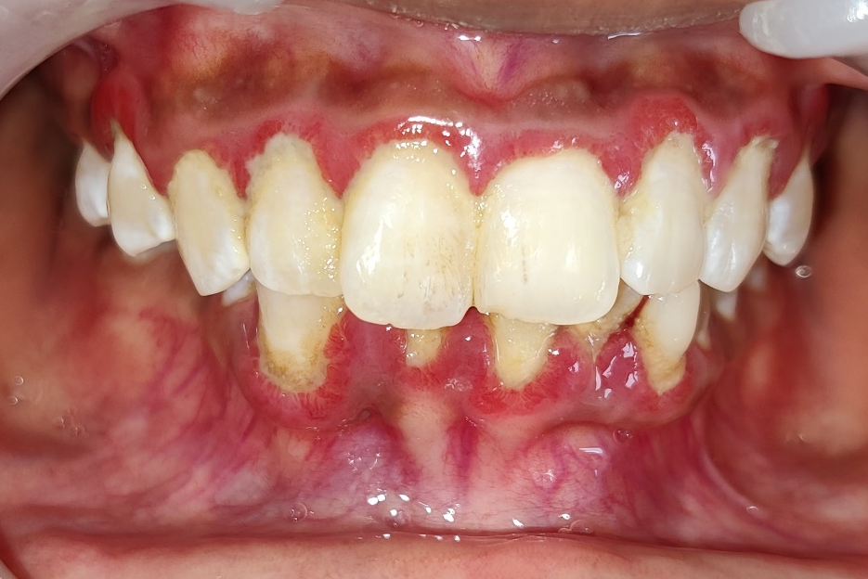
STAGE IV GINGIVITIS (ADVANCED LESION):
Phase of periodontal breakdown
Extension of lesion into alveolar bone
Higher IL-1β & lower IL-8 at 28days
Microscopic:
-fibrosis of gingiva
-widespread manifestation of inflammatory and immunologic tissue
damage
-plasma cell dominates in CT
-neutrophils dominates JE

Slide 14
Stages | Time (days) | Blood vessels | JE & SE | Predominent cell | Collagen | Clinical Features
Initial lesion | 2-4 | vasculitis | PMNs | PMNs | Perivascular loss | GCF flow
Early lesion | 4-7 | Vascular proliferation | Same as stage I retepegs | Lymphocyte | Loss around infiltrate | Erythema BOP
Established lesion | 14-21 | As stage II +Blood stasis | As stage II +more advanced | Plasma cells | Continued loss | Changes in color, size & texture etc

Slide 15
Conclusion:
Gingival inflammation is highly prevalent. Most population presented moderate Gingivitis.
Gingivitis can be reduced /prevented with the Awareness of good oral hygiene practice, use of mouthwash and interdental cleansing aids like Flossing and interdental brushes.

Slide 16
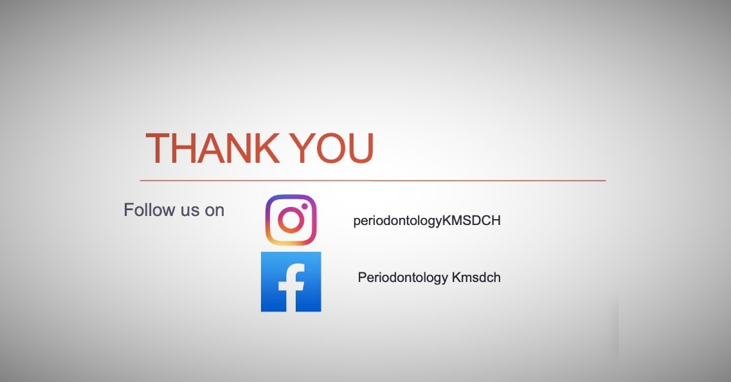

Slide 17
REFERENCES
Carranza’s Clinical Periodontology 11th Edition
Carranza’s Clinical Periodontology 12th Edition

