Slide 1
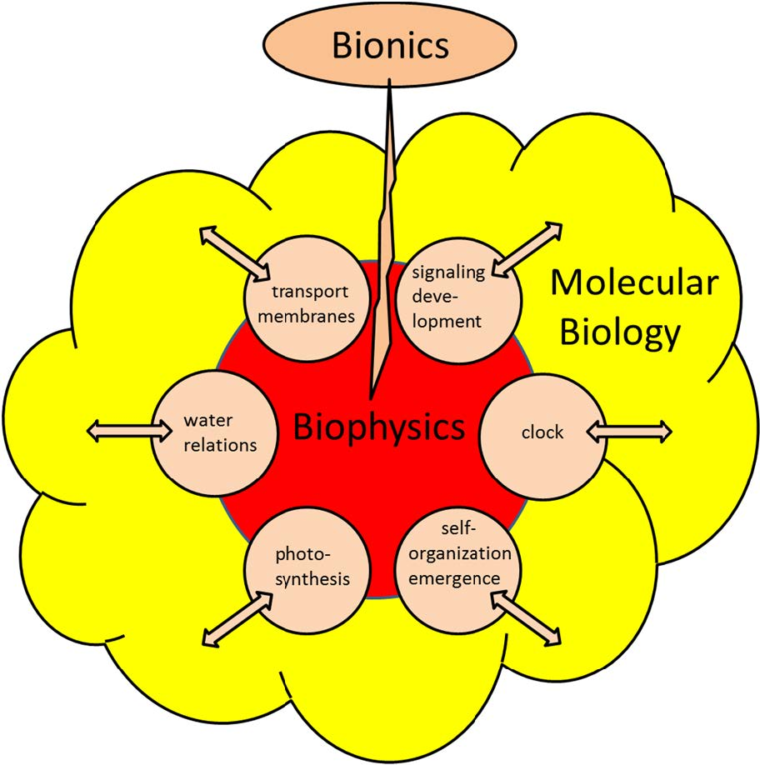
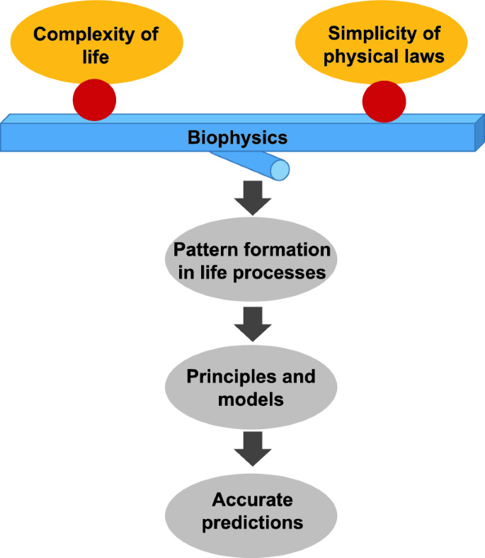

Biophysics
Dr. Navneet Kumar Singh
Associate Professor
Department of Paramedical Sciences
Sumandeep Vidyapeeth Deemed to be University
Waghodia,Vadodara

Slide 2
Learning Objectives
Diffusion
Osmosis
Osmotic Pressure and osmolality.
Dialysis
Viscosity
Surface tension
Colloids
Sedimentation

Slide 3
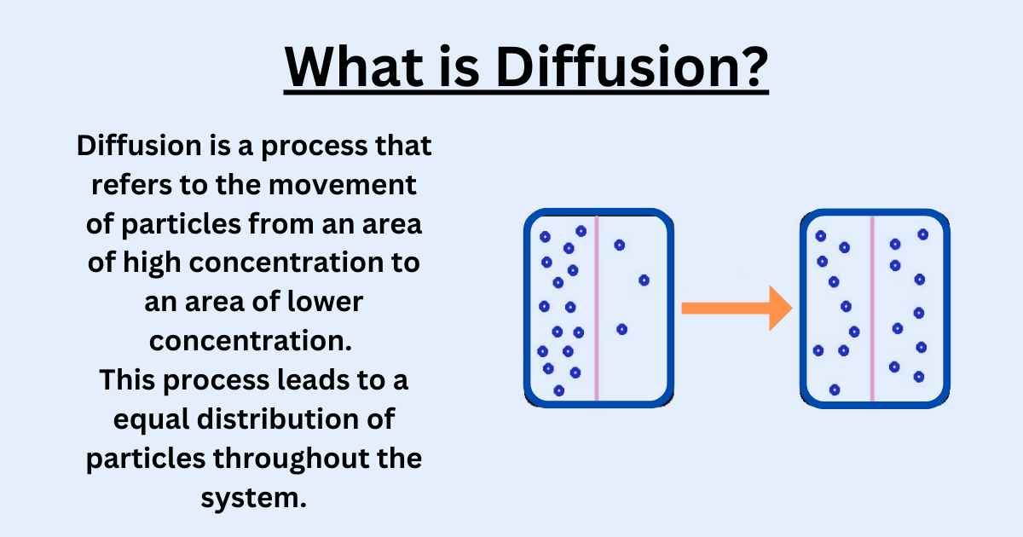

Slide 4
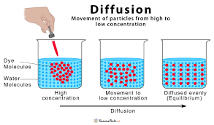
Example of diffusion

Slide 5
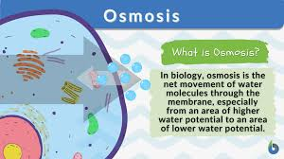
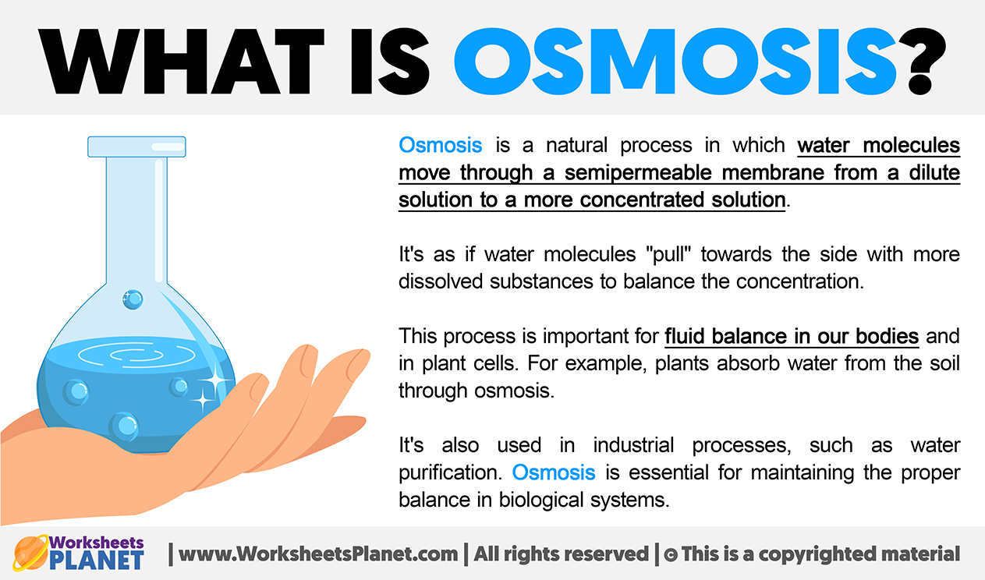
Osmosis

Slide 6
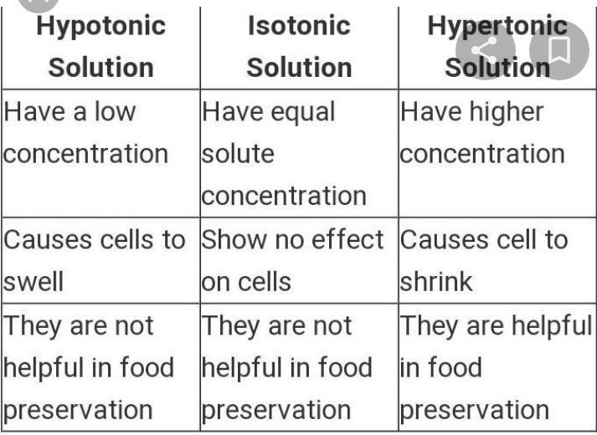
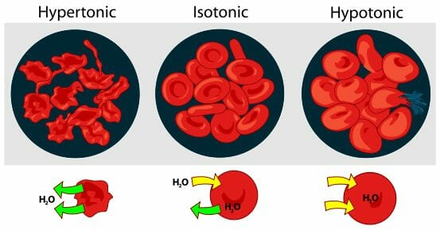
Examples of Osmosis

Slide 7
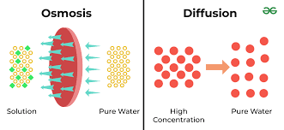
Difference between Diffusion and Osmosis

Slide 8
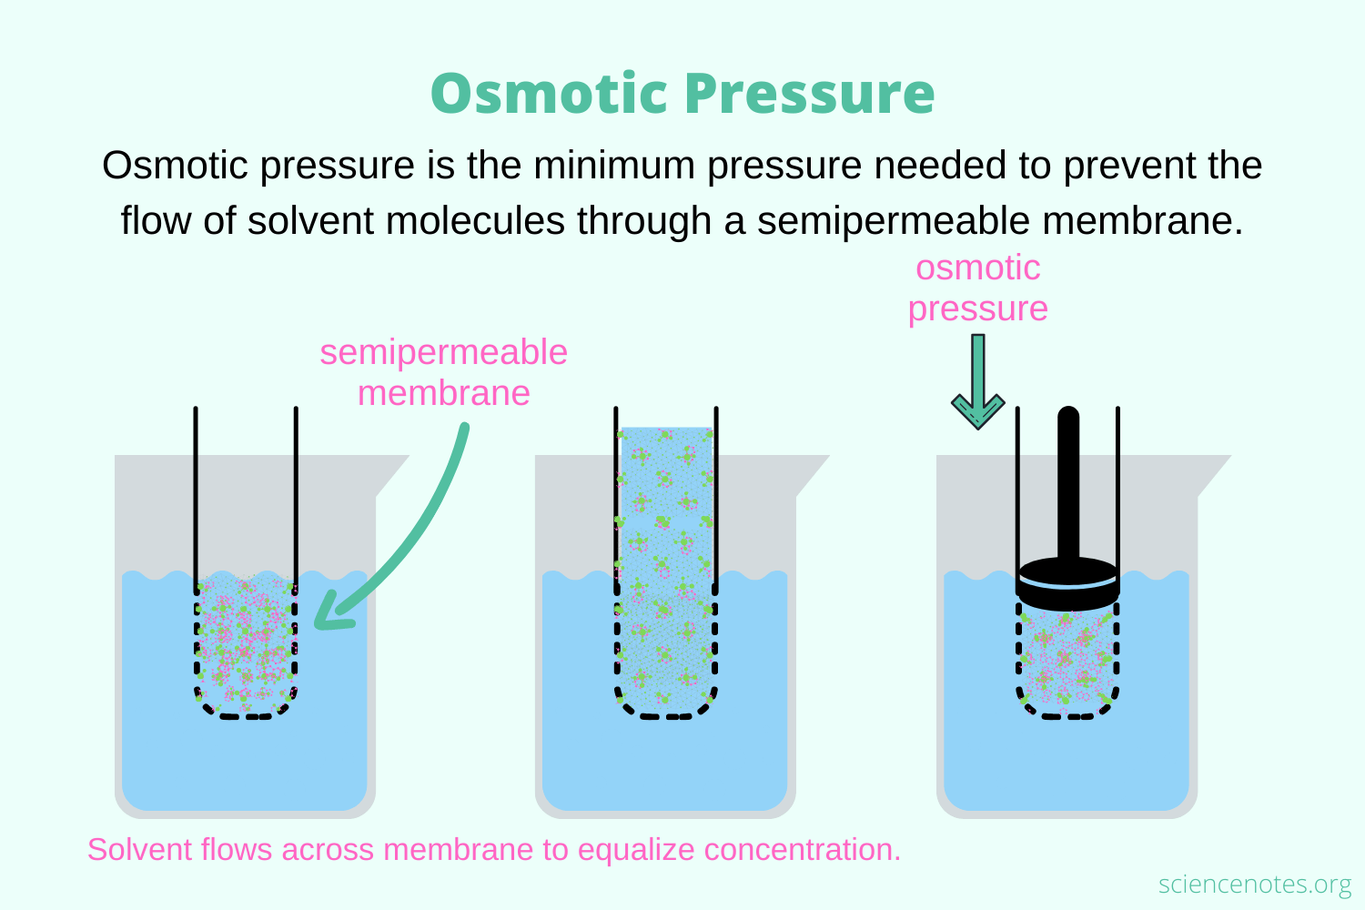

Slide 9
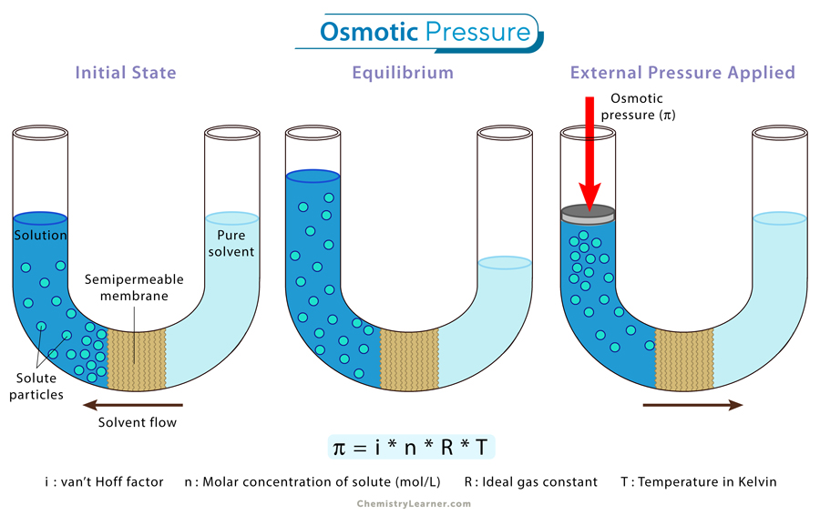

Slide 10
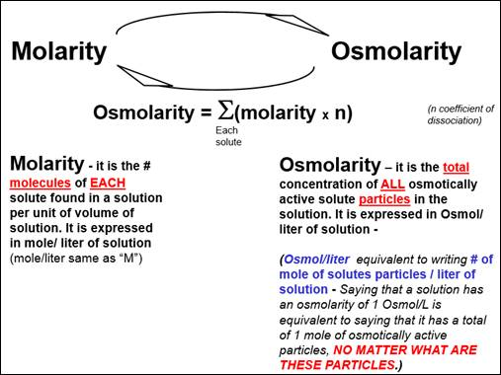
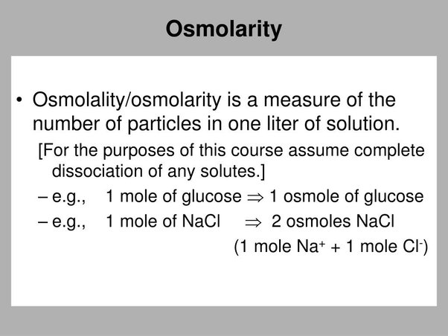

Slide 11
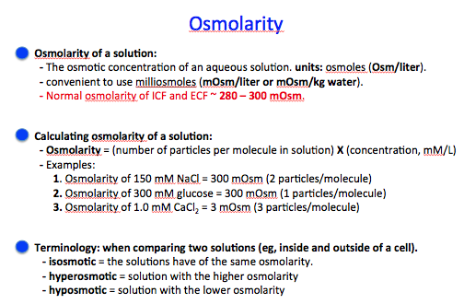

Slide 12
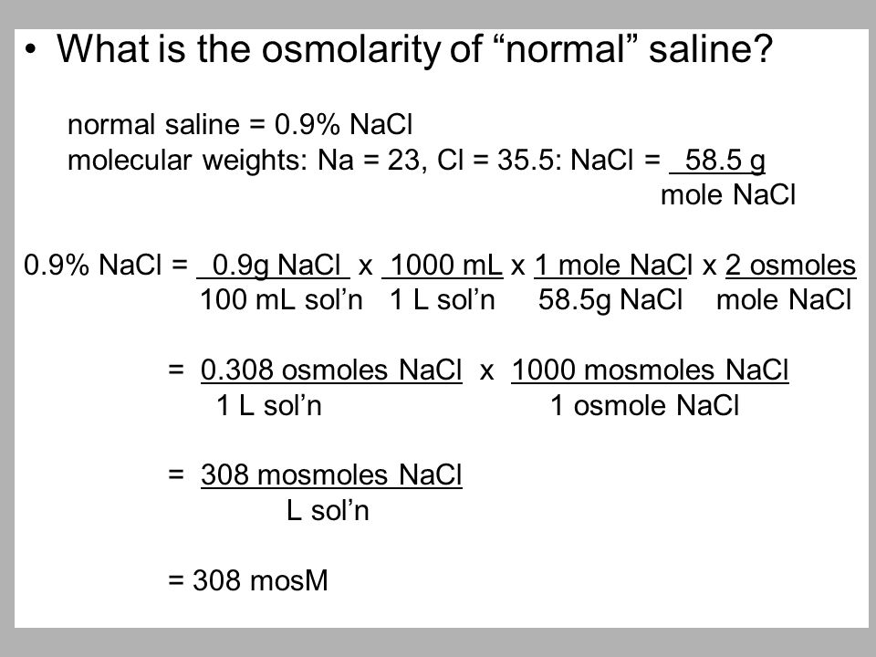

Slide 13
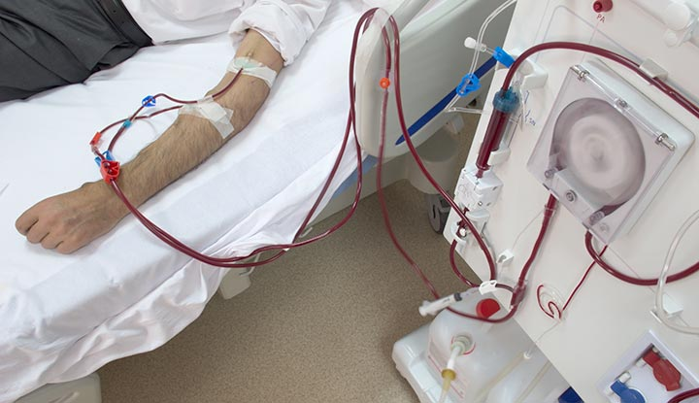
Dialysis

Slide 14
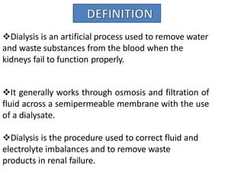
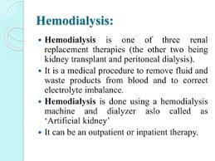
Dialysis

Slide 15
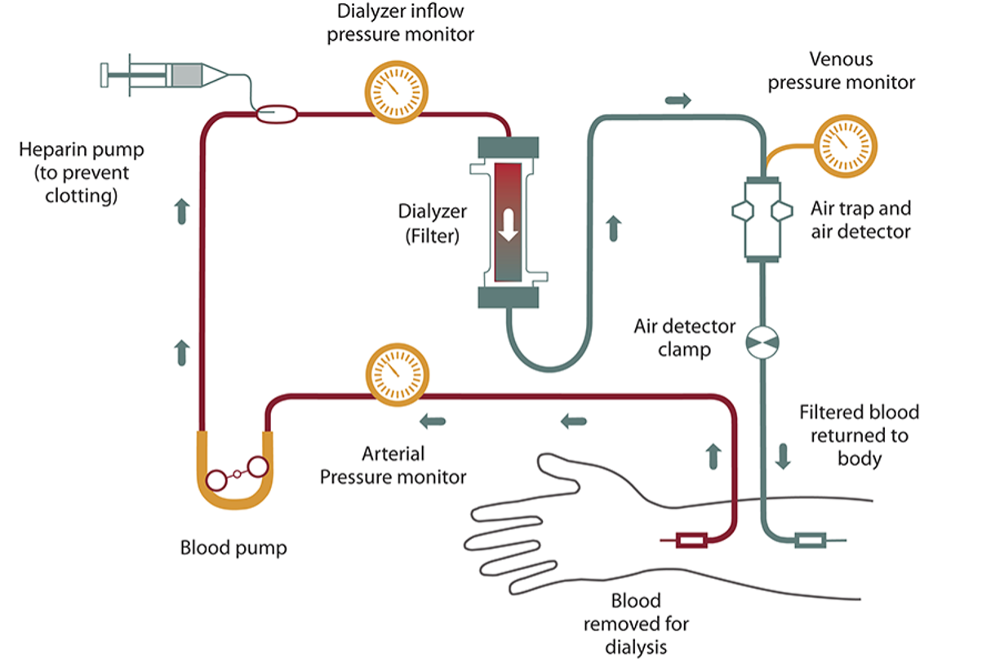

Slide 16
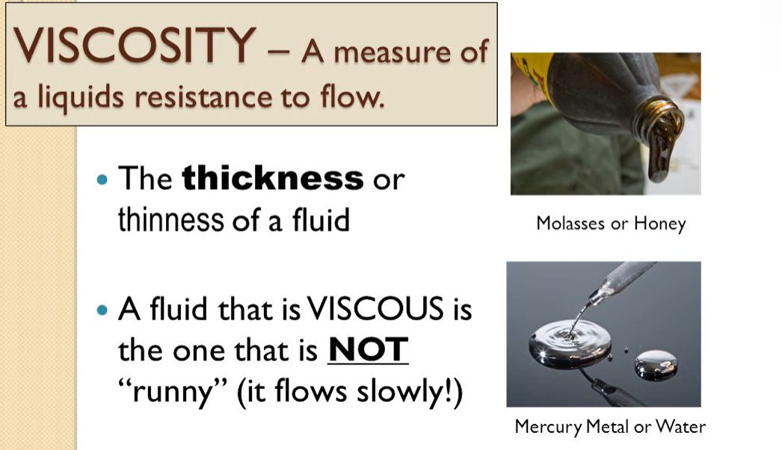

Slide 17
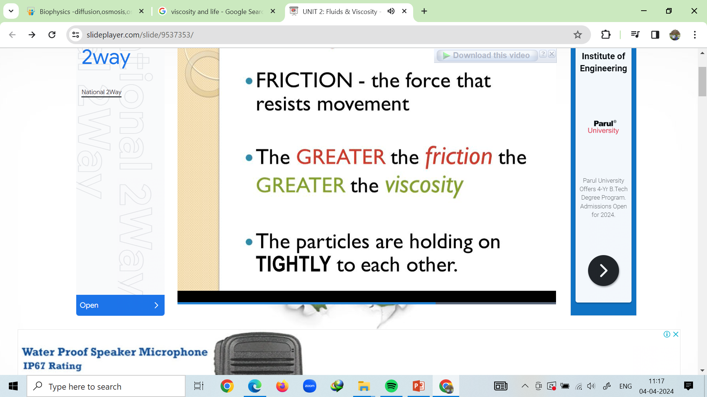
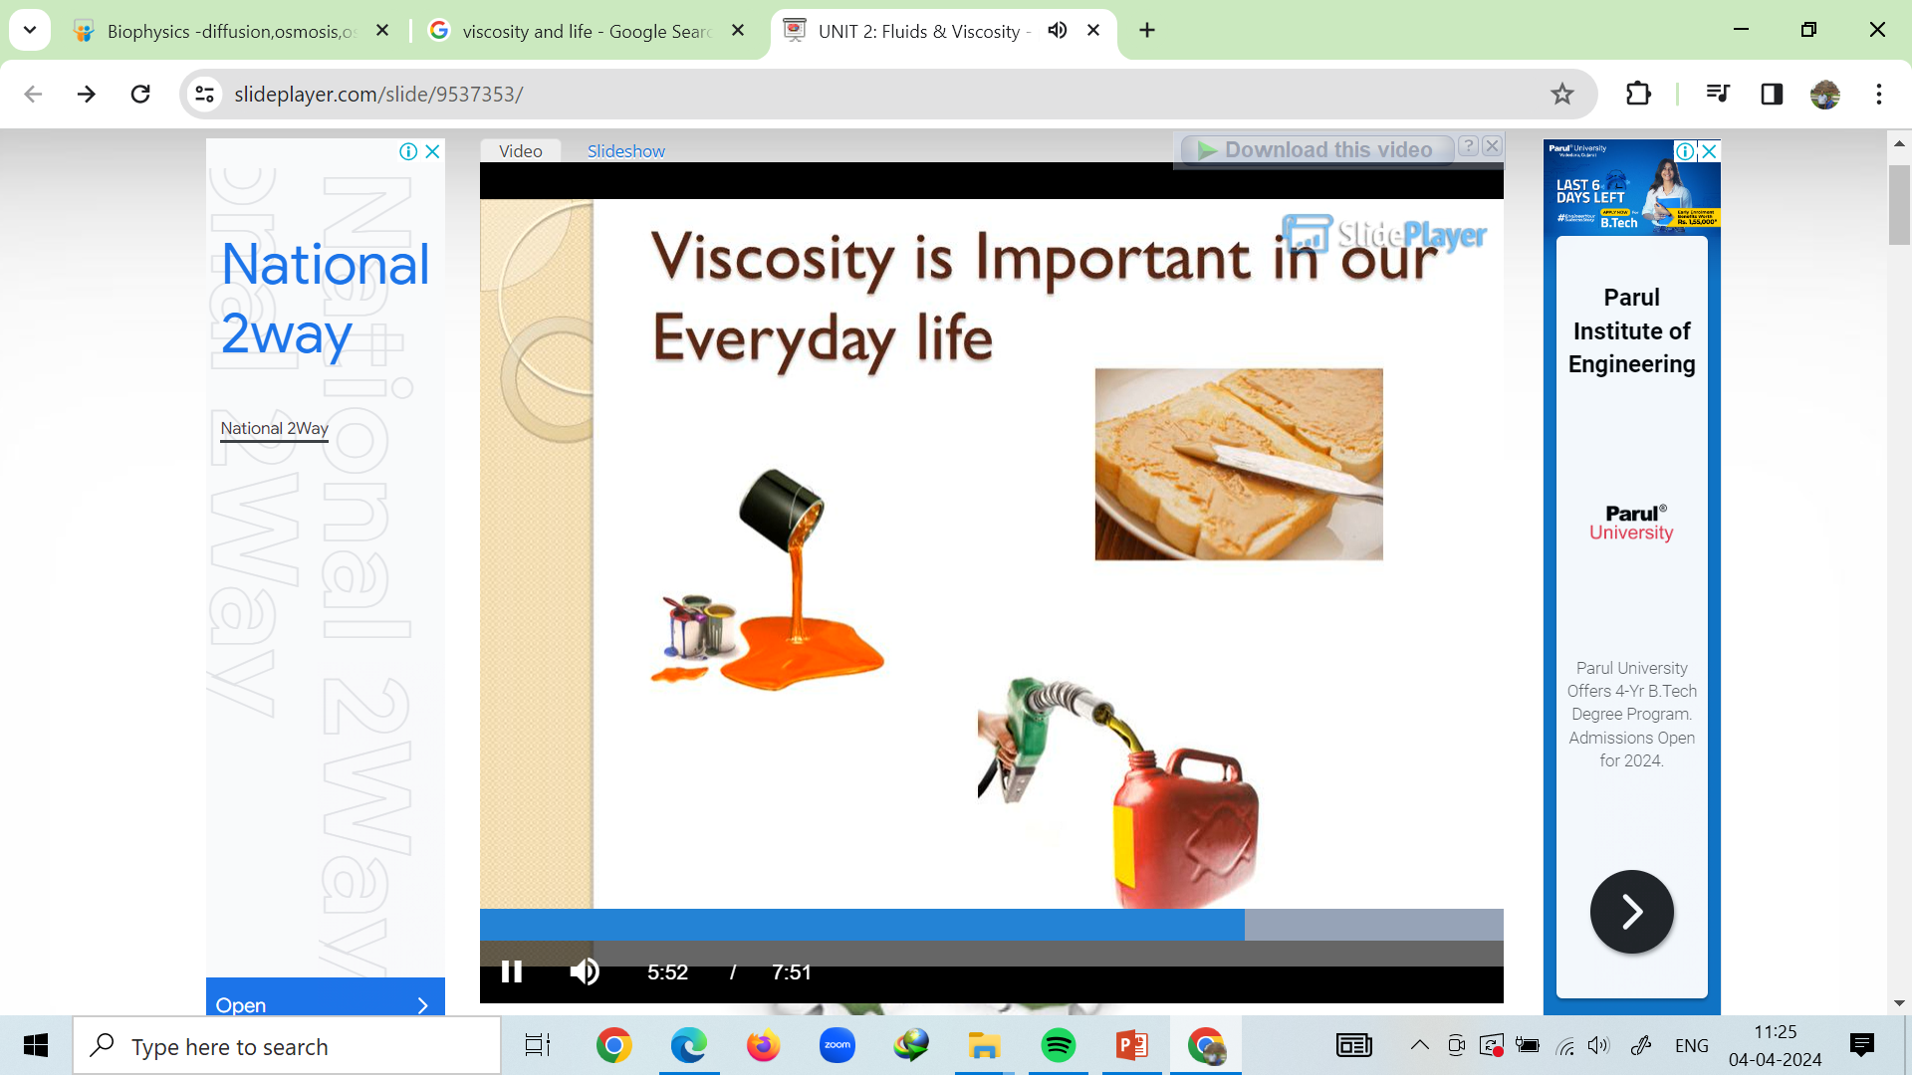
Importance of Viscosity

Slide 18
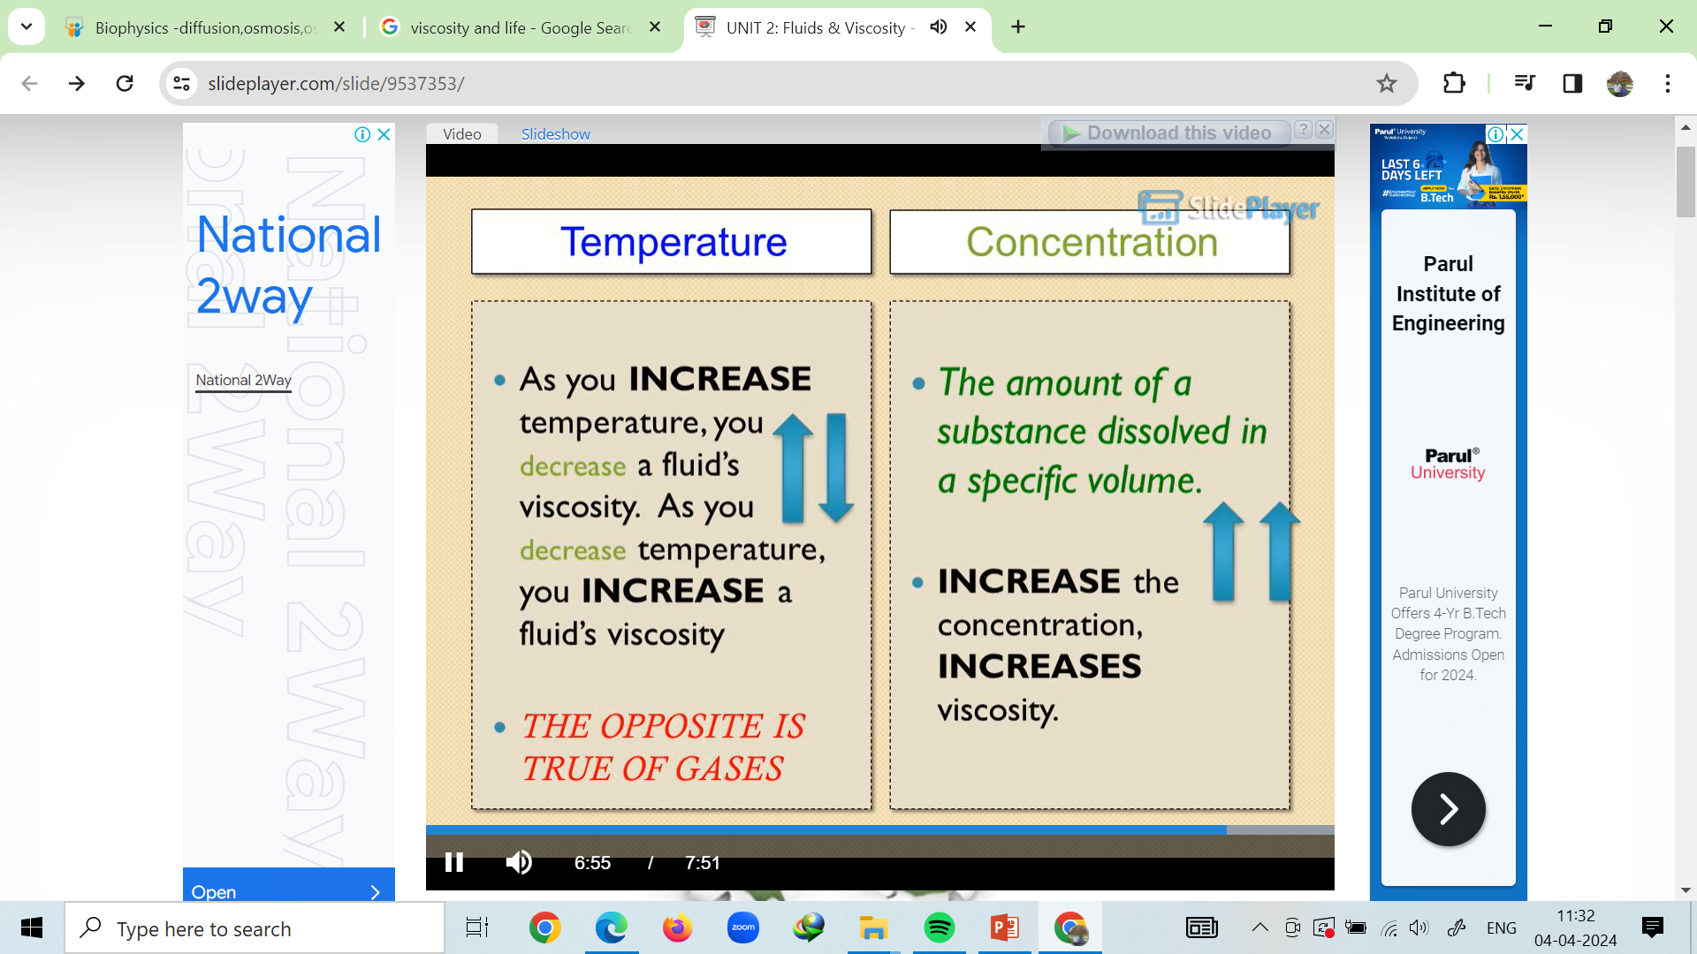
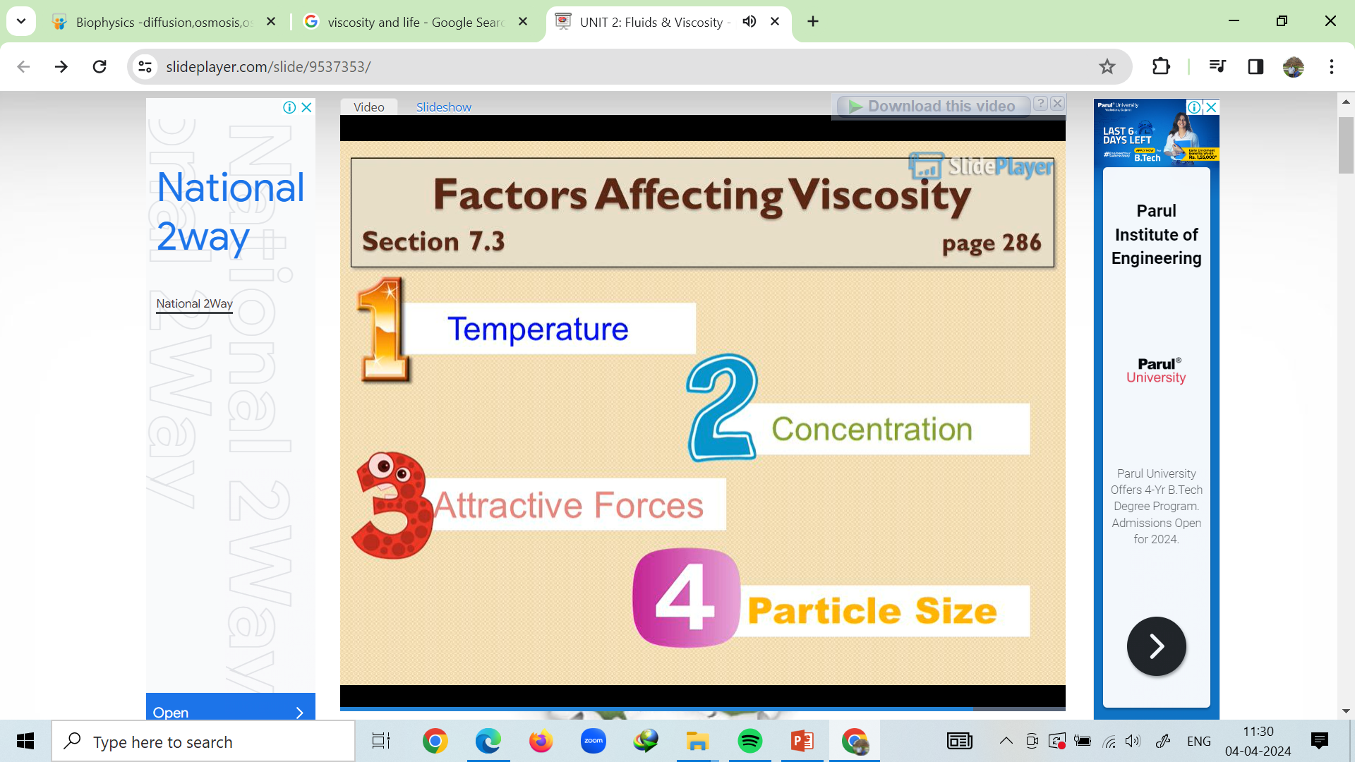
Factors affecting Viscosity

Slide 19
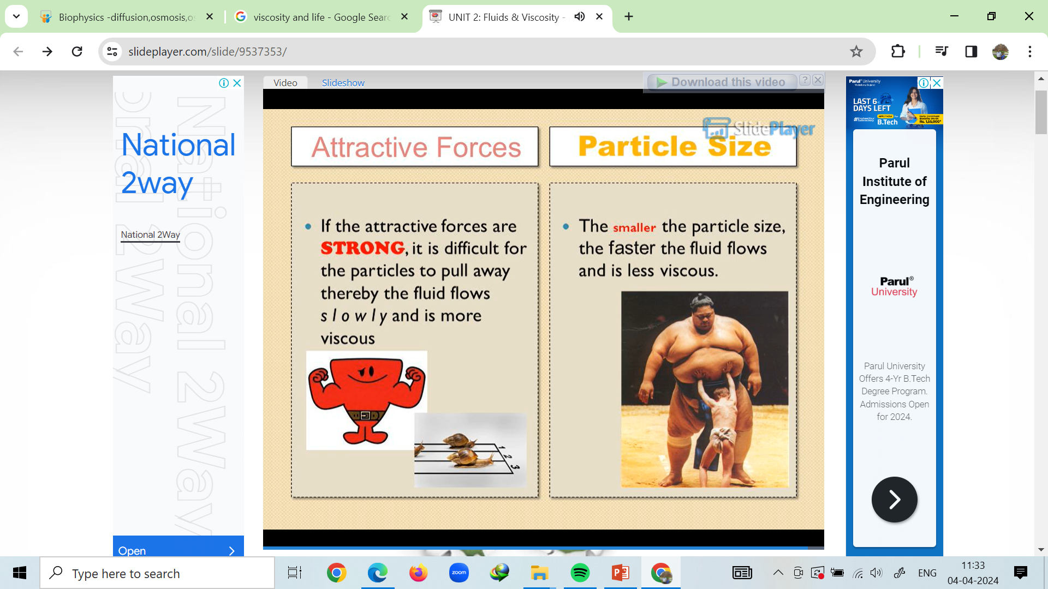
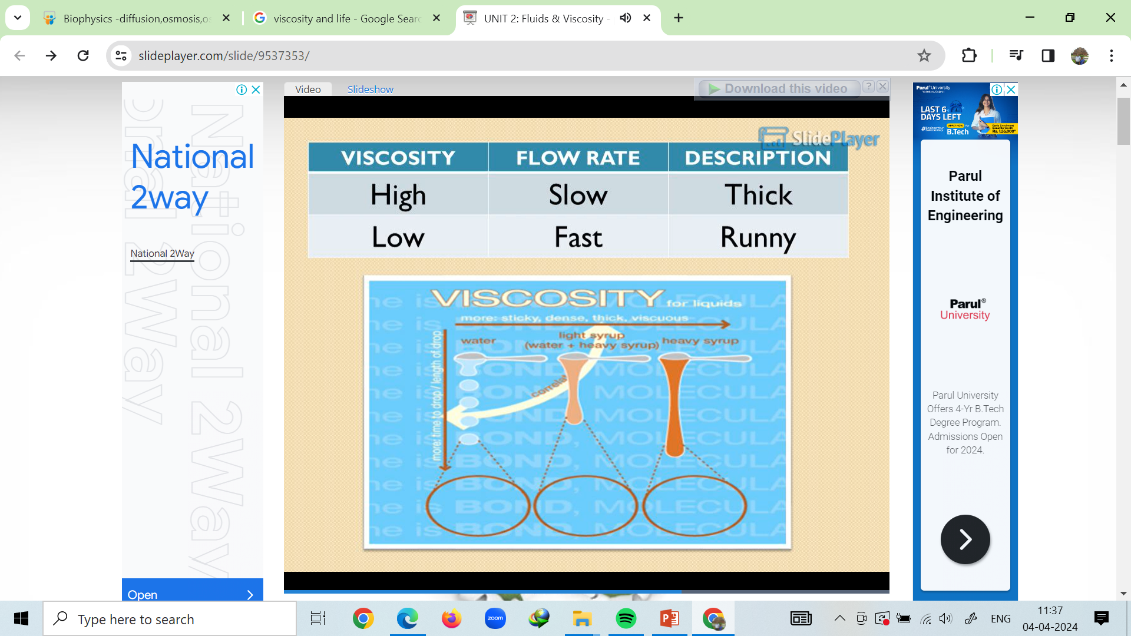
Factors affecting Viscosity

Slide 20
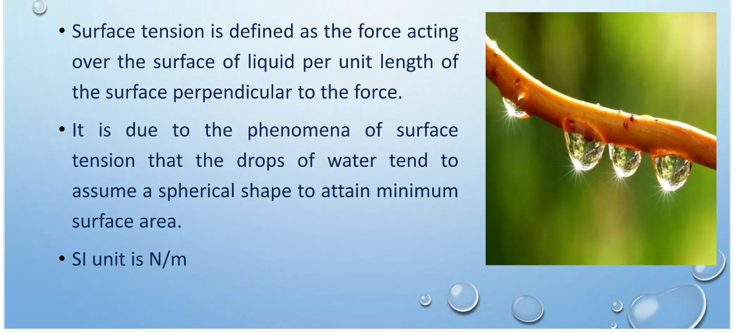
Surface Tension

Slide 21
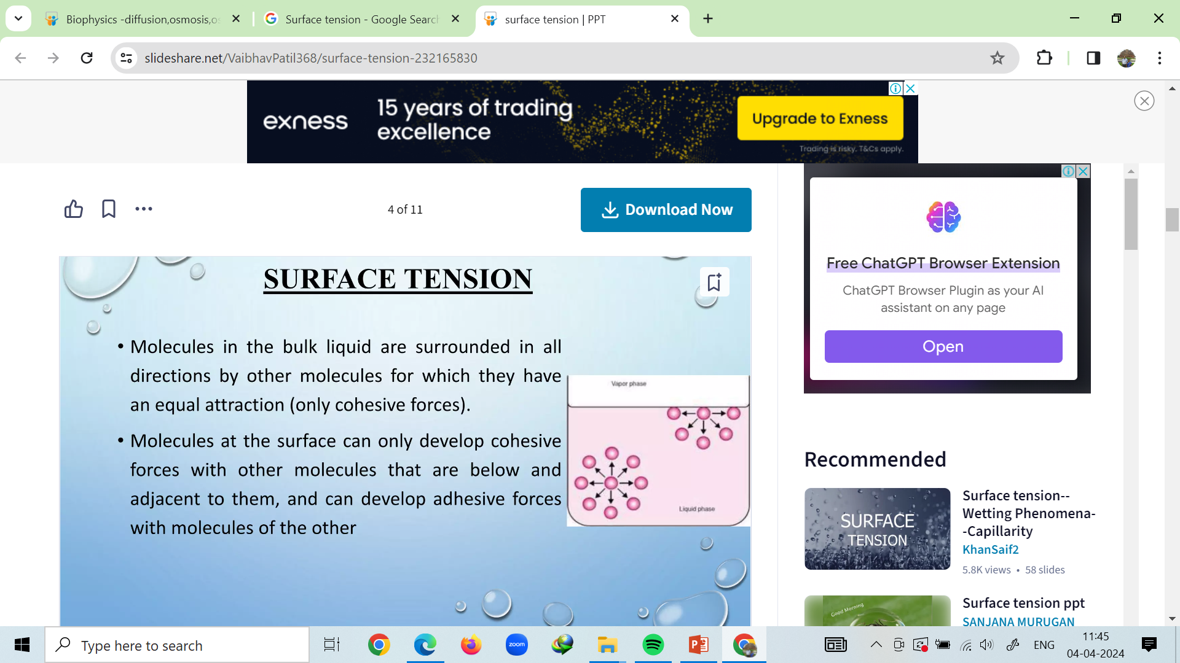
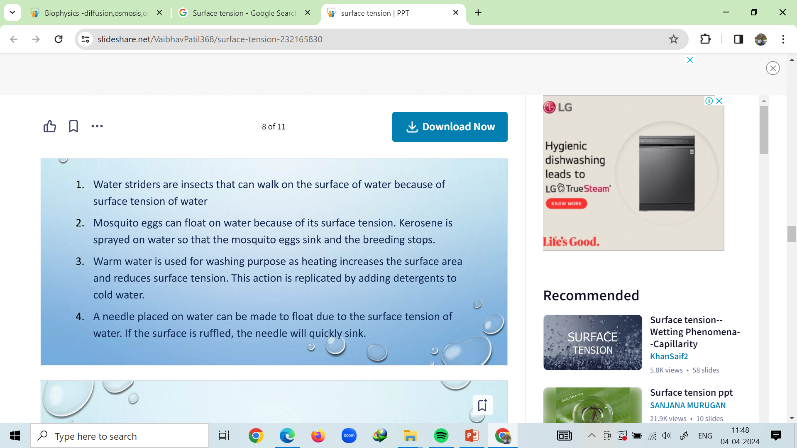
Surface tension
Examples

Slide 22
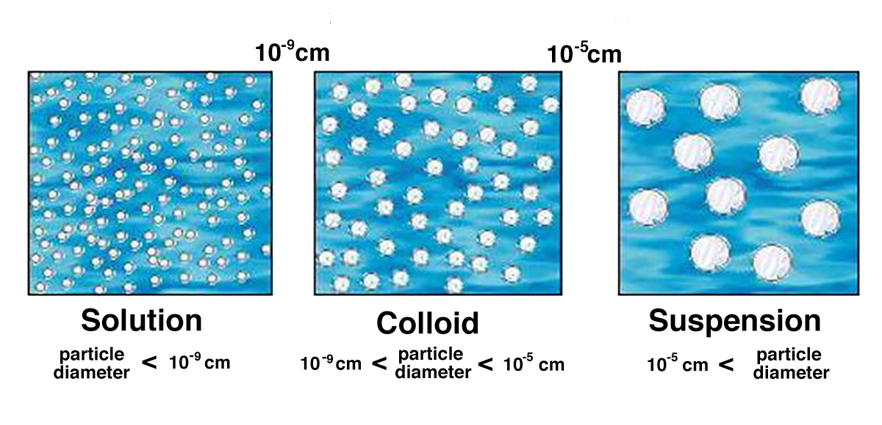
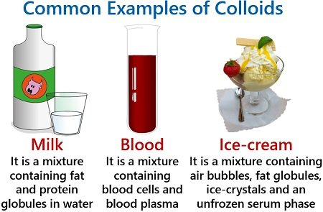
Colloid
A colloid is a mixture that has particles ranging between 1 and 1000 nanometers in diameter, yet are still able to remain evenly distributed throughout the solution.
These are also known as colloidal dispersions because the substances remain dispersed and do not settle to the bottom of the container.
A colloid has a dispersed phase (the suspended particles) and a continuous phase (the medium of suspension).
The dispersed phase particles have a diameter of approximately 1 nanometre to 1 micrometre

Slide 23
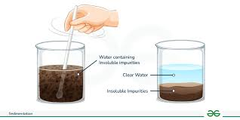
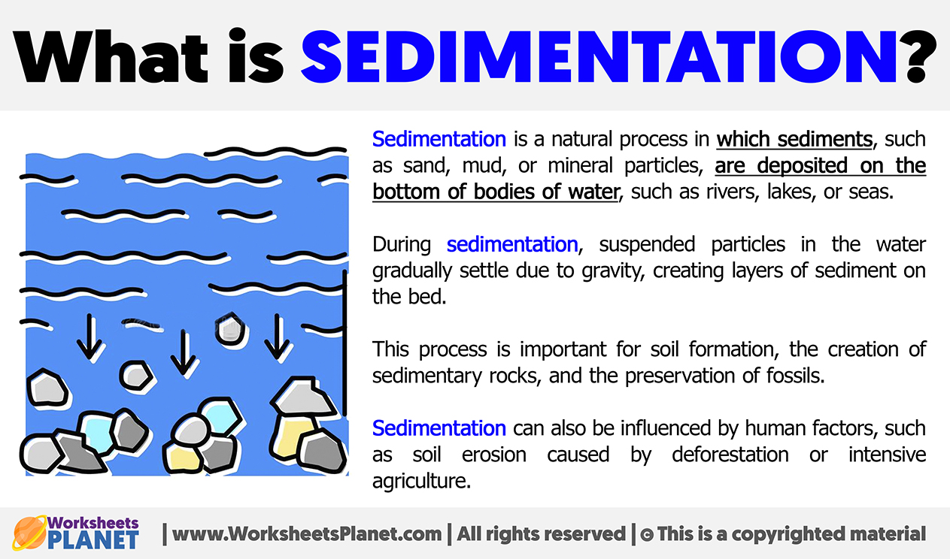
Sedimentation

Slide 24
