Slide 1

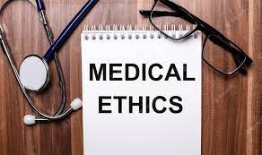
                Dr. Navneet Kumar Singh

Slide 2
Important terminologies
Etiquette
Consent,
Confidentiality,
Competence,
Negligence,
Malpraxis
Euthansia,

Slide 3

Ethics - signifies moral values
Medical ethics – moral principles for registered medical practitioners in their dealings with each other, their patients and state
Four basic principles of Ethics are,
Beneficence,
Nonmaleficence
Autonomy, and
Justice,

Slide 4


Medical ethics is concerned with the obligations of the doctors and the hospital to the patient along with other health professionals and society.

Slide 5
Medical etiquette
conventional laws, customs of courtesy and code of conduct for doctor with his colleagues
Difference between Ethics and Etiquette
Medical ethics tends to focus upon ensuring appropriate treatment of patient populations, whereas medical etiquette also prescribes standards of integrity for interactions among physicians and Healthcare team.

Slide 6
National medical commission
RECOGNITION OF MEDICAL QUALIFICATION
SUPERVISION OF UNDERGRADUATE MEDICAL
EDUCATION
SUPERVISION OF POST GRADUATE MEDICAL
EDUCATION
RECOGNITION OF FOREIGN MEDICAL
EDUCATION
DERECOGNITION
MEDICAL REGISTEaR
WARNING NOTICE
APPEAL AGAINST DISCIPLINARY ACTION

Slide 7
State medical council
Medical register
Disciplinary control
Warning notice
Professional death sentence

Slide 8
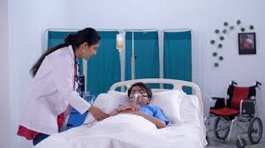
DUTIES OF MEDICAL PRACTITIONERS towards patient
Treatment of patient is implied contract
Duty to sick
Duty to continue treatment
Duty to earn confidence
Duty to children and infirm

Slide 9
Charge for professional service
Right to choose a patient
Duty to give proper directions
Duty to offer proper regime of treatment
Duty to notify communicable diseases
Examination and consent
Duty as regards result of examination

Slide 10

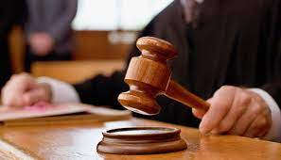
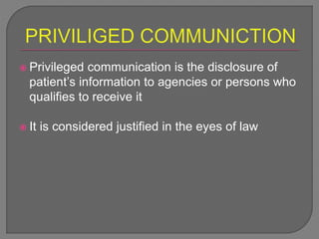
Professional secrecy & privileged communication

Slide 11

Conditions of privileged communication
1. Infectious diseases
2. Venereal diseases
3. Employers & employees
4. Notifiable diseases
5. Suspected crime
6. Patient’s own interest
7. In courts of law

Slide 12
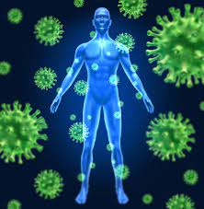
DUTIES OF MEDICAL PRACTITIONERS towards state
Notification of infectious diseases
Notice to police
Notification of births and deaths
Issuing of certificates
Respond to emergency military services

Slide 13
DUTIES OF MEDICAL PRACTITIONERS towards one another
1. Extend same honour, respect & good behavior as expected from them
2. Should not do or utter anything to lower down the name of colleagues
3. Should not entice patients away from colleagues
4. Free medical service to fellow colleagues

Slide 14
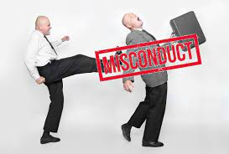
Professional misconduct
Conduct considered as disgraceful or dishonorable by professional breathern of good repute and competency
Issue of false medical certificates
Covering up unqualified persons
Helping quacks
Canvassing

Slide 15

To personally open chemist shop
To prescribe habit forming drugs
Disclosing professional secrets of patients
Failure to notify
Treating patients under the influence of drink or drugs
Fee splitting/dichotomy

Slide 16
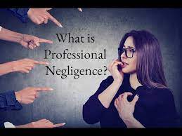
Professional Negligence
(malpraxis)
Negligence - doing something that one is not supposed to do, or failing to do something that he is supposed to do
Professional negligence - absence of reasonable care and skill, or wilful negligence of a medical practioner in the treatment of patient which causes bodily injury or death of patient

Slide 17
Civil negligence
Following conditions should be satisfied for proving liability of negligence-
1.Duty-existance of duty of care by the doctor
2.Dereliction-failure on the part of doctor to maintain applicable standard of care and skill
3.Direct causation- any damage was caused by breach of duty
4.Damage – lost wages, medical expenses and mental duress

Slide 18
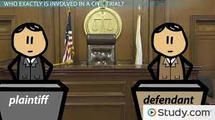
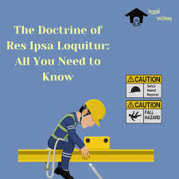
Res ipsa loquitur
“the thing or fact speaks for itself”
Elements
Injury could not have occurred without negligence
Defendant had full control over the agency/treatment causing injury
Plaintiff did not contribute to the injury

Slide 19
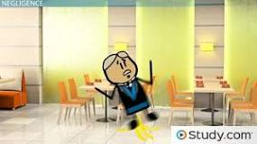
Defense to negligence
The defendant had a duty to the injured party.
The defendant failed to act on his duty.
The negligent act caused direct injury.
The injury should have been reasonably foreseeable.

Slide 20

Contributory negligence
Contributory negligence is a legal doctrine that prohibits victims from recovering compensation in a personal injury claim if they were even 1% responsible for their own injuries.
For example, a plaintiff who was driving 30 mph over the speed limit was hit by the defendant who turn sharply into their lane.

Slide 21
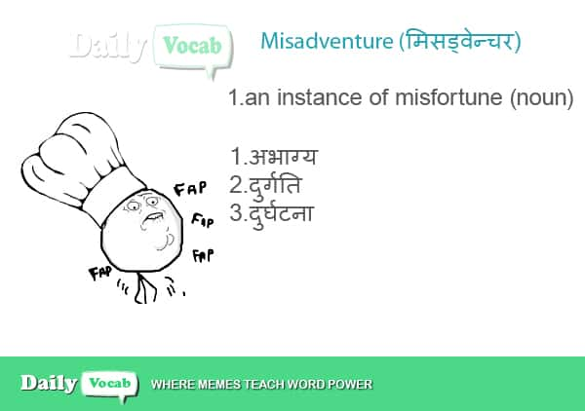
misadventure
Dangerous unforeseeable effects, following use of some procedure, measures or drugs
Therapeutic
Diagnostic
Experimental

Slide 22
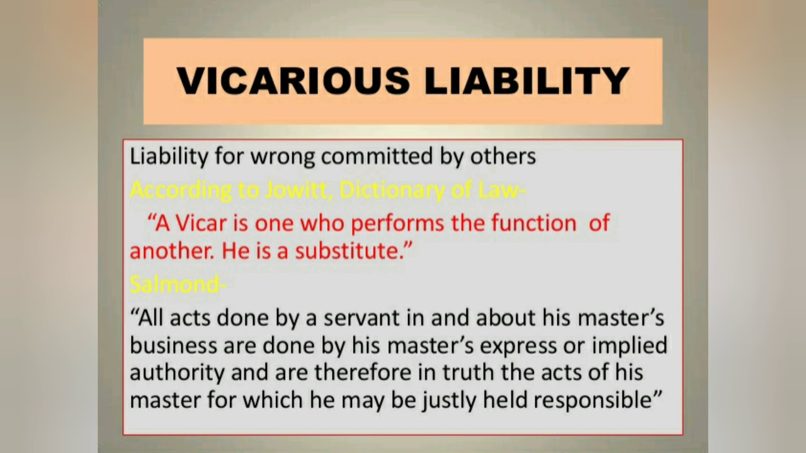
Vicarious liability
Liability of employer for the negligent act of his employees, within the course and scope of their employment
principle of Respondent Superior

Slide 23
Criminal malpraxis
Medical practitioner prosecuted in criminal court on the charge of having caused death of his patient
By a rash or negligent act not amounting to murder
Gross carelessness in the treatment
Sec 304A IPC

Slide 24
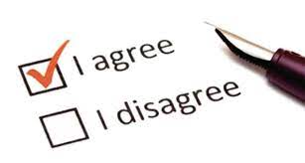
consent

Slide 25
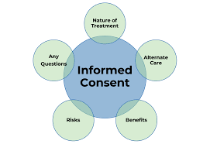
Agreement, compliance or permission given voluntarily without compulsion
Express
- verbal
- written
Implied

Slide 26
Informed consent
Nature of ailment or disease process
Nature and plan of proposed line of treatment
Alternative form or line of treatment
Nature of risks involved in both
Relative chances of success, benefit, burden or failure
Freedom of choice

Slide 27
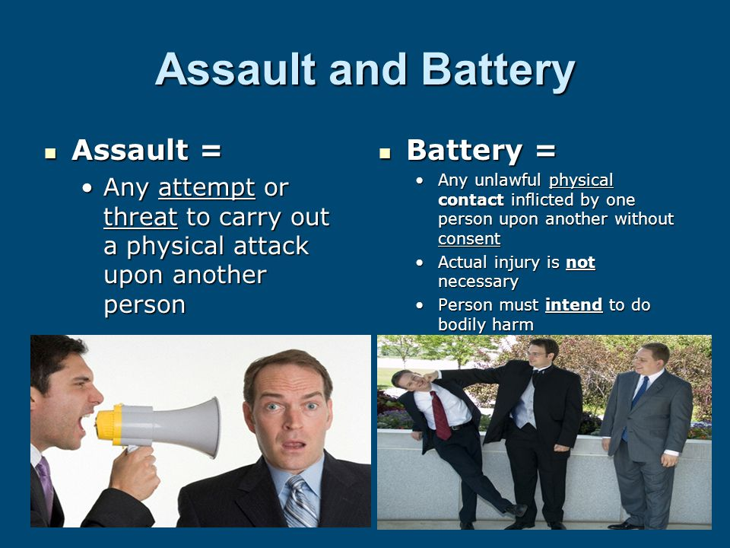
Why consent is necessary
Assault & Battery
Negligence

Slide 28
Consent in writing ALWAYS before medico legal examination
Express consent ALWAYS before any procedure beyond ordinary medical examination
Open Consent
A child below 12 yrs can not give valid consent
Loco parentis

Slide 29
Consent given under fear, misinterpretation, by insane or intoxicated person is not valid Sec 90 IPC
It is not an offence, when any harm is caused by any act done in good faith, even without consent, under circumstances when it was not possible to take the consent Sec 92 IPC

Slide 30
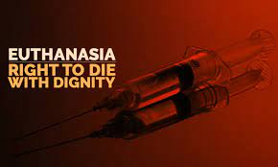
euthanasia

Slide 31
Mercy killing
“Good” “death”
“Painlessly killing the victim suffering from some incurable disease, severe pain etc. by himself or others specially when the victim’s life is presumed to have become unuseful”
Passive Euthanasia is legal in India
legal in – Albania, Netherlands, Luxenburg

Slide 32
Active Euthanasia: positive act of killing with drugs
Passive Euthanasia: act of omission to continue life sustaining measure
Involuntary: patient in position to give consent, but decision taken by relatives and physician
Non voluntary: patient not in a position to give consent
Voluntary/Physician assisted suicide: with consent of the patient

Slide 33
Question
Q.1.Acceptance of part of fees received by senior doctor, for referring the case is known as:
A.Priveledge communication
b.Malpraxis
c.Dichotomy
d.Corpus delecti

Slide 34
Q.2.Contributary negligence means:
a.Negligence of the doctor
b. Negligence of nurse
c. Negligence of patient
d. Negligence of doctor & patient both

Slide 35
Q3.Res ipsa loquitor means
Negligence of surgen
Punishment in Negligence
Liability in Negligence
Things speaks for itself

Slide 36
Q4.Minimum age required to give valid consent for risky surgery:
a.12 years
b 16 years
c.18 years
d.21 years

Slide 37
Q5.Professional death sentence refers to:
a.Rigorous imprisonment
b.Capital punishment
c.Issue of warning Notice
d.Penal eraser of the name from medical register

Slide 38
Q6. Priveledge communication is used by doctor:
a.To protect his own interest
b. To protect the interest of society
c. To punish the patient
d.To Blackmail the patient

Slide 39
Q7.In carporate negligence damage suffered is due to:
a.Lack of skill by qualified doctor
b.Faulty Instrument
c.Fault by the Nurse
d.Lack of infrastructure of Hospital

Slide 40
Q8.Disciplinary control over registered medical practitioner is under:
a.State Medical Council
b.World medical council
c.Director general of health
d.Health secretary of state

Slide 41
Q9.Standard of Medical education in India is regulated by:
a. State Medical Council
b.National Medical Commission
c.Indian Medical Association
d.National Board

Slide 42
Q.10.Repeated advertisement of a doctor in lay press leads to:
a.Gross Negligence
b.Professional misconduct
c.infamous conduct
d.Ethical negligience

