Slide 1
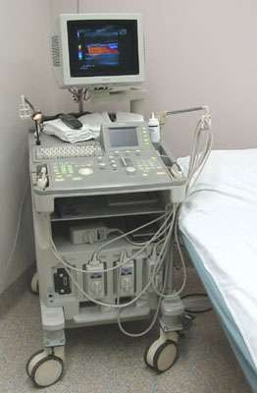
ULTRASOUND
Dr.Jayapandiyan,
Assistant Professor,
Department of Paramedical Sciences,
Sumandeep Vidyapeeth Deemed to be University,
Waghodia, Vadodara,
Gujarat

Slide 2
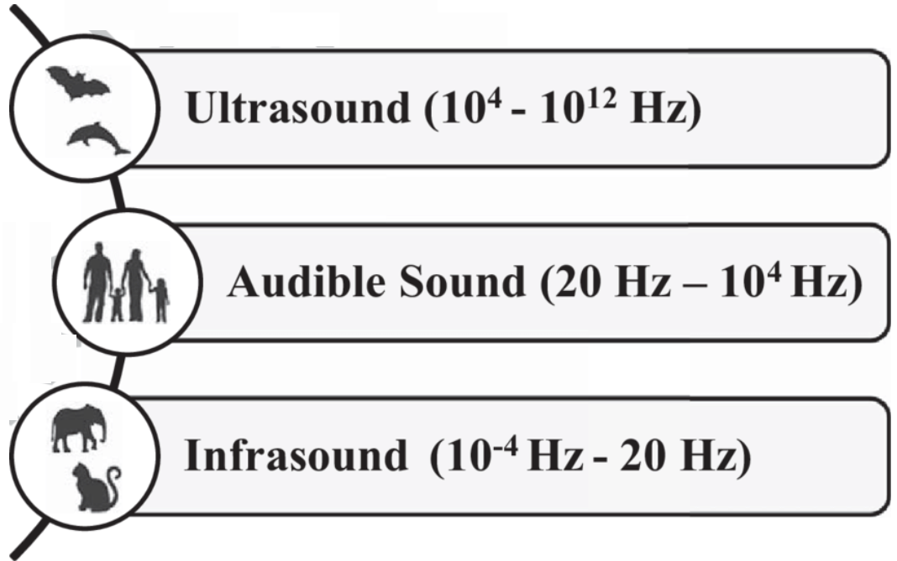
ULTRA SOUND
In physics, the term "ultrasound" applies to all acoustic energy (longitudinal, mechanical wave) with a frequency above the audible range of human hearing.
Frequency:
▫ Medical ultrasound – 2.5 - 40 MHz

Slide 3
Ultrasound Imaging - USG
Ultrasound imaging, also called sonography, involves exposing part of the body to high-frequency sound waves to produce images of parts of the body.
Ultrasound examinations do not use ionizing radiation (as used in x-rays).
Since the ultrasound images are captured in real- time, they can show the structure and movement of the body's internal organs, as well as blood flowing through blood vessels.

Slide 4
Why Ultra Sound?
Ultrasound (US) is the most widely used imaging technology worldwide due to
availability
Speed
low cost,
patient-friendliness (no radiation)
Ongoing research to improve image quality, speed and new application areas such a intra- operative navigation, tumor therapy

Slide 5
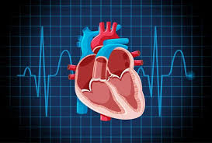
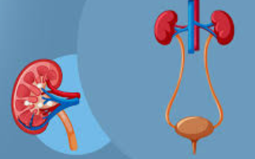
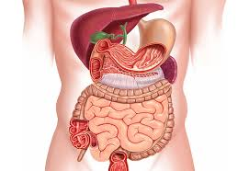
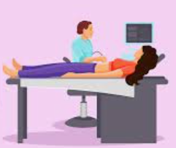
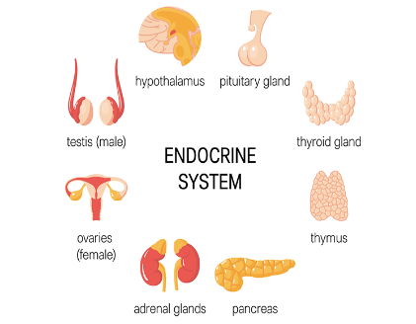
Where do we use ?
Ultrasonography is widely utilized in medicine, primarily in
Gastroenterology
Cardiology
Urology
Gynecology and obstetrics
Endocrinology
It is possible to perform diagnosis or therapeutic procedures with the guidance of ultrasonography (biopsies or drainage of fluid collections).

Slide 6
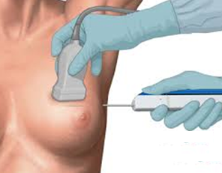
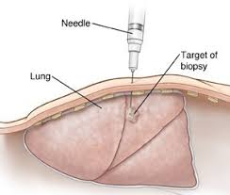
Ultrasound is also used to:
Image the breasts and guide biopsy of breast cancer
Guide procedures such as needle biopsies, in which needles are used to extract sample cells from an abnormal area for laboratory testing.
Diagnose a variety of heart conditions and assess damage after a heart attack or diagnose valvular heart disease.

Slide 7
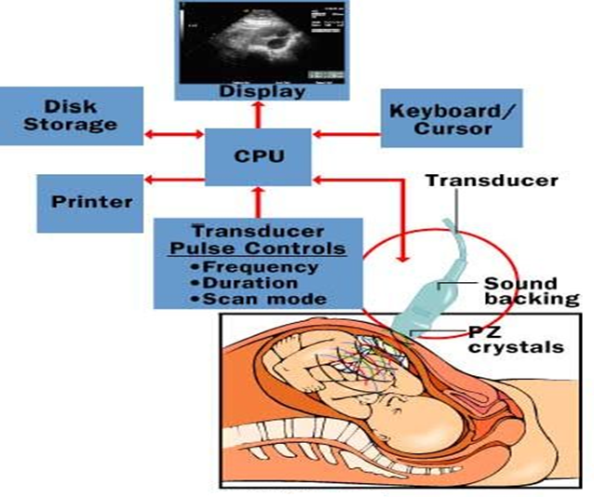
Ultrasound INSTRUMENT

Slide 8
Ultrasound Instrument
A basic ultrasound machine has the following parts:
Transducer probe - probe that sends and receives the sound waves
Central processing unit (CPU) - computer that does all of the calculations and contains the electrical power supplies for itself and the transducer probe
Transducer pulse controls - changes the amplitude, frequency and duration of the pulses emitted from the transducer probe
Display - displays the image from the ultrasound data processed by the CPU
Keyboard/cursor - inputs data and takes measurements from the display
Disk storage device (hard, floppy, CD) - stores the acquired images
Printer - prints the image from the displayed data

Slide 9
Procedure
Ultrasound imaging is based on the same principles involved in the sonar used by bats, ships, fishermen and the weather service.
When a sound wave strikes an object, it bounces back, or echoes.
By measuring these echo waves, it is possible to determine how far away the object is and its size, shape and consistency (whether the object is solid, filled with fluid, or both).
Also used to detect changes in appearance of organs, tissues, and vessels or detect abnormal masses, such as tumors.

Slide 10
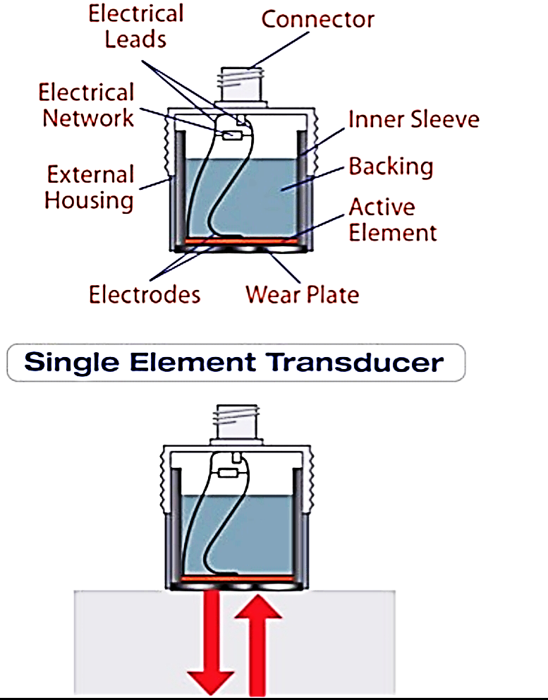
Steps Involved
Producing a sound wave
Receiving echoes
Interpreting the echoes.
In ultrasonography, a signal generator is combined with
a transducer.
Piezoelectric crystals in the signal generator convert electricity into high-frequency sound waves, which are sent into tissues.
The tissues scatter, reflect, and absorb the sound waves to various degrees.
The sound waves that are reflected back (echoes) are converted into electric signals.
A computer analyses the signals and displays the information on a screen.

Slide 11
How is the Procedure Performed?
For most ultrasound exams, the patient is positioned lying face-up on an examination table that can be tilted or moved.
A clear water-based gel is applied to the area of the body being studied to help the transducer make secure contact with the body and eliminate air pockets between the transducer and the skin that can block the sound waves from passing into your body.
The sonographer (ultrasound technologist) or radiologist then presses the transducer firmly against the skin in various locations, sweeping over the area of interest or angling the sound beam from a farther location to better see an area of concern.

Slide 12
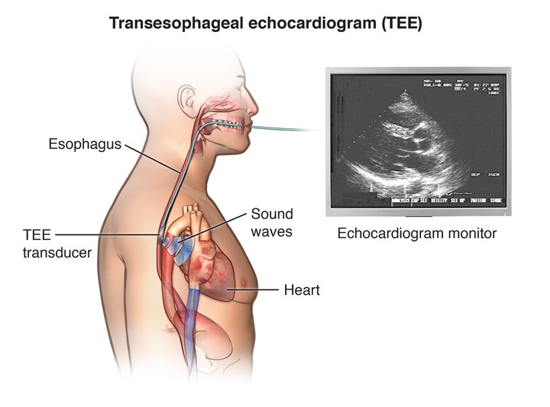
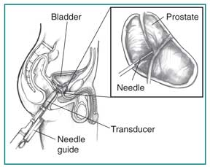
In some ultrasound studies, the transducer is attached to a probe and inserted into a natural opening in the body.
These exams include:
Transoesophageal echocardiogram.
The transducer is inserted into
the esophagus to obtain images
of the heart
Transrectal ultrasound.
The transducer is inserted into a man’s rectum to view the prostate.

Slide 13
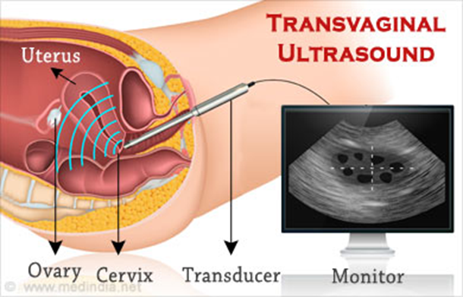
Transvaginal ultrasound.
The transducer is inserted into a woman's vagina to view the uterus and ovaries.
Most ultrasound examinations are completed within 30 minutes to an hour.

Slide 14
Absorption of Sonic waves
Kinetic energy is converted to heat energy as it passes through the material.
The energy will decrease exponentially with distance from the source because a fixed proportion of it is absorbed at each unit distance so that the remaining amount will become a smaller and smaller percentage of the initial energy
The conversion of sonic energy to heat is due to increased molecular motion

Slide 15
Half value depth: depth of tissue at which the US intensity is half its initial intensity
Absorption of sonic energy is greatest in tissues with largest amounts of structural protein and lowest water content.
Blood – least protein content and least absorption
Bone - greatest protein content and greatest absorption

Slide 16
Attenuation of Ultrasound
The loss of energy from the ultrasound beam in the tissues is called attenuation and depends on both absorption and scattering
Absorption accounts for some 60 – 80% of the energy loss. The scattered energy may also be absorbed other than in the region to which the ultrasound beam is applied.
Scattering is caused by reflections and refractions, which occur at interfaces throughout the tissues. This is particularly apparent where there is a large difference in acoustic impedance.

Slide 17
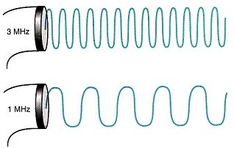
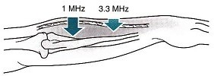
Effect of Frequency:
Increasing the frequency of Ultrasound causes a decrease in its depth of penetration and concentration of the Ultrasound energy in the superficial tissues.

Slide 18
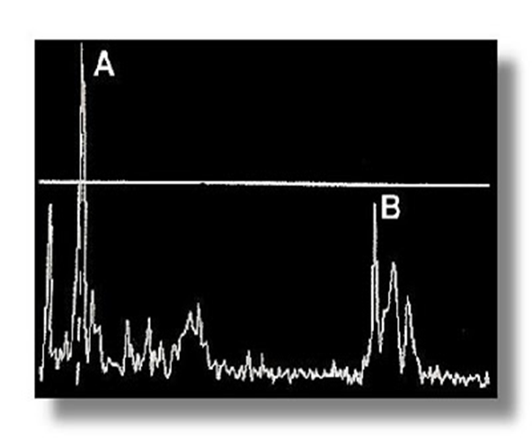
A-MODE
USG Modes
Ultrasound information can be displayed in several ways.
Amplitude modulation - This display mode is the simplest.
The display will have an amplitude of spikes of different heights.
It represents the time required for the ultrasound beam to strike a tissue interface and return its signal to the transducer.
The greater the reflection at the tissue interface, the larger the signal amplitude on the A-mode screen.
The vertical (Y) axis of the display shows the echo amplitude, and the horizontal (X) axis shows the depth or distance into the patient.

Slide 19
Applications
A mode is used in
Ophthalmology (deals with the diagnosis and treatment of eye disorders)
Echoencephalography (a method for detecting abnormalities within the cranial cavity, based on the reflection of high-frequency sound pulses delivered to the head through a probe held firmly to the scalp)
Echocardiology (used to look at the heart and nearby blood vessels)
Used when accurate depth measurements are required.
Disadvantages
No memory is built. So cannot be stored.
Discards previous pulses as it receives new ones
Permanent record made by photographing the electronic display

Slide 20
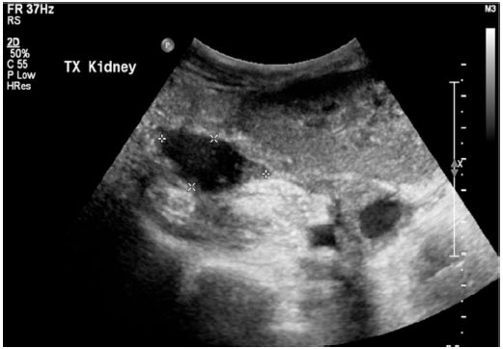
B-mode (gray-scale) or Brightness Modulation :
This mode is most often used in diagnostic imaging; signals are displayed as a 2-dimensional anatomic image.
B-mode is commonly used to evaluate the
developing fetus and to evaluate organs,
including the liver, spleen, kidneys, thyroid gland,
testes, breasts, and prostate gland.
B-mode ultrasonography is fast enough to show
real-time motion, such as the motion of
the beating heart or pulsating blood vessels.
Real- time imaging provides anatomic and functional information.

Slide 21
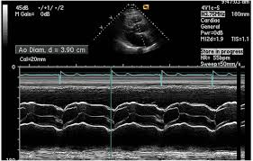
M-Mode or Motion Mode (also called Time Motion or TM-Mode):
This mode is used to image moving structures; signals reflected by the moving structures are converted into waves that are displayed continuously across a vertical axis.
M-mode is used primarily for the assessment of fetal heartbeat and in cardiac imaging, most notably to evaluate valvular disorders.
Advantages
It is most useful in echocardiography and
fetal cardiac imaging.
Disadvantages
Only one dimension is represented
Short time that can be recorded

Slide 22
Strengths of ultrasound imaging:
It images muscle and soft tissue very well and is particularly useful for indicating the exact position, and the interfaces between solid and fluid-filled spaces.
It renders "live" images, where the operator can dynamically select the most useful section for diagnosing and documenting changes, often enabling rapid diagnoses.
It shows the structure as well as some aspects of the function of organs.
It has no known long-term side effects and rarely causes any discomfort to the patient.
Equipment is widely available and comparatively flexible; examinations can be performed at the bedside.

Slide 23
Weaknesses of ultrasound imaging:
Ultrasound cannot penetrate bone and performs poorly when there is air between the scanner and the organ of interest. For example, overlying gas in the gastrointestinal tract often makes ultrasound scanning of the pancreas difficult.
Even in the absence of bone or air, the depth penetration of ultrasound is limited, making it difficult to image structures that are far removed from the body surface, especially in obese patients.
The method is operator-dependent. A high level of skill and experience is needed to acquire good-quality images and make accurate diagnoses.

Slide 24
Risks and Side Effects
Ultrasonography is generally considered a "safe" imaging modality.
Diagnostic ultrasound studies of the fetus are generally considered to be safe during pregnancy.
World Health Organizations technical report supports that ultrasound is harmless.

Slide 25
Ultrasound Terminology
Acoustic Impedance
Product of density and velocity of sound in a particular material. The amount of reflection of a sound beam is determined by the difference in the impedances of the two tissues.
Acoustic Power
Quantity of energy generated by the transducer, expressed in watts. Also transmit power.
Acoustic Scattering
Reflections from small objects that are the size of the wavelength or smaller.
Acoustic Shadow
Loss of echo signals from distal structures due to attenuation of overlying structures.
Acoustic Velocity
The speed of sound through a medium as determined by the stiffness and density of the medium.
Also: speed of sound; propagation speed; sound velocity.

Slide 26
Aliasing
A technical artifact occurring when the frequency change is so large that it exceeds the sampling view and pulse repetition frequency. The frequency display wraps around so that the signal is seen at both the top and bottom of the image.
Amplitude
Strength or height of the wave, measured in decibels.
Amplitude mode (A-mode)
A one-dimensional image displaying the amplitude strength of the returning echo signals along the vertical axis and the time (the distance from the transducer) along the horizontal axis.
Anechoic
Refers to a structure that returns no echoes. This could be a simple cyst or cystic structure such as the gall bladder, urinary bladder, or chambers of the heart. Also, sonolucent, echo-free, echolucent, transonic.

Slide 27
Attenuation
Reduction in amplitude and intensity with increasing distance traveled due to scatter, reflection and absorption. Dependent on frequency; higher frequencies give less penetration.
Axial Resolution
Depth resolution; ability to separate two objects lying in tandem along the axis of the beam.
Azimuthal
The dimension perpendicular to the image slice, the thickness of the slice of anatomy.
Bandwidth
The frequency range represented in a pulse from the transducer; quality factor.

Slide 28
B-Scan
A two-dimensional cross-sectional image displayed on a screen in which the brightness of echoes and their position on the screen are determined by the movement of a transducer and the time it takes the echoes to return to the transducer. Also static scan.
Cineloop
The system memory stores the most recent sequence of images in a series of frames before the freeze button is pressed allowing a continuous loop of images to be reviewed.
Color Flow Doppler
Operating mode in which a two-dimensional image is generated that portrays moving reflectors in color simultaneously with B-mode images.
Complex
Refers to a structure that is heterogeneous and may contain both cystic (fluid-filled) and solid components.

Slide 29
Compression
Regions of high pressure and density as sound travels through a medium.
Crystal
The active transducer component that actually generates and receives ultrasonic energy by converting electrical impulses into sound waves and vice versa.
Cystic
A sac or pouch with a definite wall that contains fluid or semisolid material
Decibel (db)
A unit used to express the intensity of amplitude of sound waves; does not specify voltage

Slide 30
Density
Concentration of matter (mass per unit volume).
Doppler Shift
The perceived frequency change that occurs dependent upon whether the source and listener are moving toward or away from one another.
Dynamic Range
(Log Compression). The range of intensity from the largest to the smallest echo that the system can display.
Echo
Reflected sound.
Echogenic
Capable of producing echoes. Correlate with the terms hyperechoic, hypoechoic and anechoic which refer to the quantity of echoes produced

Slide 31
Echopenic
Few echoes within a structure; less echogenic. Echo-poor.
Echolucent
Without internal echoes; anechoic.
Edge Enhancement
An electronic postprocessing function which makes contours of structures within the image more distinct and clear.
Electronic Focusing
Each crystal element within a group is pulsed separately to focus the beam at a particular area of interest.

Slide 32
Enhancement
Because sound traveling through a fluid-filled structure is barely attenuated, the structures distal to a cystic lesion appear to have more echoes than neighboring areas. Also called through transmission.
Far Gain
Control that affects the strength of the distant echoes in the image.
Focal Zone
The depth of the sound beam where resolution is the highest.
Focusing
The act of narrowing the beam to a small width at a set depth.
Footprint
Shape of the transducer that is in contact with the patient

Slide 33
Frame rate
Rate at which the image is refreshed in a real-time system display.
Frequency
The number of times in a given interval of time that a particular action occurs.
Gain
Regulates the amplification (brightness) of returning echoes to compensate for loss of transmitted sound caused by absorption and reflection.
Gray Scale
Display mode in which echo intensity is recorded as degrees of brightness or shades of gray.

Slide 34
Heterogeneous
Refers to an uneven echo pattern or reflections of varying echodensities.
Homogeneous
Refers to an even echo pattern or reflections that are relative and uniform in composition.
Hyperechoic
A relative term that refers to the echoes returned from a structure. Hyperechoic refers to a lesion or tumor which produces a stronger echo than surrounding structures or tissues.
Hertz
Unit for wave frequency (cycles per second); pulse repetition frequency (pulses per second); frame rate (frames per second).

Slide 35
Interface
Surface forming the boundary between media having different properties.
Isoechoic
Refers to a lesion or tumor which produces an echo of the same strength as that of the surrounding structures or tissues.
Kilohertz
1000 hertz or 10³ cycles/s
Lateral Resolution
Ability to separate two objects that are positioned perpendicular to the axis of the ultrasound beam. Related to beam width.
Linear Array
Many small electronically coordinated transducers producing a rectangular image.

Slide 36
Near Gain
The amplification of echoes returning from the near field.
Noise
Artefactual echoes result from too much gain rather than echoes from true anatomic structures.
Overall Gain Control
Single gain control increases amplification at all depths.
Phased Array
Electronically steered system where many small transducers are electronically coordinated to produce a focus wavefront.

Slide 37
Piezoelectric Effect
Electric current created by pressure forces. Certain types of ceramic materials can convert pressure to electricity and vice versa. Transducer elements utilize this phenomenon, which is also referred to as piezoelectricity.
Persistence
The accumulation of echo information over a specified period of time.
Power Doppler
The presentation of two-dimensional Doppler information by color-encoding the strength of the Doppler shifts. Power Doppler is free of aliasing and angle dependence and is more sensitive to slow flow and flow in small or deep vessels.
Pulse-echo Principal
Sending pulses of ultrasound into the body so that they react with tissue and return reflections.

Slide 38
Pulse Repetition Frequency (PRF)
The number of times per second that a transmit-receive cycle occurs.
Refraction
Bending of waves as they pass from one medium to another.
Resolution
Ability to distinguish between two adjacent structures (interfaces).
Reverberation
The phenomenon of multiple back-and-forth reflections created by two strong reflectors that causes the echoes to be misplaced in the display thereby representing a false image; ring-down effect.
Scattering
Redirection of ultrasound from a reflector which is small compared to the wave length of the beam. This occurs with rough surfaces or heterogeneous substances such as a solid organ.

Slide 39
Shadowing
Failure of the sound beam to pass through an object.
Slice thickness
Elevational resolution. The size of the beam perpendicular to the image plane.
Sonodense
A structure that transmits sound poorly.
Spatial Resolution
How closely positioned two reflectors can be to one another and still be identified as separate reflectors on an image display. Reflector resolution.

Slide 40
Speckle
Interference effects of the scattered sound from the distribution of scatterers in the tissue that is not related to the scattering properties of tissue (echo texture). Produces granular appearance.
Specular Reflectors
Reflections from surfaces, which are smooth, compared to the wavelength of sound thereby creating a bright echo on the monitor.
Stiffness
Resistance of a material to compression. Hardness.
Temporal Resolution
The ability of a display to distinguish closely spaced events in time and to present rapidly moving structures correctly. Improves with frame rate.

Slide 41
Texture
The echo pattern within an organ.
Time Gain Compensation (TGC) or Depth Gain Compensation
Control that compensates for the loss (attenuation) of the sound beam as it passes through tissue.
Transducer
An electromechanical device that is part of an ultrasound system. The device that contacts the patient and converts electrical energy into mechanical energy and vice versa.
Wavelength
Distance a wave travels in a single cycle. As frequency becomes higher, wavelength becomes smaller.

Slide 42
THANK YOU

