Slide 1
FLUOUROSCOPY
Dr. Jayapandiyan,
Assistant Professor,
Department of Paramedical Sciences,
Sumandeep Vidyapeeth Deemed to be University,
Waghodia, Vadodara,
Gujarat

Slide 2
Fluoroscopic Imaging
The primary function of a fluoroscope is to perform dynamic studies - used to visualize the motion of internal structures and fluids.
Fluoroscopy differs from most other X-ray imaging and the purpose of this technique is to get real-time and moving images of the organs inside a person, allowing evaluation of dynamic, biological processes and guiding interventions.
Early fluoroscopes had an X-ray source and a fluorescent screen, between which the patient was placed. After passing through the patient, the remnant beam impinged upon the fluorescent screen and produced a visible glow, which was directly observed by the practitioner.

Slide 3
Fluoroscopist need not stand in close proximity to the fluorescent screen in order to observe the live image and results in a substantial reduction in radiation dose to the fluoroscopist
In modern systems, the fluorescent screen is coupled to an electronic device that amplifies and transforms the glowing light into a video signal suitable for presentation on an electronic display.
Patients receive less radiation dose as well, because of the amplification and overall efficiency of the imaging system.

Slide 4

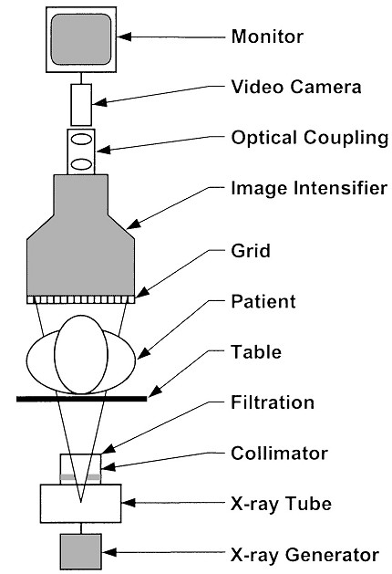
x-ray generator
x-ray tube
collimator
filters
patient table
grid
image intensifier
optical coupling
television system
image recording

Slide 5
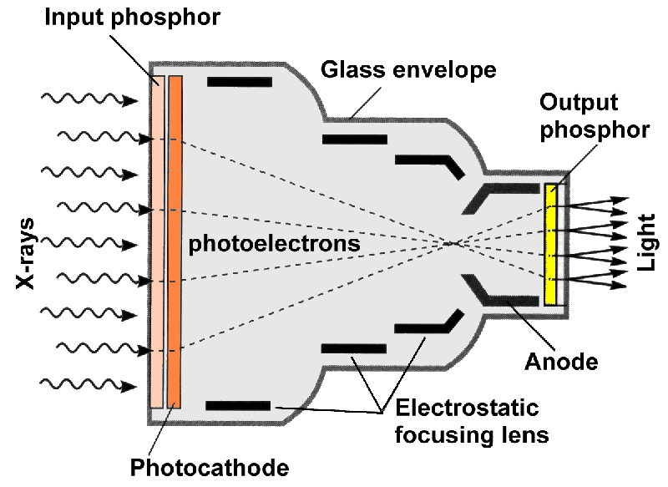
X RAY IMAGE INTENSIFIER - XRII
The X-ray image intensifier is an electronic device that converts the X-ray beam intensity pattern into a visible image suitable for capture by a video camera and displayed on a video display monitor.
➢

Slide 6
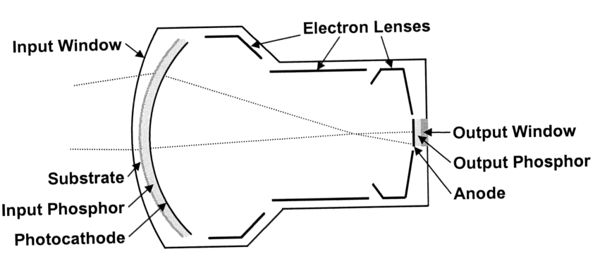
Components of XRII
Glass envelope
Input phosphor
Photocathode
Electrostatic focusing lenses
Output phosphor

Slide 7
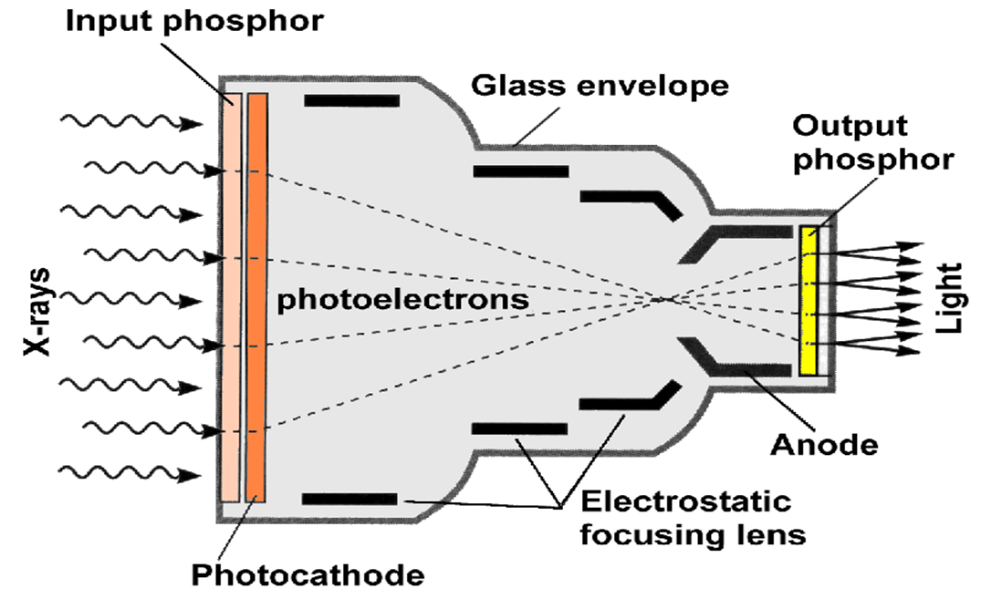
Glass envelope
Maintains tube vacuum to allow control of e-flow, has no functional part in image formation.
Input phosphor
X-Rays that exit the patient and are incident on the image intensifier tube are transmitted through the glass envelope and interact with the input phosphor, which is cesium iodide.
When X-Rays interact with the input phosphor,
its energy is converted into a burst of visible light
photons as occurs on the intensifying screen.

Slide 8
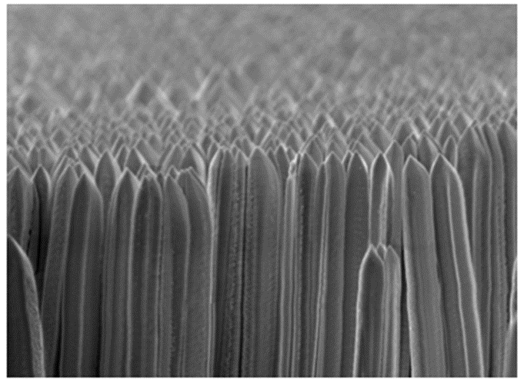
Input Phosphor Materials
1st Generation Image Intensifiers
Input phosphor - Zinc Cadmium Sulfide
Output phosphor - Zinc Cadmium Sulfide
2nd Generation Image Intensifiers
Input phosphor- Cesium Iodide
(crystals have grown in a dense needle-like structure
– prevents the lateral light spread)
Output phosphor - Zinc Cadmium Sulfide.

Slide 9

Photocathode
It is bonded directly to the input phosphor
with a thin, transparent, adhesive layer.
The photocathode is a thin metal layer,
composed of cesium and antimony compounds, that respond to stimulation by light with the emission of electrons.
This process is known as photoemission or photoelectric effect

Slide 10
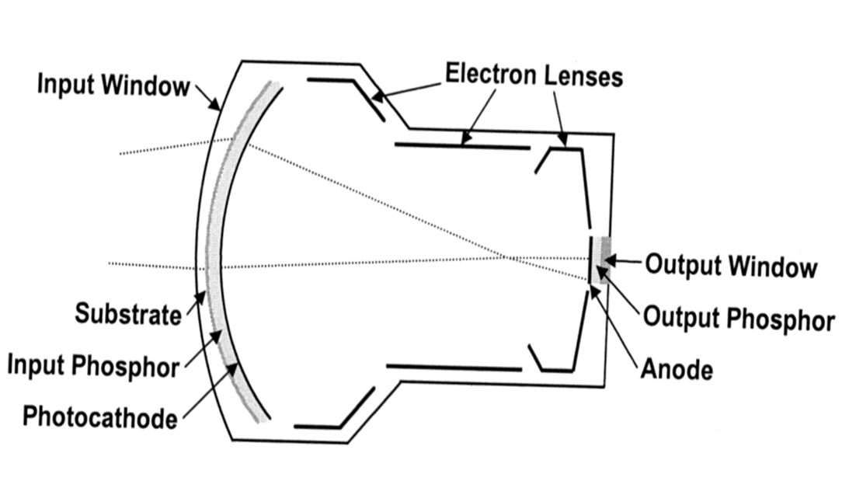
Electrostatic Focusing Lenses
Located along the length of the tube, responsible
for focusing the electrons across the tube from
the input to the output phosphor.
The image is reversed from input to the output phosphor
(right becomes left, superior to inferior).
The concave input screen reduces distortion by keeping
the same distance between all points on the input & output screens.

Slide 11
ANODE
An anode is normally charged with 25 kV and is used to accelerate electrons across the
tube to increase kinetic energy and to increase light energy too.
.
OUTPUT PHOSPHOR
The output Phosphor is normally made of Zinc Cadmium Sulfide crystals.
Each photoelectron reaches the output phosphor results in approximately 50 -70 more
than the input.
The electrons that are steered, accelerated, and multiplied in number by the electron optic components, and finally impinge upon a surface coated with a phosphor material that glows visibly when struck by high-energy electrons. This is the output phosphor of the XRII.

Slide 12
The XRII achieves orders of magnitude more light per X-ray photon than a simple fluorescent screen.
This occurs through electronic gain (amplification by the electron optics) and minification gain (concentrating the information from a large input surface area to a small output phosphor area.
This allows relatively high image quality (signal-to-noise ratio) at modest dose levels compared with non-intensified fluoroscopy.
The use of video technology added an important convenience factor — it allows several people to observe the image simultaneously and offers the ability to record and post-process fluoroscopic image sequences.

Slide 13
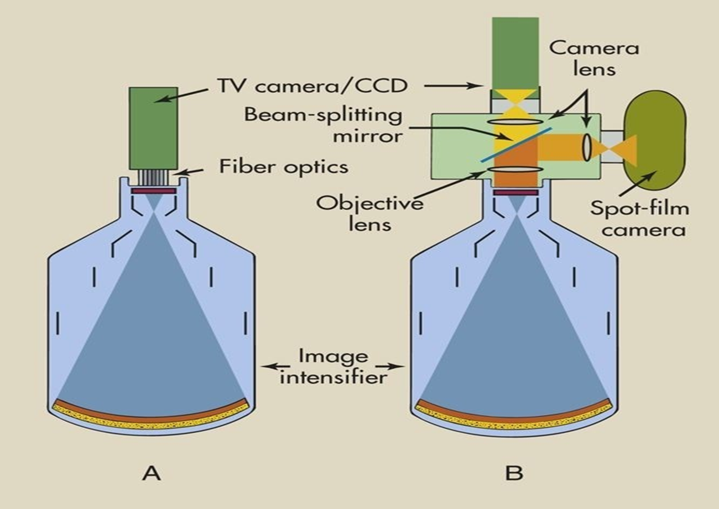
The two methods commonly used to couple the television camera tube to the image-intensifier tube are
Fiber optics
Lens system
The simplest method is to use a bundle of fiber optics

Slide 14
Viewing and Recording of Images
The output screen image can be transferred to different optical displaying systems:
Conventional TV
Cine film
Photography
Two methods are used to electronically convert the visible image on the output phosphor of the image intensifier into an electronic signal.
Thermionic television camera tube
The solid-state charge-coupled device (CCD)

Slide 15
Types of TV Camera
VIDICON TV camera
  improvement of contrast
  improvement of signal-to-noise ratio
  high image lag
PLUMBICON TV camera (suitable for cardiology)
  lower image lag (follow-up of organ motion)
  higher quantum noise level
CCD TV camera (Digital fluoroscopy)
  digital fluoroscopy spot films are limited in resolution since they depend on the TV camera (no better than about 2 c/mm) for a 1000-line TV system.

Slide 16
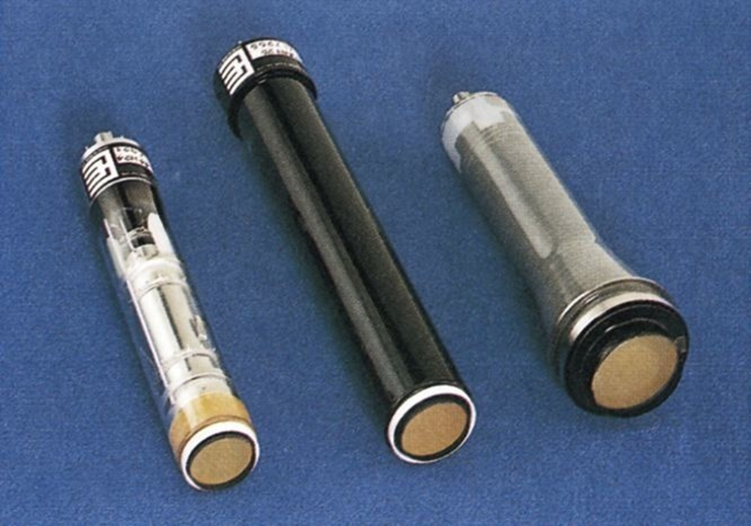
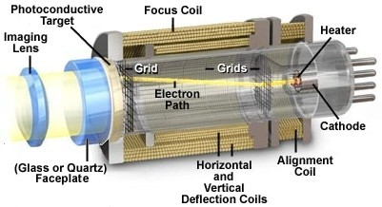
Older fluoroscopy equipment will have a television system using a camera tube.
The camera tube has a glass envelope containing a thin conductive layer coated onto the inside surface of the glass envelope.
The television camera consists of cylindrical housing, approximately 15 mm in diameter by 25 cm in length, that contains the heart of the camera, the TV camera tube.
It also contains electromagnetic coils that are used to properly steer the electron beam inside the tube
Vidicon and Plumbicon are used most often

Slide 17
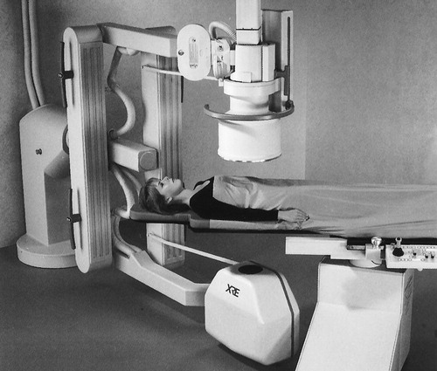
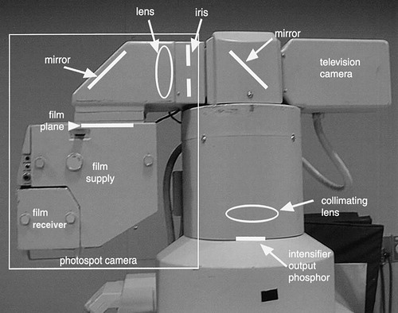
Recording Instruments

Slide 18
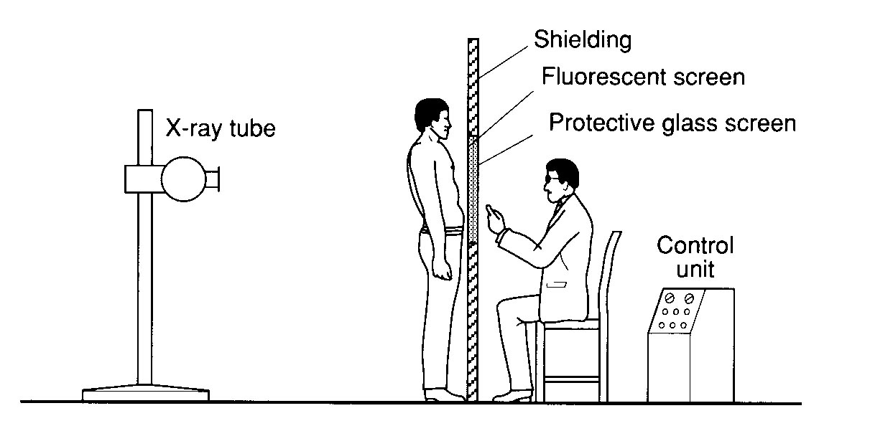
Direct Fluoroscopy: obsolete
In older fluoroscopic examinations radiologist stands behind the screen and views the picture.
Radiologist receives high exposure; despite protective glass, lead shielding in the stand, apron, and perhaps goggles.

Slide 19
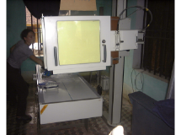
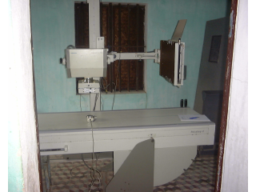
Older Fluoroscopic Equipment
(still in use in some countries)
Staff in the DIRECT beam

Slide 20
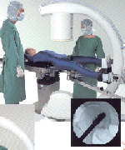
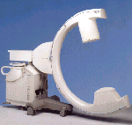
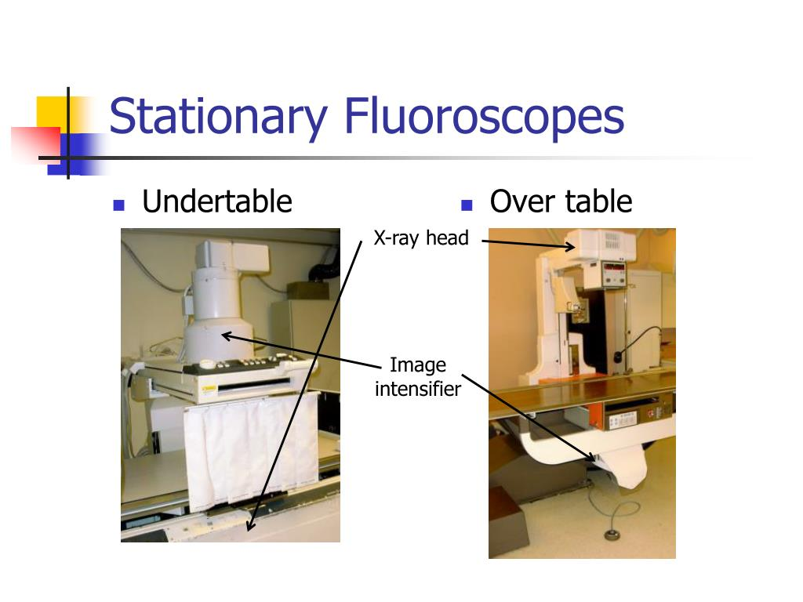
Different Fluoroscopy Systems
Remote control systems
  Not requiring the presence of medical specialists inside the X-Ray room
Mobile C-arms
  Mostly used in surgical theatres.
  Stationary
  Mobile

Slide 21
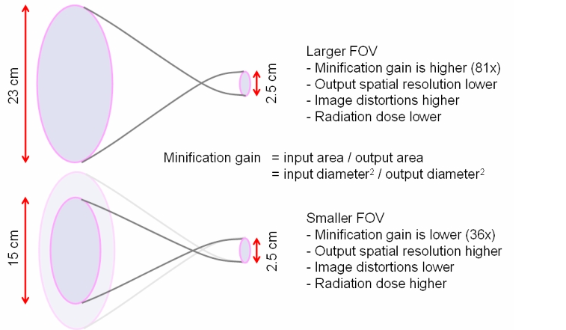
Multi-field Image Intensifier
Multifield image intensifier tubes are usually either dual-field or tri-field
Designed in order to permit magnification of imaging.
Image intensifiers come in a range of input field of view (FOV) diameters from 6 inches (15 cm FOV) to 16 inches (40 cm FOV), and many dimensions in between, depending on the type of imaging procedure.
The output phosphor dimension is typically about 1 inch (2.54 cm) in diameter.
Higher the voltage on the electrostatic focusing lens more the electrons focused.

Slide 22
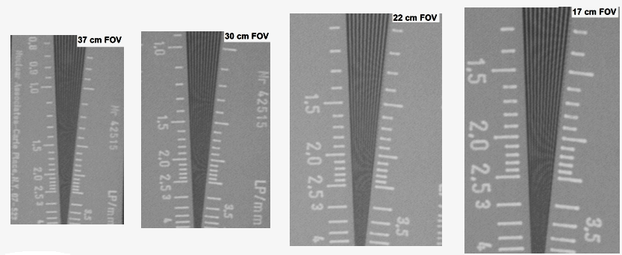
Image intensifiers can electronically vary the size of the input radiation field of view whilst keeping the output field fixed, equal to 2.54 cm (1 inch).
If the input field of view is halved, then the size of the patient being viewed is also halved, resulting in a two-fold magnification of the image.
This type of magnification, known as electronic zoom, doubles the spatial resolution performance.

Slide 23
If the input field of view is halved, then only one-quarter of the input phosphor is being irradiated since the area is proportional to the square of the field of view.
Halving the input field of view, while keeping all the other parameters constant, would reduce the image brightness to a quarter of the original brightness at the full field of view.
To compensate for this effect, the amount of radiation that is incident at the input of the image intensifier needs to be quadrupled to compensate for the r reduction in the exposed area.
Automatic brightness control feedback circuits in the image intensifier/x-ray generator system accomplish this with feedback signals to adjust the kVp , mA or both (kV and mA are both modulated) to maintain the brightness at the output phosphor.
The consequence to the patient is an increase in the dose when the "magnification mode" is utilized.

Slide 24

Image Quality
The quality of an image can be described by three parameters: spatial resolution, contrast, and noise. Each parameter has implications for patient dose.
Spatial Resolution
It is the ability to portray small features and is considered as the “sharpness” of the image.
Image spatial resolution is governed by:
X-ray tube focal spot size (small focal spot results in sharper image)
Design of the image receptor
Flat panel detectors (major factor is the size of the detector elements)
Image Intensifiers (resolution is limited by the design of the video camera and other factors)
Magnification mode selected (magnified image has higher resolution)
Motion blur
Number of pixels in the acquired or stored image
Design of the display monitor, particularly the number of pixels

Slide 25
Contrast
Contrast is the relative difference between light and dark areas of an image and the ability to differentiate gray-scale gradations ranging from white to black.
Factors that influence contrast include:
Kilovoltage (higher voltage reduces contrast)
X-ray scatter in the patient (scatter increases image haze, reducing contrast)
Body part thickness and x-ray field size selected (a thicker body part and larger x-ray field size cause more scatter to reach the image receptor)
Anti-scatter grid
Design of the image receptor
Calibration of the video display system
Design of the display monitor
Ambient light in the viewing room, which detracts from the perception of contrast

Slide 26
Noise
Noise is a random variation in the intensity of individual image pixels that do not provide information about the patient’s anatomy or material in the patient known as “graininess” or “snow.”
A major source of noise is the variation in the number of x-ray photons detected by individual areas on the image receptor. This phenomenon is called “quantum mottle.” These variations become apparent if there are insufficient x-ray photons reaching the detector elements of the image receptor.
Another source may be electronic noise. Electronic noise can be caused by vibrations of any of the hardware components or power fluctuations.

Slide 27
Factors that can influence image noise include:
mA and kV (Thicker patients and oblique and lateral views require greater radiation doses or more energetic beams to maintain the image quality.)
Resolution (Small detector areas require more photons per area to maintain the same level of noise. When a magnification mode is selected, the mA and possibly the kV must be increased to achieve the same level of apparent image noise.)
Duration of the acquisition (Pulsed fluoroscopy with longer pulses results in more signal at the expense of motion blurring.)
Scattered radiation reaches the image receptor (the amount increases with the thickness of the body part and the x-ray field size) If noise is high, it may indirectly degrade the apparent resolution and contrast as well.
If you need to reduce noise, then you must increase the intensity of the x-ray beam, thereby exposing the patient to a higher dose of radiation.

Slide 28
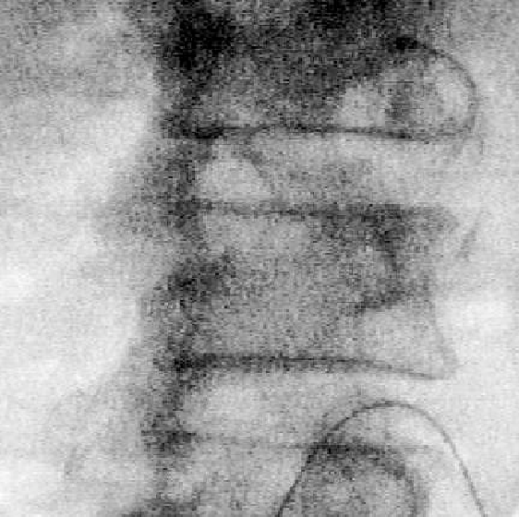
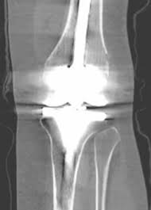
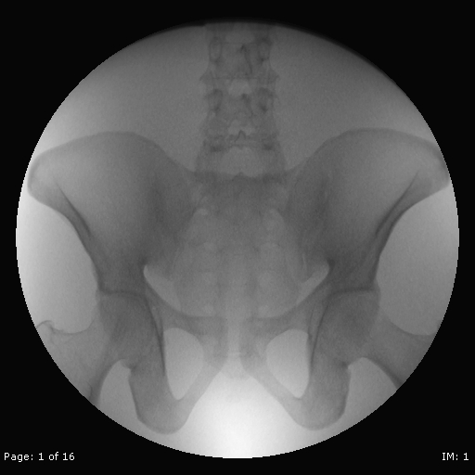

Slide 29
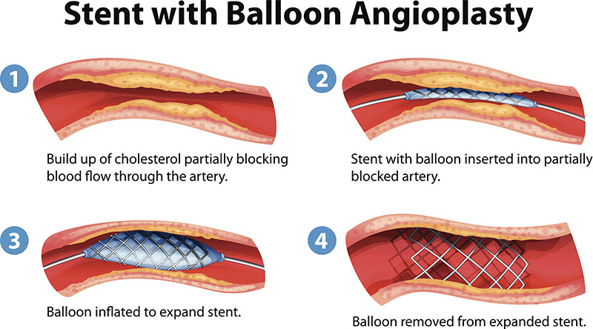
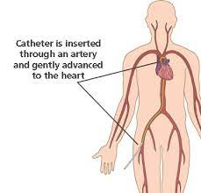
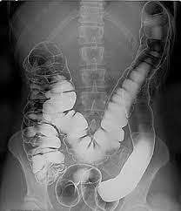
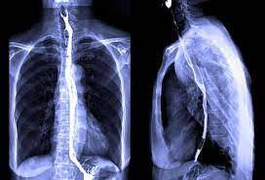
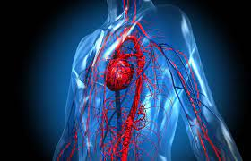
Uses of Fluoroscopy
Used in a variety of procedures
    Orthopedic Surgery
      Observe fractures and healing bones
    Catheter Insertion
      Direct catheter placement (Angiography/Angioplasty)
    Barium X-Rays
      Observe movement through GI tract
    Blood Flow Studies
      View blood flow to organs

Slide 30
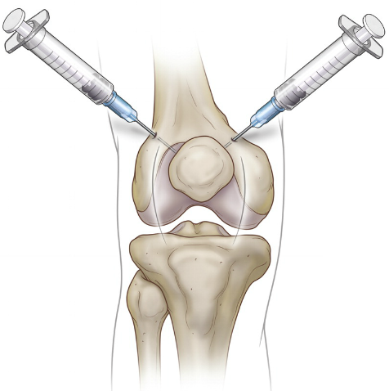
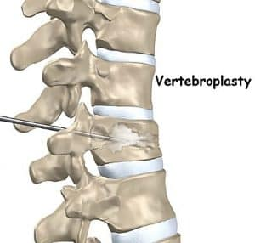
Uses cont….
Injections into the knees
  Visco-supplementation injections
  (a gel-like fluid called hyaluronic acid is injected into the knee joint)
Locating foreign bodies
Percutaneous Vertebroplasty
  Treating compressed fractures of the spine
Injections into joints or spine
  Image-guided anesthetic injections

Slide 31
Risks/benefits of fluoroscopy
Since Fluoroscopy is an x-ray machine,
it has the same risks as other x-ray machines.
Two major risks
  There is a small possibility of developing
  cancer due to exposure to the radiation
  Injuries such as burns caused by the
  radiation
Benefit
  If a patient is in need of a Fluoroscopy, the benefit outweighs the minute risks

Slide 32
SAFETY

Slide 33
THANK YOU

