Slide 1
COLLECTION, TRANSPORT AND PROCESSING OF CLINICAL SPECIMEN.
PUS
PRESENTATION BY:
Ms. Pooja Shashikant Chavan (2023-24)
F Y Microbiology for B. Sc Cardiac/Perfusion
Radio Imaging/Medical Laboratory Technology

Slide 2
CONTENTS
INTRODUCTION OF PUS
HOW PUS IS FORMED ?
COLLECTION OF PUS
TRANSPORT OF PUS
PROCESSING OF PUS

Slide 3
INTRODUCTION
A thick, opaque, usually yellowish white protein rich fluid that is formed as a part of an inflammation typically associated with an infection and is composed of exudate chiefly containing dead white blood cells (such as neutrophils), tissue debris and pathogenic microorganisms (such as bacteria).

Slide 4
HOW PUS IS FORMED?
Pus is the result of the body’s natural immune system automatically responding to an infection, usually caused by bacteria or fungi.
Leukocytes or white blood cells are produced in the marrow of bones. They attack the organisms that cause infection.
Neutrophils, a type of leukocyte, have the specific task of attacking harmful fungi or bacteria.
For this reason, pus also contains dead bacteria.

Slide 5
Macrophages, another type of leukocyte, detect the foreign bodies and release an alarm system in the form of small, cell signalling protein molecules called cytokines.
Cytokines alert the neutrophils, and these neutrophils filter from the blood stream into the affected area.
The rapid accumulation of neutrophils eventually leads to the presence of pus.

Slide 6
COLLECTION OF PUS
Pus can be collected from the following areas :
Through abscess
Deep seated pus
Post operative wound pus
Wound exudate

Slide 7
METHOD OF COLLECTION
As far as possible, collect specimens before application of antiseptic dressing.
Ideally, a minimum volume of 1ml (up to 5ml) of pus should be collected because large volumes of purulent material maintain the viability of anaerobes for longer.
The aspirant should be collected in a sterile syringe – any air bubbles should be expelled.
A tissue specimen should be place in a sterile container and sent to the lab for immediate processing if anaerobes are suspected.

Slide 8
Swabs are less desirable because of the smaller amount of specimen that is sampled and the fact that they are often contaminated with normal skin flora, making interpretation of results difficulties.
When using swabs, the deepest part of the wound should be sampled, avoiding the superficial microflora.
Swabs should be well soaked in pus .

Slide 9
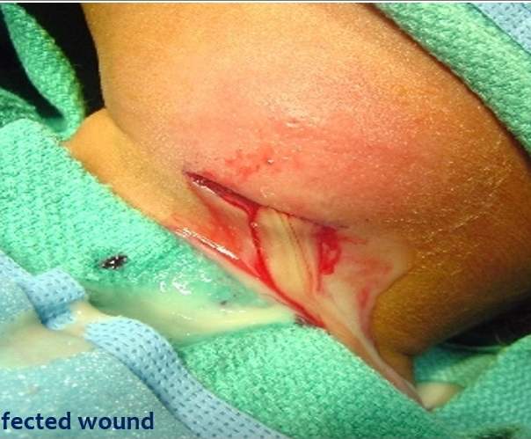
SURGICAL WOUND

Slide 10
TRANSPORT OF PUS
Label the specimen and deliver it to the laboratory as soon as possible with a complete request form.
If delays in transportation to the laboratory are unavoidable sample should be placed in the (Amies transport medium or Cary- Blair transport medium ) to minimize drying and minimize exposure to oxygen if anaerobes are suspected.
If processing is delayed, refrigeration is preferable to storage at ambient temperature.

Slide 11
LABORATORY EXAMINATION OF PUS SAMPLE ( PROCESSING )
After the submission of sample of pus in laboratory, two main methods are done:
Staining method
Pus culturing method
Staining method : (a) Make an evenly spread smear of specimen on a clean grease free slide.
( b) Allow the smear to air dry in a free space.
(c) Heat fix the specimen and stain by gram staining technique.
(d) examine the presence of bacteria and pus cell in 100 x objective lens.

Slide 12
Pus culturing method : (a) wound specimen swabs or pus aspirant should be plated onto the following medias :
1. Blood agar – to isolate Streptococcus pyogenes or Streptococci
2. Macconkey agar – to isolate gram negative rods.
Processing :- 1. four flame method.
2. streaking plate technique

Slide 13
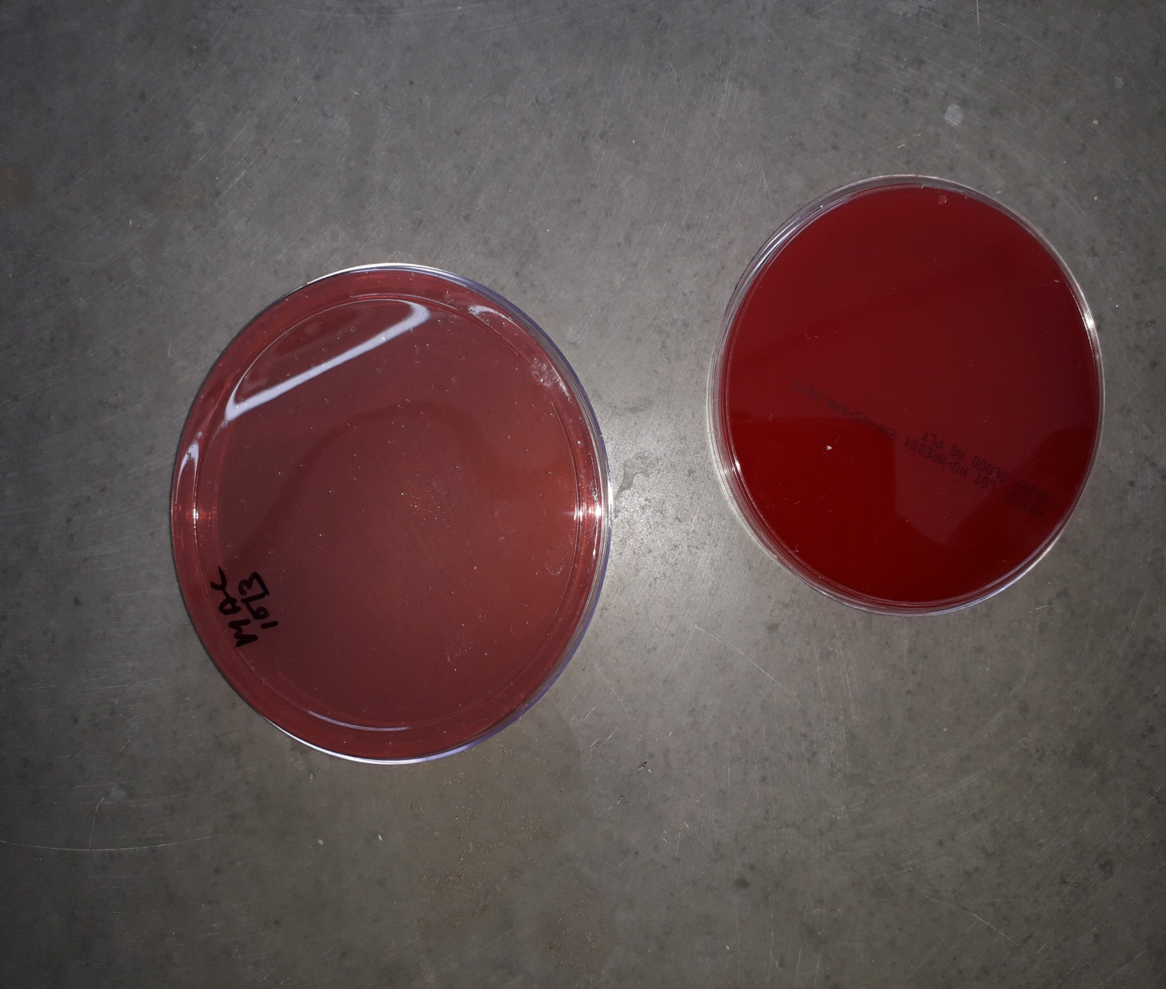
BLOOD AGAR PLATE
MAC CONKEY PLATE

Slide 14
Streaking plate technique:
First day of processing : 1. Streaking of pus on the plate is done and kept for incubation for 24 hrs in incubator.
Incubation condition : 1. Temperature : 35 degree C to 37 degree C.
Second day of processing : 1. After 24hrs, if growth is not seen in the culture media plate, then it is kept for more 24hrs to check whether it becomes infected or not.
If seen, examination, morphology, identification should be done.

Slide 15
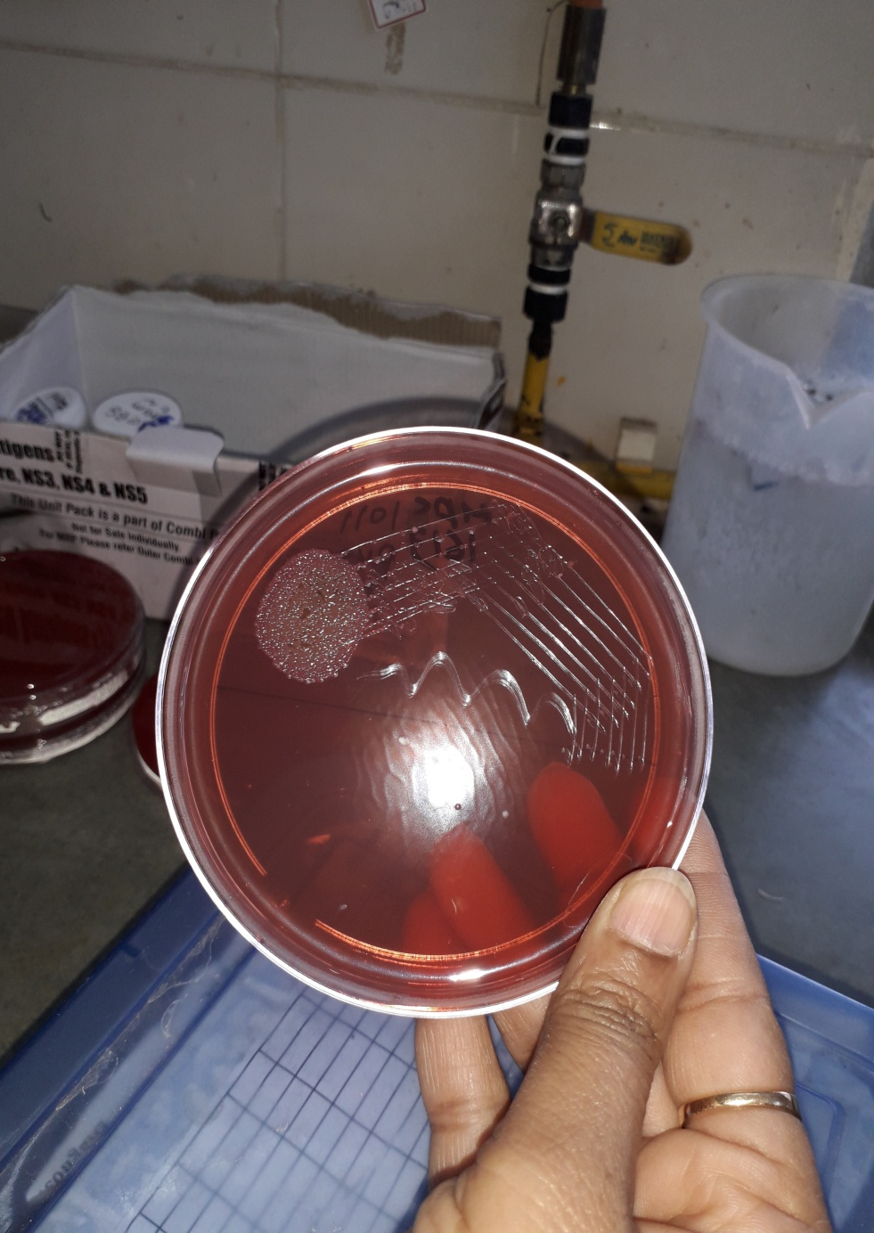
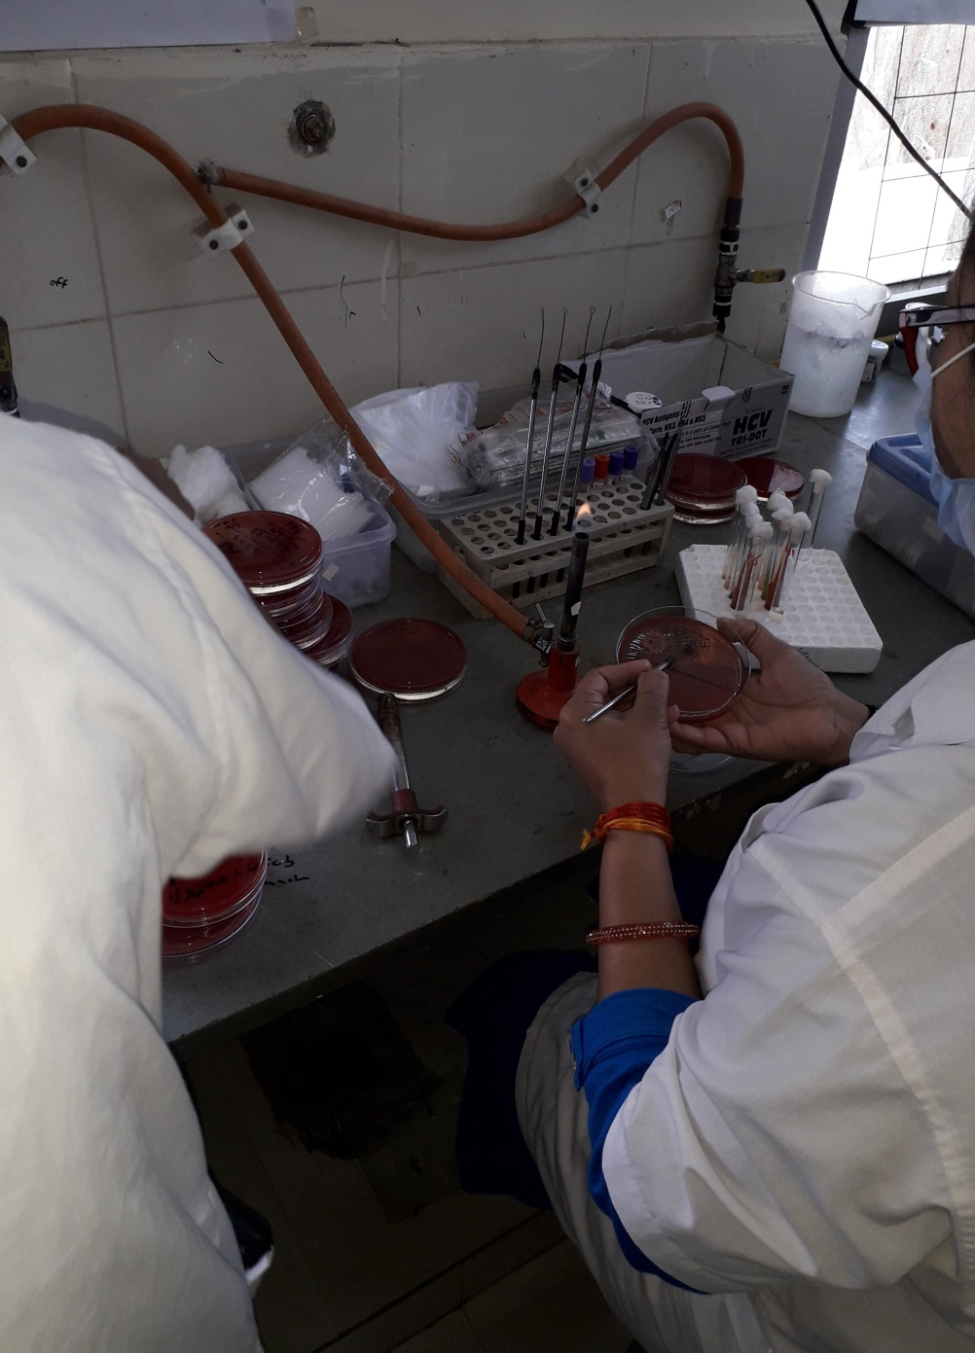
( A) WELL
(B) TECHNICIAN DOING STREAKING METHOD

Slide 16
Third day of processing : Result of sensitivity :-
(a) Antibiotic is added in the plate and bacterial response is seen towards it.
Names of antibiotics : 1. Vancomycin 2. Oxacillin 3. Clindamycin 4. Penicillin 5. Erythromycin 6. Ampicillin.
Possible pathogen can be seen : Escherichia coli
It is a parasite .
Tribe : Escherichia
Recognized : human enteric flora
Gram negative

Slide 17
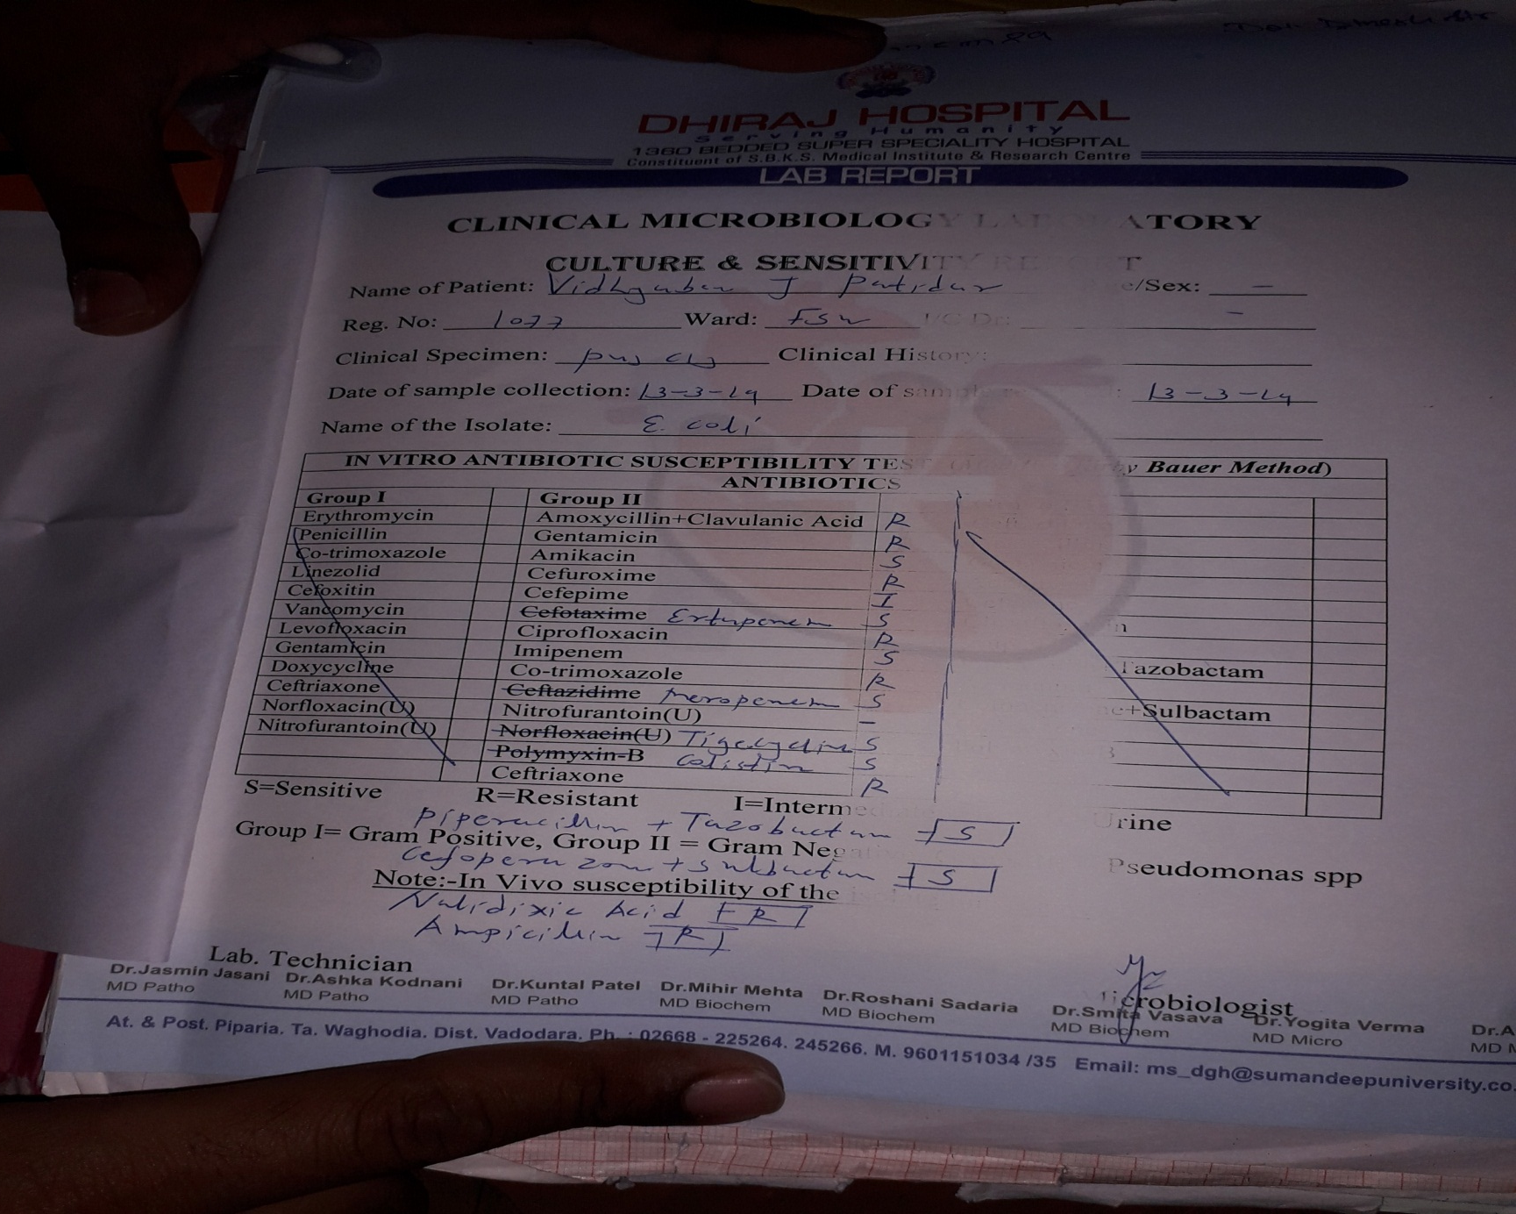
REPORT OF PUS CULTURE AND SENSTIVITY

