Slide 1
By Passang D. Sherpa
Course Coordinator of
Radio-imaging Technology
Dpt. Of paramedical science
MRI ARTIFACTS

Slide 2
Types of artifacts
PATIENT MOTION
INHOMOGENETY
ALIASING ARTIFACT
METAL ARTIFACT
CHEMICAL SHIFT ARTIFACT
GIBBS ARTIFACT
ZIPPER ARTIFACT
SHADING ARTIFACT
MOIRE ARTIFACT
MAGIC ANGLE

Slide 3
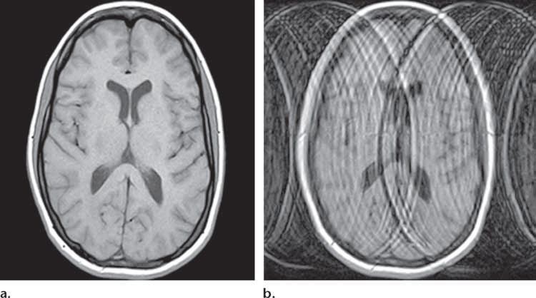
ARTIFACTS CAUSED BY PATIENT MOTION
GHOSTING AND SMEARING
CAUSE: when there is a magnitude and/or phase deviation from optimal k-space encoding

Slide 4
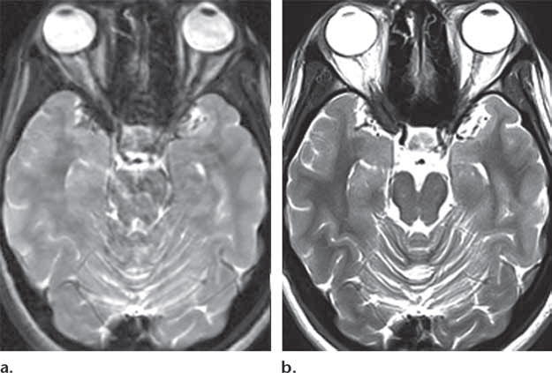
REMEDIES FOR PATIENT MOTION ARTIFACTS
OTHER REMEDIES: single shot section imaging HASTE and
Parellel imaging
DISADVANTAGE:
The higher signal intensity of periorbital fat -effect of J coupling and other factors.
AX T2-spin-echo in acquisition time 12 minutes 48 seconds
REMEDY: Fast Spin Echo
acquisition time 2 minutes 22 seconds
Images of the brain at the level of the pons shows higher spatial resolution

Slide 5
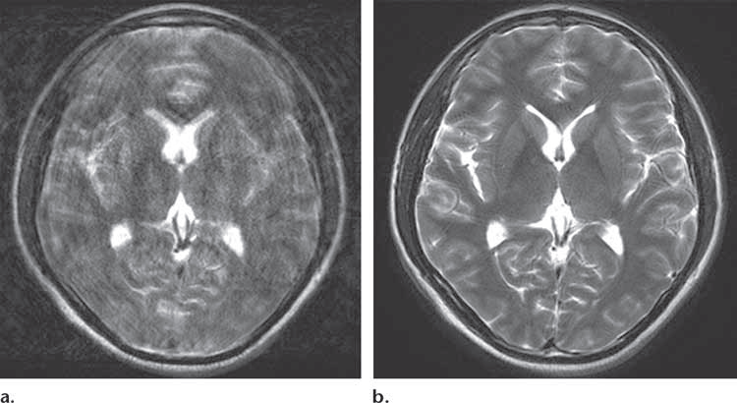
REMEDY: radial k-space sampling method (syngoBLADE, gePROPELLER)
Phase encoding changes in every section thereby reducing motion artifact
DISADVANTAGE: low spatial resolution`

Slide 6
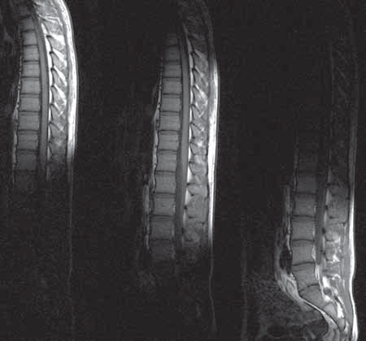
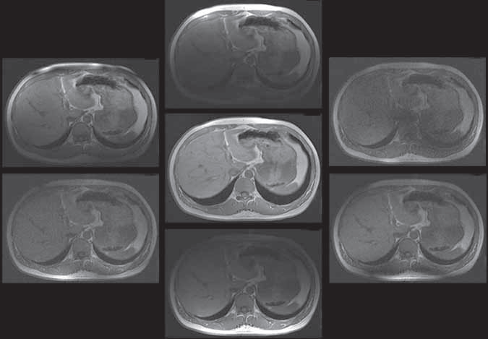
OTHER REMEDY:
MULTICHANNEL PHASED-ARRAY BODY COIL
with six elements ,
each coil element sensitive to a different region of interest,
The image at center is the final composite image—the one viewed
.
MULTICHANNEL, MULTI-COIL
systems reduce image noise by limiting the sensitivity profile of each coil to a single region of interest.

Slide 7
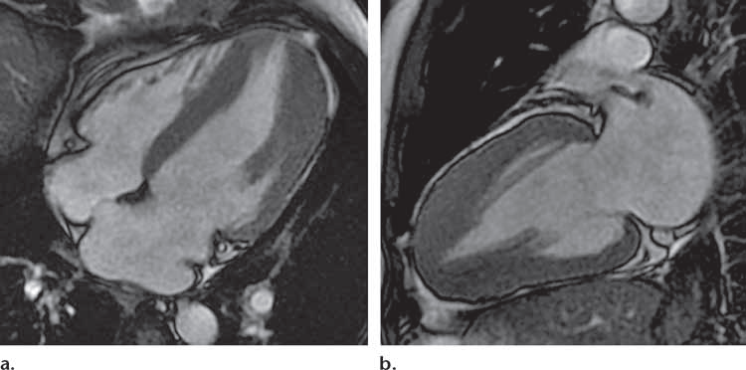
REMEDIES FOR INVOLUNTARY MOTION
CARDIAC GATING- k-space is linked with a specific time point in the cardiac cycle with help of a ECG
PROSPECTIVE TRIGGERING: image acquired at the end of diastole- static imaging – mainly for anatomy
CAUSE: CARDIAC MOTION

Slide 8
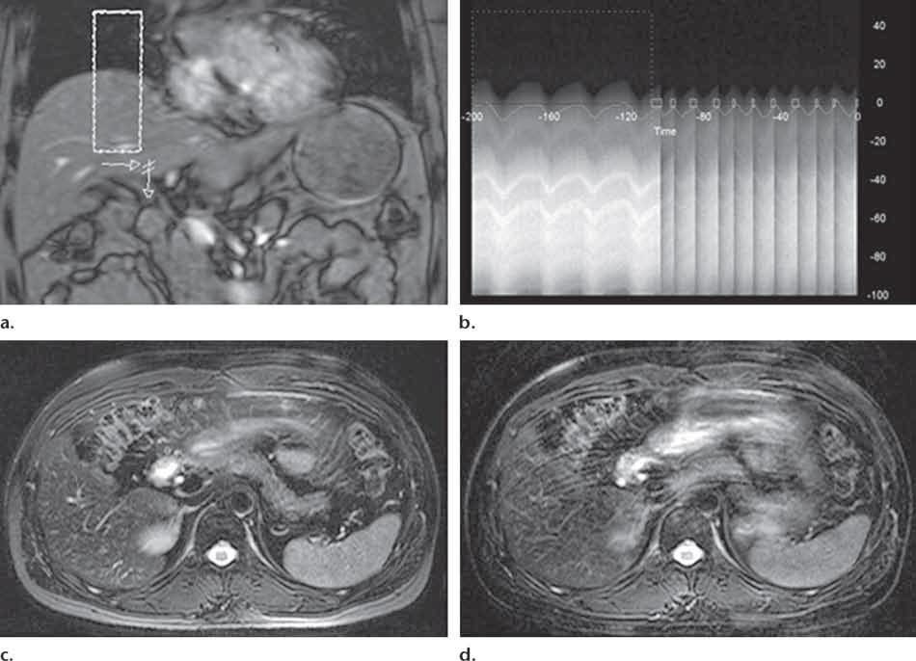
rectangular box) selected for respiratory monitoring with a navigator pulse.
). The one-dimensional temporal data is collected show the relative position of the diaphragm (y-axis) over time (x-axis
REMEDY:
Breath holding
Examination divided into breif aquisations
Gating using bellows placed at lower abdomen level
CAUSE: RESPIRATORY MOTION

Slide 9
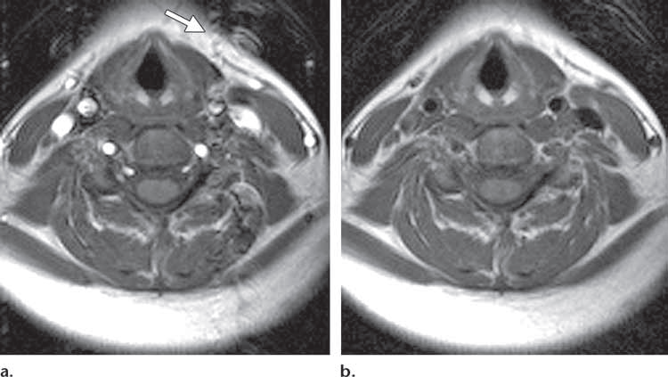
ARTIFACTS DUE TO PULSATILE MOTION
CAUSE: Artifact due to the pulsation of the vascular structures (CSF, BLOOD) ghosting will occur at a constant interval in phase encoding direction

Slide 10
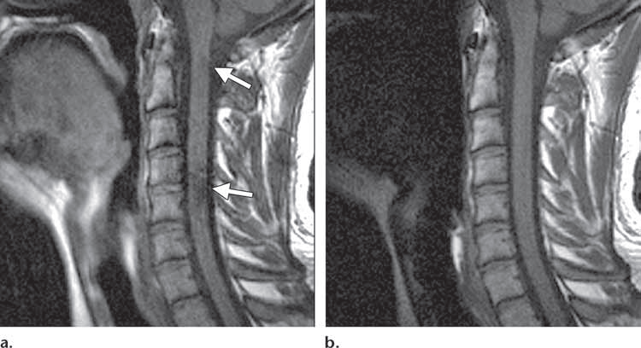
INVOLUNTARY MOTION ARTIFACTS
REMEDY: SATURATION PULSE applied anterior to the spine.
They are additional RF pulses that are applied before the imaging sequence- thereby reducing the signal intensity of pulsating stuctures
CAUSE: ESOPHAGEAL MOTION - low signal intensity (arrows) that represent ghosting artifacts
DISADVANTAGE: SAR increases

Slide 11
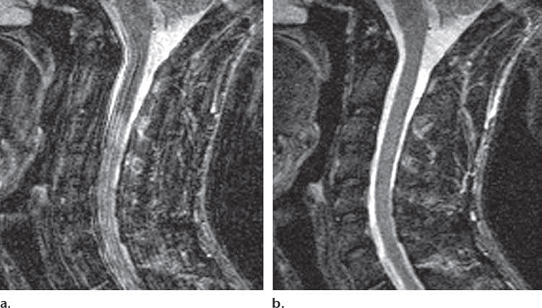
INVOLUNTARY MOTION ARTIFACTS
REMEDY: GRADIENT NULLING
Performed by applying additional gradient pulses to eliminate the phase shifts produced by moving protons,while signal from their stationary counter parts is rephased
DISADVANTAGE: more complicated gradients increased TE time which made it difficult to image T1 sequences (short TE)
CAUSE: CSF PULSATION–related atifact in the phase encoding direction

Slide 12
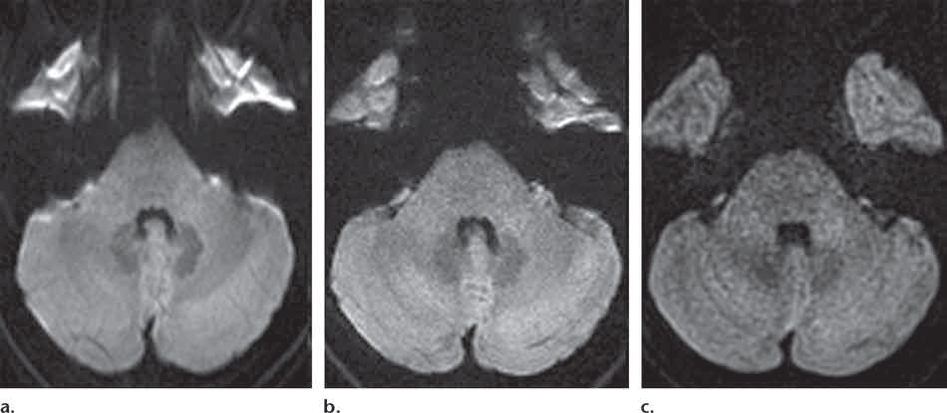
ARTIFACTS CAUSED BY FIELD DISTORTION
MAGNETIC FIELD INHOMOGENITIES: inhomogeneity in the main magnetic field causes distortion in image because of mis-mapping the signal in frequency or phase encoding
REMEDY: Radial k-space sampling
MAGNETIC SUSCEPTIBILITY ARTIFACT seen usually in echo planar imaging (diffusion weighted)- where kspace filled by one RF pulse
Artifactual pontine stretching due to MAGNETIC SUSCEPTIBILITY at the junction of the pons and sphenoid sinuses
A high-signal-intensity artifact also is seen at the interface of the temporal horns and mastoid air cells.

Slide 13
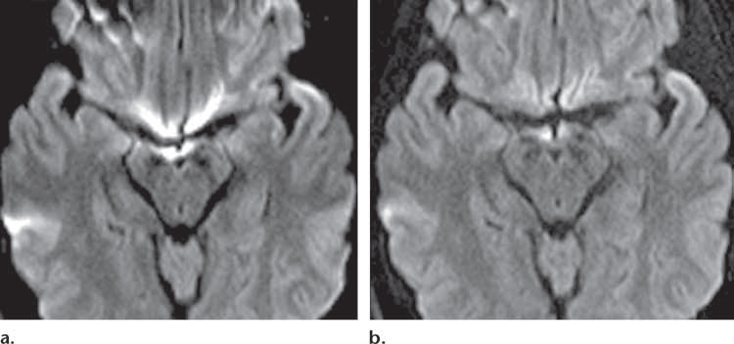
MAGNETIC SUSCEPTIBILITY
CAUSE: MAGNETIC SUSCEPTIBILITY
substantial high-signal-intensity at the junction of the midbrain and sphenoid sinus and at the interface of the temporal horns and mastoid air cells
REMEDY:
PARALLEL IMAGING factor of 4 shows the reduction of these artifacts

Slide 14
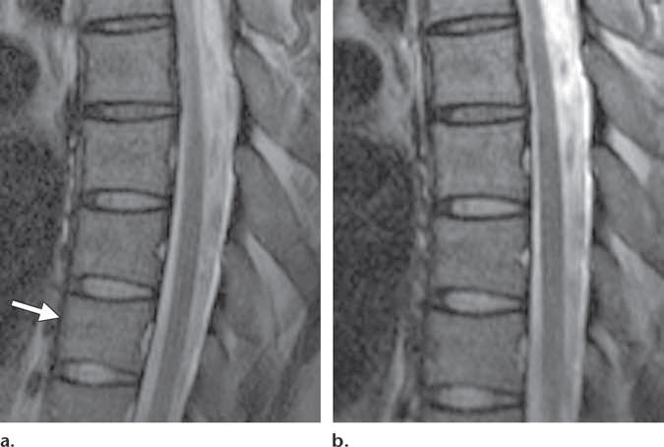
GRADIENT NON-LINEARITY
CAUSE: GRADIENT NON-LINEARITY resulting in geometric distortions, with vertebral bodies appearing progressively smaller toward the inferior edge of the FOV (arrow)
REMEDY: An automatic correction technique was used to correct the artifactual distortion. These are in built.

Slide 15
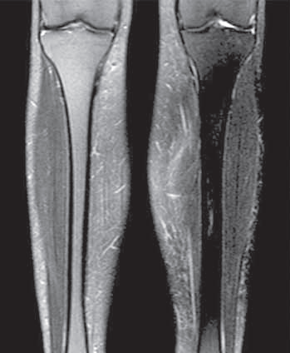
RF FIELD INHOMOGENIETY
RF FIELD INHOMOGENEITY causing prominent inhomogeneity of fat suppression.
REMEDY: independent control of the RF transmission elements- RF SHIMMING

Slide 16
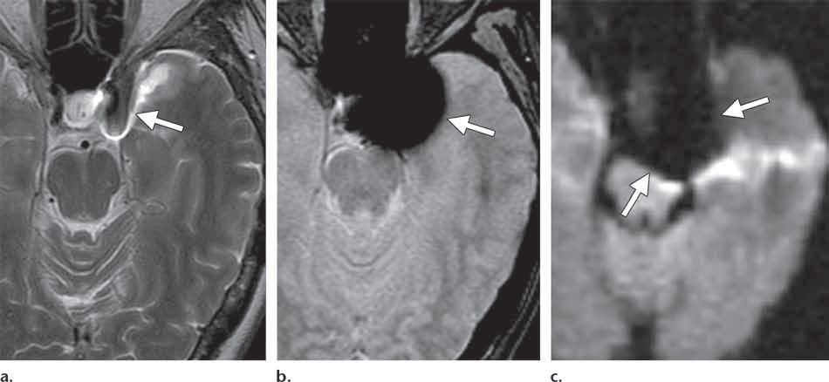
METTALLIC OBJECTS ARTIFACT
OTHER REMEDIES:
Smaller pixel sizes
Using a short TE or short inter-echo interval
Increasing the sampling bandwidth
REMEDY:
Adding of a 180° RF PULSE- time of TE/2 –inverts the polarity of phase change among protons.
so, at TE, the protons that were exposed to field inhomogeneities are once again in phase with those that were not exposed to those inhomogeneities.
CAUSE: METALLIC OBJECT ARTIFACT
Due to its presence (eg: surgical hardware), it distorts nearby structures and also may result in signal dropout, depending on the sequence used
Aneurysm clip seen without affecting image quality
T2 spin echo

Slide 17
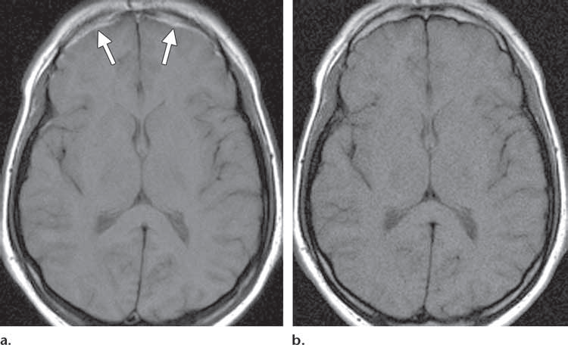
CHEMICAL SHIFT ARTIFACT
REMEDY:
Higher bandwidth sampling rate
Fat suppression will eliminate it totally
Adjust orientation of frequency encoding so decrease in ROI
CAUSE: CHEMICAL SHIFT ARTIFACT due to differences in larmor frequency of fat and water leads spatial mis-registration of the MR signal
Seen more in fat-water interface

Slide 18
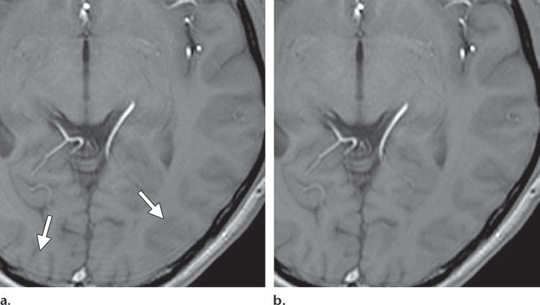
TRUNCATION ARTIFACT
CAUSE: data is omitted(truncated) in k-space,causing signal intensity of a given pixel on the final image to vary from its ideal intensity
Manifest as ripple
REMEDY: Decrease the pixel size or use additional filters

Slide 19
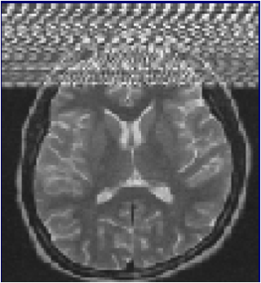
ZIPPER ARTIFACT
CAUSE: extraneous RF entering the room at a certain frequency.
Leak in the RF shielding of the room
REMEDY:
Call the engineer to locate the leak and repair it.
dense line on the
image at specific point

Slide 20
ALIASING OR WRAP AROUND ARTIFACT
REMEDY:
Increasing sampling bandwidth/oversampling
Use of surface coil in ROI
Switching phase and frequency encoding direction
Saturation pulses may be applied to structure non-imaged
Occurs when the field of view (FOV) is smaller than the body part being imaged
Caused by undersampling in the phase or (rarely) frequency direction.
May occur in end slices of a 3D acquisition

Slide 21
Slice-overlap (cross-slice) Artifacts
Correction:
Avoid steep change in angle between slice groups.
Use separate acquisitions.
Use small flip angle, i.e. GE sequence
Loss of signal seen in an image from a multi-angle, multi-slice acquisition.

Slide 22
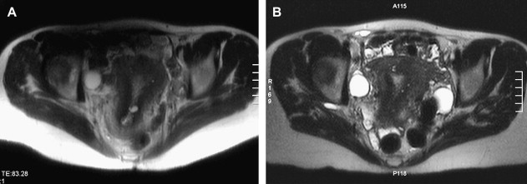

SHADING ARTIFACT
CAUSE:1. uneven excitation of pulse due to RF pulse applied other than 90 & 180
2.Abnormal loading of the coil
3.When patient body touches the coil
REMEDY:
1.Correct excitation
2.Load the coil correctly
3.Position the patient without touching the coil
Difference in signal intensity across the imaging volume

Slide 23
Black Line Artifact
Occurs at TE when the fat and water spins located in the same pixel are out of phase, cancelling each other’s signal. Particularly noticeable on GE sequences. Both freq and phase direction
An artificially created black line located at fat-water interfaces such as muscle-fat interfaces.
REMEDY
Use in-phase TE’s
Fat suppression
Increase bandwidth or matrix size.

Slide 24
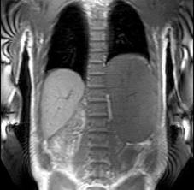
MOIRE ARTIFACT
CAUSE: combination of wrap & inhomogeneity in gradient sequence.
Banding Appearance
REMEDY: use SE sequence or ensure the patient keeps their arms within the FOV
A black and white banding artifact , always seen in gradient echo imaging typically when large FOV is used.

Slide 25
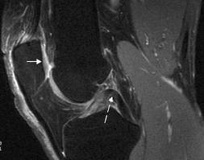
MAGIC ANGLE
Appears as high signal intensity on some tendons and mimic pathology
REMEDY:
1.alter the position of anatomy
2. Change TE
CAUSE: structures that contain tightly bound fibres lie at an angle of 55 deg to the main field ,altering its signal intensity

Slide 26
Thank you

