Slide 1
SILVER RECOVERY
By Passang D. Sherpa
Course Coordinator of
Radio-imaging Technology
Dpt. Of paramedical science

Slide 2
SILVER RECOVERY
Reclamation of silver after it has been used for its intended photographic purpose
Sources-
used fixer solution
Scrap films

Slide 3
REASONS
Profit
Economic
Anti-pollution
Conservation
efficiency

Slide 4
METHODES OF RECOVERING
ELECTROLYSIS
METALIC REPLACEMENT

Slide 5
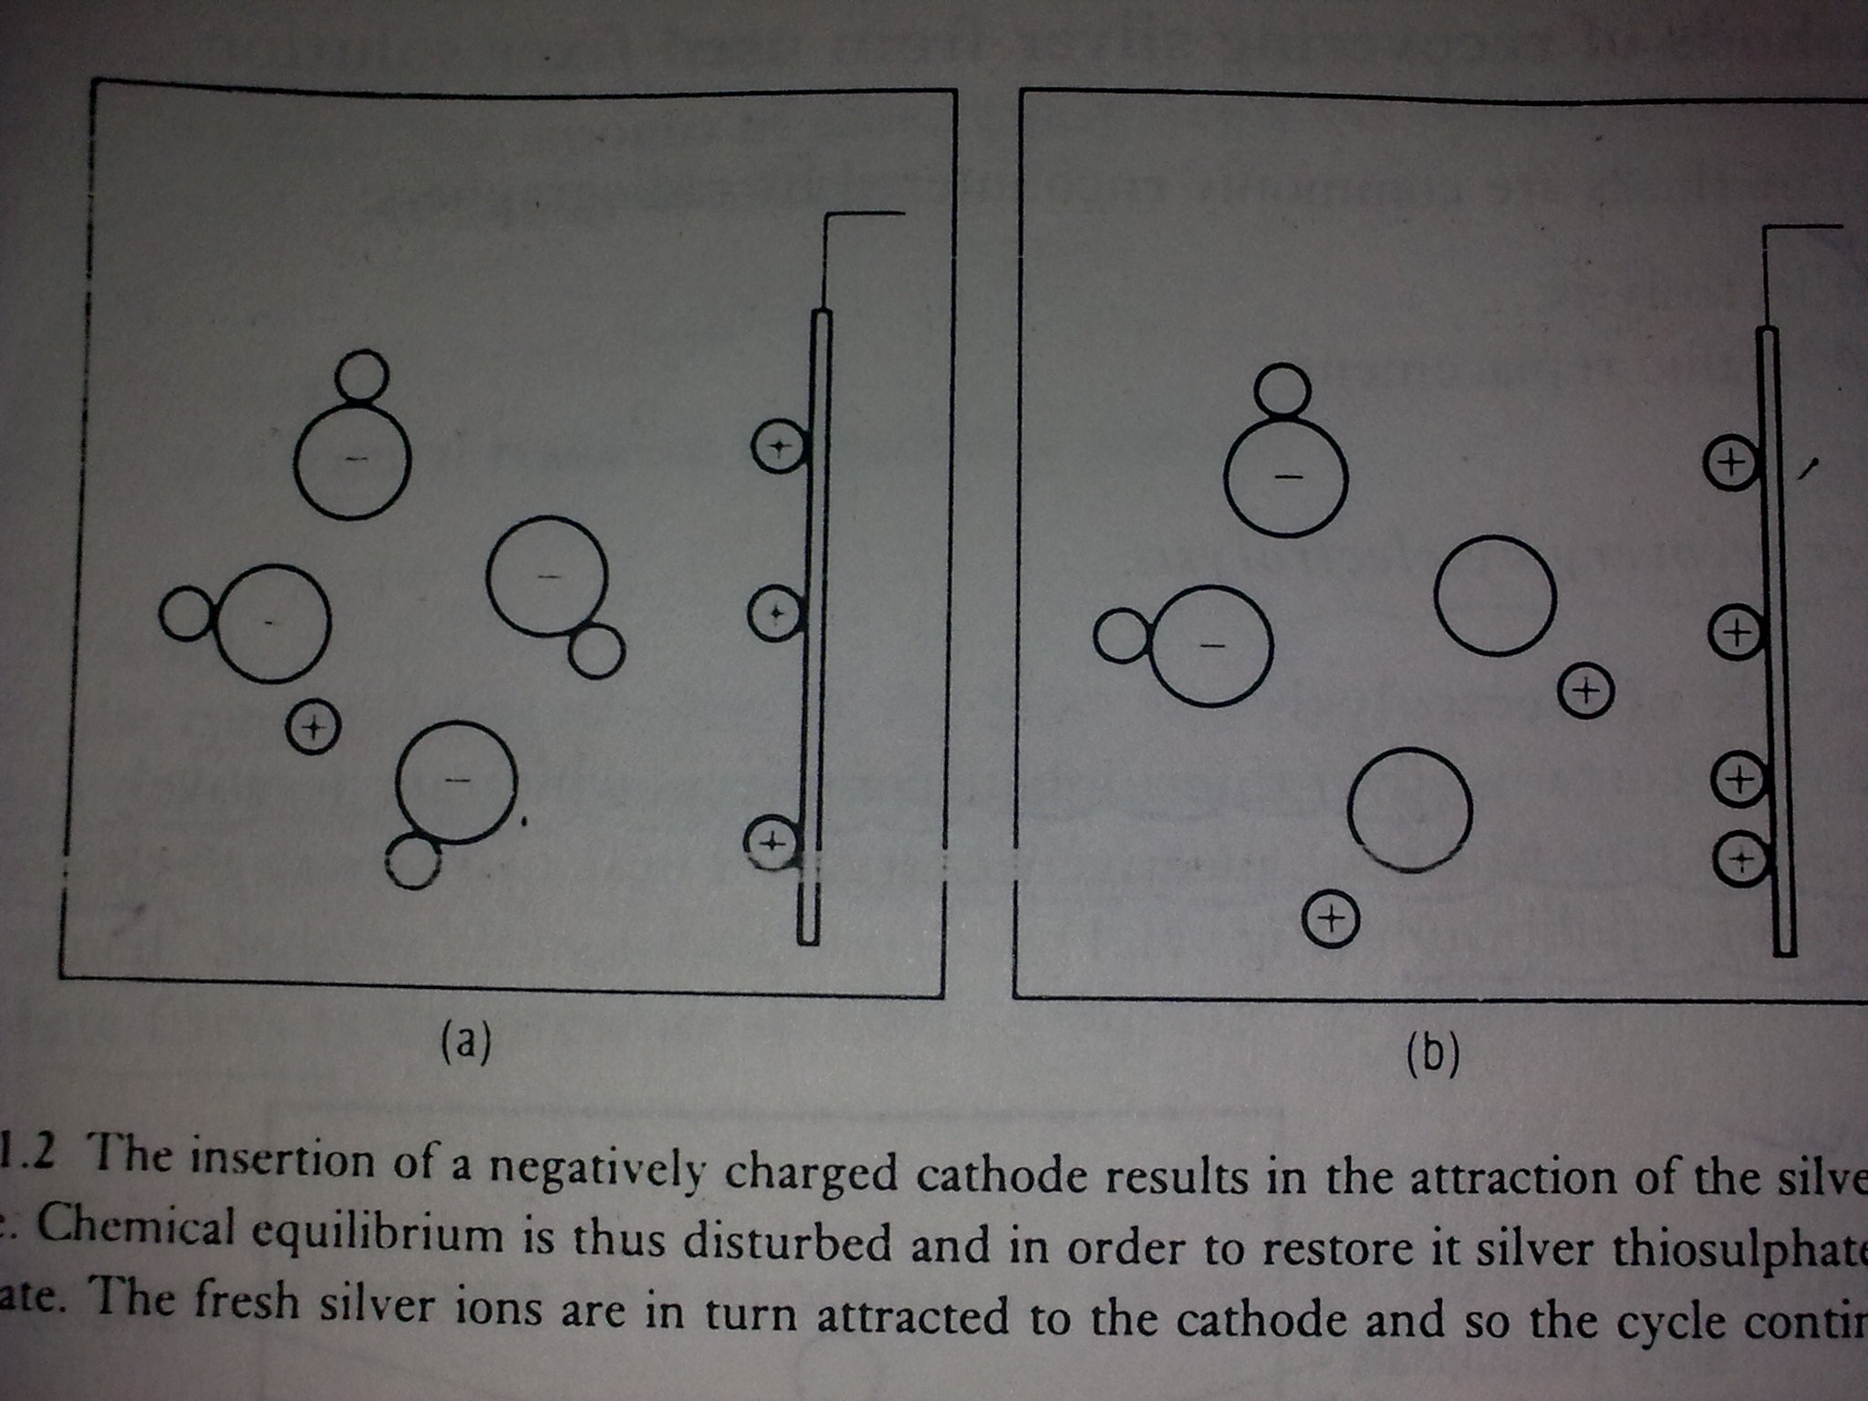
ELECTROLYSIS

Slide 6
HIGH CURRENT DENSITY ELECTROLYSIS
It uses currents up to 20 A
UNIT CONSISTS OF
  Holding tank
  Recovery tank
  Control unit

Slide 7
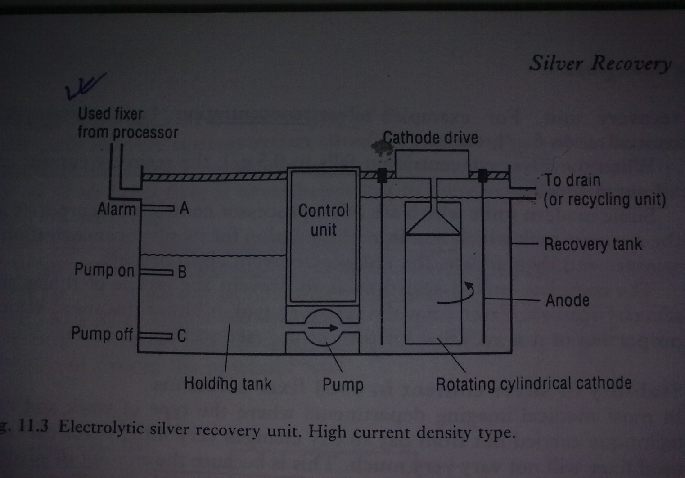

Slide 8
HOLDING TANK
  Holds used fixer
  Silver concentration 4-6 grams/L
  3 float operated switches. When the fixer level rises to B the pump is energized and fixer flow to recovery vessel
  If fixer level fall below C the pumping stops
RECOVERY TANK
  Silver is collected in the centrally placed stainless steel cathode.
CONTROL UNIT
  Provides a low voltage DC voltage to the electrolytic unit

Slide 9
ADVANTAGES
  High purity of silver thus less costly to refine
  Fixer may be recycled
  Silver easily removed from cathode
  Cleaner method than metal exchange
  DISADVANTAGE
  Equipment is costly
  Efficiency depends on regular monitoring

Slide 10
METALIC REPLACEMENT
PRINCIPLE-
  If base metal such as copper , iron or zinc are placed in a solution containing silver salts, the base metals dissolve into the solution while the silver is deposited out of the solution in exchange.

Slide 11
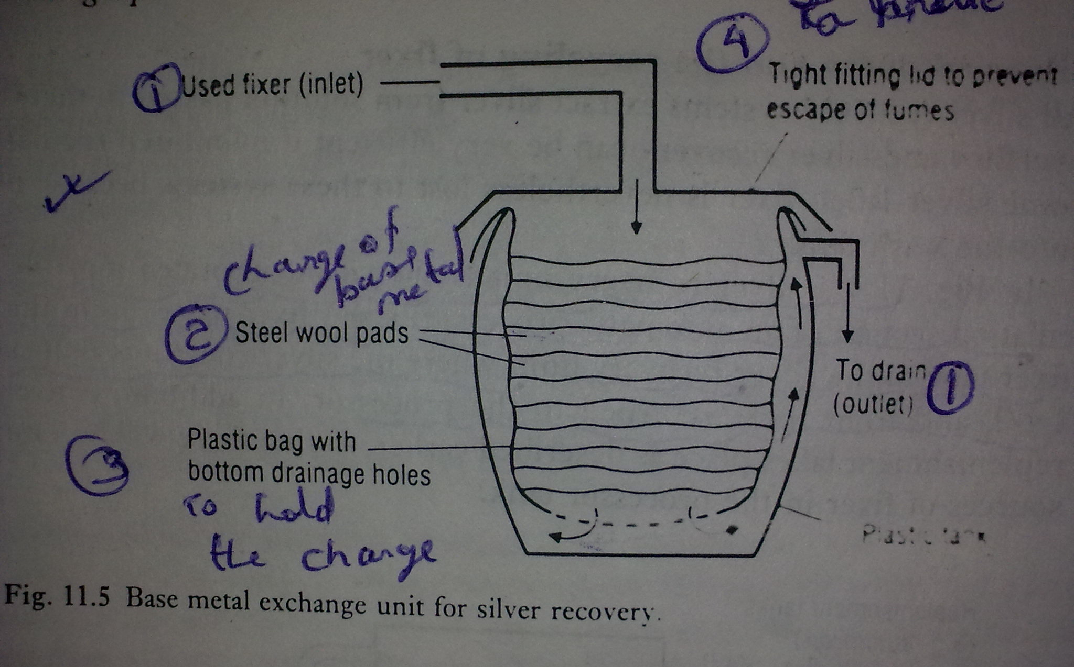

Slide 12
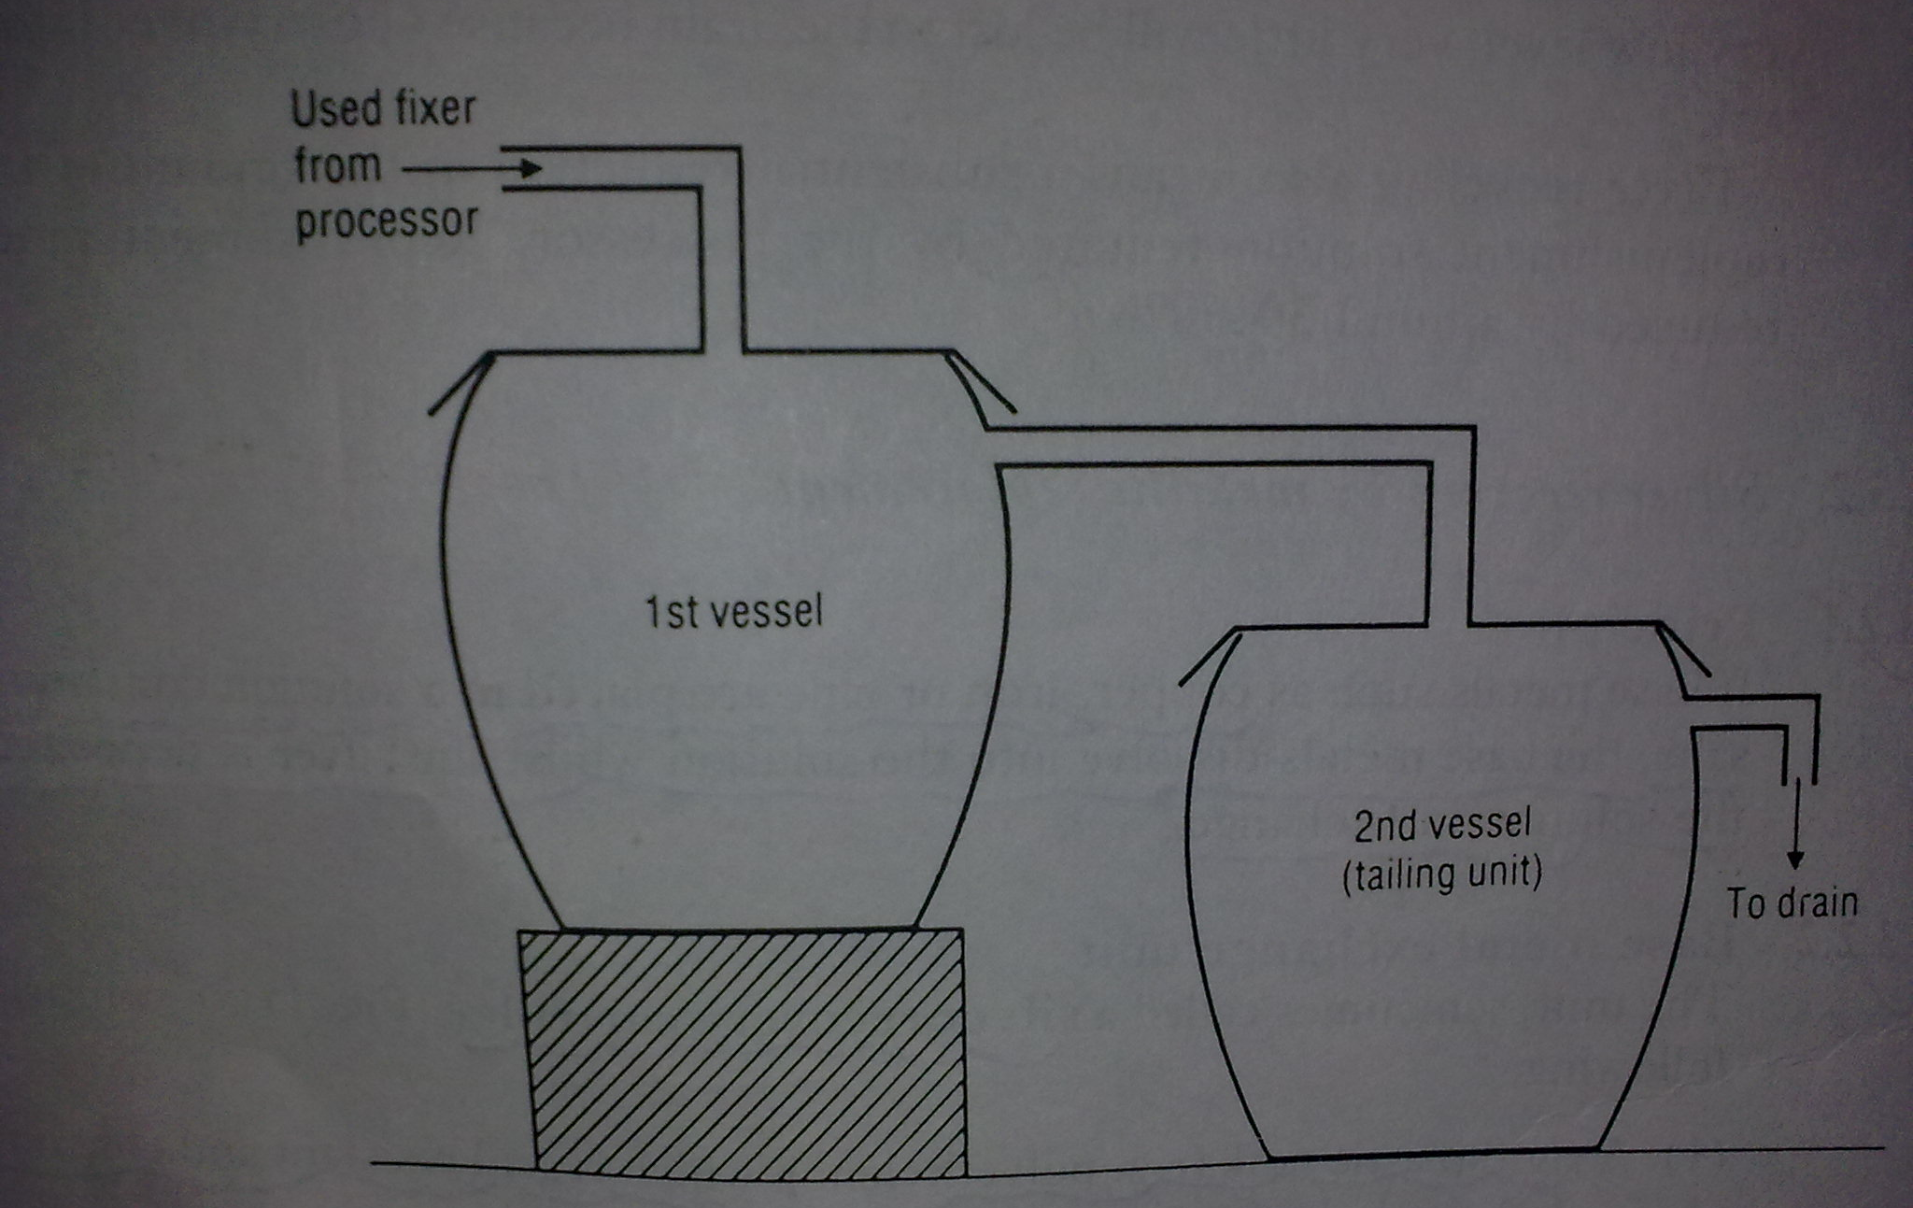

Slide 13
BASE METAL EXCHANGE UNIT
  A rigid plastic tank witch is acid resistant and contains inlet and outlet holes.
  A charge of base metal(eg.. Steel wool)
  A plastic bag or liner to hold charge
  A light fitting lid to prevent the escape of fumes

Slide 14
Fixer enters the unit through and passes down through steel wool
Metal exchange occurs
The steel will dissolves to leave a silver precipitate witch accumulate in the base of the liner
The silver free fixer passes out.

Slide 15
ADVANTAGE
  Equipment is inexpensive
  Efficiency is more
  Easy to install
  No electric supply required
DISADVANTAGE
  Fixer can’t be used again
  The efficiency of unit falls as the metal charge becomes exhausted
  smell if lid is not securely fitted

Slide 16
RECOVERING FROM FILM
CHEMICAL
  Bulk film is mechanically broken into fragments
  It is then subjected to chemical wash
  The silver rich solution is passed through electrolytic recovery units
BURNING
  Involves burning of the films and recovering silver from the ashes

Slide 17
THANK YOU

