Slide 1
TMT AND STREES TESTING introduction and protocols
Presented by: Yash Rakholiya

Slide 2
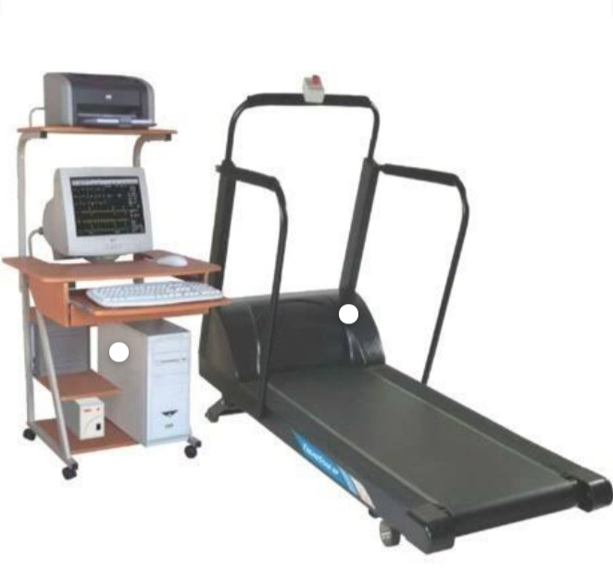
TMT
MACHINE

Slide 3
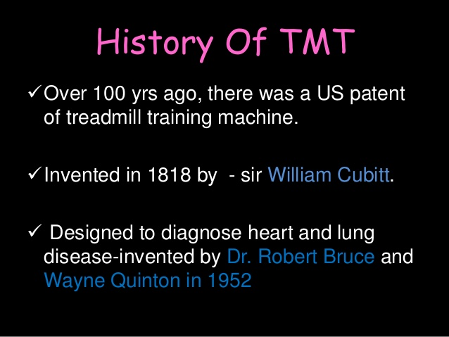
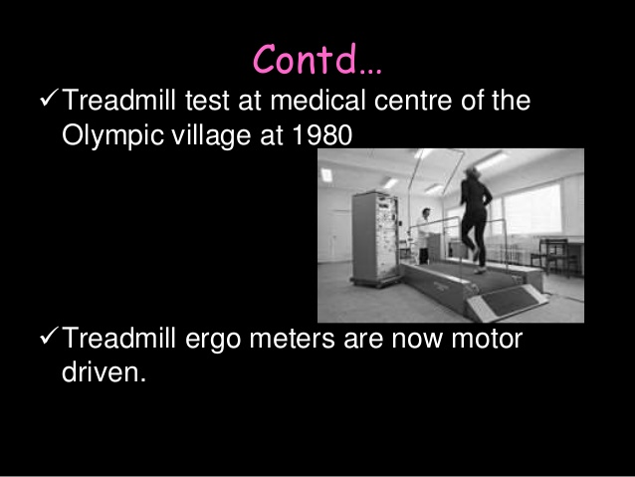
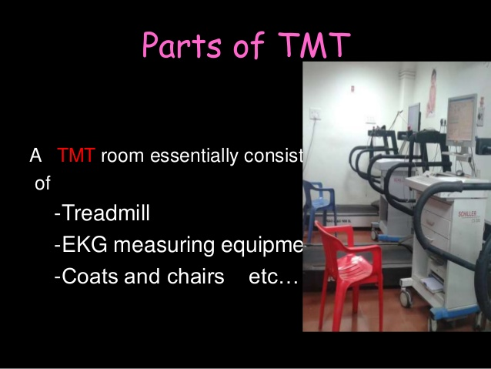
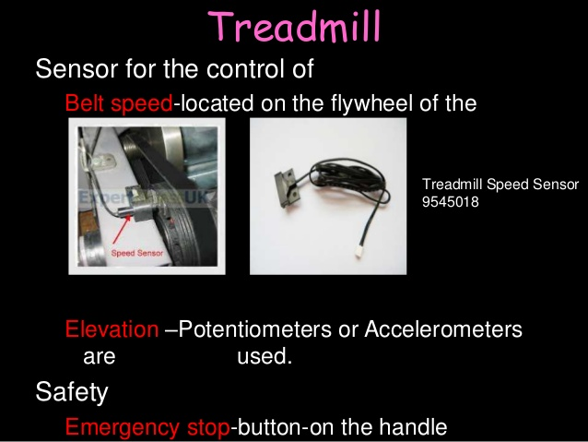

Slide 4
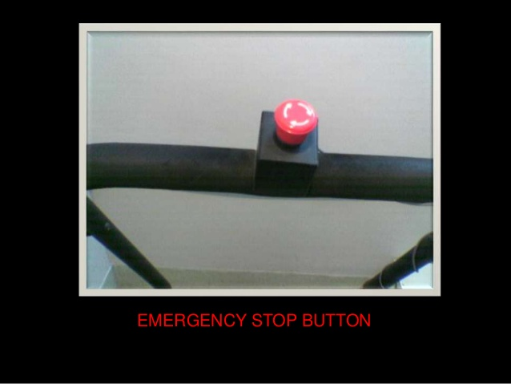
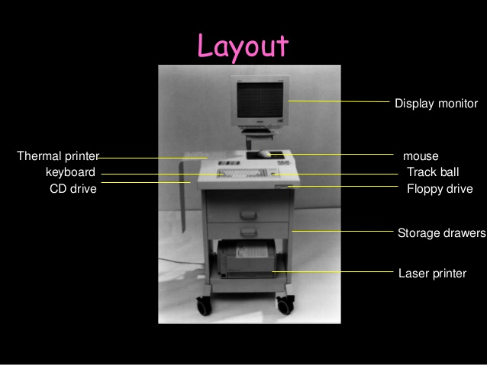
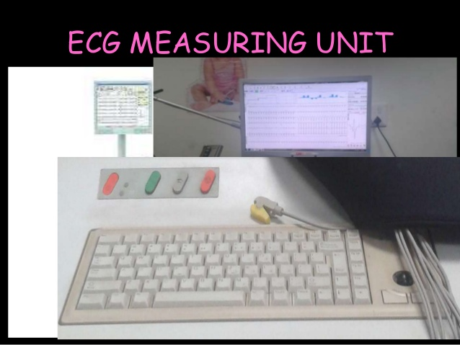
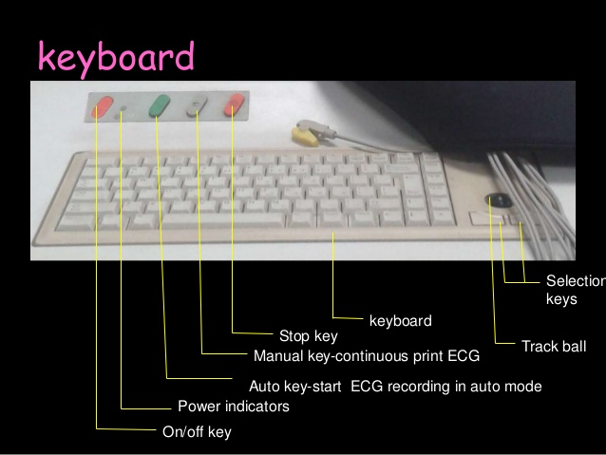

Slide 5
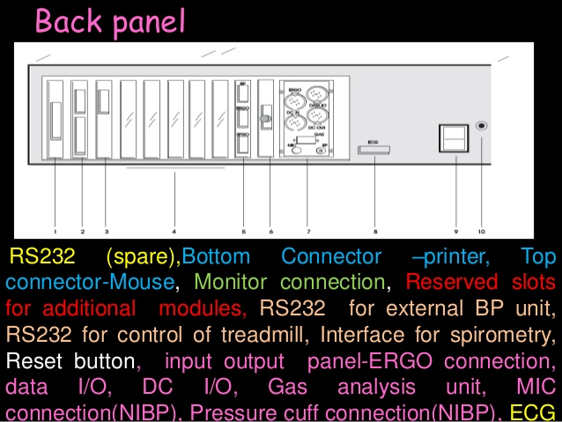
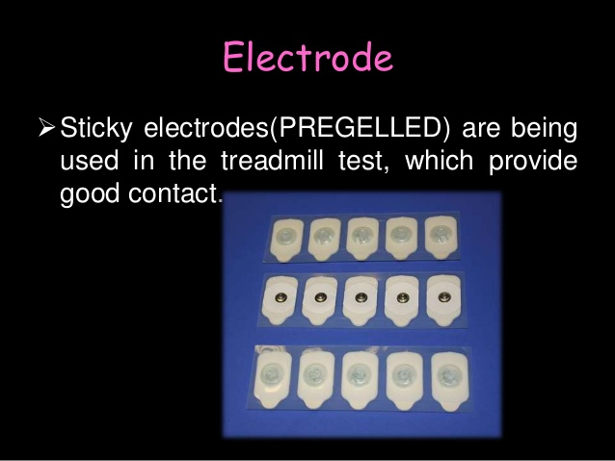
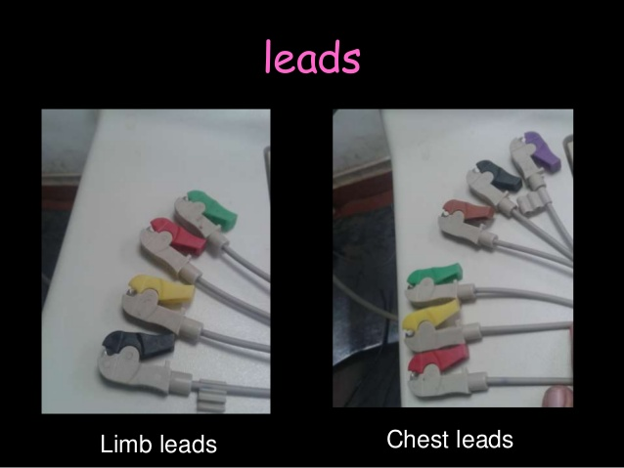

Slide 6
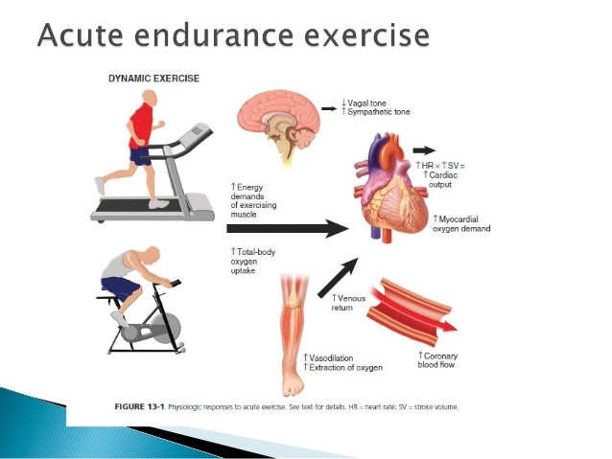

Slide 7
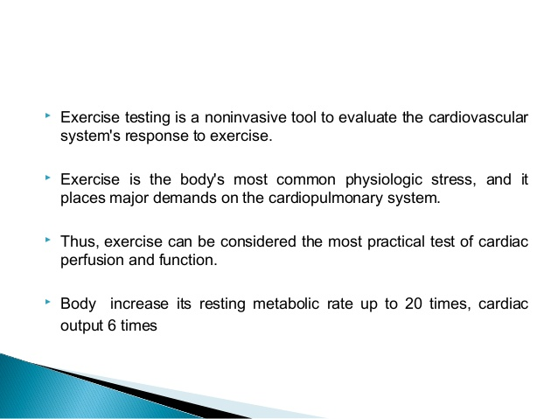
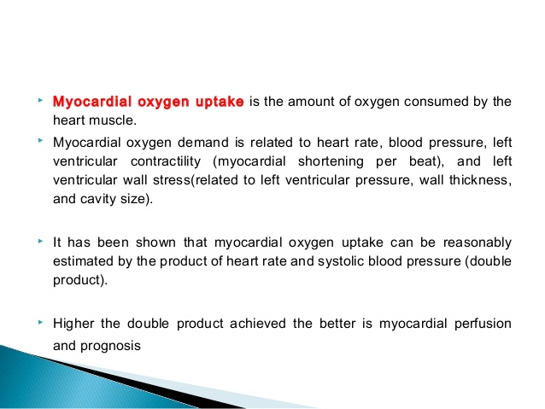

Slide 8
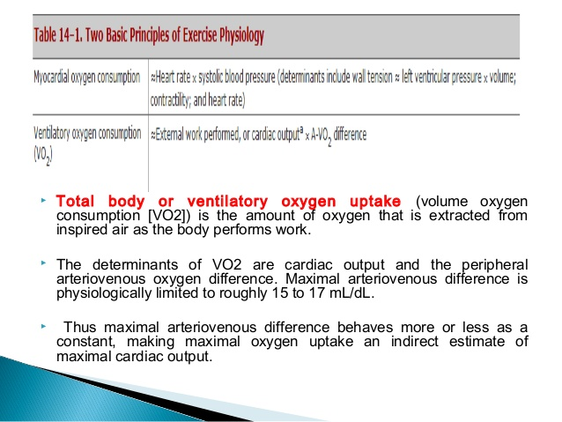

Slide 9
Metabolic Equivalents  Exercise testing fundamentally involves the measurement of work.
 The MET, or metabolic equivalent, is a term commonly used clinically to express the oxygen requirement of the work rate during an exercise test on a treadmill or cycle ergometer.
 One MET is equated with the resting metabolic rate (approximately 3.5 mL of O2/kg/min)

Slide 10
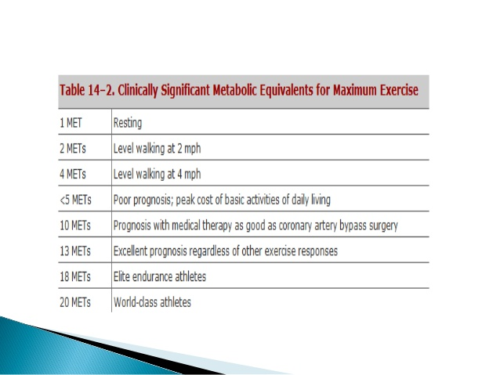

Slide 11
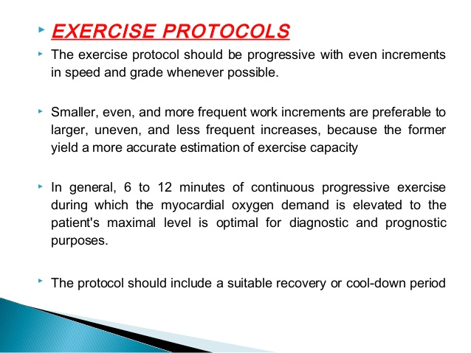

Slide 12
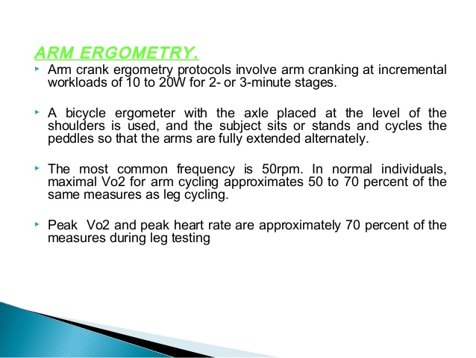
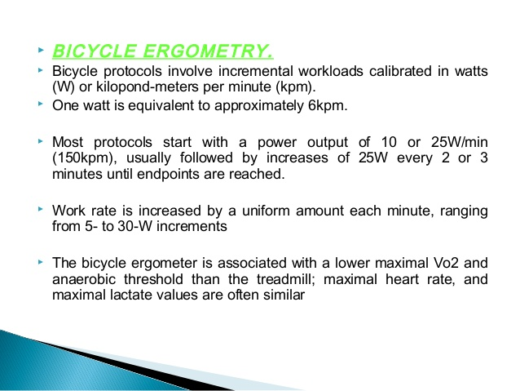

Slide 13
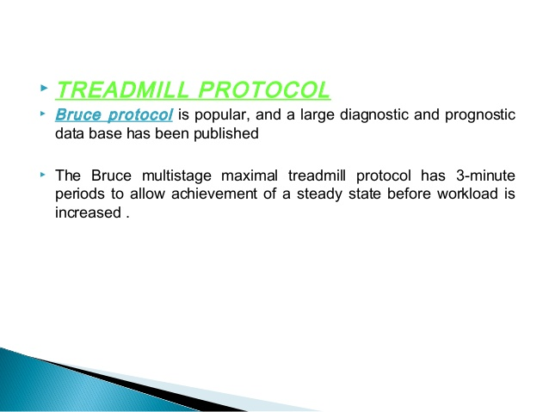
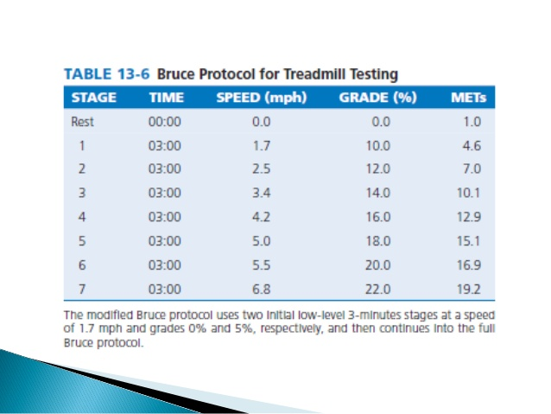

Slide 14
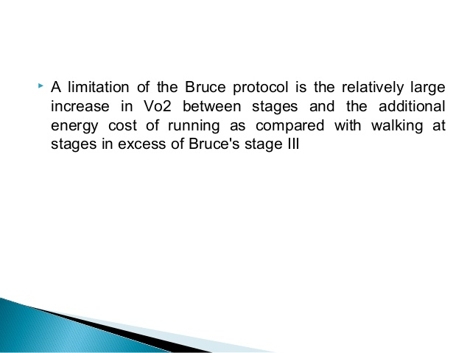
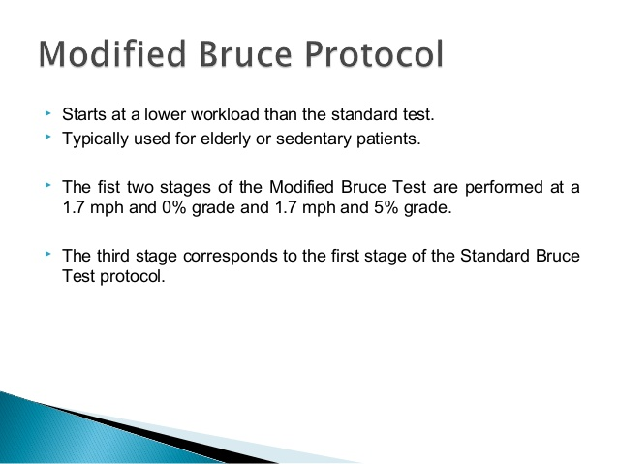

Slide 15
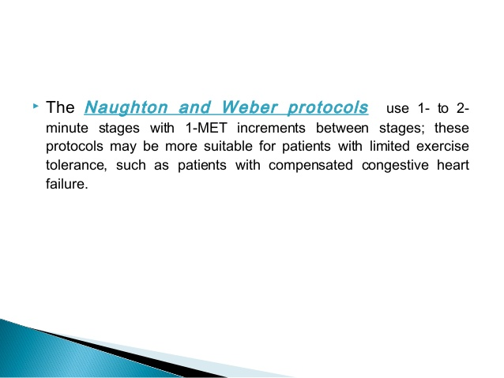
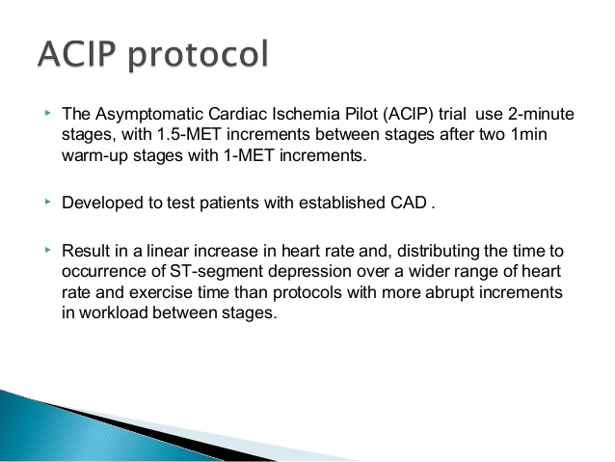

Slide 16
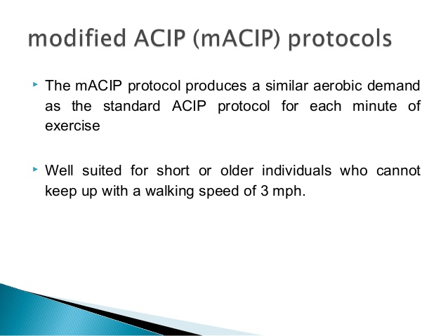
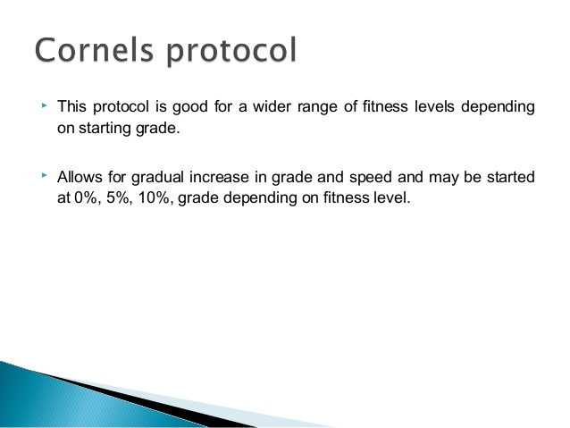

Slide 17
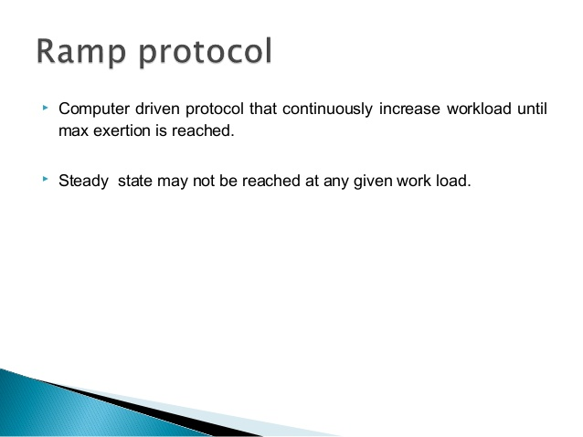
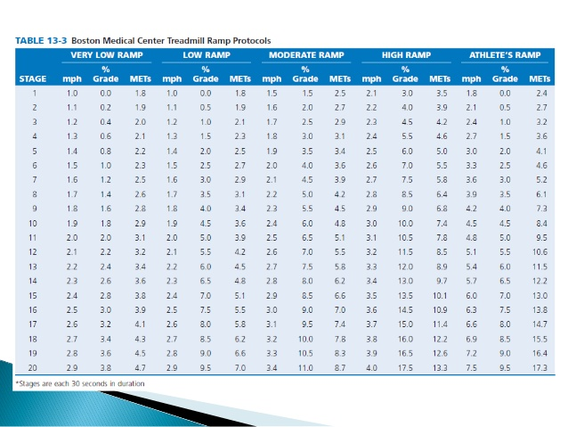

Slide 18
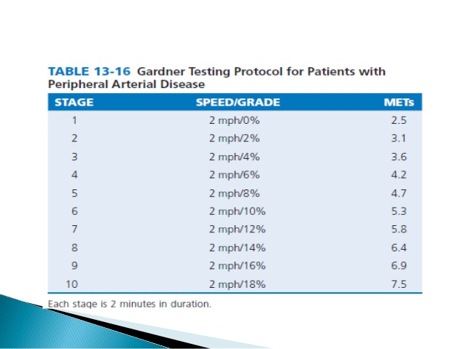
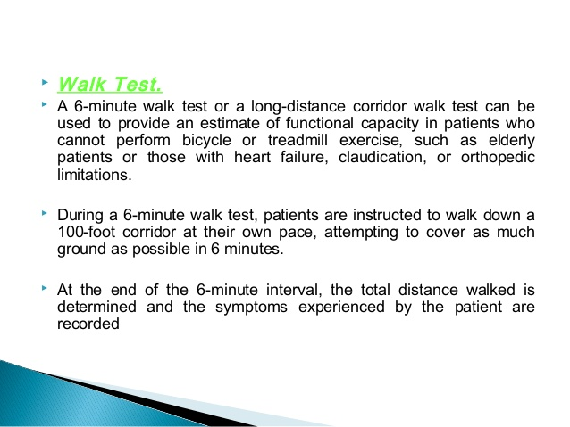

Slide 19
Indication for terminating exercise
1.St segment elevation more than 1mm in leads without Q waves caused by prior myocardial infarction.
2.Drop in systolic blood pressure of more10mmg despite an increase in work load when accompanied by any other evidence of ischemia.
3.Moderate to severe angina.
4.Central nervous system symptoms :ataxia dizziness, near syncope.
5.Signs of poor perfusion.
6.Sustained ventricular tachycardia or other arrythmia that interfere s with normal maintenance of cardiac output during exercise.
7.Technical difficulties monitoring the ecg or systolic blood pressure.
8.Patients request to stop.

Slide 20
Relative indication
Marked STT,segment displacement horizontal or down sloping of more than 2mm in a patient with suspected ischemia.
2. Drop in SBP more than 10mmhg persisitently below base line despite an increase in workload ,in the absecnce of other evidence of iscahemia.
3. Increase in chest pain.
4. Fatigue ,shortness of breath wheezing leg cramping or claudication.arrythmia other than sustained VT including multifocal ectopy ventricular triplets SVT,atrioventricular heart block or bradyarrythmias.
5. Exaggerated hypertension response (SBP morethan 250mmhg and diastolic bp morethan 115mmhg).
6. Development of bundle branch block that cannot be distinguished from VT.

Slide 21
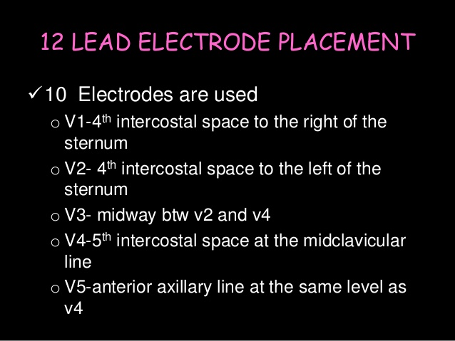
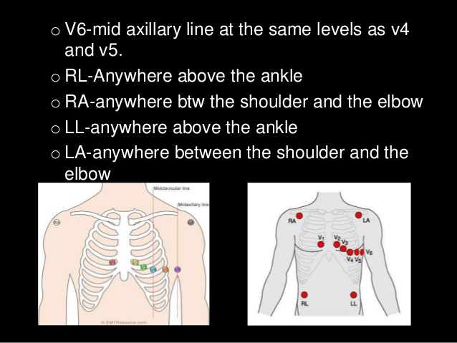

Slide 22
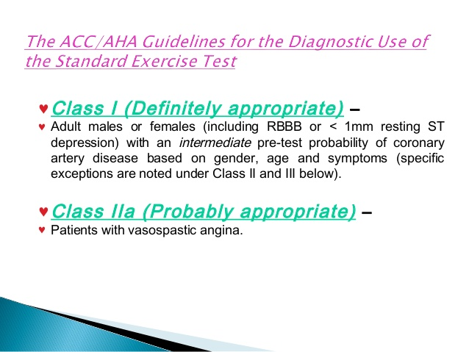
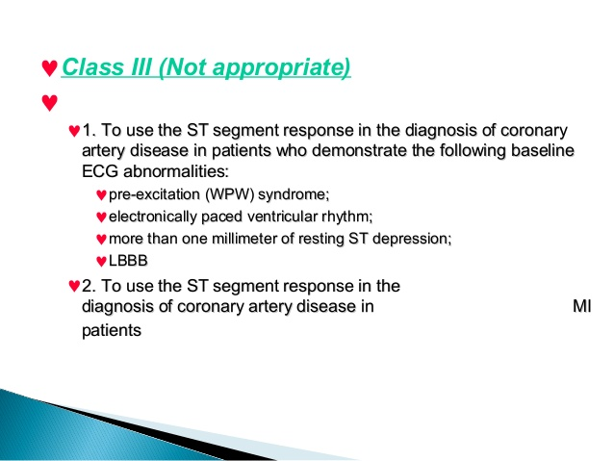

Slide 23
ACC/AHA practice guidelines on exercise testing
pretest probability of coronary artery disease by age sex and symptoms
AGE | TYPICAL ANGINA | ATYPICAL ANGINA | NONANGINAL CHEST PAIN | ASYMPTOMATIC
30-39 | INTERMEDIATE | VERY LOW | VERY LOW | VERY LOW
40-49 | INTERMEDIATE | LOW | VERY LOW | VERY LOW
50-59 | INTERMEDIATE | INETRMEDIATE | LOW | VERY LOW
60-69 | HIGH | INTERMEDIATE | INETRMEDIATE | LOW
≥70 | HIGH | INTERMEDIATE | INTERMEDIATE | LOW

Slide 24
Contraindication of exercise testing Absolute
1.acute myocardial infarction with in 2days.
2.high risk unstable angina.
3.uncontrolled cardiac arrythmias.
4.active endocarditis.
5.symptomatic severe aortic stenosis.
6.decompensated heart failure.
7.acute pulmonary embolism or infarction .
8.acute myocarditis ,pericarditis.
9.physical disability that precludes safe and adequate testing.

Slide 25
RELATIVE CONTRAINDICATIONS
1.known left main coronary artery stenosis.
2.moderate aortic stenosis with uncertain relation to symptoms.
3.tachyarrythmia with uncontrolled ventricular rates.
4.acquired complete heart block.
5.hypertrophic cardiomyopathy with severe resting gradient .
6.mental impairment with limited ability to cooperate .

Slide 26
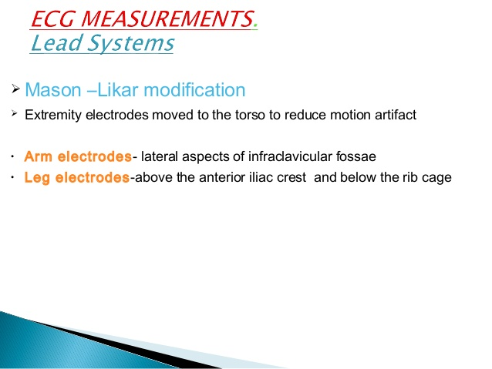
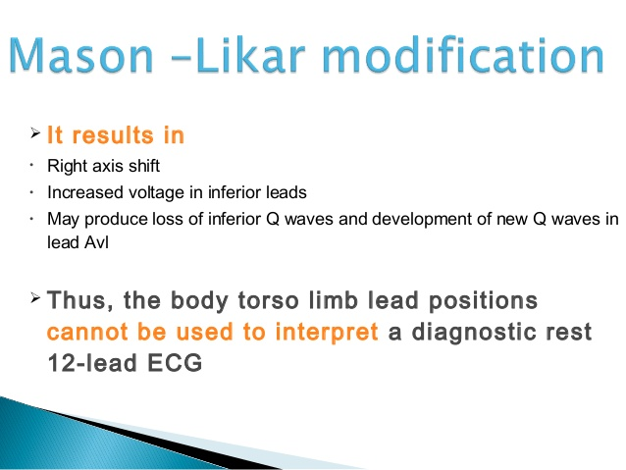

Slide 27
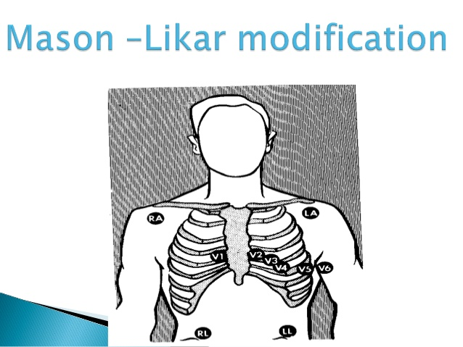

Slide 28
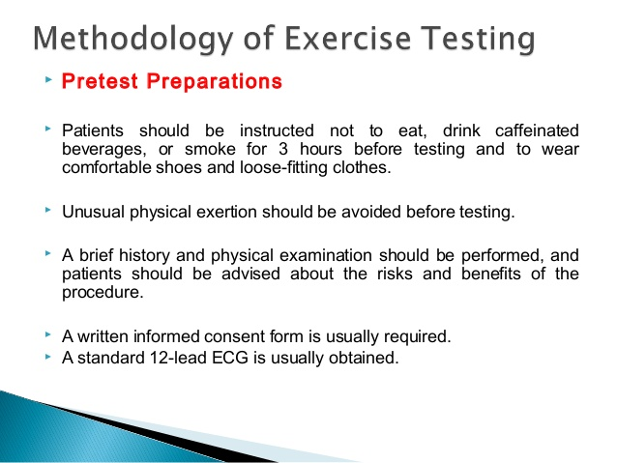
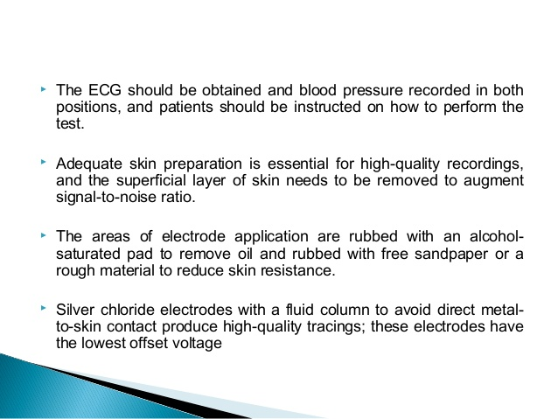

Slide 29
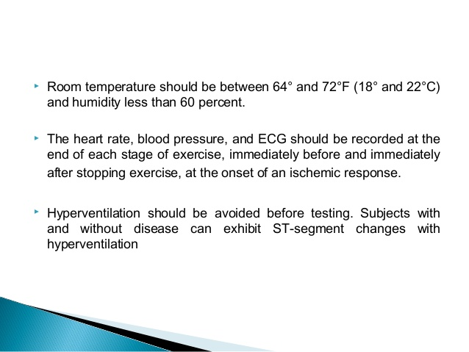

Slide 30
