Slide 1
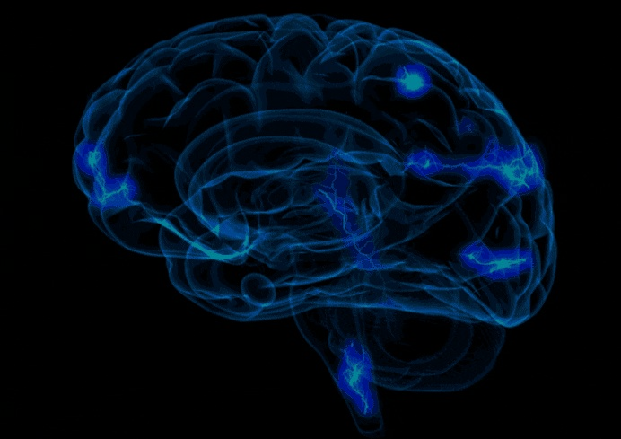
aphasia
Faculty:
Dr. Santosh Kumar
Professor
Dept. of Audiology and Speech Language Pathology, SVDU

Slide 2
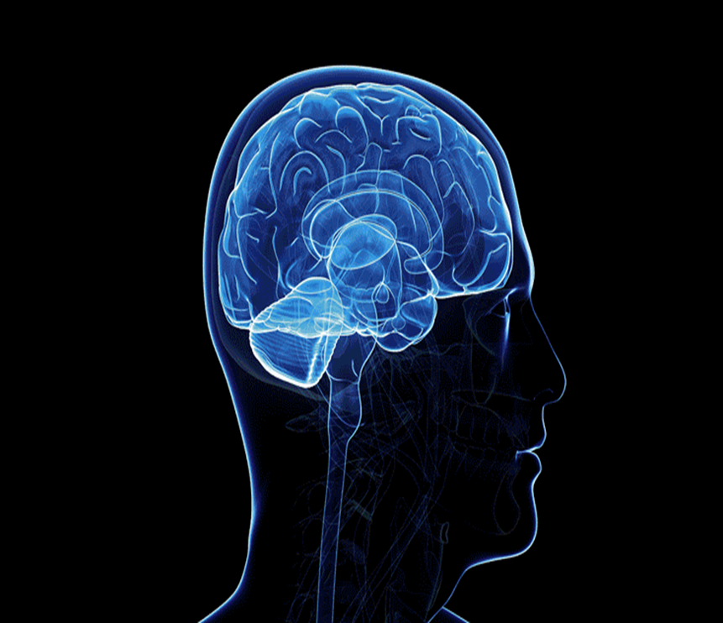
Aphasia
Benson (1979) defined aphasia as ‘‘. . . the loss or impairment of language caused by brain damage’’. This definition, according to most aphasiologists, is accurate According to the current paradigm, aphasia is a disorder of language opposed to a nonlinguistic disorder and is caused by brain damage rather than by a functional, psychogenic, or anaffective disorder.
Kussmaul (1877) "... The impairment of execution, expression or understanding of any symbols by which man communicates his ideas or feelings to others

Slide 3
Chapey (1981)
"An acquired impairment in language and the cognitive processes which underlie language caused by organic damage to the brain.
It is characterized by a reduction in and dysfunction of language content or meaning, language form or structure and language use or function and the cognitive processes which underlie language such as memory and thinking."

Slide 4
We considered that a good way to define aphasia is to make sure we include four elements in our definition:
1. It is acquired.
2. It has a neurological cause.
3. It affects reception and production of
language across modalities.
4. It is not a sensory, motor, psychiatric, or intellectual disorder.

Slide 5
Anatomical classification of Aphasia
Fluent type of Aphasia
Non – Fluent type of Aphasia

Slide 6
Fluent Aphasia:- Lesion in the posterior portion of the cortex.
Individual may appear to be non-fluent for any of a variety of reasons, or according to any of a large array of measures. Generally, persons with aphasia are considered fluent if they can speak in spontaneous conversation without abnormal pauses, abundant nonmeaningful filler phrases, or long periods of silence.
Non – Fluent Aphasia:- Lesion in the frontal region of the cortex.
Non - fluent patients tend to have a reduced rate of speech and to express less communicative content per
unit of time than normal speakers do. Of course, patients who are completely nonverbal are nonfluent.

Slide 7
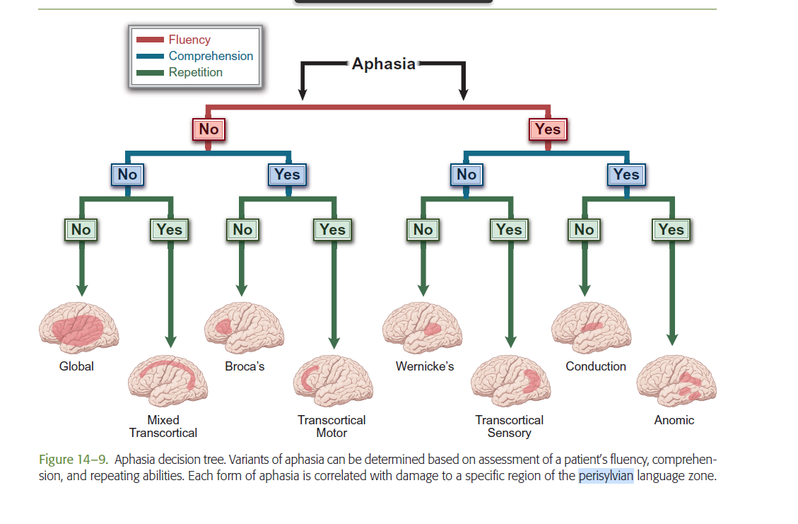

Slide 8
FLUENT
TRANSCORTICAL SENSORY APHASIA
WERNICKE’S APHASIA
CONDUCTION APHASIA
NON - FLUENT
BROCA’S APHASIA
TRANSCORTICAL MOTOR APHASIA
ISOLATION APHASIA
ANOMIC APHASIA
GLOBAL APHASIA

Slide 9
Types
Characteristics
Agrammatism
Effortful speech
Short, telegraphic phrases
Presence of apraxia
Marked naming problems
Slow speech rate, lacking intonation
Poor reading and writing ability
Relatively good auditory comprehension
Broca’s aphasia
Transcortical motor aphasia
Intact repetition
Lack of spontaneous speech
Naming problems
Short, telegraphic sentences
Good articulation
Agrammatism
Paraphasias

Slide 10
CONDUCTION APHASIA
Marked difficulty repeating words and phrases
Only minor comprehension problems
Good articulation and prosody
Naming problems
Recognition of errors with attempts to self-correct

Slide 11
Marked naming difficulty
Severely impaired comprehension
Mild to moderately impaired repetition skills
Isolation aphasia
All language functions severely affected
Severe deficits in comprehension and production
Naming problems
Difficulty with gestural skills
Impaired reading and writing
Global aphasia
Fluent but meaningless speech
Severe auditory comprehension deficit
Jargon, paraphasias, and neologisms
Good articulation and intonation
Naming difficulties
Poor reading comprehension
Writing deficits
Wernicke’s aphasia

Slide 12
Marked difficulty repeating words and phrases
Only minor comprehension problems
Good articulation and prosody
Naming problems
Recognition of errors with attempts to self-correct
Conduction aphasia
Transcortical sensory aphasia
Intact repetition
Poor auditory comprehension
Naming difficulties
Paraphasias
Marked naming problems
Near-normal language
Good comprehension
Good repetition skills
Relatively good auditory comprehension
Good articulation
Good grammatical structures
Anomic aphasia

Slide 13
ETIOLOGY
Cerebrovascular accidents(strokes)
Ischemic strokes
Hemorrhagic strokes
Intracranial Neoplasms
Meningioma
Metastatic tumors

Slide 14
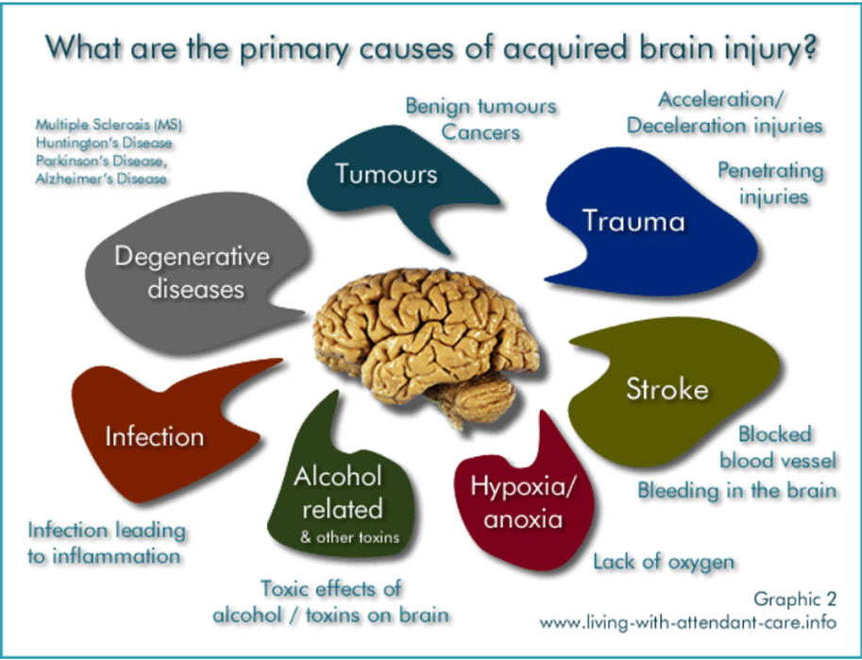

Slide 15
Brain Trauma
Metabolic
Brain abscess
Toxic damage
Obstructive hydrocephalus
Viral infection

Slide 16
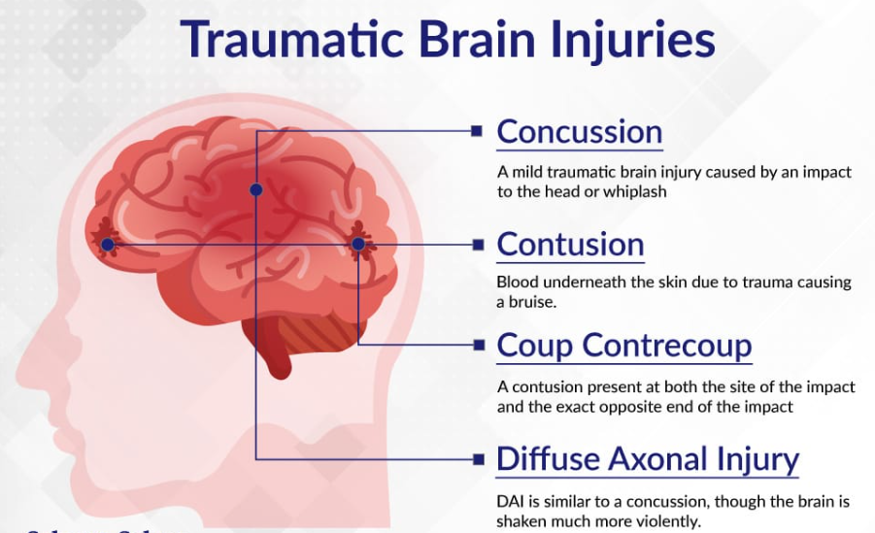
Traumatic brain injury
Traumatic brain injury (TBI), also called acquired brain injury, closed head injury, or simply head injury occurs when a sudden trauma causes damage to the brain.
TBI can result when the head suddenly and violently hits an object, or when an object pierces the skull and enters brain tissue.
Symptoms of a TBI can be mild, moderate, or severe, depending on the extent of the damage to the brain.

