Slide 1
MULTI FREQUENCY MULTI COMPONENT TYMPANOMETRY
Faculty:
Mr. Mukesh Sharma
Associate Professor
Dept. of Audiology and Speech Language Pathology, SVDU

Slide 2
INTRODUCTION
Acoustic immittance :
Acoustic impedance to acoustic admittance or both the quantities
Acoustic impedance (Z- in acoustic milliohm):
The opposition to the flow of sound energy
Acoustic admittance (Y-in acoustic millimho) :
Ease of flow of sound energy through a system.

Slide 3
Acoustic Impedance
Acoustic impedance
Frictional component- Acoustic resistance (Ra)
Stiffness component – Negative (stiffness) acoustic reactance
(-Xa)
Mass component - Positive (mass) acoustic reactance (+Xa)

Slide 4
Acoustic Admittance
Acoustic
Admittance
Acoustic conductance - (Ga)
Stiffness component – Positive (stiffness) acoustic susceptance (+Ba)
Mass component-Negative (mass) acoustic susceptance (-Ba)

Slide 5
TYMPANOMETRY
Tympanometry is the measurement of the acoustic immittance at the level of probe tip or eardrum (compensated) with various amount of air pressure in the ear canal.
Transmission of the sound energy will be maximum when the air pressure is equal in both sides of the tympanic membrane.
There will be maximum amount of sound transmission when the atmospheric pressure equals the middle ear pressure.

Slide 6
TYPES OF TYMPANOMETRY
Low probe tone tympanometry :
Acoustic immittance (usually acoustic admittance) will be recorded using 226Hz.
High frequency tymanometry : This make use of probe frequencies such as 600Hz, 678Hz, 800Hz, 1000Hz.
Multi frequency and multi component tympanometry : A broad spectrum of ranges with two or more probe tones tympanogram obtained

Slide 7
NEED FOR MULTI FREQUENCY AND MULTICOMPONENT TYMPANOMETRY
Single frequency tympanogram is not appropriate in identifying the high impedance pathology affects the ossicular chain such as neoplasm, otosclerosis and ossicular fixation.
The abnormality is more clearly observed when the probe frequency is near to the middle ear resonance frequency (800-1200Hz).

Slide 8
NEED FOR MULTI FREQUENCY AND MULTICOMPONENT TYMPANOMETRY
Continued…..
Appropriate frequency for tympanometry was initially considered as 800Hz (Liden, Bjorkman &Peterson, 1972). It was proved that it is appropriate for neonates.
When a transmission system possesses on or more resonant frequencies then the changes in the transmission characteristics can be easily identified that also the probe tone frequency is approximate to the middle ear resonant frequency.

Slide 9
NEED FOR MULTI FREQUENCY AND MULTICOMPONENT TYMPANOMETRY
Continued…..
Comparison of the tympanometric data between below, near and above the resonance frequencies will give more diagnostic information than a single frequency probe tone.
Give more information about aditus and mastoid hair cells (Shanks, 1984).

Slide 10
MULTI FREQUENCY TYMPANOMETRY
Colletti (1975, 1976, 1977) developed multi frequency tympanometry for identifying the middle ear pathologies.
According to him the instrument will be capable of generating continuously variable probe tone between 200-2000Hz and this provided an option for detailed analysis of the middle ear via tympanometry.

Slide 11
Tympanometric Pattern :By Colletti
V shaped pattern : This was observed for stiffness controlled middle ear with a probe frequency bellowed the 1000Hz.
Notched W shaped pattern : This was obtained from 650-1400 Hz near the resonating frequency of the middle ear.
Inverted V shaped pattern : This was obtained above 1400 Hz with mass loaded middle ear.

Slide 12
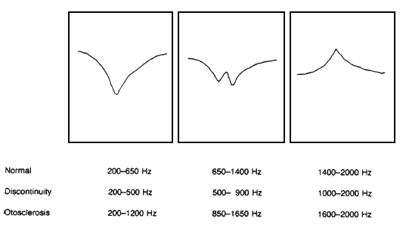

Slide 13
MULTI COMPONENT TYMPANOMETRY
Tympanometry which can measure the admittance sub components such as susceptance (Ba) and conductance (Ga).
While varying the pressure across a range of frequency is known as multi frequency and multicomponent (Ba/Ga) tympanometry (Willey&Flower ,1997).
Give information about the magnitude of the static admittance

Slide 14
Mass susceptance directly proportional to frequency and compliance is inversely proportional to frequency.
Whenever there is an increase of frequency then the total susceptance (mass susceptance+ stiffness susceptance) also increases. So the system will be stiffness controlled (Positive ) to zero (resonance) and mass controlled (negative).

Slide 15
Recording and Measuring
Measurement starts by 200Hz and the pressure change will be 0f -200 to +200 mm H2O descending direction with a pump speed of 10mm H2O.
Measurement repeated by 200Hz increment.
When new tympanogram obtained increase the frequency resolution and keep the step size as 20Hz.

Slide 16
Methods of Measuring
Sweep frequency
Pressure will be kept as constant and the frequency will be varied across a broad range.
Sweep pressure
Frequency will be held as the constant and the pressure will be varied.

Slide 17
Mesures of multi frequeuncy and multi component tympanometry
Tympanometric configuration:Vanhuyse model.
High frequency probe tone can result in multiple peaks which were initially considered as the anomalies of the tympanic membrane and the ossicles.
Studies showed that the multiple probe tone of frequencies less than 650 Hz can result in notched admittance peak in normal ears.

Slide 18
This is due to the interaction between the resistance and reactance in the middle ear
Carried out in pressure of -300 to +300 dapa.
Important contribution in understanding the multi frequency and multi component tympnometry.

Slide 19
This will divide the tympanogram based on the number of peaks (positive/ negative) and predicts four tympanometric patterns at 678 Hz.
Named as 1B1G, 3B1G, 3B3G and 5B3G based on the number of positive and negative peaks or externa in the susceptance and conductance tympanogram.
Complexicity of the tympanogram will increase based on the interaction between the resistance and reactance.

Slide 20
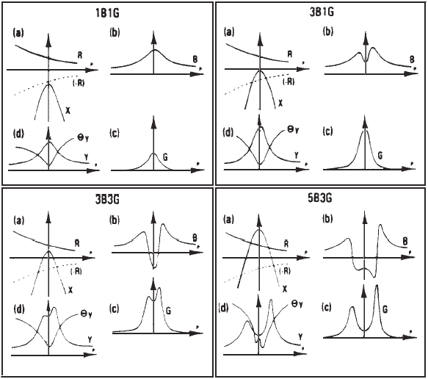
Figure : The Vanhuyse et al. (1975) model showing four patterns for susceptance (Ba) and
conductance (Ga) tympanograms, 1B1G (A); 3B1G (B); 3B3G (C); and 5B3G (D).

Slide 21
Assumptions of this model:Changes in the resistance and reactance as a function of ear canal pressure.
Acoustic resistance (R) will decrease monotonically as a function of negative to positive pressure change.
Acoustic reactance (x) is a single peaked function symmetric around the ambient air pressure.

Slide 22
1B1G Pattern
One peak for the susceptance (B) and one peak for the conductance (G).
B will be shifted towards the positive side and G will be shifted towards the negative side.
Susceptance will be usually greater than conductance.
Reactance will be the negative value.

Slide 23
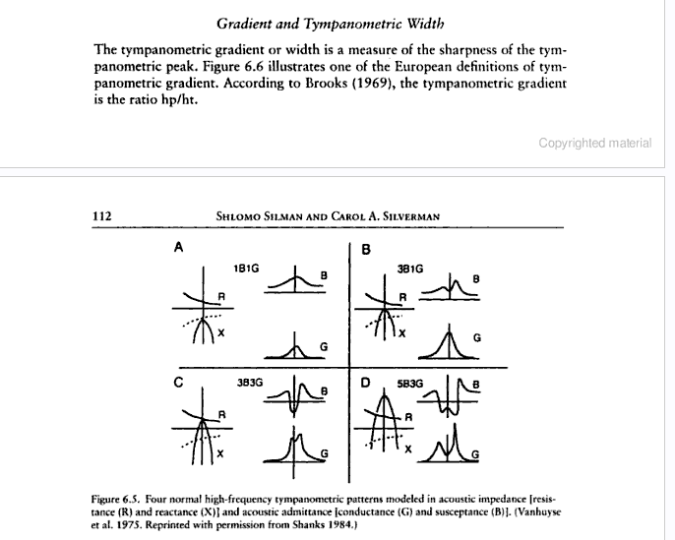

Slide 24
3B1G Pattern
Susceptance will have three peaks in the tympanogram (two peaks in the side and notch in the center) and one peak of conductance.
Obtained in two condition,{where the phase angle will be between the 0 and 45 degree}.
resonance condition
stiffness dominated condition

Slide 26
3B3G Pattern
Three peaks for the conductance as well as the susceptance.
Obtained when the system is in resonance or mass controlled the phase angle is between 0 and -45 degree.

Slide 28
5B3G Pattern
Susceptance tympanogram will have five peaks and conductance will have three peaks.
Obtained in the condition of mass dominated system where the phase angle is between -45 and -90 degree.

Slide 29
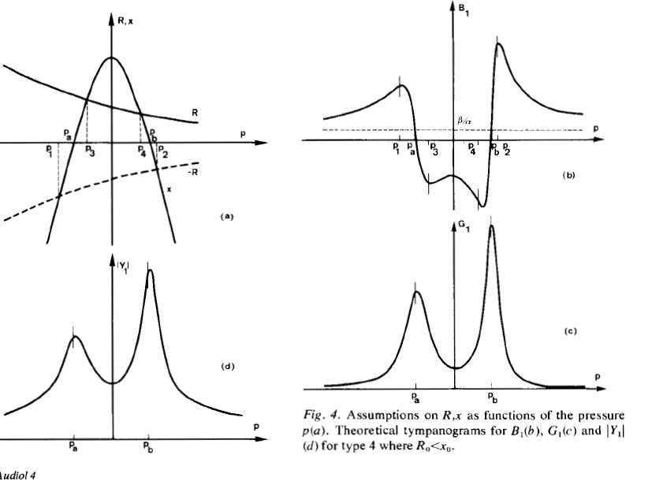

Slide 30
Interpretation of the model
If the low probe tone frequencies are used for tympanometric measurements then presence of multiple peaks can be an abnormal condition.

Slide 31
In the case of high frequency probe tone the presence of multiple peaks are applicable only in conditions
Peaks should not exceed 5 for susceptance and 3 for conductance.
Distance of the maxima externa should not exceed 75dapa in 3B3G pattern and 100dapa for 5B3G pattern.
Distance between the outermost maxima externa of G should not exceed the maxima of B.

Slide 32
Resonant frequency
In this frequency region the outer and middle ear operates most efficiently .
This region the mass and stiffness will have less impact over the impedance.
The sum of mass and stiffness will be zero and resonant frequency.

Slide 33
The primary utility of the MFT is to identifying the resonating character of the middle ear ie, whether it is higher than the resonating frequency (otosclerosis) and it is lower than the resonating frequency (ossicular discontinuity).

Slide 34
The simple method of estimating the resonating frequency will be establishing the point at which the susceptance approximates the positive tail (Hunter and Margolis, 1992).
A quantitative way of estimating RF includes a sweep-frequency approach where the difference between B at a tympanogram tail (either positive or negative) and B at peak pressure (e.g., ΔB) is plotted as a function of frequency; the frequency at which ΔB approaches 0 (0 mmhos) is considered the middle-ear RF (see Hunter and Shahnaz, 2014).

Slide 35
Phase of angle of 45­ degree
This refers to the frequency which is corresponding to the 45 degree angle of admittance.
Lowest frequency where the susceptance and conductance becomes equal or larger than the compensated value.
This can be measured using susceptance ad conductance tympanogram.

Slide 36
It will be shifted upward or downward based on the middle ear pathology.
45° phase angle may be a better index than resonant frequency with respect to distinguishing healthy ears from otosclerotic ears (Shanks, Wilson, & Palmer, 1987; Shahnaz, Polka, 1997).

Slide 38
Disadvantages:
The shape of the multi frequency tympanogram can not be estimated.
It can not be interpretted with Vanhuyse model.

Slide 39
Other parameters
Age and Gender
Willey et al: Women have lower static admittance than both younger and older males. It means stiffer middle ear.

Slide 40
Willey et al: Measured resonating frequency with multi frequency and multi component tympanometry in a group of older adults and found that their resonating frequencies were lower than those of the young adult studied by Margolis and Goycoolae.

Slide 41
ADVANTAGES
Both qualitative and quantitative changes in the immittance component can be measured across a range of frequencies and this will give more detailed information about admittance characteristics.
It has a good specificity and sensitivity in identifying conditions such as otosclerosis, ossicular disruptions between malleus& incus and malleus fixation, middle ear effusion.
Used for research purposes.

Slide 42
DISADVANTAGES
High frequency probe tone can cause standing waves in the ear canal. So it can result in artifactural notches.
Test retest reliability is poorer from 1000-2000Hz compared to low frequencies.
Complex notching pattern is difficult for the experienced clinicians also to interpret.

Slide 43
Lack of user friendly equipment.
Time consuming
Lack of interpretation guidance.

Slide 44

CONCLUSION
Basic principles [Immittance-Admittance &Impedance.
Tympanometry
Types of tympanometry
Need for multi frequency multi component tympanometry
Multi frequency multi component tympanometry
Recording &Measuring
Measures of multi frequency multi component tympanometry [Tympanometric configuration, resonant frequency &phase angle of 45 degree]
Advantages &Disadvantages

Slide 45
References
Ross J Roser, Michael Valente, Holly Hosford Duhn ()- Audiology Dignosis( 2nd edition PN:389)
William F Rinthelman- Hearing assessment (2nd edition- PN: 236,238,239)
Lisa L Hunter- Acoustic immittance measures (PN: 63-78)
Katz, J(2002).Handbook of Clinical Audiology. Lippincott Williams & Wilkins, Newyork.
Silman, S& Silverman, C. A., (1995). Auditory Diagnosis- Principles & Applications. Academic Press. New York.
Gelfand- Essentials of Audiology (2ND Edition)

