Slide 1
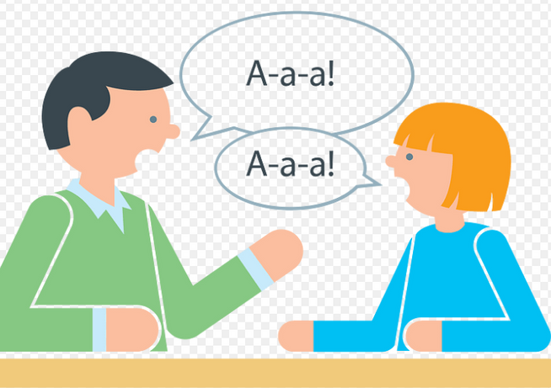
DIFFERENTIAL DIAGNOSIS FOR SPEECH RELATED FUNCTIONS
Faculty:
Mr. Ajay Kumar Mishra
Assistant Professor
Dept. of Audiology and Speech Language Pathology,
SVDU

Slide 2
INTRODUCTION
  The primary purpose of an evaluation is to gather the relevant information to make a differential diagnosis regarding the type of speech/resonance disorder .
  This information is important because it has a direct effect on the treatment recommendation
(Garrett , Deal , Prathanee , 2002; Kummer, 2016 ; Marsh,2004 )
  Abnormalities of structure such as dental malocclusion or velopharyngeal insufficiency can cause obligatory distortions of speech or compensatory productions .
  Differential diagnosis is important because obligatory distortions require physical correction only , whereas compensatory error require correction of structure and speech therapy.

Slide 3

What is obligatory distortion and compensatory error ?
Obligatory Distortion :
  when function (i.e., articulation) is normal, but the abnormal structure causes distortion of the speech sound or resonance
  Examples of obligatory distortions are hypernasality or nasal emission that occur secondary to velopharyngeal insufficiency (VPI).
  An obligatory distortion can occur with sibilant productions when the teeth are in a position to interfere with the air stream, yet tongue placement is normal.
  It is important to note that obligatory distortions can only be eliminated with correction of the structure. Speech therapy is not indicated because the articulation placement is normal

Slide 4
Compensatory errors:
  when articulation placement is altered in response to the abnormal structure. For example, when there is VPI and therefore a lack of adequate oral pressure for certain speech sounds, oral placement may be changed to the pharynx where there is adequate air pressure.
  Thus, common compensatory productions for VPI include pharyngeal fricatives, pharyngeal plosives and glottal stops. Compensatory speech errors can also be developed with other structural anomalies, such as dental malocclusion.
  Compensatory speech errors always require speech therapy for correction because articulation placement is abnormal

Slide 5
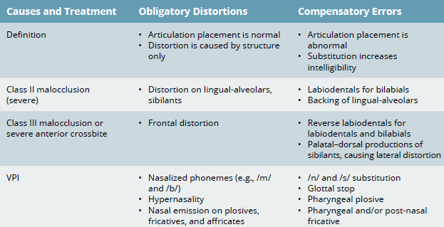
OBLIGATORY DISTORTION V/S COMPENSATORY ERRORS

Slide 6
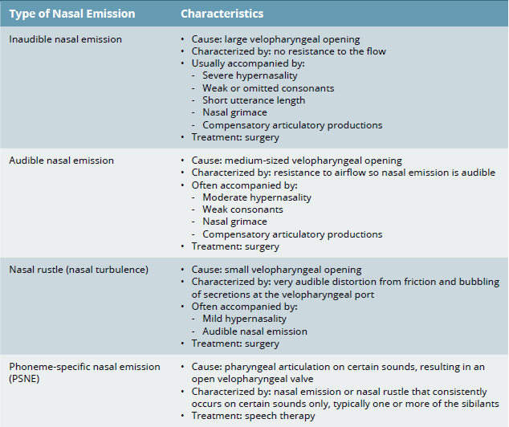
TYPES OF NASAL EMISSION

Slide 7
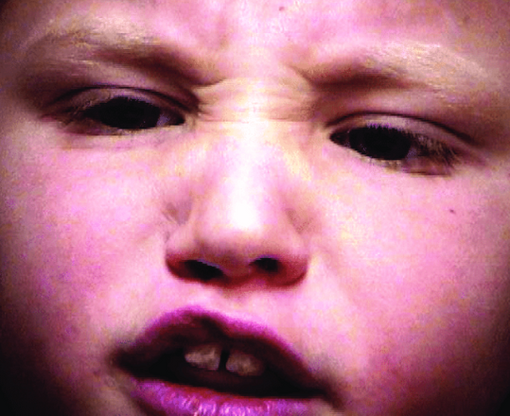
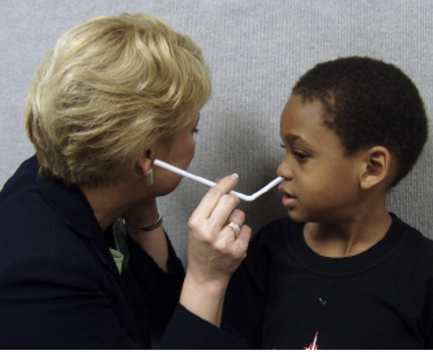
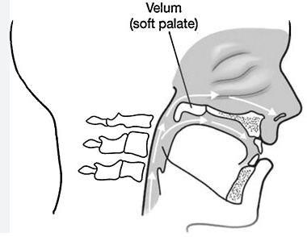
Nasal grimace
Straw test for nasal emission
Velopharangeal opening

Slide 9
  Differential diagnosis of the cause of nasal emission can be particularly challenging if the child has an oronasal fistula.
  If the fistula is small, it is unlikely to cause nasal emission during
speech because the airflow in the oral cavity primarily
flows horizontally across the opening.
  If the fistula is 5 mm or more in diameter, nasal emission may be noted with the production of sibilants, which are anterior sounds.
  If the fistula is very large, there may be hypernasality as well as
nasal emission.
  To determine whether nasal emission is from a fistula, from VPI, or from
both.
  Compare the amount of nasal emission on /k/ with the amount of nasal emission on /t/ and /s/.

Slide 10
  Because most fistulas occur in the hard palate, which is anterior to the placement of a /k/, the airstream from /k/ flows horizontally to the
opening and not up into the fistula.
  In contrast, the tongue tip movement on /t/ and /s/ can direct
the airstream into the fistula. Considering these facts, if there is no nasal emission on /k/ but nasal emission on anterior sounds, then the source of
the nasal emission is the fistula.
  If there is nasal emission on the /k/, then there is VPI. If there is
more nasal emission on anterior sounds than /k/, then it is caused by both VPI and the fistula.

Slide 11
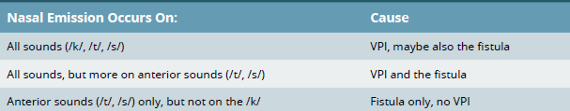
FISTULA V/S VPI AS CAUSE OF NASAL EMISSION

Slide 12
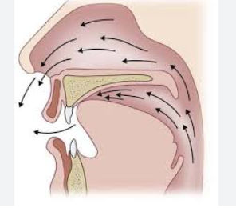
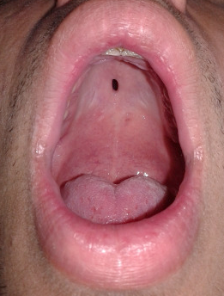
VPI
FISTULA

Slide 13
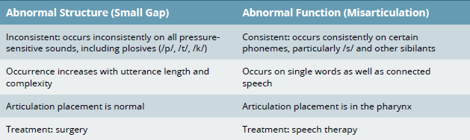
STRUCTURE V/S FUNCTION AS CAUSE OF NASAL EMISSION
Differential diagnosis is important because structural defects require surgical intervention whereas articulation placement error require speech therapy

Slide 14
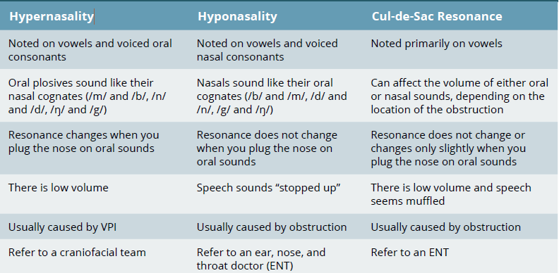
DIFFERENTIAL DIAGNOSIS OF RESONANCE DISORDERS

Slide 15
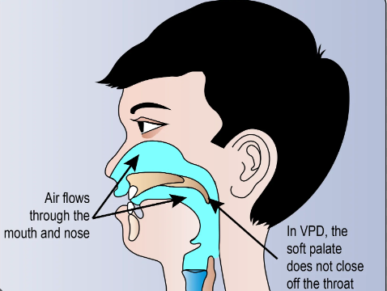

Slide 16
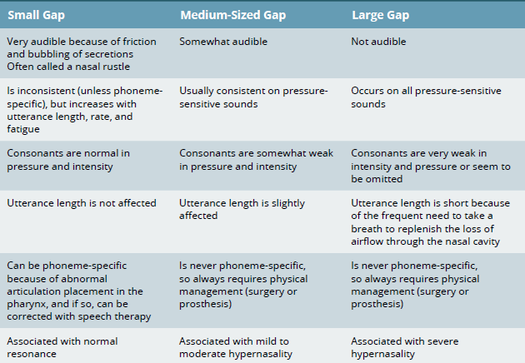
ESTIMATION OF VELOPHARYNGEAL GAP

Slide 18
Thank
you!

