Slide 1
Specific Treatment techniques
  Faculty:-
  Mr. Ajay Kumar Mishra
  Assistant Professor
  Dept. of Audiology & Speech Language Pathology,
  SVDU

Slide 2
Point to be Discussed
Self talk
Parallel talk
Expansion
Extension
Recasting
Joint routine
Joint book reading

Slide 3
Self talk
Self talk is the way you talk to yourself or your inner voice example: I am really happy for my self .I am doing well, or that is not great, but it could be worse . self -talk called is intrapersonal communication

Slide 4

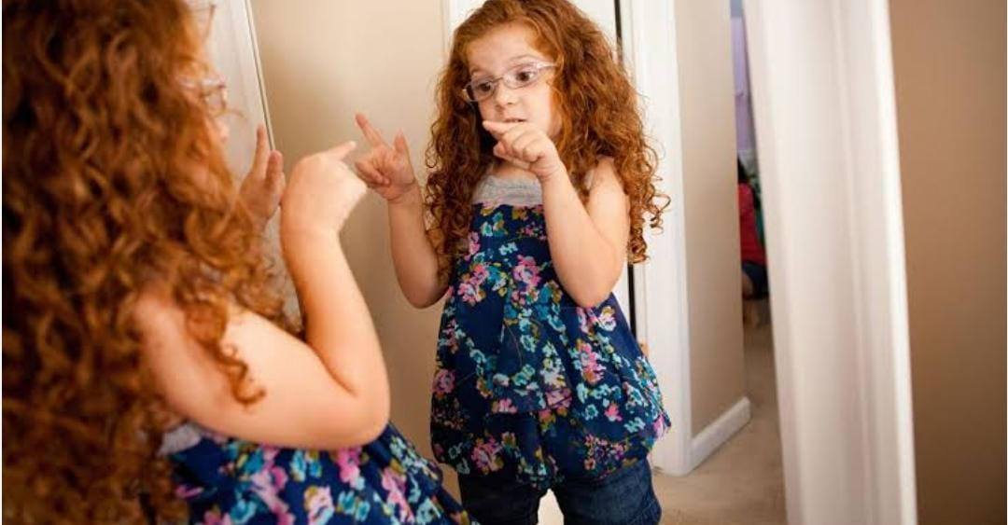

Slide 5
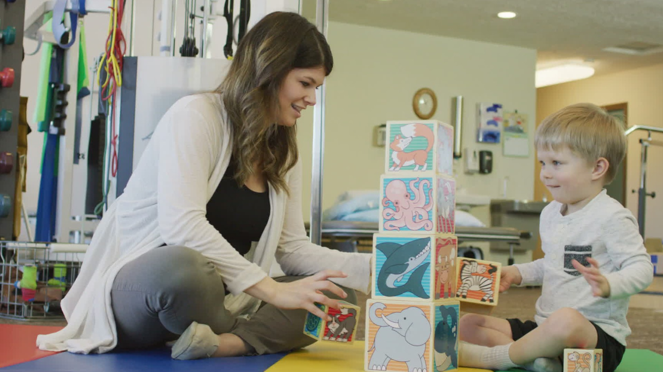
Parallel talk
Parallel Talk Is Using Simple Child Friendly Language To Talk About What The Child Is Doing . Talk About What The Child Is Seeing ,Touching ,Hearing,etc.We Talk About The Client Providing A Running Commentary ,Something Like A Play-by Play At A Sporting Event . Parallel Talk Also Can Help Us Make Connection To Children With Severe Disorder Whose Choice Of Action May Not Be Typical..We Talk About The Child Focus Of Attention …. For Example:children With Autism ,If Given A Set Of Toy May Use Them In Unconventional Ways Instead A Building A Tower With Block , A Child With Autism May Smell Them Or Focus On The Texture Of The Rug Underneath The Block .

Slide 6
RECASTING
These Are Similar To Expansion . In Recasting, We Expand The Child Remark Into A Different Type Or More Elaborate Sentence .If The Child Make Statement “Doggy House “We Can Recast It As A Question , “Is The Doggy In The House.? Or A Negative Sentence. Has Demonstrate That Recast Treatment Is Effective In Teaching Grammatical Forms To Children With DLD, But Only When The Recast Were Presented At Rates That Are Much Greater Than Those Available In Typical Conversation With Young Children …When Engaging In Any Child-centered Language Activity .

Slide 7
expansion
This Refers To Responses To A Child’s Spontaneous Utterance, Where The
Child Repeats Some Of The Child’s Words And Corrects The Utterance By
Using A Simple Correct Form.
For Example:
If Child Says, “Dog!” You Can Say, “Yes, Big Dog!”
If Child Says, “Dog Woof” You Can Say, “Dog Says Woof!”
Child: Push Car , Adult: Yes, You Are Pushing A Car
In Expanding The Child’s Utterance, We Take What The Child Said And Add The Grammatical Markers And Semantic Details That Would Make It An Acceptable Adult Utterance. For Example, If The Child Puts A Toy Dog In A Dollhouse And Says “Doggy,” Or “Doggy House,” This Could Be Expanded As “The Doggy Is In The House.” Expansions Have Been Shown To Increase The Probability That A Child Will Spontaneously Imitate At Least Part Of The Expansion

Slide 8
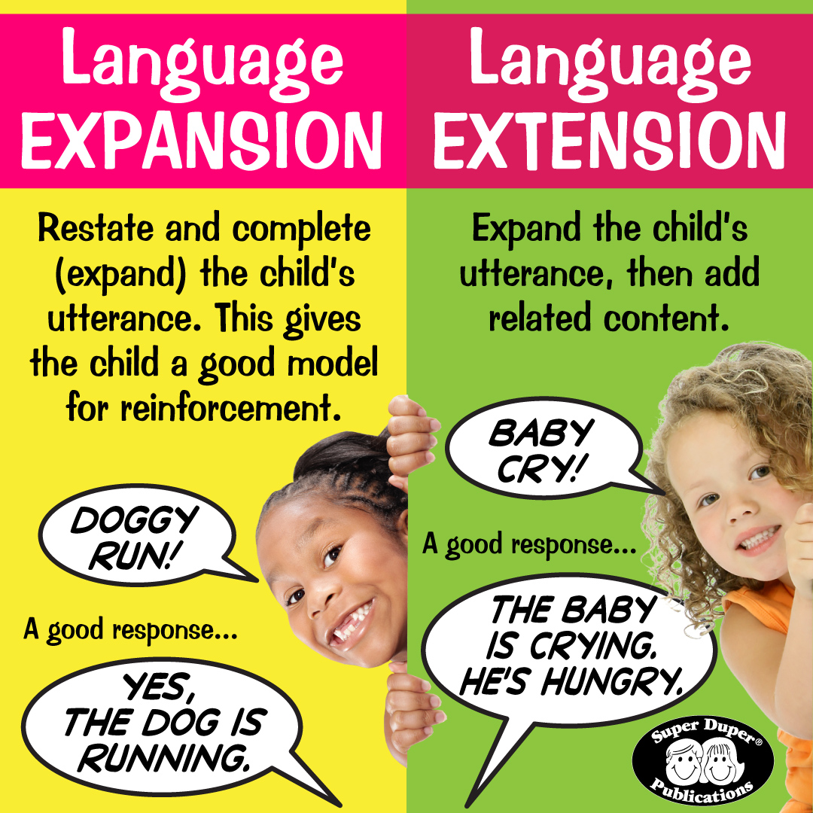

Slide 9
extension
Extension takes what the child says and add information. Extension is typically used in conjunction with expansion.
These responses expatiations (Fey, 1986). They are comments that add some semantic information to a remark made by the child. In “doggy house” example, saying “He went inside”.
RECAST SENTENCES- are similar to expansions.
Expansions, we will remember the utterance and elaborate the child’s utterance into a grammatically correct version of the intended sentence type.In recasting we expand the child’s remark into a different type of sentence the child makes the statement “doggy house”, we can recast it as a question, “Is the doggy in the house”, a negative sentence (used as a playful denial of the child’s utterance).
“The doggy is not in the house,” or even a negative question. “Isn’t the doggy in the house?” Nelson et al (1996) showed that recast treatment was highly effective in teaching grammatical forms to children with specific language impairment.

Slide 10
JOINT ROUTINE
Joint routine are activities involving two or more people, where shared engagement, communication, and play are the primary focus.
The therapist and child build the activity together through “shared control” where the adult and child take turns leading the activity.
This is like how a parent and child might interact during everyday life.

Slide 11
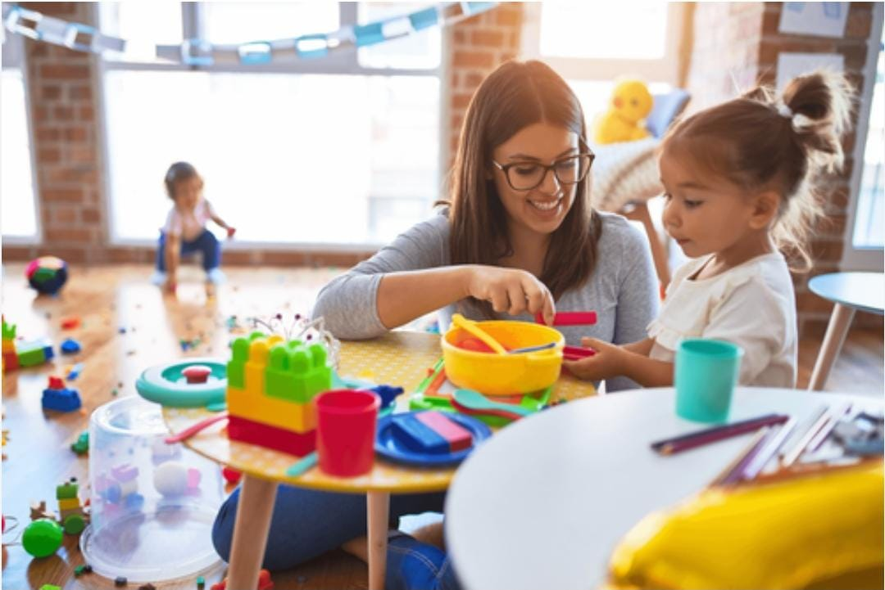
You would see this when a child purposefully directs his/her focus of attention with another person or on an object of attraction. An example of this can be when a baby makes eye contact, coos, or smiles at their mother.

Slide 12
JOINT BOOK READING
This approach capitalizes on the familiarity and naturalness of interacting with young children around storybook reading.
Cole, maddox, and lim (2006) argue that book sharing contexts are particularly effective because the book provides parents with greater opportunities for asking questions, making comments, and taking turns than unsupported conversational settings.

Slide 13

But they emphasize that simply reading to children is not enough; the reading must be accompanied by specific interactive techniques if it is to be effective as a language therapeutic tool.

Slide 14


