Slide 1
Overview of instrumental procedures
Faculty:
Ms. Sarita Rautara
Assistant Professor
Dept. of Audiology & Speech Language Pathology,
SVDU

Slide 2
Velopharyngeal insufficiency/incompetence (VPI) can be diagnosed by an experienced and knowledgeable speech-language pathologist based on the characteristics of the speech, as determined through a perceptual speech evaluation.
However, instrumental assessment of the velopharyngeal valve can provide important additional information. In some cases, this information can be used to help determine the surgical procedure for the patient. It can also help in measuring change as a result of surgery or therapeutic intervention.
There are two basic categories of instrumental procedures for evaluation of velopharyngeal function—those that give indirect yet objective information and those that give direct yet subjective information. Indirect instrumental procedures include the use of nasometry and aerodynamic instrumentation.

Slide 3
The advantage of these procedures is that they provide objective data regarding the results of velopharyngeal function, such as acoustic output or airflow and air pressure. They are considered indirect measures because they do not allow visualization of the structures.
Direct instrumental procedures include videofluoroscopy and nasopharyngoscopy.
The advantage of these procedures is that they allow the examiner to directly visualize the structures of the velopharyngeal valve during speech (and swallowing). However, these procedures require interpretation of the examiner, and therefore they are somewhat subjective.

Slide 4
Indirect instrumental procedures (nasometry and speech aerodynamics) give objective data regarding the physical correlates of velophar yngeal function, such as acoustic output, air flow, and air pressure.
The advantage of objective data is that they can be compared to standardized norms for interpretation.
In addition, data from these instruments can be used for determination and comparison of treatment outcomes.
For example, such data can be used to determine the outcome of surgery or therapy, or they can be used to compare treatment outcomes between professionals and centers.

Slide 5
The disadvantage of indirect procedures is that they do not allow visualization of the structures.
Nasometry
Speech aerodynamics

Slide 6
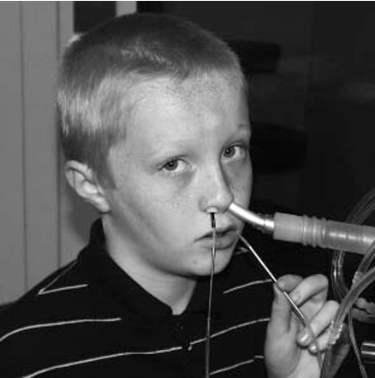
Speech aerodynamics
Speech aerodynamics is a procedure to mea sure the mechanical properties of airflow and air pressure during speech production. Because speech production requires a buildup and release of air pressure during consonant production, aerodynamic procedures are ideal to assess air pressure and airflow during speech.
The aerodynamic procedure involves the use of oral and nasal catheters, which are connected to pressure transducers. There is also a flow tube that is connected to a heated pneumotachograph.

Slide 7
The transducers convert the detected air pressure or flow into electrical signals.
The pneumotachograph determines the rate of airflow.
Aerodynamic instrumentation can be used in the evaluation of VPI because it can provide objective documentation of intraoral air pressure levels and the amount of nasal air emission.

Slide 8
The data collected allow the examiner to calculate an estimate of velopharyngealorifice size during consonant production. Aerodynamic methods can be used to provide information on the timing aspects of velopharyngeal function during certain phonetic con texts and the patency of the nasal airway during breathing.
This information can be used as a basis for making diagnostic decisions that impact the recommendations for treatment of VPI. Aerodynamic instrumentation can also provide evidence of airway obstruction through measurements of nasal airway resistance.

Slide 9
Direct Measures
Direct instrumental procedures (videofluoroscopy and nasopharyngoscopy) allow the examiner to visualize aspects of the velopharyngeal valve during speech. These procedures allow the examiner to look for the cause of velopharyngeal dysfunction and also to deter mine the location of a velopharyngeal gap.
This information is important for surgical planning. Through direct procedures, the examiner can view both the anatomy of the velophar yngeal structures and the physiology during function (e.g., speech and swallowing).

Slide 10
The examiner can also directly observe defects that cause VPI. Because there is a wide spectrum of anatomic and physiologic causes for VPI, this information is important to obtain so that the appropriate and most effective treatment can be determined.
Finally, direct procedures can be helpful in assessing the placement of a prosthetic device or evaluating the results of surgical procedures for correction of VPI (e.g., pharyngeal flap, sphincter pharyngoplasty, etc.). Videofluoroscopy was the gold standard for evaluation of velopharyngeal function in the 1970s.
Although the structures and function of the velopharyngeal valve can be seen through these measures, the evaluation of what is seen is still subjective and open to examiner judgment and interpretation. Therefore, the usefulness of these procedures depends greatly on the experience of the examiner(s).

Slide 11
Videofluoroscopy
Videofluoroscopy is a radiological technique used to obtain real-time moving images of internal structures. This is done through the use of a fluoroscope, which consists of an X-ray source and fluorescent screen.
A videofluoroscopic speech study provides visualization of the velopharyngeal valve during speech, along with simultaneous audio recording. Therefore, this procedure is useful in the evaluation of velopharyngeal dysfunction.
Videofluoroscopy is also used to assess swallowing and is called either a modified barium swallow (MBS) or a video fluoroscopic swallowing study.

Slide 12
Videofluoroscopy requires fluoroscopy equipment and a video capture system. This is usually available in radiology departments. Because videofluoroscopy involves two dimensional imaging, a videofluoroscopic speech study requires several views in order to see all aspects of the velopharyngeal port.
On the lateral (sagittal) view, where the beam goes through the side of the head from ear to ear, the examiner can see the occlusion of the jaws, the hard palate, tongue, velum, posterior pharyngeal wall, adenoids, and larynx. During speech, the movement of the tongue can also be observed.

Slide 13
On the frontal view, also called the anterior–posterior (AP) view because the beam goes from the front of the face to the back, the examiner can see the septum and lateral pharyngeal walls. Finally, on the base view, where the beam goes from under the chin up through the port, the examiner can see the outline of the lateral and posterior pharyngeal walls, and to some extent the velum.
There are other supplementary views that can be used as needed. To obtain an impression of the function of the entire velopharyngeal valve, all views must be considered together. To be able to see the pharyngeal walls, a coating of barium is usually required.

Slide 14
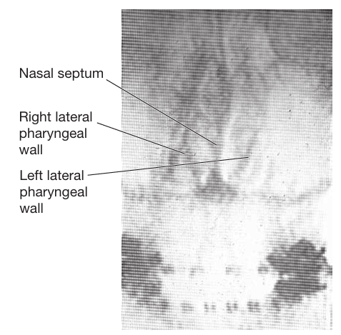
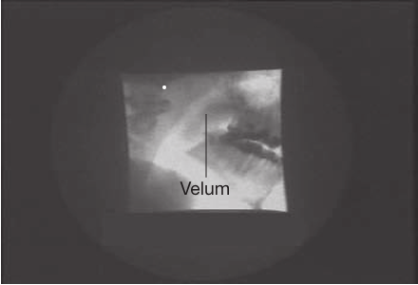
This is usually introduced into the pharynx by a rubber catheter that goes through the nose. Videofluoroscopy for speech is done in a radiology department by a radiologist and/or a radiology technician. However, these studies should always be interpreted by both a radiol ogist and a speech-language pathologist.
Frontal view showing the nasal septum in midline. The lateral pharyngeal walls are well coated with barium and bow outward during nasal breathing, as noted in the frame.
Lateral view showing a short velum relative to the posterior pharyngeal wall, which results in velopharyngeal insufficiency.

Slide 15
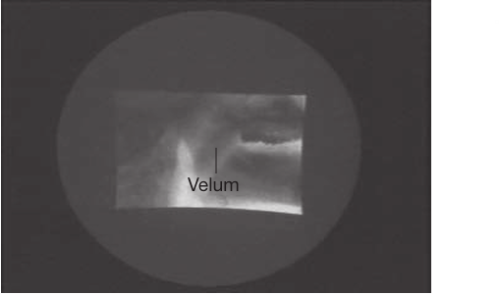
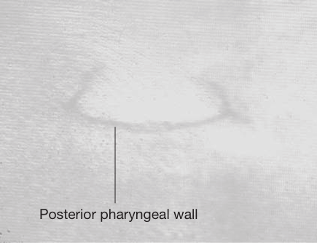
Lateral view showing a velum of normal length but poor movement during speech, which results in velopharyngeal incompetence.
Base view with the posterior pharyn geal wall at the bottom of the screen. The open port can be clearly seen.

Slide 16
Nasopharyngoscopy
Nasopharyngoscopy (also called nasendoscopy or videonasendoscopy) is a minimally invasive nasal endoscopic procedure that allows direct visual observation and analysis of the velophar yngeal mechanism during speech.
The required equipment includes a flexible fiberoptic nasopharyngoscope and a cold light source. It is preferable to also have a monitor and recording system.
With this procedure, the nasopharyngo scope is inserted into the nose and then directed back to the pharynx where the tip “periscopes” down to see the nasopharyngeal structures from above.

Slide 17
Nasopharyngoscopy allows the examiner to view the nasal surface of the velum.
Various other nasopharyngeal structures can be viewed, including the nasal cavity and turbinates, the posterior choana an each side, the nasal surface of the velum, the velopharyngeal valve, the Eustachian tube orifices, the nasopharynx, adenoids, base of the tongue, pharyngeal and lingual tonsils, vallecula and pyriform spaces, epiglottis, glottis, and vocal folds. Nasopharyngoscopy is used to assess the results of surgery for velopharyngeal insufficiency/incompetence (e.g., pharyngeal flap or sphincter pharyngoplasty).

Slide 18
Nasopharyngoscopy is not only a powerful tool in the evaluation of velopharyngeal function, but it is also commonly used in the evaluation of swallowing, upper airway obstruction, and the structure and function of the larynx and vocal cords.
Nasopharyngoscopy can be done by a physician. However, it is also in the scope of practice for specially trained speech-language pathologists. Regardless, the recorded study should be reviewed by both the speech language pathologist and the surgeon to deter mine the appropriate course of treatment.

Slide 19
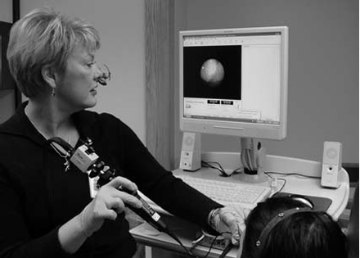
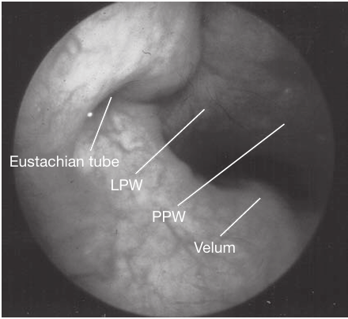
The nasopharyngoscopy procedure with the patient positioned to see the monitor.
A nasopharyngoscopy view of normal velopharyngeal structures. The nasal surface of the velum is always at the bottom of the screen, and the posterior pharyngeal wall is always at the top of the screen. The opening to the Eustachian tube can be seen on the left side of the view.

Slide 20
Speech Sample for Videofluoroscopy/ Nasopharyngoscopy
The speech sample for both videofluoroscopy and nasopharyngoscopy should include a combination of repetition of syllables, counting, and repetition of sentences loaded with pressure-sensitive phonemes.
It is helpful to have the patient repeat certain syllables with pressure-sensitive pho nemes and high and low vowels (e.g., /pɑ,pɑ, pɑ/; /pi, pi, pi/; /ta, ta, ta/; /ti, ti, ti/; /kɑ,kɑ,kɑ/; /ki, ki, ki/; /sɑ,sɑ,sɑ/; /si, si, si/; etc.).

Slide 21
This helps to illustrate phoneme-specific openings that are due to misarticulation. To test the effect of the fistula on the velopharyngeal valve, the examiner should compare velopharyngeal function on repeated velar syllables (e.g., /kɑ/ and /ki/), which would be produced behind the fistula, and repeated syllables with anterior sounds (e.g., /tɑ/, /ti/, /sɑ/, /si/, /pɑ/, /pi/).
Having the individual prolong an /s/ can be informative, as in some cases the velopharyng eal closure that is initially achieved may break down with this task.

Slide 22
Having the patient count from 60 to 70 or repeat “60, 60, 60, 60” is particularly helpful because the combination of plosives, the sib ilant /s/, a high vowel (/i/), and even a triple blend (/kst/) is particularly taxing on the velopharyngeal mechanism The examiner should have the patient repeat some sentences loaded with pressure sensitive . Because the /s/ sound is most often affected by VPI, the sample should include at least one sentence with a frequent occurrence of this sound.
The sentence “Sissy sees the sun in the sky” is particularly good because it not only contains many /s/ sounds, but it also contains an /s/ blend and a high vowel (/i/), which further challenge the velopharyngeal mechanism. In addition, this sentence has some nasal sounds in the middle, so the velum has to go up and down for the sentence.

Slide 23
If apraxia of speech is suspected as a cause of velopharyngeal dysfunction, having the child repeat multisyllabic words with a combination of placement points can be helpful (e.g., “baseball bat,” “kitty cat,” “puppy dog,” “teddy bear,” “patty cake,” “basketball,” “ice cream cone,” etc.).

Slide 24
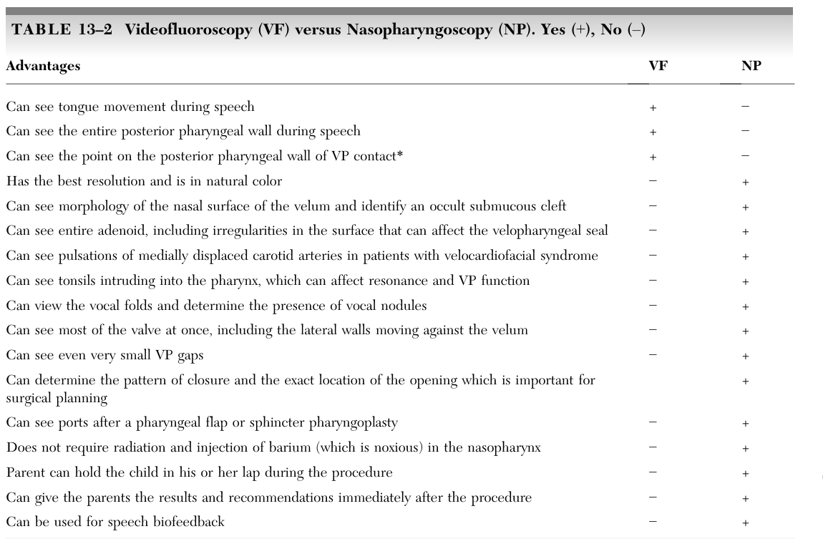

Slide 25
Reporting the Results of Videofluoroscopy/ Nasopharyngoscopy
Precise measurements are not necessary for determination of treat ment. Instead, documentation of the size, location, and cause of the opening are what is most important.
Although the results are used to make treatment recommendations and also to report to other professionals, they should also be shared with the family.
It is important that the person who counsels the family uses clear, easy-to-understand language.

Slide 26
After the initial explanation, it may also be helpful to play the videotape of the procedure and point out the structures and their function.
All medical terms should be clearly defined. When discus sing the function of the velopharyngeal mech anism, supplementary pictures and diagrams should be used.

Slide 27
Magnetic Resonance Imaging (MRI)
Magnetic resonance imaging (MRI) is a non invasive method to produce a very clear and detailed view of internal body structures, using a magnetic field and radio waves.
It has only recently been used to evaluate the structures of the velopharyngeal valve. MRI can provide high-resolution images of the soft tissues of the velopharyngeal sphincter in all planes.
Therefore, MRI has been used successfully for the evaluation of obstructive sleep apnea in pediatric patients. It has also proved to be an effective method of imaging and examining the morphology of the levatorvelipalatini muscle and related structures or for diagnosing an occult submucous cleft.

Slide 28
Some authors have suggested the use of MRI as a means for evaluating velopharyngeal function in addition to velopharyngeal structure.
However, a primary disadvantage of MRI is the static nature of the imaging. To view velopharyngeal closure, an image is typically taken during production of a vowel or sustained /s/.
Therefore, movement of the structures during speech cannot be appreciated. In addition, MRI only shows a two-dimensional view, although the use of serial images and computer modeling to obtain 3D images has been suggested.

Slide 29
Other disadvantages include noise in the scanner, the potential for claustrophobia during the exam, and current expense. Because of these disadvantages, MRI is not currently a standard procedure for clinical evaluation of velopharyngeal function. However, it is providing information that is very valuable for research.

Slide 30
NASOMETRY
Nasometry is a method of measuring the acoustic correlates of resonance and velopharyngeal function through a computer-based instrument.
Nasometry testing gives the examiner a nasalance score, which is the percentage of nasal acoustic energy of the total (nasal plus oral) energy.

Slide 31
History
The first instrument to measure nasal and oral acoustic energy was developed by Samuel Fletcher in 1970. This instrument was called TONAR
The TONAR was later updated, revised, and then renamed the TONAR II (Fletcher,1976a; Fletcher, 1976b).
Although the TONAR instruments provided objective data regarding the acoustic product of speech, the data acquisition was somewhat unreliable (Dalston,1997).
Samuel Fletcher, along with colleagues Larry Adams and Martin McCutcheon at the University of Alabama, Birmingham, developed the Nasometer based on Fletcher’s early work. It was then introduced by Kay Elemetrics Corp in 1986.

Slide 32
In 2002, a second version of the Nasometer was released as Nasomete™ II, Model 6400
The latest hardware/software version is the Nasometer™ II, Model 6450. With this version, there is a built-in sound chip installed in the hardware.
Two other instruments have been developed to measure nasalance:
The NasalView
The OroNasal System
These instruments are not as widely used, perhaps because there are no published normative studies for their use.

Slide 33
WHAT IS NASOMETER
A Nasometer is a computer-assisted instrument that measures the relative amount of nasal acoustic energy in an individual’s speech.
The Nasometer provides an easy, noninvasive method for obtaining objective data regarding resonance during speech by analyzing the acoustic energy from both the oral and nasal cavities in real time.

Slide 34
PURPOSE
Nasometer has been a useful tool in the evaluation of resonance and velopharyngeal function of patients with a history of cleft palate.
Nasometry is used to assess upper airway obstruction and hyponasality through their acoustic correlates during speech.

Slide 35
EQUIPMENTS
The Nasometer requires a host computer, specialized software, an external module, a headset, and a means for calibration.

Slide 36
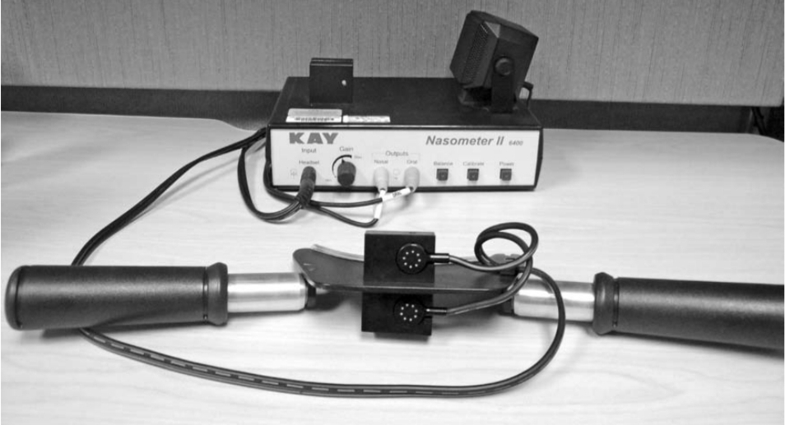
NASOMETER

Slide 37
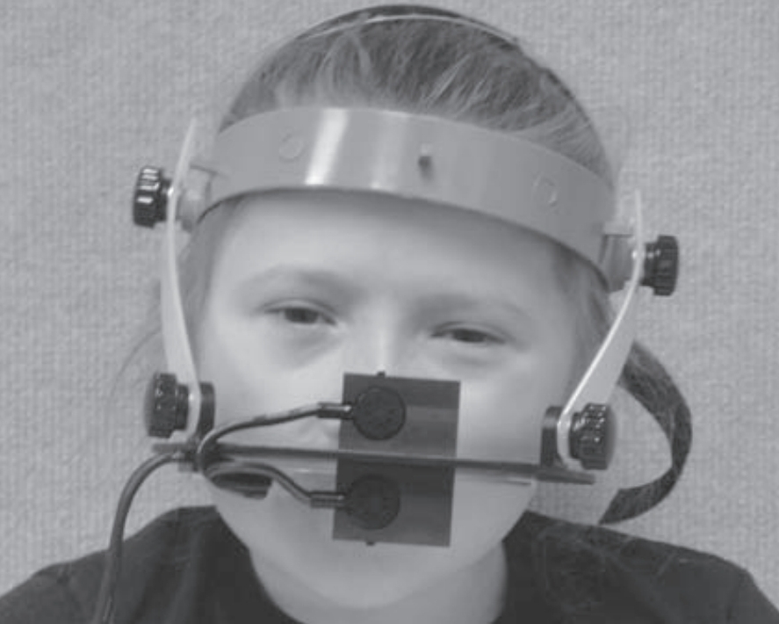
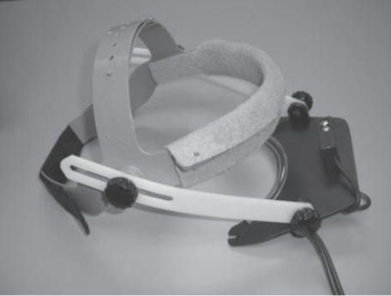
HEAD SET

Slide 38
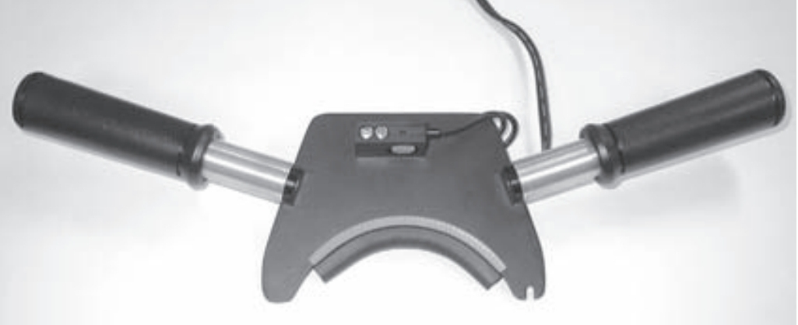
HAND-HELD SEPARATOR

Slide 39
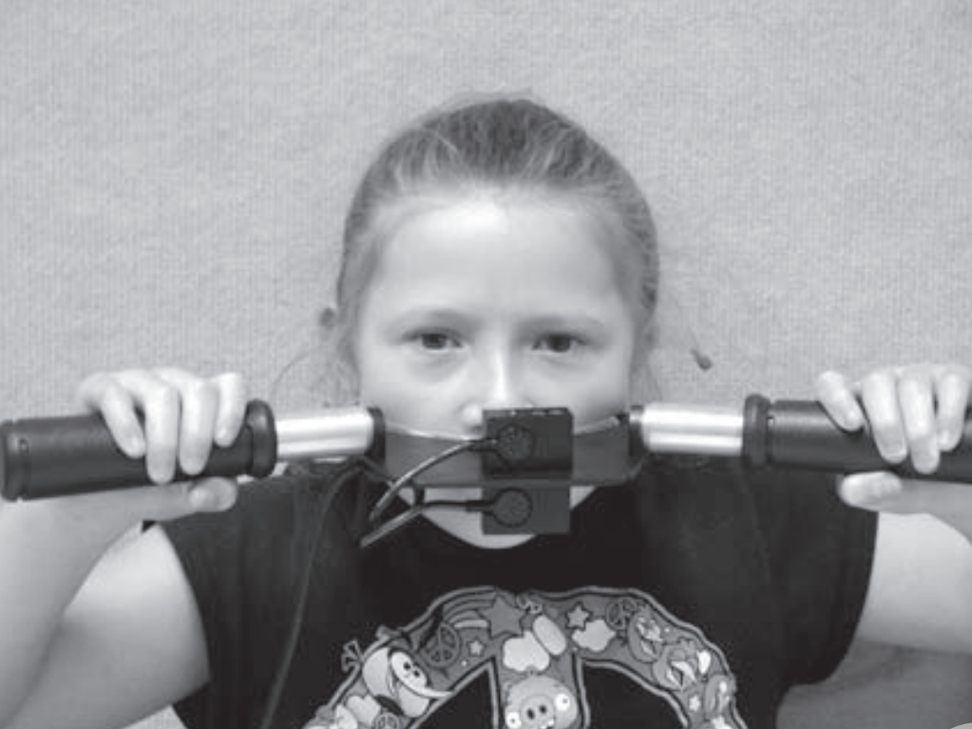
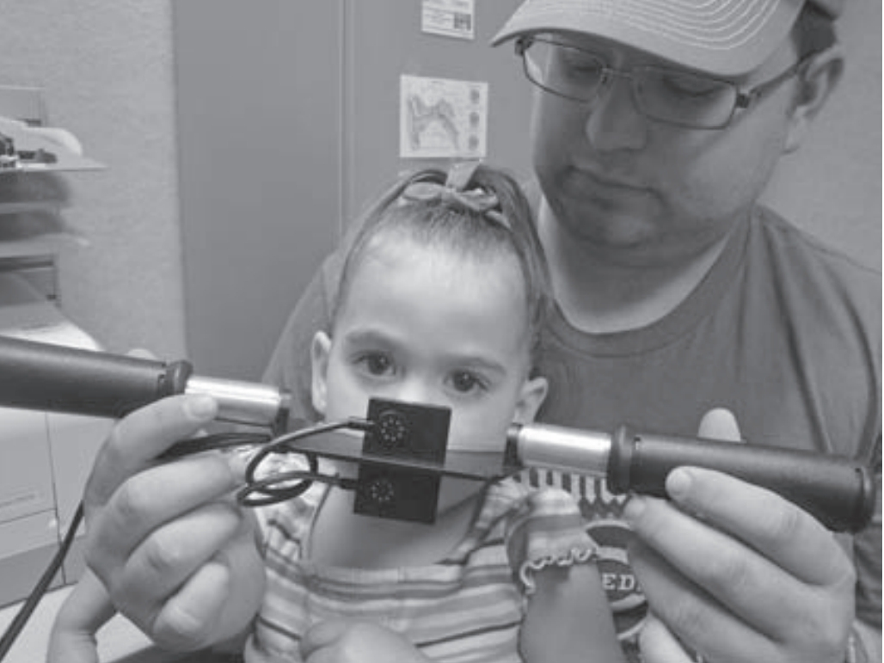

Slide 40
RESULTS

Slide 41
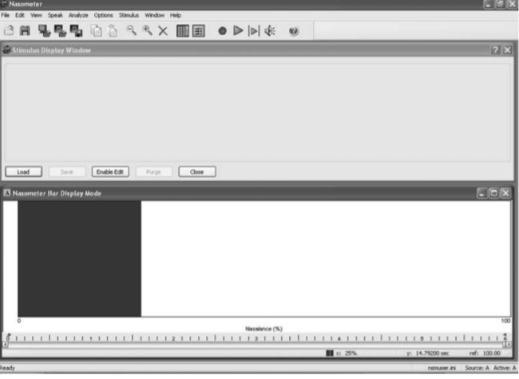

Slide 42
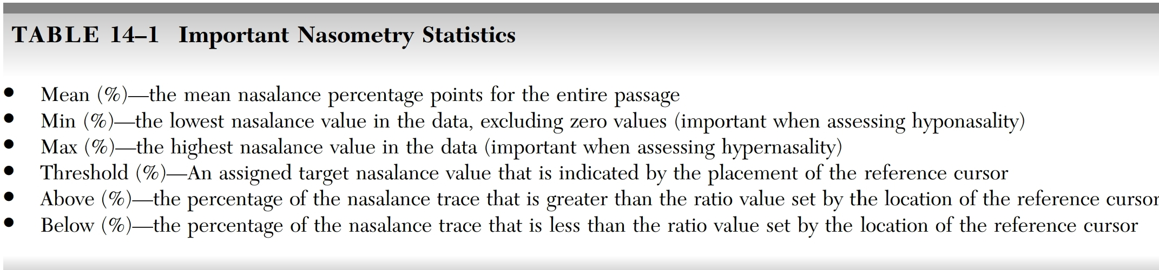

Slide 43
